Slide 1

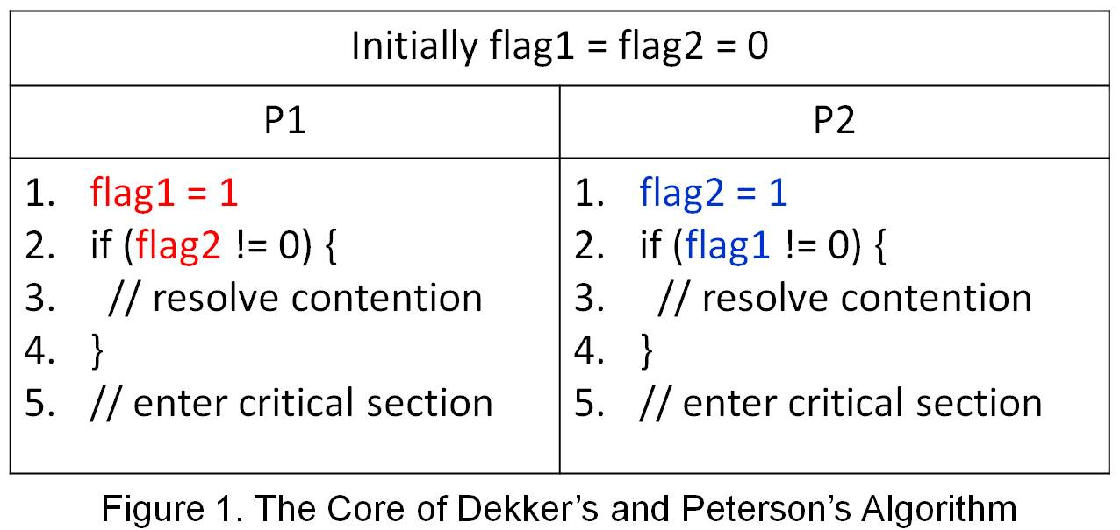
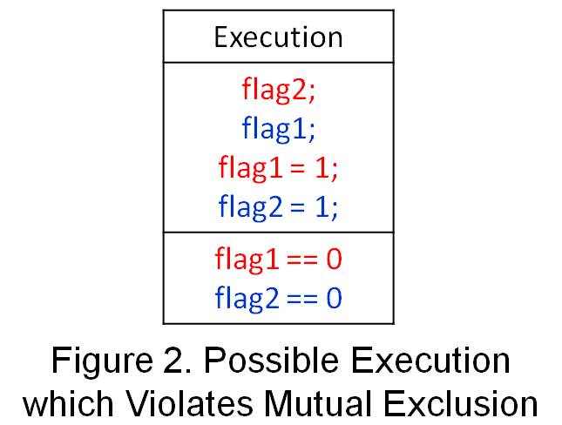
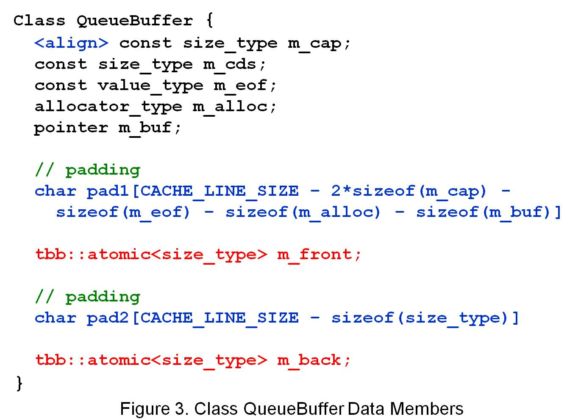
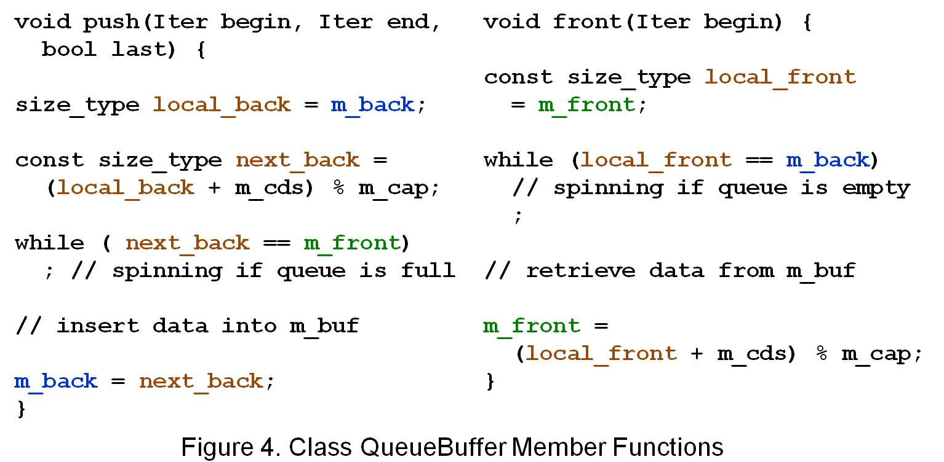
Lock-free Cache-friendly Software Queue
for Decoupled Software Pipelining
Student: Chen Wen-Ren Advisor: Wuu Yang
學生: 陳韋任 指導教授: 楊武
Abstract
Multicore has become a trend on server and client computers in recent years. Parallelization is one way to fully utilize the computing power provided by multicore architectures. Most applications of interest have complex data and control dependency, which make traditional parallelization techniques, such as DOALL and DOACROSS, inapplicable. Decoupled Software Pipelining (DSWP), a new parallelization technique, shows its potential on parallelizing general applications. However, its success relies on fast inter-core synchronization and communication. On commodity multicore platforms, the performance of current DSWP disappoints us since the overhead involving lock-based, cache dishonored software approach offsets the benefit from DSWP.
We present a lock-free, cache-friendly software queue designed for DSWP. A lock-free, cache-friendly solution need take two different aspects of memory system, memory coherence and memory consistency, into consideration. We show how inattention to these two aspects leads to incorrect or inefficient solutions. We also present our approach to providing a correct and efficient solution with detailed explanation. Due the nondeterministic nature of parallel programs, traditional testing techniques cannot be used to fully verify the correctness of the implementation. We also discuss the correctness of our implementation both in informal formal ways.
Dekker’s and Peterson’s Algorithm
could be broken on multicore system
As shown in Figure 1, mutual exclusion is guaranteed only if variables flag1 and flag2 are both zero at the end of execution. Otherwise, mutual exclusion will be violated.
In order to improve the performance of sequential programs, compilers, CPU, and cache put much emphasis on optimizing memory reads and writes. They may reorder, insert, or remove memory reads and writes in order to avoid or delay memory accesses. Figure 2 gives a possible execution of Dekker’s and Peterson’s algorithm after reordering memory operations by compilers, CPU, or cache. As shown in Figure 2, variables flag1 and flag2 are zero which means P1 and P2 will enter the critical section at the same time.
Our Approach
- Class QueueBuffer Data Members
We declare shared, mutable variables m_front and m_back as ordered atomic variables by using template class atomic<T> provided by Intel Thread Building Blocks library. An atomic<T> class supports atomic read, write, fetch-and-add, fetch-and-store, and compare-swap operations. For reads and writes, their default memory fences are acquire and release, respectively.
Since false sharing hurts performance, we also take false sharing avoidance into consideration when layout class QueueBuffer data members. According to their locality, we group class QueueBuffer data members into different chunks that are multiples of the cache line size and aligned on cache line boundaries by using alignment and padding.
Our Approach
- Class QueueBuffer Member Functions
Since atomic<T> support atomic read and atomic write, it is safe for member functions push and front to access m_front and m_back concurrently without lock. Besides, atomic <T> associates acquire and release memory fence with read and write operation respectively. Those memory fences ensure that member function push won’t update m_back until data is inserted into m_buf.
Finally, we use local variables (e.g., local_back) as much as possible since they can be cached. Accessing ordered atomic variables, however, might involve expensive memory accesses.

