Slide 1
Lock-free cache-friendly STL-compliant queue for decoupled software pipelining
研究生 : 陳韋任 指導教授 : 楊武 博士

Slide 2
Outline
Introduction
Memory Coherence and Consistency
Lock-freedom
Cache-friendliness
Implementation and Verification
Experiment
Related Work
Conclusion

Slide 3
Outline
Introduction
Memory Coherence and Consistency
Lock-freedom
Cache-friendliness
Implementation and Verification
Experiment
Related Work
Conclusion

Slide 4
Introduction
The era of ILP (instruction level parallelism) is coming to an end
Microprocessor manufacturers have shifted their focus from single-core to multi-core processors
One way to use those cores efficiently is through TLP (thread level parallelism)

Slide 5
Introduction
Automatic parallelization done by compiler focuses on loops
Conventional techniques for parallelizing loops are DOALL and DOACROSS
DOALL only suit scientific and numerical applications
DOACROSS distributes dependent loop iterations on different cores with brute-force

Slide 6
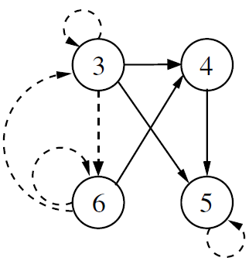
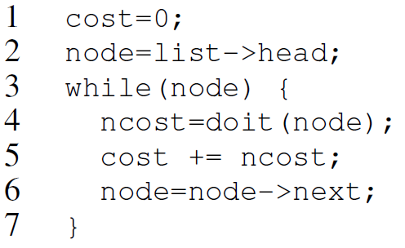
DOACROSS & DSWP
Data/Control dependency edges that participate in dependence recurrences are shown as dashed lines
Notes:
This is the program dependency graph which contains data and control dependency edges. The outgoing edges of node 3 are control dependency edges. The definition of control dependency is as followed:
An instruction B is control dependent on a preceding instruction A if the latter determines whether B should execute or not.
For example, if variable node is not null, then line 4–6 can continue executing. However, if variable node is null which means we are at the end of the linked-list, then line 4-6 will not be executed. The loop on node 5 is a data dependency edge. Note line 5 is
cost += ncost;
which is a short hand statement for
cost = cost + ncost;
Therefore, the variable cost in i^{th} iteration depends on the one in i-1th iteration which a data dependency.

Slide 7
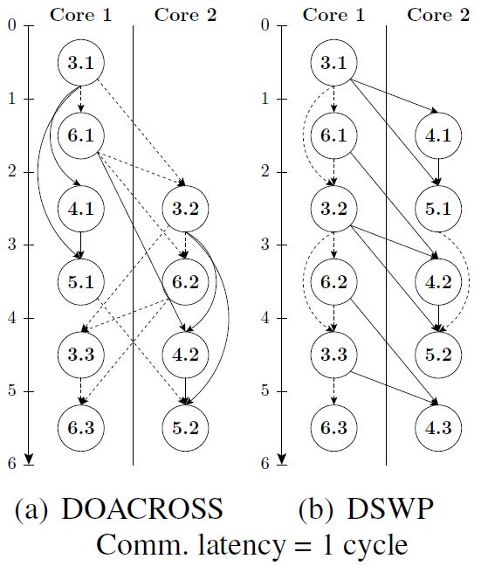
DOACROSS & DSWP
3.1
The execution of the 3rd instruction in the 1st iteration
Notes:
The reason that node 3.2 should be executed at cycle 2 is it depends on 6.1 (which retrieves the next node in the linked-list), so it has to wait node 6.1 to complete.

Slide 8
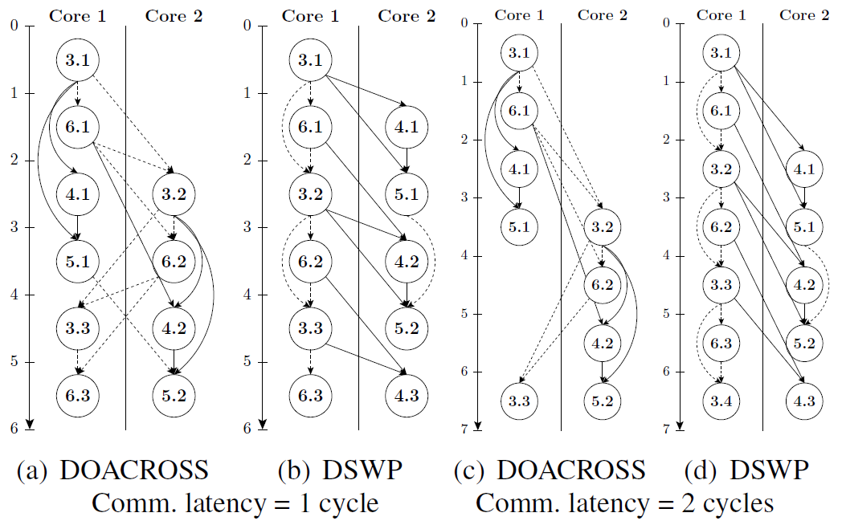
DOACROSS & DSWP
2 cycles/iter
2 cycles/iter
3 cycles/iter
2 cycles/iter
One iteration has completed
Notes:
3.1 -> 3.2 差 2 cycles (你有點誤會了): 主要是因為 3.2 還得等 6.1. 如果不必等6.1,
那3.2還可以提前一個cycle執行.
6.1 -> 3.2 差 1 cycle: 這是因為communication latency
6.1 -> 6.2 差 2 cycles: 這是因為 6.2 要等 6.1 (communication) 和 3.2 (local
dependence; on the same core)
6.1 -> 4.2 差 3 cycles: 這是因為 4.2 要等 6.1 (communication) 和 3.2 (local
dependence; on the same core). 所以看起來4.2跟6.2可以同時執行才對? 但是,
一個core一次只能執行一個instruction. 你可以說4.2在等6.2. 如果你的core是SMT(比如說T2), 那這裡你就可以加速了.

Slide 9
Transit and COMM-OP delays
Transit delay
The amount of time to communicate a data value from one processor core to another
It is exclusive of all the time necessary to produce a value or to initiate communication
COMM-OP delay
The overhead experienced by a single core due to communication. For example, checking the buffer between cores empty or not is an overhead

Slide 10
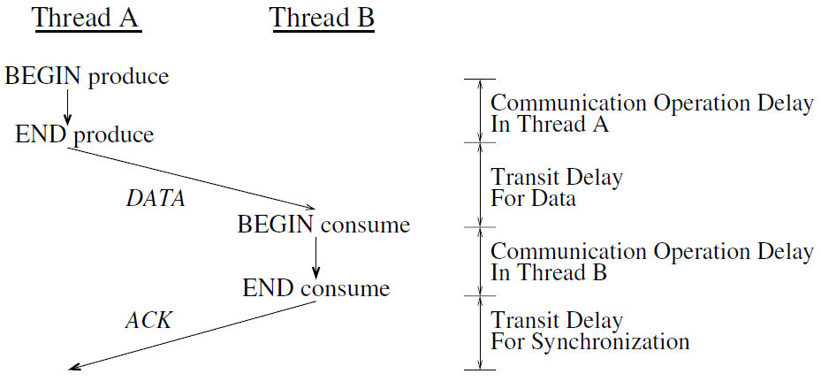
Transit and COMM-OP delays
COMM-OP delay -
Ensure the share buffer is empty
Fill the share buffer with the value to be communicated
Transit delay is hidden
by overlapping computation
and communication
Transit delay -
The effects of signal propagation delay, bus contention, and the like

Slide 11
Terminology
CMP (chip multiprocessor)
Also called multi-core microprocessors. CMP combines two or more cores on a single chip
Sync Array (synchronization array)
A non-memory-based hardware structure for communication between cores

Slide 12
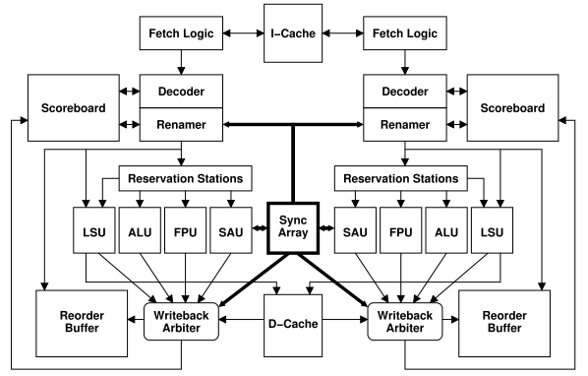
produce 1 R_{A}
consume 1 R_{A}
SA
DN | DATA
1
2
Core 1
Core 2
produce 2 R_{B}
consume 2 R_{B}
Memory

Slide 13
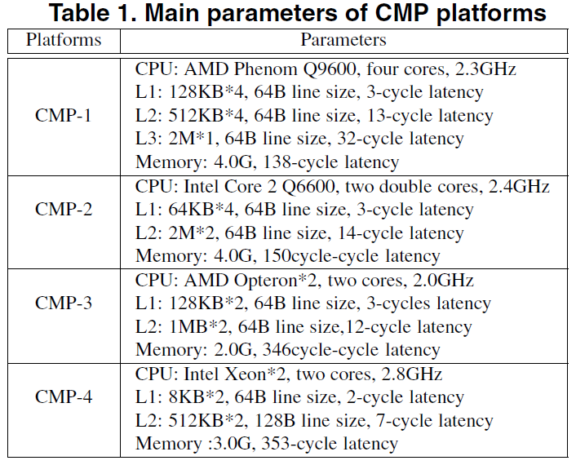
DSWP on commodity CMP
NO Sync Array

Slide 14
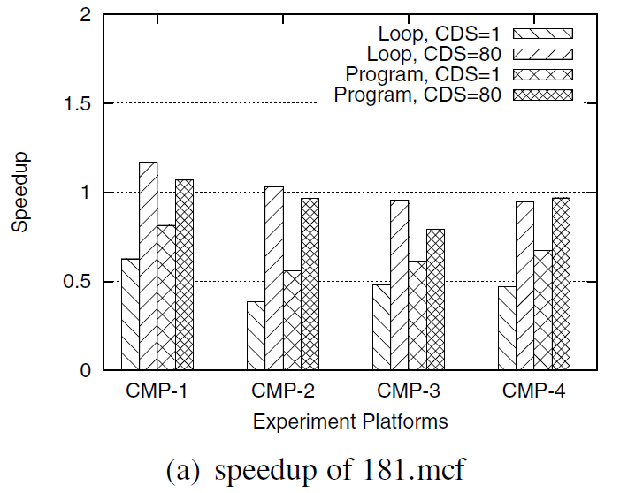
DSWP on commodity CMP

Slide 15
Introduction
Decoupled Software Pipelining (DSWP) exploits the fine-grained pipeline parallelism
Fast communication and synchronization mechanisms are not only need but also necessary for DSWP

Slide 16
Introduction
Such mechanisms are not efficiently supported in hardware on existing multi-core platforms
We propose a C++ template class QueueBuffer to implement such mechanisms for DSWP

Slide 17
Outline
Introduction
Memory Coherence and Consistency
Lock-freedom
Cache-friendliness
Implementation and Verification
Experiment
Related Work
Conclusion

Slide 18
Memory coherence & consistency
Memory coherence
What values can be return by a read
The behavior of reads and writes to the same memory locations
Memory consistency
When a written value will be returned by a read
The behavior of reads and writes with respect to accesses different memory locations

Slide 19
Memory Coherence
What values can be return by a read
The behavior of reads and writes to the same memory locations
P1
P2
R_{A}
20
W_{A}(20)
$
A(10)
A(10)
$
A(10)
MEM

Slide 20
Memory Consistency
When a written value will be returned by a read
The behavior of reads and writes with respect to accesses different memory locations
P1
P2
A = 1 // W_{A}(1)
R1 = B // R_{B}
B = 1 // W_{B}(1)
R2 = A // R_{A}

Slide 21
Memory Consistency
P1
P2
A = 1 // W_{A}(1)
R1 = B // R_{B}
B = 1 // W_{B}(1)
R2 = A // R_{A}
P1
P2
R_{B}
W_{A}
SB
R_{A}
W_{B}
SB
$
$
A(0)
B(0)
MEM

Slide 22
Sequential consistency
Most commonly used memory consistency model
Definition of sequential consistency (SC)
[A multiprocessor is sequentially consistent if] the result of any
execution is the same as if the operations of all the processors
were executed in some sequential order, and the operations of
each individual processor appear in this sequence in the order
specified by its program.
Notes:
The granularity of an operation is a machine instruction. However, the granularity might be larger just for demonstration, like the example at page 23.

Slide 23
Sequential consistency
Sufficient conditions for SC:
Ordering
Atomicity
Each processor issues memory requests in the order specified
by its program (program order)
Memory requests from all processors issued to an individual
memory module are serviced from a single FIFO queue.
Issuing a memory request consists of entering the request on
this queue
Notes:
We emphasize on FIFO not on queue here. FIFO implies the former request issued to a memory module will not be interrupted by the latter one. We will give an example latter to show how atomicity is broken.

Slide 24
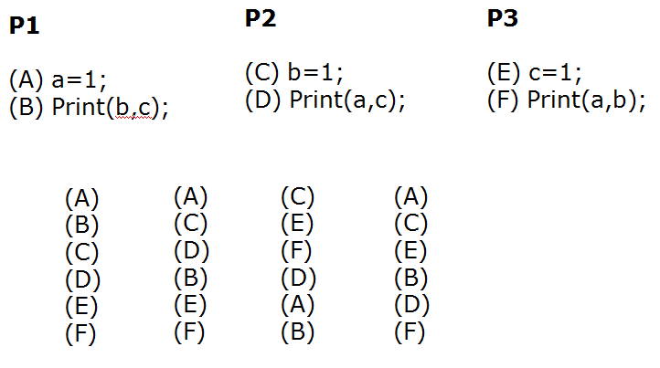
Sequential consistency

Slide 25
Relaxed Memory Model
Sequential consistency (SC)
Maintains all possible orderings: R → R, R → W, W → W, and W → R
Constrains hardware and compiler optimizations
Relaxed memory consistency
Are classified according to the read-and-write orderings that are relaxed

Slide 26
Memory Model Issues
Varied hardware have different memory models
Different hardware and OS combinations might have different memory models
Compilers will reorder memory operations arbitrarily if the programming languages do not define memory model

Slide 27
Outline
Introduction
Memory Coherence and Consistency
Lock-freedom
Cache-friendliness
Implementation and Verification
Experiment
Related Work
Conclusion

Slide 28
Lock-free
Lamport proved that a queue for SPSC (single producer single consumer) can be accessed concurrently without explicit lock only if the multiprocessor system is sequentially consistent
Most hardware and compilers DO NOT maintain sequential consistency

Slide 29
Ordering
Dekker’s and Peterson’s algorithm
Initially flag1 = flag2 = 0
P1 | P2
flag1 = 1 if (flag2 != 0) { // resolve contention } // enter critical section | flag2 = 1 if (flag1 != 0) { // resolve contention } // enter critical section
Variables flag1 and flag2 cannot be both zero at the end of execution. Otherwise, mutual exclusion will be violated!

Slide 30
Memory Consistency
P1
P2
flag1 = 1 (1)
r1 = flag2 (3)
flag2 = 1 (2)
r2 = flag1 (4)
Boom!!!
Both P1 and P1 enter the critical section
P1
P2
0
flag = 1
0
flag2 = 1
SB
SB
flag2
flag1
$
$
flag1(0)
flag2(0)
MEM

Slide 31
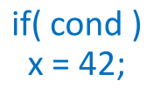
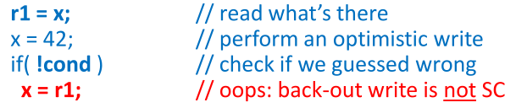
Ordering
x is a shared variable
Compiler speculates that cond may be true

Slide 32
Ordering
If cond is false, thread 2 should NOT execute statA
Too late!
StatA was executed when cond is false.
 | Thread 1 | Thread 2
Before Optimization | if (cond) x = 42; | if (x == 42) statA;
After Optimization | r1 = x; x = 42; if (!cond) x = r1; | If (x == 42) statA;
(1)
(3)
(2)
(4)
(5)
(6)

Slide 33
Ordering
Hardware and compiler are free to reorder memory operation
Reordering might break the program which is correct at source level

Slide 34
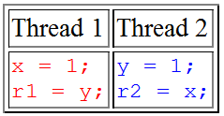
Atomicity
If x were a 32-bit integer on a 16-bit processor
The assignment statement could be compiled into two machine store instructions

Slide 35
Ordered atomic type
Ordered atomic type has two characteristics:
Ordering
Atomicity
Reads and writes to order atomic variables are guaranteed to
be executed in some ordering rules defined by programming
languages and libraries
Each read or write operation on ordered atomic variables is
guaranteed to be atomic, all-or-nothing

Slide 36
Ordered atomic type
A few programming languages and libraries define ordered atomic type
volatile in C/C++ DOES NOT ensure atomicity either ordering
Java | volatile
.NET | volatile
C++0x | atomic<T>
Intel TBB | atomic<T>

Slide 37
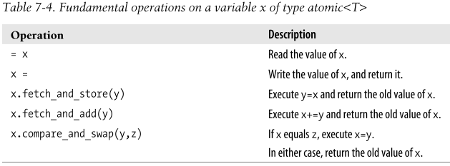
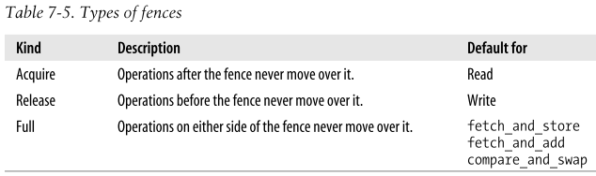
Intel TBB ordered atomic type

Slide 38
Memory Fence
Take IA64 (Itanium) as an example
Full | Acquire | Release
load/store A
load/store A
load/store A
mf
ld.acq B
st.rel B
load/store C
load/store C
load/store C

Slide 39
Memory Fence
Read usually is associated with acquire fence (load-acquire)
Write usually is associated with release fence (store-release)
Acquire
Lock
Release
Unlock

Slide 40
Dekker’s algorithm
Acquire/release do not fix the problem with Dekker’s algorithm
Boom!!!
Both P1 and P1 enter the critical section
Initially flag1 = flag2 = 0
P1 | P2
flag1 = 1 // store-release if (flag2 != 0) // read-acquire {…} // enter critical section | flag2 = 1 // store-release if (flag1 != 0) // read-acquire {…} // enter critical section
flag2 == 0
flag1 == 0
r1 = flag2;
flag1 = 1;
r2 = flag1;
flag2 = 1;

Slide 41
Outline
Introduction
Memory Coherence and Consistency
Lock-freedom
Cache-friendliness
Implementation and Verification
Experiment
Related Work
Conclusion

Slide 42
False sharing
P1
P2
R_{A}
W_{B}(30)
$
S
I
M
A(10) B(20)
A(10) B(20)
S
$
B(30)
A(10)
B(20)
MEM
We use MESI (Modified, Exclusive, Shared and Invalid) protocal.

Slide 43
False sharing
False sharing introduces unnecessary cache misses and extra memory traffic.
We use the following strategies to circumvent false sharing:
Take false sharing avoidance into consideration while designing the software interfaces
Group the variables used in the implementation according to their locality
Notes:
We use alignment and padding to group the variables according to their locality. We will explain this latter.

Slide 44
SA extended ISA
Two SA extended ISA
produce DN REG
consume DN REG
SA
DN | DATA
1
2
Core 1
Core 2

Slide 45
False sharing
Producer
Consumer
W_{C}(30)
R_{A}
R_{B}
$
M
E
A(10) | B(20) | C(??) | D(??)
I
$
C(30)
A(10) | B(20) | C(??) | D(??)
A (10) | B (20) | C (??) | D(??)
MEM

Slide 46
Interface
void push_back_n(Iterator begin, Iterator end, bool last)
produce DN REG
void front_n(Iterator begin)
consume DN REG

Slide 47
Locality
According to the locality, the variables can be divided into the following categories:
Thread-private
Thread-shared read-only
Exclusive-access
Wild-West
We group the variable in our implementation according to their locality by using alignment and padding

Slide 48
Four kinds of locality
Thread-private
These locations are private to a given thread and are never shared with other threads.
Thread-shared read-only
These locations are shared by multiple threads, but are never written by those threads.

Slide 49
Four kinds of locality
Exclusive-access
These locations are read and written, but are protected by a lock (e.g., mutex)
Wild-west
These locations are read and written by unsynchronized threads (e.g., order atomic variable)

Slide 50
C++0X facility - Attributes
Attributes are compile-time tokens that let you to designate special properties of certain C++ constructs
C++0X currently defines four attribute tokens
align
noreturn
final
carries_dependency
Usage: [[attribute token]]
Notes:
Attribute is a new feature in the next generation of C++ standard. We mention attribute here is it make alignment more portable. So far, programmers have to use compiler-specific syntax to do alignment.
See http://www2.research.att.com/~bs/C++0xFAQ.html for more details.

Slide 51
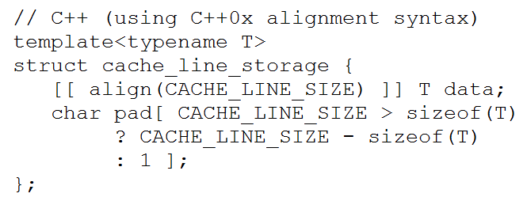
C++0X facility

Slide 52
C++0X facility - Attributes
GCC and Sun Studio do not support C++0X attributes so far
GCC
__attribute__((aligned()))
Sun Studio C++
#pragma align integer(variable [,variable...])

Slide 53
Outline
Introduction
Memory Coherence and Consistency
Lock-freedom
Cache-friendliness
Implementation and Verification
Experiment
Related Work
Conclusion

Slide 54
Implementation
Class QueueBuffer {
<align> const size_type m_capacity;
const size_type m_cds;
const value_type m_eof;
allocator_type m_allocator;
pointer m_buffer;
char pad1[] // padding
tbb::atomic<size_type> m_front;
char pad2[] // padding
tbb::atomic<size_type> m_back;
}

Slide 55
Implementation
void push(Iter begin, Iter end,
bool last) {
while (((m_back + m_cds) % m_cap)
== m_front)
; // spining if queue is full
// insert data into m_buffer
m_back =
(m_back + m_cds) % m_cap;
}
void front(Iter begin) {
while (m_front == m_back)
// spinning if queue is empty
;
// retrieve m_cds data from
// m_buffer
m_front =
(m_front + m_cds) % m_cap;
}
Read associated with acquire fence,
and write associated with release fence.
atomic<T> supports atomic read, write.

Slide 56
Implementation
void push(Iter begin, Iter end,
bool last) {
size_type local_back = m_back;
const size_type next_back =
(local_back + m_cds) % m_cap;
while ( next_back == m_front)
; // spinning if queue is full
// insert data into m_buffer
m_back = next_back;
}
void front(Iter begin) {
const size_type local_front
= m_front;
while (local_front == m_back)
// spinning if queue is empty
;
// retrieve data from m_buffer
m_front =
(local_front + m_cds) % m_cap;
}
Local variables can be cached in register or cache. We can avoid reloading ordered atomic variables from memory unnecessarily.

Slide 57
Verification
Duo to the non-deterministic of parallel systems, we cannot use traditional testing techniques to verify parallel systems

Slide 58
Verification
Promela (Process Meta Language)
Support modeling of asynchronous distributed algorithms as non-deterministic automata.
SPIN (Simple PROMELA Interpreter)
A general tool for verifying the correctness of distributed software models.
SPIN converts correctness claim specified as a temporal logic formula into a automata A

Slide 59
Verification
SPIN translates each process template into a finite automaton
Behavior of the concurrent system S is obtained by computing an asynchronous interleaving product of automata
SPIN compute a automaton R = A S, if R is nonempty, then the correctness claims are satisfied

Slide 60
active proctype producer(){
do
:: !((head + cds) % cap == tail)−>
printf(“Produce \n”);
head = (head + cds) % cap;
od
}
producer
FA
active proctype consumer(){
do
:: !(head == tail)−>
printf(“Consume \n”);
tail = (tail + cds) % cap;
od
}
consumer
FA

Slide 61
producer
FA
consumer
FA
Parallel System
FA
Parallel
System
FA
Assert
FA
Final FA
If Final FA is non-empty, then the parallel system is correct.
We should implement the design with atomicity and ordering in mind!

Slide 62
Outline
Introduction
Memory Coherence and Consistency
Lock-freedom
Cache-friendliness
Implementation and Verification
Experiment
Related Work
Conclusion

Slide 63
Experiment
Benchmark
Benchmark | Function | jvm | nigara
429.mcf | refresh_potential | 5.27% | 3.2%
450.soplex | CLUFactor::forestPackColumns | 0.00% * | 0.00% *
453.povray | Build_Bounding_Slabs | 0.00% * | 0.00% *
llubench | main | ** | **
* Called once
Notes:
We found some loops can be applied DSWP manually with our lock-free cache friendly queue in those functions. However, the execution time of some functions are too short so we have to mention that these functions have been called once.

Slide 64
Experiment Platforms
Machine Name | JVM | NIAGARA
System | IBM System x3400 | Sun SPARC Enterprise T5120
CPU | Intel Xeon E5335 | Sun UltraSPARC T2
CPU / System | 2 | 1
Core / CPU | 4 | 8
Thread / Core | 1 | 8
L1 I Cache | 32 KB | 16 KB
L1 D Cache | 32 KB | 8 KB
L2 Cache | 4MB (shared by two cores) | 4MB (shared by 8 cores, 8 banks)
Cache Line Size | 64 B | 64 B
Memory | 10 GB | 32 GB
OS | Linux 2.6.32 | Solaris 10 10/09
Compiler | g++ 4.4 | Sun Studio 12 u1 CC
Compiler Opt. | -O3 | -xO5

Slide 65
 | JVM |  | NIAGARA
 | Serial | Parallel | Serial | Parallel
429.mcf | 5.832s | 17.377s | 31.7568s | 155.893s
450.soplex | 0.164s | 0.176s | 1.642s | 1.797s
453.povray | 3.336s | 3.580s | 29.238s | 30.588s
llubench | 0.275759s | 0.4368813s | 0.0183277s | 0.0286987s

Slide 66
Outline
Introduction
Memory Coherence and Consistency
Lock-freedom
Cache-friendliness
Implementation and Verification
Experiment
Related Work
Conclusion

Slide 67
Outline
Introduction
Memory Coherence and Consistency
Lock-freedom
Cache-friendliness
Implementation and Verification
Experiment
Related Work
Conclusion

Slide 68
Conclusion
We present a lock-free cache-friendly software queue with detailed explianation both in informal and formal ways

Slide 69
Conclusion
Memory coherence and consistency play important roles in writing a lock-free program
The lack of memory model in programming language makes writing lock-free programs difficult

Slide 70
Conclusion
Cache can provide performance improvement or degradation of applications
There is no explicit control over the usage of cache

