Slide 1
GoogleTest Primer

Slide 2
Outline
Basic Concepts
Assertions
Basic Assertions
Binary Comparison
String Comparison
Floating-Point Comparison
Simple Tests
Test Fixtures
Invoking the Tests
Writing the main() Function

Slide 3
Basic Concepts
Start by writing assertions. An assertion's result can be success, nonfatal failure, or fatal failure
Test Program
Test Case
Test Case
Test
Test
Test
Test
Test
Test
Test
Notes:
Google Test groups the test results by test cases, so logically-related tests should be in the same test case.

Slide 4
Assertions
Assertions are macros that resemble function calls
Test a class or function by making assertions about its behavior
ASSERT_* generate fatal failures when they fail, and abort the current function
EXPECT_* generate nonfatal failures, which don't abort the current function

Slide 5

Assertions
Usually EXPECT_* are preferred, as they allow more than one failures to be reported in a test
However, you should use ASSERT_* if it doesn't make sense to continue when the assertion in question fails

Slide 6

Basic Assertions
ASSERT_* yields a fatal failure and returns from the current function, while EXPECT_* yields a nonfatal failure, allowing the function to continue running

Slide 7
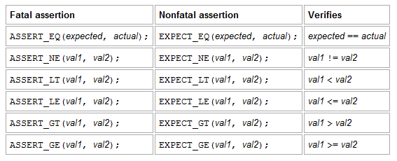
Binary Comparison
put the expression you want to test in the position of actual, and put its expected value in expected

Slide 8
Binary Comparison
Value arguments must be comparable by the assertion's comparison operator
Values must support the << operator for streaming to an ostream
If the corresponding operator is defined for the user-defined type, prefer using the ASSERT_*() macros

Slide 9
Binary Comparison
It's OK for the arguments to have side effects, because arguments are always evaluated exactly once
But your code should not depend on any particular argument evaluation order
ASSERT_EQ() does pointer equality on pointers. If used on two C strings, use ASSERT_STREQ() instead

Slide 10
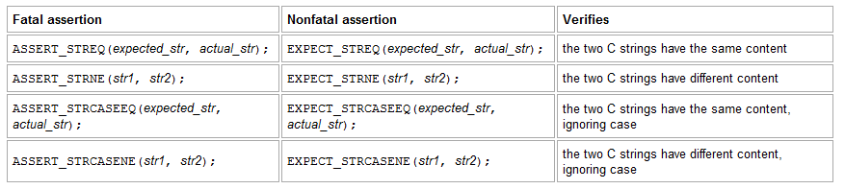
String Comparison
The assertions in this group compare two C strings. If you want to compare two string objects, use EXPECT_EQ, EXPECT_NE, and etc instead

Slide 11
String Comparison
Note that "CASE" in an assertion name means that case is ignored
A NULL pointer and an empty string are considered different.

Slide 12
Floating-Point Comparison
Due to round-off errors, it is very unlikely that two floating-points will match exactly
For floating-point comparison to make sense, the user needs to carefully choose the error bound
Google Test provides a good default assertions to do the comparison in terms of Units in the Last Place (ULPs)

Slide 13
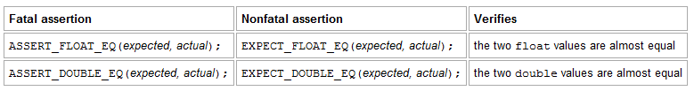
Floating-Point Comparison
By "almost equal", we mean the two values are within 4 ULP's from each other
The above assertion allow you to choose the acceptable error bound

Slide 14
Simple Tests
Use the TEST() macro to define and name a test function, These are ordinary C++ functions that don't return a value
In this function, along with any valid C++ statements you want to include, use the various Google Test assertions to check values
The test's result is determined by the assertions; if any assertion in the test fails (either fatally or non-fatally), or if the test crashes, the entire test fails. Otherwise, it succeeds

Slide 15

Simple Tests
The first argument is the name of the test case, and the second argument is the test's name within the test case
A test's full name consists of its containing test case and its individual name
Tests from different test cases can have the same individual name

Slide 16
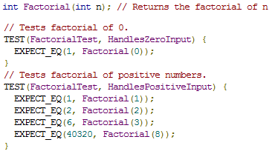
Simple Tests
Google Test groups the test results by test cases, so logically-related tests should be in the same test case; in other words, the first argument to their TEST() should be the same

Slide 17
Test Fixtures
A test fixture allows you to reuse the same configuration of objects for several different tests

Slide 18
Test Fixtures
Derive a class from testing::Test . Start its body with protected: or public: as we'll want to access fixture members from sub-classes
Inside the class, declare any objects you plan to use
If necessary, write a default constructor or SetUp() function to prepare the objects for each test
If necessary, write a destructor or TearDown() function to release any resources you allocated in SetUp()
If needed, define subroutines for your tests to share

Slide 19

Test Fixtures
TEST_F() allows you to access objects and subroutines in the test fixture
The first argument is the test case name, but for TEST_F() this must be the name of the test fixture class
A test fixture class must be defined before using it in a TEST_F()

Slide 20
Test Fixtures
For each test defined with TEST_F(), Google Test will:
  Create a fresh test fixture at runtime
  Immediately initialize it via SetUp() ,
  Run the test
  Clean up by calling TearDown()
  Delete the test fixture
Google Test does not reuse the same test fixture for multiple tests. Any changes one test makes to the fixture do not affect other tests

Slide 21
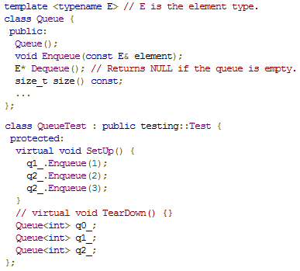
Test Fixtures
By convention, you should give it the name FooTest where Foo is the class being tested
In this case, TearDown() is not needed since we don't have to clean up after each test, other than what's already done by the destructor

Slide 22
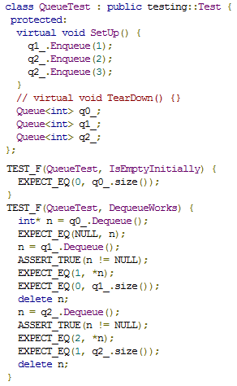
Test Fixtures
When these tests run, the following happens:
1. Google Test constructs a QueueTest object (let's call it t1 ).
2. t1.SetUp() initializes t1 .
3. The first test ( IsEmptyInitially ) runs on t1 .
4. t1.TearDown() cleans up after the test finishes.
5. t1 is destructed.
The above steps are repeated on another QueueTest object, this time running the DequeueWorks test

Slide 23
Test Fixtures
The rule of thumb is to use EXPECT_* when you want the test to continue to reveal more errors after the assertion failure, and use ASSERT_* when continuing after failure doesn't make sense

Slide 24
Invoking the Tests
After defining your tests, you can run them with RUN_ALL_TESTS() , which returns 0 if all the tests are successful, or 1 otherwise
RUN_ALL_TESTS() runs all tests in your link unit -- they can be from different test cases, or even different source files

Slide 25
Invoking the Tests
When invoked, the RUN_ALL_TESTS() macro:
  Saves the state of all Google Test flags
  Creates a test fixture object for the first test
  Initializes it via SetUp()
  Runs the test on the fixture object
  Cleans up the fixture via TearDown()
  Deletes the fixture
  Restores the state of all Google Test flags
  Repeats the above steps for the next test, until all tests have run
Notes:
If the text fixture's constructor generates a fatal failure in step 2, there is no point for step 3 - 5 and they are thus skipped. Similarly, if step 3 generates a fatal failure, step 4 will be skipped.

Slide 26
Invoking the Tests
Whether a test has passed based on its exit code. Thus your main() function must return the value of RUN_ALL_TESTS()
RUN_ALL_TESTS() should be called only once. Calling it more than once conflicts with some advanced Google Test features and thus is not supported

Slide 27
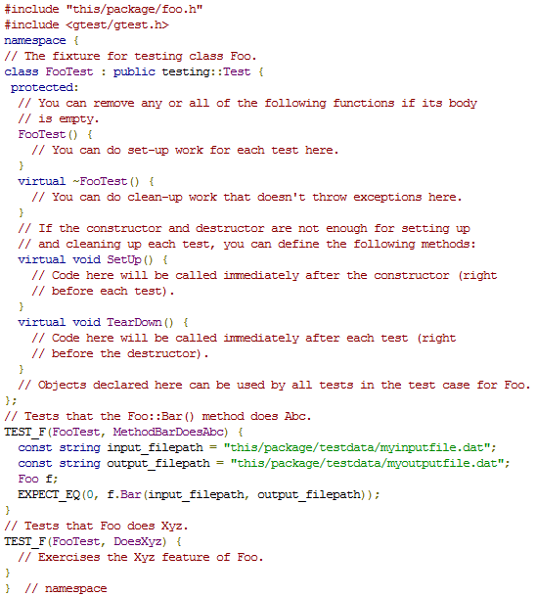
Writing the main() Function
Include gtest/gtest.h to use googletest facilities

Slide 28

Writing the main() Function
This function parses the command line for Google Test flags, and removes all recognized flags. This allows the user to control a test program's behavior via various flags, which we'll cover in GTestAdvanced. You must call this function before calling RUN_ALL_TESTS(), or the flags won't be properly initialized.
In your main() function must return the value of RUN_ALL_TESTS()

Slide 29
Reference
http://code.google.com/p/googletest/wiki/GoogleTestPrimer
http://code.google.com/p/googletest/wiki/GoogleTestAdvancedGuide
http://code.google.com/p/googletest/wiki/GoogleTestSamples

