Slide 1
Create a Working Linker with the MCLinker framework
Luba Tang
2013/02/24

Slide 2

Agenda
Getting Started
Build MCLinker
Run and cross linking
A simplest linker
Understanding the MCLinker IR framework
Module
LinkerConfig
Linker
Use IRBuilder to build up the input tree
Use IRBuilder to build up the fragment-reference graph
Luba Tang, software architect of MCLinker
MediaTek, inc.

Slide 3
Download and Install LLVM
MCLinker requires LLVM libraries. Before building MCLinker, you must have LLVM
Download LLVM trunk@r173175
Install LLVM
svn co -r 173175 http://llvm.org/svn/llvm-project/llvm/trunk llvm
cd llvm
cd ../.. #go back to where you started mkdir llvm-build cd llvm-build ../llvm/configure --prefix=${LLVM_INSTALL} make all install

Slide 4
Download and Install MCLinker
MCLinker building system is the GNU auto tool system
Download Developing MCLinker
Configure MCLinker with llvm-config tool
Install MCLinker
git clone https://code.google.com/p/mclinker/ mcld
cd mcld
./autogen.sh
./configure –with-llvm-config=${LLVM_INSTALL}/bin/llvm-config –prefix=${MCLD_INSTALL}
make && make install

Slide 5
Run!
GNU ld is the de facto standard. MCLinker option must compatible to the GNU ld
Synopsis
ld.mcld [options] objfile …
Cross linking options
-mtriple=target-triple
-march=cpu-arch
Cross Linker
Rename the `ld.mcld` with the prefix of triple
ld.mcld -shared -march=arm a.o –o out.so
ld.mcld -shared –mtriple=arm-none-linux-gnueabi a.o –o out.so
arm-none-linux-ld –shared a.o –o out.so

Slide 6
The MCLinker Library
Executable Programs
bin/ld.mcld
bin/ld.bcc
Archive Library
lib/libmcld.a
Headers
include/mcld/*
include/mcld/*.h | The major interfaces
include/mcld/ADT/ | Abstract data type. Fast hash table for huge amount of elements Binary tree Traits Misc.
include/mcld/Support/ | Support libraries. Memory management layer. File system libraries

Slide 7
Using MCLinker as a library
Everything in MCLinker is in the mcld namespace
Major interfaces are under the `mcld` directory
#include <mcld/Module.h> #include <mcld/Linker.h> #include <mcld/Environment.h> #include <mcld/IRBuilder.h> #include <mcld/LinkerConfig.h>
using namespace mcld;
int main(int argc, char* argv[]) {
Initialize(); /** Add Linker, Module, IRBuilder, and LinkerConfig **/ Finalize();
}

Slide 8
Link with MCLinker
Use –lmcld linker flags
LDFLAGS = ${LLVM_LDFLAGS} -lmcld

Slide 9
Major Components in MCLinker
Module consists of
the input tree, and
the fragment-reference graph
LinkerConfig has
script options, and
general options
IRBuilder builds up
The input tree, and
The fragment-reference graph
Linker lowers IRs
Normalization
Resolve
Layout
Emission
IRs
Options
Control of IR
Control of Linking

Slide 10
A Simplest Linker
A Linker without any command line language
[user@local]$ ld –mtriple=arm-none-linux –o out.exe
Error: no inputs
mcld::Initialize()
mcld::Module module("test");
mcld::LinkerConfig config("arm-none-linux”); // -mtriple=arm-none-linux
mcld::Linker linker;
linker.config(config);
mcld::IRBuilder builder(module, config);
if (linker.link(module, builder))
linker.emit("./out.exe"); // -o ./out.exe
mcld::Finalize();

Slide 11
Setting Up General Options (1/2)
To emit a shared library or an executable program
mcld::LinkerConfig config("arm-none-linux”); ///< -mtriple=arm-none-linux
config.setCodeGenType(LinkerConfig::DynObj); ///< --shared
config.options().setSOName("libplasma.so"); ///< --soname=libplasma.so
config.options().setBsymbolic(); ///< -Bsymbolic
config.options().directories().insert(“/opt/lib”); /// -L/opt/lib

Slide 12
Setting Up General Options (2/2)
Most frequently used options are in class GeneralOptions
Method | Linker Option | Meaning
SearchDirs& directories() | -L | The search pathes
void setEntry(const std::string& pEntry) | -entry [symbol] | Set up the default entrance for an executable
void addZOption(const mcld::ZOption& pOption); | -z [description] | The –z option
void setStripDebug() | -S | Strip debug
void setTrace() | -t | Trace normalization
void setHashStyle(HashStyle pStyle) | --hash-style | Set hash table to SysV or GNU

Slide 13
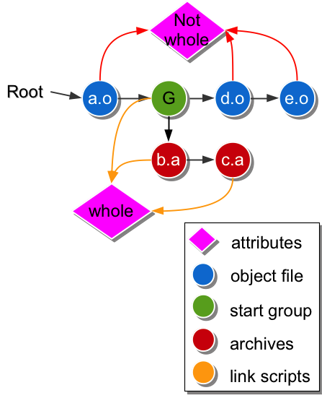
mcld::Input
A mcld::Input consists of
Type
object file
archive,
shared object
linker script
group
Path/Name
A reference to an attribute set
MemoryArea
high performance memory handler for file image
LDContext
sections and symbols

Slide 14
Read an Input File by IRBuilder
mcld::IRBuilder provides a convenient way for creating the Input Tree or the Fragment-Reference graph
mcld::IRBuilder::ReadInput() reads a file and append it into the input tree of a mcld::Module
mcld::Module module("libplasma.so"); mcld::IRBuilder builder(module, config);
// /opt/gcc/lib/crtbegin.so builder.ReadInput(”prolog", “/opt/gcc/lib/crtbegin.so”);
// -lm –llog builder.ReadInput("m"); builder.ReadInput("log");
cerr << module.getInputTree().size() << end; ///< should be 3

Slide 15
Change the Attribute Set
Example
$ld ./a.o --whole-archive --start-group ./b.a ./c.a --end-group --no-whole-archive ./d.o ./e.o
builder.ReadInput(”obj a", “./a.o”);
builder.WholeAchieve();
builder.StartGroup(); builder.ReadInput(“archive b”, “./b.a”); builder.ReadInput(“archive c”, “./c.a”); builder.EndGroup();
builder.NoWholeArchive();
builder.ReadInput(“obj d”, “./d.o”); builder.ReadInput(“obj e”, “./e.o”);

Slide 16
Traverse the input tree
BinaryTree::dfs_iterator file = module.getInputTree().bfs_begin(); BinaryTree::dfs_iterator End = module.getInputTree().bfs_end(); while (file != End) { cerr << (*file)->name() << “; ”;
}
// print out: // archive a; archive b; obj e; obj d; obj a;

Slide 17
Create A Customized mcld::Input
IRBuilder::CreateInput() help developers to create a customized mcld::Input
mcld::Module module("libplasma.so"); mcld::IRBuilder builder(module, config);
// ./plasma.o builder.CreateInput(“plasma object”, “./plasma.o”, mcld::Input::Object);

Slide 18
Section Header and Data
mcld::LDContext contains input symbols and sections
mcld::LDSection is the section header
mcld::SectionData is a container of input mcld::Fragment
LDSection
SectionData
Fragment
LDContext
LDSection
SectionData
Fragment
LDSection
SectionData

Slide 19
Create A Customized Section
IRBuilder::CreateELFHeader() help developers to create a customized ELF header
IRBuilder::CreateSectionData prepares a mcld::SectionData for the header
IRBuilder::AppendFragment defines a isolated vertex which belongs to the mcld::SectionData
/// [ 1] .text PROGBITS 00000000 000034 000010 00 AX 0 0 4
LDSection* text = builder.CreateELFHeader(*input, ".text”, llvm::ELF::SHT_PROGBITS, llvm::ELF::SHF_ALLOC | llvm::ELF::SHF_EXECINSTR, 4);
SectionData* text_data = builder.CreateSectionData(*text);
static uint8_t text_content[] = { 0x00, 0x48, 0x2d, 0xe9, 0xfe, 0xff, 0xff, 0xeb}; Fragment* text_frag = builder.CreateRegion(text_content, 0x10);
builder.AppendFragment(*text_frag, *text_data);

Slide 20
Create A Symbol
IRBuilder::AddSymbol() defines a new symbol to a fragment
/// 6: 00000000 16 FUNC GLOBAL DEFAULT 1 _Z1fv
builder.AddSymbol(*input, ///< input file (optional)
"_Z1fv", ResolveInfo::Function,
ResolveInfo::Define, ResolveInfo::Global,
16, ///< size
0x0, ///< value
text ); ///< fragment

Slide 21
Create A Reference
MCLinker will provide a reference rewriter to re-write the topology of the reference graph.
Already in the `diana` branch (under code reviewing)
That branch illustrates how to eliminate dead fragment by reachability
Basic Interfaces
Define FRGraph::reference, plug and slot
Provide FRGraph::connect(plug, slot) to create a reference
Provide FRGraph::break(reference) to remove a reference

Slide 22
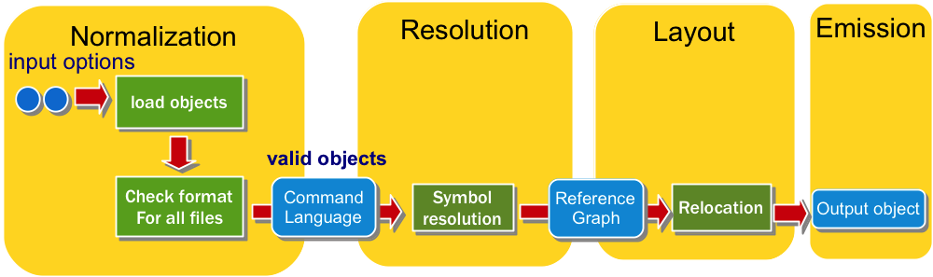
Modify Module at different linking stages
Modify mcld::Module between among stages
IRBuilder builder(module, config);
Linker::resolve()
Linker::layout()
Linker::emit(“out.so”)

Slide 23
Connect with LLVM
MCLinker provides mcld::raw_mem_ostream
LLVM can use mcld::raw_mem_ostream as an output
MCLinker can read mcld::raw_mem_ostream as an input
mcld::raw_mem_ostream os;
Target->createAsmStreamer(…, os, …); ///< LLVM Target
builder.ReadInput(os);

Slide 24
Conclusion
We introduce MCLinker major components
Module
LinkerConfig
IRBuilder
Linker
We illustrate how to
Append a input file in the input tree
Create sections in a customized input
Create symbols and relocations
Connect MCLinker and LLVM

