Slide 1
MCLinker Intermediate Representation
Luba Tang
2013/2/24

Slide 2

Agenda
Introduction to Linkers and Loaders
  Related works
  The value of MCLinker Intermediate Representation
MCLinker Intermediate Representation
  Module and Input Tree
  Fragments and Reference Graph
MCLinker linking algorithm
  Normalization
  Resolution
  Layout
  Emit
Luba Tang, software architect of MCLinker
MediaTek, inc.

Slide 3
Introduction to MCLinker Intermediate Representation
MCLinker is the first *ELF linker to provide an intermediate representation (IR) for efficient transformation and analysis
MCLinker provides IR on two levels
  Linker Command Line Language
  Fragment-Reference Graph
Fragment is the basic linking unit, it can be
  A section (coarse granularity)
  A block of code or instructions (middle granularity)
  An individual symbol and its code/data (fine granularity)
MCLinker can trade linking time for the output quality.
  The finer granularity,
    Fast, smaller program
    Longer link time
* Nick Kledzik invents the Atom IR in ld64 for MachO. ld64 inspires MCLinker IRs

Slide 4
The Linker Command Line Language
Linker’s command line options is a kind of language
  The meaning of a option depends on
    their positions
    the other potions
  Some options have its own grammar
Four categories of the options
Examples
  Input files
  Attributes of the input files
  Linker script options
  General options
  ld /tmp/xxx.o –lpthread
  ld –as-needed ./yyy.so
  ld –defsym=cgo13=0x224
  ld –L/opt/lib –T ./my.x

Slide 5
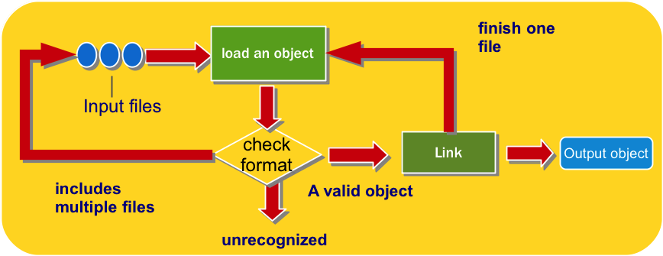
The GNU ld Linker
The GNU ld linker is an interpreter of the command line language
  Processing is recursive.
  No clear separation between individual steps
  Binary File Descriptor (BFD) is the only IR

Slide 6
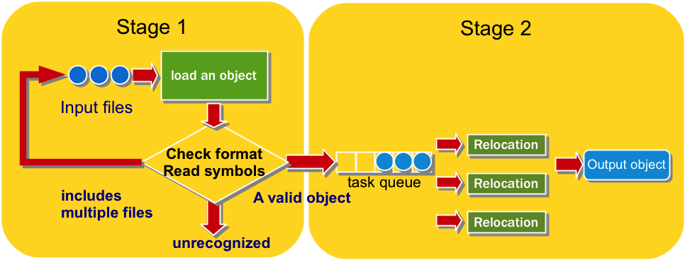
The Google gold Linker
The Google gold linker separates linking into two stages
  Symbol resolution
  Relocation of instructions and data
Although it has separated the linking processes, it does not provide reusable IR for optimization and analysis
The Google gold linker illustrates an efficient linking algorithm
  It’s x2 faster than the GNU ld linker
  Support multiple threads. Appropriate to cloud computing

Slide 7
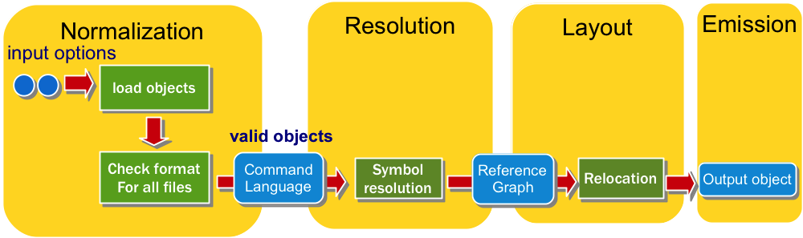
MCLinker
MCLinker separates the linking into four distinct stages
  Normalization – parse the command line language
  Resolution – resolve symbols
  Layout – relocate instructions and data
  Emission – emit file by various formats
MCLinker provides two level intermediate representation (IR)
  The command line language level
  The reference graph level

Slide 8
Input Files on The Command Line
An input file can be an object file, an archive, or a linker script
Some input files can be defined multiple times
The result of linking depends on the positions of inputs on the command line.
  Weak symbols are first-come-first-served
  COMDAT sections are first-come-first-served
Two semantics to read input files
  INPUT( file1, file2, file3, ...)
  GROUP( archive1, archive2, archive3, ...)
Archives in a group are searched repeatedly until no new undefined references are created
  $ ld a.o –start-group b.a c.a –end-group d.o e.o

Slide 9
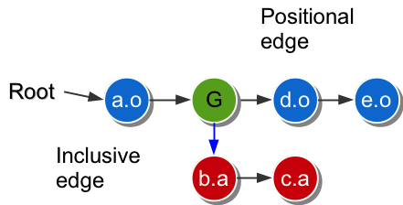
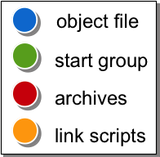
The Input File Tree
We can represent the input files on
the command line by a tree structure
  Vertices describes input files and
  groups on the command line
    Object files
    Archives
    Linker scripts
    Entrances of groups
Edges describe the relationships between
vertices
  Positional edges
  Inclusive edges
Linkers resolve symbols by DFS and merge sections by BFS
Example
  $ ld a.o –start-group b.a c.a –end-group d.o e.o

Slide 10
Attributes of Input Files
Attributes change the way that a linker handles the input files
Attributes affect the input files after the attribute options
Functions | Options | Meanings
Whole archives | --whole-archive | Includes every file in the archive
Link against dynamic libraries | -Bdynamic | Search shared libraries for -l option
As needed | --as-needed | Only add the necessary shared libraries to resolve symbols
Input format | --format= | The format of the following input files

Slide 11
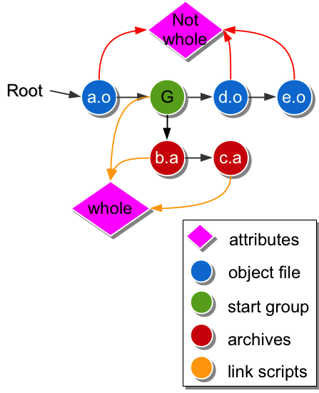
Attributes in The Input File Tree
Every input has a set of attributes
In the MCLinker implementation,
we give every vertex a reference
to its attribute set
If two vertices have identical attributes, they can share a common attribute set.
Example
  $ld ./a.o --whole-archive
  --start-group ./b.a ./c.a --end-group
  --no-whole-archive
  ./d.o ./e.o

Slide 12
Normalization
Transform the command line language into the input file tree
  Parse command line options
  Recognize input files to build up sub-trees
  Merge all sub-trees to a form the input file tree

Slide 13
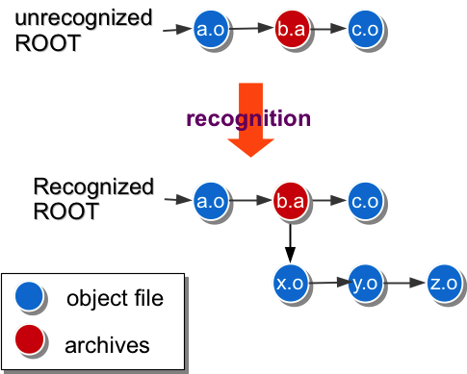
Steps of Normalization
Step of normalization
  Parse the command line options
  Recognize archives and linker scripts
  Read the linker scripts and archives to create sub-trees
  Merge all sub-trees
Example
  $ ld ./a.o ./b.a ./c.o

Slide 14
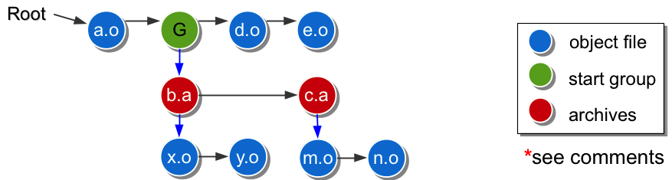
Traverse the Input File Tree
MCLinker provides different iterators for different purposes
  For symbol resolution
    Depth first search for correctness
  For section merging
    Breadth first search for cache locality of the output file

Slide 15
Resolution
Transform the input file tree into the reference graph
  Resolves symbols
  Reads relocation
  Builds the reference graph

Slide 16
Symbols and Relocations
A fragment is a block of instruction code or data in a module
  A fragment may be
    a function,
    a label (Basic block),
    a 32-bit integer data, and so on.
A defined symbol indicates a fragment
A relocation represents an use-define relationship between two fragments
Module X
Symbol @a
Module Y
Symbol @bar
…
@a = global i32 0
…
define @bar()
…
add @a, 0x1, 0x2
relocation
define
use

Slide 17
Fragment-Reference Graph (1/2)
A reference is a symbolic linkage between two fragments
  A reference is an directed edge from use to define
define
use
define fragment
symbol
relocation
use fragment
a reference
MCLinker represents the input modules as a graph structure
  Vertices describe the fragments of modules
  Edges describe the references between two fragments

Slide 18
Fragment-Reference Graph (2/2)
A Fragment-Reference Graph is a digraph, FRG = (V, E, S, O)
  V is a set of fragments
  E is a set of references, from use to define
  S is a set of define symbols. They are the entrances of the graph
  O is a set of exits and explains later.
__global
__start
fragment
edge

Slide 19
Symbol Resolution
Determine the topology of the reference graph
  Relocation is a plug
  Define symbol is a slot
  Symbol resolution connects plugs and slots.
Symbols has a set of attributes to help linkers determine the correct topology
Which one?
define
symbol
define fragment
use
define
use fragment
relocation
Undefine symbol
define
symbol
define fragment

Slide 20
Optimizations on the Fragment-Reference Graph
Fragment stripping
  Remove unused fragment for shrink code size (Reachability problem)
  Traditional linkers strip coarse sections. But MCLinker can strips finer-grained fragments.
  The finer granularity, the smaller code size
Branch optimization
  Replace high cost branch by low cost branch
  Optimizing by change of the relocation type
Low-level inlining
Fragment duplication for TLS optimization and copy relocations

Slide 21
Layout
To serialize the reference graph into a address space
  Scan relocations
  Layout
  Apply relocations

Slide 22
Exits of The Fragment-Reference Graph
A Fragment-Reference Graph is a digraph, FRG = (V, E, S, O)
  O is a set of exits. An exit represents a dynamic relocation to GOT.
  Represent to access external variables or to call an external function exits the FRG
If the defining fragment is in an external module, then MCLinker will add exits for the references to the outside module.
  We have no way to know the memory address of the external module until the load time
  We add the Global Offset Table (GOT) for the unknown addresses
  We add dynamic relocations for all entries of the GOT
  Loader will apply the dynamic relocations and set the correct address in the GOT.
  The program use the GOT to accesses the external module indirectly
use
define
__start
GOT
relocation
relocation
__global
exit

Slide 23
Layout
Layout is a process to finalize the address of fragment and symbols
  Sorts FRG=(V, E, S, O) topologically
  Assigns addresses to {V, S, O}
Before layout, we must calculate the sizes of all elements of the graph
  Relocation scanning
    Reserve exits and calculate the sizes of all exits
    Undefined global symbol, GOT, and dynamic relocations
  *Pre-layout
    Calculate the size of all fragments
    Calculate the size of all entrances
      Global symbols and the hash table
* MCLinker follows the Google gold linker’s naming. But pre-layout is opaque and may be renamed.

Slide 24
Apply relocation (1/2)
Adjusts the content of using fragments
  Final addresses of symbol is known after layout
  Correct use fragment by accessed address
Symbol Table
define
use
Module Y
…
0x24 @a
…
add @a , 0x1, 0x2
relocation
0x24

Slide 25
Apply relocation (2/2)
Replaces absolute addresses by PC-related offset if supported by the target
Basic Relocation Formula
  S – P + A
  S: the symbol value
  P: the place of the use instruction
  A: addend, adjustment (by the instruction format)
…
@a
…
add @a , 0x1, 0x2
S
S - P
P
A
address space

Slide 26
Optimizations on Layout
Dynamic Prelinking
  If the system puts shared libraries at a fixed memory location, we can fill GOT with fixed addresses to avoid symbol look up in the loader
Static Prelinking
  If the system puts shared libraries at a fixed memory location, we can directly refer to the fixed addresses without any exits
Symbol Stripping
  Strip the undefined symbols which is not a exit

Slide 27
Emission
Emits the module in the output formats
  Adds format information
  Writes down the IR
In order to improve both cache and page locality, MCLinker collects and performs most file operations in this stage.
  MCLinker copies the content in the inputs and applies the resolved reference in this stage.

Slide 28
Conclusion
We’ve introduced MCLinker intermediate representations
  The Linker Command Line Language
  The Fragment-Reference Graph
We’ve indicated many optimization opportunities in MCLinker IRs.

