Slide 1
LLVM IR
LLVM IR
Object File
Assemble
DAG Lowering
Assembly File
SDNode
Object File
Writer
DAG of Target Operation
(might be illegal)
Assembly
Printer
Legalization
Machine Code Layer
(MCInst)
DAG of Target Operation
(legal)
MCInst
Instruction Selection
MC Lowering
DAG of Machine Instructions
Sequence of Machine Instructions
MachineInstr
Scheduling and Formation
Prolog/Epilog Code Insertion
Sequence of Machine Instructions
Register
Allocation
Sequence of Machine Instructions
SSA-based Machine Code Optimization

Slide 2
LLVM IR
DAG of Target Operation
(might be illegal)
DAG of Target Operation
(might be illegal)
DAG of Target Operation
(legal)
DAG of Target Operation
(legal)
DAG of Machine Instructions
DAG of Machine Instructions
Sequence of Machine Instructions
Sequence of Machine Instructions
Machine Code Layer
(MCInst)

Slide 3
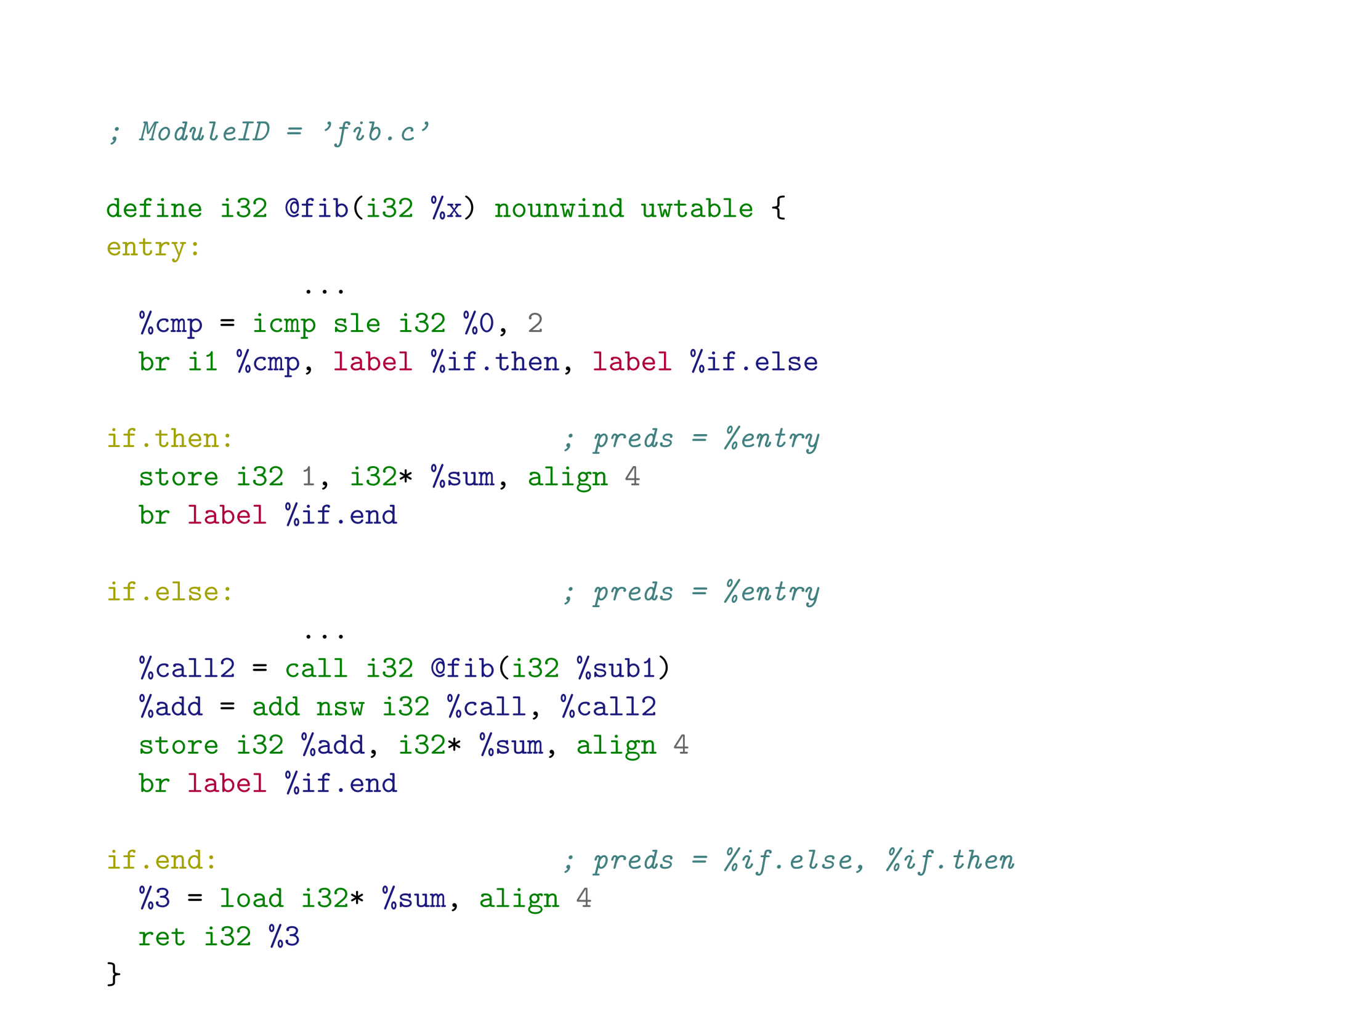
Module
Function
LLVM IR
Basic Block

Slide 4
LLVM IR
MachineInstr
Assembly
Parsing
MCInst
(MC Layer)
Assembly
Printer
Decode
Object File
Writer
Assembly File
Object File
Assemble
Disassemble

Slide 5
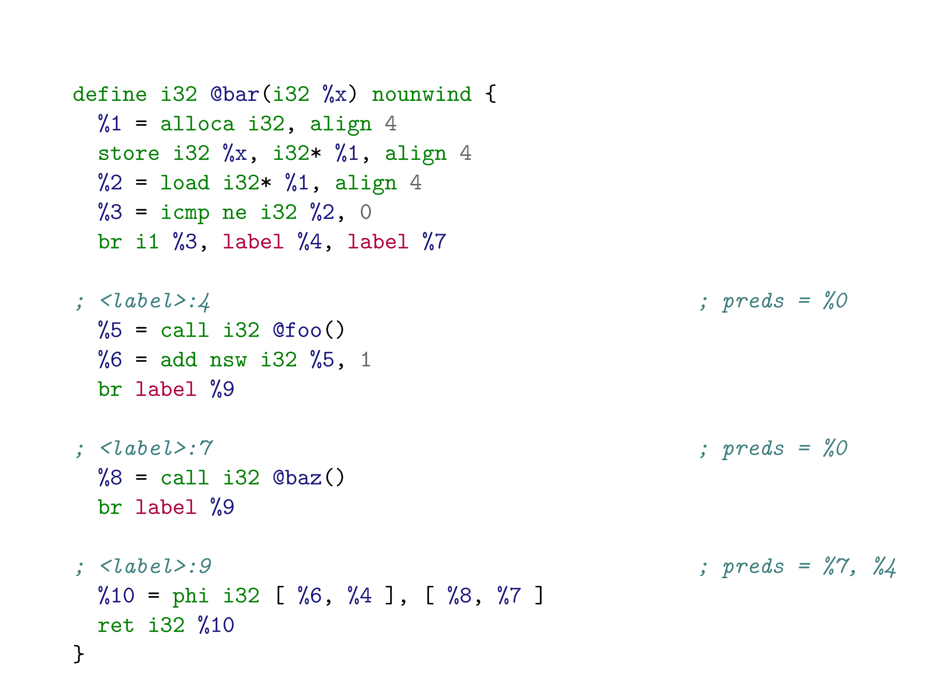
SSA Form & Infinite Virtual Register
Phi Node

Slide 6
Assembly (.s)
Code (.c)
Code (.c)
Code (.c)
Object (.o)
Assembler
Parser
Code
Generator
Code
Generator
Code
Generator
Disassembler
MCStreamer
MCInst
Object
Writer
Assembly
Printer
Object
Writer
MCJIT
Assembly
Printer
Object (.o)
Assembly (.s)
Object (.o)
Execution
Assembly (.s)
Assembly
Compile
Compile
&
Assembly
JIT
Disassembly

Slide 7
Assembly File
Source File
AsmParser
MC
InstPrinter
AsmPrinter
&
MCInstLower
MC
AsmStreamer
&
ObjectStreamer
Code
Generator
MC
CodeEmitter
Disassembler
Object File

Slide 8
MCSection
MCSection
MCFragment
MCFragment
MCFragment

