Slide 1
Introduction to LLVM and MCLinker
Luba Tang

Slide 2

What is the LLVM Project?
Collection of Compiler Technology, not only compiler tools
Optimizers and Code Generator
Flexible front-ends – dragonegg, clang
Capacity to modularize
Open Source Project with many contributors
BSD-like license, not GPL
Industry: Google, Apple, Adobe, ARM, AMD
Many individuals

Slide 3


The MCLinker Project
A Collection of Toolchain Technologies
Design for on-device linking
Ahead-of-Time compilation (AOT) is the ultimate solution of virtual machines. For AOT, BSD-like license linker is necessary
2-stage compilation is the trend for GPGPU computing to solve the target platform fragmentation problems
Mobile device has limited computing power and memory
MCLinker is a candidate linker of Android and BSD standard systems
Is already part of the Android Open Source Project
Is able to link BSD buildworld

Slide 4
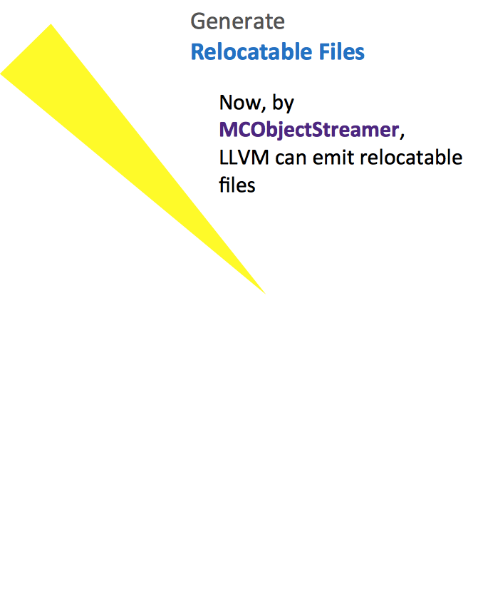
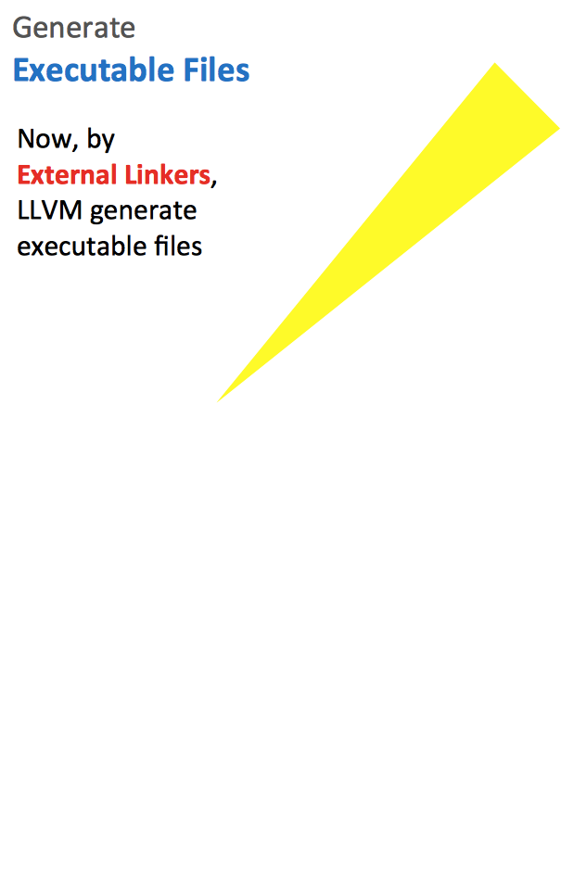

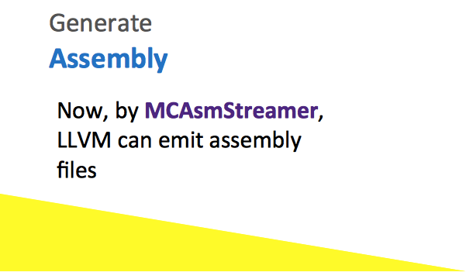
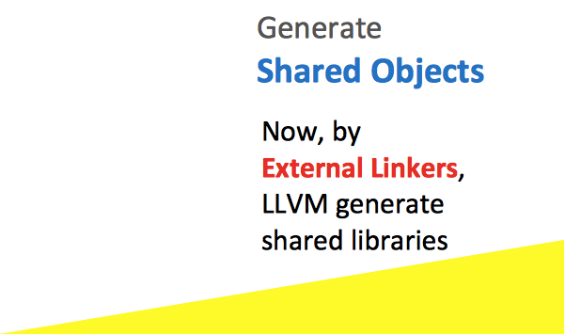
LLVM is Sexy
MCLinker
LLVM generates executable file
MCLinker
LLVM generates shared libraries

Slide 5
Key success factors of an open source project
Elegant Solution to Complex Problem
Reliability and Feasibility
Community Trust

Slide 6
Why LLVM is popular
LLVM is an elegant solution for compiler technologies
LLVM is modular. It allows developers customizing his own tools
LLVM IR is self-contained and serializable to a human-readable format
LLVM is reliable
LLVM provides shim layer to manage memory. It protects developers from tedious memory management
LLVM community is growing up
LLVM is distributed under UIUC BSD-Style license. It allows proprietary use and allows the software released under different licenses
LLVM improves not only developers’ creativities but also developers’ productivities

Slide 7
MCLinker is a full-fledge ELF system linker
System linkers are very complicated. Only a few team can make a full-fledge system linker.
There are only four open source linkers that can be said full-fledge.
GNU ld, Google gold can link Linux kernel
Apple ld64 can link Mac OS X and iOS
MCLinker can link 100% BSD base system and will be able to link BSD kernel before BSDCan 5/15 2013
ELF linkers are super complicated. There are many undocumented behaviors and target-specific behaviors.
Some linkers are developed for three years and can not be released. The linking problem is intricate.
GNU ld, Google gold and MCLinker may be the only three workable ELF system linkers.

Slide 8
Comparison of ELF Linkers
 | GNU ld | Google gold | MCLinker
License | GPLv3 Cannot be adopted by Android |  | UIUC BSD-Style
Target Platform | All Linux mainstream devices | ARM, X86, X86_64, (Mips, SPARC) | All Android devices. ARM, X86, Mips (X86_64, X32, Mips64 and Hexagon)
Object Format | COFF, a.out, ELF | ELF only | ELF, extensible
Line of Code | 500+K | 100+K | 50+K
Performance | - | Fast | Fastest Steadily x2 than GNU ld, x1.3 than Google gold
Intermediate Representation | The BFD library for reference graph | None | Command line language and reference graph

Slide 9
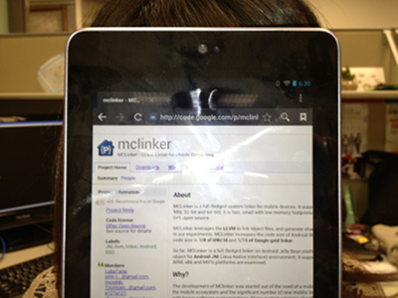
MCLinker is reliable
MCLinker can link every applications and libraries in
Android
BSD Base System
We are going to link
BSD kernel
Linux kernel
Bootable Android Jelly Bean

Slide 10
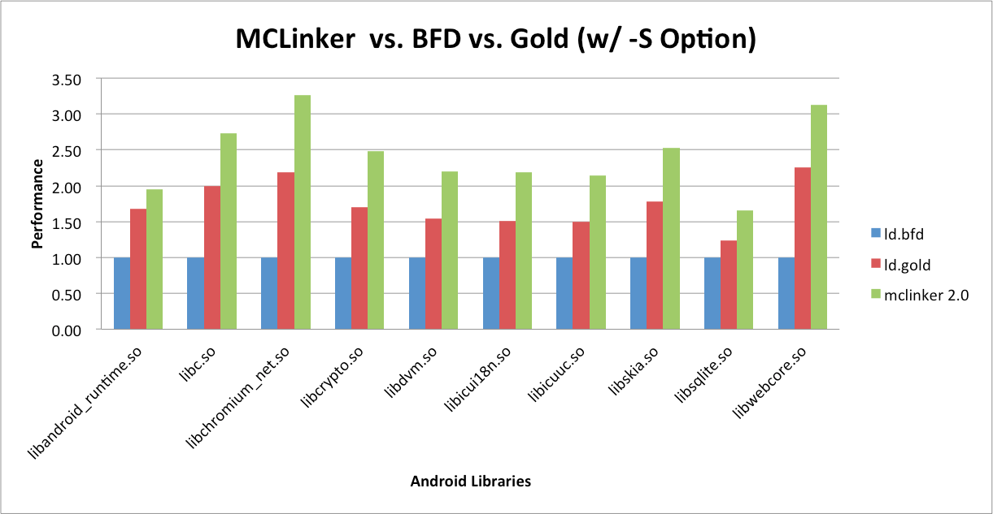
MCLinker is fast
MCLinker is 30% faster than the Google gold, and the Google gold is ~200% faster than GNU ld
The output quality is identical to all linkers (< 1%)

Slide 11







MCLinker Objectives of 2013
For Android, For BSD, For Linux, For virtual machines
Support more processors

