Slide 1
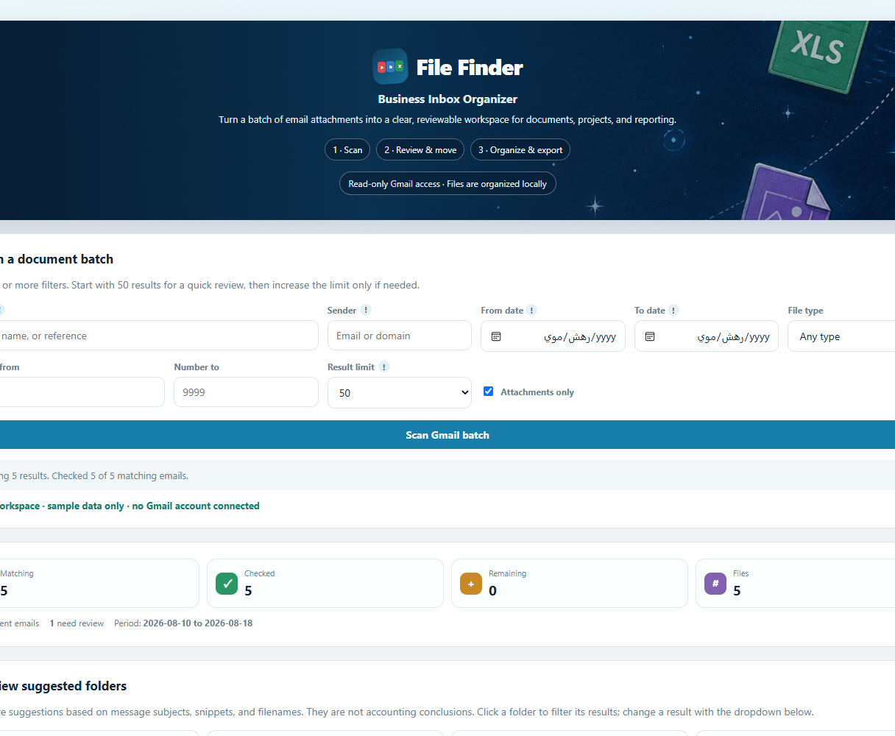
INDEPENDENT SOFTWARE PROJECT · 2026
File Finder
Find the files you need in Gmail.
Check the suggested folders.
Save only what you choose.
Gmail search, folder review and local save
FILE FINDER / CASE STUDY
01
Notes:
The public capture contains only synthetic example messages. It does not represent a live customer mailbox.

Slide 2
THE PROBLEM
Finding email attachments
without repeating the search
The problem
What File Finder does
Who it's for
Invoices, orders and agreements arrive in different threads. Finding one later means searching Gmail again and opening messages one by one.
File Finder lists matching attachments, suggests folders and saves the files you select. Unclear files stay in a review list.
People who deal with many invoices, orders and other documents in Gmail.
Unclear files stay visible for review instead of being filed by guesswork.
FILE FINDER / CASE STUDY
02

Slide 3
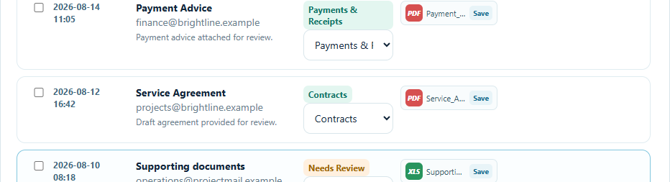
THE WORKFLOW
Search, check, save
01
02
03
Search
Review
Export
Find attachments by sender, date or keywords.
Change a suggested folder or leave a file for review.
Save selected files on your computer with a record of the batch.
App screens with sample messages
Check each suggestion before saving.
FILE FINDER / CASE STUDY
03

Slide 4
WHAT'S NEXT
The next version of
File Finder
CURRENT VERSION
Windows app with Gmail search, folder review and local saving.
REVIEW STEP
The app suggests a folder. You decide whether to keep or change it.
NEXT
Test more document types and unusual cases with people who manage many attachments.
A small user trial will show where this workflow helps and where it needs work.
FILE FINDER / CASE STUDY
04

