Slide 1
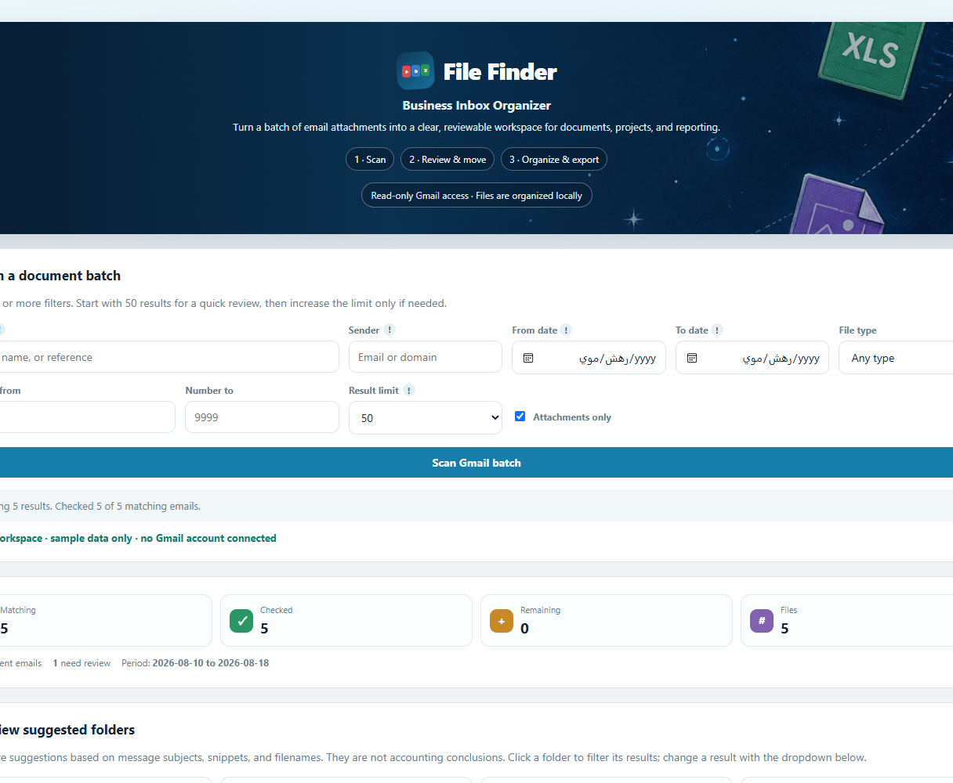
INDEPENDENT SOFTWARE PROJECT · 2026
File Finder
Find business documents in email.
Review suggested folders.
Export only what you select.
Local review • Gmail read-only • Synthetic public demo
FILE FINDER / CASE STUDY
01
Notes:
The public capture contains only synthetic example messages. It does not represent a live customer mailbox.

Slide 2
THE OPPORTUNITY
From scattered attachments
to one reviewable batch
The everyday friction
The product response
Who it is for
Invoices, purchase orders, payment advice and agreements arrive in different threads. Finding one file later means repeating the same inbox search.
Search messages with attachments, inspect suggested document folders, keep uncertain items visible, then export a selected batch locally.
Professionals handling recurring business paperwork in Gmail who need a traceable, human-reviewed filing workflow.
Design goal: reduce repeated retrieval work without replacing the user’s judgement.
FILE FINDER / CASE STUDY
02

Slide 3
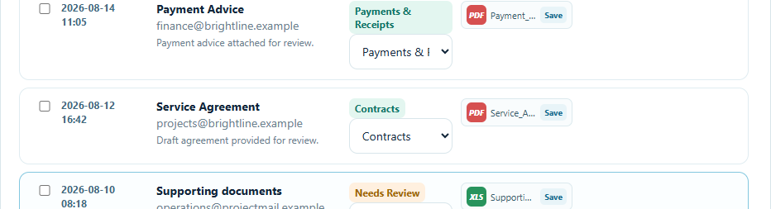
THE WORKFLOW
Search. Review. Export.
01
02
03
Search
Review
Export
Filter messages and attachments by sender, date and keywords.
Check suggested folders and items needing human attention.
Download only the selected files, with a local manifest.
Actual interface · synthetic sample data
The review step makes ambiguity visible before any file is saved.
FILE FINDER / CASE STUDY
03

Slide 4
STATUS AND TRUST BOUNDARIES
Built to be useful,
clear about its limits
WHAT EXISTS
Desktop app, local review workflow, export, and a synthetic public showcase.
ACCESS BOUNDARY
Gmail integration requests read-only scope; this showcase does not request visitor access.
WHAT REMAINS
Broader user testing, distribution hardening and Google verification for a public Gmail release.
No adoption, accuracy or time-saving metric is claimed without measured evidence.
FILE FINDER / CASE STUDY
04

