Slide 1


Slide 2


CAM OVERFLOW
WITH
GNS3 & SCAPY
TEAM 2
AZSHWANTH
HEMANTH

Slide 3
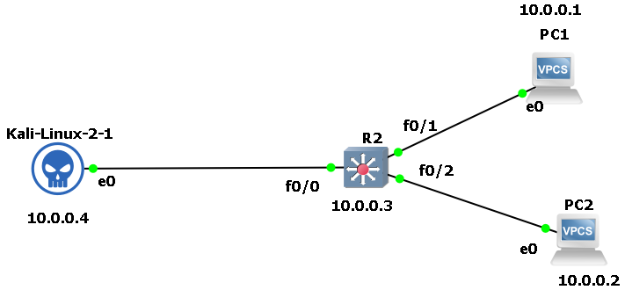
GNS3 SETUP

Slide 4
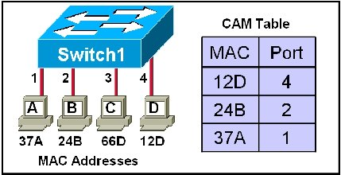
CAM TABLE ADDRESS
LIMITED BY PHYSICAL AND PRACTICAL ENTITY

Slide 5
FLOW
Send live mac addresses to switch
Overflow it
Switch can not remember new addresses
Acts like hub
Sniff the data

Slide 6
MODULES
Topology creation in GNS3
Configuring the topology
Generating random MAC addresses
Generation of live packets
Attacking and overloading the CAM table
Recording the network traffic
Sniffing the data

Slide 7
PREVENTION
Prevention
Create a limit for MAC address storage in CAM table.
In time of an attack, limit will shut down the switch.
Admin is given a alert message.

Slide 8
HANK
Y U
1
0

