Slide 1
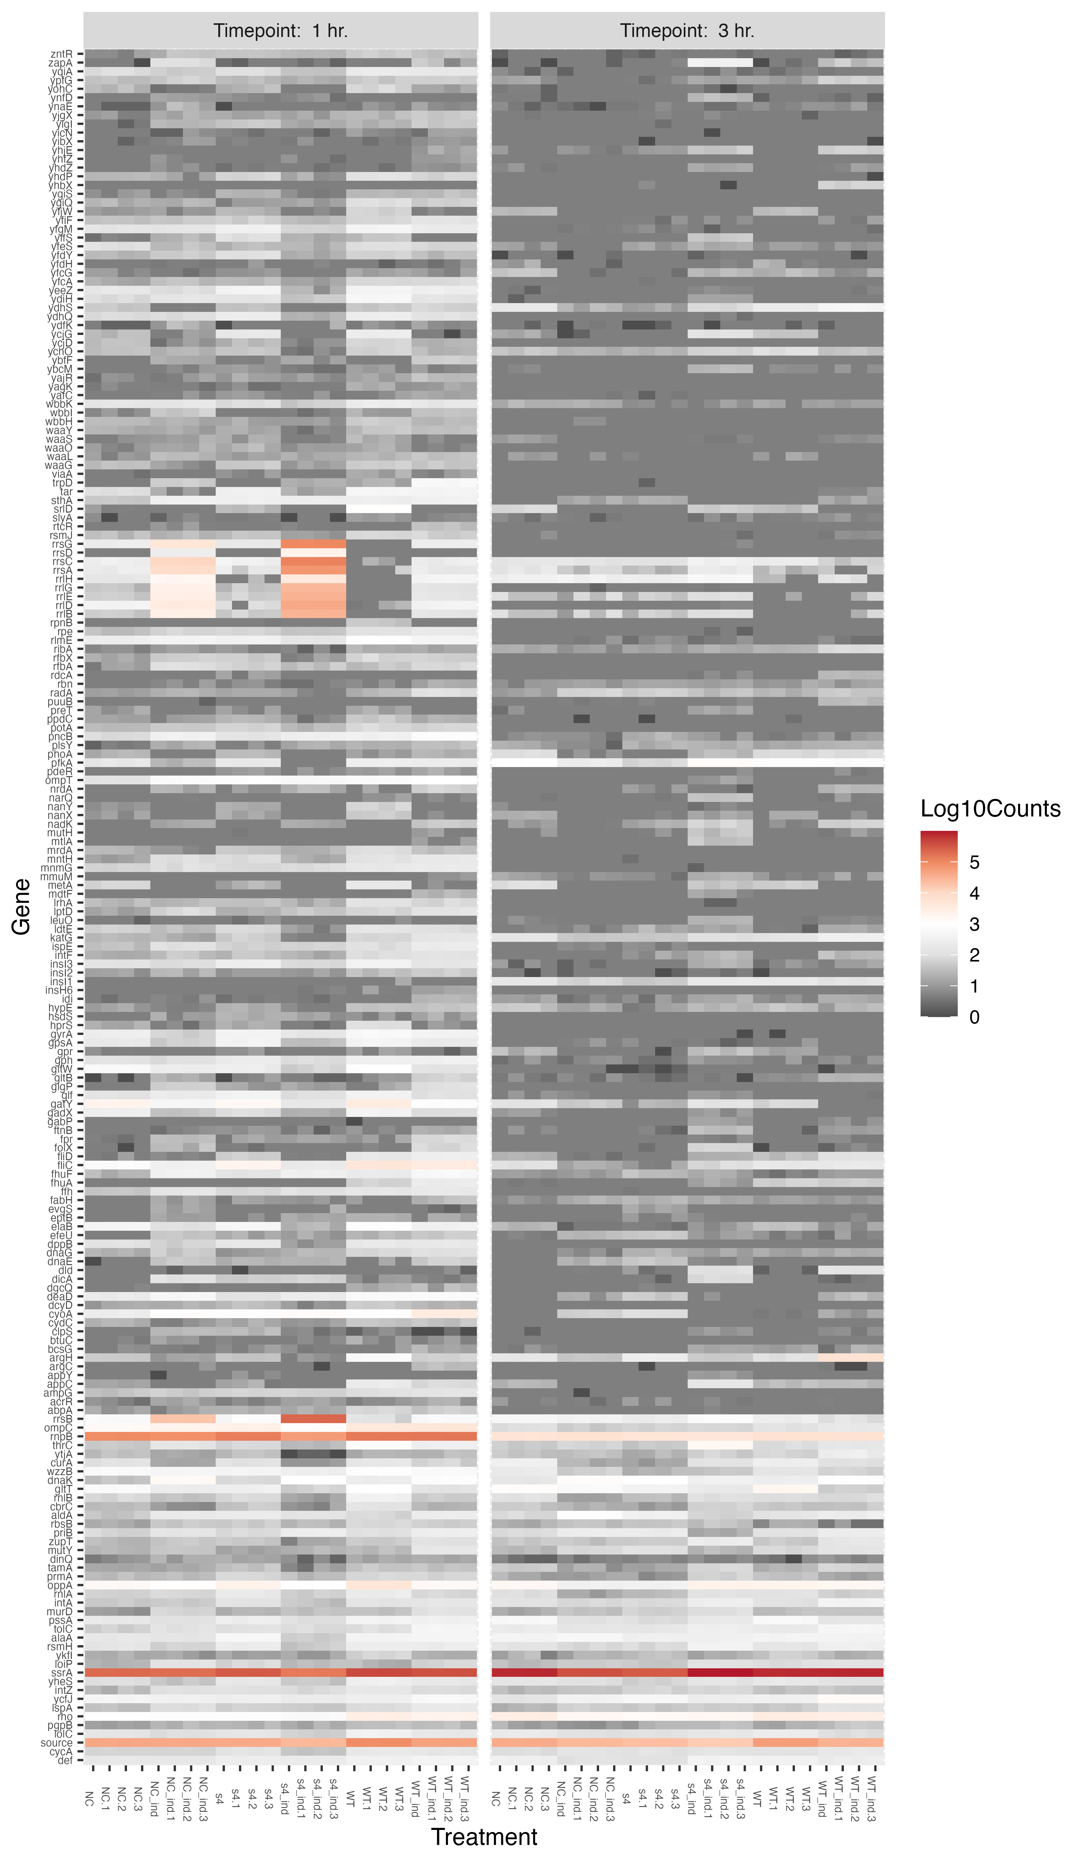
Schematic of timescale
re

Slide 2
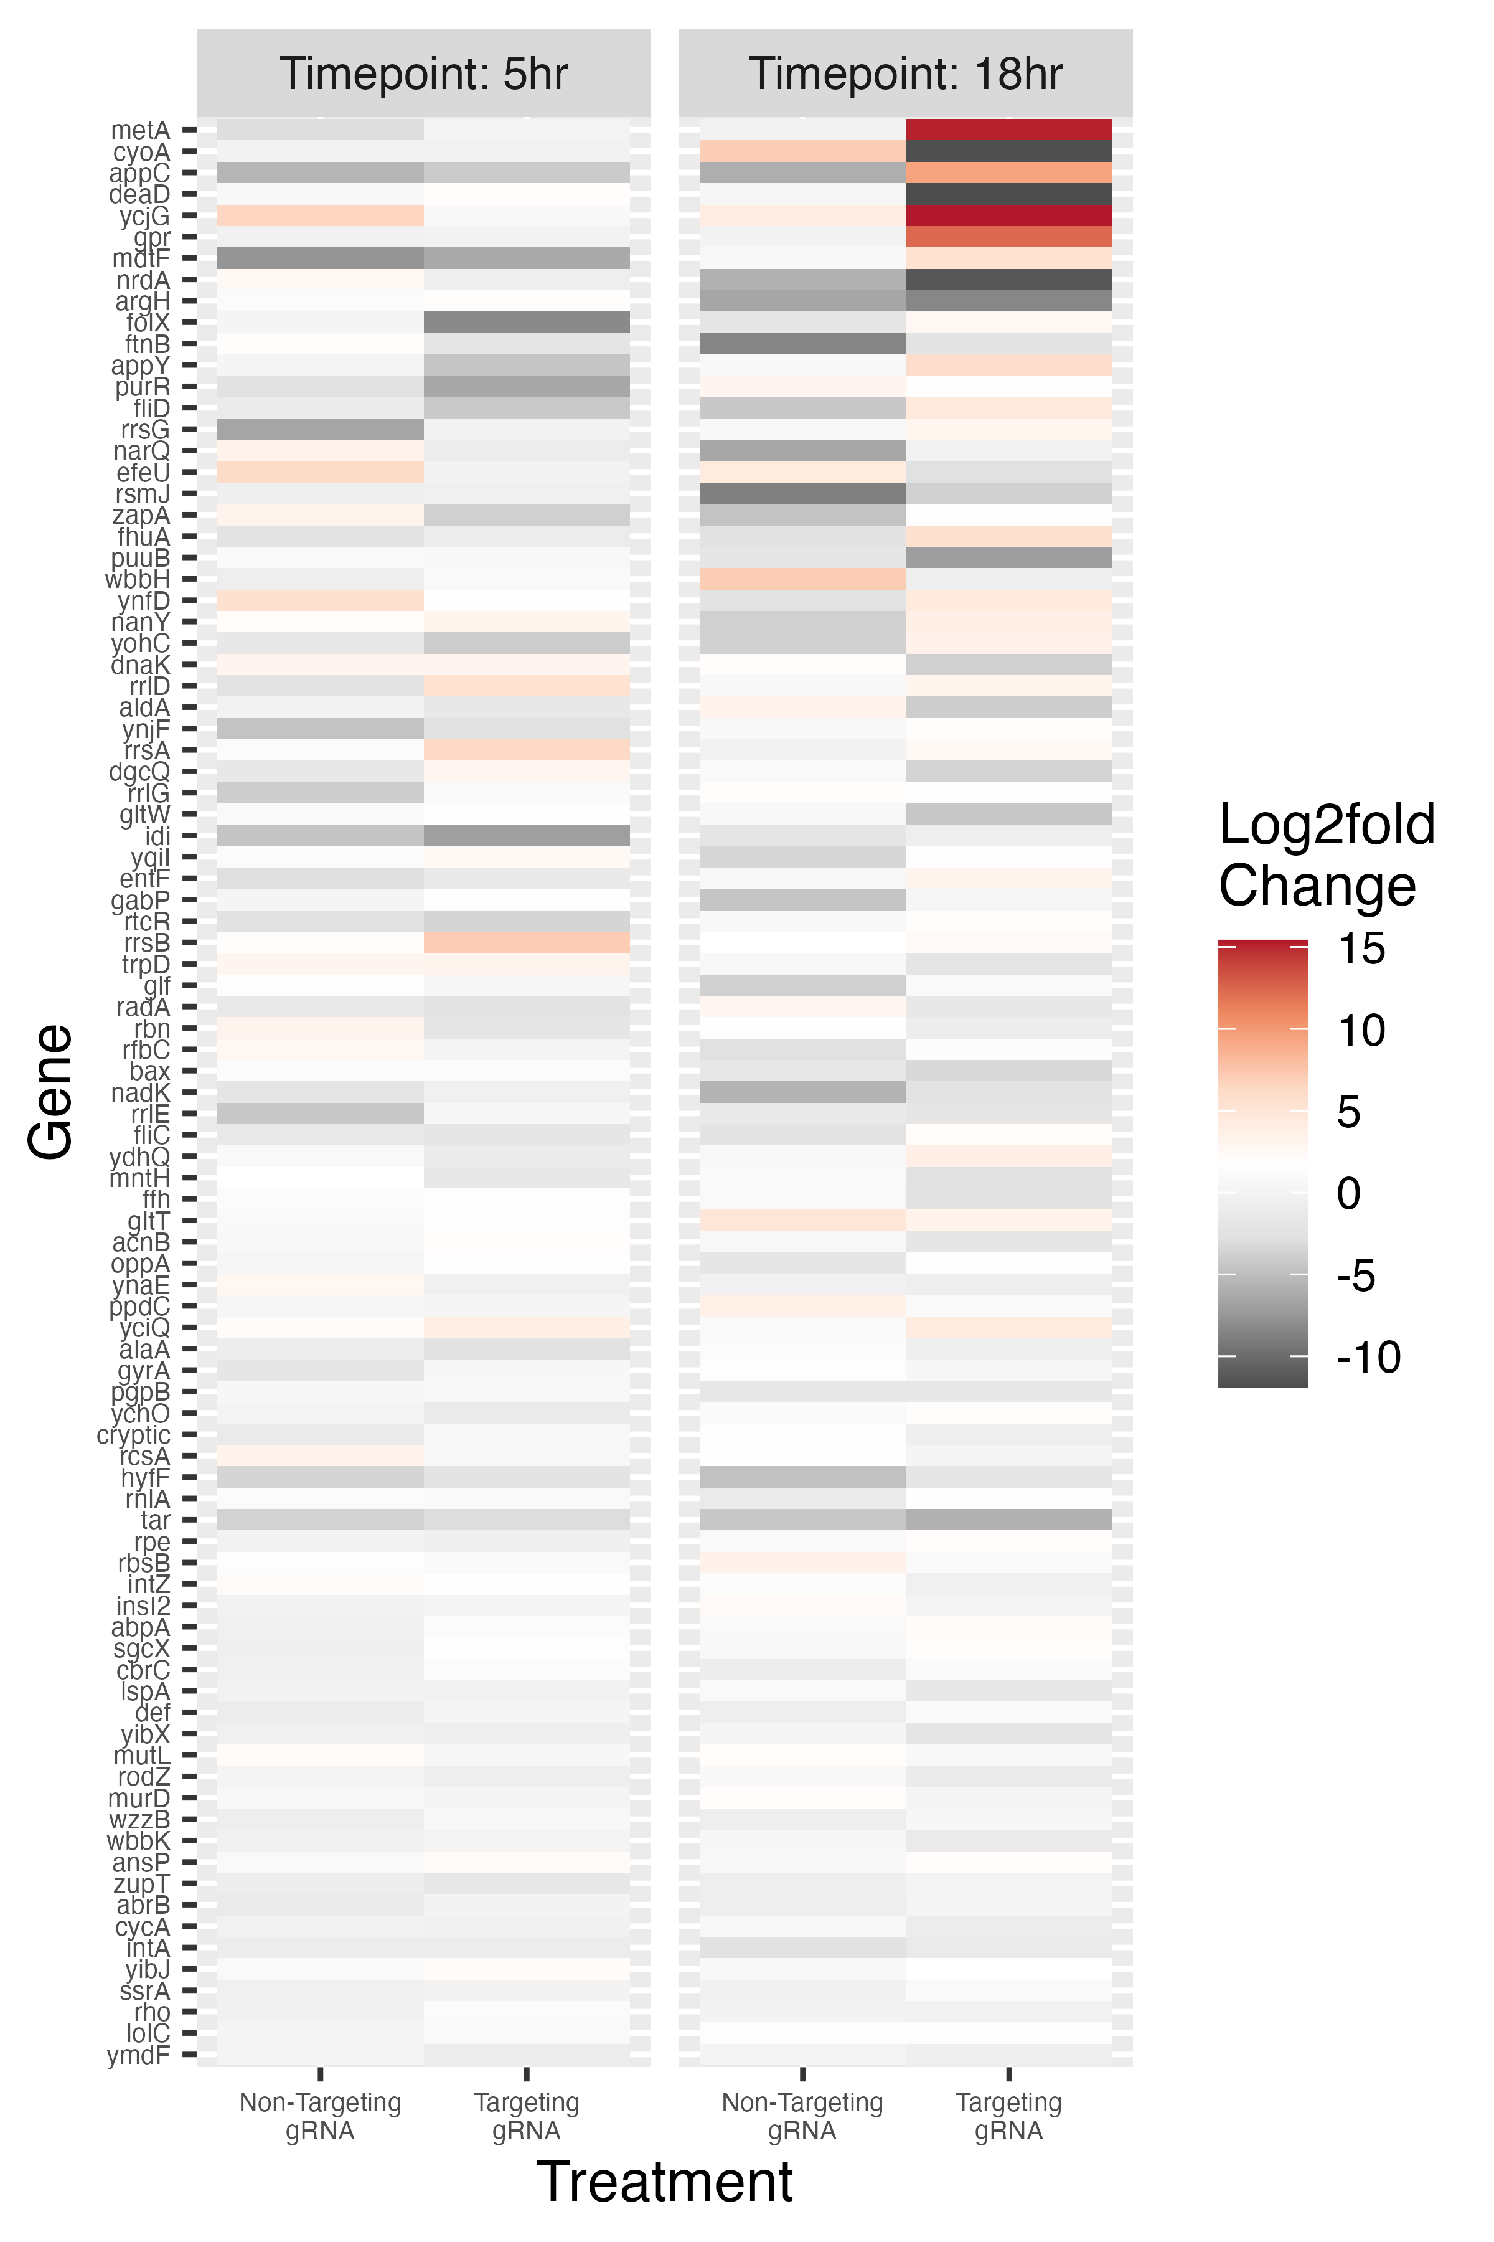
Supplement and
Refer to in paper

Slide 3
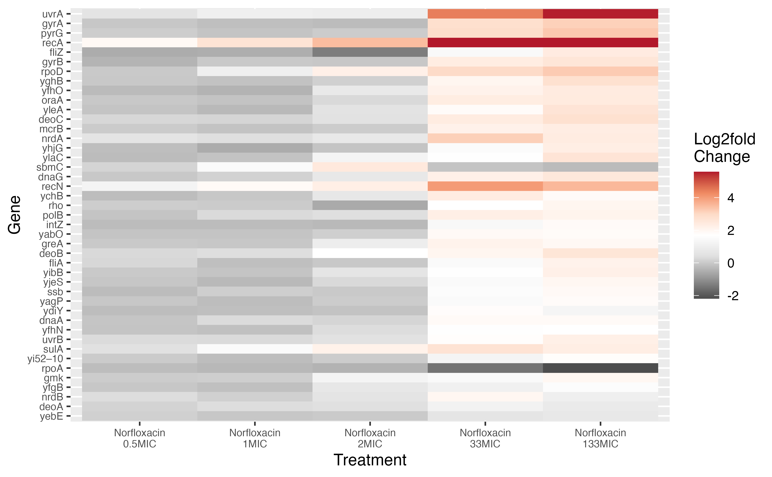
Add More genes to show what percentage of nors effect we can reproduce

Slide 4
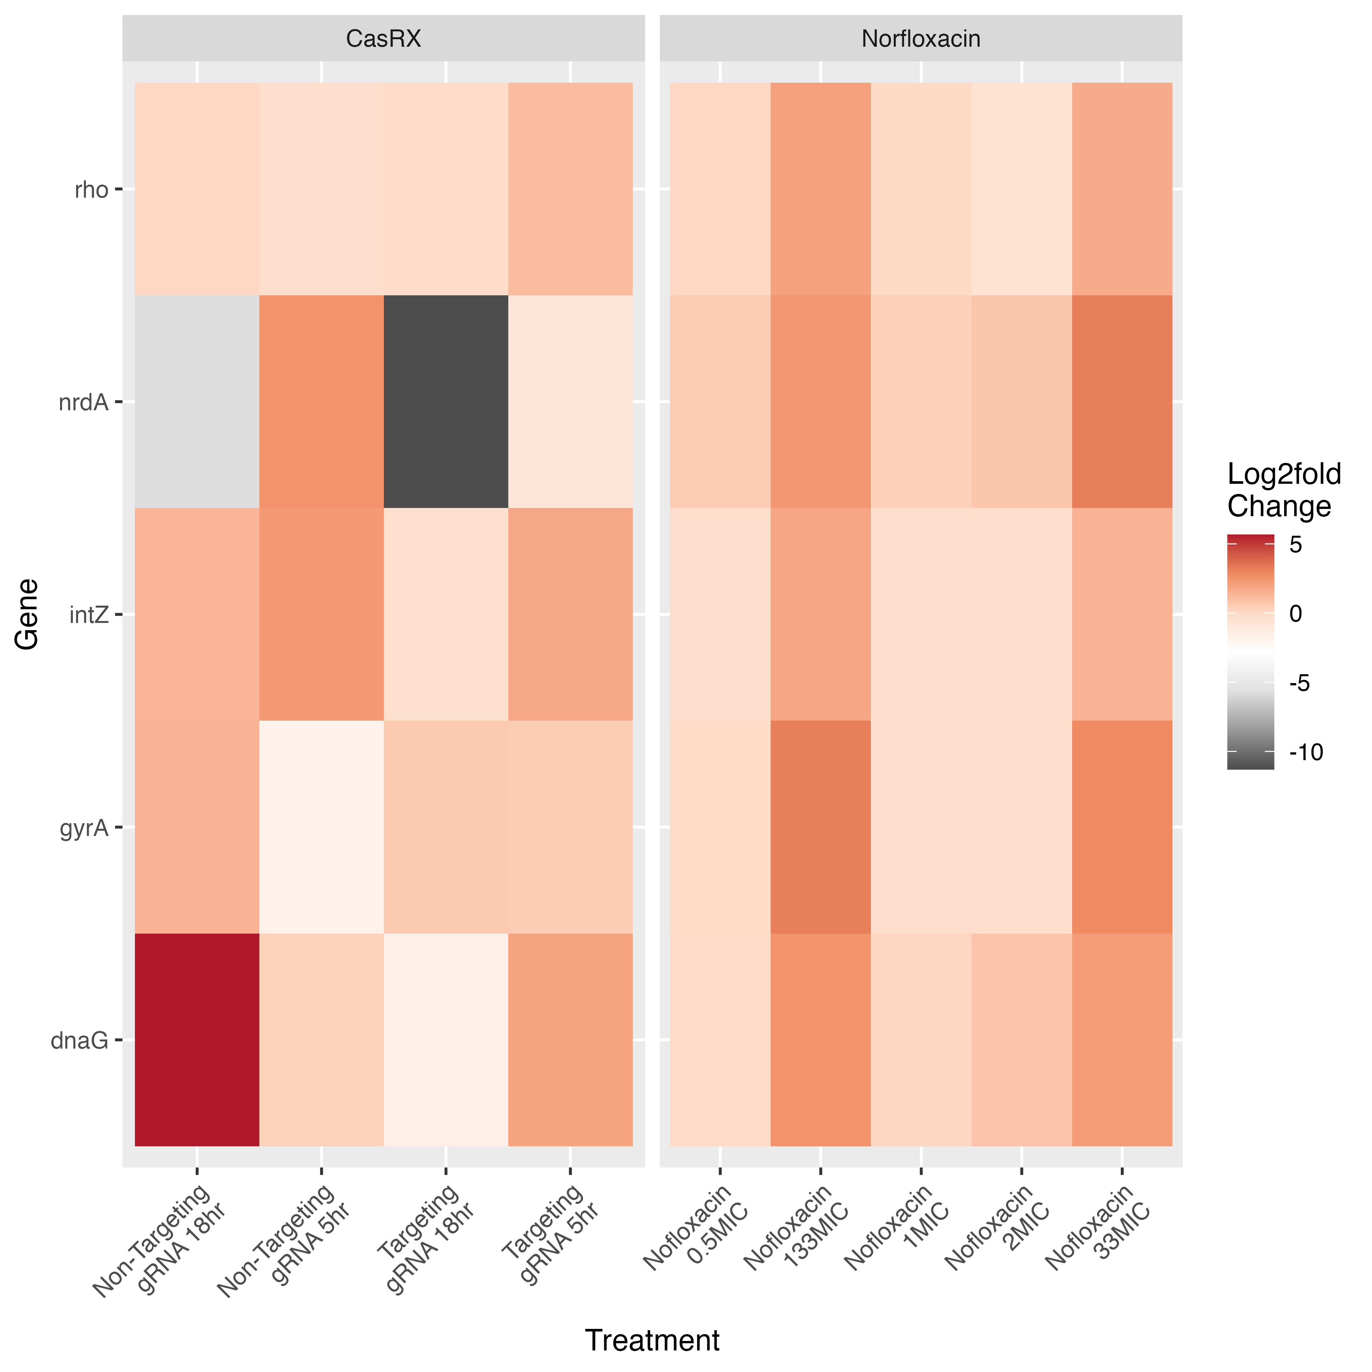
Add More genes to show what percentage of nors effect we can reproduce

