Slide 1
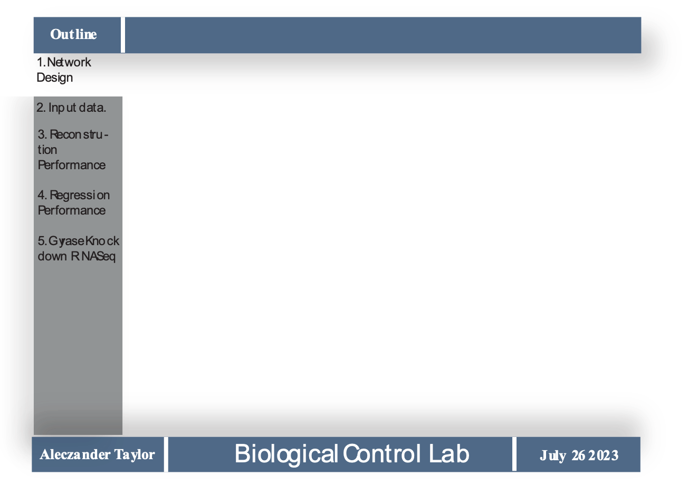
CRISPR – CasRx gRNA Design by Autoencoder
Neural Networks
Alec Taylor, Enoch Yeung

Slide 2
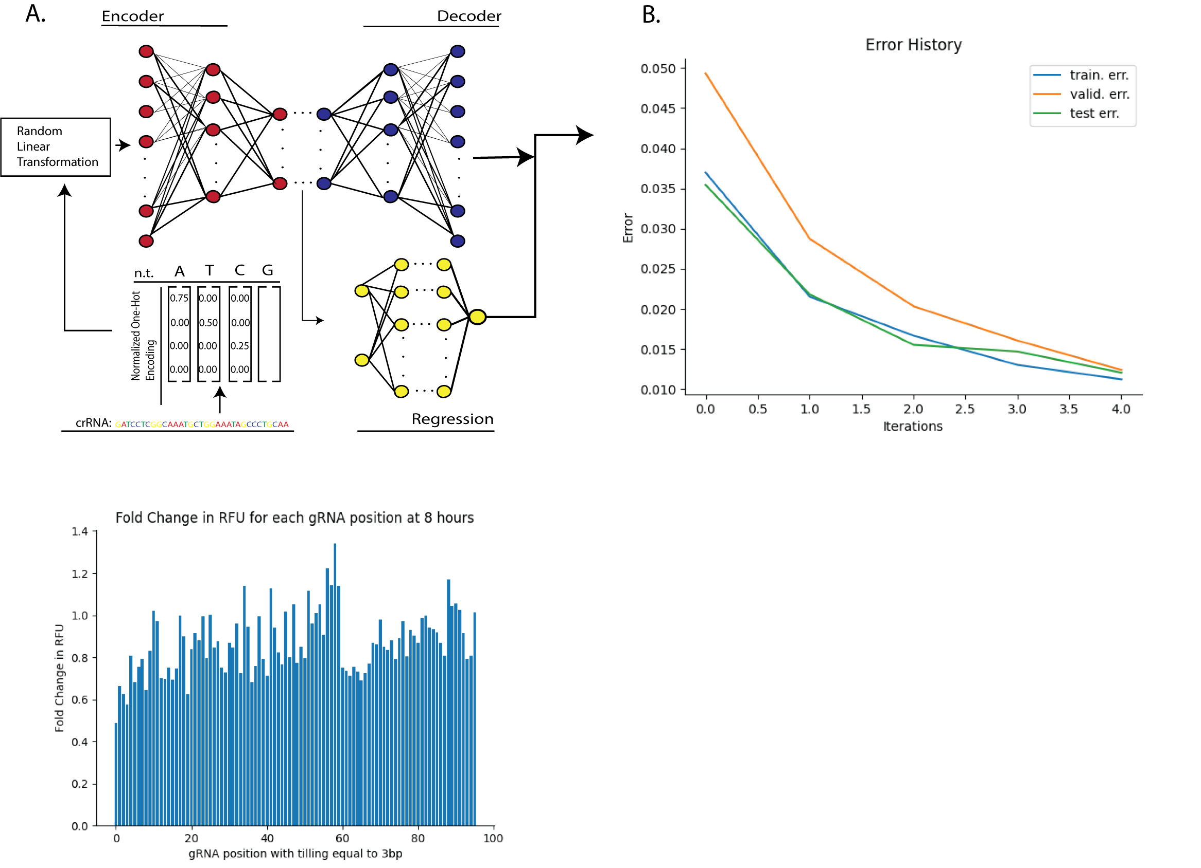
Network Design
0.00
0.00
0.00
0.00

Slide 3
Network Design
Encoder width: 30
Encoder depth: 10. Decoder depth: 10
Embedding width: 15
0.00
0.00
0.00
0.00
Regression Depth: 2
Encoder width: 100

Slide 4

Network Design
Hyperparameters
Encoder depth: 10
Embedding: 15
Decoder width: 30
Decoder depth: 10
Feedforward width:100
Feedforward depth:2
Loss Function:
${\left|\left|y_{true}−y_{model}\right|\right|}_{2}$/ ||y_(true)||_2

Slide 5
Maximum Fold Change

Slide 6
Maximum Fold Change

Slide 7
Maximum Fold Change

Slide 8
Maximum Fold Change

