Slide 1
DIGITRAK ONLINE MOBILE STORE WEBSITE

Slide 2
Digitrak Online Mobile Store Website
View Items
Order Items
USER
Pay
ADMIN
Register
VISITOR
Forum
Manufacturer
Inventory

Slide 3
SPECIALS
ADD PRODUCTS
DELETE PRODUCTS
VIEW MY CART
RATINGS
SUBMIT ORDER
SHOPPING CART
PAY
LOGOUT
USER
REGISTRATION
LOGIN
WRITE RATING
VALIDATE EMAIL
UPDATE DETAILS
THREADS
FORUM
POSTS

Slide 4
MANUFACTURER
ADD MANUFACTURERS
QUERYING ORDERS
ORDERS
EXECUTE ORDERS
MODIFY DETAILS
REIGISTER USER
DELETE USER
ADMIN
INVENTORY
ADD PRODUCTS
DELETE PRODUCTS
ADMINISTRATOR
REORDER
REPORTS
LOGIN & LOGOUT
MODIFY PASSWORD

Slide 5
FORUM
RE STOCKS
MANUFACTURER
NAME
ADMIN
THREAD
INVENTORY
PRODUCES
VALIDATES
SUPPLIES
POST
CREATES
ADD ITEM
NAME
DEVICES
REVIEWS
PRICE
SHOPPING CART
CONTAINS
USER ID
USER
USER ID
ADRESS
PURCHASE
MAKES
REGISTRATION
/LOGIN
LOGIN
PHONE
PAYMENT
PASSWORD
ORDER ID
PURCHASE
ORDER
PRODUCES

Slide 6
DATABASE DESIGN
DATBASE NAME:
DIGITRAK
SCHEMA NAMES:
Users
Stock
Order
Forum
Primary Filegroups
D:\DIGITRAK_DB\Data\FB_PRIMARY.mdf
All system tables are allocated to the primary filegroup
Order_Hist Filegroups
D:\DIGITRAK_DB\Data\FG_DIGITRAK_2020.ndf
A secondary filegroup contains secondary datafiles and database objects from the year 2020
Log file
D:\DIGITRAK_DB\Logs\FB_LOG.ldf
Log files are not part of a filegroup. The logfile tracks all the changes that have taken place since the last database backup.
When the current year of the database ends, a new filegroup as PHONE_HIST2021 should be created to store readable and writeable data.
After 2020 the filegroup PHONE_HIST2020 should be altered to read only

Slide 7
USERS
ORDERS
FORUM
STOCK
The basic initial layout of the database system will be split into four main schemas. This will ensure that when the database gets more complex and gains new information, it will remain easy to use.

Slide 8
USERS
USERS
CREATE TABLE CUST_DETAILS (
cust_id int IDENTITY(1,1) PRIMARY KEY,
fname varchar(50) NOT NULL,
lname varchar(50) NOT NULL,
mname varchar(50),
date_join date DEFAULT GETDATE(),
birthdate date NOT NULL,
email varchar(100) NOT NULL,
login varchar(50) NOT NULL,
password varchar(50) NOT NULL,
val_email bit DEFAULT 0);
CREATE TABLE ADDRESS (
cust_id int, /*FOREIGN KEY*/
address_line1 varchar(100) NOT NULL,
address_line2 varchar(100),
postcode int NOT NULL,
curr_address bit,
type varchar(50),
city varchar(100) NOT NULL,
country varchar(100) NOT NULL,
description varchar(100),
FOREIGN KEY (cust_id) REFERENCES CUST_DETAILS(cust_id));
CREATE TABLE PHONE (
cust_id int, /*FOREIGN KEY*/
number int NOT NULL,
description varchar(100),
cur_phone bit,
FOREIGN KEY (cust_id) REFERENCES CUST_DETAILS(cust_id));
CREATE TABLE ADMIN_INFO (
admin_id int IDENTITY(1,1) PRIMARY KEY,
login varchar(100) NOT NULL,
password varchar(50) NOT NULL,
email varchar(100) NOT NULL);

Slide 9
CREATE TABLE PHONE_DEVICES(
phone_id int IDENTITY(1,1) PRIMARY KEY,
manufac_id int NOT NULL, /*FOREIGN KEY*/
model varchar(100) NOT NULL,
color varchar(50) NOT NULL,
description varchar(100) NOT NULL,
date_released date NOT NULL,
date_published date NOT NULL,
battery_type varchar(50) NOT NULL,
display_type varchar(50) NOT NULL,
available bit NOT NULL,
large_img varchar(50) NOT NULL,
small_img varchar(50) NOT NULL,
thumbnail_img varchar(50) NOT NULL,
price int NOT NULL,
not_avail_date date NOT NULL,
FOREIGN KEY (manufac_id) REFERENCES MANUFACTORER(manufac_id));
STOCK
CREATE TABLE MANUFACTORER(
manufac_id int IDENTITY(1,1) PRIMARY KEY,
name varchar(100) NOT NULL,
logo varchar(50) NOT NULL);
CREATE TABLE INVENTORY(
phone_id int, /*FOREIGN KEY*/
stock int,
re_order_qty int,
min_stock int,
lead_time date,
FOREIGN KEY (phone_id) REFERENCES PHONE_DEVICES(phone_id));
CREATE TABLE SPECIALS_PHONE(
phone_id int, /*FOREIGN KEY*/
date_until date NOT NULL,
discounted_price int NOT NULL,
FOREIGN KEY (phone_id) REFERENCES PHONE_DEVICES(phone_id));

Slide 10
ORDERS
CREATE TABLE ONLINE_ORDER (
order_id int IDENTITY(1,1) PRIMARY KEY,
order_date date DEFAULT GETDATE(),
pay_approv_code int,
cust_id int NOT NULL, /*FOREIGN KEY*/
backorder bit,
status varchar(50),
FOREIGN KEY (cust_id) REFERENCES CUST_DETAILS(cust_id));
CREATE TABLE ONLINE_ORDER_ITEM(
order_id int NOT NULL, /*FOREIGN KEY*/
phone_id int NOT NULL, /*FOREIGN KEY*/
price int NOT NULL,
number_of_units int NOT NULL,
due_date date,
FOREIGN KEY (order_id) REFERENCES ONLINE_ORDERS(cust_id),
FOREIGN KEY (phone_id) REFERENCES PHONE_DEVICES(phone_id));
CREATE TABLE RATING_PHONE (
phone_id int, /*FOREIGN KEY*/
cust_id int, /*FOREIGN KEY*/
rating int,
FOREIGN KEY (phone_id) REFERENCES PHONE_DEVICES(phone_id),
FOREIGN KEY (cust_id) REFERENCES PHONE_DEVICES(cust_id),
CHECK(rating>=0 and rating<=10));

Slide 11
ORDERS
CREATE TABLE PAY_RECIEVED(
pay_id int IDENTITY(1,1) PRIMARY KEY,
order_id int, /*FOREIGN KEY*/
cust_id int, /*FOREIGN KEY*/
transac_id int, /*FOREIGN KEY*/
pay_approv_code int,
date_pay date,
fee int,
IP int,
FOREIGN KEY (order_id) REFERENCES ONLINE_ORDER(order_id),
FOREIGN KEY (cust_id) REFERENCES CUST_DETAILS(cust_id),
FOREIGN KEY (transac_id) REFERENCES TRANSACTION(cust_id));
CREATE TABLE SHOPPING_CART(
cust_id int, /*FOREIGN KEY*/
phone_id int NOT NULL, /*FOREIGN KEY*/
price int NOT NULL,
date_added date DEFAULT GETDATE(),
units int NOT NULL,
FOREIGN KEY (cust_id) REFERENCES CUST_DETAILS(cust_id),
FOREIGN KEY (phone_id) REFERENCES PHONE_DEVICES(phone_id));
CREATE TABLE TRANSACTIONS(
transac_id int IDENTITY(1,1) PRIMARY KEY,
order_id int, /*FOREIGN KEY*/
cust_id int, /*FOREIGN KEY*/
total_number_items int,
FOREIGN KEY (order_id) REFERENCES ONLINE_ORDER(order_id),
FOREIGN KEY (cust_id) REFERENCES CUST_DETAILS(cust_id));

Slide 12
FORUM
CREATE TABLE FORUM(
forum_id int IDENTITY(1,1) PRIMARY KEY,
name varchar(100),
description varchar(100),
cust_id int NOT NULL, /*FOREIGN KEY*/
manufac_id int, /*FOREIGN KEY*/
active bit,
date_start date DEFAULT GETDATE(),
login_req bit DEFAULT 1,
FOREIGN KEY (cust_id) REFERENCES CUST_DETAILS(cust_id),
FOREIGN KEY (manufac_id) REFERENCES MANUFACTURER(manufac_id));
CREATE TABLE THREADS(
thread_id int IDENTITY(1,1) PRIMARY KEY,
forum_id int, /*FOREIGN KEY*/
name varchar(100) NOT NULL,
cust_id int NOT NULL, /*FOREIGN KEY*/
date_start date DEFAULT GET_DATE(),
FOREIGN KEY (forum_id) REFERENCES FORUM(forum_id),
FOREIGN KEY (cust_id) REFERENCES CUST_DETAILS(cust_id));
CREATE TABLE POSTS(
post_id int IDENTITY(1,1) PRIMARY KEY,
thread_id int, /*FOREIGN KEY*/
forum_id int, /*FOREIGN KEY*/
subject varchar(100),
posted_by int NOT NULL, /*FOREIGN KEY*/
post_date date,
IP int,
message varchar(200),
FOREIGN KEY (thread_id) REFERENCES THREADS(thread_id),
FOREIGN KEY (forum_id) REFERENCES FORUM(forum_id),
FOREIGN KEY (posted_by) REFERENCES CUST_DETAILS(cust_id));

Slide 13
CREATE TABLE ADMIN_INFO (
admin_id int IDENTITY(1,1) PRIMARY KEY,
login varchar(30),
password varchar(30),
email varchar(50)l
CREATE TABLE CUST_DETAILS (
cust_id int IDENTITY(1,1) PRIMARY KEY,
.
email varchar(50),
login varchar(50),
password varchar(50),
val_email bit DEFAULT 0);
CREATE TABLE RATING_PHONE (
phone_id int, /*FOREIGN KEY*/
cust_id int, /*FOREIGN KEY*/
.
FOREIGN KEY (phone_id) REFERENCES PHONE_DEVICES(phone_id),
FOREIGN KEY (cust_id) REFERENCES PHONE_DEVICES(cust_id));
CREATE TABLE SHOPPING_CART(
cust_id int, /*FOREIGN KEY*/
phone_id int, /*FOREIGN KEY*/
.
FOREIGN KEY (cust_id) REFERENCES CUST_DETAILS(cust_id),
FOREIGN KEY (phone_id) REFERENCES PHONE_DEVICES(phone_id));
CREATE TABLE ADDRESS (
cust_id int, /*FOREIGN KEY*/
.
FOREIGN KEY (cust_id) REFERENCES CUST_DETAILS(cust_id));
CREATE TABLE PAY_RECIEVED(
pay_id int IDENTITY(1,1) PRIMARY KEY,
order_id int, /*FOREIGN KEY*/
cust_id int, /*FOREIGN KEY*/
.
FOREIGN KEY (order_id) REFERENCES ONLINE_ORDER(order_id),
FOREIGN KEY (cust_id) REFERENCES CUST_DETAILS(cust_id));
CREATE TABLE ONLINE_ORDER (
order_id int IDENTITY(1,1) PRIMARY KEY,
cust_id int, /*FOREIGN KEY*/
.
FOREIGN KEY (cust_id) REFERENCES CUST_DETAILS(cust_id));
CREATE TABLE MANUFACTORER(
manufac_id int IDENTITY(1,1) PRIMARY KEY,
name varchar(20),
logo varchar(20));
CREATE TABLE PHONE (
cust_id int, /*FOREIGN KEY*/
.
FOREIGN KEY (cust_id) REFERENCES CUST_DETAILS(cust_id));
CREATE TABLE PHONE_DEVICES(
phone_id int INDETITY(1,1) PRIMARY KEY,
manufac_id int, /*FOREIGN KEY*/
.
FOREIGN KEY (manufac_id) REFERENCES MANUFACTORER(manufac_id));
CREATE TABLE ONLINE_ORDER_ITEM(
order_id int, /*FOREIGN KEY*/
phone_id int, /*FOREIGN KEY*/
.
FOREIGN KEY (order_id) REFERENCES ONLINE_ORDERS(cust_id),
FOREIGN KEY (phone_id) REFERENCES PHONE_DEVICES(phone_id));
CREATE TABLE THREADS(
thread_id int IDENTITY(1,1) PRIMARY KEY,
forum_id int, /*FOREIGN KEY*/
.
started_by varchar(20),
FOREIGN KEY (forum_id) REFERENCES FORUM(forum_id));
CREATE TABLE FORUM(
forum_id int IDENTITY(1,1) PRIMARY KEY,
name varchar(20),
description varchar(50),
cust_id int, /*FOREIGN KEY*/
manufac_id int, /*FOREIGN KEY*/
.
FOREIGN KEY (cust_id) REFERENCES CUST_DETAILS(cust_id),
FOREIGN KEY (manufac_id) REFERENCES MANUFACTURER(manufac_id));
CREATE TABLE POSTS(
post_id int IDENTITY(1,1) PRIMARY KEY,
thread_id int, /*FOREIGN KEY*/
forum_id int, /*FOREIGN KEY*/
posted_by int, /*FOREIGN KEY*/
FOREIGN KEY (thread_id) REFERENCES THREADS(thread_id),
FOREIGN KEY (forum_id) REFERENCES FORUM(forum_id),
FOREIGN KEY (posted_by) REFERENCES CUST_DETAILS(cust_id));
CREATE TABLE SPECIALS_PHONE(
phone_id int, /*FOREIGN KEY*/
.
FOREIGN KEY (phone_id) REFERENCES PHONE_DEVICES (phone_id));
CREATE TABLE INVENTORY(
phone_id, /*FOREIGN KEY*/
.
FOREIGN KEY (phone_id) REFERENCES PHONE_DEVICES( phone_id));
CREATE TABLE TRANSACTIONS(
transac_id int IDENTITY(1,1) PRIMARY KEY,
order_id int, /*FOREIGN KEY*/
cust_id int, /*FOREIGN KEY*/
total_number_items int,
FOREIGN KEY (order_id) REFERENCES ONLINE_ORDER(order_id),
FOREIGN KEY (cust_id) REFERENCES CUST_DETAILS(cust_id));

Slide 14
TRIGGERS
EMAIL VALIDATION
When an email is updated in the customer details table this trigger will set the validity attribute to 0.
PASSWORD CHANGE
If an attempt to change a password is made, an email is to be sent to the customer informing them of the password change.
CUSTOMER DETAILS CHANGED
If an attempt to change any customer details like phone or address is made, a trigger should occur to email the customer that their details have been altered.

Slide 15
PROCEDURES
PASSWORD ENCRYPTION USER REGISTRATION
When a user registers, the insertion of details into the CUST_DETAILS, ADDRESS and PHONE tables will also insert the password with a MD5 encryption.
LOGIN
A user can enter their login details and if the login is successful it will be printed that it is correct or false when the details are wrong.
REORDER UPDATE INVENTORY
A new table REORDER is required.
The procedure needs to run twice daily which can be achieved using a scheduled job.
When the procedure runs, it checks the inventory and compares the stock on hand to the minimum stock requirement. From this information a record of how many units need to be ordered will be inserted into the REORDER table.
SHOPPING CART
Users will place items into their shopping cart, with this procedure ensuring that if any specials are available in the products of the order, the discounted price is placed in the cart.
PLACING ORDER
A user should be logged in or prompted to register before this procedure can be executed.
If an item is partially in stock, the items available should be supplied while the remaining number are back ordered, and the order is placed on backorder.
The shopping cart items are used to create an order.
A procedure is also in place where the shopping cart can be presented with the customers id.

Slide 16
BACKUP
BACKUP DATABASE DIGITRAK
TO DISK = ‘C:\DIGITRAK_BACK_UP\DIGITRAK.bak’
WITH DIFFERENTIAL
Create a full database backup firstly each Sunday at midnight. Create a differential backup to disk ‘C’ every day at midnight.
CREATE NONCLUSTERED INDEX IX_ORDER
ON [dbo].[Orders_2020]([order_id])
ON [FG_DIGITRAK_2020]
An annual backup for tables are stored in the PHONE_HIST filegroup. Alongside this back up a corresponding non-clustered index can be created and stored in the filegroup, using a view to get orders by year.
BACKUP LOG[DIGITRAK]
TO DISK = ‘C:\ DIGITRAK_BACK_UP \DIGITRAKLOGBACKUP.bak’
Create a transaction log backup of the database which can occur daily.

Slide 17
Logins and Users
A staff member at the server level will have various admin duties. A customer will be able to only view items and order as a registered customer.
Example:
CREATE LOGIN admin_1
WITH PASSWORD = ‘abcdeF123’
CREATE USER admin_1 FOR LOGIN admin_1
GRANT SELECT, INSERT, UPDATE, DELETE ON CUST_DETAILS TO admin_1
GRANT EXECUTE ON STOCK_UPDATE
A manager at the server level will have access to all database objects.
Example:
CREATE LOGIN manager_1
WITH PASSWORD = ‘abcdeF123’
CREATE USER manager_1 FOR LOGIN manager_1
GRANT ALL PRIVLEGES TO manager_1

Slide 18
VIEWS
PRODUCTS
Show all phone devices
ORDERS
Order history by year
CUSTOMERS
Customers registered per month
Current inventory details
Inventory by manufacturer
Order by month from manufacturers
Payments per month
Sales per country
Backorders
Number of customer ratings per device
Customer posts on forums per thread

Slide 19
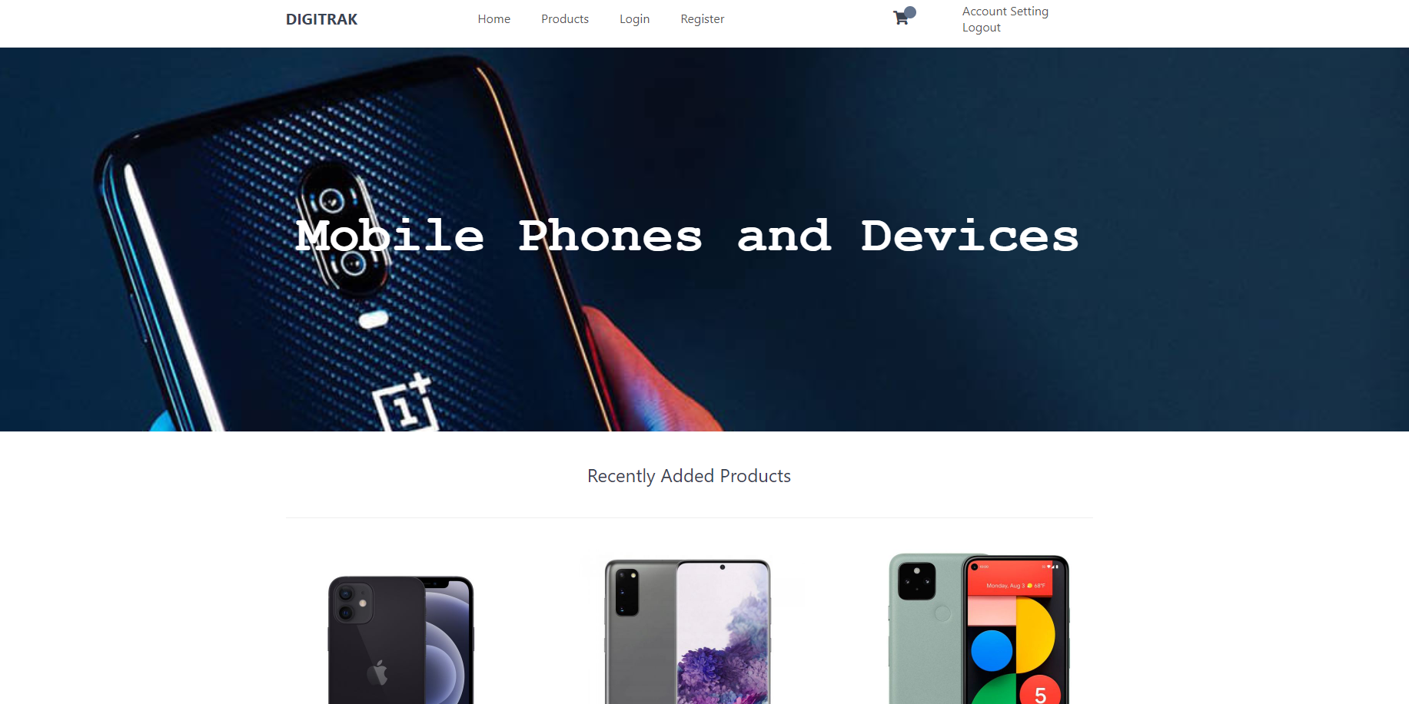

Slide 20
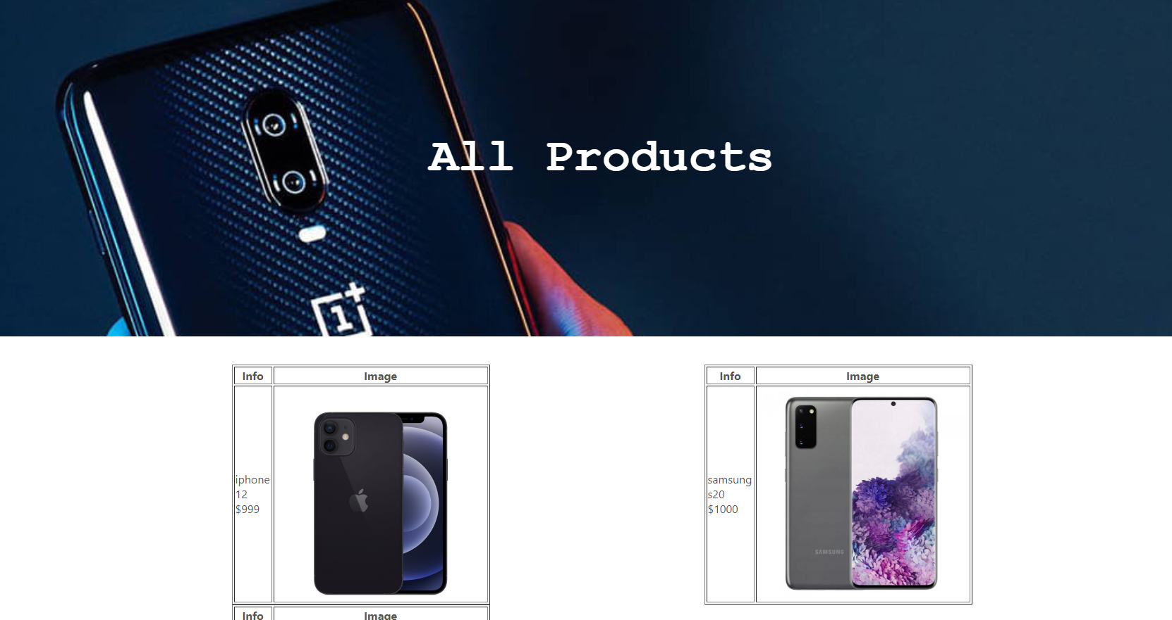

Slide 21
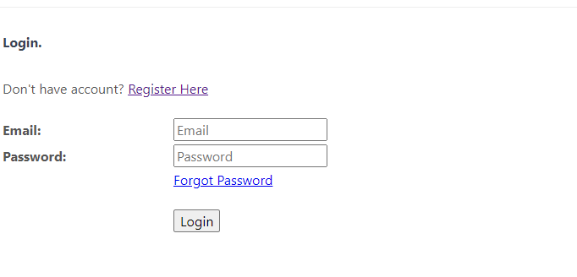
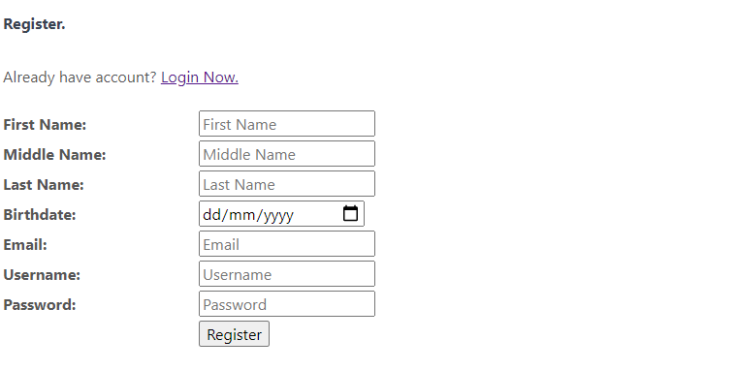

Slide 22
WEBSITE
header.php
index.php
footer.php
login.php
register.php
db.php
functions.php
cart.php
checkout.php
my_account.php
checkout.php
style.css

Slide 23
TEST PLAN
TABLE DATA
Random records can be added to CUST_DETAILS, ADDRESS, PHONE via the stored procedure
STORED PROCEDURES
DATABASE
A text file with the database creation of only tables can be imported in phpMyAdmin and then included into the website at that phase of implementation.
ONLINE_ORDER AND ONLINE_ORDER_ITEM can be filled via stored procedure, where the cart is selected and a cust_id is selected
Initially inventory can be filled with random numbers
Using the shopping cart stored procedure does not require a cust_id as website visitors can select items into the cart
Forums, threads and posts all require a cust_id if a record is to be added and then can have random posts added
IMAGES
Images are referenced in the PHONE_DEVICES tables. The text will be the name of the image with the file type and will be placed in the website folder in an images folder, which can then be used in the website.
MANFACTURER and PHONE_DEVICES can also be loaded with random data

Slide 24
CHALLENGES
TABLE CONSTRAINTS
Adding constraints to ensure values have defaults when required
TABLE DESIGN
SECURITY LAYERS
Backup
Logins
Number of tables
TIME MANAGEMENT

Slide 25
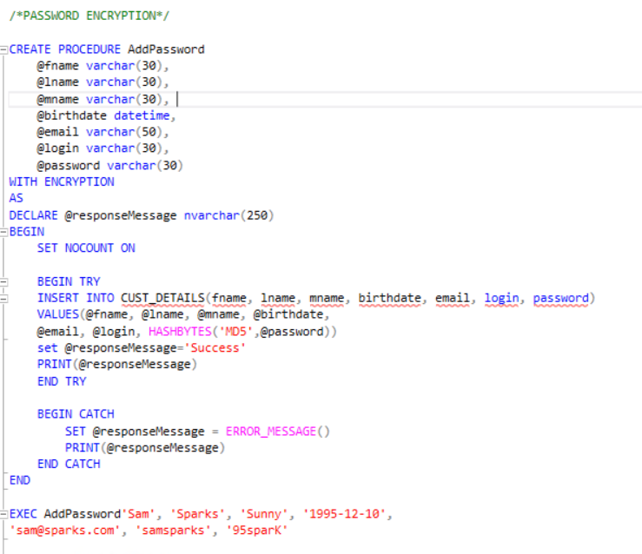
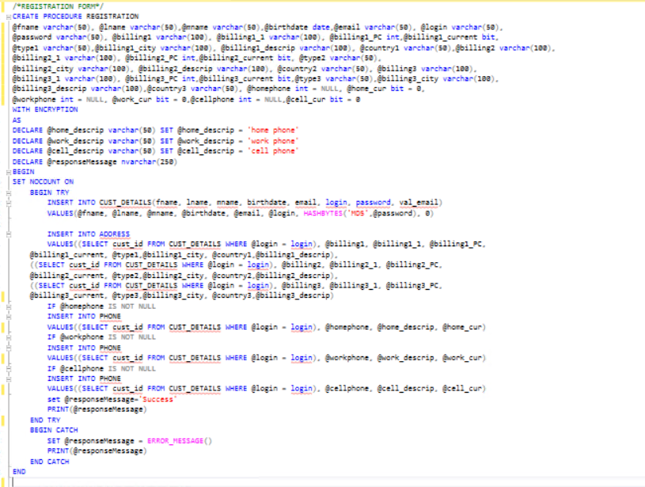
CHALLENGES

Slide 26
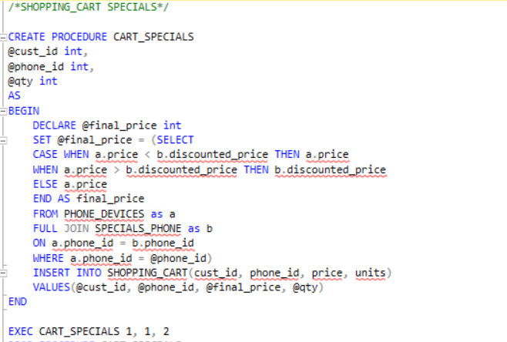
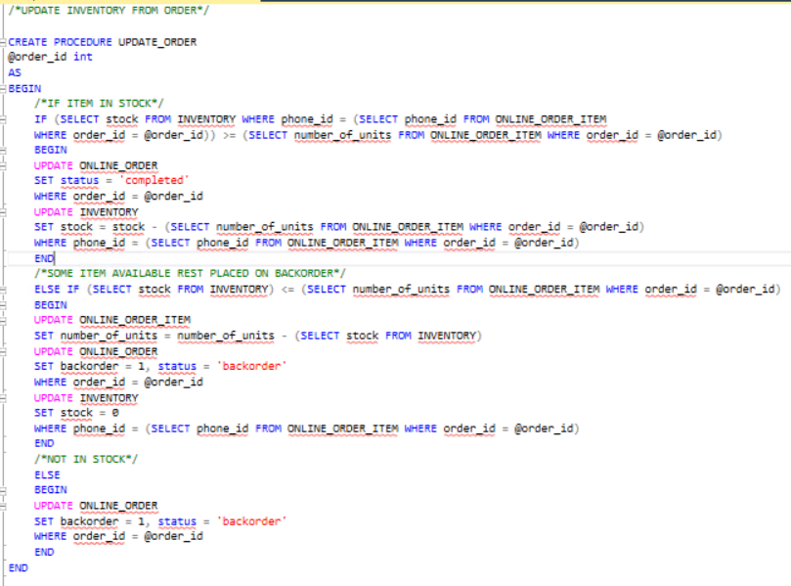
CHALLENGES

Slide 27
PRIVACY ISSUES
ENCRYPTION
Login details
VALIDATION
Customer email
PAYMENT
Record of payment
LOGIN
Customer login details

Slide 28
ETHICAL ISSUES
DATE PROTECTION
Secure management of database
DATA QUALITY
Have meaningful data in tables
DUPLICATE DATA
Reduce unreliable information
DATA INTEGRITY
Unaltered interactions between end users and database.
CUSTOMER DETAIL ACCESS
A user should be able to access their own details
USER ACCESLIBITY
Disability considerations

Slide 29
REFERENCES
Books:
20761C
20762C
20764C
Online Websites:
Microsoft SQL https://docs.microsoft.com/en-us/sql/sql-server/?view=sql-server-ver15
Online Shoes Shopping Website https://meeraacademy.com/download-online-shopping-website-in-asp-net/
Shopping Cart System with PHP https://codeshack.io/shopping-cart-system-php-mysql/
Banner phone image https://www.designlisticle.com/oneplus-6t-mclaren-edition-salute-to-speed/
Google pixel 5 image https://indicesbovespa.com.br/pixel-5-e-pixel-4a-5g-sao-os-novos-celulares-do-google/
Iiphone 12 image https://pdaplaza.ca/products/apple-iphone-12-mini-a2398-factory-unlocked
Samsung s20 image https://www.coolblue.nl/en/product/856260/samsung-galaxy-s20-128gb-gray-5g.html

