Slide 1
ZIKA 101
Updated September 21, 2017
Notes:
Content of these slides comes from CDC’s Zika Virus Disease Key Messages (http://www.cdc.gov/zika/pdfs/zika-key-messages.pdf). Supplemental talking points are provided in the notes section throughout this presentation.

Slide 2
Introduction
Notes:
This presentation provides information on the current Zika outbreak, how Zika is spread, symptoms, associated risks, and how to prevent the spread of Zika.

Slide 3
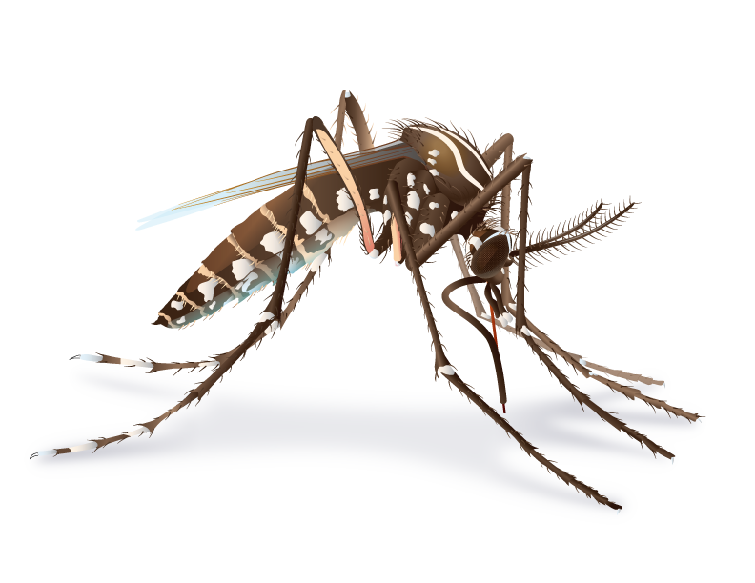
What is Zika?
Zika virus is spread to people primarily through the bite of an infected Aedes species mosquito (Ae. aegypti and Ae. albopictus).
Many people infected with Zika virus won’t have symptoms or will only have mild symptoms.
Zika virus infection during pregnancy can cause microcephaly and other severe brain defects.
Notes:
Primarily through the bite of an infected Aedes aegypti or Aedes albopictus mosquito.
Many people won’t have symptoms or will only have mild symptoms.
Infection during pregnancy can cause microcephaly and other severe brain defects.

Slide 4

Where has Zika been found?
Before 2015, Zika outbreaks occurred in Africa, Southeast Asia, and the Pacific Islands.
Currently outbreaks are occurring in many countries and territories.
Areas with Risk of Zika
Notes:
Historical background on Zika:
Zika virus was first discovered in a monkey in the Zika Forest of Uganda in 1947.
Before 2007, at least 14 human cases of Zika had been documented, although other cases were likely to have occurred and were not reported.
Zika outbreaks have probably occurred in many locations. Because the symptoms of Zika are similar to those of many other diseases, many cases may not have been recognized.
Since May 2015, CDC has been responding to increased reports of Zika and has assisted in investigations with PAHO and countries’ ministries of health. The first travel notice for Zika in Brazil was posted in June 2015.
On January 22, 2016, CDC activated its Emergency Operations Center (EOC) to respond to outbreaks of Zika occurring in the Americas and increased reports of birth defects and Guillain-Barré syndrome in areas affected by Zika. On February 8, 2016, CDC elevated its EOC activation to a Level 1, the highest level.
On February 1, 2016, the World Health Organization (WHO) declared a Public Health Emergency of International Concern (PHEIC) because of clusters of microcephaly and other neurological disorders in some areas affected by Zika.

Slide 5
Spread and Symptoms

Slide 6

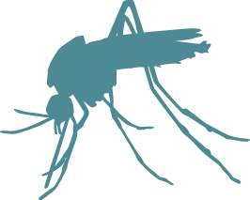
How is Zika spread?
Zika can be spread through
Mosquito bites
From a pregnant woman to her fetus
Sex with an infected person
Laboratory exposure
Zika may be spread through blood transfusion.
No reports of infants getting Zika through breastfeeding.
Notes:
Zika virus is spread to people primarily through the bite of an infected Aedes species mosquito (Ae. aegypti and Ae. albopictus).
Mosquitoes that spread Zika virus bite during the day and night.
A pregnant woman can pass Zika virus to her fetus during pregnancy or around the time of birth.
A person infected with Zika virus can pass it to his or her sex partners.
Zika virus may be spread through blood transfusions.
Transmission of Zika virus through breast milk has not been documented. Benefits of breastfeeding outweigh theoretical risk of Zika virus transmission through breast milk.
There is no evidence that Zika is spread through touching, coughing, or sneezing.

Slide 7
How does Zika affect people?
Many people with Zika will not have symptoms or will only have mild symptoms.
Symptoms last several days to a week.
People usually don’t get sick enough to go to the hospital.
People very rarely die of Zika.
Notes:
Anyone who lives in or travels to an area with risk of Zika and has not already been infected with Zika virus can get it.
Symptoms of Zika are similar to other illnesses, like dengue and chikungunya, that spread through mosquito bites.
Many people will not have symptoms or will only have mild symptoms.
Symptoms last several days to a week.
People usually don’t get sick enough to go to the hospital.
People very rarely die of Zika.

Slide 8
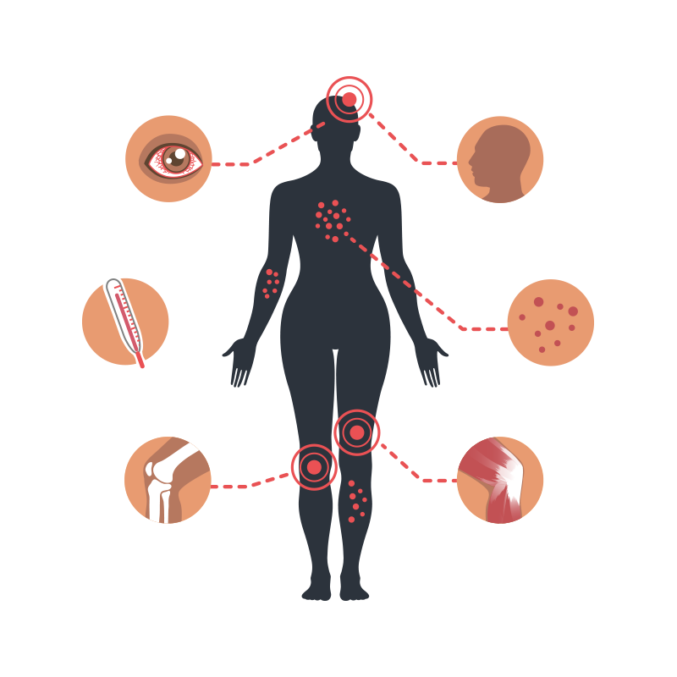
What are the symptoms?
For people with symptoms, the most common symptoms of Zika are
Fever
Rash
Headache
Joint pain
Conjunctivitis (red eyes)
Muscle pain
Notes:
Anyone with possible exposure to Zika virus through travel or sexual transmission should go to a doctor or healthcare provider if they have any of the symptoms listed.
Symptoms include
Fever
Rash
headache
Joint pain
Conjunctivitis (red eyes)
Muscle pain

Slide 9
Zika and pregnancy

Slide 10

How can Zika affect pregnancies?
Zika virus can pass from a pregnant woman to her fetus during pregnancy or around the time of birth.
It is not known how often this happens.
Notes:
We expect that women who develop Zika will have similar illness to people who are not pregnant. No evidence exists to suggest that pregnant women are more susceptible or experience more severe disease during pregnancy.
We do not know if pregnant women are more likely to develop symptoms compared to the general population.
We do not know if pregnant women are more likely to get Guillain-Barré syndrome.
We do not know how likely it is that Zika infection will affect a pregnancy.
We do not know if a baby will have birth defects if a woman is infected while pregnant.
More information on Zika and pregnancy is found here: http://www.cdc.gov/zika/pregnancy/index.html

Slide 11
How can Zika affect pregnancies?
Infection during pregnancy can cause damage to the brain, microcephaly, and congenital Zika syndrome
Linked to other problems, such as miscarriage, stillbirth, and birth defects
No evidence that past infection will affect future pregnancies once the virus has cleared the body
Notes:
Microcephaly is a severe birth defect that is a sign of a problem with brain development.
Microcephaly can occur because a baby’s brain has not developed properly during pregnancy or has stopped growing after birth.
Currently, there is no evidence to suggest that past Zika virus infection poses an increased risk of birth defects for future pregnancies once the virus has completely cleared a woman’s body.
More information on microcephaly and birth defects is found here: http://www.cdc.gov/zika/healtheffects/birth_defects.html

Slide 12
How can Zika affect pregnancies?
Congenital Zika syndrome
Distinct pattern of birth defects in fetuses and infants of women infected during pregnancy
Associated with 5 types of birth defects not seen or rarely seen with other infections during pregnancy
Severe microcephaly (small head size) resulting in a partially collapsed skull
Decreased brain tissue with brain damage
Damage to the back of the eye with a specific pattern of scarring and increased pigment
Limited range of joint motion, such as clubfoot
Too much muscle tone restricting body movement soon after birth
Notes:
All infants born to mothers with laboratory evidence of Zika virus infection during pregnancy should receive a comprehensive physical exam, head ultrasound to assess the brain’s structure, standard newborn hearing assessment, and lab testing for Zika virus, even if no abnormalities are apparent at birth.
Microcephaly has been identified as one feature of a unique pattern of birth defects, called congenital Zika syndrome, among fetuses and infants of women infected with Zika during pregnancy. https://www.cdc.gov/mmwr/volumes/65/wr/mm6533e2.htm?s_cid=mm6533e2_w
Zika virus infection during pregnancy can cause birth defects including damage to the brain, microcephaly, and congenital Zika syndrome, a pattern of birth defects that includes brain abnormalities, eye defects, hearing loss, and limb defects.
Recognizing that Zika is a cause of certain birth defects does not mean that every pregnant woman infected with Zika will have a baby with a birth defect. It means that infection with Zika during pregnancy increases the chances for these problems.
Although Zika virus is a cause of microcephaly and other severe brain defects and has been linked with these other problems in infants, there is more to learn. Researchers are collecting data to better understand the extent Zika virus impact on mothers and their children.

Slide 13
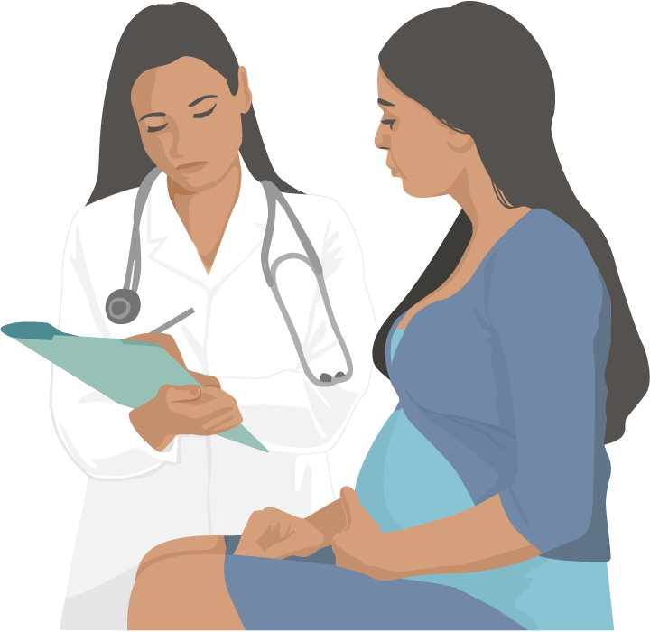
Assessing pregnant women for possible Zika exposure
At each prenatal care visit, all pregnant women should be asked if they
Traveled to or live in an area with risk of Zika
Had sex without a condom with a partner who lives in or traveled to an area with risk of Zika
Notes:
Pregnant women who live in or have recently traveled to an area with risk of Zika should talk to a doctor or other healthcare provider about their risk of Zika virus infection even if they don’t feel sick.
Pregnant women should also talk to their doctor or other healthcare provider if their sex partner lives in or recently traveled to an area with risk of Zika.
Pregnant women should see a doctor or other healthcare provider if they develop a fever, headache, rash, joint pain, muscle pain, or conjunctivitis (red eyes). They should tell the doctor or other healthcare provider where they live and where they have traveled.
Pregnant women with possible exposure to an area with risk of Zika that has a CDC Zika travel notice should be tested for Zika infection even if they do not have symptoms.

Slide 14
Guillain- barré syndrome

Slide 15
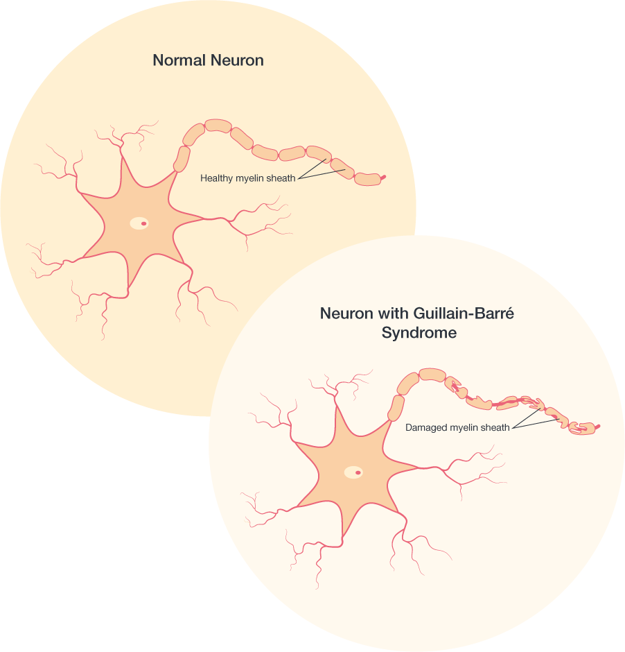
Does Zika cause Guillain-Barré syndrome (GBS)?
GBS is an uncommon sickness of the nervous system in which a person’s own immune system damages the nerve cells, causing muscle weakness, and sometimes, paralysis.
GBS is strongly associated with Zika but only a small proportion of people with recent Zika infection get GBS.
CDC is continuing to investigate the link between GBS and Zika to learn more.
Notes:
Several countries that have experienced Zika outbreaks recently have reported increases in people who have Guillain-Barré syndrome (GBS).
GBS symptoms include weakness of the arms and legs and, in severe cases, can affect the muscles that control breathing.
These symptoms can last a few weeks or several months. Most people fully recover from GBS, though some people have permanent damage. Very few people die from GBS.
Researchers do not fully understand what causes GBS. Most people with GBS report an infection before they have GBS symptoms. CDC is continuing to investigate the link between GBS and Zika to learn more.

Slide 16
testing

Slide 17
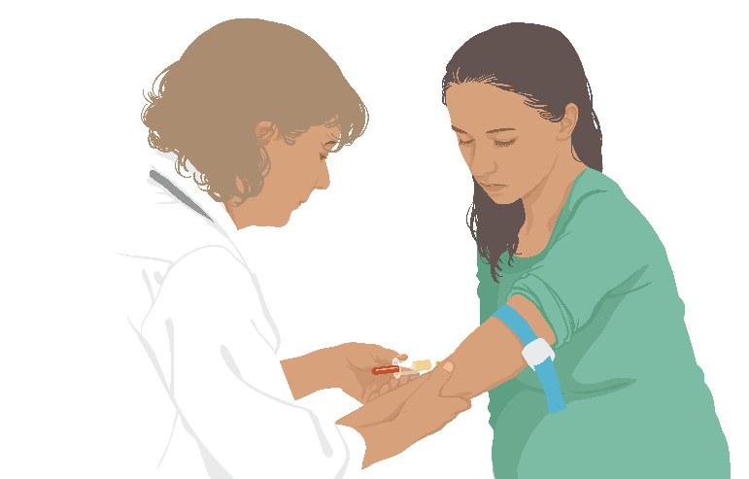
How is Zika diagnosed?
A doctor or other healthcare provider will ask about any recent travel and any signs and symptoms.
A blood or urine test can confirm a Zika infection.
Notes:
A doctor or other healthcare provider will ask about any recent travel and any signs and symptoms.
Testing blood, semen, vaginal fluids, or urine is not recommended to determine how likely a person is to pass Zika virus through sex. Because Zika virus can remain in some fluids (for example, semen) longer than blood, someone might have a negative blood test, but still carry Zika in their genital secretions. Testing semen and vaginal fluids for Zika virus is not currently available outside of the research setting. Testing is not recommended for asymptomatic men and women who are not pregnant.
Detailed testing guidance is found here: http://www.cdc.gov/mmwr/volumes/65/wr/pdfs/mm6529e1.pdf

Slide 18
Who should be tested for Zika?
Anyone who has or recently had Zika symptoms
And lives in or traveled to any area with risk of Zika, or
Had unprotected sex with a partner who lives in or traveled to any area with risk of Zika
Notes:
Detailed testing information can be found here
https://www.cdc.gov/zika/hc-providers/testing-for-zika-virus.html
Updated guidance on testing of pregnant women can be found here
https://www.cdc.gov/mmwr/volumes/65/wr/mm6529e1.htm?s_cid=mm6529e1_e

Slide 19
Who should be tested for Zika?
Pregnant women who live in or frequently travel to areas with risk of Zika
Pregnant women who have a fetus with prenatal ultrasound findings consistent with congenital Zika virus infection and
Live in or traveled to any area with risk of Zika, or
Had unprotected sex with a partner who lives in or traveled to any area with risk of Zika
Notes:
Pregnant women who live in an area with a Zika travel notice are at risk of getting Zika throughout pregnancy. For this reason, testing should be offered at the first prenatal care visit, followed by two rounds of testing at regular prenatal care visits during the pregnancy.
Pregnant women exposed to Zika who do NOT have symptoms are not recommended to receive routine t
Zika virus testing is not recommended for
Non-pregnant asymptomatic individuals
Preconception screening

Slide 20
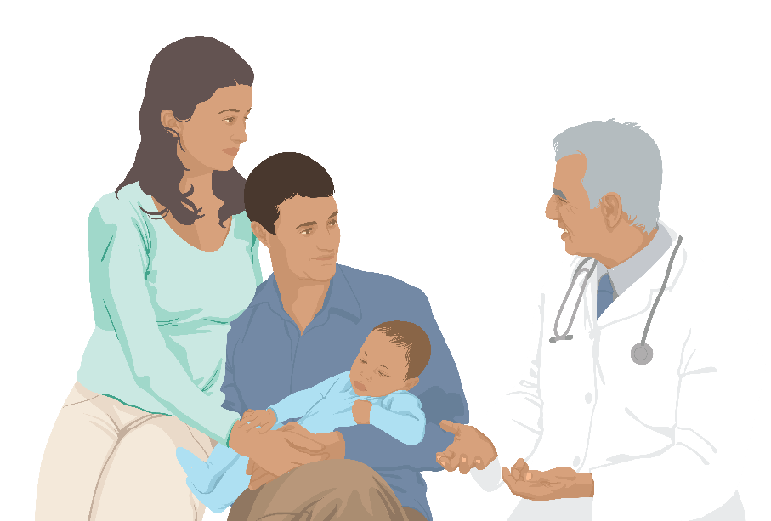
Testing babies for Zika
CDC recommends laboratory testing for
All infants born to mothers with laboratory evidence of Zika virus infection during pregnancy
Infants who have abnormal clinical or neuroimaging findings suggestive of congenital Zika syndrome and a mother with a possible exposure to Zika virus, regardless of maternal Zika virus testing results
Notes:
Infant samples for Zika virus testing should be collected ideally within the first 2 days of life; if testing is performed later, distinguishing between congenital, perinatal, and postnatal infection will be difficult.

Slide 21
What to do if you get infected

Slide 22
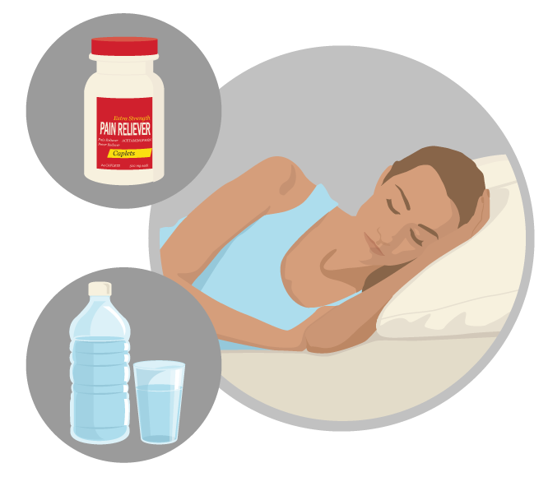
How is Zika treated?
There is no specific medicine or vaccine for Zika virus infection.
Treat the symptoms
Rest
Drink fluids to prevent dehydration
Do not take aspirin or other non-steroidal anti-inflammatory drugs (NSAIDS)
Take acetaminophen (Tylenol®) to reduce fever and pain
Notes:
No specific medicine for Zika
Treat the symptoms
Do not take aspirin or other non-steroidal anti-inflammatory drugs (NSAIDS) until dengue can be ruled out to reduce the risk of bleeding.
If you are taking medicine for another medical condition, talk to your doctor or other healthcare provider before taking additional medication.

Slide 23
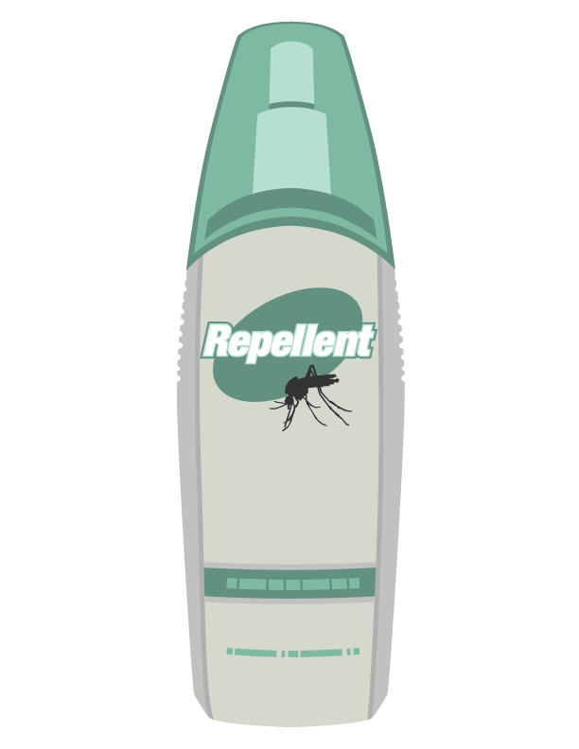
What to do if you have Zika
Protect yourself from mosquito bites. During the first week of illness, Zika virus can be found in blood.
The virus can be passed from an infected person to a mosquito through bites.
An infected mosquito can spread the virus to other people.
Notes:
To help prevent others from getting sick, strictly follow steps to prevent mosquito bites during the first week of illness.

Slide 24
Surveillance

Slide 25

Reporting of Zika in the United States
Healthcare providers should report cases to their local, state, or territorial health department.
State and territorial health departments are encouraged to report confirmed cases to CDC through ArboNET, the national surveillance system for arboviral diseases.
Pregnant women with any lab evidence of possible Zika virus infection should be reported to the US Zika Pregnancy Registry.
2017 Case Counts in the US
Notes:
Zika is a nationally notifiable disease. State and territorial health departments are encouraged to report laboratory-confirmed cases to CDC through ArboNET, the national surveillance system for arboviral diseases. Healthcare providers should report cases to their local, state or territorial health department according to the laws or regulations for reportable diseases in their jurisdiction.
CDC maintains enhanced surveillance of women with any laboratory evidence of possible Zika virus infection, with or without symptoms, during pregnancy and their babies for the first year of life.
CDC watches for and reports the number of Zika cases and the areas where Zika is spreading, which will help improve our understanding of how and where Zika is spreading.

Slide 26
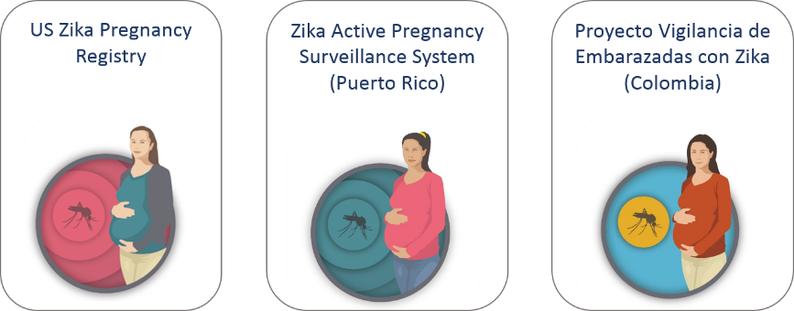
Zika Pregnancy Registries
Notes:
To learn more about the impact of Zika infection on pregnant women, their fetuses, and infants, CDC is conducting enhanced surveillance for women with evidence of possible Zika virus infection during pregnancy.
With state, tribal, local and territorial health departments, CDC established the US Zika Pregnancy Registry.
CDC also helped develop a similar system in Puerto Rico, the Zika Active Pregnancy Surveillance System.
CDC provided assistance to establish enhanced surveillance of pregnant women with Zika in Colombia.
Data collected will be used to update recommendations for clinical care, plan for services for pregnant women and families affected by Zika, and improve prevention of Zika infection during pregnancy

Slide 27
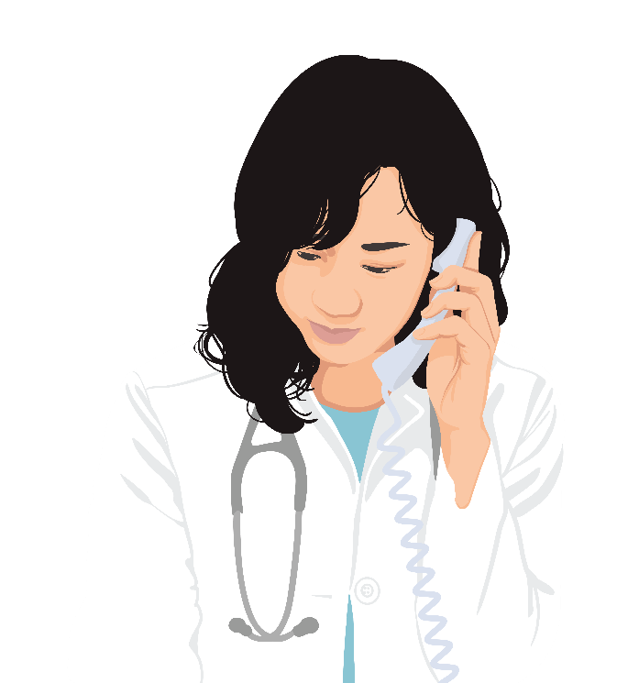
US Zika Pregnancy Registry
CDC established the US Zika Pregnancy Registry to collect information and learn more about pregnant women in the US with Zika and their infants.
Data will be used to
Update recommendations for clinical care
Plan for services for pregnant women and families affected by Zika
Improve prevention of Zika infection during pregnancy
Zika Active Pregnancy Surveillance System is used in Puerto Rico.
https://www.cdc.gov/zika/hc-providers/registry.html
https://www.cdc.gov/zika/public-health-partners/zapss.html
Notes:
CDC established the US Zika Pregnancy Registry and is collaborating with state, tribal, local, and territorial health departments to collect information about - pregnancy and infant outcomes among pregnant women with laboratory evidence of Zika virus infection and their infants.
CDC reports pregnancy data from these two surveillance systems. The numbers reported reflect counts of pregnant women in the US, including US territories, with any laboratory evidence of possible Zika virus infection, with or without symptoms or pregnancy complications.

Slide 28
prevention
Protect from mosquito bites

Slide 29
Zika is primarily spread through the bite of an infected Aedes aegypti or Ae. albopictus mosquito. Take steps to protect yourself and others.
Notes:
Zika virus is primarily spread through the bite of an Aedes aegypti or Aedes albopictus mosquito.
Aedes aegypti mosquitoes live in tropical, subtropical, and in some temperate climates. They are the primary vector of Zika, dengue, chikungunya, and other arboviral diseases. Because Aedes aegypti mosquitoes live near and prefer to feed on people, they are considered highly efficient at spreading these diseases.
To produce eggs, the female mosquito bites people to feed on blood. When feeding, a mosquito will pierce the skin (like a needle) and inject saliva into a person’s skin.

Slide 30

Control mosquitoes outside
Here’s what you can do to help control mosquitoes outside your home
Once a week, empty and scrub, turn over, cover, or throw out items that hold water.
Tightly cover water storage containers.
Use larvicides to kill larvae in containers of water that cannot be emptied and will not be used for drinking.
Use an outdoor insect spray made to kill mosquitoes in areas where they rest.
If you have a septic tank, repair cracks or gaps.
Notes:
Once a week, empty and scrub, turn over, cover, or throw out any items that hold water like tires, buckets, planters, toys, pools, birdbaths, flowerpot saucers, or trash containers. Mosquitoes lay eggs near water.
Tightly cover water storage containers (buckets, cisterns, rain barrels) so that mosquitoes cannot get inside to lay eggs.
For containers without lids, use wire mesh with holes smaller than an adult mosquito.
Use larvicides to kill larvae in containers of water that will not be used for drinking and cannot be covered or dumped out.
If you have a septic tank, repair cracks or gaps. Cover open vent or plumbing pipes. Use wire mesh with holes smaller than an adult mosquito.
Use an outdoor insect spray made to kill mosquitoes in areas where they rest. Mosquitoes rest in dark, humid areas like under patio furniture, or under the carport or garage.

Slide 31
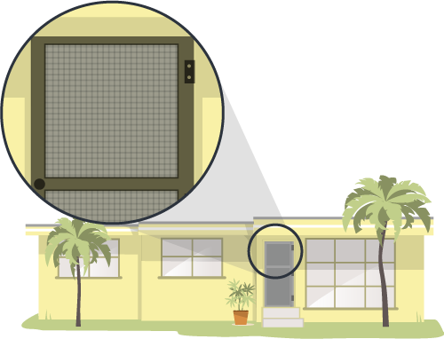
Control mosquitoes inside
Here’s what you can do to help control mosquitoes inside your home:
Use window and door screens.
Use air conditioning when possible.
Once a week, empty, scrub, turn over, or throw out items that hold water.
If you have mosquitoes inside your home, use an indoor insect fogger or indoor insect spray.
When using insecticides, always follow label directions.
Notes:
Install or repair and use window and door screens. Do not leave doors propped open.
Use air conditioning when possible.
Once a week, empty and scrub, turn over, cover, or throw out any items that hold water like vases and flowerpot saucers. Mosquitoes lay eggs near water.
Kill mosquitoes inside your home. Use an indoor insect fogger or indoor insect spray to kill mosquitoes and treat areas where they rest. These products work immediately, and may need to be reapplied. When using insecticides, always follow label directions. Only using insecticide will not keep your home free of mosquitoes.
Mosquitoes rest in dark, humid places like under the sink, in closets, under furniture, or in the laundry room.

Slide 32
Wear insect repellent
Use Environmental Protection Agency (EPA)-registered insect repellents.
Use a repellent with one of the following active ingredients: DEET, picaridin, IR3535, or oil of lemon eucalyptus, para-menthane-diol, or 2-undecanone.
Always follow the product label instructions.
Do not spray repellent on the skin under clothing.
If also using sunscreen, apply sunscreen before applying insect repellent.
Notes:
Choosing an EPA-registered repellent ensures the EPA has evaluated the product for effectiveness.
Insect repellents registered by the EPA repel the mosquitoes that spread Zika and other viruses like dengue, chikungunya, and West Nile.
When used as directed, EPA-registered insect repellents are proven safe and effective even for pregnant and breastfeeding women.

Slide 33
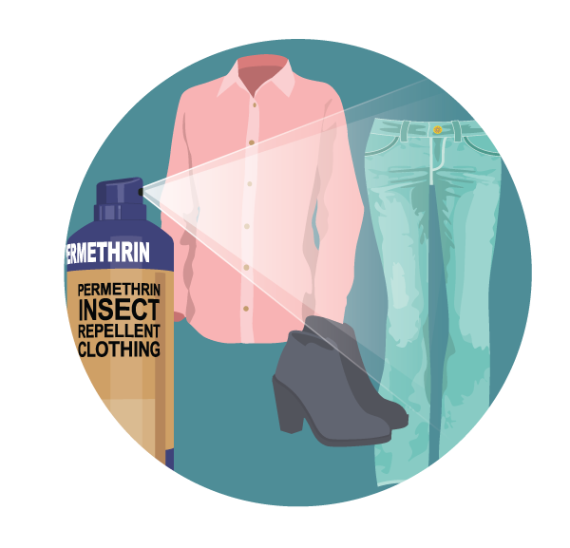
Create a barrier between you and mosquitoes
Cover up exposed skin
Wear long-sleeved shirts and long pants.
Treat clothing and gear
Use permethrin* to treat clothing and gear or buy pre-treated items.
See product information to learn how long the protection will last.
Do not use permethrin products directly on skin.
* Permethrin is not effective in Puerto Rico.
Notes:
The EPA has reviewed scientific studies on the use of permethrin-treated clothing. Based on EPA’s review, there is no evidence of reproductive or developmental effects to mother or child following exposure to permethrin.
Treated clothing remains protective after multiple washings. See product information to learn how long the protection will last.
If treating items yourself, follow the product instructions carefully.
Do NOT use permethrin products directly on skin. They are intended to treat clothing.

Slide 34
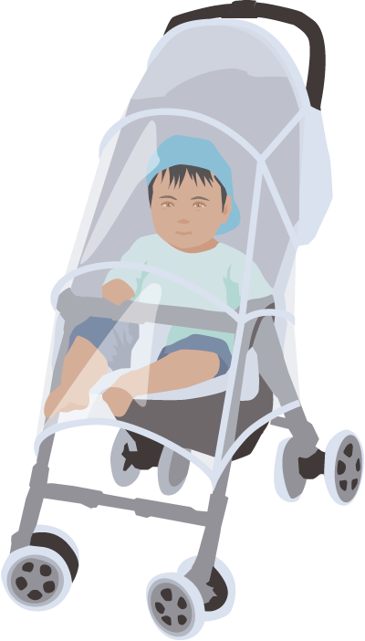
Protect your family
For babies and children
Dress your child in clothing that covers arms and legs.
For children older than 2 months, use insect repellent on exposed skin.
Cover crib, stroller, and baby carrier with mosquito netting.

Slide 35
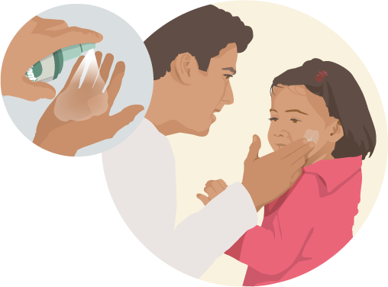
Protect your family
Applying insect repellent on children
Do not apply repellent onto hands, eyes, mouth, and cut or irritated skin.
Adults: Spray onto your hands and then apply to a child’s face.
Do not use insect repellent on babies younger than 2 months old.
Do not use products containing oil of lemon eucalyptus or para-menthane-diol on children younger than 3 years old.

Slide 36
prevention
Preventing sexual transmission

Slide 37
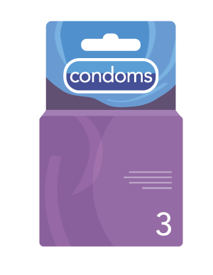

About sexual transmission
Zika can be passed through sex from a person who has Zika to his or her sex partners.
Sex includes vaginal, anal, and oral sex and the sharing of sex toys.
Zika can be passed through sex before symptoms start, during, and after symptoms end.
It can be passed even if the infected person does not have symptoms at the time or never develops symptoms.
Zika virus can stay in semen longer than in vaginal fluids, urine, and blood.
Notes:
Zika can be passed through sex from a person who has Zika to his or her sex partners.
Sex includes vaginal, anal, and oral sex, and the sharing of sex toys.
Zika can be passed through sex, even if the infected person does not have symptoms at the time.
It can be passed from a person with Zika before their symptoms start, while they have symptoms, and after their symptoms end.
Although not well documented, the virus may also be passed by a person who carries the virus but never develops symptoms.
Studies are underway to find out how long Zika stays in the semen and vaginal fluids of people who have Zika and how long it can be passed to sex partners. We know that Zika can remain in semen longer than in other body fluids, including vaginal fluids, urine, and blood.
Sexual exposure includes sex without a condom with a person who traveled to or lives in an area with Zika.
This includes vaginal, anal, and oral sex and the sharing of sex toys.

Slide 38
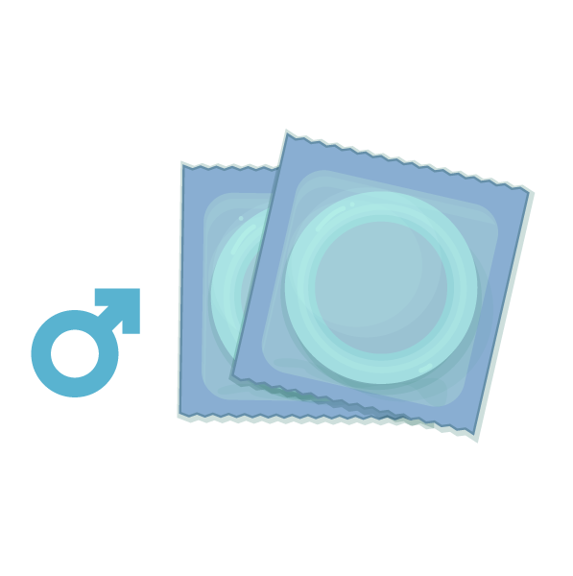

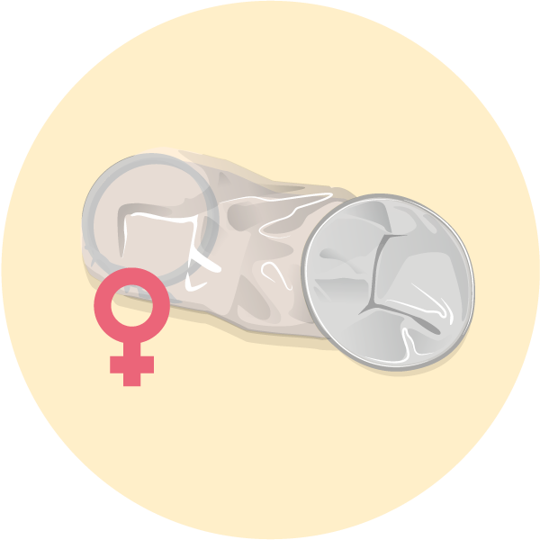
Protect your partner
Not having sex eliminates the risk of getting Zika from sex.
Condoms can reduce the chance of getting Zika from sex.
Includes male and female condoms.
Condoms should be used from start to finish, every time during vaginal, anal, and oral sex and the sharing of sex toys.
http://www.cdc.gov/mmwr/volumes/65/wr/pdfs/mm6529e2.pdf
Notes:
Not sharing sex toys may also reduce the risk of spreading Zika to sex partners.
The full sexual transmission guidance can be found here: http://www.cdc.gov/mmwr/volumes/65/wr/pdfs/mm6529e2.pdf

Slide 39

Protect your partner
People with a partner who traveled to an area with risk of Zika can use condoms or not have sex
If the traveler is female: For at least 8 weeks after return, or after start of symptoms or diagnosis
If the traveler is male: For at least 6 months after return, or after start of symptoms or diagnosis
People living in an area with risk of Zika can use condoms or not have sex.
Notes:
The extended period for men is because Zika stays in semen longer than in other body fluids.
Decisions about having sex and using condoms depend on each person’s understanding of the risks and benefits, including
▪ The mild nature of the illness for many people
▪ Their possible exposure to mosquitoes while in an area with risk of Zika
▪ Their plans for pregnancy (if appropriate) and access to birth control
▪ Their access to condoms
▪ Their desire for intimacy, including willingness to use condoms or not have sex
▪ Their ability to use condoms or not have sex
o If either partner develops symptoms of Zika or has concerns, they should talk to a healthcare provider.

Slide 40
During pregnancy
Pregnant couples in which one or both partners live in or traveled to an area with risk of Zika should:
Use condoms from start to finish every time they have sex (oral, vaginal, or anal) or not have sex during the pregnancy.
Not share sex toys during the pregnancy.
Notes:
The risk from sex is of greatest concern for pregnant women, who can pass Zika to their developing fetus if infected during pregnancy.

Slide 41
If you’re thinking about having a baby
Exposure from travel to or sex without a condom with someone who lives in or traveled to an area with a CDC Zika travel notice
Women | Men
Wait at least 2 months after symptoms start or last possible exposure before trying to get pregnant. | Wait at least 6 months after symptoms start or last possible exposure before trying to conceive with your partner.
Notes:
Women and their partners thinking about pregnancy should consider avoiding nonessential travel to areas with risk of Zika with CDC Zika travel notices.
If the female traveler was exposed to this area, wait at least 2 months after the last possible exposure or after symptoms start (if she developed symptoms) before trying to conceive. During this waiting period, use condoms or do not have sex.
If the male traveler was exposed to this area, wait at least 6 months after the last possible exposure or after symptoms start (if he developed symptoms) before trying to conceive. During this waiting period, use condoms or do not have sex.
Decisions about pregnancy planning are personal and complex, and the circumstances will vary for women and their partners. Women and their partners should discuss pregnancy planning with a trusted doctor or healthcare provider. As part of counseling with healthcare providers, some women and their partners living in areas with risk of Zika might decide to delay pregnancy.
The full sexual transmission guidance can be found here: http://www.cdc.gov/mmwr/volumes/65/wr/pdfs/mm6529e2.pdf

Slide 42
If you’re thinking about having a baby
Exposure from travel to or sex without a condom with someone who lives in or traveled to an area with risk of Zika but without a CDC Zika travel notice
Women | Men
If no symptoms, talk with a healthcare provider about plans for pregnancy. |  | If no symptoms, talk with a healthcare provider about plans for pregnancy.
Wait at least 2 months after symptoms start before trying to get pregnant. |  | Wait at least 6 months after symptoms start before trying to get pregnant.
Notes:
Because the level of risk in this area is unknown and information is limited about the risk of infection around the time of conception, talk with your healthcare provider about your plans for pregnancy, your travel plans, your risk of Zika virus infection, the possible health effects of Zika virus infection on a baby, and ways to protect yourself from Zika.
If either of you develops symptoms consistent with Zika and/or test positive for Zika, you should follow the suggested timeframes above before trying to conceive.

Slide 43
If you’re thinking about having a baby
People living in or frequently traveling to any area with risk of Zika
Women | Men
If no symptoms, talk with a healthcare provider about plans for pregnancy. | If no symptoms, talk with a healthcare provider about plans for pregnancy.
Wait at least 2 months after symptoms start before trying to get pregnant. | Wait at least 6 months after symptoms start before trying to get pregnant.
Notes:
Men and women who live in areas with risk of Zika who are considering pregnancy in the near future should talk with their healthcare providers about their pregnancy plans during a Zika virus outbreak, the potential risks of Zika, and how they can prevent Zika virus infection during pregnancy.
If either partner has symptoms of Zika or tests positive for Zika, they should follow the suggested timeframes above before trying to conceive.

Slide 44
prevention
Traveling

Slide 45
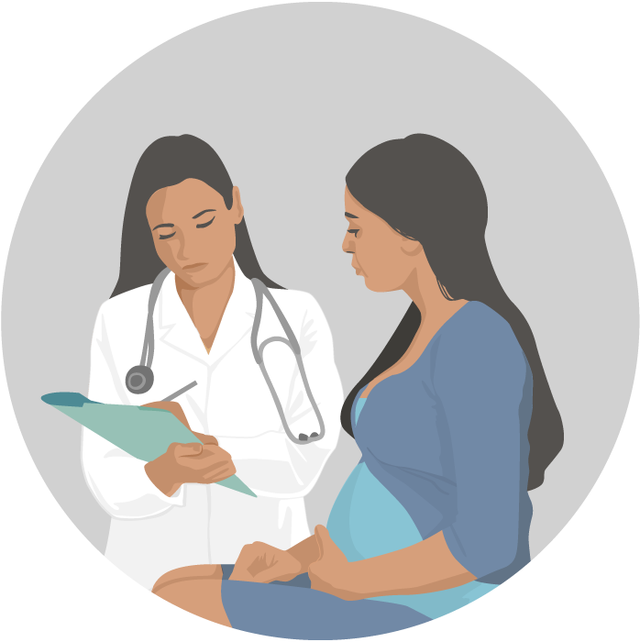

Travel guidance for pregnant women
If you are pregnant, do not travel to areas with risk of Zika.
If you must travel, talk to your doctor or other healthcare provider and strictly follow steps to prevent mosquito bites during the trip.
Notes:
Pregnant couples with a partner who traveled to an area with risk of Zika should:
Use condoms from start to finish every time they have sex or not have sex during the pregnancy. This is important, even if the pregnant woman’s partner does not have symptoms of Zika or feel sick.
Not share sex toys throughout the entire pregnancy.
Until more is known, CDC recommends the following:
Women trying to get pregnant and their partners
Before you or your partner travel, talk to your doctor or other healthcare provider about your plans to become pregnant and the risk of Zika virus infection.
If you do travel to an area with Zika, you and your partner should strictly follow steps to prevent mosquito bites during the trip.

Slide 46
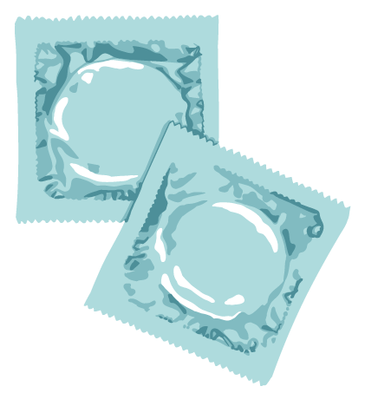
Protect yourself while traveling
If you travel to an area with risk of Zika
Strictly follow steps to prevent mosquito bites.
Use condoms or do not have sex during the trip.
Notes:
People with a partner who traveled to an area with risk of Zika should use condoms or not have sex. The period of time for taking these precautions depends on whether the traveler is female or male:
If traveler is female: Use condoms or do not have sex for at least 8 weeks after travel to an area with risk of Zika (if she doesn’t have symptoms) or for at least 8 weeks from the start of her symptoms (or Zika diagnosis).
If traveler is male: Use condoms or do not have sex for at least 6 months after travel to an area with risk of Zika (if he doesn’t have symptoms) or for at least 6 months from the start of his symptoms (or Zika diagnosis). This extended period is because Zika stays in semen longer than in other body fluids.
Some travelers become infected while traveling but do not get sick until they return home. Be aware of any illness or symptoms during your trip or after you return home. Tell your doctor or other healthcare provider where you have traveled and when you were there

Slide 47

Protect yourself while traveling
Stay in places with air conditioning and with window and door screens.
Use a bed net if air conditioned or screened rooms are not available or if sleeping outdoors.

Slide 48
Protect yourself and others after travel
Even if they do not feel sick, travelers returning from an area with risk of Zika should take steps to prevent mosquito bites for 3 weeks so they do not spread Zika to uninfected mosquitoes.

Slide 49
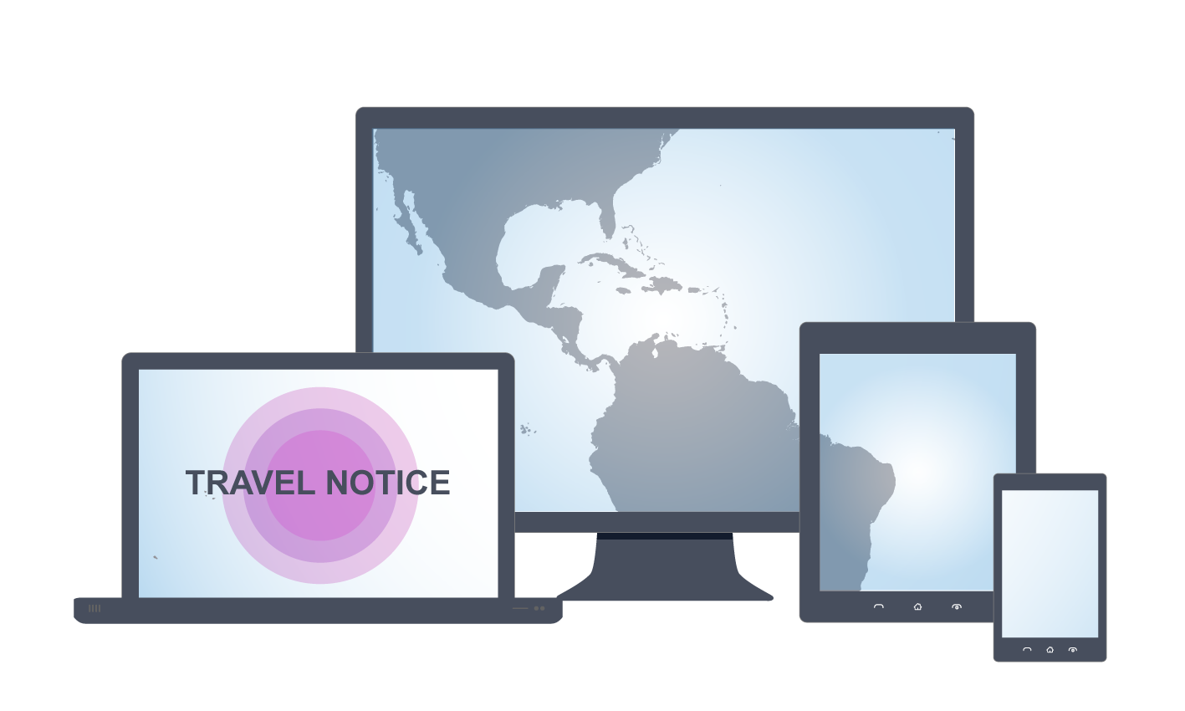
Do your homework before traveling
See the latest travel notices at: wwwnc.cdc.gov/travel/page/zika-travel-information

Slide 50
What cdc is doing

Slide 51
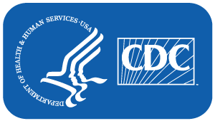
What is CDC doing?
Activated Emergency Operations Center (EOC) to level 1
Alerting healthcare providers and the public about Zika
Posting travel guidance
Monitoring infections among pregnant women to identify the long-term consequences of congenital Zika infection.
Working with clinical experts and organizations to update guidance
Researching factors that might affect birth defects in fetuses and babies, including the timing of Zika infection during pregnancy.
Improving laboratory testing for Zika and providing state, tribal, local, and territorial health laboratories with diagnostic tests.

Slide 52
CDC is working with partners to
Monitor and report cases of Zika.
Conduct studies to learn more about the potential link between Zika and Guillain-Barré syndrome.
Create action plans for state and local health officials to improve Zika preparedness.
Publish and disseminate guidelines to inform testing and treatment of people with suspected or confirmed Zika.
Working with partners to better understand the risk and spectrum of birth defects from Zika infection during pregnancy and risks for sexual transmission.

Slide 53
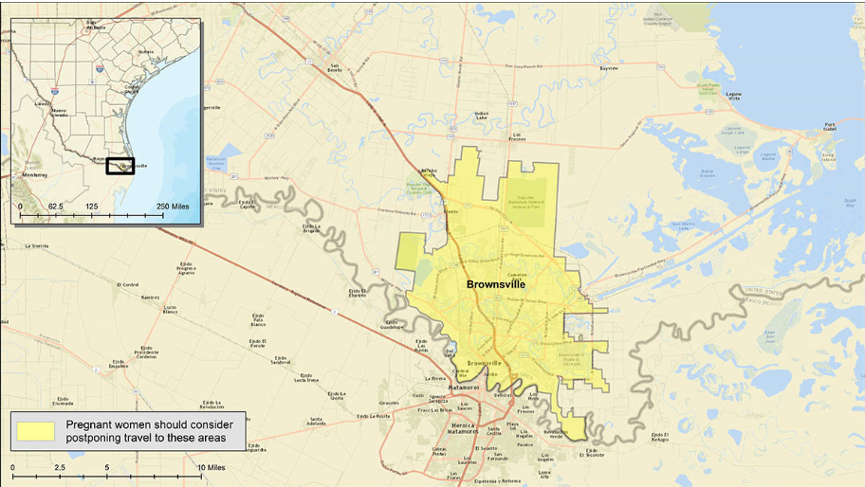
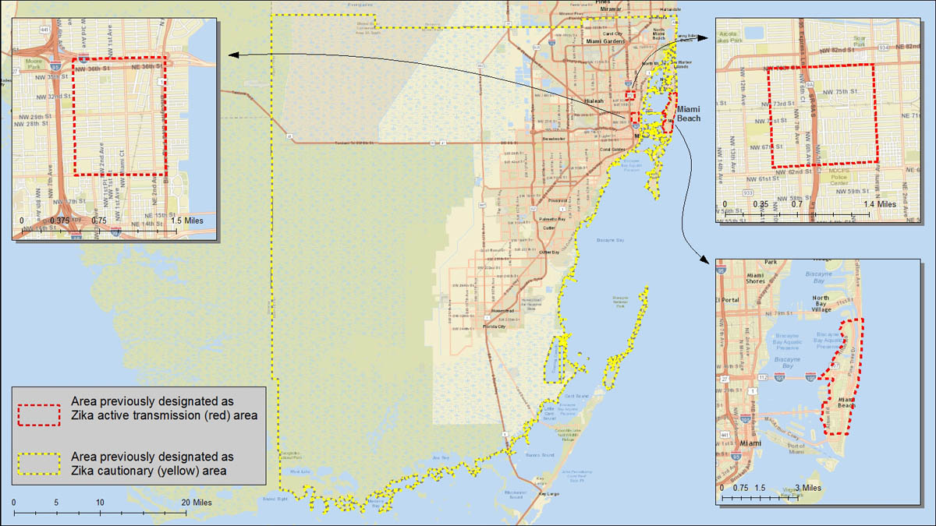
Zika in the United States
Local mosquito-borne spread of Zika virus was identified in Miami-Dade County, Florida, and Brownsville, Texas.
Pregnant women should consider postponing travel to Brownsville, Texas (currently a yellow area).
CDC lifted the yellow area designation for Miami-Dade County on June 2, 2017.
Brownsville, Texas
Miami-Dade County, Florida
Notes:
Local mosquito-borne Zika virus transmission has been reported in the continental United States.
CDC has guidance (https://www.cdc.gov/zika/intheus/florida-update.html) for people living in or traveling to South Florida.
CDC has guidance (https://www.cdc.gov/zika/intheus/texas-update.html) for people living in or traveling to Brownsville, Texas.

Slide 54
For more information, contact CDC 1-800-CDC-INFO (232-4636) TTY: 1-888-232-6348 www.cdc.gov The findings and conclusions in this report are those of the authors and do not necessarily represent the official position of the Centers for Disease Control and Prevention.

