Slide 1
KIDNEY TRANSPLANTATION SURVIVAL PREDICTION
GROUP NO: 6
ALEN P SAJI (CEK20CS005)
AZULAJ A (CEK20CS011)
DEEPAK D (CEK20CS025)
MUHAMMED HASSIL H (CEK20CS029)
GUIDED BY PROF.AJEESH S
ASST. PROF IN CSE

Slide 2
TABLE OF CONTENTS
INTRODUCTION
LITERATURE REVIEW
PROBLEM STATEMENT
PROPOSED SYSTEM
SYSTEM DESIGN
DATASET
CHALLENGES
MODEL EVALUATION
RESULTS AND CONCLUSIONS
FUTURE SCOPE
REFERENCES

Slide 3
INTRODUCTION

Slide 4
In today’s world, kidney transplantation has become very common.
Our project titled “kidney transplantation survival prediction“ is a method to predict the survival rate of the patients.
In this presentation, we will explore the development of a web tool that utilizes machine learning to predict kidney transplantation survival.
This proposed system addresses all scenarios from organ donation to transplantation.
Data will be processed in the form of CSV files.

Slide 5
LITERATURE REVIEW

Slide 6
TITLE | AUTHOR | CONTENT | RESULT
“Kidney transplantation in the next decade ” | Domingo Hernandez, Abelardo Cabellero | It proposes the strategies in the upcoming future of kidney transplantation. It mentions the challenges that may arise in the future generation in the field of kidney transplantation. | This paper proposes future strategies for kidney transplantation while addressing potential challenges that may arise, guiding the advancement of transplant medicine.
TITLE | AUTHOR | CONTENT | RESULT
“Application of machine learning in chronic kidney disease : current status and future prospects.” | Charlotte Delrue, Sander De Bruyne, Marjin M Speeckaert | It suggests the application of machine learning in the chronic kidney disease also focuses on early detection , risk prediction ,personalized treatment and decision support. | This paper explores the application of machine learning in the field of chronic kidney disease.

Slide 7
TITLE | AUTHOR | CONTENT | RESULT
“A comparative analysis of survival of patients on dialysis and after kidney Transplantation.” | Mohammed A. Kaballo , Mark Canney, Patrick O’Kelly, Yvonne Williams, Conall M. O’Seaghdha , Peter J. Conlon | It compares the survival analysis of patients undergoing dialysis with that of patients undergoing kidney transplantation. | This paper highlights the significance of kidney transplantation as the preferred treatment option for the patients seeking improved long-term survival.
TITLE | AUTHOR | CONTENT | RESULT
“A Detailed Study On The Quality Of Life of Kidney Transplant Patients.” | Yin Jiali , Amanda .J , Shao Qilu. | It explains about the living conditions of the patients after having kidney transplnatation. | This study provides clear insights into the quality of life of kidney transplant patients, addressing factors like physical health, psychological well-being, and social support.

Slide 8
PROBLEM STATEMENT

Slide 9
It is hard for doctors to memorize the data of each patients which is one of the main problems.
Calculating the survival outcome of each person is hard and sometime it can turn out to be wrong and we aim to solve this problem.
At present advanced ML based techniques are not seriously employed.

Slide 10
PROPOSED SYSTEM

Slide 11
Our project aims to develop a web application with an AI model that predict whether a patient will survive after kidney transplantation before the procedure occurs.
And with the use of ML algorithms such as Random forest, Linear regression , Support vector machine etc we try to obtain high accuracy results.

Slide 12
SYSTEM DESIGN

Slide 13
MODULES
1. Admin Module:
Its functionalities are : Add and view doctor, manage organ need request, assign doctor for organ need request, manage organ donation, view user details.
2. User Module:
Its functionalities are : Add details, add organ request , view the status of their organ request.
3. Doctor Module:
Its functionalities are : view organ donation request, approve organ donation request, send public notes and personalized messages, monitors the survival outcome .

Slide 14
4. Donor Module:
Its functionalities are : registering as a donor, providing health parameters.
5. Analyst Module:
Its functionalities are : data collection and integration, data cleaning and preprocessing.

Slide 15
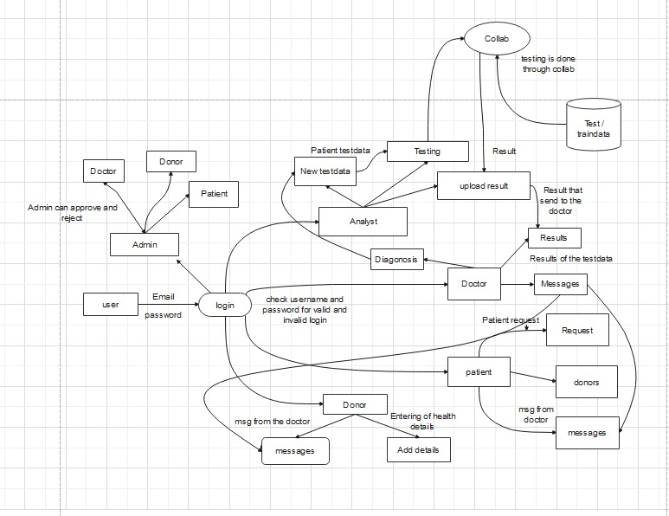
SYSTEM FLOW

Slide 16
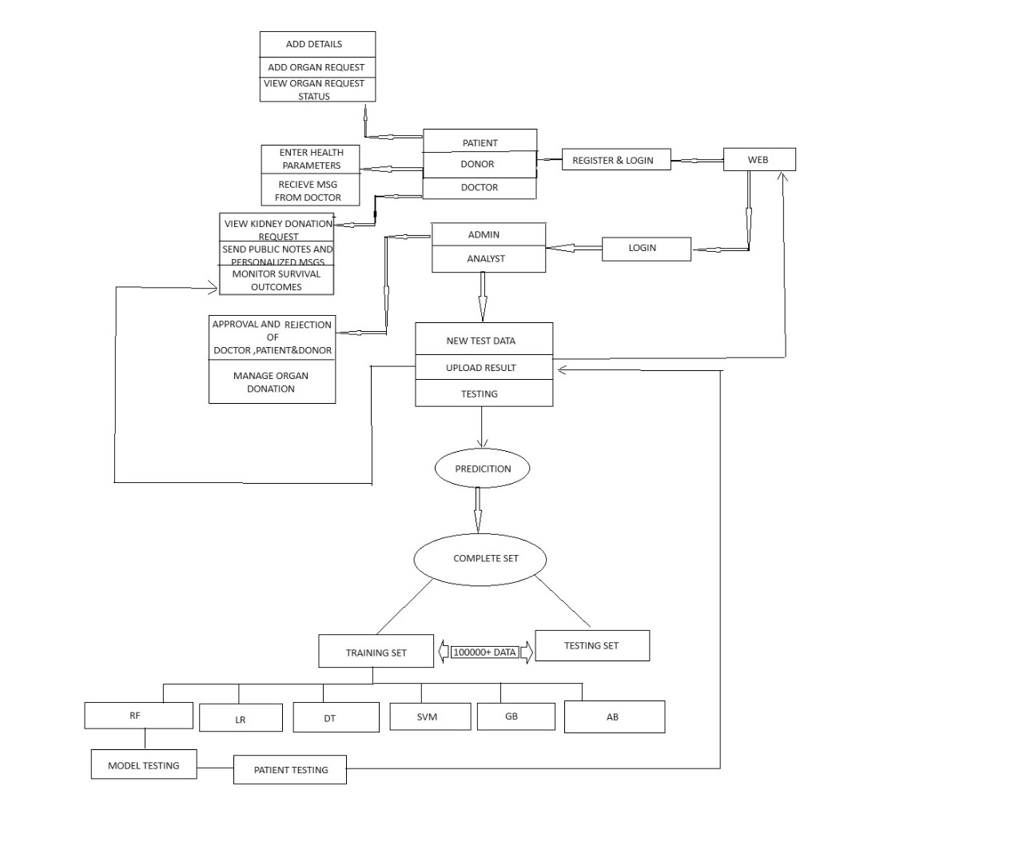
SYSTEM DESIGN

Slide 17
DATA SET
The dataset utilized in the kidney transplantation system is sourced mainly from Kaggle and GitHub.
From Kaggle we collected the organ transplantation dataset from 2017 - 2023.
From GitHub we collected datasets on the basis of age, living conditions ,donor health etc.
We have collected 100000+ data for training and testing purposes.

Slide 18
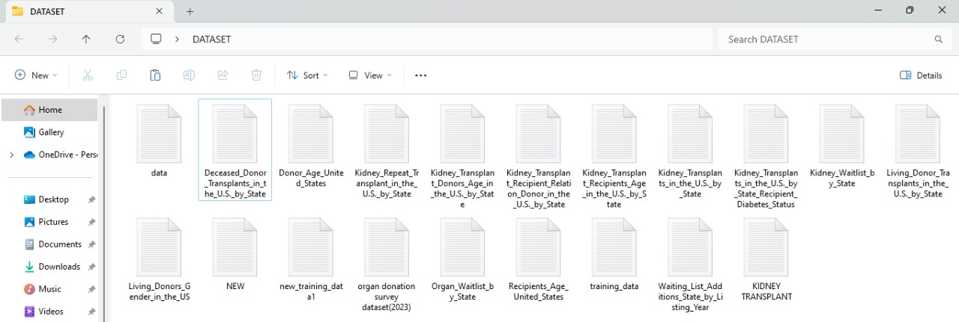

Slide 19
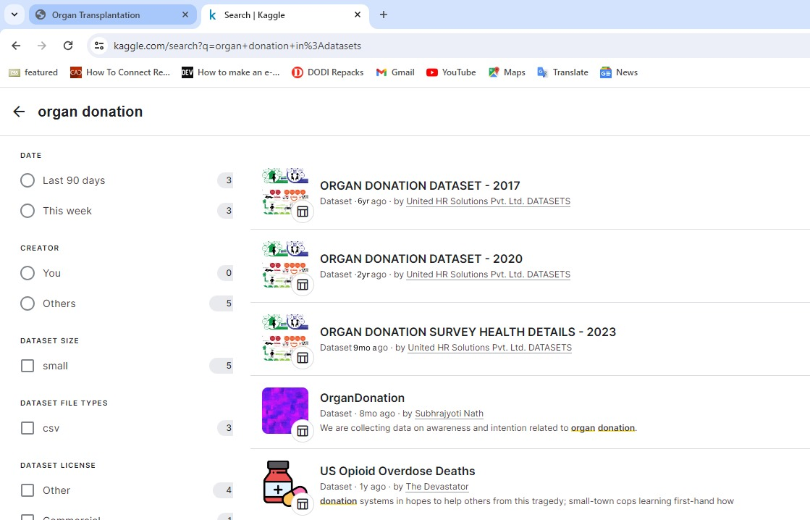

Slide 20
PARAMETERS USED
1.Age(numerical) age in years
2.Blood Pressure(80-120) bp in mm/Hg
3.Albumin(0,1,2) al - (0,1,2,3,4,5)
4.Sugar(0,1,2,2.5) su - (0,1,2,3,4,5)
5.Pus Cell (0) pc - (0-normal,1-abnormal)
6.Pus Cell clumps(1) pcc - (1-present,0-not present)
7.Bacteria(0) ba - (1-present,0-notpresent)

Slide 21
8.Blood Glucose Random(numerical) bgr in mgs/dl
9.Blood Urea(numerical) bu in mgs/dl
10.Serum Creatinine(numerical)
11.Hemoglobin(numerical) hemo in gms
12.White Blood Cell Count(numerical) wc in cells/cumm
13.Red Blood Cell Count(numerical) rc in millions/cmm
14.Hypertension(nominal) htn -(1-yes,0-no)
15.Blood Group(Text) bg-(A+,A-,B+,B-,O+,O-,AB+,AB-)

Slide 22
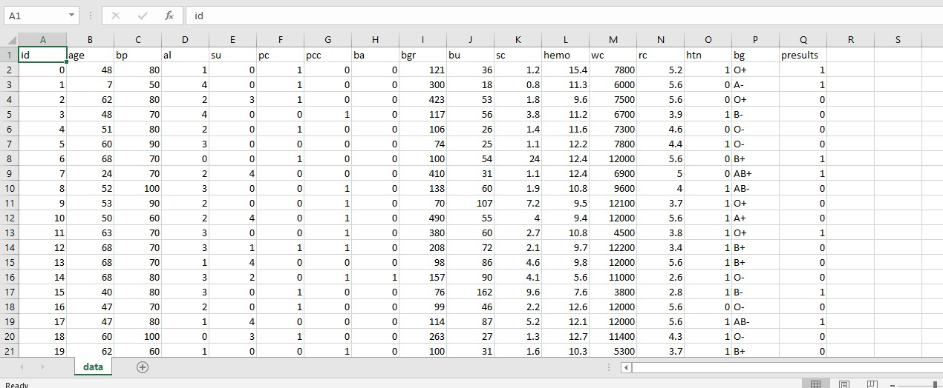

Slide 23
CHALLENGES
Presence of irrelevant and empty data.
Since it is in the medical field, accessing the data was difficult.
Duplicate data were present in the dataset.

Slide 24
ML ALGORITHMS
The ML algorithms used for the accuracy testing are as follows :
Random forest
Support vector machine
Linear regression
Decision tree
Gradient boosting
Adaboost

Slide 25
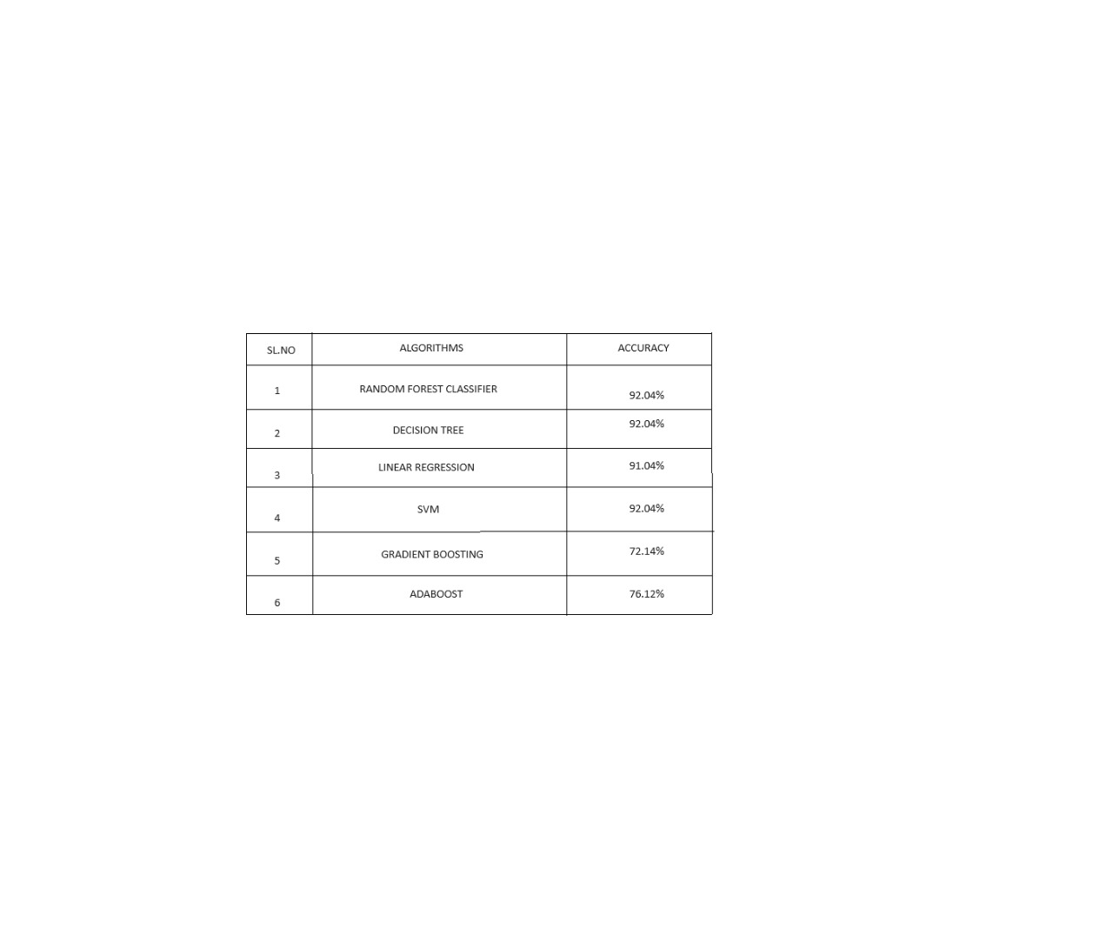

Slide 26
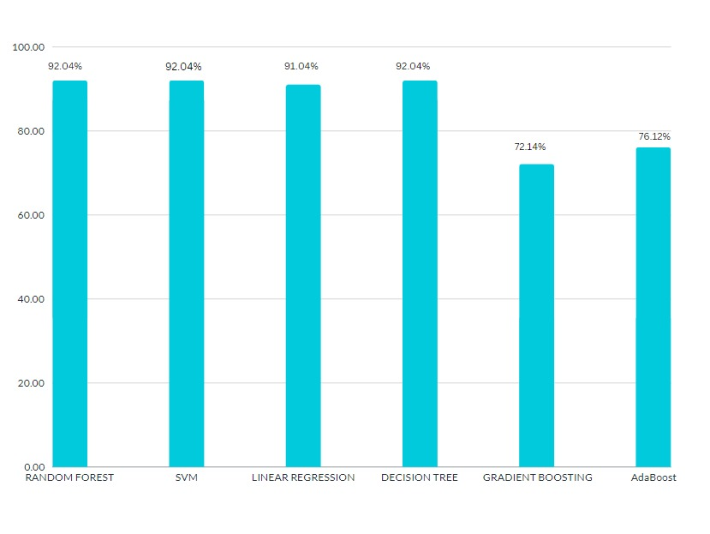
ACCURACY OF ALGORITHMS

Slide 27
MODEL CREATION AND EVALUATION
Selecting Random Forest (RF) over SVM and Decision Tree, despite similar accuracies, has various advantages:
1. Ensemble Learning: RF combines decision trees to improve predictive performance and reduce overfitting, making it more robust and stable.
2. Handling Non-Linearity: RF can capture complex nonlinear relationships in data, unlike SVM which may struggle without appropriate kernel functions.
3. Feature Importance: RF provides insights into influential features for better model interpretation and feature selection.
4. Robustness to Overfitting: RF's ensemble approach reduces overfitting, particularly with a large number of trees, offering a simpler solution compared to SVM.
5. Ease of Implementation: RF is easier to implement and less sensitive to tuning than SVM, making it more practical, especially with limited computational resources or expertise.

Slide 28
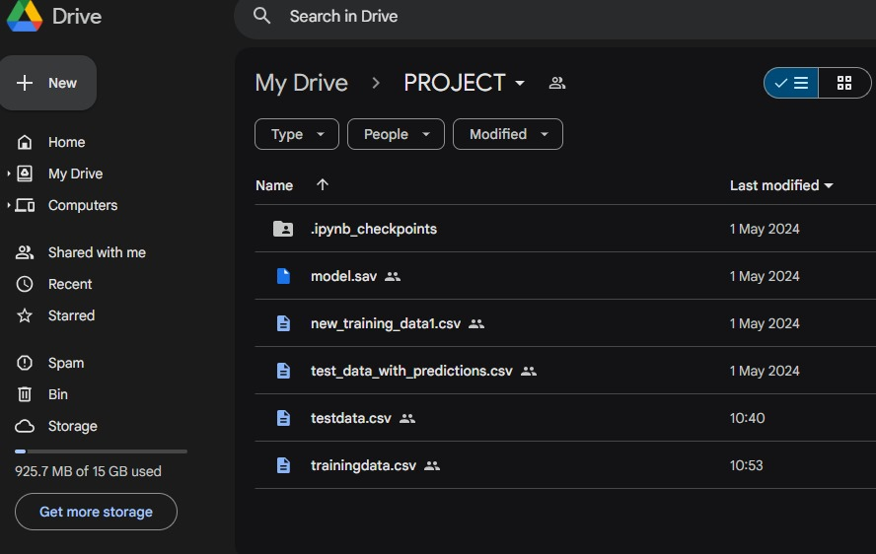
Based on the 100000 above collected data , we split 80% of the data for training and 20% for testing the model.
The testing accuracy was obtained as 92.04%.
After completion of the model ,it is uploaded in the drive.

Slide 29
RESULTS

Slide 30
The kidney transplantation survival prediction project utilized various machine learning algorithms, with the Random Forest model achieving the highest accuracy of 92.04%.
This model's success highlights the potential of machine learning to improve patient care outcomes in kidney transplantation

Slide 31
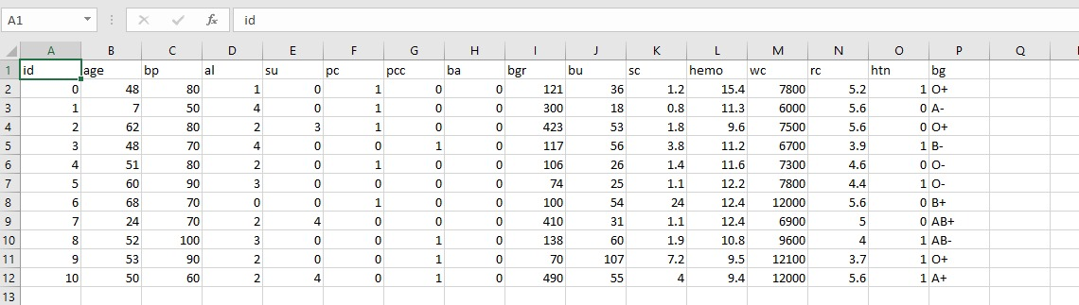
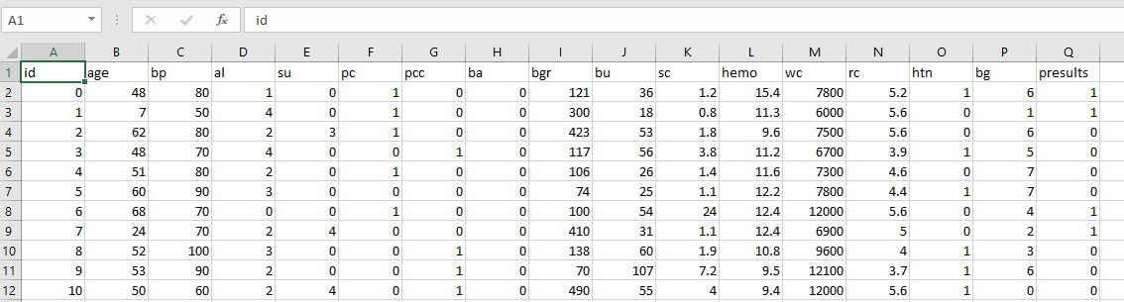
Test data
Result data

Slide 32
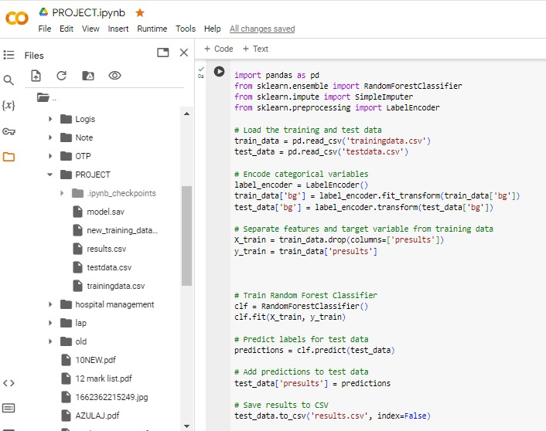

Slide 34
CONCLUSION
The project employed machine learning to predict survival rates in kidney transplantation , also contributing to improved patient care and medical decision-making.
We were able to validate , test and confirm the proper working of the system we developed.

Slide 35
FUTURE SCOPE

Slide 36
Enhanced Model Accuracy: Continuous refinement and optimization of the machine learning models can lead to even higher prediction accuracies.
Real-Time Monitoring: Integration of the predictive models into healthcare systems could enable real-time monitoring of transplant patients.

Slide 37
Clinical Decision Support Systems: Integration of the predictive models into clinical decision support systems could assist healthcare providers in making informed decisions regarding patient care.
Global Application: Scaling the project to a larger population and across different healthcare settings could enable the development of more robust and generalizable predictive models.

Slide 38
REFERENCES

Slide 39
[1] Domingo Hern´andez , Abelardo Caballero;Kidney transplant in the next decade: Strategies, challenges and vision of the future.
[2] Charlotte Delrue , Sander De Bruyne and Marijn M. Speeckaert; Application of Machine Learning in Chronic Kidney Disease: Current Status and Future Prospects.
[3] Mohammed A. Kaballo, Mark Canney, Patrick O’Kelly, Yvonne Williams, Conall M. O’Seaghdha and Peter J. Conlon; A comparative analysis of survival of patients on dialysis and after kidney transplantation.
[4] Briceno J, Ayll´on MD, Ciria R. Machine-learning algorithms for predicting results in liver transplantation: the problem of donor-recipient matching.
[5] Yin Jiali , Amanda .J and Shao Qilu;A Detailed Study On The Quality Of Life of Kidney Transplant Patients.
[6] Chapman JR. What are the key challenges we face in kidney transplantation today?
[7] Briceno˜ J. Artificial intelligence and organ transplantation: challenges and expectations.

Slide 40
SCREENSHOTS

Slide 41


Slide 42

Admin

Slide 43

Doctor

Slide 44

Analyst

Slide 45

Donor

Slide 46

Patient

Slide 47
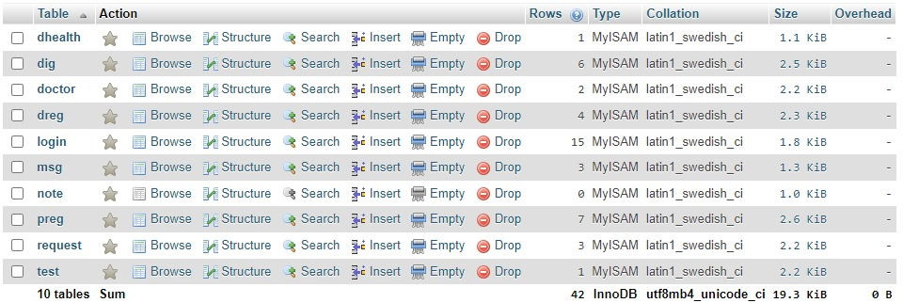
Db table

