Slide 1

A more convenient way to read notifications and messages

Slide 2
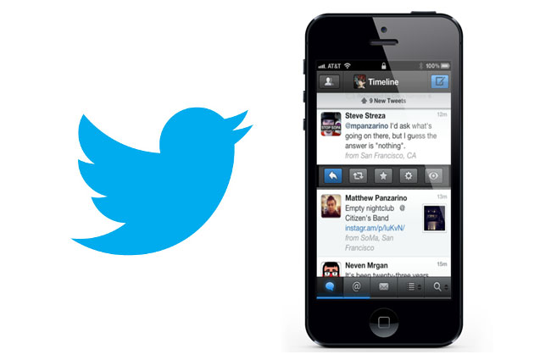
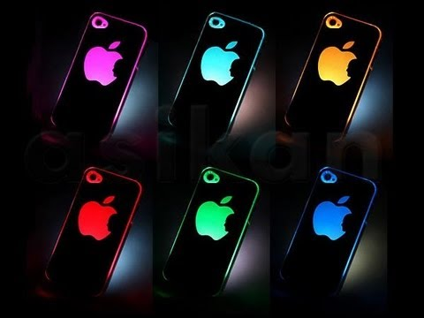
The Product

Slide 3
The Spectrum
0-.25
.25-.50
.50-.70
.70-.75
.75-1.0
Positivity Percentage

Slide 4



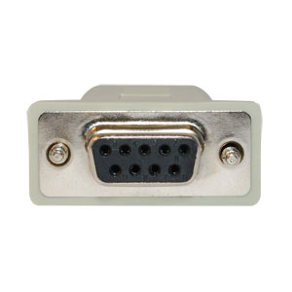
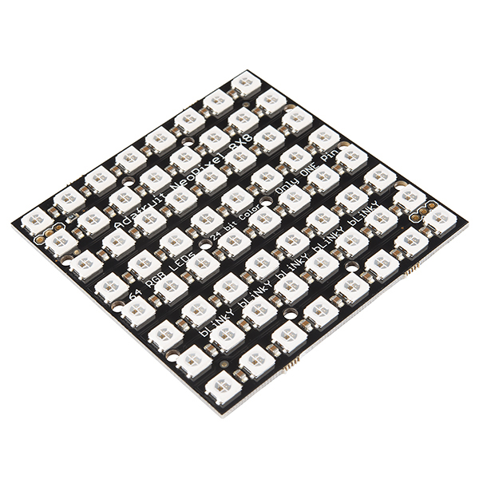
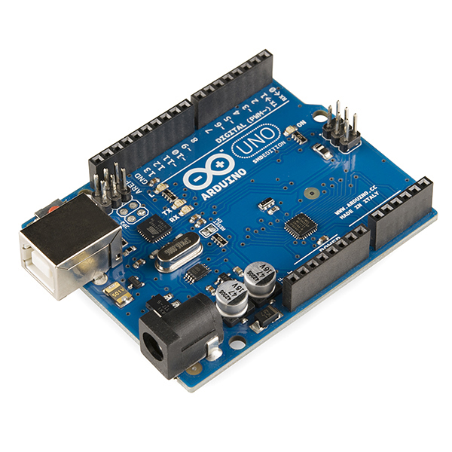
How it works

Slide 5



The Impact

Slide 6

Our Vision

