Slide 1

Service Fabric Diagnostics
Paolo Salvatori
Principal Program Manager
Azure CAT

Slide 2
Agenda
Problem
Monitor a remote Service Fabric application running on a Service Fabric cluster on Azure
Monitor a Service Fabric cluster on Azure
Solution
Use the VMDiagnosticsSettings and MicrosoftMonitoringAgent VM extensions to track ETW events, Windows Logs Events and Performance Counters
Use Operational Insights, Application Insights or a custom solution/dashboard (e.g. PowerBI, ElasticSearch + Kibana, etc.) to monitor the health status of a Service Fabric cluster, applications, and services

Slide 3
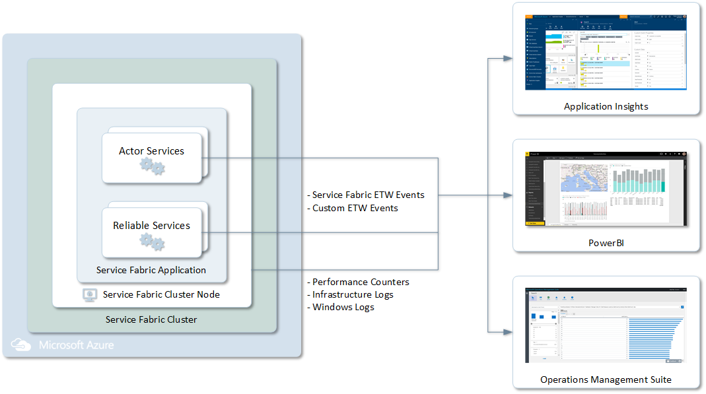
Scenario

Slide 4
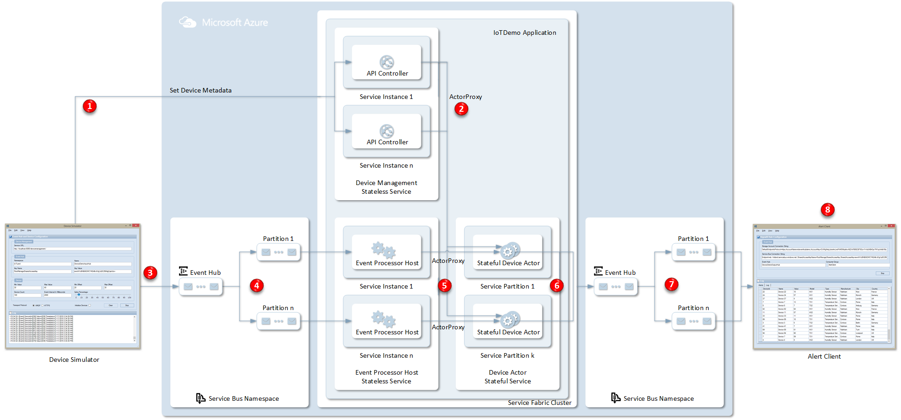
Demo

Slide 5
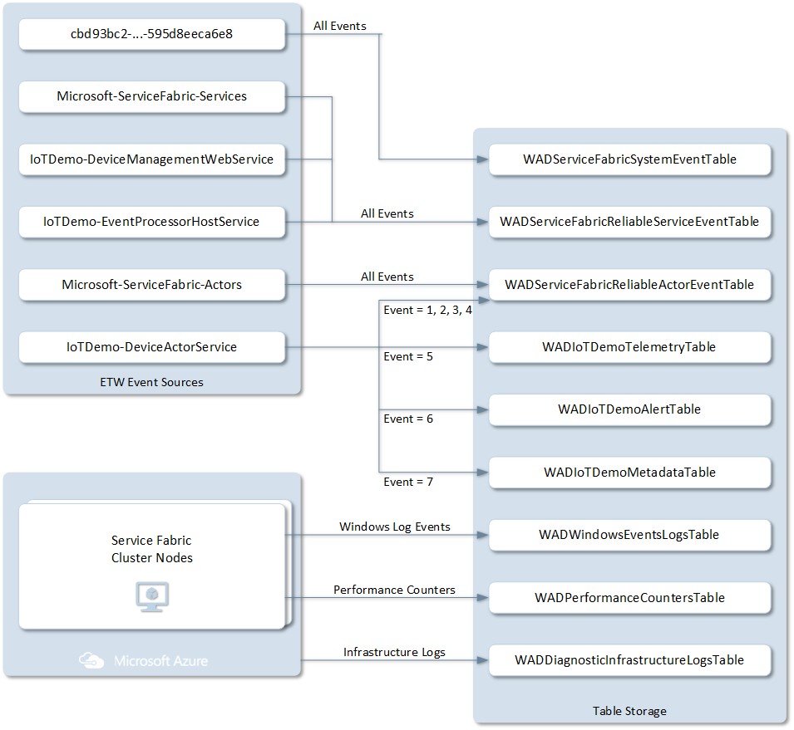
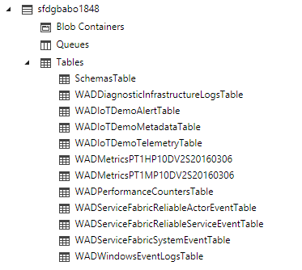
WAD Tables

Slide 6
OMS, Application Insights and Power BI Compared and Contrasted
Technology | Service Fabric ETW Events | Custom ETW Events | Windows Logs | Performance Counters
Operational Insights | Yes. It requires the installation of VMDiagnosticsSettings VM extension on the SF cluster nodes and the creation of an Insight on ServiceFabric*Tables on the OMS workspace | No. OMS does not support reading events from custom tables | Yes. It requires the deployment of the MicrosoftMonitoringAgent VM extension on the SF cluster nodes | Yes. It requires the deployment of the MicrosoftMonitoringAgent VM extension on the SF cluster nodes
Application Insights | Yes. It requires the creation of an Application Insights resource and installation of Application Insights NuGet packages and Service Fabric NuGet package for Application Insights | Yes. It requires the creation of an Application Insights resource and installation of Application Insights NuGet packages | Need to check | Yes. It requires the creation of an Application Insights resource and installation of Application Insights NuGet packages. To monitor Service Fabric counters, it requires the Service Fabric NuGet package for Application Insights.
PowerBI | Yes. A PowerBI dashboard can read data from WAD tables | Yes. A PowerBI dashboard can read data from WAD tables | Yes. A PowerBI dashboard can read data from WAD tables | Yes. A PowerBI dashboard can read data from WAD tables

Slide 7
Feedbacks
[Proactima] The ability to extract fields from an ETW event is useful but is not practical when the number of custom fields is quite high (>50)
[Paolo\Proactima] OMS should rather support custom tables and support ETW events with any custom columns. This is possible just reading the schema of a custom table from the Schema column of the SchemasTable in the storage account. This would allow OMS to read the events from any WAD table generated by a Service Fabric application using a custom ETW provider\EventSource.
[Proactima] The OMS UI is not very user friendly, not very appealing and not in line with the look & feel portal
[Codit] They were impressed by the possibilities offered by OMS, Application Insights and PowerBI

