Slide 1
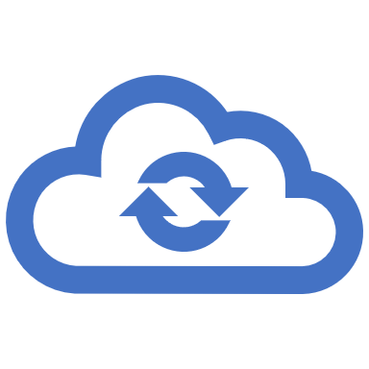
Container Observability and Monitoring

Slide 2

About …
Keiko Harada
Microsoft
Senior Program Manager – Azure Compute - Application Platform
Bio:
  Lehman Brothers (Japan) - IT
  Goldman Sachs and Co (New York) – Senior Storage Engineer
  Hitachi Data Systems (New York) – Product Strategist and Senior Product Manager
  Microsoft – Senior Program Manager – Azure Container Compute

Slide 3
Agenda
Shift in Monitoring with containerized microservice
Observability and Monitoring
How does Monitoring play in Enterprise?
Observability/Monitoring tools

Slide 4
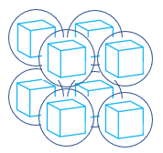
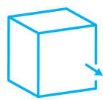
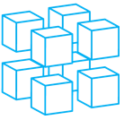

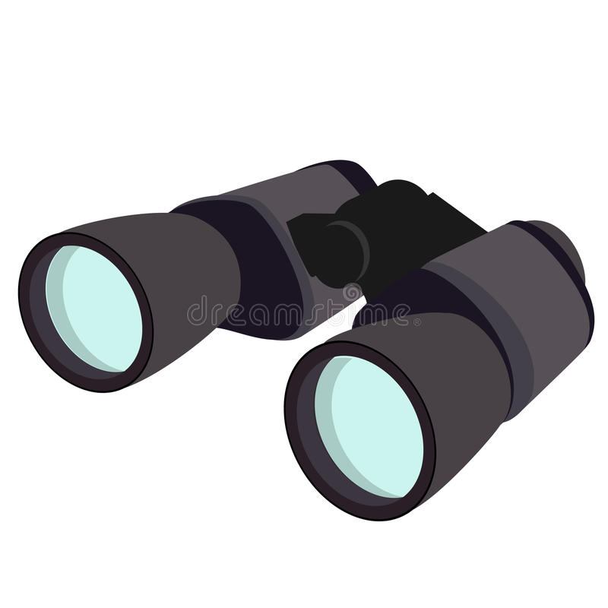

Monitoring Paradigm Shift with Microservice and Containers
Monolithic Application
Microservices
Microservices in
Containers
Open Source
Vendor Defined
Metrics Monitoring
Custom Metrics
Observability

Slide 5
What is Observability?
Observability:
A measure of how well internal states of a system can be inferred from knowledge of its external outputs. It is more a property of a system.
Monitoring:
Monitoring is something we perform against our applications and systems to determine their state.

Slide 6
Observability
Observability
(Tracing
Log
Metrics)
Monitoring
(Log
Metrics
Health)
Alerting
Manifestation of the issue
Notification
Subset of Observability data
Capture essence for troubleshooting
Present what can be the issues or
more insights.
Human interaction and intuition
There is no known issue surfaces.
It is to just answer “any” questions
regardless of issues.

Slide 7
Observability Example) Application Digital Footprints
Compare Digital footprint
(CPU/Memory Consumption …)
Application A (200mc, 15MB)
VS
Application B (220mc, 15MB)
VS
Application C (150mc, 13MB)

Slide 8
How are people using “Observability and Container Monitoring” in Enterprise?

Slide 9
Gap in Stack
App
App
App
App
APM monitor
identify and pinpoint bottlenecks or errors
thru APM
Containers
Gap
OS
OS
Infrastructure monitor
CPU, memory, network, storage
perf and logs
Hypervisor
Notes:
containers exist somewhere between hosts and applications where neither application performance monitoring nor traditional infrastructure monitoring are effective.
Why is that? Containers are created to provide isolation and portability. Container does not expose any metrics or logs to regular apm or host performance tools. If you using docker, docker metrics are exposed thru dockerd and you will need another monitoring tools for this.

Slide 10
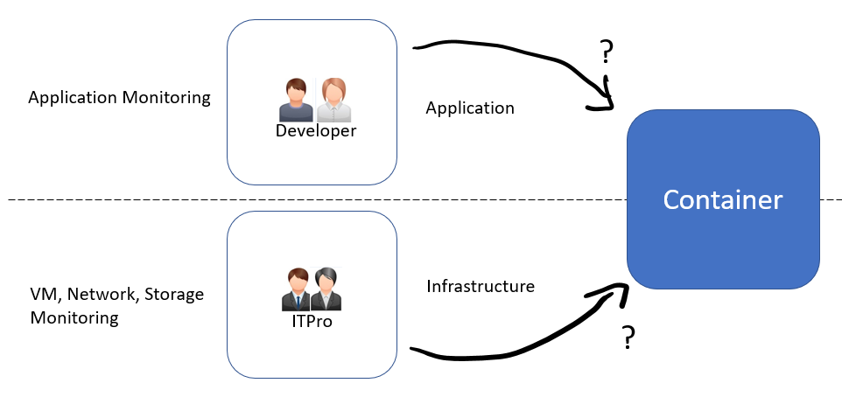
Who would monitor containers?

Slide 11




Container bringing changes to IT Organization
Traditional Monitoring with
Microservice/Container Monitoring
Traditional Monitoring
Application Monitoring
Microservice/Container Monitoring
Application Monitoring
Application
Developer
VM (CPU, Network, Storage Monitoring)
Kubernetes Monitoring
(storage, VM, networking)
Container Monitoring
VM(CPU), Network,
Storage Monitoring
Infrastructure
ITPro

Slide 12
Container bringing changes to IT Organization
Application
Infrastructure
Developer/
DevOps
ITPro
Application Monitoring
Microservice/Container Monitoring
VM (CPU, Network, Storage Monitoring)
+
VM (CPU, Network, Storage Monitoring)
Kubernetes Monitoring
(storage, VM, networking)
Container Monitoring
Shift Left

Slide 13
Troubleshooting Example
Workload
Developer/
DevOps
Kubernetes
Agent Node
(VM)
Workload/
pod1
schedule
Deploy
Kubernetes
Agent Node
(VM)
Workload/
pod2
scheduler
Kubernetes
Agent Node
(VM)
Workload/
pod3
Kubernetes Master Node

Slide 14
Personas and Stacks
Application
Container
Service
Container
(orchestrator)
Infrastructure
Developer
Cloud Operator
Observability
Personas
DevOps
Central IT/Security
Notes:
AppInfra

Slide 15
Monitoring per Kubernetes stack
Stack | Metrics, Logs, Health, Inventory | Tools
Workload | Distributed Tracing with APM, Ingress controller (req/sec, failure rate, response time) Liveness, Readiness Probe Container logs (Stdout, stderr) Container metrics (cpu/memory/iops) Pod/container health (restart time, uptime..) | ebpf embedded tcpdump, lsof, strace sysdig fluentd
Orchestrator | Event log PV, Service Mesh/CNI/Ingress Controller, Node Conditions Pod health (pending pods), kubelet health | kubectl tcpdump
Containers | Container runtime health | docker, ps
Infrastructure (Platform) | Journalctl, systemctl, syslog Host performance/health/capacity networking latency, storage iops/bandwidth and capacity | top, sar, iostat

Slide 16
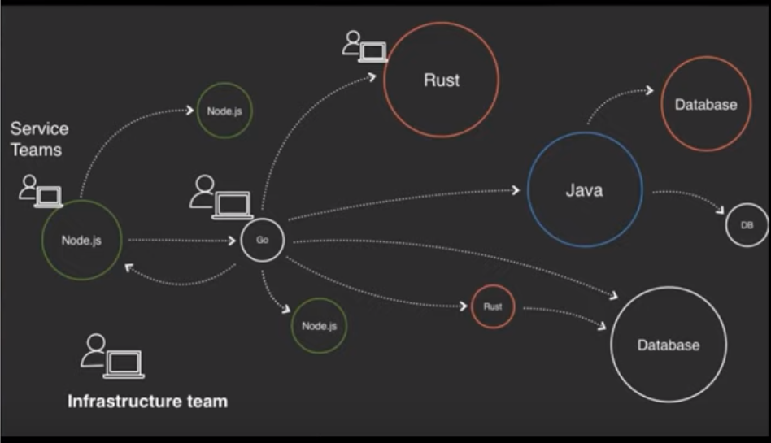
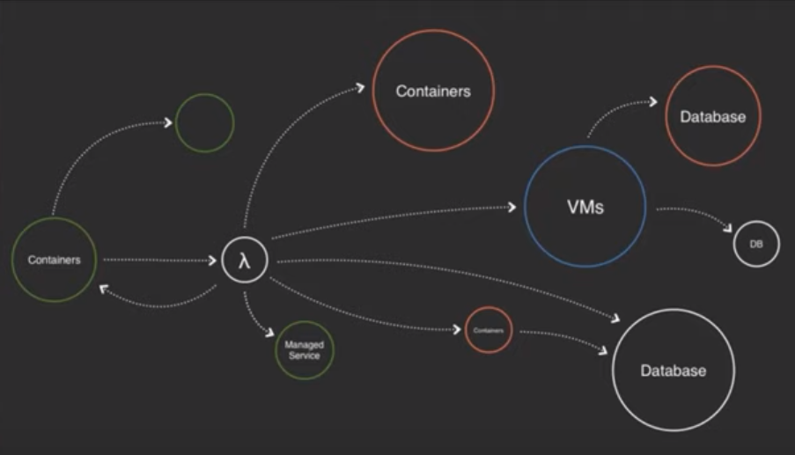
Development Experience
Application scope is beyond a platform
Services in multiple language
Various Service Deployments

Slide 17
Monitoring Vendors
APM/Tracing
Kubernetes
Infrastructure
Observability
Dynatrace
AppDynamics
NewRelic
Jaegar
Zipkin
Application Insights
Sysdig
Datadog
Weavesworks
Dynatrace
AppDynamics
New Relic
Container Insights
Prometheus/Grafana
InfluxDB
Sysdig
Datadog
Weavesworks
Tanzu
Honeycomb
NewRelic
Prometheus/Grafana
Container Insights
Sysdig
Datadog
Tanzu

Slide 18
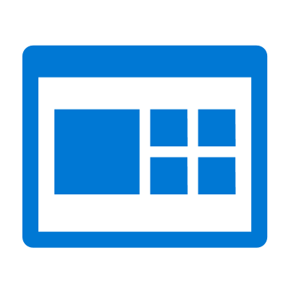
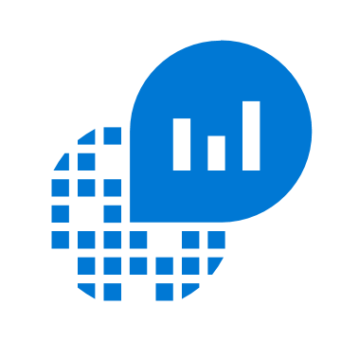

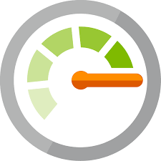
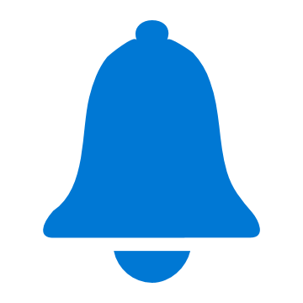
Container Insights with Prometheus Integration
node
End point (url/ipaddress)
Node Exporter
http://myurl:9101/metrics
Dashboards
Scrap metrics
Azure Monitor
for containers
pod1
(application)
End point (pod annotation)
annotations:
prometheus.io/scrape: "true"
prometheus.io/path: "/mymetrics"
prometheus.io/port: "8000"
prometheus.io/scheme: "http"
Log Analytics
Log Analytics
agent
pod2
(application)
End point (pod annotation)
Alerts
kube-service
(i.e. - kube-dns, kube-state-metrics)
End point (Kubernetes service)
http://my-service-dns.my-namespace:9100/metrics
https://metrics-server.kube-system.svc.cluster.local/metrics
Notes:
Container Insights have integrated with Prometheus. Using configmap settings, customer can scrap metrics from the Prometheus end-points by specifying pod annotation, URL/ipaddress, Kubernetes services without setting up a Prometheus server. This way, you can collect the Prometheus metrics without managing Prometheus server and the same Log Analytics agent will collect the rest of the monitoring data such as logs, events, kubernetes inventory, and etc.

Slide 19
Microservice is Distributed System
Reliability and Availability
Performance and Capacity
Application Model and Application Lifecycle

Slide 20
What to see in monitoring/observability tools?
Application Lifecycle with platform
Cohesiveness among platform services
Correlation among platform to application
Metric Cardinality
Aggregated Insights and Interpretation (application model)
Serverless vs Managed Kubernetes

Slide 21
Thank you

Slide 22
Questions:
What tools do you use today?
What would you like to see in observability?
Does it make sense to have a simple observability in the platform?
(or something like NPDs?)

Slide 23
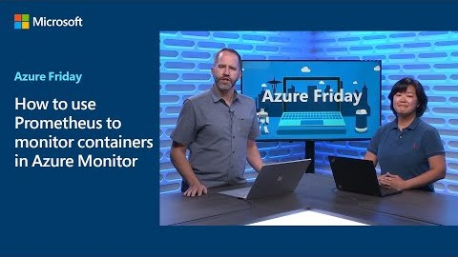

Slide 24








Cluster Security
Infrastructure
DevOps
ITPro
Cloud Operator
Central IT

