Slide 1
Next Level Terraform
With Robert Jordan

Slide 2

Robert Jordan:
LinkedIn
GitHub
Notes:
https://www.linkedin.com/in/robertjordan2/
https://github.com/rojopolis

Slide 3
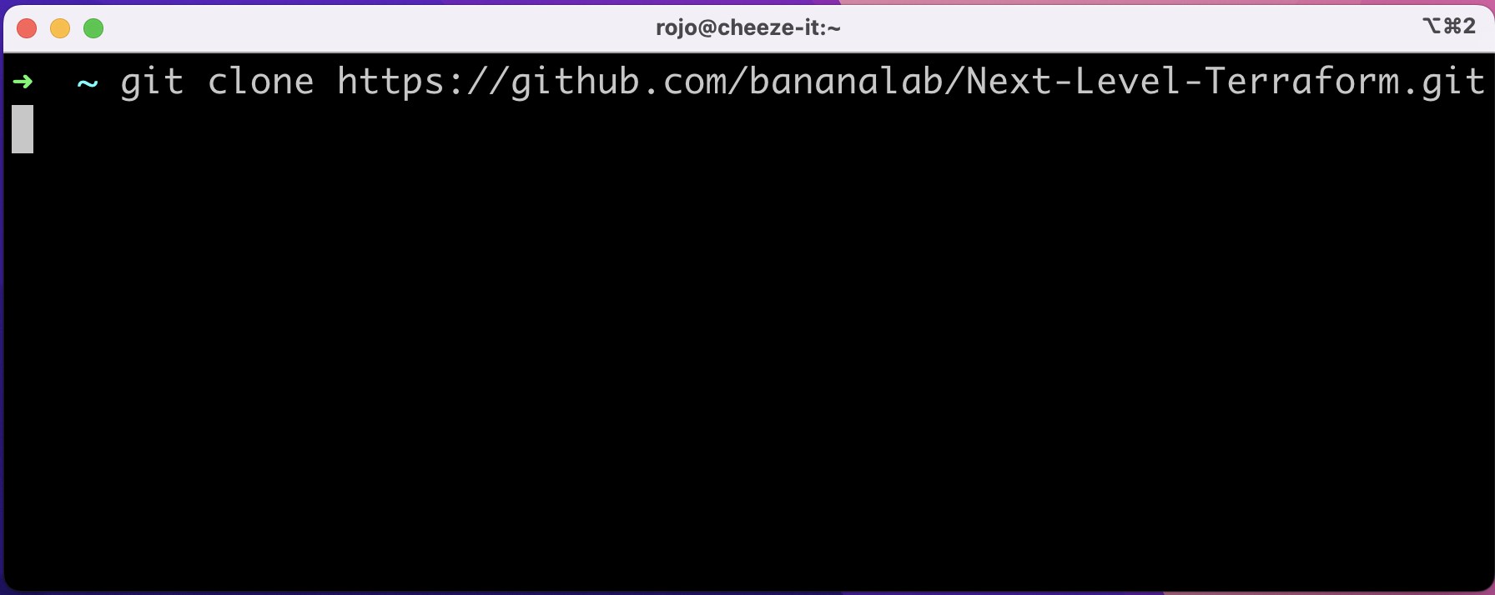

Slide 4
Poll
What is your primary technical function?
Software Developer
System Architect
Operations Engineer (SRE, DevOps, etc.)
Supervisor / Technical Management
Product / project Management
Other (Please post in chat)

Slide 5
Poll
What is your primary cloud platform?
AWS
Azure
GCP
On Premises (VMWare, OpenStack, etc.)
Other (Please post in chat)

Slide 6
Review
What is Terraform?
Declarative Infrastructure as Code (IaC) command line tool.
Domain specific programming language (DSL).
Multi cloud provider ecosystem.

Slide 7
Review
Why Terraform?
Repeatable environments.
Change management.
Collaboration.
Ecosystem.

Slide 8
Review
Alternatives
General programming languages (Cloud SDKs).
CLI tools (aws, gcloud, etc.).
Hybrid tools (Pulumi, CDK).
Web console.

Slide 9
Challenges
Batteries Not Included
Very low level of abstraction.
Detailed expertise of cloud services required.
No guardrails.

Slide 10
Challenges
Batteries Not Included
Community modules vary in quality.
Many community modules are too generalized to be useful.

Slide 11
Challenges
Batteries Not Included
Scaling is hard
Collaboration is hard
Compliance is hard

Slide 12
Licensing Change
Hashicorp changed Terraform from a FOSS model to BSL.
Impacts TACOS (Terraform Automation and COlaboration Software)

Slide 13
Demo Architecture

Slide 14
Terraform Modules

Slide 15
Terraform Modules
Module Types
Module
Low level
Un-opinionated
Composable

Slide 16
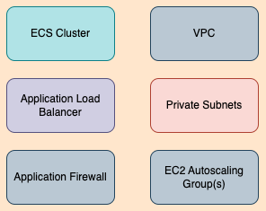
Terraform Modules
Module Types
Module

Slide 17
Terraform Modules
Module Types
Component
Higher level of abstraction
Pattern
Composed of modules
Deployable

Slide 18
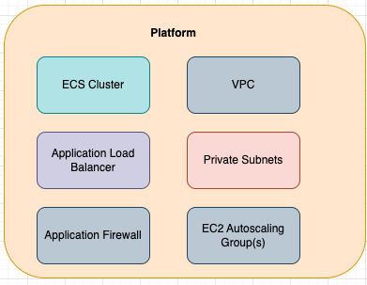
Terraform Modules
Module Types
Component

Slide 19
Terraform Modules
Exercise
Set up dev environment
Explore module code
Explore tooling
Workflow

Slide 20
Terraform Live
Represents the desired state of infrastructure.
Single source of truth
Root modules
Deployment pipeline

