Slide 1
Azure Times #128
August 2, 2024

Slide 2
Security & Identity

Slide 3
Security & Identity Updates (Entra ID)
Public Preview - MS Graph API support for per-user multifactor authentication
MS Graph API support per-user multifactor authentication. Starting June 2024, MS rollout the capability to manage user status (Enforced, Enabled, Disabled) for per-user multifactor authentication through MS Graph API. This replaces the legacy MSOnline PowerShell module that is being retired. The recommended approach to protect users with Microsoft Entra multifactor authentication is Conditional Access (for licensed organizations) and security defaults (for unlicensed organizations).
Public Preview - Easy authentication with Azure App Service and Microsoft Entra External ID
MS improved the experience when using Microsoft Entra External ID as an identity provider for Azure App Service’s built-in authentication, simplifying the process of configuring authentication and authorization for external-facing apps. It is possible to complete initial configuration directly from the App Service authentication setup without switching into the external tenant.
General Availability - Refactored account details screen in Microsoft Authenticator
In July, enhancements for the Microsoft Authenticator app UX roll-out. The account details page of a user account will be reorganized to help users better understand, and interact with, the information and buttons on the screen. Key actions that a user can do today will still be available in the refactored page, but they're organized in three sections or categories that help better communicate to users:
Credentials configured in the app
Additional sign in methods they can configure
Account management options in the app
General Availability - SLA Attainment Report at the Tenant Level
In addition to providing global SLA performance, Microsoft Entra ID reports tenant-level SLA performance for organizations with at least 5,000 monthly active users. This feature entered general availability in May 2024. The Service Level Agreement (SLA) sets a minimum bar of 99.99% for the availability of Microsoft Entra ID user authentication, reported on a monthly basis in the Microsoft Entra admin center.

Slide 4
Security & Identity Updates
Private Preview – QR code sign-in, a new authentication method for Frontline Workers
MS introduced a new simple way for Frontline Workers to authenticate in Microsoft Entra ID with a QR code and PIN, eliminating the need to enter long UPNs and alphanumeric passwords multiple times during their shift.
With the private preview release of this feature in August 2024, all users in tenant see a new link ‘Sign in with QR code’ on navigating to https://login.microsoftonline.com > ‘Sign-in options’ > ‘Sign in to an organization’ page. This new link, ‘Sign in with QR code’, will be visible only on mobile devices (Android/iOS/iPadOS). If you aren't participating in the private preview, users from your tenant won't be able to sign-in through this method while we're still in private preview. They receive an error message if they try to sign-in.
Entra ID Connect
Functional changes
TLS 1.2 or greater is required for Microsoft Entra Connect.
TLS 1.3 is supported by Microsoft Entra Connect.
Other Changes
SQL related drivers shipped with Microsoft Entra Connect have been updated. ODBC to 17.10.6, OLE DB to 18.7.2.
Changes to SSPR handling to reduce SQL deadlocks during sync cycles.
Changes to what elements in the Wizard that Narrator will read to improve Accessibility.
Microsoft Entra Connect icon branding

Slide 5
Security & Identity Updates
Azure Update Manager to support CIS hardened images among other images
Azure Update Manager will add support for 35 CIS hardened images. This is the first time that Update Management product in Azure is supporting CIS hardened images. Apart from CIS hardened images, Azure Update Manager will also add support for 59 other images to unblock Automation Update Management migrations to Azure Update Manager.

Slide 6
Management & Governance

Slide 7
Management & Governance Updates (Azure ARC Enabled SQL Servers )
Azure Arc Enabled SQL Servers
Extended Security Updates enabled for SQL Server 2014
Extended Security Updates (ESU) subscription for SQL Server 2014 (12.x) will automatically start billing when SQL Server 2014 ESU program starts. Requires SQL Server 2014 (12.x) be enabled for ESU.
Azure extension for SQL Server
SqlServerExtensionPermissionProvider task no longer runs hourly. The task is triggered by specific events.
Business continuity
Inventory and manual failover of availability groups is now generally available.
Inventory of failover cluster instance is now generally available. Failover cluster instance in portal now shows instance name, instance type, network name, active node, and passive nodes. For details, review View Always On failover cluster instances in Azure Arc.
Migration
Run assessment on demand (preview): The SQL Server migration assessment runs every Sunday around 11:00 PM. Beginning with this release, you can initiate the SQL Server migration assessment whenever you want. This immediate assessment shows readiness evaluations and Azure SQL configuration assessments right away.

Slide 8
Management & Governance Updates (Azure ARC Enabled Servers )
Fixes:
Fix for OpenSSL Vulnerability for Linux (Upgrading OpenSSL version from 3.0.13 to 3.014)
Added Server Name Indicator (SNI) to service calls, fixing Proxy and Firewall scenarios
Skipped lockdown policy on the downloads directory under Guest Configuration
Fixed a bug where the service would sometimes reject reports from an upgraded extension if the previous extension was in a failed state.
Setting OPENSSL_CNF environment at process level to override build openssl.cnf path on Windows.
Fixed access denied errors in writing configuration files.
Fixed SYMBIOS GUID related bug with Windows Server 2012 and Windows Server 2012 R2 Extended Security Updates enabled by Azure Arc.
New features
Extension service enhancements:
Added download/validation error details to extension report.
Increased unzipped extension package size limit to 1 GB.
Update of hardware profile information to support upcoming Windows Server licensing capabilities.
Update of the error json output to include more detailed recommended actions for troubleshooting scenarios.
Block on installation of unsupported operating systems and distribution versions. See Supported operating systems for details.

Slide 9
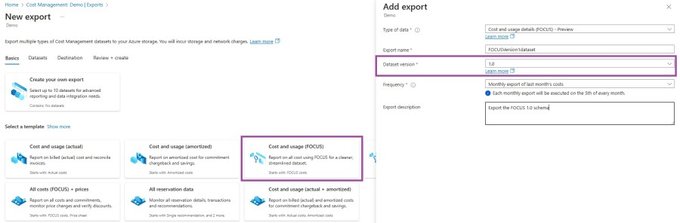
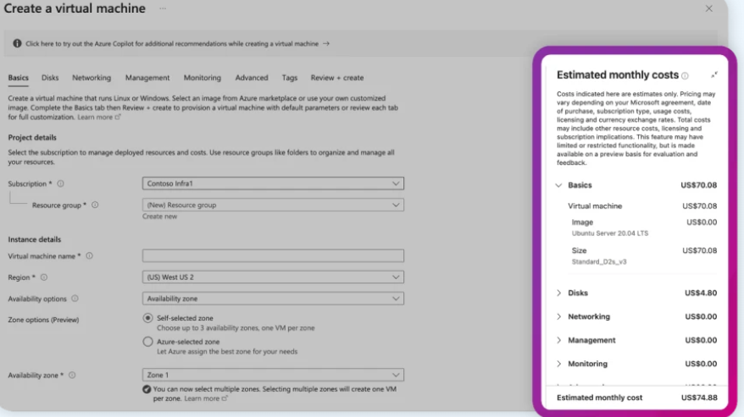
Management & Governance Updates
Microsoft Cost Management updates—June 2024
FOCUS 1.0 support in exports - now it is possible to get the newly released version through exports experience in the Microsoft Azure portal or the REST API.
Azure Bastion: Added pricing for premium and developer stock-keeping units (SKUs).
Virtual Machines: Removal of CentOS for Linux, added 5 year reserved instances (RI) pricing for the Hx and HBv4 series, as well as pricing for the new NDsr H100 v5 and E20 v4 series.
Databricks: Added pricing for all-purpose serverless compute jobs.
Azure Communication Gateway: Added pricing for the new “Lab” SKU.
Azure Virtual Desktop for Azure Stack HCI: Pricing added to the Azure Virtual Desktop calculator.
Azure Data Factory: Added RI pricing for Dataflow.
Azure Container Apps: Added pricing for dynamic session feature.
Azure Backup: Added pricing for the new comprehensive Blob Storage data protection feature.
Azure SQL Database: Added 3 year RI pricing for hyperscale series, zone redundancy pricing for hyperscale elastic pools, and disaster recovery pricing options for single database.
Azure PostgreSQL: Added pricing for Premium SSD v2.
Defender for Cloud: Added pricing for the “Pre-Purchase Plan”.
Azure Stack Hub: Added pricing for site recovery.
Azure Monitor: Added pricing for pricing for workspace replication as well as data restore in the pricing calculator.
Cost card in Azure portal - Engineers now can quickly get a breakdown of their estimated virtual machine (VM) costs before deploying them and adjust as needed. This new experience is currently available only for VMs running on pay-as-you-go subscriptions and will be expanded in the future.

Slide 10
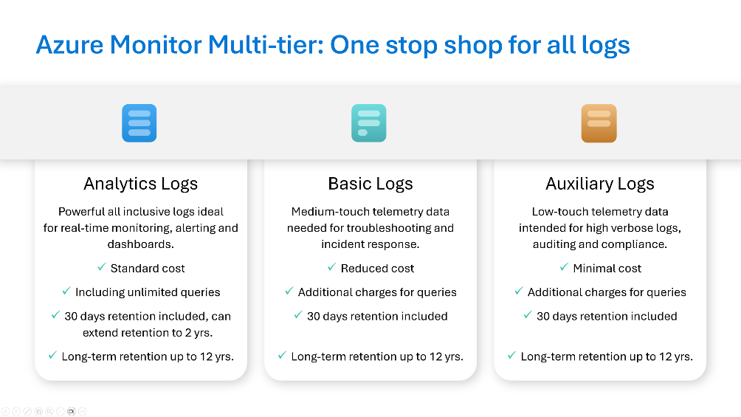
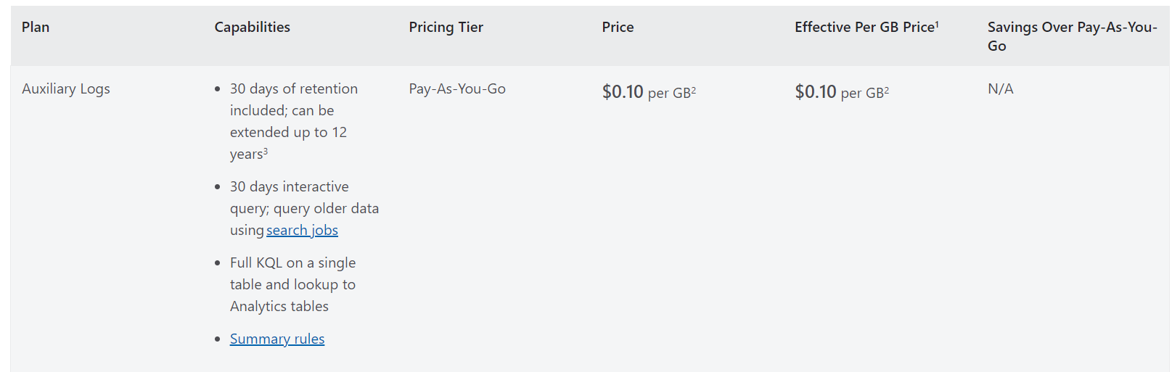
Management & Governance Updates
Public Preview: New Azure Monitor Auxiliary Logs Plan
Azure Monitor Logs introduces a new plan in multi-tier strategy for optimal consumption and cost optimization: Auxiliary Logs. Auxiliary Logs are for verbose logs and are designed to be inexpensive, while providing you with a set of capabilities to manage and consume your data.
Azure Monitor’s multi-tier strategy now supports three plans - Analytics, Basic and the new Auxiliary plan - and allows to store all logs in one place and retain different data types for as long or as little as you need, with a cost-effective pricing model
Optimize cost by ingesting low value or verbose logs to Auxiliary table.
Retain the data for up to 12 years at a low cost.
Use queries to access the last 30 days of your data, or search for older data using search jobs.
Use summary rules (Preview) to aggregate data and ingest the results into a table with an Analytics plan for use in dashboards, alerts, or to run complex analysis on the aggregated data.

Slide 11
Management & Governance Updates
Generally Available: New capabilities added to Azure Monitor Basic Logs plan
The following improvements were added to the Basic Logs plan:
Extending the included interactive retention period from 8 days to 30 days; interactive queries are supported for this entire period.
Adjusting the supported query language capabilities on Basic Logs from reduced KQL to full KQL on a single table and lookup of additional data in Analytics tables.
Generally Available: Delete or Reset Azure Site Recovery replication appliance
MS announced the General Availability of Delete or Reset Azure Site Recovery replication appliance. If all the appliance components are in a healthy state, you can reset the appliance to its factory state. If the appliance is in critical state and there’s no connectivity with the appliance, you can delete the appliance from Azure Portal.

Slide 12
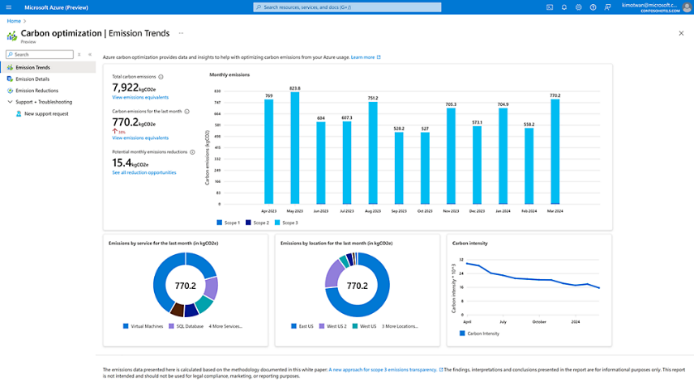
Management & Governance Updates
Generally Available: IT Service Management Connector (ITSMC) is now certified with ServiceNow Washington version
MS certified IT Service Management Connector (ITSMC) on Washington version of ServiceNow.
Azure services like Log Analytics and Azure Monitor provide tools to detect, analyze and troubleshoot issues with your Azure and non-Azure resources to enable work item integration with IT Service Management products. The ITSM connector provides a bi-directional connection between Azure and ITSM tools to help track and resolve issues faster.
Public Preview: Azure Carbon Optimization
Azure Carbon Optimization, now in preview, equips Azure developers and IT professionals with the data and insight to optimize the carbon footprint of their cloud consumption. Through providing insights into carbon emissions and offering recommendations to enhance efficiencies of the cloud resources, organizations can make more informed decisions to meet the needs of their business and cloud sustainability goals.

Slide 13
Management & Governance Updates
Windows Admin Center (v2) Public Preview build has been updated!
Upgrade to .NET Core - from the .NET Core 6 to .NET Core 8, bringing enhanced security and improved cryptography to our product. This also includes support for HTTP 2, reducing latency and enhancing the responsiveness of Windows Admin Center.
Virtual machine tool update
Updated installer
Data migration
Settings update (Azure Like)
Multi-process, micro-service based
Kestrel HTTP web server

Slide 14
Compute

Slide 15
Compute Updates (Azure Virtual Desktop Updates)
Azure Virtual Desktop Updates
Configuring the default chroma value for Azure Virtual Desktop is now in public preview
The chroma value determines the color space used for encoding. By default, the chroma value is set to 4:2:0, which provides a good balance between image quality and network bandwidth. You can increase the default chroma value to 4:4:4 to improve image quality. You don't need to use GPU acceleration to change the default chroma value.
New Teams SlimCore changes are now available in preview
Microsoft Teams on Azure Virtual Desktop supports chat and collaboration. With media optimizations, it also supports calling and meeting functionality by redirecting it to the local device when using Windows App or the Remote Desktop client on a supported platform.
Preferred application group type behavior for pooled host pools in Azure Virtual Desktop has been updated
To help prevent users from connecting to a desktop and RemoteApp application at the same time from application groups assigned to the same host pool, pooled host pools have the setting Preferred application group type.
Additional data and metrics for Connection Reliability for Azure Virtual Desktop is now available
Using Azure Virtual Desktop Insights can help understand deployments of Azure Virtual Desktop. It can help with checks such as which client versions are connecting, opportunities for cost saving, or knowing if you have resource limitations or connectivity issues.
Configuring RDP Shortpath for Azure Virtual Desktop now supports host pool settings
You can granularly control how RDP Shortpath is used by configuring the networking settings of a host pool using the Azure portal or Azure PowerShell. Configuring RDP Shortpath on the host pool enables to optionally set which of the four RDP Shortpath options you want to use and is used alongside the session host configuration.
Adding and managing app attach applications in Azure Virtual Desktop is now available
App attach enables to dynamically attach applications from an application package to a user session in Azure Virtual Desktop. Applications aren't installed locally on session hosts or images, making it easier to create custom images for your session hosts, and reducing operational overhead and costs for your organization. Delivering applications with app attach also gives you greater control over which applications your users can access in a remote session.

Slide 16
Compute Updates (Windows 365 Updates)
Cloud PC support for FIDO devices and passkeys on macOS and iOS (preview)
Windows 365 Cloud PCs now support FIDO devices and passkeys for Microsoft Entra ID sign in on macOS and iOS.
Chroma subsampling default change to 4:2:0
To reduce monitor support issues, the Windows 365 service now defaults the chroma subsampling at 4:2:0. (instead of the previous 4:4:4).
Windows 365 Cloud PC gallery images use new Teams VDI
Windows 365 Cloud PC gallery images now use the new Teams Virtualized Desktop Infrastructure (VDI).
Cross region disaster recovery
Windows 365 now supports cross region disaster recovery
License: Windows 365 cross region disaster recovery
RTO < 4 Hours & RPO < 4 Hours
DR Data on local drives is not preserved
Windows 365 Boot and Windows 365 Switch now support battery status redirection
Windows 365 Boot and Windows 365 Switch now support battery status redirection. Cloud PCs now show the local PC's battery status.
Upgrade Windows 365 licenses in Microsoft admin center
Customers that have Modern Microsoft Cloud Agreements can upgrade their existing Windows 365 licenses in the Microsoft Admin Center.
Windows 365 Government now supports Cloud PC utilization report
Cloud PC size recommendation report is now generally available
Windows 365 support for Microsoft Purview forensic evidence
Troubleshoot action now supports bulk

Slide 17
Compute Updates
Deprecation of Virtual Network Injection for Azure Data Explorer
MS announced the deprecation of the feature of Virtual Network Injection for Azure Data Explorer. This feature allows customers to inject their Azure Data Explorer cluster into their own virtual network and control the inbound and outbound network traffic. However, this feature has limitations and challenges, such as:
Customers face a lot of maintenance work, because of things like updating firewall lists of FQDNs or using public IP addresses in a restricted and secured environment.
Customers are responsible for ensuring that the intra-cluster communication is working.
It requires a dedicated subnet for each cluster, which can lead to subnet exhaustion and increased management overhead.
It does not support cross-region or cross-subscription scenarios, which can limit the scalability and flexibility of the data platform.
Please note the following important dates and actions regarding the migration:
Effective immediately, no new customers will be able to create virtual network injected clusters. Existing customers can continue to use their clusters until the migration deadline.
Starting from February 1, 2025, all running virtual network injected clusters will be stopped. Customers who have not migrated by then will not be able to start them until they complete the migration process.

Slide 18
Compute Updates
ADX Continuous Export to Delta Table - Public Preview
Continuous export in ADX allows to export data from Kusto to an external table with a periodically run query. The results are stored in the external table, which defines the destination, such as Azure Blob Storage, and the schema of the exported data. This process guarantees that all records are exported "exactly once", with some exceptions.
Generally Available: App Configuration references on App Service
Azure App Configuration references are now generally available on App Service. With App Configuration, you centrally manage configuration and feature settings for multiple services in a single configuration store and seamlessly access them through references in your environment variables. Enhance your App Service deployments with streamlined configuration management and improve operational efficiency.
Public Preview: Managed Java component (Admin for Spring) in Azure Container Apps
It is now possible to use managed Java components to access platform features for apps that would otherwise have to manage yourself. Azure Container Apps now offers managed Admin for Spring to monitor and configure Spring Boot web applications. This component is based on the Spring Boot Admin community project and currently available in public preview.

Slide 19
Compute Updates
Generally Available: OS SKU in-place migration for AKS
Today, traditional OS SKU migration involves creating a new node, cordoning and draining existing nodes, and then deleting existing nodes. This can involve a large surge of new nodes and operational overhead to cordon and drain existing nodepools.
The OS SKU in-place migration feature, now GA, allows you to trigger a node image upgrade between one Linux SKU (i.e. Ubuntu) to another (i.e. Azure Linux) on an existing nodepool.
The OS SKU migration feature isn't available through PowerShell or the Azure portal.
The OS SKU migration feature isn't able to rename existing node pools.
Ubuntu and Azure Linux are the only supported Linux OS SKU migration targets.
An Ubuntu OS SKU with UseGPUDedicatedVHD enabled can't perform an OS SKU migration.
An Ubuntu OS SKU with CVM 20.04 enabled can't perform an OS SKU migration.
Node pools with Kata enabled can't perform an OS SKU migration.
Windows OS SKU migration isn't supported.
Public Preview: Windows Annual Channel on AKS
Windows Server Annual Channel for Containers is now in public preview on Azure Kubernetes Service (AKS). With the Annual Channel, it is possible to get the latest release in Windows Server but also get the added benefit of portability between container hosts and container images.
Each channel version is released annually and is supported for two years. This channel is beneficial if you require increased innovation cycles and portability.
Generally Available: Model fine-tuning support for Kubernetes AI Toolchain Operator (KAITO)
With parameter-efficient fine-tuning (PEFT) support, it is possible to customize pre-trained models from the KAITO repository to data and use cases directly in cluster, while maintaining the data compliance rules for organization.
Simply choose a target model, select one of the various tuning methods, point to retraining data and where to store fine-tuning results in your KAITO tuning workspace. This allows you to serve your “smarter” model and simplify ML lifecycle management directly from the AKS cluster.

Slide 20
Compute Updates
Retirement: App Service Environment v1/v2 will be retired on August 31, 2024
In August 2021, Azure announced that the retirement of Cloud Services (classic) is happening on 31 August 2024. As App Service Environment v1 and v2 run on Cloud Services (classic), MS will retire App Service Environment v1 and v2 on the same date. Before that date, please complete migration to App Service Environment v3.
After 31 August 2024, App Service Environment v1 and v2 and the applications running on them will be deleted and any application data associated with them will be lost.
Public Preview: 6th generation Intel-based VMs – Dv6/Ev6
MS announced the public preview of the D and E family VMs built on the new 5th Gen Intel® Xeon® Platinum 8537C (Emerald Rapids) processor.
These VMs will offer:
Up to 27% higher vCPU performance and 3x larger L3 cache than the previous generation Intel Dl/D/Ev5 VMs
Up to 192vCPU and >18GiB of memory
Azure Boost which enables:
Up to 400k IOPS and 12 GB/s remote storage throughput
Up to 200 Gbps VM network bandwidth
46% larger local SSD capacity and >3X read IOPS
NVMe interface for local and remote disks
Enhanced security through Total Memory Encryption (TME) technology
Retirement: Upgrade your Azure Logic Apps Integration Service Environment workloads
After August 31st, 2024, access to deployed Azure Logic Apps Integration Service Environments will be terminated, meaning any workflows currently running on these ISEs will cease execution, all historical data associated with these workflows will be permanently deleted, and any integration accounts linked to the retired ISEs will be removed.
Retirement: Azure Synapse Runtime for Apache Spark 2.4 Disablement
Disablement for Azure Synapse Runtime for Apache Spark 2.4 was announced on August 15th, 2024. MS recommend to Azure Synapse Runtime for Apache Spark 2.4 workloads to Azure Synapse Runtime for Apache Spark 3.4 - Azure Synapse Analytics | Microsoft Learn otherwise your jobs will stop executing

Slide 21
Compute Updates
Generally Available: Azure Container Storage for Ephemeral (Local NVMe/Temp SSD) and Azure Disk
It is now possible to use Azure Container Storage to run production level stateful container workloads. Azure Container Storage orchestrates the placement and lifecycle of persistent volumes (PV) on behalf, simplifying container storage management and optimizing for scalability, flexibility, and cost efficiency. Now it supports:
Ephemeral disk (Local NVMe/Temp SSD): With the Ephemeral disk backing storage option, it is possible to take advantage of the local storage that comes with nodes. For instance, workloads requiring low latencies could benefit from locally attached storage. You can also enable replication on your local NVMe storage to experience added resiliency.
Azure Disk: Azure Disk storage option lets choose from Ultra, Premium SSD, Premium SSD v2, and Standard SSD disk types to back your storage pool. With Azure Container Storage, your PVs are optimally placed on your disk - mapping multiple volumes to a disk, overcoming traditional persistent volume scale limitations, and saving you storage costs in the long run.
Hotpatching is now available in preview on Windows Server 2025 Evaluation VMs in Azure
MS announced the preview of Hotpatch on Windows Server 2025 Evaluation VMs running in Azure. Hotpatching in Azure is only supported on Azure Edition SKUs. Evaluation version is made available to validate the capability and ensure readiness. When this is made generally available Azure Edition will be the only supported SKU in Azure for Hotpatching.

Slide 22
Storage & Data

Slide 23
Storage & Data Updates (Azure NetApp Files)
Application volume group for SAP HANA extension 1
Extension 1 of application volume group for SAP HANA improves volume group deployment experience for SAP HANA with:
The use of availability zone volume placement, eliminating the need for manual AVSet pinning with proximity placement groups.
Support for Standard network features for SAP HANA volumes
Azure NetApp Files backup is now available in Azure US Gov regions.
Metrics enhancement: New performance metrics for volumes
New counters have been added to Azure NetApp Files performance metrics to increase visibility into your volumes' workloads:
Other IOPS: any operations other than read or write.
Total IOPS: a summation of all IOPS (read, write, and other)
Other throughput: any operations other than read or write.
Total throughput: Total throughput is a summation of all throughput (read, write, and other)
.
Azure NetApp Files large volume enhancement: increased throughput and maximum size limit of 2-PiB volume (preview)
Azure NetApp Files large volumes now support increased maximum throughput and size limits. This update brings an increased size limit to one PiB, available via Azure Feature Exposure Control (AFEC), allowing for more extensive and robust data management solutions for various workloads, including HPC, EDA, VDI, and more.
This update also introduces a preview of a large volume type, starting from one PiB up to two PiB, available upon request. This 2-PiB enhancement is subject to regional availability and capacity, ensuring that Azure NetApp Files can meet your specific needs and requirements. This feature is currently in preview. To take advantage of the 2-PiB large volume feature, contact your account team.

Slide 24
Storage & Data Updates
Public Preview: Azure NetApp Files volume encryption key transition
This feature allows customers to transition their existing volumes protected with platform-managed key (PMK) to a volume encrypted, using a customer-managed key (CMK) stored in Azure Key Vault.
Key benefits:
Secure key management: The keys are generated and managed by the customer organization. This provides additional security layer by reducing the risk of unauthorized key access.
Regulatory/compliance: Several entities have strict regulations for data protection. CMK helps comply with various requirements and provide ability to track key management for regulatory purposes.
Performance: There is no performance impact when using CMK. It simply protects the account encryption key using the Azure Key Vault.
NOTE:
Once complete the migration, it can not be reverted to platform-managed keys.
You must perform the transition for every virtual network where your Azure NetApp Files account has volumes.
Generally Available: AzAcSnap 10 — Azure Application Consistent Snapshot tool updates
Version 10 of the AzAcSnap tool is now generally available. Azure Application Consistent Snapshot tool (AzAcSnap) is a command-line tool that enables you to simplify data protection for third-party databases in Windows and Linux environments.
Features added to Preview:
Microsoft SQL Server application consistent snapshot backup support.
Features moved to GA (generally available):
Windows support: AzAcSnap is now able to be run on supported Linux distributions and Windows.
New configuration file layout to simplify use.
Azure Large Instance
Consistency Group snapshots on supported Azure Large Instance storage
Storage management via REST API over HTTPS
Other fixes and improvements
Logging improvements & simplification of usage

Slide 25
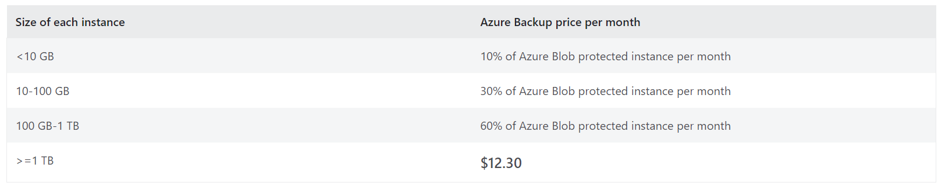
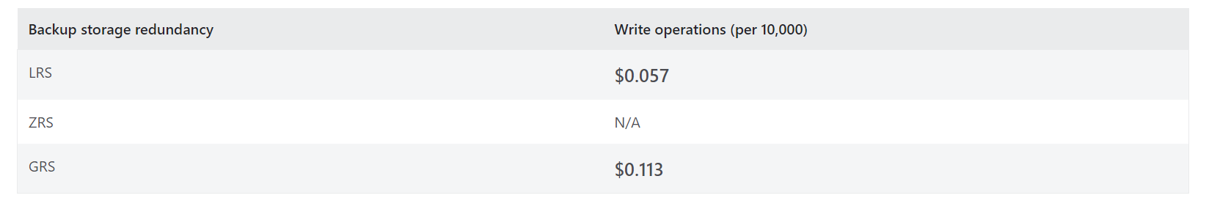
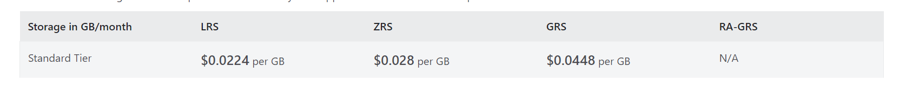
Storage & Data Updates
Soft delete for NFS Azure file shares is now Generally Available.
MS announced the general availability of soft delete for NFS Azure file shares. The functionality will remain the same. Soft delete is like a recycle bin for file shares. When a NFS file share is deleted, it transitions to a soft deleted state in the form of a soft deleted snapshot. You get to configure how long the soft deleted data is recoverable before it is permanently erased as part of the retention policy, by default its set to 7 days.
Today, soft deleted NFS shares are not being counted towards the Storage account limit.
By Sept 1st, 2024, we will roll out the change to start counting soft deleted capacity towards the account limit.
Generally Available: Vaulted backup for Azure Blob Storage
MS announced that vaulted backups for Azure Blob Storage is now generally available. This native, managed, and secure backup solution keeps an offsite copy of data and comprehensively safeguards business-critical data stored in Azure Blob Storage against accidental deletion, corruption, and malicious attacks. It allows quick data recovery and business continuity, minimizing the impact of data loss.

Slide 26
Storage & Data Updates
Public Preview: Convert to Azure Premium SSD v2 disks
Azure announced Public Preview for Converting to Premium SSD v2 disks (Pv2). This feature allows to migrate existing Standard SSD, Standard HDD, or Premium SSD v1 disks to PV2 disks in a few clicks with minimal downtime.
You can't switch an OS disk to a Premium SSD v2 disk.
Existing disks can only be directly switched to 512 sector size Premium SSD v2 disks.
You can only perform 40 conversions at the same time per subscription per region.
If your existing disk is a shared disk, you must detach all VMs before changing to Premium SSD v2.
If your existing disk is using host caching, you must set it to none before changing to Premium SSD v2.
If your existing disk is using bursting, you must disable it before changing to Premium SSD v2.
If your existing disk is using double encryption, you must switch to one of the single encryption options before changing to Premium SSD v2.
You can't directly switch from a Premium SSD v2 to another disk type. If you want to change a Premium SSD v2 to another disk type, you must migrate using snapshots.
You can't directly switch from Ultra Disks to Premium SSD v2 disks, you must migrate using snapshots.
If you're using the rest API, you must use an API version 2020-12-01 or newer for both the Compute Resource Provider and the Disk Resource Provider.

Slide 27
Storage & Data Updates
Generally Available: Azure Blob Storage Lifecycle Management now supports improved control on archiving
Lifecycle management now provides users more control over how objects that are rehydrated from the archive tier are returned back to archive after access.
Users can prevent the immediate re-archiving of objects that were recently rehydrated from the archive tier by using the daysAfterLastTierChangeGreaterThan property in lifecycle rules. However, earlier this option only applied to rules based on Last Modified Time (daysAfterModificationGreaterThan). The daysAfterLastTierChangeGreaterThan option has now been extended to archiving rules based on Creation Time (daysAfterCreationGreaterThan) and Last Accessed Time (daysAfterLastAccessTimeGreaterThan).

Slide 28
Databases

Slide 29
Databases Updates
Announcing v7.0 Support on vCore-based Azure Cosmos DB for MongoDB
MS announced that vCore-based Azure Cosmos DB for MongoDB now officially supports version 7.0.
Oracle Database@Azure Achieves Extensive Certifications: Elevating Security, Reliability, and Trust
MS announced that Oracle Database@Azure has reached a pivotal milestone by achieving compliance with a comprehensive array of industry-leading global certifications, including PCI-DSS, SOC Type 1, SOC Type 2, SOC Type 3, C5, ISO 9001, ISO 20000-1, ISO 27001, ISO 27017, ISO 27701, ISO 20000-1, ISO 27018, CSA STAR and HIPAA.
Generally Available: vCore-based Azure Cosmos DB for MongoDB integration with Semantic Kernel (.NET)
It’s now even easier to get started using Azure Cosmos DB for vector search and retrieval-augmented generation (RAG) in generative AI applications. In vCore-based Azure Cosmos DB for MongoDB, it is now possible to use a .NET memory connector for integration with Semantic Kernel.

Slide 30
Databases Updates
Generally Available: Storage autogrow replica support
MS now support to enable database storage to automatically increase for primary and replica servers in Azure Database for PostgreSQL - Flexible Server. When the storage autogrow feature is enabled, Azure Database for PostgreSQL increases the size of the provisioned storage of database servers as needed, preventing them from running out of space.
Note:
It must be first enabled on the replica and than on the primary
It must be first disabled on the primary and then on the replica
Public Preview: Long-term retention for CMK-enabled Azure Database for PostgreSQL - Flexible Server
It is now possible to configure long-term backups for Azure Database for PostgreSQL - Flexible Server data that is encrypted using customer-managed keys (CMKs).

Slide 31
Integration

Slide 32
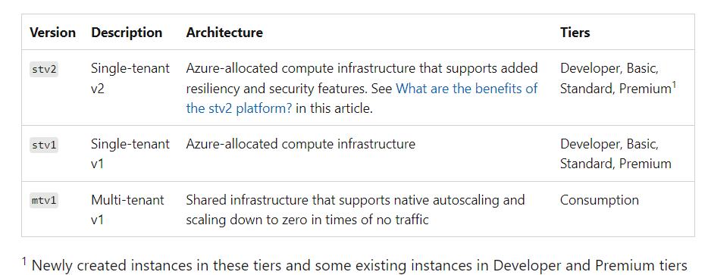
Integration Updates
Retirement: Upgrade from Azure API Management stv1 to stv2 by Aug. 31, 2024
The August 31st deadline to upgrade from Azure API Management stv1 to stv2 is rapidly approaching. After this date, stv1 platform will no longer receive the latest updates and additional features available in stv2.
The stv2 provides:
Availability zones
Private endpoints
Protection with Azure DDoS
Public Preview: Azure API Management WordPress plugin enables customers to build highly customizable developer portals
Now it will be possible to leverage the power of a Content Management System such as WordPress to build and host developer portal.
WordPress is an open-source Content Management System (CMS) used by over 40% of the web to create websites, blogs, and other applications. It can be deeply customized to fit unique developer portal needs. Further, it has a vibrant community with a rich ecosystem of themes and plugins.
Microsoft Azure App service provides customers with a fully managed, performant, secure and scalable hosting solution for WordPress.

Slide 33
ML & AI & IOT

Slide 34
ML & AI & IOT Updates
Announcing Deploy To Teams from Azure OpenAI Studio
Microsoft announced the public preview of Deploy to a Teams app, in Azure OpenAI Studio allowing developers to seamlessly create custom engine copilots connected to their enterprise data and available to over 320+ million users on Teams.
Add your data in the Azure OpenAI Studio Playground allow to create personalized copilots tailored to data, improving user understanding, expediting task completion, and facilitating decision-making. Enterprise data from Azure AI Search, Azure Blob Storage (preview), URL/web address (preview), local files (preview), Azure Cosmos DB for MongoDB vCore, and Elasticsearch (preview) all can be used to ground responses from custom copilot with your data.
Deploy to a Teams app creates a project source code integrated with configuration and data from Azure OpenAI Studio. The source code is powered by Teams AI Library, which helps developers build custom engine copilots designed to harness the powerful capabilities of Large Language Models (LLMs) for seamless user interaction on Teams. Once you are ready, you can publish your Teams app to your end users!
OpenAI’s fastest model, GPT-4o mini is now available on Azure AI
GPT-4o mini allows to deliver stunning applications at a lower cost with blazing speed. GPT-4o mini is significantly smarter than GPT-3.5 Turbo—scoring 82% on Measuring Massive Multitask Language Understanding (MMLU) compared to 70%—and is more than 60% cheaper.1 The model delivers an expanded 128K context window and integrates the improved multilingual capabilities of GPT-4o, bringing greater quality to languages from around the world.

Slide 35
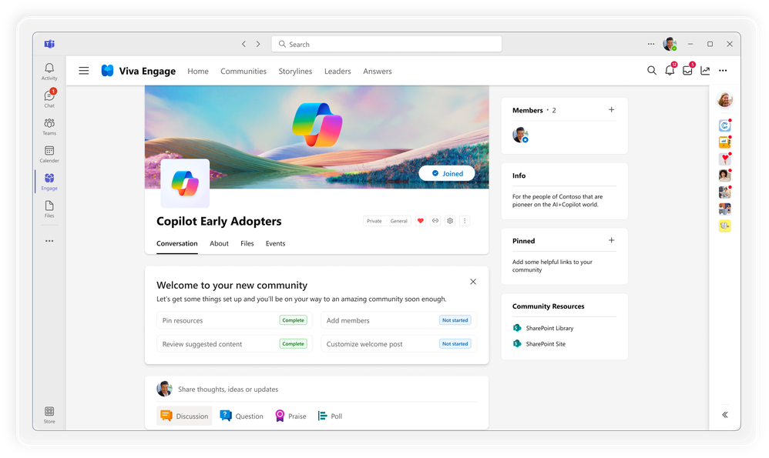
ML & AI & IOT Updates
What’s new in Copilot | July 2024
Admin and management capabilities:
Enable a Copilot adoption community in Viva Engage
Expanded availability of the Microsoft Copilot Dashboard
Mitigate oversharing risk with extended IT controls for SharePoint Advanced Management
User capabilities:
Turn prompt inspiration into action with Copilot Lab
Enhance data understanding with Copilot in Excel
Craft and organize emails faster with Copilot
Improved document summarization in Copilot in Word
Create quizzes using Copilot in Forms
Improve centralized communications with Copilot in Viva Amplify Editor
Improvements based on your feedback

Slide 36
DevOps & IaC & Automation

Slide 37
DevOps & IaC & Automation
Azure SDK Release (July 2024)
New Python (Conda) packages are available in the Microsoft channel.
Client Library for Java
Event Grid Namespaces
Client Library for JavaScript
Dev Center
Deployment Stacks
Management Library for Go
App Compliance Automation
Deployment Stacks
Informatica Data Management
Oracle Database
Scvmm
Management Library for Java
App Compliance Automation
Informatica Data Management
Oracle Database
System Center Virtual Machine Manager
Management Library for JavaScript
App Compliance Automation
Informatica Data Management
Oracle Database
Scvmm
Management Library for Python
App Compliance Automation
Informatica Data Management
Oracle Database
Scvmm

Slide 38
Miscellaneous

Slide 39
Miscellaneous Updates
ALZ AMA Migration Guidance · Azure/Enterprise-Scale Wiki · GitHub
MS release a migration guide and script for transition from one solution to another as part of the ALZ offering.

Slide 40
Information

Slide 41
Information
Azure Times GitHub Repo

Slide 42
Questions

