Slide 1
Azure Times #120 (Build Edition)
May 29, 2024

Slide 2


Slide 3
Networking

Slide 4
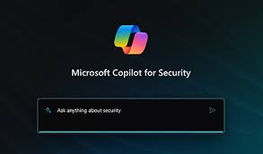
Networking Updates
Public preview: Azure Web Application Firewall (WAF) integration in Microsoft Copilot for Security
Azure Web Application Firewall (WAF) integrated in Microsoft Copilot for Security standalone experience is now available in public preview. This integration is available with both Azure Front Door WAF and Azure Application Gateway WAF. The top WAF rules triggered analysis generate summary of WAF requests blocked by WAF due to web application and API attacks. The top offending IPs analysis generate a list of malicious IPs in customer environment along with related WAF rules triggered. The SQL injection and Cross-site scripting WAF detection summaries include contextual details about the WAF blocks including the WAF rules, pattern matches, and related IPs.
Public preview: Azure Firewall integration in Microsoft Copilot for Security
MS announced the public preview of Azure Firewall integration in Microsoft Copilot for Security. These preview features are now available:
Retrieve the top IDPS signature hits for an Azure Firewall: Get log information about the traffic intercepted by the IDPS feature instead of constructing KQL queries manually.
Enrich the threat profile of an IDPS signature beyond log information: Get additional details to enrich the threat information/profile of an IDPS signature instead of compiling it yourself manually. The Microsoft Defender Threat Intelligence plugin is another source that Copilot may use to provide threat intelligence for IDPS signatures.
Look for a given IDPS signature across tenant, subscription, or resource group: Perform a fleet-wide search (over any scope) for a threat across all your Firewalls instead of searching for the threat manually.
Generate recommendations to secure environment using Azure Firewall's IDPS feature: Get information from documentation about using Azure Firewall's IDPS feature to secure your environment instead of having to look up this information manually. Copilot may also use the Ask Microsoft Documentation capability to provide this information.

Slide 5
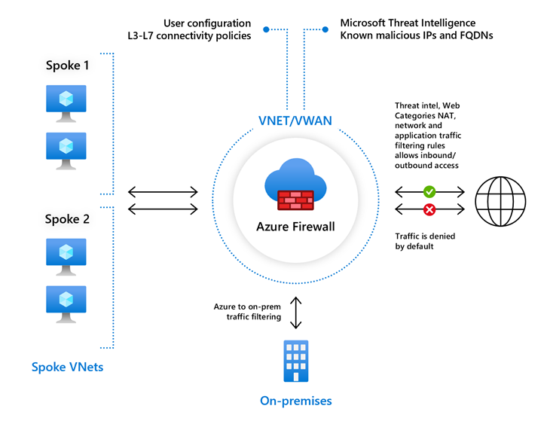
Networking Updates
Azure Firewall: New Regions Availability
Azure Firewall Basic, Standard, Premium and Azure Firewall Manager are now generally available in these four new regions:
Israel Central
Italy North
Mexico Central
Spain Central

Slide 6
Networking Updates
Update on Inter-Availability Zone Data Transfer Pricing
MS announced that Azure will not charge for the data transfer across availability zones regardless of using private or public IPs on Azure resources. Availability zones allow Azure services to enhance greater resiliency for customers’ cloud infrastructure. With this change, Azure will further encourage and support customers’ efforts in building more resilient and efficient applications and solutions on Azure.

Slide 7
Security & Identity

Slide 8
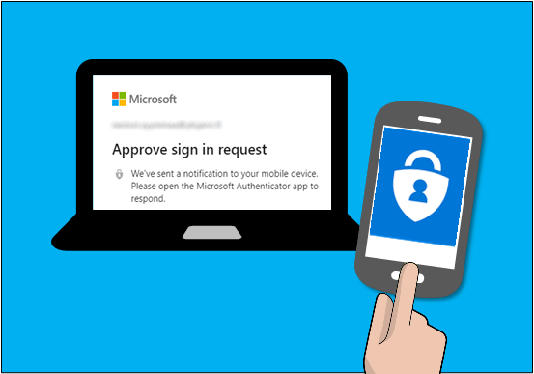
Security & Identity Updates
Microsoft will require MFA for all Azure users
This July, Azure teams will begin rolling out additional tenant-level security measures to require multi-factor authentication (MFA). Establishing this security baseline at the tenant level puts in place additional security to protect your cloud investments and company.
Who will be impacted:
Users who use:
Azure Portal
Azure Power Shell
Azure CLI
Users who perform deployment via TF
Who will NOT be impacted:
SPN
MI

Slide 9
Management & Governance

Slide 10
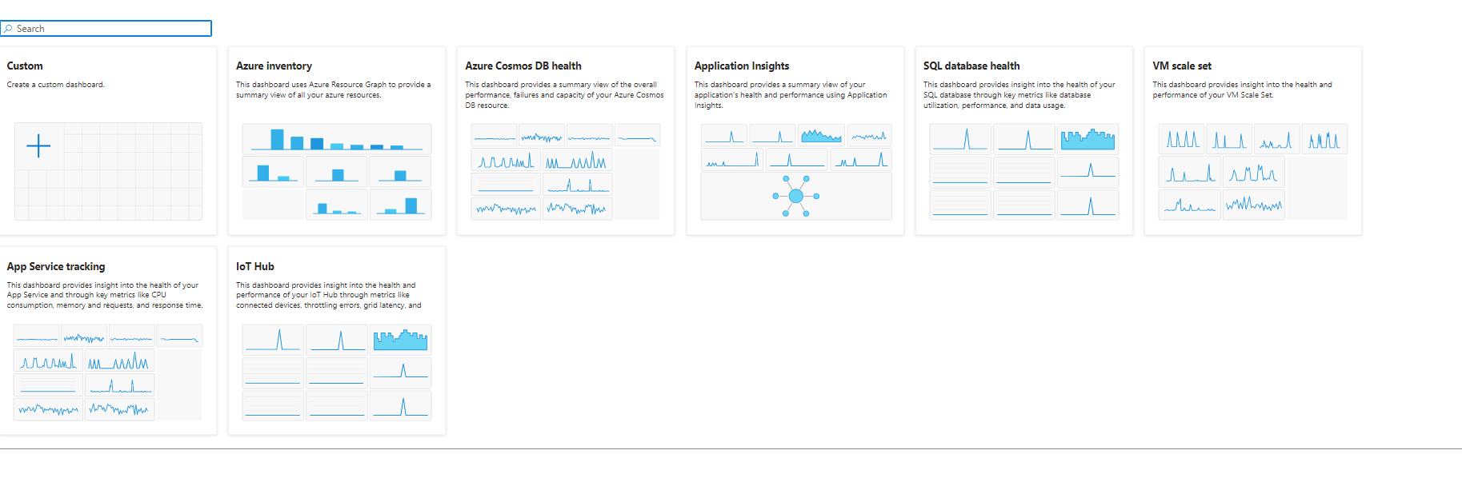
Management & Governance Updates
Visual Studio Code extension for Azure Web PubSub now in preview
To minimize context switching between development tools and improve developer productivity, Azure Web PubSub now offers a Visual Studio Code extension (in preview).
View, create, delete, and restart Azure Web PubSub resources
View, create, and delete hub settings
View, create, delete and update event handlers
View resource metrics
Scale up and scale out
Check resource health
Re-generate access key
Copy connection string or endpoint of the service to clipboard
Switch the anonymous connect policy of hub setting
Attach Azure Web PubSub local tunnel tool
View Realtime resource logging during development
Public Preview: Next-Gen Dashboards Experience in Azure Portal
MS added a new Dashboards experience within the Azure Portal. This new experience includes a richer editing experience, dashboard as a view, mobile support, and works in parallel with our current experience.
Currently, Dashboards are a focused and organized view of cloud resources in the Azure portal. It is possible to use dashboards as a workspace where it is possible to monitor resources and quickly launch tasks for day-to-day operations. This new experience is accessible through the Dashboard Hub, the Browse experience, and in our Azure Mobile app. You can create your own dashboards or transform an existing dashboard into the new experience.

Slide 11
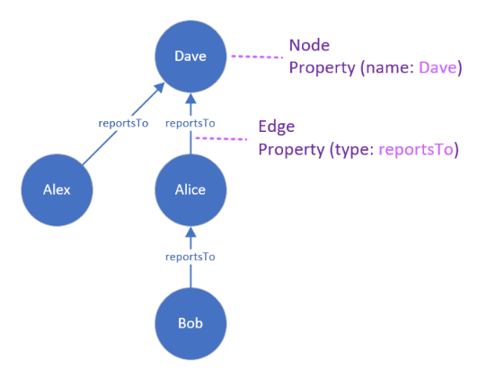
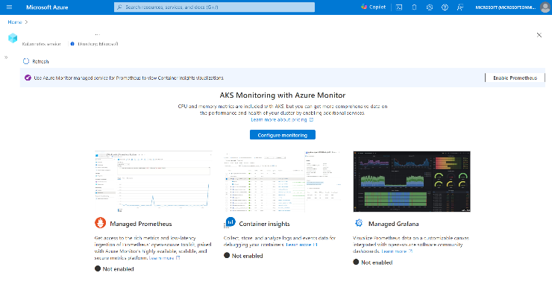
Management & Governance Updates
Public preview: Managed Prometheus visualizations for Azure Monitor container insights
Container insights visualizations were previously powered using metric data from Log Analytics, this new feature offers the ability to visualize using only managed Prometheus data instead of Log Analytics.
With this release, customers can now:
Optimize costs by migrating from Log Analytics based metrics to managed Prometheus
Improve performance with faster metric query load times
Integrate with the recently announced Prometheus based recommended alerts
Announcing General Availability of Graph Semantics in Kusto
MS announced that the Graph Semantics extension to Kusto, the powerful database engine behind Fabric Real-Time Intelligence, Azure Data Explorer (ADX) and more, is now generally available!
Now that the graph semantics extension is generally available, MS encourage all users to integrate this powerful tool into their data analysis workflows. Whether you're looking to enhance understanding of complex datasets or uncover hidden patterns in data, the graph semantics extension offers a robust framework for achieving these goals.

Slide 12
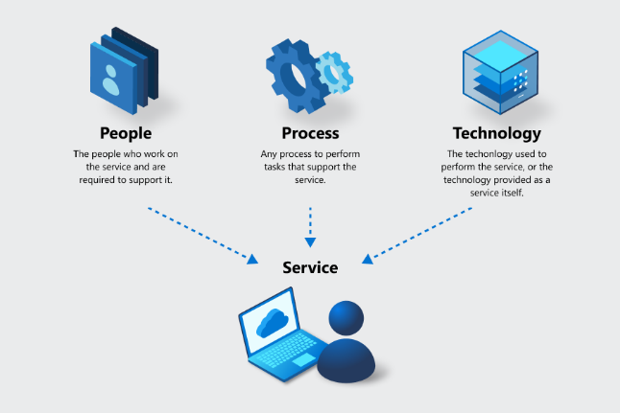
Management & Governance Updates
Monitor effectively using Azure Monitor for Azure Site Recovery
Azure Site Recovery (ASR) now surfaces default alerts via Azure Monitor for critical events such as replication health turning unhealthy, failover failures, agent expiry, and so on. It is possible to monitor these alerts via the Azure Business Continuity Center, Azure Monitor dashboard, or Recovery Services vault and route these alerts to various notification channels of choice (Email, ITSM, Webhook, SMS).
MS recommend using built-in Azure Monitor alerts over classic alerts to leverage the following benefits of Azure Monitor:
Ability to configure notifications to a wide range of notification channels supported by Azure Monitor
Ability to select which scenarios to get notified for
Ability to have a consistent alerts management experience for multiple Azure services including backup, with at-scale management capabilities
Preview: Introducing Reporting Capabilities for Azure Site Recovery
Azure Site Recovery is introducing reporting capabilities to enable BCDR Admin get rich insights into estate protected with Site Recovery for audit and tracking purposes. These reports are highly customizable and are available out of box on Business Continuity Center, Recovery Service Vault and Backup Center. They cover the following reporting scenarios:
Site recovery reports are available to provide historical information on Site Recovery Jobs and, Site Recovery Replicated Items
Site Recovery reports are supported for Azure VM replication to Azure, Hyper-V replication to Azure, VMWare replication to Azure – Classic & Modernized. You can find them as filterable options under Replication Scenario: Azure/ Hybrid.

Slide 13
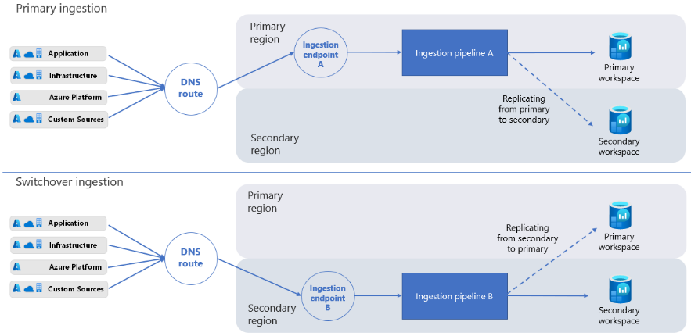
Management & Governance Updates
Public preview: Azure Log Analytics enhances resilience with workspace replication across regions
Log Analytics now supports workspace replication, a new capability that enhances resilience to regional incidents. When replication is enabled, a copy of workspace is created on another region. From that moment on, new logs ingested to primary workspace are also replicated to the secondary (existing logs are not copied over). Secondary workspace can’t be directly managed or accessed, and only serves to create an active-passive setup: at any given time, workspace has one active instance, and an inactive instance that is updated in the background.
If an outage impacts primary workspace, it will be possible to switch to secondary workspace by triggering failover. This operation reroutes all ingestion and query requests to secondary workspace. Secondary workspace stores a copy of all logs ingested since enabled replication. During that period, your secondary region also replicates incoming logs back to the primary workspace, so when your primary region is healthy again you can switch back to it and continue working as usual.
Workspace replication is billed per replicated GB. You can apply replication to a subset of your Data Collection Rules (DCRs) to limit the replication scope, and related costs.

Slide 14
Compute

Slide 15
Azure Function Updates
Generally Available: Azure Functions Support for HTTP Streams in Node.js
Azure Functions support for HTTP streams in Node.js is now generally available. With this feature, it is possible to stream HTTP requests to, and responses from, Functions Apps.
With HTTP Streams, scenarios like processing large data, streaming OpenAI responses, delivering dynamic content etc. are possible. Users can leverage this feature for use cases where real time exchange and interaction between client and server over HTTP connections is needed. MS recommend using streams to get the best performance and reliability for apps.
HTTP Streams in Node.js is supported only in the Azure Functions Node.js v4 programming model.
Public preview: SDK type bindings for Azure Blob Storage with Azure Functions in Python
Azure Functions triggers and bindings enable to easily integrate event and data sources with function applications. This feature enables to use types from service SDKs and frameworks, providing more capability beyond what is currently offered.
Specifically, SDK type bindings for Azure Storage Blob enable the following key scenarios:
Downloading and uploading blobs of large sizes, reducing current memory limitations and GRPC limits.
Improved performance by using blobs with Azure Functions
General availability: Azure Cache for Redis triggers and bindings for Azure Functions
Azure Cache for Redis now has trigger and binding support for Azure Functions, opening multitudes of possibilities for serverless app development. Now Azure Function can be triggered on a variety of Redis data types, including pub/sub channels, lists, and streams. Keyspace notifications and keyevent notifications are also supported, meaning that you can trigger Azure Functions when a certain key is changed or when a chosen command is used.
Public preview: Azure Functions support for HTTP streams in Python
Azure Functions support for HTTP streams in Python is now in preview. With this feature, customers can stream HTTP requests to and responses from their Function Apps, using function exposed FastAPI request and response APIs. Previously with HTTP requests, the amount of data that could be transmitted was limited at the SKU instance memory size. With HTTP streaming, large amounts of data can be processed with chunking.
This feature enables new scenarios including processing large data streaming OpenAI responses and delivering dynamic content.

Slide 16
Azure Function Updates
Public preview: Get started with Azure Functions using Visual Studio Code for the Web
Azure Functions now supports a fully browser based getting started experience with Visual Studio Code for the Web. Starting from the Azure Portal, with just a few clicks, it is possible to develop, run, test, debug and deploy functions to the Function app. This feature is available for Python, Node and PowerShell apps in the Flex Consumption hosting plan.
Using this feature, it is possible to evaluate the service or build a proof-of-concept quickly and easily, eliminating the need for a local environment setup. This also addresses known limitations of the current code editing experience in the Azure Portal like lack of IntelliSense, debugging and support for third party libraries.
Public preview: Azure Functions extension for OpenAI
Azure Functions extension for OpenAI, now in public preview, enables developers to build Function applications that integrate with OpenAI.
It is now possible to perform the following tasks when building a Function App with the Open AI extension. The below capabilities are available in all languages (.NET, Java, Python, Node.js, PowerShell)
Retrieval Augmented Generation (Bring your own data for semantic search)
Data ingestion with Functions bindings.
Automatic chunking and embeddings creation.
Store embeddings in vector database including AI Search, CosmosDB for MongoDB, and Azure Data Explorer.
Binding that takes prompts, retrieves documents, sends to OpenAI LLM, and returns to user.
Text completion for content summarization and creation
Input binding that takes prompt and returns response from LLM.
Chat assistants
Input and output binding to chat with LLMs.
Output binding to retrieve chat history from persisted storage.
Skills trigger that is registered and called by LLM through natural language.
Generally Available: Azure Functions extension for Dapr
Azure Functions extension for Dapr is now in generally available. It is possible to use Dapr’s powerful cloud native building block APIs (e.g. Service Invoke with service discovery & mTLS, PubSub, Bindings, Secrets and Actors) and a large array of ecosystem components in the native and friendly Azure Functions triggers & bindings programming model. The extension is available to run on AKS and ACA services.
Dapr integrates with the Azure Functions runtime via an extension that lets a function seamlessly interact with Dapr.
Azure Functions provides an event-driven programming model.
Dapr provides cloud-native building blocks.
The extension combines the two for serverless and event-driven apps.

Slide 17
Azure Function Updates
Generally Available: Azure Functions can now run on Azure Container Apps
It is now possible to use Azure Functions on Azure Container Apps environment to deploy multitype services to a cloud-native solution designed for centralized management and serverless scale. Azure Function’s host, runtime, extensions, and Azure Function apps can be developed and deployed as containers using familiar Functions tooling including Core Tools, AzCLI/Portal/code-to-cloud with GitHub actions and DevOps tasks into the Container Apps compute environment.
This enables centralized networking, observability, and configuration boundaries for multitype application development when building microservices. Azure Functions on Azure Container Apps can be integrated with DAPR, scaled using KEDA and provisioned to a highly performant serverless plan. This allows you to maximize productivity with a serverless container service built for microservices, robust autoscaling, and fully managed infrastructure.
This feature is now generally available.
Public Preview: Azure Functions brings new flexibility with Azure Functions Flex Consumption
Flex Consumption Plan is a new Azure Functions hosting plan that builds on the consumption pay for what you use, serverless billing model, and gives users more flexibility and customizability without compromising on existing capabilities. Now, customers can build serverless Functions-as-a-Service (FaaS) using Azure Functions for higher throughput, improved reliability, better performance, and additional security on their own terms.
New capabilities include fast and large elastic scale, instance size selection, private networking, availability zones, and higher concurrency control. Run your serverless apps for event driven scale with negligible cold-start latency with always ready instances on Flex Consumption.

Slide 18
AKS Updates
Public preview: Kubernetes version 1.30 support in AKS
Kubernetes version 1.30, the latest version of Kubernetes, is now in public preview for AKS. Version 1.30 introduces several enhancements focused on security and orchestration capabilities of the platform.
Public preview of the App Configuration Extension for AKS
MS introduced the public preview of the Azure App Configuration extension for Azure Kubernetes Service (AKS). This extension allows to install and manage Azure App Configuration Kubernetes Provider on AKS cluster via Azure Resource Manager (ARM). The provider enables centralized management of application settings and feature flags within AKS clusters, using ConfigMaps and Secrets for streamlined management. With this extension it is possible to enhance operational efficiency with Azure sourced Configuration, without modifying application code.
Key benefits include:
Dynamic Configuration: Update configurations without redeploying your applications, enabling faster iterations and reduced downtime.
Immutable Snapshots: Ensure secure deployment practices with unchangeable configuration snapshots.
Feature Management: Seamlessly control feature rollouts, allowing for safe and gradual feature deployment.
Experimentation: Drive continuous improvement and elevate business value through robust experimentation features.
Enhanced Operational Efficiency: Improve overall efficiency with centralized management of configuration data of all services running in AKS clusters.
Replica Auto-Discovery and Failover: Achieve scalability and enhanced resiliency against transient failures and regional outages.
Public preview: Deployment safeguards mutations in enforcement mode for AKS
Deployment safeguards in AKS now support mutations in enforcement mode in public preview.
In enforcement mode, deployment safeguards will either deny or mutate (automatically fix) deployment based on the individual safeguards.
A mutation will be triggered if Kubernetes resources lack the best practices.
Public Preview: Azure HDInsight on AKS is now available for preview in 6 new regions
Azure HDInsight on AKS is now available for preview in six new regions -Norway East, Switzerland North, France Central, Central US, Southeast Asia and South Central US.

Slide 19
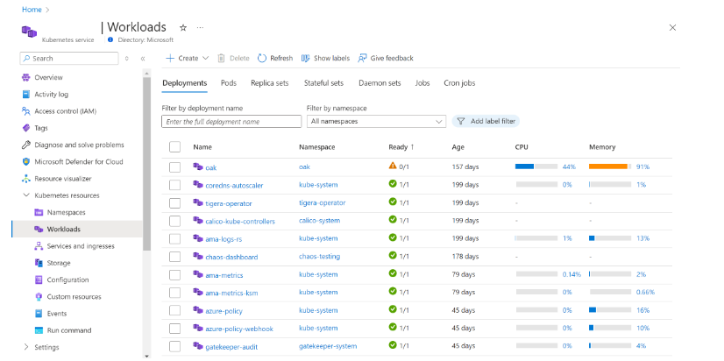
AKS Updates
Public preview: AKS Automatic
Azure Kubernetes Service (AKS) Automatic is now available in public preview. Kubernetes offers organizations the flexibility to build and customize their deployments of to fit their business needs. For many, this level of control and choice is what they need, but for others it may be overwhelming or unnecessary for their workload.
AKS Automatic offers a simplified Kubernetes experience for customers. Automatic manages the cluster configuration, including nodes, scaling, security, updates, and other preconfigured settings. Automatic clusters are optimized to run most production workloads and provision compute resources based on Kubernetes manifests. The streamlined configuration follows AKS best practices and recommendations for cluster and workload setup, scalability, and security, freeing developers to run cloud native apps without spending too much time on managing clusters.
Azure portal now offers in context observability for AKS object overviews
AKS portal blades now show observability data powered by Azure Monitor managed service for Prometheus. With this, customers can now more easily
Monitor your cluster's performance
Ensure key workloads are healthy and running optimally
Troubleshoot issues with pending or failed pods
Generally Available: Automated deployments for AKS
Automated deployments for AKS is now generally available. It simplifies the process of setting up the authorization of a workflow to a repository, generation of a starter application, and configuration of a CI/CD pipeline to build and deploy container images and Kubernetes manifests to a cluster.

Slide 20
AKS Updates
Public preview: Azure Kubernetes Fleet Manager support for property-based scheduling and override
Azure Kubernetes Fleet Manager support for property-based scheduling and override is now available in public preview. Organizations looking to manage hundreds to thousands of AKS clusters efficiently can now leverage Kubernetes Fleet Manager's smart orchestration engine to intelligently place workloads on clusters and have the flexibility to customize cluster-specific resources. From the heuristics of per CPU or per memory cost to availability of resources and number of nodes, Kubernetes Fleet Manager property-based scheduling will help you maximize resource usage. You can continue to tailor workload placement on cluster groups with Kubernetes Fleet Manager resource override, by changing the resources propagated from hub to member clusters.
Draft now supports best practices via deployment safeguards
The Microsoft open-source project Draft has been updated to include a new feature called “validate”. Draft validate will allow for users to scan their manifests to see if their manifests are following best practices, allowing for users to catch potential problems early in their development lifecycle. All best practices are via the brand-new AKS feature deployment safeguards.
Generally Available: Azure Kubernetes Fleet Manager workload orchestration
Workload orchestration for Azure Kubernetes Fleet Manager is now generally available with several enhancements, giving more control over upgrade and workload placement scenarios.
With availability-based app rollout, Kubernetes Fleet Manager will perform availability checks on Kubernetes workload type resources such as deployment, statefulset, daemonset, job when rolling out an update. This helps ensure that staged rollouts only proceed when your workloads are ready.
It is also possible to set taints to restrict deployment and avoid application scheduling to specific member clusters. For added flexibility, it is possible to set tolerations to allow scheduling to clusters with matching taints.
Generally Available: KEDA in the Azure Portal
Azure Portal now supports KEDA scaling on memory, CPU, cron and Azure Service Bus scalers.
It is now possible to easily create and monitor scaled objects all within the Portal interface, and for Azure Service Bus, Portal will handle the deployment and configuration of workload identity. This will streamline the creation and management of KEDA resources through the Portal interface.

Slide 21
Azure Logic App Updates
Public Preview Azure Logic Apps Standard .NET 8 Custom Code Support
MS introduced support for .NET 8 custom code within Azure Logic Apps Standard, now available in public preview. This enhancement expands MS built-in action capabilities, providing users with the flexibility to leverage the latest .NET technology in their workflows.
With this update, users can seamlessly integrate .NET 8 custom code into their Logic Apps workspace. This allows for a smooth transition to the latest .NET version while ensuring compatibility with existing workflows.
Developers can now easily develop and debug their custom code within the Logic Apps environment, accelerating the development process and leveraging the advancements of .NET 8 technology. This empowers users to build more robust and efficient workflows with the most up-to-date tools and capabilities.
GA EDI capabilities in Azure Logic Apps Standard
MS announced the General Availability of EDI capabilities in Azure Logic Apps Standard, featuring built-in operations for processing B2B workloads at scale. With this release, customers can leverage native connectors to handle both single and batched EDI messages efficiently, including larger payloads.
One of the key benefits of these built-in actions is that customers have greater control over performance, as they manage the underlying compute resources. This flexibility allows for optimal resource allocation and scaling to meet the demands of B2B workloads.
Public Preview Azure Logic Apps Monitoring Dashboard for Workflow Monitoring, Troubleshooting, and Resubmissions
MS announced the Public Preview release of UI dashboards for Logic Apps Standard, designed to enhance the monitoring, diagnosis, and troubleshooting of Logic Apps workflow runs and failures. This dashboard provides users with valuable insights into the health and performance of their workflows, empowering them to quickly identify and address any issues that may arise.
Public Preview Azure Logic Apps Standard Deployment Scripting Tools in VS Code
MS introduced the Logic Apps Standard Deployment Scripting Tools in Visual Studio Code, now available in Public Preview. With this enhancement, users can streamline the development, testing, and storage of Standard logic app workflows running in single-tenant Azure Logic Apps directly within VS Code, using any source control system.
The Azure Logic Apps (Standard) extension now offers tools to facilitate the creation and maintenance of automated build and deployment processes using Azure DevOps and ARM templates.

Slide 22
Azure Logic App Updates
Public Preview Azure Logic Apps Standard Support for Zero Downtime deployment scenarios
MS introduced support for Zero Downtime Deployment scenarios in Azure Logic Apps Standard, now available in Public Preview. This feature addresses one of the primary challenges in developing and maintaining mission-critical applications: ensuring continuous availability and responsiveness, even during updates or maintenance activities.
Zero downtime deployment is a crucial technique for updating applications without disrupting availability or performance for end-users. With Logic Apps Standard, users can now leverage deployment slots, which are isolated environments capable of hosting different versions of the application. These slots can be seamlessly swapped with the production slot without any interruption, enabling smooth transitions between versions while maintaining uninterrupted service for end-users.
By utilizing deployment slots, users can confidently deploy updates to their Logic Apps Standard workflows, knowing that any changes will be seamlessly integrated without causing downtime or impacting performance. This feature empowers users to maintain high availability and reliability for their mission-critical applications, ensuring a smooth and seamless experience for both developers and end-users alike.
GA Improved Onboarding Experience on VS Code for Azure Logic Apps Standard
MS announced the General Availability of the improved onboarding experience for the Logic Apps standard VS Code extension. This enhancement aims to streamline the process of transitioning from developing workflows in the cloud to a local environment, making it easier for developers to get started with Logic Apps development.
The Logic Apps standard VS Code extension seamlessly extends the Logic App designer, empowering users to harness the combined power of the intuitive no-code designer of Logic Apps and the robust pro-code capabilities of VS Code. With this integration, developers can now build, run, and test their Logic App workflows locally, leveraging features such as breakpoint debugging for enhanced debugging capabilities.
Furthermore, the enhanced onboarding experience includes seamless integration with traditional DevOps pipelines for continuous integration and deployment. This enables Logic Apps to seamlessly integrate into enterprise project lifecycles, becoming a core part of the development process. Additionally, these enhancements ensure that Azure Logic Apps Standard can coexist with other extensions, even as dependent frameworks evolve and drift from the latest versions. With these improvements, developers can now seamlessly onboard to Logic Apps development and accelerate their workflow development processes.

Slide 23
Azure Logic App Updates
Public Preview Azure Integration Account Enhancements
MS introduced enhancements to the Azure Integration Account in Public Preview, aimed at providing users with increased flexibility, resilience, and security in managing their integration artifacts.
With this release, the Integration Account Premium now offers UI-based Trading Partner management capabilities, streamlining the management of trading partners and facilitating seamless collaboration in B2B integration scenarios. Additionally, the Integration Account serves as a centralized store for artifacts such as maps and schemas, enhancing organization and accessibility.
Users can now leverage Availability Zone support for their Integration Account, enhancing resiliency by distributing resources across multiple availability zones within an Azure region. This ensures high availability and fault tolerance, minimizing the impact of potential failures.

Slide 24
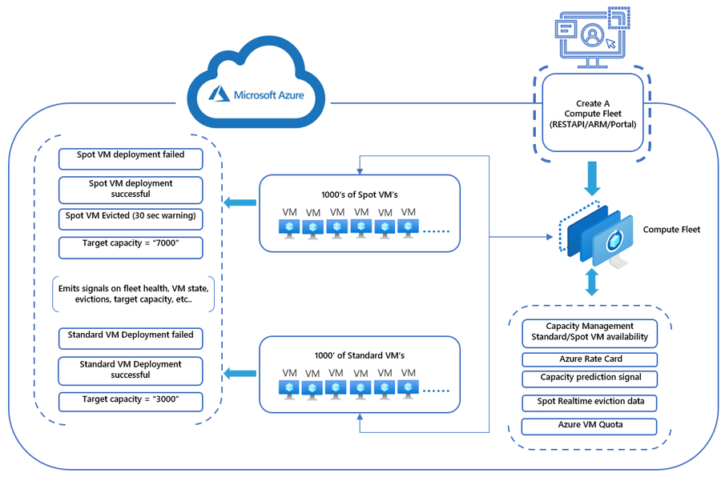
Azure VM Updates
Public Preview - Azure Compute Fleet
Azure is pleased to announce the public preview of Azure Compute Fleet, anew service that streamlines the provisioning and management of Azure compute capacity across different virtual machine (VM) types, availability zones, and pricing models to achieve desired scale, performance, and cost.
Azure Compute Fleet provides customers with many features to deploy and manage diverse groups of VMs at scale. Key capabilities include:
Integration of multiple pricing models within a single fleet request.
Automated configuration of a fleet of VMs to achieve the best mix of VM sizes, pricing models, and performance, based on current capacity availability.
Adjustable settings to prioritize either deployment speed, operational cost, or a balance of both.
Capability to manage and deploy up to 10,000 VMs in a region within a single fleet.
Numerous options that allow users to automatically and programmatically control how fleets respond to changing variables, such as cost overruns, capacity shortages for specific VM sizes, or the eviction of Spot VMs.
Key Benefits
Deploy up to 10,000 VMs
Mix multiple VM types (Standard /Spot)
Mix multiple Azure pricing models
Mix multiple VM SKUs/sizes
Expedite capacity access
Hyperscale using Spot VMs
Maintain Spot VM target capacity
Optimize for price, capacity or both

Slide 25
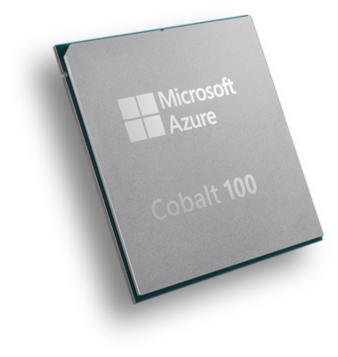
Azure VM Updates
Preview: Azure Cobalt 100 Arm-based Virtual Machines
Microsoft is announced the preview of the new Azure Virtual Machines (VMs) featuring the Azure Cobalt 100 Arm-based processor. The Cobalt 100 processor is based on the Neoverse N-series (N2) Arm CPU design, which is optimized for the performance of scale out cloud-based applications. The preview includes the general purpose (Dpsv6-series and Dplsv6-series) and memory optimized (Epsv6-series) VM series.
The Azure Cobalt 100 VMs can deliver up to 1.4x CPU performance, up to 1.5x performance on Java-based workloads and up to 2x performance on web servers, .NET applications and in-memory cache applications compared to previous generation Azure Arm-based VMs. These VMs support 4x local storage IOPS (with NVMe direct) and up to 1.5x network bandwidth compared to the previous generation Azure Arm-based VMs.
The new Dpsv6-series offers up to 96 vCPUs with 384 GiBs of RAM (4:1 memory-to-vCPU ratio).
The new Dplsv6-series offers up to 96 vCPUs with 192 GiBs of RAM (2:1 memory-to-vCPU ratio).
The new Epsv6-series offer up to 96 vCPUs with up to 672 GiBs of RAM (up to 8:1 memory-to-vCPU ratio) for more memory intensive workloads.

Slide 26
Azure Container Apps
Public preview: Dynamic sessions in Azure Container Apps
Azure Container Apps now supports dynamic sessions in public preview. This fast, sandboxed, ephemeral compute is suitable for running untrusted code at scale in hostile multi-tenancy scenarios. Each session has full compute isolation using Hyper-V. Two modes are supported for dynamic sessions:
code interpreter
custom container
Public Preview: Set Java log levels in Azure Container Apps
It is now possible to set Java application log levels in Azure Container Apps without redeploying or restarting apps. This feature, now available in public preview, allows to dynamically adjust the verbosity of logs and troubleshoot issues more easily
Public preview: Aspire dashboard support in Azure Container Apps
Azure Container Apps now supports .NET 8’s Aspire dashboard in public preview to access live data about project and containers in the cloud to evaluate the performance of your applications and debug errors with comprehensive logs, metrics, traces, and more.
Public Preview: Monitor apps with Java metrics in Azure Container Apps
It is now possible to monitor the performance and health of apps with Java metrics such as garbage collection and memory usage. These metrics are automatically collected and reported to Azure Monitor, where can be integrated into dashboard. It is also possible to set alerts and troubleshoot issues based on these metrics.

Slide 27
Compute Updates
Preview: Windows gRPC support is now available on App Service
gRPC support for Azure App Service is now available for Windows.
Azure Static Web Apps offers new Dedicated plan in preview
To help customers deliver more advanced capabilities, Azure Static Web Apps now offers a Dedicated pricing plan (in preview) supporting enterprise-grade features for enhanced networking and data storage. This functionality creates new opportunities for customers that are looking for a simplified option to host static and frontend web applications.
The Dedicated plan for Static Web Apps utilizes dedicated compute capacity. For preview, this includes:
Data residency, to help customers comply with data management policies and requirements
“Always-on” functionality for Static Web Apps managed functions, which provide built-in API endpoints to connect to backend services.
For preview, the Dedicated plan will be available in the following regions:
East US 2, Central US, West US 2, East Asia

Slide 28
Storage & Data

Slide 29
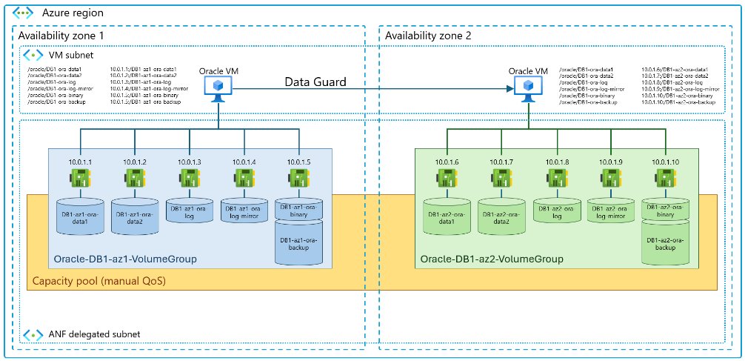
Storage & Data Updates
Public preview: Azure NetApp Files application volume group for Oracle
Application volume group (AVG) for Oracle enables to deploy all Azure NetApp Files volumes required to install and operate Oracle databases at enterprise scale, with optimal performance and according to best practices, in a single one-step and optimized workflow. The application volume group feature is using the Azure NetApp Files ability to place all volumes in the same availability zone (as the VMs) to achieve automated, latency-optimized deployments. Application volume group for Oracle has implemented many technical improvements that simplify, standardize and streamline the entire process of volume deployments for Oracle. All required volumes such as up to 8 data volumes, online redo log and archive redo log, backup and binary volumes are created in a single 'atomic' operation (through portal, RP, or API).
Azure NetApp Files application volume group for Oracle will shorten database deployment time and increase overall application performance and stability, including the use of multiple storage endpoints. The application volume group feature supports a wide range of Oracle database layouts from small databases with a single volume up to multi-hundred TiB sized databases with up to 8 data volumes and with latency-optimized performance and only limited by the database VM's network capabilities.
Application volume group for Oracle is supported in all Azure NetApp Files enabled regions.

Slide 30
Databases

Slide 31
Azure Cosmos DB Updates
General Availability: Azure Cosmos DB Vercel integration
Easily deploy apps with existing Azure Cosmos DB setups or create new ones instantly.
General availability: Azure Cosmos DB for NoSQL integrations in LangChain and Semantic Kernel
Azure Cosmos DB for NoSQL now features integrations as a vector store in LangChain (python) and Semantic Kernel (.NET)!
This allows to leverage the scalability and flexibility of Azure Cosmos DB for NoSQL to store and retrieve high-dimensional vectors as part of your LLM pipelines! Easily bring data to LLMs, leveraging the extreme performance and highly accurate vector search built into Azure Cosmos DB.
General availability: Azure Cosmos DB Go SDK
The Azure Cosmos DB Go SDK is now generally available. The Go SDK allows to connect to an Azure Cosmos DB for NoSQL account and perform operations on databases, containers, and items. This release brings critical Azure Cosmos DB features for multi-region support and high availability to Go, such as the ability to set preferred regions, cross region retries, and improved request diagnostics. It is now possible to fine grained control over which region in Azure Cosmos DB account the Go SDK connects to, and which order regions are contacted in case of retries or region failovers.
General availability: Computed properties in Azure Cosmos DB for NoSQL
Computed properties in Azure Cosmos DB for NoSQL offer a powerful tool to streamline work. They allow to create values based on existing item properties without persisting them in the items themselves. This means can craft complex query logic just once and use it repeatedly, saving you time and effort.
But the benefits don’t stop there. Computed properties can be indexed individually or as part of a composite index, leading to enhanced performance. This not only makes queries faster but also more cost-effective. So, with Computed properties, you’re getting a tool that makes work easier, performance better, and costs lower.
Public preview: Change from serverless to provisioned capacity mode
It is now possible to change the capacity mode of an Azure Cosmos DB account from serverless to provisioned capacity in-place using the Azure portal or Azure CLI. This new capability makes it easy for you to transition to the performance and comprehensive SLA provided by provisioned capacity mod

Slide 32
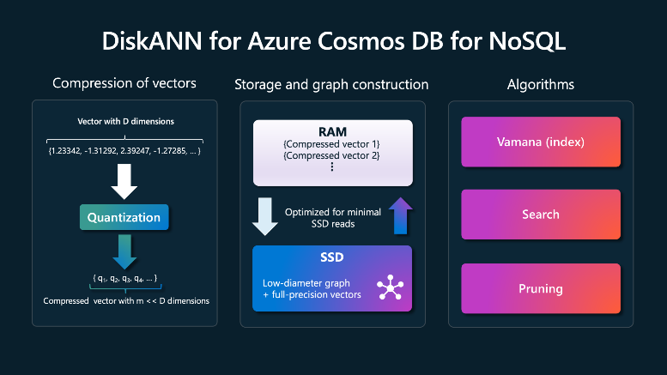
Azure Cosmos DB Updates
Public Preview: vCore-based Azure Cosmos DB for MongoDB cross-region disaster recovery (DR)
With cross-region DR (disaster recovery) it is possible to create a replica of a vCore-based Azure Cosmos DB for MongoDB cluster in another region. This cluster replica is continuously updated with the data written in the primary region. In a rare case of an outage in the primary region and primary cluster unavailability, you can promote this replica to become the new read-write cluster in another region.
In addition, it is allowed to use cluster replica in another region for reading. This helps offload read operations from the primary cluster as well as deliver reads with lower latency to applications that are hosted in or closer to the other region.
When the cluster replica in region B is promoted and becomes the new read-write cluster, it mirrors the original configuration by maintaining a read replica in the former primary region A. Connection strings pointing to the read-write cluster and read-only cluster replica are preserved after replica promotion.
Public Preview: DiskANN vector indexing and search in Azure Cosmos DB NoSQL
Azure Cosmos DB for NoSQL built-in vector search is now in public preview. This feature can be used with a flat vector index, quantized vectors, and with a vector index powered by DiskANN, a state-of-the-art suite of vector indexing algorithms developed at Microsoft Research. This enables your applications to perform a vector similarity search with high performance,accuracy, and scale.
It is now possible to easily combine vector search with Azure Cosmos DB's rich query filters. Plus, take advantage of Azure Cosmos DB's flexible schema-less document structures, serverless or provisioned throughout models, 99.999% availability, instant autoscale, and more!
Simplify your RAG and Generative AI architectures and keep data and vectors in sync by leveraging Azure Cosmos DB as your one database for transactional and vector data workloads.

Slide 33
Azure PostgreSQL Updates
Public preview - Major version upgrade support for PostgreSQL 16
Azure Database for PostgreSQL - Flexible Server now supports in-place major version upgrades to PostgreSQL 16 in public preview. This update offers access to the latest PostgreSQL features with minimal downtime and a simplified upgrade process.
Key Benefits include:
Enhancements like pg_stat_io for I/O monitoring, improved query execution, and advanced replication.
The ability to upgrade directly without data migration or changing server settings.
A streamlined process ensuring a smooth transition with reduced production disruptions.
Public Preview: Index recommendations in Azure Database for PostgreSQL Flexible Server
Index recommendations analyzes the most resource intensive set of queries in workload and produces recommendations of indexes that, once created, improve the performance of those queries.
It also recommends indexes can drop if they are identified as duplicates or are considered irrelevant for lack of use.
The new index recommendations feature builds on query store in Azure Database for PostgreSQL - Flexible Server, which captures and retains a history of queries executed in your workload and the runtime statistics of those queries.

Slide 34
Azure PostgreSQL Updates
Public Preview: In-database embeddings in Azure Database for PostgreSQL - Flexible Server
Use language models to create text embeddings within PostgreSQL database with the public preview release of azure_local_ai. This new extension for Azure Database for PostgreSQL enables to create text embeddings from an LLM deployed within the same VM as Azure Database for PostgreSQL database. This feature greatly reduces latency and improves performance for text analytics applications that rely on embeddings to measure semantic similarity, perform clustering, or extract insights. With the azure_local_ai extension, you can leverage the power of LLMs without leaving your database or compromising on security.
To get started, visit the azure_local_ai extension documentation page, enable the extension and begin creating embeddings from your text data without leaving the Azure Database for PostgreSQL boundary.
General Availability: Azure AI extension in Azure Database for PostgreSQL
The Azure AI extension simplifies building intelligent applications on Azure Database for PostgreSQL from right within the database using SQL. It is possible to call Azure OpenAI to generate LLM based vector embeddings and store those embeddings within native vector types with a single SQL statement. Embeddings open up new scenarios from semantic search to other rich natural language interactions. In addition, you can invoke a variety of Azure AI language services from sentiment analysis to summarization and translation. Invoke real-time predictions calling pre-trained or custom models hosted on Azure ML online inference endpoints to openup real-time scoring scenarios from fraud detection to healthcare predictions and more.

Slide 35
Azure Database for MySQL Updates
Public Preview: Microsoft Copilot now offers supportability in Azure Database for MySQL
This experience adds Azure Database for MySQL skills into Microsoft Copilot in Azure, empowering with self-guided assistance with the ability to solve issues independently.
Public Preview - On-demand backup and Export in Azure Database for MySQL - Flexible Server
Using this feature, it is possible to export at-moment physical backup of the server to Azure storage account (Azure Blob Storage). Once exported, these backups can be used for data recovery, migration, and redundancy. It is possible to use these exported backups to restore to an on-prem MySQL server using simple steps.
Generally Available: 32TB storage support in Azure Database for MySQL Flexible Server Business Critical
Customers can now leverage storage support up to 32TB on the Business Critical service tier.
In all service tiers, the minimum storage supported is 20 GiB and maximum is 16 TB. Now, customers in the Business Critical tier can provision servers with storage up to 32TB.
Generally Available: Accelerated logs in Azure Database for MySQL - Flexible Server
The accelerated logs feature in Azure Database for My SQL – Flexible Server allows to boost the performance of servers in the Business Critical service tier. Enable this feature to store server transactional logs on faster storage thereby enhancing throughput without incurring any extra cost.

Slide 36
Azure SQL Database Updates
Public Preview: New Azure SQL Database skills introduced to Microsoft Copilot in Azure
Copilot’s reach is extended to Azure SQL Database, introducing capabilities that assist in the efficient management and operation of SQL-dependent applications, empowering to quickly and independently solve issues as they arise. These tools draw from a variety of sources, including public documentation, dynamic management views, Query Store, catalog views and Azure supportability diagnostics. Moreover, the Azure SQL Database query editor now features a Copilot experience that converts natural language inquiries into T-SQL commands, making database queries more user-friendly.
Public Preview: Azure SQL updates for late-May 2024
In late-May 2024, the following updates and enhancements were made to Azure SQL:
New JSON functionality: Use native JSON type to manage and query JSON documents. Use ANSI SQL JSON Aggregates - JSON_ARRAYAGG and JSON_OBJECTAGG to aggregate data into JSON documents.
Monitor the database availability for Azure SQL Database using the SLA compliant availability metric.
General availability: Azure SQL updates for late-May 2024
Use update policy for Azure SQL Managed Instance to choose between getting access to all new SQL engine features as soon as they are released in Azure or receiving only fixes and small functional improvements of the latest major release of SQL Server.
Enable disaster recovery for Azure SQL Database at a lower cost using standby replica which does not incur license costs.

Slide 37
Azure Cache for Redis Updates
General availability: Azure Cache for Redis now supports Microsoft Entra ID authentication and authorization
Microsoft Entra ID based authentication and authorization is now generally available with Azure Cache for Redis. With this Microsoft Entra ID integration, you can connect to your cache instance without an access key and use role-based access control to connect.
This feature is available for Azure Cache for Redis Basic, Standard, and Premium SKUs.
Public preview: Azure Cache for Redis Enterprise now offers a 1GB E1 SKU
Experience the power of Azure Cache for Redis Enterprise with the new E1 SKU, featuring 1GB of memory, now in public preview. Ideal for hands-on experimentation, this smaller SKU unlocks the powerful vector similarity search and semantic caching capabilities of Redis Enterprise. Not only is it perfect for exploring generative AI functionalities, but it's also a cost-effective solution for development and testing. The E1 SKU will be available starting June 1, 2024.

Slide 38
Information

Slide 39
Information
Azure Times GitHub Repo

Slide 40
Questions

