Slide 1
Azure Times #122 (Build Edition – Part 2)
June 5, 2024

Slide 2
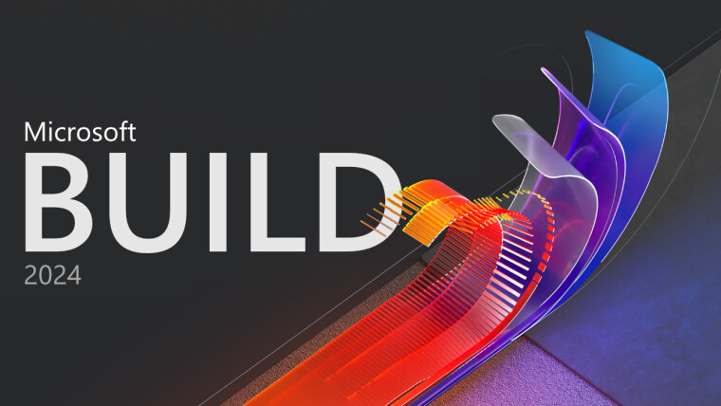

Slide 3
Networking

Slide 4
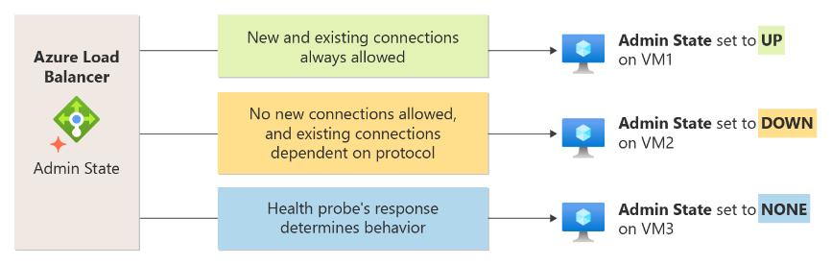
Networking Updates
Public preview: Azure Load Balancer now supports Admin State
MS announced the public preview of Azure Load Balancer Administrative State (Admin State) to make managing VMs in the backend pool of Azure Load Balancer simple and effective.
Administrative state (Admin state) is a feature of Azure Load Balancer that allows to override the Load Balancer’s health probe behavior on a per backend pool instance basis. This feature is useful in scenarios where would like to take down backend instance for maintenance, patching, or testing.
Admin State | New Connections | Existing Connections
Up | Load balancer ignores the health probe and always considers the backend instance as eligible for new connections. | Load balancer disregards the configured health probe’s response and always allows existing connections to persist to the backend instance.
Down | Load balancer ignores the health probe and doesn't allow new connections to the backend instance. | Load balancer ignores the health probe and existing connections are determined according to the following protocols: TCP: Established TCP connections to the backend instance persists. UDP: Existing UDP flows move to another healthy instance in the backend pool. Note: This is similar to a Probe Down behavior.
None | Load balancer respects the health probe behavior. | Load balancer respects the health probe behavior.
Limitations:
Admin state isn't supported with inbound NAT rule.
Admin state isn't supported for nonprobed load balancing rules.
Admin state can't be set as part of the NIC-based Load Balancer backend pool Create experiences.

Slide 5
Networking Updates
Public preview: Azure Load Balancer health event logs
MS announced the public preview of Azure Load Balancer health event logs. With health event logs, it is possible to collect, store, and analyze information to help understand the health of your Azure Load Balancer resource.
As part of this public preview, the following 5 event types are provided:
LoadBalancerHealthEventType | Scenario
DataPathAvailabilityWarning | Detect when the Data Path Availability metric of the frontend IP is less than 90% due to platform issues
DataPathAvailabilityCritical | Detect when the Data Path Availability metric of the frontend IP is less than 25% due to platform issues
NoHealthyBackends | Detect when all backend instances in a pool are not responding to the configured health probes
HighSnatPortUsage | Detect when a backend instance utilizes more than 75% of its allocated ports from a single frontend IP
SnatPortExhaustion | Detect when a backend instance has exhausted all allocated ports and will fail further outbound connections until ports have been released or more ports are allocated

Slide 6
Networking Updates
Public preview: Azure Bastion Premium
Azure Bastion Premium is a new SKU to target customers handling highly sensitive virtual machine workloads. Its mission is to offer enhanced security features that ensure customer virtual machines are connected securely and to monitor VMs for any anomalies that may arise.
Private-only deployment
Private-only Bastion deployments lock down workloads end-to-end by creating a non-internet routable deployment of Bastion that allows private IP address access. Private-only Bastion deployments don't allow connections to the bastion host via public IP address.
Session recording
When the Azure Bastion Session recording feature is enabled, it record the graphical sessions for connections made to virtual machines (RDP and SSH) via the bastion host. After the session is closed or disconnected, recorded sessions are stored in a blob container within your storage account (via SAS URL).
Feature | Developer SKU | Basic SKU | Standard SKU | Premium SKU
Connect to target VMs in same virtual network | Yes | Yes | Yes | Yes
Connect to target VMs in peered virtual networks | No | Yes | Yes | Yes
Support for concurrent connections | No | Yes | Yes | Yes
Access Linux VM Private Keys in Azure Key Vault (AKV) | No | Yes | Yes | Yes
Connect to Linux VM using SSH | Yes | Yes | Yes | Yes
Connect to Windows VM using RDP | Yes | Yes | Yes | Yes
Connect to Linux VM using RDP | No | No | Yes | Yes
Connect to Windows VM using SSH | No | No | Yes | Yes
Specify custom inbound port | No | No | Yes | Yes
Connect to VMs using Azure CLI | No | No | Yes | Yes
Host scaling | No | No | Yes | Yes
Upload or download files | No | No | Yes | Yes
Kerberos authentication | No | Yes | Yes | Yes
Shareable link | No | No | Yes | Yes
Connect to VMs via IP address | No | No | Yes | Yes
VM audio output | Yes | Yes | Yes | Yes
Disable copy/paste (web-based clients) | No | No | Yes | Yes
Session recording | No | No | No | Yes
Private-only deployment | No | No | No | Yes

Slide 7
Networking Updates
Features:
Network security group (NSG) rules
Application security group (ASG) rules
Azure Virtual Network Manager security admin rules
Azure Virtual Network Manager mesh topology (connected group)
Virtual network peering
Route tables
Service endpoints & access control lists
Private endpoints
Virtual WAN
Limits
A reachability analysis can only be run on a single reachability analysis intent.
Subnets selected as the source and/or destination of a reachability analysis intent must have at least one running virtual machine for a reachability analysis result to be provided.
Reachability analysis results are based on the evaluation of supported Azure services, resources, and policies listed as supported features here. Actual traffic behavior resulting from services not explicitly listed above can vary from the reachability analysis result.
Azure Virtual Network Manager’s virtual network verifier is now in public preview
Virtual network verifier enables to check if network policies allow or disallow traffic between Azure network resources, helping answer simple diagnostic questions, triage why reachability isn’t working as expected, and prove conformance of Azure setup to your organization’s security compliance requirements.
Within network manager resource, can access Virtual Network Verifier’s capabilities by creating a verifier workspace, then defining reachability analysis intents that capture the traffic want to evaluate.
Virtual network verifier’s reachability analysis evaluates several Azure policies and resources within the network manager’s scope (see the documentation below for supported features).

Slide 8
Management & Governance

Slide 9
Management & Governance Updates
General availability: Activity log alerts can now run in EU Data Boundary
Activity log alert rules can now be saved in one of the following EU Data Boundary regions:
North Europe
West Europe
This capability is avilable when creating a new activity log alert rule. Saving the rule in a European regions ensures that the alert rule metadata and its processing remains within EU Data Boundary.
Note that action groups can also be saved in EU regions. This means combining an EU-based activity log alert rule with an EU-based action group will ensure an end-to-end experience within Europe, encompassing alert evaluation and actions.
Public Preview: Analyze data using Log Analytics Simple mode
Azure Monitor Logs is excited to introduce the next leap in log experience: Simple mode.
Until now, Azure Monitor Logs relied on KQL for users to express their questions as queries.
Simple mode experience was created to bridge this knowledge gap - allowing most popular KQL operators and actions to be utilized using a very simple, point-and-click experience requiring no KQL knowledge at all!
Simple mode is currently an opt-in experience.

Slide 10
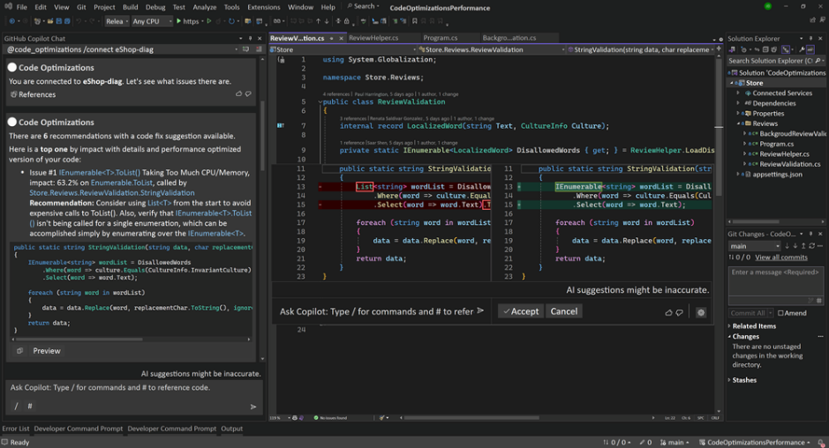
Management & Governance Updates
Feature Update: Azure Action Groups
Action groups has recently updated the Email notification when using Resource Manager.
In the previous behavior, emails would send only to users who were assigned an RBAC role as a user assignment with an email address configured in their user object profile. Emails in this previous behavior would not have been sent to users who inherit the relevant RBAC role through a group level assignment.
In the new behavior, the users who inherit a role assignment from being a group member will start receiving emails. The emails will be sent to users regardless of role inheritance or direct user assignment, including to users inheriting role assignment through group-level assignment on Azure Lighthouse. This new behavior was rolled out mid May 2024
New Code Optimizations features
Azure Application Insights Code Optimizations is an AI-based service that helps detect and remediate performance issues on a code-level in running .NET applications. The following features have been released:
One place for all Code Optimizations across all Application Insights resources and subscriptions
Personalized and more actionable AI-generated recommendations.
GitHub Copilot with Code Optimizations extension (preview) for Visual Studio and Visual Studio Code.

Slide 11
Management & Governance Updates
Public Preview: Kubernetes Metadata and Logs Filtering in Azure Monitor - Container Insights
Kubernetes Metadata and Logs Filtering enhances the ContainerLogsV2 schema with additional Kubernetes metadata such as PodLabels, PodAnnotations, PodUid, Image, ImageID, ImageRepo and ImageTag. The Logs Filtering feature provides filtering capabilities for both workload and platform (i.e. system namespaces) logs coming out of containers. Enhance your Kubernetes Metadata experience by leveraging the Grafana dashboard to visualize log levels, volume, rate, records and much more. With these features, users gain richer context and improved visibility into their workloads.
Azure Database Migration Service consistent snapshot without locks (Preview)
Azure Database Migration Service (DMS) now offers preview support for consistent snapshot without locks, which can help businesses migrate their databases to Azure while the databases remain operational. With this feature, users can take a consistent snapshot of a MySQL server without losing data integrity at source.
When MySQL Consistent Snapshot without locks is enabled, after the initial load, a reconciliation phase occurs to ensure that the data written to the target is transactionally consistent with the source server from a specific position in the binary log.

Slide 12
Management & Governance Updates
Azure CLI and PowerShell Tools Build 2024 Announcement
Extending our coverage
MS added or refreshed coverage for those new or existing Azure services within 30 days of their general availability:
AzureSphere, AzureMonitor/DataCollectionRule, AzureMonitor/Metricdata, AzureMonitor/ActionGroup, Workloads, Fleet, CustomLocation, EventGrid, Subscription, ContainerApp modules or API upgrades, Azure CLI upgraded or added new commands exceeding 600, Azure PowerShell upgraded or added more than
Credential detection from Az CLIs outputs
In Azure CLI 2.61.0 and Azure PowerShell 12.0.0 versions, MS enabled secret detection by default in Local installation, Azure DevOps, GitHub action, and CloudShell. The Client command line tool will detect whether secrets, access tokens, and storage account keys are in pipeline or logs and display warning messages. This detection has covered most key modules and extensions, such as Compute, Network, and Storage.
Public preview of Bicep templates support for Microsoft Graph
MS announced that Bicep templates for Microsoft Graph resources will be in public preview starting May 21st. Bicep templates bring declarative infrastructure-as-code (IaC) capabilities to Microsoft Graph resources. This new capability will initially be available for core Microsoft Entra ID resources.

Slide 13
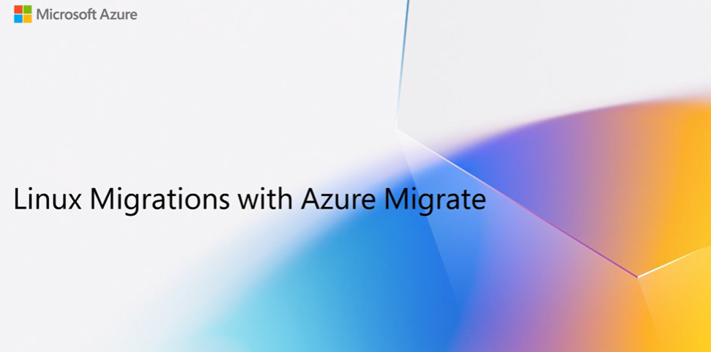
Management & Governance Updates
Azure Migrate - Build 2024 Announcements
Cost-effective Linux migrations: Microsoft is announcing support in Azure Migrate for Azure Hybrid Benefits (AHuB) during assessments and business cases for Linux workloads. This capability will provide higher savings for RHEL and SLES Linux workloads moving to Azure through Azure Migrate.
Envision cost and check the readiness of SAP workloads: Now it is possible to import SAP system inventory using a simple excel template (csv) and get a comprehensive assessment report with Azure sizing recommendations, cost estimates, and compatibility analysis for running your SAP workloads on Azure.
Coming soon! On-premises extension for VMware workloads: Microsoft understands that some workloads requiring near real-time response may stay on-premises.

Slide 14
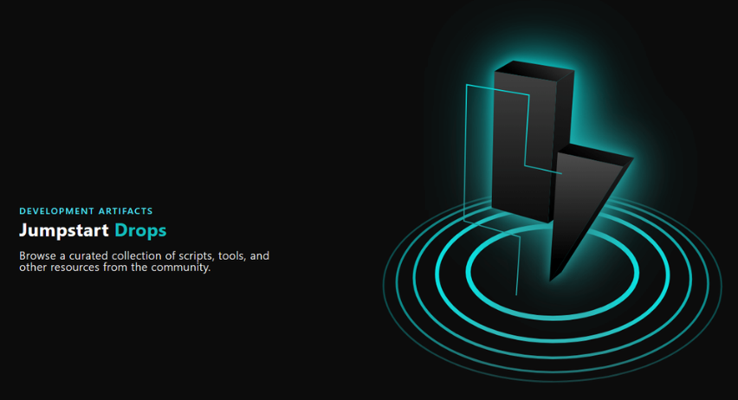
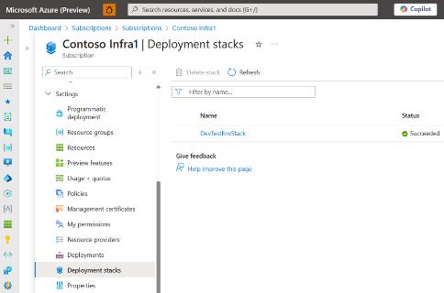
Management & Governance Updates
Announcing Jumpstart Drops
Jumpstart Drops - This new offering signifies a significant leap forward in automation and community collaboration, empowering every member to contribute to and benefit from our shared expertise.
t's a repository brimming with scripts, tools, and assorted assets tailored to streamline the daily workflows of developers, IT, OT, and Day-2 Operations professionals
Jumpstart Drops is designed for anyone eager to contribute to or utilize community-driven innovations. Whether possess a piece of code, a guide, a dashboard, or any other artifact, creating a Drop takes mere minutes and unlocks the wealth of benefits offered by the Arc Jumpstart community.
ARM Deployment Stacks now GA!
Deployment Stacks is a new resource type for managing a collection of Azure resources as a single unit for faster update and delete (cleanup), while also preventing unwanted changes to those resources. Now Generally Available!
Deployment Stacks will enable users to deploy a collection of resources across scopes as a single atomic unit (Bicep or ARM Template). The deployment stack protects its managed resources against unwanted changes.
The Solution: 1st Party resource enabling 1-to-many CRUD operations and resource change prevention.
Cleanup: easily delete or update resources across scopes with a single update to the deployment stack resource as a 1-to-many operation. You can also delete the entire stack to clean up the entire set of managed resources in one atomic action.
Unwanted (Accidental) changes: block changes to managed resources with the deny settings capability of a deployment stack.

Slide 15
Compute

Slide 16
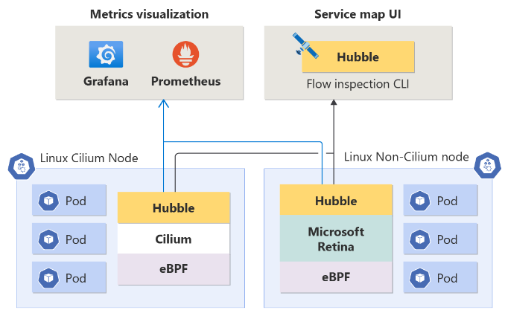
Azure Compute Updates
Public preview: Advanced Container Networking Services for Azure Kubernetes Services (AKS)
Microsoft released Advanced Container Networking Services for Azure Kubernetes Service (AKS).
Advanced Container Networking Services is a suite of services built on top of existing networking solutions for AKS to address complex challenges around observability, security, and compliance. The first feature in this suite, Advanced Network Observability, is now available in Public Preview.
Advanced Network Observability provides monitoring and diagnostics tools, providing unparalleled visibility into containerized workloads. These tools empower to pinpoint and troubleshoot network issues with ease, ensuring optimal performance for applications.
Advanced Network Observability is compatible with all Linux workloads seamlessly integrating with Hubble regardless of whether the underlying data plane is Cilium or non-Cilium (both are supported) ensuring flexibility for your container networking needs. It provides the following benefits:
Node-Level Metrics
Hubble Metrics (DNS and Pod-Level Metrics)
Hubble Flow Logs
CNI-Agnostic
Cilium and Non-Cilium:
eBPF-Based Network Observability
Deep Visibility into Network Activity
Limitations
Pod-level metrics are available only on Linux.
Cilium data plane is supported starting with Kubernetes version 1.29.
Metric labels may have subtle differences between Cilium and non-Cilium clusters.
Cilium data plane does not currently support DNS metrics.

Slide 17
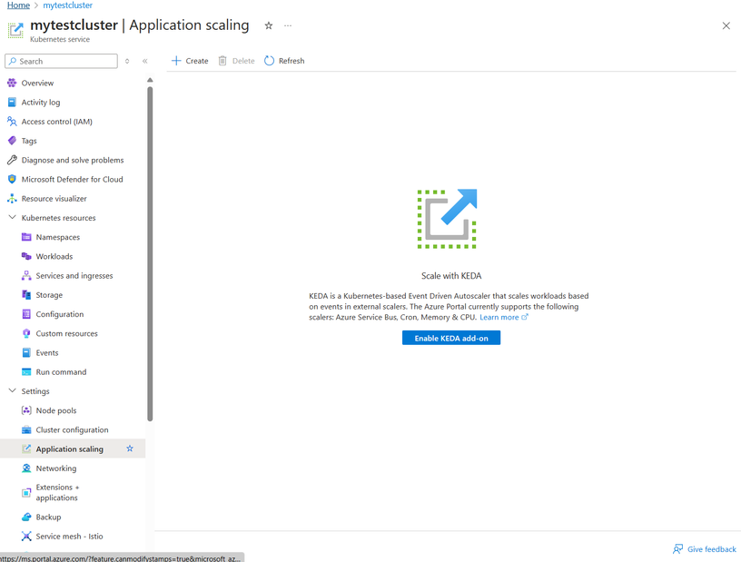
Azure Compute Updates
General Availability of Kubernetes Event-Driven Autoscaler (KEDA) in Azure Portal
Azure Portal now supports KEDA scaling on memory, CPU, cron and Azure Service Bus scalers. Now it will be possible to create scaled objects and monitor them all within the Portal interface. This should streamline the creation and management of KEDA resources through the Portal interface.
General Availability of Kubernetes Event-Driven Autoscaler (KEDA) in Azure Portal
Azure Portal now supports KEDA scaling on memory, CPU, cron and Azure Service Bus scalers. Now it will be possible to create scaled objects and monitor them all within the Portal interface. This should streamline the creation and management of KEDA resources through the Portal interface.
Mosaic AI Vector Search General Availability in Azure Databricks
MS announced the general availability of Mosaic AI Vector Search in Azure Databricks. Vector Search is a serverless vector database that helps customers build high-quality Generative AI applications using Retrieval Augmented Generation (RAG). With its native integration in Azure Databricks, Vector Search supports automatic data synchronization from source to index, eliminating complex and costly pipeline maintenance. It also leverages the same security and data governance tools organizations have already built for peace of mind.
GA Pricing
Vector Search will continue to be priced at $0.28/hr (eastus2) with a capacity of 2 million vectors per unit
Each unit of Vector Search will include 30 GB of storage at no additional cost
Any usage above 30 GB will be charged at $0.23/GB/month (eastus2)
Storage overage billing starts on Aug 1, 2024
Capacity and Storage prices vary by region

Slide 18
Azure Compute Updates
General Availability: VM Hibernation for General Purpose VMs
VM hibernation for general-purpose VMs is now generally available in all public regions. Hibernation is supported on both Linux and Windows operating systems. This feature enables to hibernate VMs to save compute costs. When you hibernate a VM, Azure persists the VM’s in-memory state in the OS disk and deallocates the VM. As a result, don’t have to pay for the VM when its hibernated and only pay for any storage and networking resources associated with the VM. When later start the VM, the applications and processes that were previously running resume from their previous state, allowing you to quickly pick up from where you left off. You can use this feature on existing and new VMs.
Public Preview: App Service Authentication Logs on Diagnostic Settings
A new log “AppServiceAuthenticationLogs” is now available in Public Preview for App Service resources on Windows. This would include Web Apps, Functions, and Logic Apps. This log provides more details for App Service Authentication to troubleshoot or self-diagnose issues
App Service Linux resources and Functions Consumption Plan (Linux and Windows) currently does not support this log.
AppServiceAuthenticationLogs currently will only generate “Warning” and “Error” logs. No logs will be generated for successful App Service Authentication requests.
Split Experimentation in Azure App Configuration
MS announced the public preview of Split Experimentation in Azure App Configuration. In today's software development, delivering high-quality features rapidly while minimizing risk is a top priority. New experimentation capability extends feature flags in App Configuration, helping balance speed, accuracy, and safety to effectively de-risk application development.
This new capability leverages the existing services use to host applications in Azure, integrating with App Configuration and Application Insights.

Slide 19
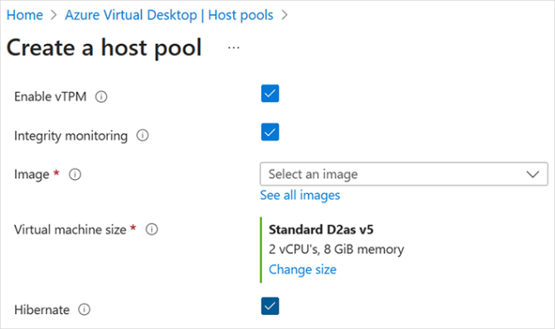
Azure Compute Updates
Public Preview: Creating Web App with a Unique Default Hostname
App Service allows to create web apps with unique default hostnames to avoid a high-severity threat of subdomain takeover.
This feature is currently in Public Preview and is only available for web apps on multi-tenants. App Service Environment (ASE) resources are not supported. Functions and Logic Apps (Standard) are currently out of scope.
The unique default hostname will have a different format than the original global default hostname in two ways. The unique default hostname will include:
A random hash appended to the web app name with a dash “-”
A region name
Hibernation support now available for Azure Virtual Desktop
MS announced the general availability of hibernation support in Azure Virtual Desktop.
The following capabilities are now generally available in Azure Virtual Desktop:
Hibernation can be enabled for session host VMs deployed to personal host pools.
Hibernation can be chosen as the scaling action for disconnect or logoff for personal host pools. For more details about configuring personal scaling plan, see Create a scaling plan.
Global (Original) | Unique (New)
Default Hostname Format | <AppName>.azurewebsites.net | <AppName>-<RandomHash>.<Region>.azurewebsites.net
SCM Endpoint Format | <AppName>.scm.azurewebsites.net | <AppName>-<RandomHash>.<Region>.scm.azurewebsites.net

Slide 20
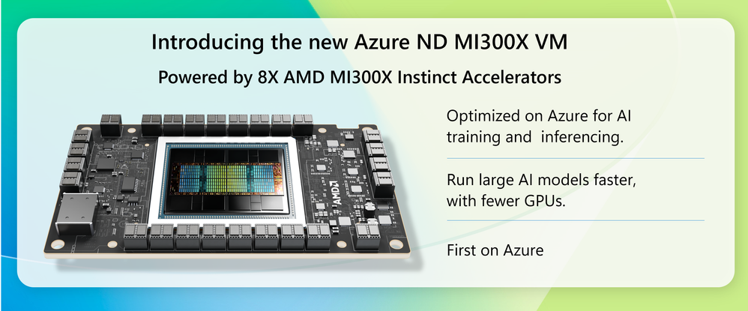
Azure Compute Updates
Azure VMware Solution now available in India Central
MS announced availability of VMware Solution in India Central. Now in 33 Azure regions.
Azure VMware Solution supports:
Rapid cloud migration of VMware-based workloads to Azure without refactoring.
Datacenter exit while maintaining operational consistency for the VMware environment.
Business continuity and disaster recovery for on-premises VMware environments.
Attach Azure services and innovate applications at your own pace.
Includes the VMware technology stack and lets you leverage existing Microsoft licenses for Windows Server and SQL Server.
Introducing the new Azure AI infrastructure VM series ND MI300X v5
Azure is the first cloud service to offer general availability of a new ND MI300X v5 virtual machine (VM) series based on AMD's latest Instinct GPU, MI300X. This new VM series is the first cloud offering of its kind and is designed to give the most high bandwidth memory (HBM) capacity of any available VM with industry-leading speeds, letting customers serve larger models faster, and with fewer GPUs.

Slide 21
Storage & Data

Slide 22
Azure NetApp Files Updates
General availability: Azure NetApp Files support for large volumes up to 500TiB in size
MS announced the general availability of Azure NetApp Files large volumes feature, allowing the creation of new volumes between 50TiB to 500TiB in size. Regular Azure NetApp Files volumes are limited to 100TiB in size. Large volumes enable a variety of use cases and workloads that require larger volumes with a single namespace, like High-Performance Computing (HPC) in the EDA and O&G space.
Azure NetApp Files large volumes is now also supported with cross-zone and cross-region replication. This capability is particularly beneficial for HPC, AI/ML, and large file content repositories, ensuring data resilience and business continuity across various scenarios.
Note: Existing regular volumes created cannot be converted to large volumes and cannot be increased beyond 100TiB.
Public preview: Azure NetApp Files support for Active Directory connection per NetApp account
The Azure NetApp Files support for Active Directory connection per NetApp account feature now allows each NetApp account to connect to its own Active Directory Forest and Domain, providing the ability to manage more than one Active Directory connections within a single region under a subscription. This enhancement enables distinct Active Directory connections for each NetApp account.
Active Directory connections can be configured multiple times for multiple NetApp accounts to make use of it. With the creation of SMB volumes in Azure NetApp Files now tied to these Active Directory connections in the NetApp account, the management of Active Directory environments becomes more scalable, streamlined and efficient. This feature is now in public preview.
Additionally, the public preview for the “Shared AD support for multiple accounts to one Active Directory per region per subscription” feature is concluding, and new registrations will no longer be accepted.

Slide 23
Azure NetApp Files Updates
General Availability: Azure NetApp Files backup
Azure Vaulted backup capability, allows to offload (vault) of Azure NetApp Files snapshots to a Backup Vault in a fast and cost-effective way, further protecting data from accidental deletion.
Backup further extends Azure NetApp Files’ built-in snapshot technology; when snapshots are vaulted to a Backup Vault only changed data blocks relative to previously vaulted snapshots are copied and stored, in an efficient format. Vaulted snapshots however are still represented in full and can be restored to a new volume individually and directly, eliminating the need for an iterative full-incremental recovery process.
Limitations:
Azure NetApp Files backup uses the Zone-Redundant storage (ZRS) account
Policy-based (scheduled) Azure NetApp Files backup is independent from snapshot policy configuration
In a cross-region replication (CRR) or cross-zone replication (CZR) setting, Azure NetApp Files backup can be configured on a source volume only
The Azure NetApp Files backup feature supports backing up the daily, weekly, and monthly local snapshots to the Azure storage

Slide 24
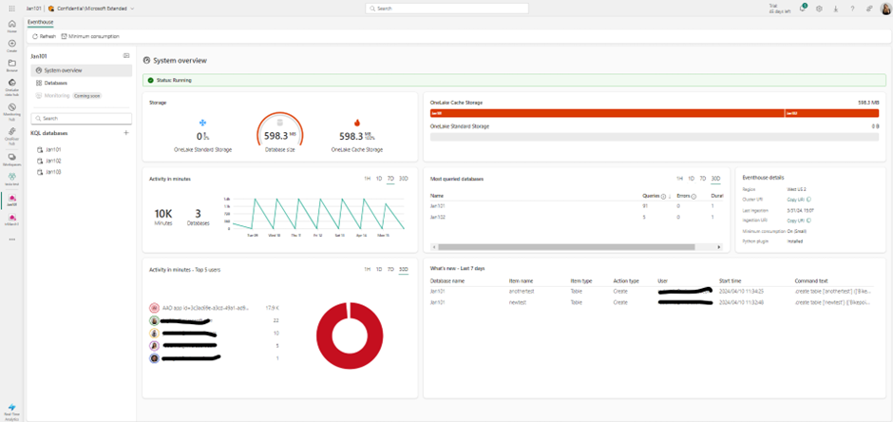
Microsoft Fabric Updates
Eventhouse is Now Generally Available!
MS announced that Eventhouse, innovative database workspace designed to manage and store event-based data, is now officially available for general use.
Eventhouse is a cutting-edge database workspace meticulously crafted to manage and store event-based data. Engineered to handle data in motion, Eventhouse seamlessly integrates indexing and partitioning into its storing process, accommodating structured, semi-structured, and free text data formats.
Copilot for Real-Time Intelligence
Copilot for Real-Time Intelligence, helps to express questions about the data in own words and Copilot will help create the KQL queries to answer them.
Announcing General Availability of Fabric Private Links, Trusted Workspace Access, and Managed Private Endpoints
Private links for Fabric tenant: Announcing Azure Private Link Support for Microsoft Fabric in Public Preview
Use trusted workspace access in OneLake Shortcuts: Introducing Trusted Workspace Access for OneLake Shortcuts
Managed PEs for Spark: Introducing Managed Private Endpoints for Microsoft Fabric in Public Preview
Introducing Data workflows in Microsoft Fabric [Announcement]
Introducing Blob Storage Event Triggers for Data Pipelines [Announcement]
Modern Get Data experience in Pipelines [Announcement]
General Availability of the Power Query Connectors SDK for VS Code [Announcement]
New Pipeline activity: HDInsight [Announcement]
New Pipeline activity: Fabric Spark Job Definition [Announcement]
Parent/child pipeline pattern monitoring improvements [Announcement]

Slide 25
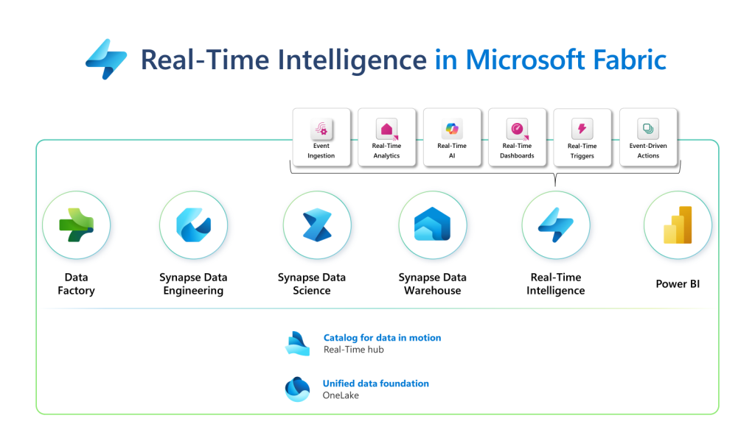
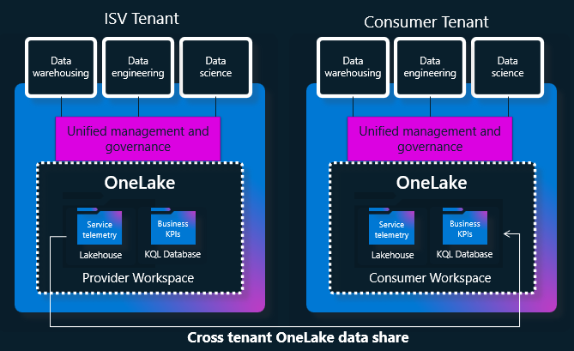
Microsoft Fabric Updates
Easily connect your data with the new modern get data experience for data pipeline
Alerting and acting on data from the Real-Time hub
Announcing the Public Preview of Copilot for Data Warehouse in Microsoft Fabric
Time travel in Fabric Warehouse (Public Preview)
Our resource for extending Fabric experiences
COPY INTO: support for firewall-enabled Storage & EntraID Authentication
Announcing Public Preview of the Microsoft Fabric Workload Development Kit
Introducing Data workflows in Microsoft Fabric

Slide 26
Databases

Slide 27

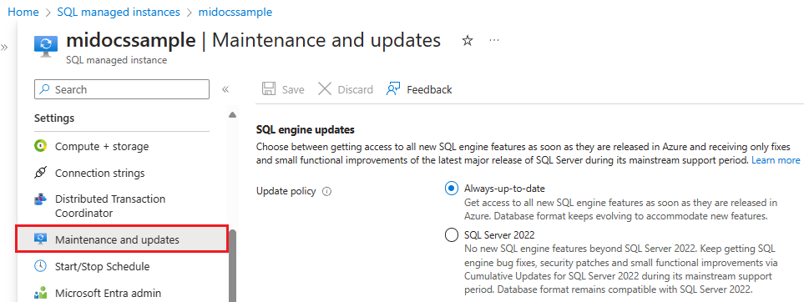
Azure Cosmos DB Updates
Announcing Oracle Database@Azure in France Central
Oracle Database@Azure was expanded to France Central.
Update Policy for Azure SQL Managed Instance
MS announced the general availability of the Update Policy feature for Azure SQL Managed Instance. This new configuration option brings more flexibility in getting access to the latest SQL engine features with no additional cost or extra downtime.
With the new feature, it is possible to choose between two update policies:
Always-up to date is a more agile policy, with cloud-native way of delivering new SQL engine features as soon as they are ready in Azure. It enables you to always be at the forefront – to quickly adopt new engine features, benefit from them in everyday operations and keep a competitive edge without waiting for the next major release of SQL Server.
SQL Server 2022 policy offers a more traditional approach to updates, following the Cumulative Update (CU) releases of SQL Server 2022.

Slide 28
Integration

Slide 29
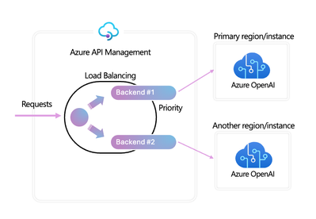
Azure API Management Updates
GA OData API type in Azure API Management
MS announced the general availability of the OData API type in Azure API Management. This exciting addition extends Azure API Management's capabilities to include OData APIs, allowing users to apply standard API protections such as authentication, authorization, and rate limiting, alongside OData-specific policies for request validation. With first-class support for OData, it's now easier for customers to leverage Azure API Management for publishing APIs from platforms like SAP, Oracle, Dataverse, and others that expose OData APIs.
GA Import Azure OpenAI endpoints as an APIs in Azure API Management
MS announced the General Availability of the Import Azure OpenAI as an API feature in Azure API Management! With this new capability, customers can seamlessly import Azure OpenAI endpoints as an API with just a single click, streamlining the entire process.
Authentication from Azure API Management to Azure OpenAI is automatically configured, eliminating the need for manual setup through API key or managed identity. Furthermore, the OpenAPI schema for OpenAI is automatically uploaded to the API, simplifying the configuration process even further.
During the import experience, customers have the option to pre-configure Azure OpenAI-related policies, providing flexibility and customization tailored to their specific requirements. This streamlined approach ensures that customers no longer need to manually upload OpenAPI schema or configure authentication settings, saving valuable time and effort.
GA Circuit Breaker in Azure API Management
The circuit breaker, now generally available in Azure API Management, is seamlessly integrated to provide customers with an easy-to-use solution for enhancing the resilience of their API environments.
With this feature, customers can configure the circuit breaker property within backend resources to protect their backend services from overload due to excessive requests. This allows customers to set specific rules for when the circuit breaker activates, including thresholds for failure occurrences within defined timeframes and identification of specific status codes indicating failures. Additionally, the circuit breaker can dynamically adjust its trip duration based on values extracted from the retry-after header provided by the backend.

Slide 30
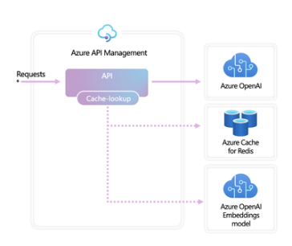
Azure API Management Updates
GA Load Balancer in Azure API Management
The General Availability of the Load Balancer feature in Azure API Management! Now, customers can effortlessly create a pool of backends and efficiently distribute the load across multiple endpoints. By establishing backend pools, users can seamlessly balance the load across various backends when integrating multiple backends for an API.
This innovative feature allows customers to spread the load across multiple backends, each potentially equipped with individual backend circuit breakers, ensuring optimal performance and resilience. Additionally, users can seamlessly shift the load from one set of backends to another for upgrades or maintenance purposes, ensuring continuous service availability.
With support for round-robin, weighted, and priority-based load balancing, customers have the flexibility to tailor the load distribution strategy according to their specific requirements. This comprehensive load balancing functionality enhances the scalability, reliability, and performance of APIs managed through Azure API Management, providing users with a robust solution for their API management needs.
Public Preview Azure OpenAI Semantic Caching policy in Azure API Management
MS announced the Public Preview for the Azure OpenAI Semantic Caching policy in Azure API Management! This innovative feature empowers customers to optimize token usage by leveraging semantic caching, which intelligently stores completions for prompts with similar meanings.
With this policy, customers can easily configure semantic caching for their Azure OpenAI endpoints. This caching mechanism utilizes Azure Redis Enterprise or any other external cache that has been onboarded to APIM, providing flexibility in caching solutions.
Customers can configure semantic caching in a centralized manner for multiple API consumers, streamlining management and ensuring consistent caching behavior across their API ecosystem. This capability enables customers to maximize the benefits of caching and optimize token usage, enhancing the scalability and efficiency of their Azure OpenAI integration.

Slide 31
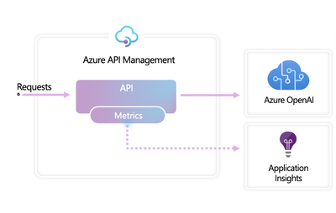
Azure API Management Updates
GA Support for gRPC APIs in Azure API Management Self-hosted Gateway
MS announced the general availability of gRPC support in Azure API Management through the self-hosted gateway. This exciting feature empowers customers to seamlessly manage their gRPC services as APIs within Azure API Management.
Full gRPC Support: Conduct unary, client streaming, server streaming, and bidirectional streaming calls.
First-Class Schema Support: Import and manage gRPC services using their protobuf definitions, letting Azure API Management handle the rest.
Security and Compliance: Implement standard Azure API Management policies to safeguard your gRPC services.
Unified Management: Seamlessly manage gRPC APIs alongside other APIs within a single Azure API Management service instance.
Deployment Flexibility: Securely and efficiently manage APIs on-premises, in Azure, and across other clouds by deploying the self-hosted gateway near your backend services.
GA Azure OpenAI Emit Token Metric policy in Azure API Management
MS announced the General Availability of the Azure OpenAI Emit Token Metric policy in Azure API Management! This new feature enables customers to effortlessly configure token usage metrics to be sent directly to Azure Application Insights, providing insights into the utilization of Azure OpenAI models across various applications and teams.
With this feature, customers can easily set up a policy to transmit token usage metrics to Application Insights with a straightforward configuration. The policy captures prompt, completions, and total token usage metrics, offering a comprehensive view of model utilization.
Customers have the flexibility to specify the Application Insights namespace to which metrics should be sent, ensuring seamless integration with their existing monitoring infrastructure.

Slide 32
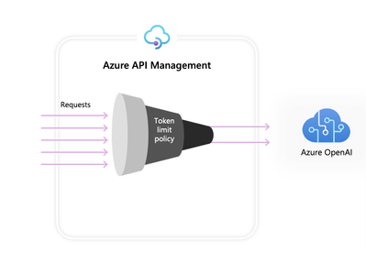
Azure API Management Updates
GA Azure OpenAI Token Limit Policy in Azure API Management
MS announced the General Availability of the Azure OpenAI Token Limit Policy in Azure API Management!
With this policy, customers can set limits on API consumers based on OpenAI token usage, expressed in tokens-per-minute (TPM). This allows for precise control over token consumption, ensuring fair and efficient utilization of OpenAI resources.
Customers have the flexibility to assign token-based limits on any counter key, such as Subscription key, IP Address, etc., tailoring the enforcement to their specific use cases. .
With the introduction of the OpenAI Token Limit Policy, customers can now centrally manage limits for multiple API consumers and OpenAI endpoints for both streaming and non-streaming scenarios, streamlining the management process and improving resource utilization efficiency.
General Availability: Azure API Center Extension for VS Code
The Azure API Center extension for Visual Studio Code is now generally available:
Build APIs - Make APIs building discoverable to others by registering them in API center. Shift-left API design conformance checks into Visual Studio Code with integrated linting support. Ensure that new API versions don't break API consumers with breaking change detection.
Discover APIs - Browse the APIs in API center, and view their details and documentation.
Try APIs - Use Swagger UI or REST client to explore API requests and responses.
Consume APIs - Generate API SDK clients for favorite language including JavaScript, TypeScript, .NET, Python, and Java, using the Microsoft Kiota engine that generates SDKs for Microsoft Graph, GitHub, and more.

Slide 33
Azure Event Hub Updates
Announcing general availability for Kafka compression in Azure Event Hubs
MS announced that compression for Kafka clients is generally available in Azure Event Hubs.
Kafka compression can help with this by reducing the data payloads that are stored and transmitted across architecture, thus reducing network bandwidth and storage requirements and costs, while still keeping the programming model simple.
To utilize Kafka compression, the settings below must be enabled Kafka producer configuration properties:
compression.type = gzip
No changes are required on the Kafka consumer side, since the compression information is made available in the message header and the consumer can automagically uncompress these and make it available for processing.
Introducing Local Emulator for Azure Event Hubs
MS announced the rollout the preview release of the local emulator for Azure Event Hubs. Azure Event Hubs emulator is designed to offer a local development experience for Azure Event Hubs, enabling to develop and test code against our services in isolation, free from cloud interference.
The emulator is available as a Docker image on Microsoft Container Registry and is platform-agnostic – it can run on Windows, macOS, and Linux. It is possible either use our automated scripts from the Installer repository or spin up the emulator container using the docker compose command.
The emulator is compatible with the latest Event Hubs SDKs and supports basic send and receive operations with Azure Event Hubs via AMQP.
Current version of emulator has the following limitations:
It can't stream messages using Kafka protocol.
It doesn't support on fly management operations using Client side SDK.

Slide 34
Azure Event Hub Updates
Announcing Large Message Support for Azure Event Hubs- Public Preview
MS announced the public preview of large message support (up to 20 MB) in Azure Event Hubs.
The introduction of large message support is a significant enhancement to our service. Typically, data in streaming scenarios is lightweight, often less than 1 MB, and characterized by high throughput. However, there are instances when messages cannot be divided into smaller segments or chunks.
With the new support for large messages, Event Hubs self-serve scalable Dedicated clusters can now accommodate events up to 20 MB in size at no additional cost. This capability allows Azure Event Hubs to handle a wide range of message sizes, ensuring uninterrupted business operations.
Schema Registry updates
In addition to the exiting AVRO schema support, the Schema Registry has added support for 2 more schema types.
JSON Schema in Schema Registry (GA) – The JSON Schema support is now GA.
Protobuf in Schema Registry (Public Preview) – Protobuf support is now available in preview in the Schema Registry.

Slide 35
Integration Updates
Public Preview Azure Service Bus Enhancements
MS announced a new feature to streamline message management and improve operational efficiency: batch delete. Currently in preview, this feature enables customers to delete messages on the service side from an entity or the dead letter queue in batches of up to 4,000 messages.
New Azure Event Grid capabilities support IoT solutions, event source
Azure Event Grid has released new generally available:
Use the last will and testament feature in compliance with MQTT v5 and MQTT v.3.1.1 specifications
Create data integrations that utilize both Event Grid Basic resources and Event Grid Namespace Topics (supported in Event Grid Standard).
Configure event subscriptions on namespace topics to send messages to Azure Event Hubs.
Support new event sources such as Microsoft Entra ID and Microsoft Outlook leveraging Event Grid’s support for the Microsoft Graph API.

Slide 36
ML & AI & IOT

Slide 37
ML & AI & IOT Updates
Azure Machine Learning - Public Preview for Build 2024
Service-side encryption of metadata (Simplified CMK architecture): It is possible to take advantage of the customer-managed key-encryption workspace’s new architecture, which will ultimately reduce costs and limit the likelihood of running into Azure policy conflicts.
Protect yourself and users from potentially harmful content: It is possible to guard against potentially harmful content for users, and utilize the flexibility to turn content filtering on or off based on the needs of your business.
Use RAG patterns across multiple data sources in AzureML & AI Studio: It will be soon possible to bring your own indexes without having to create them from scratch, allowing you to meet customers where data is already available and giving you the flexibility to use more index types.
Azure Machine Learning - General Availability for Build 2024
Use Language tools and sample flows available in Prompt Flow tooling: It will be possible now promptly get bootstrapped with Language services, significantly reducing your time to market, and confidently deploy solutions with trustworthy evaluations.

Slide 38
ML & AI & IOT Updates
Announcing Video Translation & Speech Translation API Enhancements
MS shared two major updates to the Azure AI Speech Translation product suite – Video Translation and an enhanced Realtime Speech Translation API.
Video Translation (Batch) provides:
Dialogue extraction and translated subtitles generation
GPT reformulation with improved translation quality and automatic time alignment
Prebuilt neural voices with content editing for precise alignment and translation preference manually
Using the personal voice capability (will be available with limited access restrictions)
Multilingual Speech Translation (Realtime) : Multilingual Speech Translation will be offered with input languages. This means these are the languages the API will automatically detect and switch between from the input. The output (target) language can still be any of the languages supported by the Azure Speech Translation Service. The 40 input languages are as follows (along with language code):
Announcing Azure OpenAI Service Assistants Public Preview Refresh
MS Announced the Public Preview Refresh of Assistants with a range of new features:
File Search (Public Preview): Enables to easily connect enterprise data sources, enable vector search and implement Retrieval-Augmented Generation (RAG).
Bring Your Indexes to File Search (Public Preview coming in July 2024): Allows existing users of Azure OpenAI On Your Data, to connect existing On Your Data indexes to the File Search tool.
Browse (Public Preview coming in July 2024): Enable Assistant to search the web to help answer questions that benefit from the most up-to-date information.
Control Assistants Outputs and Manage Costs (Public Preview): Allow users to view the input and output tokens used in a thread, message and run, control the maximum number of tokens a run uses in the Assistants API, and set limits on the number of previous messages used in each run.
GPT-4o Support (Public Preview coming in June 2024): GPT-4o is the latest preview model from OpenAI. GPT-4o integrates text and images in a single model, enabling it to handle multiple data types simultaneously. This multimodal approach enhances accuracy and responsiveness in human-computer interactions. We are announcing support for gpt-4o on Assistants to enable you to create interactive multi-modal experiences.

Slide 39
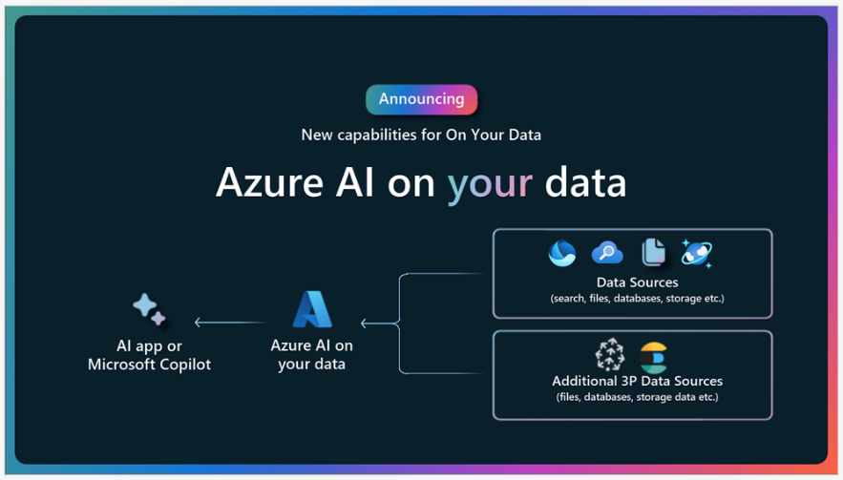
ML & AI & IOT Updates
Introducing Model Customization for Azure AI
MS announced the launch of Model Customization for Azure AI, an engineering service designed to accelerate co-innovation with customers to deliver tailored AI solutions. Custom models can offer significant benefits for enterprises and complement other techniques such as fine-tuning, retrieval-augmented generation (RAG), and prompt engineering by encapsulating specialized domain knowledge and understanding nuanced context in the domain.
Announcing New Capabilities for Azure OpenAI On Your Data
Microsoft announced a significant feature expansion of Azure OpenAI Service On Your Data. On Your Data allows users to create personalized copilots tailored to their data, improving user understanding, expediting task completion, and facilitating decision-making. With the addition of new data sources, security enhancements, the latest GPT-4o model, and deployment to Teams, users now can leverage the capabilities of advanced AI models while integrating the advanced features of RAG (Retrieval Augmented Generation) directly onto their data with enterprise-grade security. This state-of-the-art capability revolutionizes how users engage with and contextualize their data, providing enhanced accuracy and speed through a user-friendly conversational interface.

Slide 40
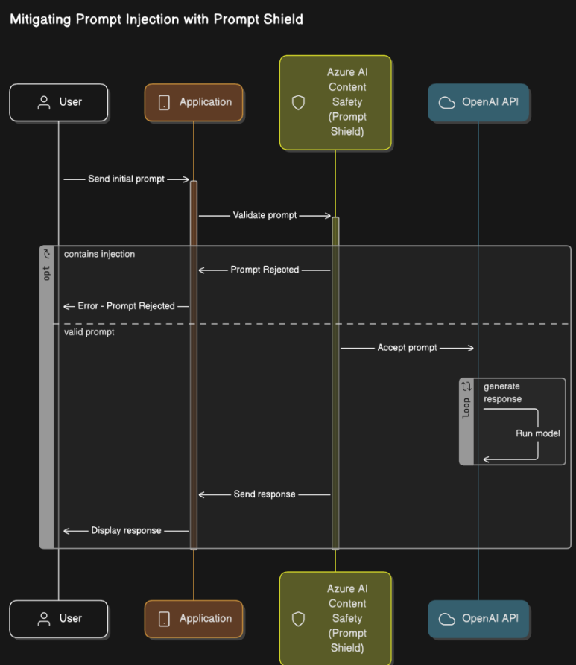
ML & AI & IOT Updates
Prompt Shields
Prompt Shields is a unified API that analyzes LLM inputs and detects User Prompt attacks and Document attacks, which are two common types of adversarial inputs.
Prompt Shields for User Prompts:
Previously called Jailbreak risk detection, this shield targets User Prompt injection attacks, where users deliberately exploit system vulnerabilities to elicit unauthorized behavior from the LLM. This could lead to inappropriate content generation or violations of system-imposed restrictions.
Prompt Shields for Documents
This shield aims to safeguard against attacks that use information not directly supplied by the user or developer, such as external documents. Attackers might embed hidden instructions in these materials in order to gain unauthorized control over the LLM session.

Slide 41
DevOps & IaC & Automation

Slide 42
DevOps & IaC & Automation
Expanding extensibility model to Pulumi in Azure Deployment Environments
Azure Deployment Environments now delivers more seamless experience to customers, enabling them to leverage popular Infrastructure-as-Code (IaC) frameworks quickly and easily with its extensibility model and perform or customize deployments based on their organizational needs. These capabilities give development teams more control to customize environment templates for their team-specific needs and provide platform engineers with additional ways to build templates in their preferred IaC format. Additional updates include:
Support for Pulumi through its new extensibility model: In addition to being able to use Arm, Bicep and Terraform already, customers can now easily perform deployments using Pulumi, another popular IaC framework Customers can build their own container image by leveraging the published guidance or directly leverage the sample container image published for Pulumi. This is in preview.
Project-based catalogs: Platform engineers can now provide project-specific templates or enable dev teams to directly customize the templates used to self-serve application infrastructure. This is in preview.
Quick-start template: Platform engineers can now deploy and configure Azure Deployment Environments with a single click deployment using the quick-start template. This is generally available.
Microsoft Dev Box introduces new ready-to-code and enterprise management capabilities
Microsoft Dev Box is an Azure service that gives developers self-service access to preconfigured, project-specific developer workstations.
New ready-to-code features for developers
Team customizations (private preview), images (private preview), and project-based catalogs (preview)
A customization template for accessibility configurations provides a popular option for the visually impaired community (preview).
Dev Box in Windows App offers an improved connection experience and the ability to seamlessly transition between Dev Box and Windows devices,
Enterprise management capabilities
Dev Box connection telemetry is now available through Azure Monitor to
Hibernation on disconnect: When enabled, dev boxes can hibernate (if there is no active RDP session), helping organizations optimize costs (preview).
Windows 11 Enterprise image can be published into Azure Marketplace for use with Microsoft Dev Box:
Dev boxes can now be deployed in South East Asia, South Africa North, Germany West Central, Italy North, Brazil South, Switzerland North, and Sweden Central* (generally available).

Slide 43

DevOps & IaC & Automation
Introducing GitHub Copilot for Azure: Your Cloud Coding Companion in VS Code!
In-Chat Azure Expertise
Personal Resource Management:
Deployment Guidance
Troubleshooting
Generally Available: Azure Chaos Studio supports a new Pause Process fault for Windows virtual machines
Azure Chaos Studio now supports a new agent-based fault action for Windows virtual machines.
Pause Process: this new agent-based fault allows customers to pause a Windows process running in an Azure virtual machine for a specified duration as part of a Chaos Experiment. This can help test applications inside virtual machines and their resilience to stutters, maintenance events, or resource constraints. This new fault can be used in Azure Chaos Studio by deploying templates, using the REST API, or designing experiments in the Azure portal.

Slide 44
Information

Slide 45
Information
Azure Times GitHub Repo
Azure Times Telegram

Slide 46
Questions

