Slide 1
Azure Times #98
December 6, 2023

Slide 2
Networking

Slide 3
Networking Updates
Standard and High-Performance VPN Gateway SKUs will be retired on 30 September 2025
Because of the retirement of Basic IP, which Standard and High-Performance SKUs only accept, MS will retire these SKUs on 30 September 2025. Starting 1 December 2023, you will no longer be able to create a new gateway with these SKUs.
If you do not upgrade your gateway by August 2025, your gateway will be automatically upgraded to VPNGw1AZ (Standard) or VPNGw2AZ (High-Performance) after 30 September 2025.
The legacy (old) VPN Gateway SKUs are:
Default (Basic)
Standard
High Performance

Slide 4
Security & Identity

Slide 5
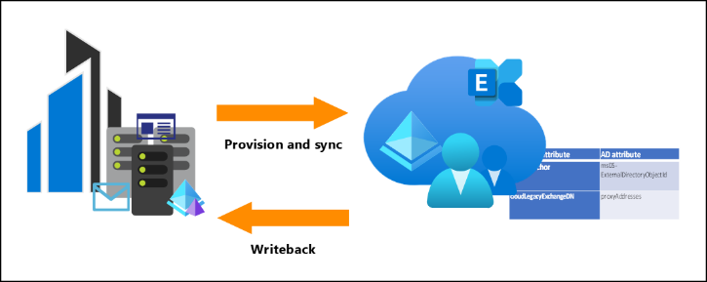
Security & Identity Updates
General Availability - Microsoft Entra Cloud Sync now supports ability to enable Exchange Hybrid configuration for Exchange customers
Exchange hybrid capability allows for the coexistence of Exchange mailboxes both on-premises and in Microsoft 365. Microsoft Entra Cloud Sync synchronizes a specific set of Exchange-related attributes from Microsoft Entra ID back into on-premises directory and to any forests that's disconnected (no network trust needed between them). With this capability, existing customers who have this feature enabled in Microsoft Entra Connect sync can now migrate, and apply, this feature with Microsoft Entra cloud sync
Requirements:
The provisioning agent must be version 1.1.1107.0 or later.
Your on-premises Active Directory must be extended to contain the Exchange schema
General Availability - Guest Governance: Inactive Guest Insights
Monitor guest accounts at scale with intelligent insights into inactive guest users in organization. Customize the inactivity threshold depending on organization’s needs, narrow down the scope of guest users want to monitor, and identify the guest users that might be inactive.
The feature require Microsoft Entra ID Governance licenses
Public Preview - lastSuccessfulSignIn property in signInActivity API
An extra property has been added to signInActivity API to display the last successful sign in time for a specific user, regardless if the sign in was interactive or non-interactive. The data won't be backfilled for this property

Slide 6
Security & Identity Updates
General Availability - Auto-rollout of Conditional Access policies
Starting in November 2023, Microsoft will begin automatically protecting customers with Microsoft managed Conditional Access policies. These are policies that Microsoft creates and enables in customer tenants. The following policies are rolled out to all eligible tenants, who will be notified prior to policy creation :
Multi-factor Authentication for admin portals: This policy covers privileged admin roles and requires multi-factor authentication when an admin signs into a Microsoft admin portal.
Multi-factor Authentication for per-user multi-factor authentication users: This policy covers users with per-user multi-factor authentication and requires multi-factor authentication for all cloud apps.
Multi-factor authentication for high-risk sign-ins: This policy covers all users and requires multi-factor authentication and reauthentication for high-risk sign-ins.
General Availability - Custom security attributes in Microsoft Entra ID
Custom security attributes in Microsoft Entra ID are business-specific attributes (key-value pairs) that can define and assign to Microsoft Entra objects. These attributes can be used to store information, categorize objects, or enforce fine-grained access control over specific Azure resources. Custom security attributes can be used with Azure attribute-based access control (Azure ABAC).
Changes were made to custom security attribute audit logs for general availability that might impact daily operations.
General Availability - Microsoft Authenticator on Android is FIPS 140-3 compliant
Beginning with version 6.2310.7174, Microsoft Authenticator for Android is compliant with Federal Information Processing Standard (FIPS 140-3) for all Microsoft Entra authentications, including phishing-resistant device-bound passkeys, push multi-factor authentication (MFA), passwordless phone sign-in (PSI) and time-based one-time passcodes (TOTP). For organizations using Intune Company Portal, it is required to have minimum CP version 5.0.6043.0 in addition to Microsoft Authenticator version 6.2310.7174. Microsoft Authenticator on iOS is already FIPS 140 compliant, as announced last year.

Slide 7
Security & Identity Updates
Defender for cloud's Agentless secret scanning for virtual machines is now generally available!
MS announced that the Agentless secret scanning for virtual machines is now GA for Defender CSPM and Defender for Servers P2 plans.
The agentless secret scanning is designed to assist in mitigating the risk of lateral movement. It broadens the coverage of cloud assets, enabling quick detection, prioritization, and remediation of exposed secrets.
Utilizing cloud APIs, it captures snapshots of your disks and conducts an out-of-band analysis, ensuring no impact on your virtual machines' performance. In addition, it identifies a variety of secrets across Azure, AWS, and GCP and provides practical suggestions for the following mitigations:
Elimination of unnecessary secrets.
Apply the Principle of Least Privilege.
Strengthening the security of your secrets
Usage of short-lived secrets

Slide 8
Management & Governance

Slide 9
Management & Governance Updates
General Availability: Azure Automation supports PowerShell 7.2 runbooks
Azure Automation announces General Availability of PowerShell 7.2 runbooks. Now it is possible to author runbooks in the long-term supported version of PowerShell, using Azure Automation extension for VS code (powered with GitHub Copilot), and execute them on a secure and reliable platform.
Note: PowerShell 7.1 is no longer supported by parent product PowerShell. It is strongly recommended to create PowerShell 7.2 runbooks for long-term support.
Azure Blueprints (Preview) deprecation
On July 11, 2026, Blueprints (Preview) will be deprecated. Migrate existing blueprint definitions and assignments to Template Specs and Deployment Stacks. Blueprint artifacts are to be converted to ARM JSON templates or Bicep files used to define deployment stacks.
Application Insights Availability Tests TLS 1.3 Enablement
This update will happen over time, starting with 5 regions between December 2023 and March 2024:
4 December 2023
North Central US
8 January 2024 - 1 March 2024
Central US
East US
South Central US
West US
As this update rolls out, you may notice tests start failing due to misconfigured or incorrect TLS implementation on the remote endpoint they are monitoring. The error you receive may include "The request was aborted: Could not create SSL/TLS secure channel" but there may be other errors which indicate an issue as well.
To correct this, please ensure that clients running on Windows Server 2022 with TLS 1.3 enabled can connect to your endpoint.

Slide 10
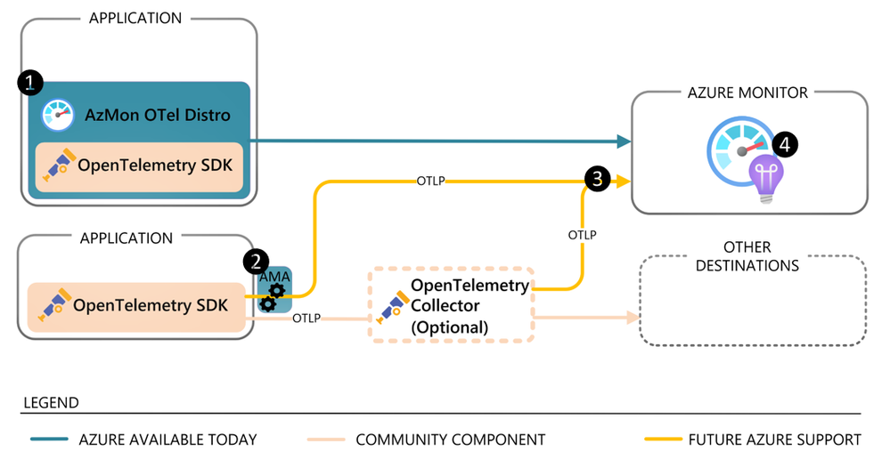
Management & Governance Updates
Generally available: Azure Monitor OpenTelemetry-based Distro for ASP.NET Core Applications
Azure Monitor application insights is a cloud native application monitoring offering which enables customers to observe failures, bottlenecks, and usage patterns to resolve incidents faster and reduce downtime.
With the latest release of Azure Monitor OpenTelemetry-based packages for ASP.NET Core Applications, we offer a GA offering that builds on our commitment to open source, vender-neutral instrumentation.
The Azure Monitor OpenTelemetry “Distro” includes a thin wrapper that enables to get started with a single line of code, and it includes added Azure-specific capabilities to give you a first-class experience on Azure. The Distro is open and extensible, meaning it is possible to send data to multiple destinations and extend the Distro with OpenTelemetry’s rich set of instrumentation libraries that collect data from a large variety of frameworks and environments.
For context, the Azure Monitor OpenTelemetry Java, Node.js, and Python Distros are already Generally Available. We will continue to add capabilities to our OpenTelemetry-based offerings, and we plan for them to reach full feature parity with the Application Insights SDKs.
Azure Update Manager
Alerting (preview)
Azure Update Manager allows you to enable alerts to address events as captured in updates data.
Azure Stack HCI patching (preview)
Azure Update Manager allows you to patch Azure Stack HCI cluster.

Slide 11
Compute

Slide 12
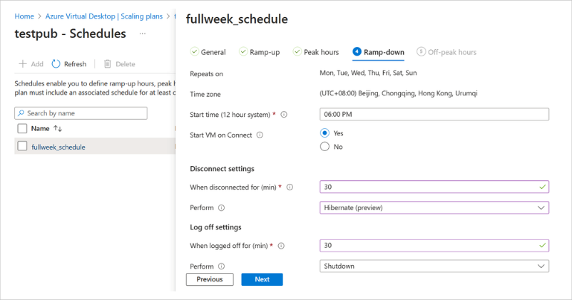
Compute Updates
Pod Security Policy is being deprecated with AKS 1.25 and 2023-06-01 API version
Pod Security Policy (preview) is removed in AKS version 1.25 and retired on 1st August 2023 with AKS version 1.24 retirement.
An AKS cluster with Pod Security Policy (preview) enabled can not be upgraded to AKS version 1.25+.
Required action
MS Recommend to migrate to pod security admission controller or Azure policy to stay within Azure support. Pod Security Admission is a built-in policy solution for single cluster implementations. If you are looking for enterprise-grade policy, then Azure policy is a better choice.
It is also possible to disable Pod Security Policy (preview) on existing clusters to upgrade to AKS version 1.25+
Personal Desktop Autoscale on Azure Virtual Desktop generally available
MS announced that Personal Desktop Autoscale on Azure Virtual Desktop is generally available as of November 15, 2023! With this feature, organizations with personal host pools can optimize costs by shutting down or hibernating idle session hosts, while ensuring that session hosts can be started when needed.
Personal Desktop Autoscale is Azure Virtual Desktop’s native scaling solution that automatically starts session host virtual machines according to schedule or using Start VM on Connect and then deallocates or hibernates (in preview) session host virtual machines based on the user session state (log off/disconnect).
Hibernation is available as a scaling action. With the Hibernate-Resume feature in public preview, you will have a better experience as session state persists when the virtual machine hibernates. As a result, when the session host virtual machine starts, the user will be able to quickly resume where they left off.

Slide 13
Storage & Data

Slide 14
Storage & Data Updates
General Availability: Azure NetApp Files support for 2 TiB capacity pools
It is now possible to choose a minimum size of 2TiB while creating a capacity pool. Capacity pools smaller than 4TiB in size can only be used with volumes using standard network features. This feature of Azure NetApp Files capacity pool enhancement provides a more cost effective solution for running workloads such as SAP shared files and VDI which require lower capacity pool sizes for their capacity and performance needs. When you have less than 2-4 TiB capacity with proportional performance, this allows customers to start with 2TiB as a minimum pool size and increase with 1 TiB increments. For capacities less than 3 TiB, this Azure update saves money by allowing customers to re-evaluate volume planning to take advantage of savings of smaller capacity pools. This feature is supported in all regions with standard network features.
Public preview: Azure NetApp Files support for 1 TiB capacity pools
It is now possible to choose a minimum size of 1TiB while creating a capacity pool. Capacity pools smaller than 2TiB in size can only be used with volumes using standard network features. This allows customers to start with 1TiB as a minimum pool size and increase with 1 TiB increments. For capacities less than 2 TiB, this Azure update saves money by allowing customers to re-evaluate volume planning to take advantage of savings of smaller capacity pools. This feature is supported in all regions with standard network features.

Slide 15
Databases

Slide 16
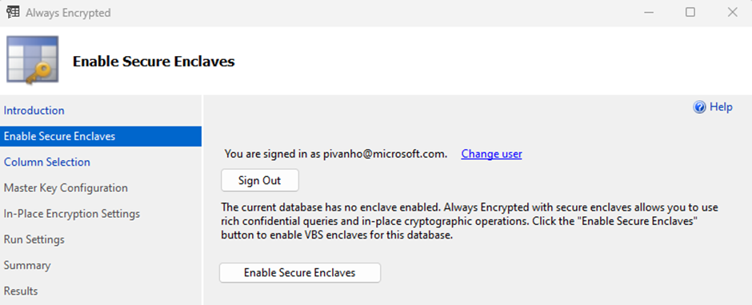
Databases Updates
SQL Server Management Studio improvements for Always Encrypted
With the release of SSMS 19.2 MS introduced a bunch of extra performance improvements and a big Always Encrypted Wizard enhancement:
Always Encrypted Wizard – Enable Secure Enclaves: MS made the wizard smart! When database is not configured with a secure enclave, the wizard will give the opportunity to enable a secure enclave. Using an enclave enables to run cryptographic operations in-place, without moving data out of the database. To enable the secure enclave, simply click the “Enable Secure Enclaves” button.
DacFx - While testing a very simple Always Encrypted scenario, encrypting 1 record with the wizard, it was noticed that DacFx sends 3000+ T-SQL calls to the database. Out of these calls only 2-3% were unique statements. These commands not only unnecessarily overload the SQL Server, but it also added considerable delay in the overall encryption process. MS optimized the repeating T-SQL calls and improved the encryption and decryption process with approximately 20%!
SSMS and Wizard Fixes
We also made some bug fixes in SSMS that were reported to us.
SSMS wizard fails if randomly encrypted columns already exist with and index.
SSMS should not allow the user to Encrypt Columns of a database that is not in an online state.
Cancelling the AE wizard/Set-SqlColumnEncryption cmdlet does not delete temporary tables.
The table owner is changed after encryption.
Encryption of computed columns should not be allowed.

Slide 17
ML & AI & IOT

Slide 18
ML & AI & IOT Updates
Azure Object Anchors Retirement
Please note that Azure Object Anchors (AOA) will be retired on May 20, 2024. Although MS is retiring the AOA service, object anchoring is generally available (GA) in Dynamics 365 Guides (as a SaaS offering). The capability uses the same technology under the hood. Please see the following link for more details: Object Anchors is available in Dynamics 365 Guides
Azure Spatial Anchors Retirement
Please note that Azure Spatial Anchors (ASA) will be retired on November 20, 2024.

Slide 19
Miscellaneous

Slide 20
Miscellaneous Updates

Slide 21
Information

Slide 22
Information
Azure Times GitHub Repo

Slide 23
Questions

