Slide 1
Azure Times #117
May 8, 2024

Slide 2
Networking

Slide 3
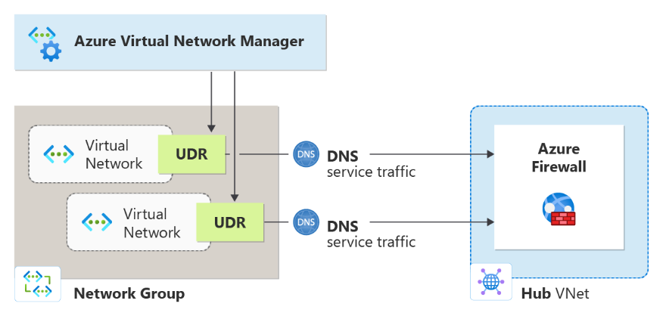
Networking Updates
Azure Virtual Network Manager user-defined route (UDR) management now in public preview
This feature enables to describe desired routing behavior in Azure Virtual Network Manager by defining and applying routing rules to multiple subnets and virtual networks without manually configuring the route tables for each subnet. UDR management works by creating a routing configuration consisting of routing rules and applying those routing rules to collections of subnets or virtual networks – achieving the application of different routing behaviors quickly and easily at scale.
Routing configurations create UDRs based on what the route rules specify.
The following are the limitations of UDR management with Azure Virtual Network Manager:
When conflicting routing rules exist (rules with same destination but different next hops), they aren't supported within or across rule collections that target the same virtual network or subnet.
When you create a route rule with the same destination as an existing route in the route table, the routing rule is ignored.
When a virtual network manager-created UDR is manually modified in the route table, the route isn't up when an empty commit is performed. Also, any update to the rule isn't reflected in the route with the same destination.
Existing Azure services in the Hub virtual network maintain their existing limitations with respect to Route Table and UDRs.
Azure Virtual Network Manager requires a managed resource group to store the route table. If you need to delete the resource group, deletion must happen before any new deployments are attempted for resources in the same subscription.

Slide 4
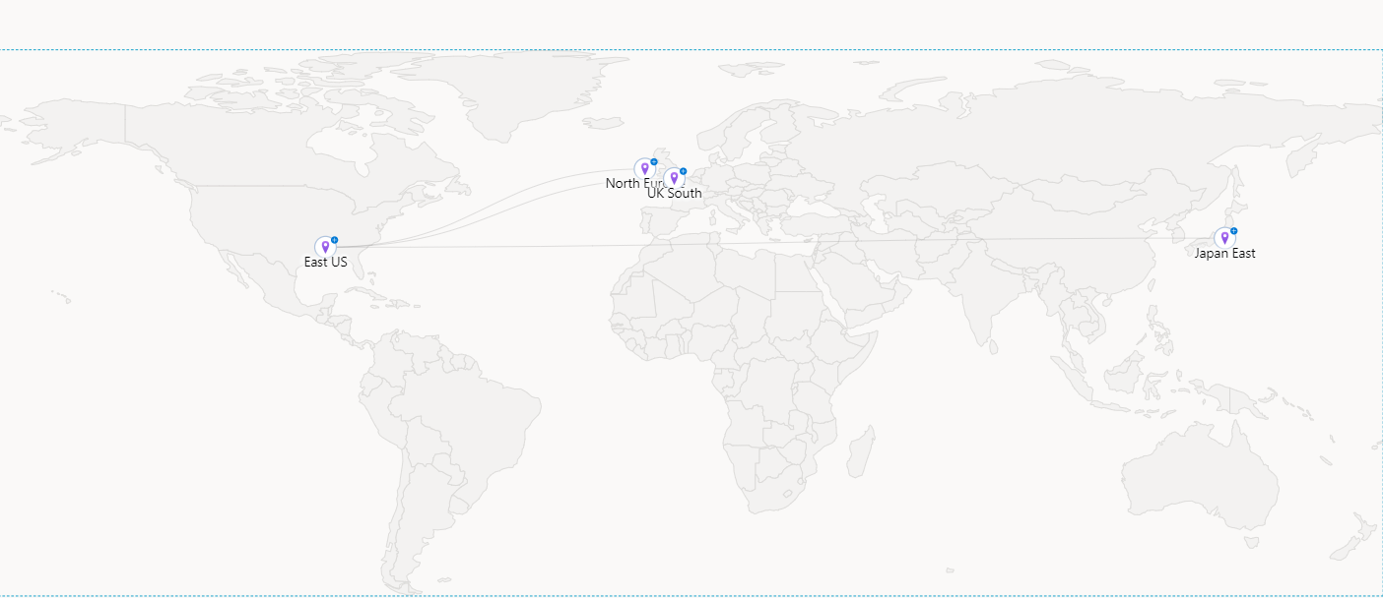
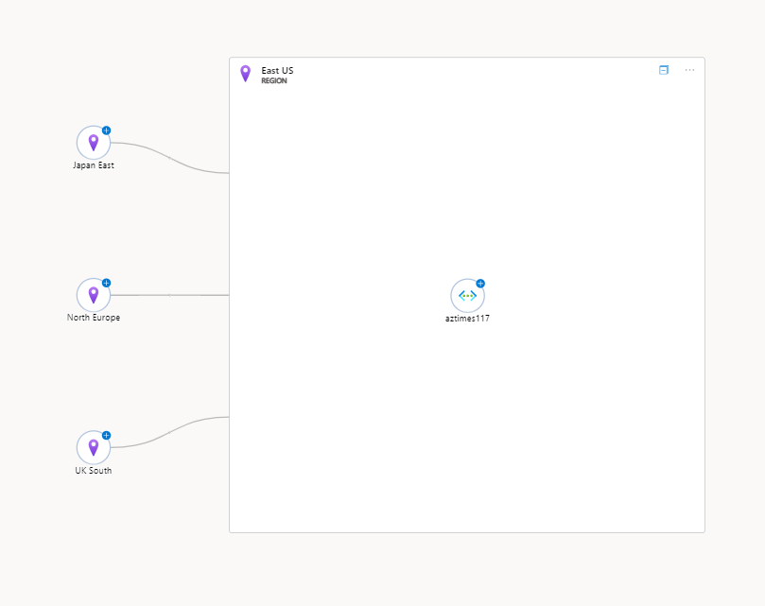
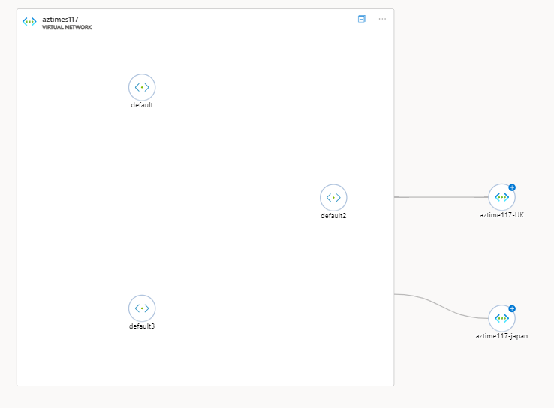
Networking Updates
Azure Network Watcher Topology Updates
The table below provides an overview:
Capability | Classic Topology | New Topology
Available at | Network Watcher | Network Watcher Network Insights Virtual Networks
Available by default | Yes, no configuration needed | Yes, no configuration needed
Cross region support | No | Yes
Cross subscription support | No | Yes
Cross resource group support | No | Yes
Resource Coverage | Limited resources on-boarded (VMs, Virtual Networks, Subnets, Network Interface, Network Security Group) | Comprehensive resource support for Azure Networking resources and VMs and VMSS. See the full list.
Resource health and metrics | No | Yes
Resource cross- connectedness | Yes, with limited information | Overlayed with extensive connectivity, traffic and resource health metrics and insights.
Loss, latency and path insights from Network Watcher - Connection Monitor | No | Yes
Traffic Insights from Network Watcher -Traffic Analytics | No | Yes
Troubleshooting capability with network diagnostic tools | No | Yes
Drill down to smaller scoped views like Virtual Networks, Subnets and resources | No | Yes
Contextual search for resources | No | Yes

Slide 5
Security & Identity

Slide 6

Security & Identity Updates
Microsoft Entra ID Connect Update
Entra ID Auto-upgrade will no longer retry if it detects the machine does not meet the OS or .NET runtime requirements.
Enterprise Scale/Azure Landing Zones
Added new AMA Policies and Initiatives to ALZ Policies documentation.
Updated community call wiki page with links
Tooling
Add new Regulatory Compliance Policy Assignment flexibility feature
Added ARM template to enable Microsoft Defender for Cloud as part of the deployment. Policies will still remediate additional subscriptions added to ALZ after deployment.
Resolved an issue that prevented the policy remediation from working properly for VM Insights, Change Tracking, Azure Update Manager policies. The root cause was a too restrictive access configuration for the Managed Identity that performs the remediation tasks.

Slide 7
Security & Identity Updates
Defender for Cloud Updates
Containers multicloud recommendations (GA)
For Azure
Azure registry container images should have vulnerabilities resolved
Azure running container images should have vulnerabilities resolved
For GCP
GCP registry container images should have vulnerability findings resolved (powered by Microsoft Defender Vulnerability Management) - Microsoft Azure
GCP running container images should have vulnerability findings resolved (powered by Microsoft Defender Vulnerability Management) - Microsoft Azure
For AWS
AWS registry container images should have vulnerability findings resolved (powered by Microsoft Defender Vulnerability Management)
AWS running container images should have vulnerability findings resolved (powered by Microsoft Defender Vulnerability Management)
Deprecation of Cognitive Services recommendation
The recommendation Public network access should be disabled for Cognitive Services accounts is deprecated.
Update to recommendations to align with Azure AI Services resources
Old recommendation | Updated recommendation
Cognitive Services accounts should restrict network access | Azure AI Services resources should restrict network access
Cognitive Services accounts should have local authentication methods disabled | Azure AI Services resources should have key access disabled (disable local authentication)
Diagnostic logs in Search services should be enabled | Diagnostic logs in Azure AI services resources should be enabled
Defender for open-source relational databases updates
Defender for PostgreSQL Flexible Servers post-GA updates
Defender for MySQL Flexible Servers Availability and GA
Defender for Containers is now generally available (GA) for AWS and GCP

Slide 8
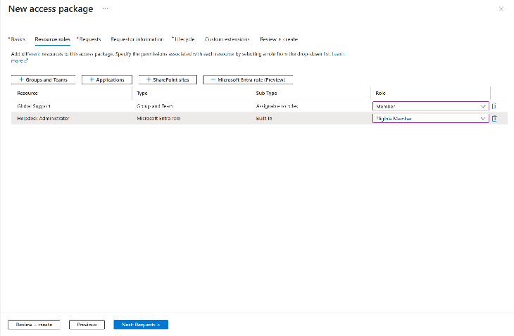
Security & Identity Updates
Entra ID Updates (Public Preview)
FIDO2 authentication in Android web browsers - Users can now sign in with a FIDO2 security key in both Chrome, and Microsoft Edge, on Android. This change is applicable to all users who are in scope for the FIDO2 authentication method. FIDO2 registration in Android web browsers isn't available yet.
Native Authentication for Microsoft Entra External ID - Microsoft Entra’s native authentication allows to have full control over the design of mobile application sign-in experiences. Unlike browser-based solutions, native authentication enables to create visually appealing, pixel-perfect authentication screens that seamlessly blend into your app’s interface.
Passkeys in Microsoft Authenticator - Users can now create device-bound passkeys in the Microsoft Authenticator to access Entra ID resources. Passkeys in the Authenticator app provide cost-effective, phishing-resistant and seamless authentications to users from their mobile devices.
Conditional Access What If API - The Conditional access What If API can be used to programmatically test the impact of conditional access policies on user and workload identity signins.
Configure custom workflows to run mover tasks when a user's job profile changes - Lifecycle Workflows now supports the ability to trigger workflows based on job change events like changes to an employee's department, job role, or location and see them executed on the workflow schedule.
Assign Microsoft Entra roles using Entitlement Management - By assigning Microsoft Entra roles to employees, and guests, using Entitlement Management, it is possible to look at a user's entitlements to quickly determine which roles are assigned to that user. When you include a Microsoft Entra role as a resource in an access package, you can also specify whether that role assignment is “eligible” or “active”. Assigning Microsoft Entra roles through access packages helps to efficiently manage role assignments at scale and improves the role.

Slide 9
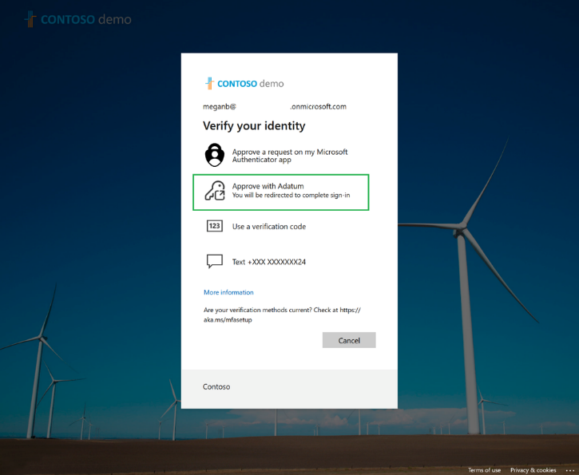
Security & Identity Updates
External authentication methods in Microsoft Entra ID
External authentication methods can be used to satisfy MFA requirements from Conditional Access Policies, Privileged Identity Management role activation, Identity Protection risk-based polices and Microsoft Intune device registration. They’re created and managed as part of the Entra ID authentication methods policy. This gives consistent manageability and experience with the built-in methods.

Slide 10
Security & Identity Updates
Entra ID Updates (GA)
Security group provisioning to Active Directory using cloud sync - Security groups provisioning to Active Directory (also known as Group Writeback) is now generally available through Microsoft Entra Cloud Sync in Azure Global and Azure Government clouds. With this new capability, you can easily govern Active Directory based on-premises applications (Kerberos based apps) using Microsoft Entra Governance.
PIM approvals and activations on the Azure mobile app (iOS and Android) are available now - PIM is now available on the Azure mobile app in both iOS and Android. Customers can now approve or deny incoming PIM activation requests, in addition to activating Microsoft Entra ID and Azure resource role assignments, directly from the app on their phone.
On-premises password reset remediates user risk - Organizations who enabled password hash synchronization can now allow password changes on-premises to remediate user risk. You can also use this to save hybrid users time and maintain their productivity with automatic self-service remediation in risk-based Conditional Access policies.
Self-service password reset Admin policy expansion to include additional roles - Self-service password reset (SSPR) policy for Admins has expanded to include 3 additional built-in admin roles related to Teams
Custom Claims Providers enable token claim augmentation from external data sources - Custom authentication extensions allow you to customize the Microsoft Entra authentication experience by integrating with external systems. A custom claims provider is a type of custom authentication extension that calls a REST API to fetch claims from external systems. A custom claims provider maps claims from external systems into tokens and can be assigned to one or many applications in your directory.
Dynamic Groups quota increased to 15,000 - Microsoft Entra organizations could previously have a maximum of 5,000 dynamic groups and dynamic administrative units combined. MS increased this quota to 15000.
Lifecycle Workflows: Export workflow history data to CSV files - in Lifecycle Workflows, IT admins can now export their workflow history data across users, runs, and tasks to CSV files for meeting their organization's reporting and auditing needs.
Maximum workflows limit in Lifecycle workflows is now 100 - The maximum number of workflows that can be configured in Lifecycle workflows has increased. Now IT admins can create up to 100 workflows in Lifecycle workflows.

Slide 11
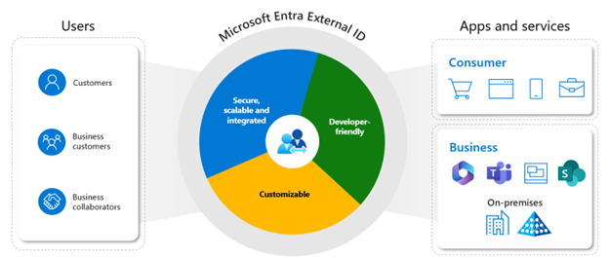
Security & Identity Updates
Entra ID Updates (GA)
Microsoft Entra External ID – is a next-generation, developer-friendly customer identity access management (CIAM) solution. It allows to
Secure B2B collaboration with partners & guests.
Implement robust Customer Identity and Access Management (CIAM) for your customer-facing applications.
The solutions provides:
Native Authentication Support
Integration with External Systems
Brand Customization for Sign-Up/Sign-In
Seamless Integration with Various Identity Providers
Robust Access Control Measures
Risk-Based Authentication for Enhanced Security
Note:
Azure AD B2C is not going to be replaced so far, no push for the migration yet.
Free of charge till 1 of July 2024
Microsoft Entra External ID’s primary package is complimentary for up to 50,000 monthly active users (MAU). Beyond this threshold, each additional active user incurs a fee of $0.03 USD per MAU (with a discounted rate of $0.01625 USD per MAU until May 2025).

Slide 12
Management & Governance

Slide 13
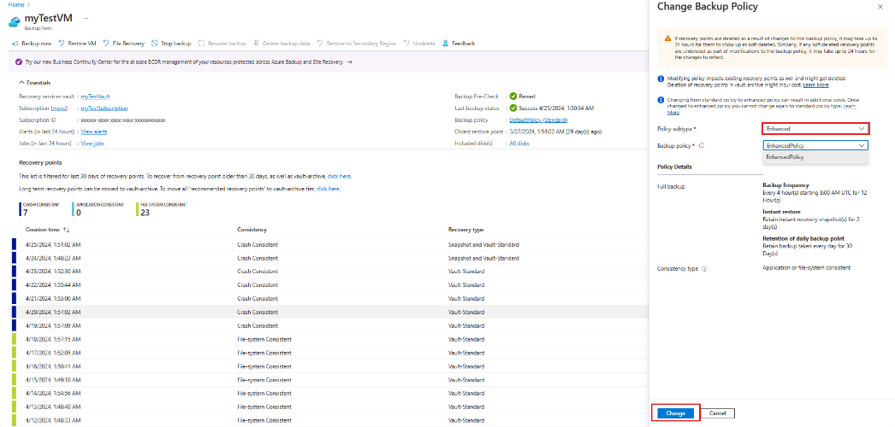
Management & Governance Updates
Migration of Azure VM backups from standard to enhanced policy (preview)
Azure Backup now supports migration to the enhanced policy for Azure VM backups using standard policy. The migration of VM backups to enhanced policy enables to schedule multiple backups per day (up to every 4 hours), retain snapshots for longer duration, and use multi-disk crash consistency for VM backups. Snapshot-tier recovery points (created using enhanced policy) are zonally resilient. The migration of VM backups to enhanced policy also allows to migrate VMs to Trusted Launch and use Premium SSD v2 and Ultra-disks for the VMs without disrupting the existing backups.
Considerations:
Before perform migration, ensure that there are no ongoing backup jobs for the VM that plan to migrate.
Migration is supported for Managed VMs only and isn’t supported for Classic or unmanaged VMs.
Once the migration is complete, it is not possible to change the backup policy back to standard policy.
Migration operations trigger a backup job as part of the migration process and might take up to several hours to complete for large VMs.
The change from standard policy to enhanced policy can result in additional costs.

Slide 14
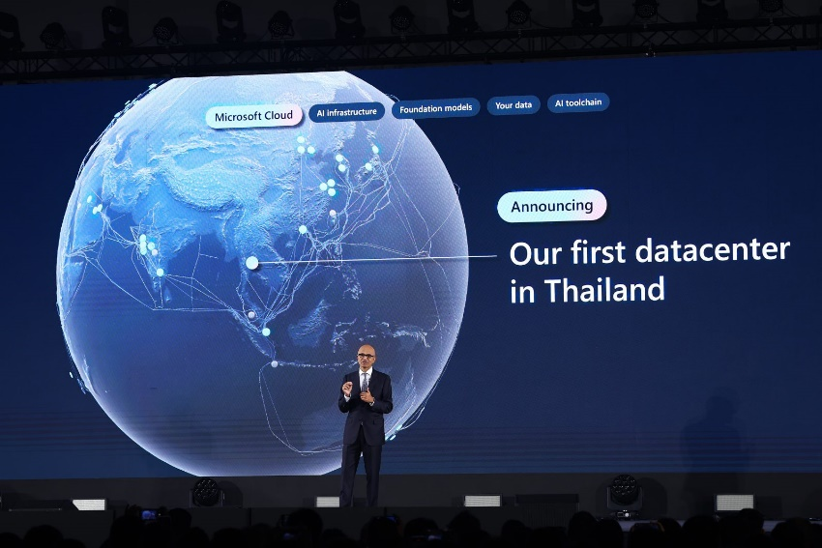
Management & Governance Updates
Azure Governance Update - Management Groups
Beginning May 3, 2024, Azure will start enabling the root management group for tenants that have not enabled it yet. Using Azure management groups leverages best practices when applying Azure Policy and having it pre-enabled reduces the initial set up work to follow the best practices.
A root management group represents the top level of the resource hierarchy
No changes will be made to the subscriptions themselves
No accesses are changed to subscription or resources with this announcement.
New Azure Region:
Microsoft Chairman and CEO Satya Nadella announces a new data center region in Thailand.

Slide 15
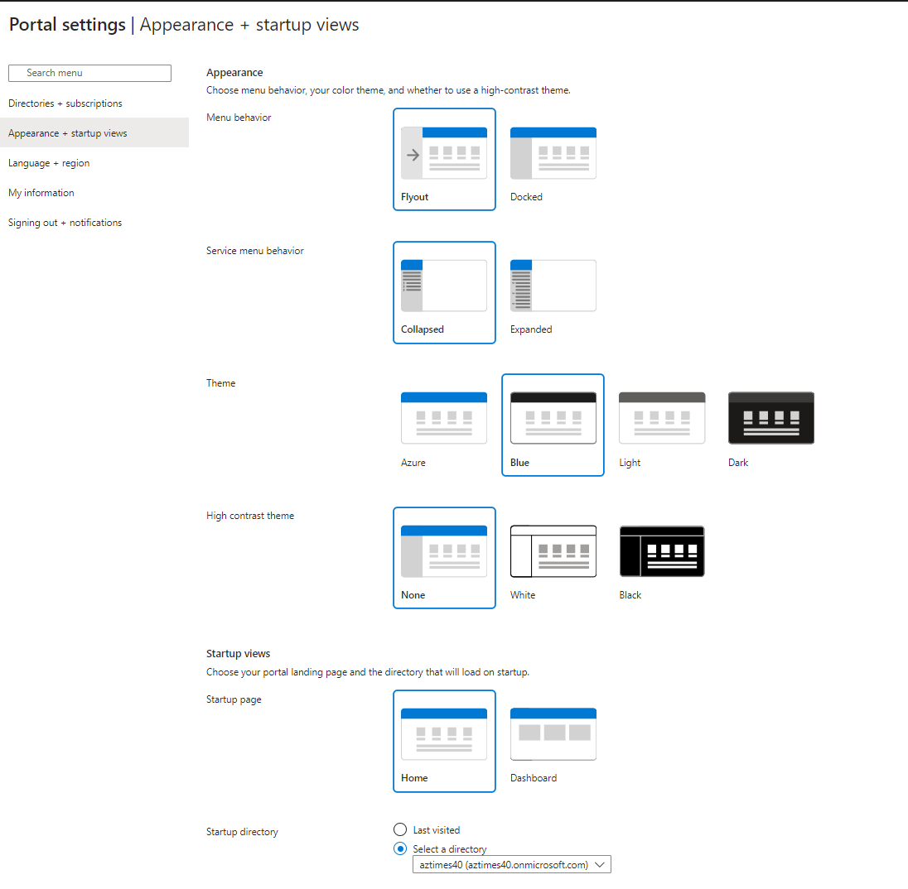
Management & Governance Updates
Azure ARC Enabled Servers Update
Oracle Linux 9 is now a supported operating system
Azure Portal Changes
MS introduced a few changes in the Azure Portal Experience:
Menu Behavior
Flyout
Docked
Service menu
Collapsed
Expanded
On Demand Capacity Reservation is now available in Azure for US Government
MS announced the general availability of on demand capacity reservations for Azure Virtual Machines in Azure for US Government Cloud . It is now possible to manage and reserve capacity with guaranteed SLA for VM sizes available on Azure for US Government Cloud.

Slide 16
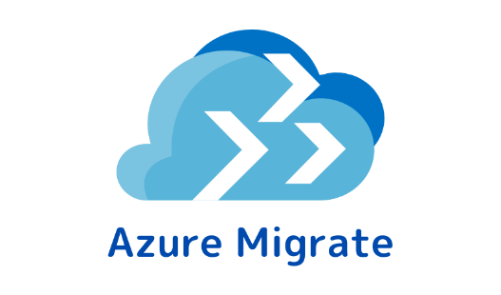
Management & Governance Updates
Azure Proactive Resiliency Library v2
Azure Proactive Resiliency Library v2 (APRL) provides a curated catalog of resiliency recommendations for workloads running in Azure. Many of the recommendations contain supporting Azure Resource Graph (ARG) queries to help identify non-compliant resources.
The site content is organized into four main sections:
Azure Resources: This section provides recommendations for individual Azure resources. Recommendations are organized by Azure resource provider and resource type.
Specialized Workloads: This section provides recommendations for popular workload types. The recommendations cover multiple resource types and include workload specific guidance.
Well-Architected Framework: This section provides resiliency recommendations from the Azure Well-Architected Framework
Tools: This section provides automation scripts for workload evaluation. The scripts execute the ARG queries and create documents for analysis, reporting, and triage.
Azure Migrate Update
Public preview: Azure Migrate now supports discovery and assessment of SAP Systems. Using this capability, it is now possible to perform import-based assessments for on-premises SAP inventory and workloads.
Public Preview: It is now possible to have the capability to assess Java (Tomcat) web apps to both Azure App Service and Azure Kubernetes Service (AKS).

Slide 17
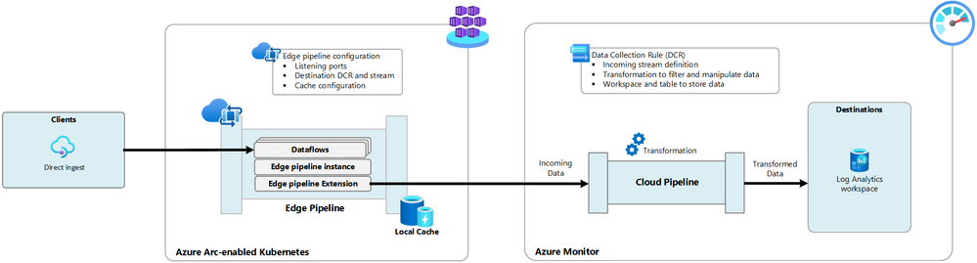
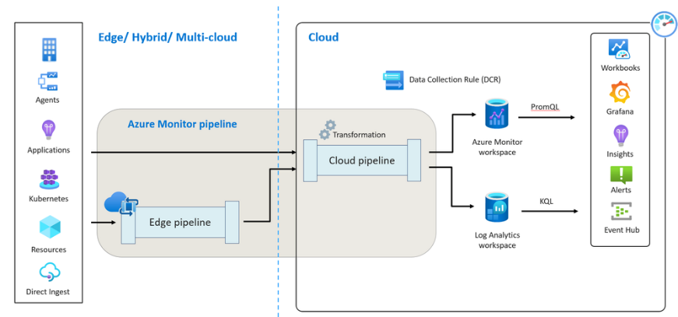
Management & Governance Updates
Public preview: Azure Monitor pipeline (at edge)
Azure Monitor pipeline, similar to ETL (Extract, Transform, Load) process, enhances traditional data collection methods. It streamlines data collection from various sources through a unified ingestion pipeline and utilizes a standardized configuration approach that is more efficient and scalable. This is particularly beneficial for cloud-based monitoring in Azure.
MS is extending Azure Monitor pipeline capabilities from the cloud to the edge, enabling high-scale data ingestion with centralized configuration management.
Azure Monitor pipeline at edge is designed to facilitate high-scale data ingestion and routing from edge environments to Azure Monitor for observability. It leverages the robust capabilities of the vendor-agnostic tool - OpenTelemetry Collector, which is used by enterprises worldwide to manage high volumes of telemetry each month.
The Azure Monitor pipeline at edge is equipped with out-of-the-box capabilities to receive telemetry from a diverse range of resources and route it to Azure Monitor.
The Azure Monitor edge pipeline is a containerized solution that is deployed on an Arc-enabled Kubernetes cluster
Private link is supported by edge pipeline for the connection to the cloud pipeline.

Slide 18
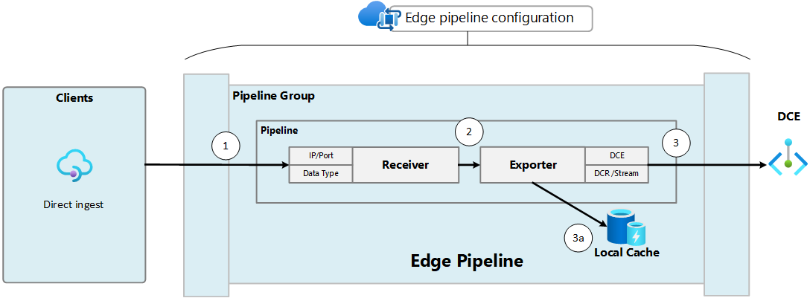
Management & Governance Updates
Public preview: Azure Monitor pipeline (at edge)
Edge pipeline is supported on the following Kubernetes distributions:
Canonical
Cluster API Provider for Azure
K3
Rancher Kubernetes Engine
VMware Tanzu Kubernetes Grid
Supported locations
Edge pipeline is supported in the following Azure regions:
East US2
West US2
West Europe
Client sends data to the edge pipeline receiver
Receiver forwards data to the exporter
Exporter tries to send the data to the cloud pipeline
Exporter stores data in the local cache if it can't connect to the DCE

Slide 19
Compute

Slide 20
Compute Updates
General availability: Mexico Central region added to Azure HDInsight
HDInsight is now generally available in Mexico Central. Azure HDInsight is a managed, full-spectrum, open-source analytics service in the cloud for enterprises. You can use open-source frameworks such as Hadoop, Apache Spark, Apache Hive, LLAP, Apache Kafka, and more.
Public Preview: Azure Dedicated Host – Redeploy
A dedicated host can encounter issues caused by user configurations or underlying host infrastructure. Host ‘Redeploy’ will simplify the process to move an Azure Dedicated Host and its associated Virtual Machines (VMs) from the current node to a different node of the same hardware generation. This could be considered as user-initiated service healing.
After redeploy all the properties of the host will remain unchanged except for 'Asset Id' and also any data on the VMs temporary disks would get deleted.
Available in all public regions
Can be configured via Portal or CLI.
Public Preview: Azure HDInsight on AKS is now available for preview in 7 new regions
Azure HDInsight on AKS is now available for preview in seven new regions - East US 2 EUAP, West US, Japan East, Australia East, Canada Central, North Europe, Brazil South. Azure HDInsight on AKS is a modern, reliable, secure, and fully managed Platform as a Service (PaaS) that runs on Azure Kubernetes Service (AKS). HDInsight on AKS allows you to deploy popular Open-Source Analytics workloads like Apache Spark™, Apache Flink®️, and Trino without the overhead of managing and monitoring containers.

Slide 21
Compute Updates
Azure Spring Apps Feature Update Q1 2024: Save up to 47% with Azure savings plan
Save up to 47%: Azure Spring Apps Enterprise is now eligible for Azure savings plan: All Azure Spring Apps regions under the Enterprise plan are eligible for substantial cost savings – 20% for one year and 47% for three years.
Azure CLI supports log streaming for Spring Cloud Gateway: This feature enables to fetch the Spring Cloud Gateway log in real time for diagnosis purposes.
Azure CLI supports log streaming for Application Configuration Service: The feature enables to retrieve the Application Configuration Service log using the Azure CLI, making it possible to detect any configuration updates.
Shows buildpack versions: The latest feature added to buildpacks assists in comprehending the version used and diagnosing issues associated with the build process.
Enhanced troubleshooting of Application Configuration Service: Now it is possible to directly view the linked configMap for apps to further assist in troubleshooting issues with unrefreshed configurations.
Infrastructure and quality enhancements for Azure Container Registry
MS announced the following significant enhancements to the Azure Container Registry (ACR) infrastructure:
Increased Registry Size: Previously capped at 20TiB, ACR’s registry size has now been auto-upgraded to 40TiB for all customers.
Geo-Replication Expansion: Geo-replication, a critical feature for redundancy and disaster recovery, can now be enabled for all registries over 20TiB. Additionally, performance was optimized, making it 10x faster than before.

Slide 22
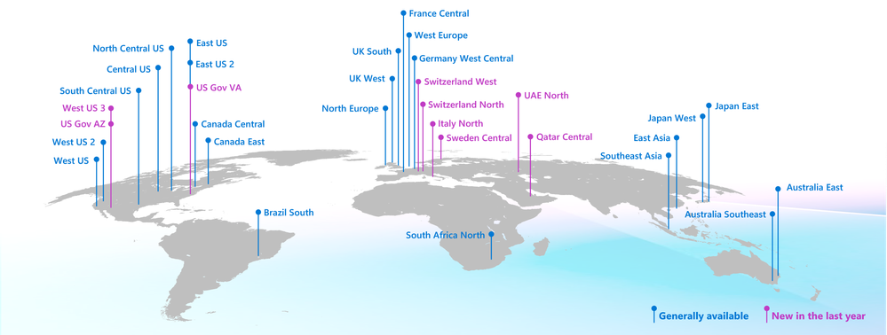
Compute Updates
Azure Linux now supports Azure Kubernetes Service LTS
Azure Kubernetes Service (AKS) added support for Long Term Support (LTS) for certain Kubernetes versions. Now Azure Linux 2.0 will support AKS LTS for v1.27. With Azure Linux support for AKS LTS, customers benefit from having a stable and regularly serviced node operating system in addition to Kubernetes.
Customers can benefit from having a stable Kubernetes version as well as a stable OS version receiving security patches for the whole duration (July 2025).
Components like the kernel, containerd, and systemd will all remain on stable versions receiving backported patches where necessary.
This significantly reduces the risk of breaking changes or compatibility issues that may arise from upgrading critical OS components along with the Kubernetes version.
Azure VMware Solution now available in Italy North, Switzerland North and UAE North
MS announced expansions to three more regions: Italy North, Switzerland North and UAE North. Now in 32 Azure regions, Azure VMware Solution empowers to seamlessly extend or migrate existing VMware workloads to Azure without the cost, effort or risk of re-architecting applications or retooling operations.

Slide 23
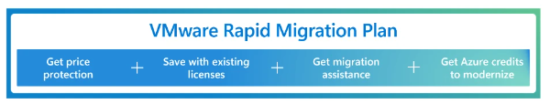
Compute Updates
VMware Rapid Migration Plan
With the VMware Rapid Migration Plan, Microsoft provides a comprehensive set of licensing benefits and programs to give price protection and savings as migrate to Azure VMware Solution.
Public Preview: Hibernation Support extended to GPU and more General Purpose VM sizes.
Azure is announced that hibernation support has been extended to the following General Purpose VM sizes up to 64GB RAM:
Esv5-series
Edsv5-series
Easv5-series
Eadsv5-series
In addition, as previously announced in March, select GPU VM sizes now have hibernation support and are available for public preview in all regions.
GPU sizes up to 112GB RAM in the following VM series now support hibernation in Public Preview-:
NVv4-series
NVadsA10v5-series
This expanded support provides even more opportunities for optimizing compute costs and effectively managing resources on Azure.
MS offer a 20% discount on Azure VMware Solution when you purchase a new one-year Reserved Instance before December 31, 2024. The five-year Reserved Instance for Azure VMware Solution is only available for a limited time and access ends on June 30, 2024.

Slide 24
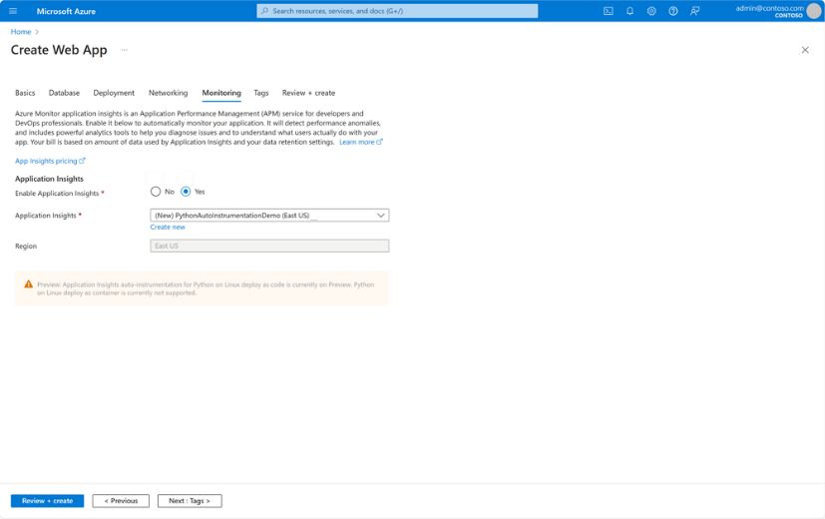
Compute Updates
Public Preview: App Insights integration for Python apps on App Service
App Services for Python apps is now available for Public Preview. It is possible to easily monitor Python apps on App Service without changing code by leveraging auto-instrumentation that is integrated into the App Services platform.
This integration supports App Service deploy as code for Python versions 3.11 and lower. Deploy as container scenarios are not currently supported, but we plan to introduce this capability at a future date.
Red Hat Summit Updates
Red Hat Enterprise Linux Landing Zone
Availability of RHEL 8.10/9.4/9.4 CVM on Azure Marketplace
AHB in Business Case and Assessment phase in Azure Migrate
Azure Red Hat OpenShift (ARO) Advancements
SQL on Linux Innovations

Slide 25
Storage & Data

Slide 26
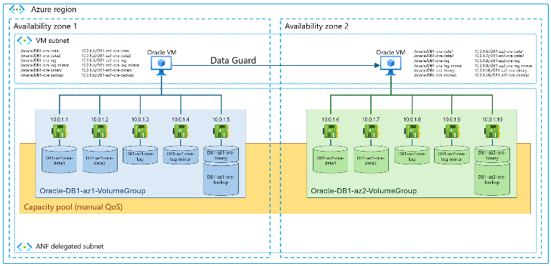
Storage & Data Updates
Azure NetApp: Application volume group for Oracle (Preview)
Application volume group (AVG) for Oracle enables to deploy all volumes required to install and operate Oracle databases at enterprise scale, with optimal performance and according to best practices in a single one-step and optimized workflow. The application volume group feature uses the Azure NetApp Files ability to place all volumes in the same availability zone as the VMs to achieve automated, latency-optimized deployments.
The application volume group feature supports a wide range of Oracle database layouts from small databases with a single volume up to multi 100-TiB sized databases. It supports up to eight data volumes with latency-optimized performance and is only limited by the database VM's network capabilities.
Capabilities:
Supporting a large variation of Oracle configurations starting with 2 volumes for smaller databases up to 12 volumes for huge databases up to several hundred TiB.
Application volume group for Oracle is supported in all Azure NetApp Files-enabled regions.
AVG can deploy 1 to 8 data, log (and optionally, log-mirror), backup, and binary volumes in the selected zone using the same network features setting
The hosting capacity pool needs to be configured with Manual QoS.
Data volumes are deployed following anti-affinity rules to ensure they're spread over as many Azure NetApp Files storage endpoints as possible in the selected zone
The use of application volume group for Oracle for applications other than Oracle is not supported.
Application volume group for Oracle creates multiple IP addresses--at a minimum four IP addresses for a single database.
Application volume group for Oracle currently only supports platform-managed keys for Azure NetApp Files volume encryption at volume creation.
Application volume group for Oracle volumes are deployed in a selectable availability zone for regions that offer availability zones.

Slide 27
ML & AI & IOT

Slide 28
ML & AI & IOT Updates
Generally available: Azure IoT Edge v1.5.0 (LTS) release
The 1.5 version is the latest long-term servicing (LTS) release for Azure IoT Edge. It will be serviced with fixes for regressions and critical security issues through November 10, 2026 (product lifecycle). Full release notes for IoT Edge v1.5 LTS can be found on the GitHub release page.
IoT Edge v1.4 LTS will be supported until November 26, 2024.
The companion release of Azure IoT Edge for Linux on Windows (EFLOW) 1.5 LTS will be coming in Q3 of this calendar year. Release notes for EFLOW can be found on the EFLOW GitHub releases page.
New languages supported in Copilot for Microsoft 365
MS is rolling out support for Copilot for Microsoft 365 in an additional 16 languages: Arabic, Czech, Danish, Dutch, Finnish, Hebrew, Hungarian, Korean, Norwegian (Bokmal), Polish, Portuguese (Portugal), Russian, Swedish, Thai, Turkish, and Ukrainian. These join the growing list of languages in which Copilot is already supported: Chinese (Simplified)​​, English (US, GB, AU, CA, IN)​​, French (FR, CA)​​, German​​, Italian​​, Japanese​​, Portuguese (BR)​​, and Spanish (ES, MX)​​.

Slide 29
ML & AI & IOT Updates
Announcing the General Availability of GPT-4 Turbo with Vision on Azure OpenAI Service
MS announce the general availability (GA) of GPT-4 Turbo with Vision on the Azure OpenAI Service. The GA model, gpt-4-turbo-2024-04-09, is a multimodal model capable of processing both text and image inputs to generate text outputs. This model replaces the following preview models:
gpt-4-1106-preview
gpt-4-0125-preview
gpt-4-vision-preview

Slide 30
DevOps & IaC & Automation

Slide 31
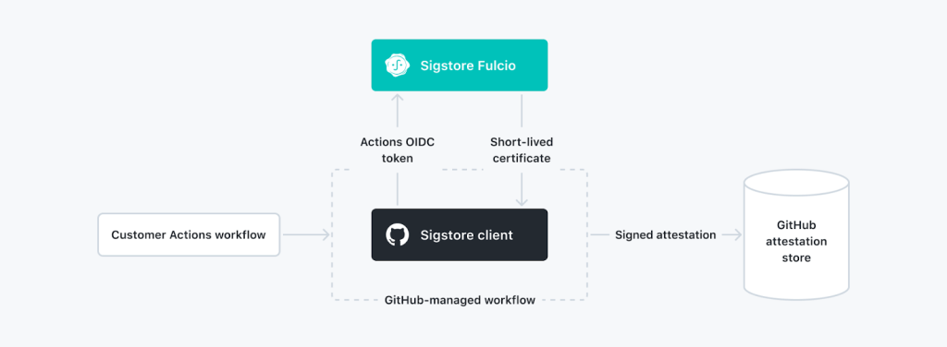
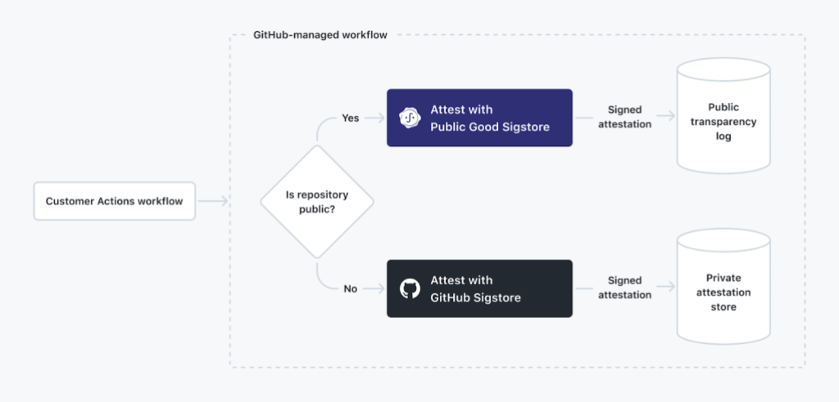
DevOps & IaC & Automation
Artifact Attestations–now in public beta
GitHub announced the public beta of Artifact Attestations, a new feature that will allow project maintainers to effortlessly create a tamper-proof, unforgeable paper trail linking their software to the process which created it. Downstream consumers of that metadata can then use it as a foundation for new security and validity checks through policy evaluation via tools like Rego and Cue. The verification support is based on GitHub CLI as a starting point
Artifact Attestations is powered by Sigstore, an open-source project for signing and verifying software artifacts. This means open-source maintainers can reduce their project’s exposure to supply chain attacks and increase the security of the broader software ecosystem–no matter where maintainers host their code, or build their artifacts.

Slide 32
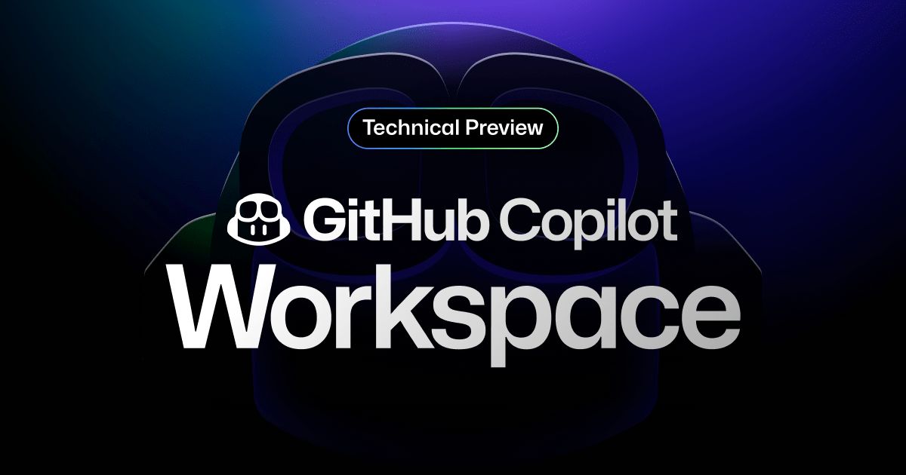
DevOps & IaC & Automation
Generally Available: Azure Chaos Studio supports Resource tags
Azure Chaos Studio is a managed service that uses chaos engineering to help measure, understand, and improve cloud application and service resilience. Chaos Studio now supports Resource tags.
GitHub Copilot Workspace: Copilot-native developer environment
Copilot Workspace allows developers to brainstorm, plan, build, test, and run code in natural language. This new task-centric experience leverages different Copilot-powered agents from start to finish, while giving developers full control over every step of the process.

Slide 33
Miscellaneous

Slide 34
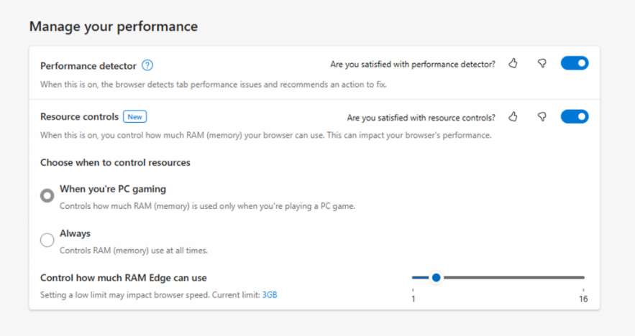
Miscellaneous Updates
MS EDGE Updates
Edge already reduces how much of computer resources the browser uses. And now, starting with Microsoft Edge Beta 125 , it is possible to have even more control over how much memory your browser uses, we’re introducing the new resource controls setting to set how much RAM Edge can use.

Slide 35
Information

Slide 36
Information
Azure Times GitHub Repo

Slide 37
Questions

