Slide 1
Azure Times #89
October 4, 2023

Slide 2
Networking

Slide 3
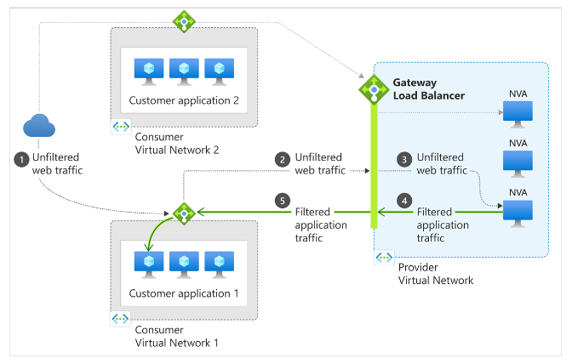
Networking Updates
General availability: Domain fronting update on Azure Front Door and Azure CDN
Domain fronting is a technique that allows an attacker to hide the true destination of a malicious request by using a different domain name in the TLS handshake and the HTTP host header.
As part of ongoing efforts to enhance the security and performance of services, MS implemented the following changes:
Starting from November 8, 2022, MS blocked any new Azure Front Door (Standard, Premium and Classic tier) or Azure CDN Standard from Microsoft (classic) .Any request that has a host header mismatching the original TLS SNI extension used during the TLS negotiation gets rejected.
Starting from September 25, 2023, MS updated the domain fronting blocking restrictions based on feedback from customers. Instead of blocking a request when the SNI and host headers don't match, MS allow the mismatch as long as the two domains are added to the same subscription.
Starting from November 8, 2023, MS Will enforce domain fronting blocking on all existing domains.
Once domain fronting gets blocked, Azure Front Door and Azure CDN Standard from Microsoft (classic) resources block any HTTP/HTTPS requests that exhibit this behavior.
General availability: Gateway Load Balancer IPv6 Support
Azure Gateway Load Balancer now supports IPv6 traffic, enabling to distribute IPv6 traffic through Gateway Load Balancer before it reaches dual-stack applications.
With this support, it is now possible to add IPv6 frontend IP addresses and backend pools to Gateway Load Balancer. This allows to inspect, protect, or mirror both IPv4 and IPv6 traffic flows using third-party or custom network virtual appliances (NVAs). Both internet inbound and outbound IPv6 traffic flows can now be routed through Gateway Load Balancer.
This feature is now generally available in all public regions, Azure China cloud regions, and Azure Government cloud regions.

Slide 4
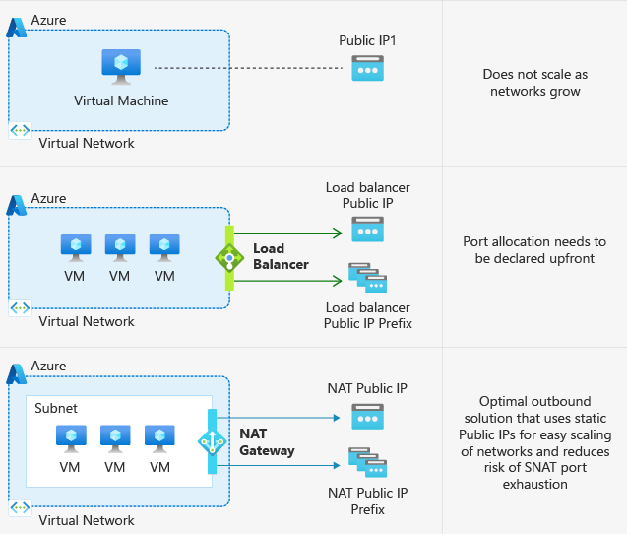
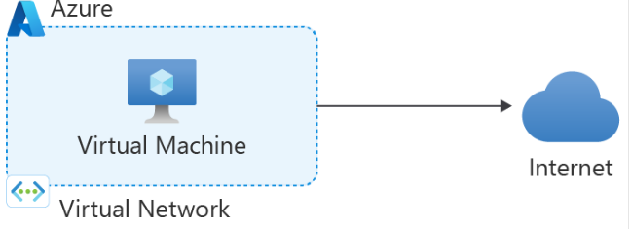
Networking Updates
Default outbound access in Azure
In Azure, virtual machines created in a virtual network without explicit outbound connectivity defined are assigned a default outbound public IP address. This IP address enables outbound connectivity from the resources to the Internet. This access is referred to as default outbound access.
On 30 September 2025, default outbound access connectivity for VMs in Azure will be retired.
After this date, all new VMs that require internet access will need to use an explicit method of outbound connectivity such as Azure NAT Gateway, Azure Load Balancer outbound rules, or a directly attached Azure public IP address. Existing VMs that use default outbound access will still have internet connectivity, however, explicit outbound methods improve reliability.

Slide 5
Security & Identity

Slide 6
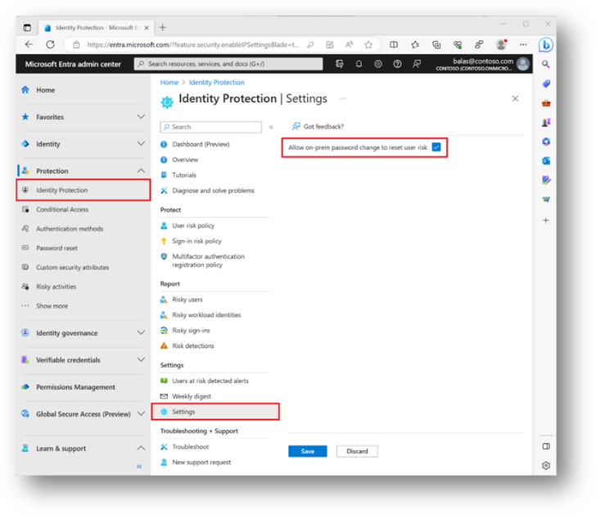
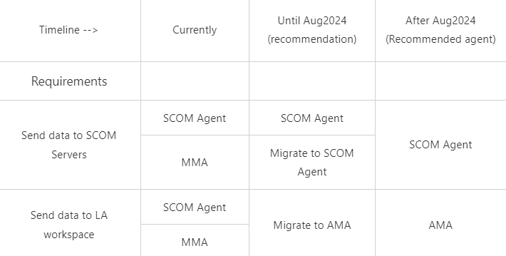
Security & Identity Updates
Remediate User Risks in Microsoft Entra ID Protection Through On-premises Password Changes
MS made it easier to manage user risk in hybrid environments in Microsoft Entra ID Protection where on-premises password change can now automatically remediate user risk.
Users’ risks will be automatically remediated when their passwords are changed on-premises, and customers can confidently deploy user risk policy to effectively protect their hybrid users.
Azure AD Connect V1 is retired
On October 1, 2023, Azure AD cloud services will stop accepting connections from Azure AD Connect V1 servers, and identities will no longer synchronize.
If you are still using Azure AD Connect V1 you must take action immediately.
Agent SCOM Recommendations
A SCOM user can currently use SCOM agent or Log Analytics agent (aka MMA) to monitor Virtual machines & send data to SCOM servers and optionally, send the data to Azure Log Analytics workspace. As the deprecation data of August 31, 2024, MS provides the following High-Level Recommendations:

Slide 7
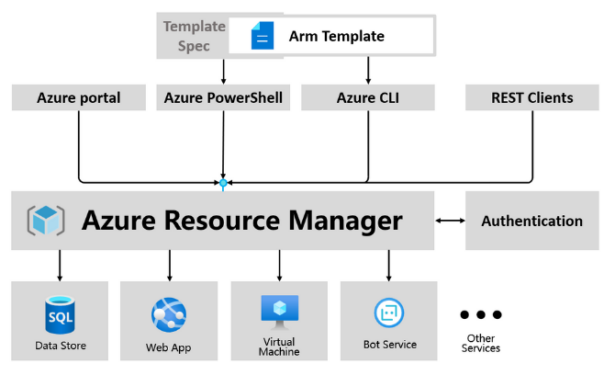
Security & Identity Updates
Announcing template-based previews of Azure CLI and Azure PowerShell for Key Vault deployments
MS switched to the ARM template mechanism for the Key Vault command line. Compared with the previous implementation, calling REST API through SDKs, this implementation scheme has the following advantages that users can benefit from.
Consistency. Ensure consistent behavior and defaults between Azure CLI, Azure PowerShell, and Portal.
What-If. Support a ‘what if’ option to predict the impact of a deployment before the command is executed.
Idempotency. Sending the same request multiple times will produce the same result, regardless of resource state.

Slide 8
Management & Governance

Slide 9
Management & Governance Updates
Ungated Public Preview: Azure API Center
Azure API Center is a new Azure service that is part of the Azure API Management platform. It is the central hub where you can effortlessly keep track of all APIs company-wide, making them readily discoverable, reusable, and manageable.
During this ungated public preview phase, the following advantages and capabilities can be gotten:
Create an Azure API Center service
Register new APIs into your API Center
View, create, edit, or delete API versions and associate API versions with environments
Define and manage custom metadata schema for your APIs
Browse, filter and search APIs based on their metadata in the Azure Portal
Key capabilities of API Center preview include:
API inventory management: Inventory all APIs in organization in a centralized place. APIs can be of any type (e.g., REST, GraphQL, gRPC), lifecycle stage (e.g., development, production, deprecated), or deployment location (e.g., Azure cloud, on-premises data centers, other clouds).
Real-world API representation: Capture and present comprehensive information about APIs, including versions, specifications, deployments, and deployment environments.
Metadata properties: Organize and enrich cataloged APIs, environments, and deployments with unified built-in and custom metadata across the whole asset portfolio for enhanced governance and discoverability.
Workspaces: Manage administrative access to APIs and other assets with role-based access control. Use workspaces to scope permissions to teams.

Slide 10
Management & Governance Updates
Azure Virtual Desktop Insights Powered by the Azure Monitor Agent
MS announced that Azure Virtual Desktop Insights (AVDI) using the Azure Monitor Agent (AMA) is now generally available.
MS announced that Azure Virtual Desktop Insights (AVDI) using the Azure Monitor Agent (AMA) is now generally available. The original version of Azure Virtual Desktop Insights utilizes the Log Analytics Agent, which is scheduled to reach end of life in August of 2024. In anticipation of that, the new default AVD Insights experience for reporting at the host pool level is now powered by the AMA.
The legacy version of AVD Insights using the Log Analytics Agent will continue to be made available and supported up to the deprecation timeframe of August 2024. To ensure a smooth and easy transition, we encourage you to plan your migration to the AMA well in advance.
Breaking Change for VM & VMSS PowerShell/CLI Customers
MS announced the upcoming changes for default security type change to Trusted Launch that will affect new virtual machines (VMs), virtual machine scale sets (VMSS), and OS Disk resource deployment in Azure. The change will set OS image to Trusted Launch (TL) compatible image and set security type as Trusted Launch by default.
This change will take effect in Azure PowerShell (PS) & command-line interface (CLI) with the November 2023 release, and will affect all new Azure VMs, VMSS and Managed OS Disks deployments.
Trusted Launch VMs provide you with foundational compute security by enabling the following capabilities:
Secure Boot: Protects OS against rootkits and boot kits.
vTPM: It serves as a dedicated secure vault for keys and measurements, enabling attestation by measuring the entire boot chain of your VM.
Boot Integrity Monitoring: Guest attestation extension enables proactive attestation and monitoring the boot integrity of your VMs.

Slide 11
Compute

Slide 12
Compute Updates
GA: Support for Python 3.11 in Azure Functions
Support for Python 3.11 with Azure Functions is now generally available.
It is now possible to develop Python 3.11 apps locally and deploy them to all Azure Functions plans. Check What’s New In Python 3.11.
Public preview: Azure Functions Support for Node.js 20
Azure Functions support for Node.js 20 is now in public preview.
It is now possible to develop functions using Node.js 20 locally and deploy them to all Azure Functions plans on Linux and Windows.
Public preview: Azure Functions extension for Dapr
Azure Functions extension for Dapr is now in public preview.
It is now possible to use Dapr’s powerful cloud native building block APIs (e.g. Service Invoke with service discovery & mTLS, PubSub, Bindings, Secrets and Actors) and a large array of ecosystem components in the native and friendly Azure Functions triggers & bindings programming model. The extension is available to run on AKS and ACA services.
Generally Available: Azure Functions v4 Programming model for Node.js
The v4 programming model for Azure Functions using Node.js is now generally available. This programming model is part of Azure Function’s larger effort to provide a flexible and intuitive experience for all supported languages.
With the v4 programming model, you will benefit from:
Flexible folder structure that allows to organize triggers in a way that makes sense to your Function App
Simplified trigger configuration that provides the ability to define functions in code
HTTP request and response types are adjusted to be a subset of the fetch standard instead of types unique to Azure Functions
Support for IntelliSense for JavaScript, and improvements to IntelliSense for TypeScript.

Slide 13
Compute Updates
GA: Vertical Pod Autoscaling add-on for AKS
The Vertical Pod Autoscaling (VPA) add-on for AKS is now generally available. Vertical Pod Autoscaling is a Kubernetes open-source project which aims to help right size workloads by setting up to date resource requests and limits for the containers in pods based on past usage, ensuring stability, cost-efficiency, and improved cluster utilization for your workloads.
Vertical Pod Autoscaler provides the following benefits:
It analyzes and adjusts processor and memory resources to right size applications. VPA isn't only responsible for scaling up, but also for scaling down based on their resource use over time.
A Pod is evicted if it needs to change its resource requests if its scaling mode is set to auto or recreate.
Set CPU and memory constraints for individual containers by specifying a resource policy
Ensures nodes have correct resources for pod scheduling
Configurable logging of any adjustments to processor or memory resources made
Improve cluster resource utilization and frees up CPU and memory for other pods.
Limitations
Vertical Pod autoscaling supports a maximum of 500 VerticalPodAutoscaler objects per cluster.
Public preview: AKS support for Kubernetes version 1.28
AKS now supports Kubernetes version 1.28 in public preview.
Among other enhancements, this latest Kubernetes version provides the following:
node components for the oldest supported minor version now work with control plane components for the newest supported minor version
Improvements to CustomResourceDefinition validation rules
Recovery from non-graceful node shutdown
Match conditions for admission webhooks
More information is available here

Slide 14
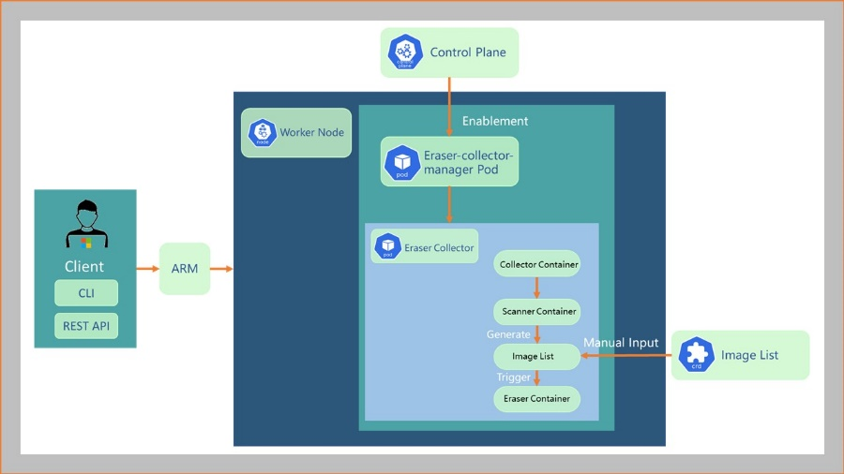
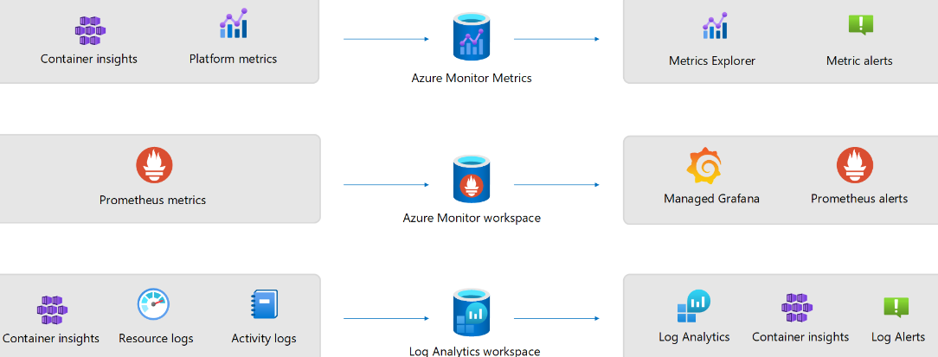
Compute Updates
GA: AKS image cleaner
AKS image cleaner feature is now generally available.
With image cleaner, all the unused, vulnerable images are detected and removed from the AKS nodes automatically. This allows to save time by no longer needing to manually remove unused images. It also minimized security risks by removing unused and potentially vulnerable images from your AKS clusters.
Limitations
Image Cleaner doesn't yet support Windows node pools or AKS virtual nodes.
GA: Node OS patching - NodeImage feature in AKS
Node OS patching – NodeImage feature is now generally available for AKS. This feature provides an exclusive channel to control OS security updates for nodes. With this feature, it is possible to have a flexible and customized strategy for node-level OS security updates and a separate plan for cluster-level Kubernetes version auto-upgrades auto-upgrade.
GA: Dedicated table support for AKS diagnostics logs
Dedicated table support for AKS diagnostic logs is now generally available. This feature makes it easier and faster to query logs, while also optimizing costs and enhancing query performance. It is now possible to sendAKS diagnostic logs to resource-specific tables in Log Analytics, which allows to take advantage of dedicated schemas that support the “Basic Log” plan. This plan offers reduced data ingestion costs and retention periods, so you can save costs while still getting the insights you need.

Slide 15
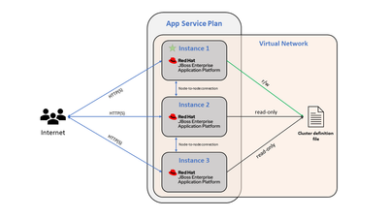
Compute Updates
Generally available: Azure Load Testing in Southeast Asia, Canada Central, Germany West Central and Central India
Enabling VNet integration is required for communication between servers that form the cluster. Clustering is enabled automatically but can be disabled using an Application Setting (WEBSITE_DISABLE_CLUSTERING). It gives:
Clustering of web applications, including HTTP session replication, HA (high availability), and Singleton Service.
High-availability support
Transaction recovery support
Advanced Clustering Features for JBoss EAP on Azure App Service
Previously JBoss EAP integration with an Azure Virtual Network (VNet) has a clustering as in option now it isn't just an option, it's a built-in feature that kicks in automatically.
One key update in this release is the automatic enablement of clustering when activate VNet Integration for web application. This results in a high-availability setup right from the get-go.

Slide 16
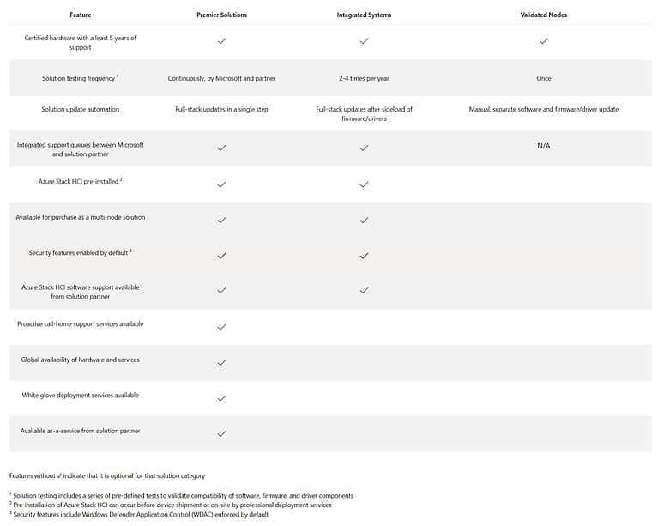
Compute Updates
Premier Solutions for Azure Stack HCI
Premier Solutions is a new type of Azure Stack HCI products that offers customers a better operational experience, quicker time to value, and more flexibility with as-a-service purchasing options.
All Premier Solutions include:
The most complete integration between hardware, software, and cloud services, so customers can reduce time spent managing infrastructure and instead focus on innovation.
Continuous testing by Microsoft and our partners to ensure higher reliability and less downtime.
End-to-end deployment workflows that make it easy to deploy one cluster, dozens of clusters, or a thousand clusters, repeatedly and reliably.
Automated and jointly tested full-stack updates that provide seamless updates with a single click.
Flexible purchasing models and a variety of available value-added services to reduce the friction of getting started.
Global availability for a consistent solution across a customer’s global estate.

Slide 17
Compute Updates
GA: Azure Container Apps in Azure China cloud
MS announced that Azure Containers Apps is now generally available in the Azure China cloud. Azure Container Apps is a fully managed serverless container service which offers an ideal platform for application developers who want to run microservices, APIs, and more using containers without managing infrastructure. Azure Container Apps is available in the China North 3 region.
Container Apps is built on a foundation of powerful open-source technology. Behind the scenes, every container app runs using the Kubernetes API, with KEDA, Dapr, and Envoy baked in.
Generally Available: Artifact cache for Azure Container Registry
Artifact cache feature for Azure Container Registry is now generally available. Artifact cache allows to cache container images and OCI artifacts inside Azure Container Registry. Caching container images inside Azure Container make pull operations more reliable.
With the generally available release, MS support seven public registries, as follows:
Docker Hub
Microsoft Artifact Registry
Quay.io
ECR Public
GitHub Container Registry
Nvidia (Azure CLI only)
registry.k8s.io (Azure CLI only)
Limitations
Artifact Cache feature doesn't support Customer managed key (CMK) enabled registries.
Cache will only occur after at least one image pull is complete on the available container image. For every new image available, a new image pull must be complete. Artifact Cache doesn't automatically pull new tags of images when a new tag is available. It is on the roadmap but not supported in this release.
Artifact Cache only supports 1000 cache rules.

Slide 18
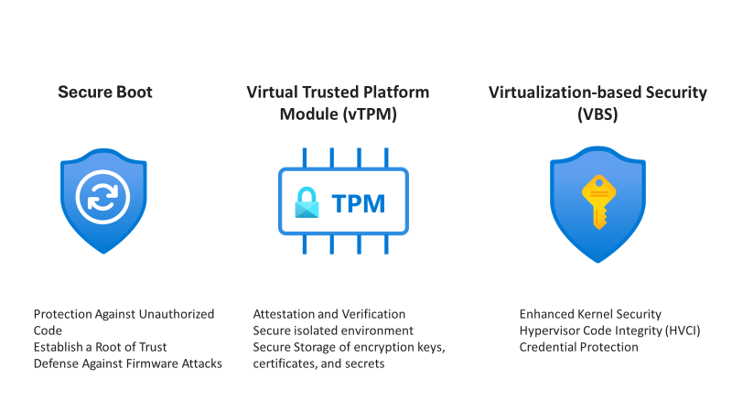
Compute Updates
Trusted Launch for Azure VMware Solution virtual machines
Azure VMware Solution introduced Public Preview of Trusted Launch for Virtual Machines. This advanced feature comprises Secure Boot, Virtual Trusted Platform Module (vTPM), and Virtualization-based Security (VBS), collectively forming a formidable defense against modern cyber threats.
Azure VMware Solution is a VMware validated first party Azure service from Microsoft that provides private clouds containing VMware vSphere clusters built from dedicated bare-metal Azure infrastructure.

Slide 19
Storage & Data

Slide 20
Storage & Data Updates
Generally available: Zone Redundant Storage for Azure Disks is now available in more regions
Zone Redundant Storage (ZRS) for Azure Disk Storage is now generally available on Azure Premium SSDs and Standard SSDs in China North 3, India Central, Switzerland North, South Africa North and Sweden Central regions.
Disks with ZRS provide synchronous replication of data across three availability zones in a region, enabling disks to tolerate zonal failures without causing disruptions to your application. This feature enables disks to tolerate zonal failures without causing disruptions to application. Additionally, it allows you to maximize virtual machine availability without the need for application-level replication of data across zones. It is also possible to use ZRS with shared disks to provide higher availability for clustered or distributed applications like SQL FCI, SAP ASCS/SCS, or GFS2.

Slide 21
Databases

Slide 22
Databases Updates
Public Preview: Additional cache sizes for Azure Cache for Redis Enterprise
The Enterprise tier of Azure Cache for Redis now offers three additional cache sizes: the E5, E200, and E400 SKUs. These additional sizes allow to optimize the price/performance of cache deployments while providing all the same Enterprise features, like vector search capability and active geo-replication. The E5 SKU is smallest offering, providing a lower price point to get started with the Enterprise tier. The E200 and E400 offerings give even larger options with 200 GB and 400 GB memory sizes, respectively. Because Redis Enterprise can take advantage of the additional vCPUs running on these VMs, the E200 and E400 offerings also provide increased compute performance.
Generally available: Custom partitioning in Azure Synapse Link for Azure Cosmos DB
Partition Azure Cosmos DB analytical data using keys that are critical for business logic to achieve better query and data load performance.
Partition pruning results in faster analytical queries and loads, as less data is scanned in the partitioned stores. You can also benefit from the data processing improvements if workloads have a significant number of updates or deletes.
This capability is available for Apache Spark in Azure Synapse Analytics, now generally available in all Azure regions.

Slide 23
Databases Updates
Public Preview: Azure SQL Database free offer
Try Azure SQL Database free of charge for the life of subscription. Power the application to build with just a couple of clicks. With this new offer it is possible to get a a 32 GB General Purpose, serverless Azure SQL database with 100,000 vCore seconds of compute free every month.
This is a great starter option for many scenarios, whether you are learning SQL, developing a web app that needs a database, or you simply need an additional database for proof of concept on an application such as PowerBI reporting. This new offer is available to any Azure subscription type. Every month your free amount will renew, for the life of the subscription. If you want to scale up your database, it's just a few clicks to continue usage for additional charges.
This offer is rolling out by region, with new regions added every week. The following regions are currently supported: East US, West Central US, UK South.
This offer is available for one database per Azure subscription
There are two options for the Behavior when free limit reached setting:
Once the monthly limits on vCore activity or storage are met, the database can be auto-paused until the beginning of the next calendar month.
This is the Auto-pause the database until next month option.
Keep the database online, with vCore usage and storage amount over the free limits charged to your subscription's billing method, at the standard General Purpose tier serverless rates.
This is the Continue using database for additional charges option.

Slide 24
Databases Updates
Public preview: Azure Database for MySQL flexible maintenance
MS introduced the flexible maintenance feature for Azure Database for MySQL. With this update, they provide more control over when maintenance happens, facilitating smoother operations and greater flexibility. Whether you are utilizing a system managed or custom managed window, It is possible to reschedule maintenance to a time that suits you, within the boundaries of earliest and latest permissible timeframes. Please note that this feature is not yet available for the burstable SKU.
Rescheduling isn't confined to fixed time slots; it depends on the earliest and latest permissible times in the current maintenance cycle. Upon rescheduling, a notification will be sent out to confirm the changes, following the standard notification policies.
Demand Constraints: Your rescheduled maintenance might be canceled due to a high number of maintenance activities occurring simultaneously in the same region.
Lock-in Period: Rescheduling is unavailable 15 minutes prior to the initially scheduled maintenance time to maintain the reliability of the service.
General availability: Azure SQL updates for late-September 2023
Max log rate on SQL Managed Instance Business Critical is now doubled: The new limit of 192 MiB/s significantly improves the overall performance for write-intensive user scenarios such as data ingestion and index maintenance and allows instances to manage more workload for the same price
Restore backups from Amazon S3 to Azure SQL Managed Instance is now available. This feature offers users a flexible way of restoring backups and makes database migration to Azure SQL Managed Instance easier.

Slide 25
Miscellaneous

Slide 26
Miscellaneous Updates
Fall for Intelligent Apps
MS provides an exciting learning journey that will empower you to create highly differentiated digital experiences. From September 18th to October 31st, dive into the realm of intelligent app development with Azure and elevate your skill set.
AI Skills Challenge
Explore how to leverage cognitive services and generative AI models with advanced language and code comprehension to responsibly build innovative apps in this challenge. This Cloud Skills Challenge invites you to uncover the incredible potential of large-scale, generative AI models. Deepen your understanding of language and code to enable groundbreaking applications that are not just cutting-edge but also responsibly designed.
Data Skills Challenge
Data is the lifeblood of intelligent solutions, and it's time to unlock the potential of our vast data stores. In this Cloud Skills Challenge, you'll embark on an exploration of cloud-scale data with Microsoft Fabric. Discover the capabilities that can supercharge your ability to build data-driven intelligent solutions. Join the vibrant Fabric Community as you delve into the fascinating world of data innovation. Connect with fellow learners and experts at https://aka.ms/fabriccommunity.

Slide 27
Miscellaneous Updates
Public Preview: Azure Communication Services Job Router
Azure Communication Services Job Router is now available in public preview, simplifying the development of routing capablities for inbound customer communications so businesses can focus on what matters most, delivering effective and efficient customer experiences.
Azure Communication Services Job Router acts as a matchmaker, intelligently queueing and steering inbound customer communications, or "jobs", to the most suitable point of contact in a business based on a mix of pre-defined and runtime rules and policies. Whether it is an agent in a contact center with a specific skill set, or an automated service designed to manage routine inquiries, Job Router ensures that every inquiry is pointed to the most appropriate resource available.
Here are examples of the routing rules that can be created with Azure Communication Services Job Router:
Skills-based routing
Priority (label)-based routing
Source-based routing
Percentage-based routing
Time-based routing
Longest idle routing
Least occupied agent routing
Round Robin
Managed identity and service principal support for Azure DevOps now in General Availability (GA)
Service Principals and Managed Identities can now be used to authenticate with Azure DevOps.
Service principals and managed identities provide an exciting new alternative to personal access tokens (PATs), one of our most widely used authentication methods that is tied to the user that created the token. Teams have traditionally relied on PATs to power applications, services, and automation tools to access organizational resources. However, using an authentication method tied to a single person also means relying on a single point-of-failure. When a user leaves the company, the PAT driving the team application will become inaccessible to all other team members.
Additionally, PATs are bearer tokens, which can be leaked easily and fall into the wrong hands. (Remember to always secure your secrets in a key management solution, like Azure Key Vault!) This leaked PAT can then be used to wreak havoc for the remaining duration of the PAT’s lifetime, or until revoked.
GA Updates:
Set object-level permissions on service principals and managed identities across the site
Extended capabilities for service principals and managed identities in the Boards space
Extended capabilities for service principals and managed identities in the Boards space

Slide 28

Miscellaneous Updates
Expanding Our AI Partnership with Meta
MS announced that the have begun to work with Meta to integrate Bing into Meta AI’s chat experiences enabling more timely and up-to-date answers with access to real-time search information. Bing’s integration extends to Meta AI and a few of Meta’s other AIs available to message with in WhatsApp, Messenger, and Instagram.
The GitHub Universe 23
GitHub Universe will take place between November 8-9, you still can register here.

Slide 29
Miscellaneous Updates
Introducing Town Halls in Microsoft Teams and Retiring Microsoft Teams Live Events
MS announced, ‘Town hall,’ a new virtual event experience that will replace Teams Live Events and will be generally available for commercial customers starting October 5, 2023.
Attendee capacity: Town hall capacity in Office and Microsoft 365 offerings will host up to 10,000 attendees and up to 20,000 attendees in Teams Premium.
Event concurrency: Town hall in Office and Microsoft 365 offerings will support up to 15 events hosted simultaneously across a tenant and up to 50 concurrent events in Teams Premium.
Event duration: As Town hall will be integrated as a part of the Teams meeting experience, events duration will be the same as meetings duration, which is up to 30 hours and will be the same for Office and Microsoft 365 offerings and Teams Premium.
Event roles
External presenter
Viva Engage integration
At the same time MS is going to retire Teams Live Events, where the Teams Live Events platform for commercial customers will continue to be supported over the next 12 months and fully retire by September 30, 2024

Slide 30
Retirement

Slide 31
Retirement
Action required: Retirement of “Get Alert Smart groups” in Azure Monitor
Azure API for FHIR retiring on 30 September 2026 | Azure updates | Microsoft Azure
Azure Internet Analyzer will be retired on 15 March 2024 – delete profiles | Azure updates | Microsoft Azure
Transition to the ContainerLogV2 table by 30 September 2026 | Azure updates | Microsoft Azure
Support for select marketplace images for Batch pools will be retired | Azure updates | Microsoft Azure
Azure Batch pool list usage metrics API will be retired on 30 September 2024 | Azure updates | Microsoft Azure
Azure Batch CLI extensions will be retired on 30 September 2024 | Azure updates | Microsoft Azure
Action required: Migrate to using ARG query for “Get Alert Summary” in Azure Monitor | Azure updates | Microsoft Azure
We’re ending support for the 2017-03-01-GA API. | Azure updates | Microsoft Azure
Azure Batch task authentication token will be retired on 30 September 2024 | Azure updates | Microsoft Azure
Azure CycleCloud support for HTCondor scheduler cluster type will be retired on 30 September 2024 | Azure updates | Microsoft Azure
Azure CycleCloud support for BeeGFS filesystem cluster type will be retired on 30 September 2024 | Azure updates | Microsoft Azure
Azure CycleCloud support for automatic configuration of LVM for Azure CycleCloud volume mounts will be retired on 30 September 2024 | Azure updates | Microsoft Azure
AI Services Personalizer will be retired on 1 October 2026 | Azure updates | Microsoft Azure
Azure AI Translator S2-S4 billing instances will be retired on 1 October 2026 – transition to Commitment Tiers for discounted pricing. | Azure updates | Microsoft Azure
AI Services Anomaly Detector will be retired on 1 October 2026 | Azure updates | Microsoft Azure
AI Services Metrics Advisor will be retired on 1 October 2026 | Azure updates | Microsoft Azure
Azure Virtual Desktop (classic) will be retired on 30 September 2026 - Please transition to Azure Virtual Desktop | Azure updates | Microsoft Azure
Computer Vision v1.0, v2.0, v2.1, v3.0, and v3.1 APIs will be retired on 13 September 2026 | Azure updates | Microsoft Azure

Slide 32
Retirement
Azure Monitor support for OpenCensus will end on 30 September 2024 - transition to using Azure Monitor OpenTelemetry Python Distro | Azure updates | Microsoft Azure
App Service Environment version 1 and version 2 will be retired on 31 August 2024 | Azure updates | Microsoft Azure
SMART on FHIR proxy feature in Azure Health Data Services will be retired on 21st September 2026 - Transition to SMART on FHIR (Enhanced). | Azure updates | Microsoft Azure
SAP HANA on Azure Large Instances will be retired by 30 June 2025 – transition to Virtual Machines | Azure updates | Microsoft Azure
Extended support for Python 3.8 ends on October 2024 | Azure updates | Microsoft Azure
Extended support for PHP 8.1 ends on 25 November 2024 | Azure updates | Microsoft Azure
Retirement notice: Azure Communication Services Network Traversal (TURN) Public Preview is retiring. | Azure updates | Microsoft Azure
Retirement notice: The Azure Storage Android client libraries will be retired on 13 September 2024 | Azure updates | Microsoft Azure
Retirement notice: The legacy Azure Storage Java client libraries will be retired on 13 September 2024 | Azure updates | Microsoft Azure
Azure Maps Web SDK Map Controls Version 1.xx will be retired on 19 September 2026 – transition to Azure Maps Web SDK Map Controls Version 3.xx | Azure updates | Microsoft Azure
Update to Azure Functions Cosmos DB extension version 4.x by 31 August 2024 for continued support | Azure updates | Microsoft Azure
Support for the 1.x version of Azure Functions ends 14 September 2026 | Azure updates | Microsoft Azure
Upgrade Azure Database for MySQL to MySQL v8.0 before support for v5.7 ends | Azure updates | Microsoft Azure
We’re ending support for the 2017-03-01-GA API. | Azure updates | Microsoft Azure

Slide 33
Information

Slide 34
Information
Azure Times GitHub Repo

Slide 35
Questions

