Slide 1
Azure Times #107
February 28, 2024

Slide 2
Security & Identity

Slide 3
Security & Identity Updates
General Availability: Trusted launch for Azure VMs in China regions
MS Announced the Trusted Launch for Azure virtual machines general availability in all Azure for China regions: China East, China East 2, China East 3, China North, China North 2, and China North 3. Trusted launch for Azure VMs allows you to bolster the security posture of an Azure Virtual Machine in the following ways.
Improve foundational security of virtual machine by booting to a defined and trusted state.
Reduce persistent malware such as boot kits and rootkits that are so sophisticated that they can run with the same kernel-mode privileges as the operating system they infect.
Enable Credential guard (isolate & protect secrets, such as user passwords, and prevent compromise of the user’s credentials. Also protects derived domain credentials) backed by secure boot, and Virtualization based security and vTPM, pre-requisites for domain controllers.
Gain continuous insights into your virtual machines for health state and boot chain integrity, plus remediate attestation (Microsoft Azure Attestation) failures via Microsoft Defender for Cloud.
Strengthen your Windows 11 virtual machines with UEFI, secure boot, and vTPM to prevent lower layer malware. (UEFI, and vTPM are pre-requisites for Windows 11)
Entra Connect Sync Updates
Starting with Entra Connect Sync v2.3.6.0, Entra Connect Sync's Automatic Upgrade functionality will no longer retry if it detects the host does not meet the Operating System (OS) or .NET Framework requirements.

Slide 4
Management & Governance

Slide 5
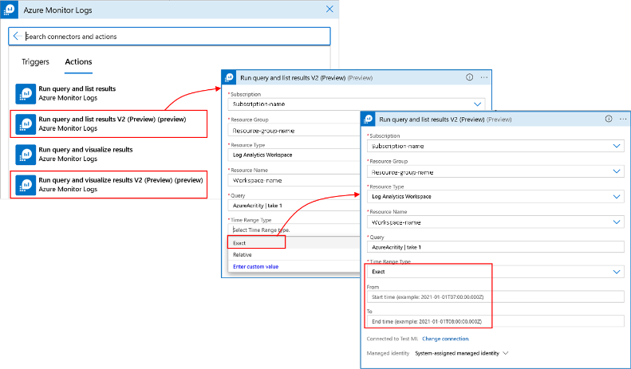
Management & Governance Updates
Public Preview: Regional Disaster Recovery by Azure Backup for AKS
Azure Backup supports storing AKS backups offsite, which is protected against tenant compromise, malicious attacks and ransomware threats. Along with backup stored in a vault, it is also possible to use the backups in a regional disaster scenario and recover backups.
Once the feature is enabled, snapshot-based AKS backups stored in Operational Tier are converted into blobs and moved to a Vault-standard tier outside of tenant.
This feature also allows to back up data for long term storage as per the compliance and regulatory requirements. With this feature, it is also possible to enable a Backup vault to be Globally redundant with Cross Region Restore, and then vaulted backups will be available in an Azure Paired region for restore. In case of primary region outage, it is possible to use these backups to restore your AKS clusters in a secondary region.
Execute Azure Monitor Logs connector on exact time range provided dynamically (preview)
Azure Monitor Logs connector allos to query data in Log Analytics workspace or Application Insights components per Logic App trigger or schedule, and list or visualize results. The Time range property in the connector provides filtering for query execution scope and relevant results, and up to now, could be either Set in query when time filter appears in query, or set with relative value such as last hour, last 12 hour, etc..
The Time range in Azure Monitor Logs connector (preview) includes Exact time range option to let you pass the start-time and end-time dynamically, and satisfy scenarios such as alert diagnosis - When connector is triggered by alert, Azure Monitor Logs connector can be provided with the alert’s time range dynamically, to replicate the results triggered the alert and allow effective investigation.

Slide 6
Security & Identity Updates
Generally available: Support for Azure VMs using Ultra disks in Azure Backup
MS announced the general availability of enabling Azure Backup on Azure VMs using Ultra disks. Ultra disks enable customers to run mission critical, I/O demanding, enterprise applications on the cloud including applications like SAP HANA, top tier SQL databases, as well as NoSQL databases. With this feature, we aim to address a key ask from customers, who are looking to enable Azure Backup on Azure VMs running on Ultra disks. It will allow you to ensure business continuity for your virtual machines and to recover from any disasters or ransomware attacks.
Enabling backup on VMs using Ultra disks is available in all regions where creation of Ultra disks is supported.
Configuration of Ultra disk protection is supported via Recovery Services vault and via virtual machine blade.
Cross-region restore is currently not supported for machines using Ultra disks.
GRS type vaults cannot be used for enabling backup.
File-level restore is currently not supported for machines using Ultra disks.
Generally available: Support for Azure VMs using Premium SSD v2 in Azure Backup
MS announced the general availability of enabling Azure Backup on Azure VMs using Premium SSD v2. Premium SSD v2 offering provides the most advanced block storage solution designed for a broad range of IO-intensive enterprise production workloads that require sub-millisecond disk latencies as well as high IOPS and throughput — at a low cost. Using them enable you to meet the ever-growing demands of your production workloads such as - SQL Server, Oracle, MariaDB, SAP, Cassandra, Mongo DB, big data, analytics, gaming, on virtual machines, or stateful containers. With this feature, we aim to address a key ask from customers, who are looking to enable Azure Backup on Azure VMs running on Premium SSD v2.
Enabling backup on VMs using Premium SSD v2 is available in all regions where creation of Premium SSD v2 disks is supported.
Configuration of Premium SSD v2 disk protection is supported via Recovery Services vault and via virtual machine blade.
Cross-region restore is currently not supported for machines using Premium v2 disks and GRS type vaults cannot be used for enabling backup.
File-level restore is currently not supported for machines using Premium SSD v2 disks.

Slide 7
Management & Governance Updates
Sending a log search alert with cross tenant target resource will no longer be supported
Log search alerts are a feature of Azure Monitor that allow to create alert rules based on the results of log queries. It is possible to specify a target resource for each alert rule, which is the resource that will receive the alert notification and the alert context.
Currently, if you configure a log search alert rule with a cross tenant target resource, the alert is generated and sent to the target resource even though there are no permissions to investigate this alert.
As of March 15, 2024, this behavior will change and sending a log search alert with a cross tenant target resource (except for the lighthouse case) will no longer be supported. Alerts will not be sent to unauthorized target resources, and log search alert rules with an unauthorized target will be ignored. This will ensure that only authorized users can receive and investigate log search alerts.
If you have any log search alert rules with cross tenant target resources, you should update them before March 15, 2024 to avoid losing alert notifications. You can either change the target resource, or use the lighthouse feature to delegate access to the target resource.
Azure architecture icons
Over 40 new icons for various services and components such as AI (including Azure OpenAI), Azure Operator, Microsoft Entra ID, and Azure networking.

Slide 8
Management & Governance Updates
SCVMM management for Azure Stack HCI 23H2
The following scenarios will be supported in SCVMM to manage Azure Stack HCI 23H2:
Addition, creation and management of Azure Stack HCI clusters.
Ability to provision and deploy Virtual Machines (VMs) on the Azure Stack HCI clusters and perform VM lifecycle operations.
Set up networking on Azure Stack HCI clusters.
Deployment and management of SDN network controller on Azure Stack HCI clusters.
Management of storage pool settings, creation of virtual disks, creation of cluster shared volumes (CSVs) and application of QoS settings.
Migration of VMware and Windows Server based workloads to Azure Stack HCI.
Management of Azure Stack HCI clusters using the same PowerShell cmdlets used to manage Windows Server clusters.
Azure based VM self-serve capabilities and Azure management services through Azure Arc-enabled SCVMM.

Slide 9
Compute

Slide 10
Compute Updates
Update records in a Kusto Database (public preview)
Kusto databases, either in Azure Data Explorer or in Fabric KQL Database, are optimize for append ingestion.
In recent years, MS introduced the .delete command allowing to selectively delete records.
Now MS introduced the .update command. This command allows to update records by deleting existing records and appending new ones in a single transaction.
This new command gives an alternative for data pipelines. Many loading scenarios involve updating records. For instance, ingesting new data in a staging table to then update the records of a main table with those new records. This is now possible with the .update command.

Slide 11
Storage & Data

Slide 12
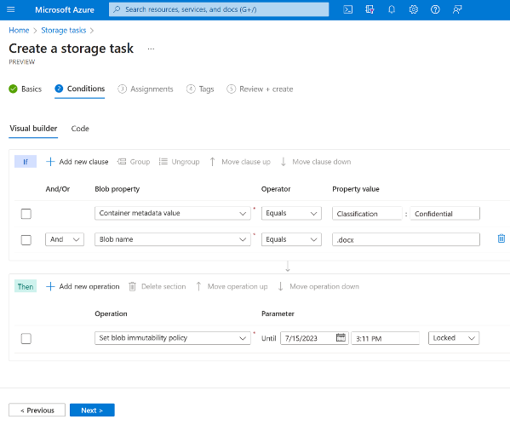
Storage & Data Updates
General Availability: Azure NetApp Files Standard Network Features - Edit Volumes
It is now possible to edit existing Azure NetApp Files volumes and upgrade Basic network features to Standard network features.
Increased IP limits for the VNets with Azure NetApp Files volumes
Enhanced network security with support for Network Security Groups (NSGs) on the Azure NetApp Files delegated subnet.
Enhanced network control with support for User-defined routes (UDRs) to and from Azure NetApp Files delegated subnets.
Connectivity over Active/Active VPN gateway setup for highly available connectivity to ANF from on-prem.
ExpressRoute FastPath connectivity to Azure NetApp Files.
Azure Storage Actions Preview
Azure Storage Actions is a serverless framework that can be used to perform common data operations on millions of objects across multiple storage accounts.
The preview release of Azure Storage Actions enables to create storage tasks that can perform operations on blobs in Azure Storage accounts based on a set of conditions that you define. Storage tasks can process millions of objects in a storage account without provisioning additional compute capacity and without requiring you to write code.
A storage task contains a set of conditions, operations, and assignments

Slide 13
DevOps & IaC & Automation

Slide 14
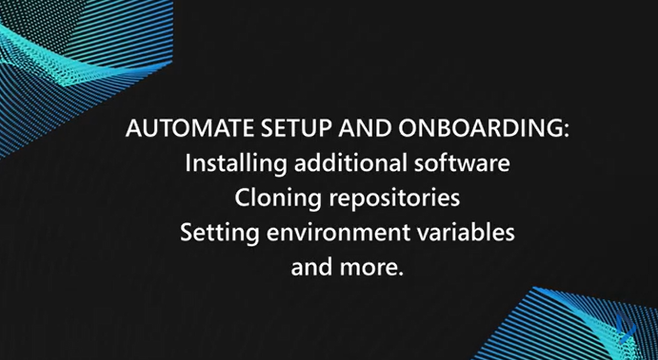
DevOps & IaC & Automation
Public preview: Configuration-as-code customizations in Microsoft Dev Box
Speed up developer onboarding by further automating the setup of development environments on Dev Box. Defining what’s needed on a dev box can now be as easy as submitting a code change.
Customization enables developers to efficiently configure workstations to their exact project requirements, within guardrails set by admins that enforce governance and security policies.
Customization now also supports the use of secrets from a private Azure Key Vault in a configuration-as-code file.

Slide 15
Miscellaneous

Slide 16
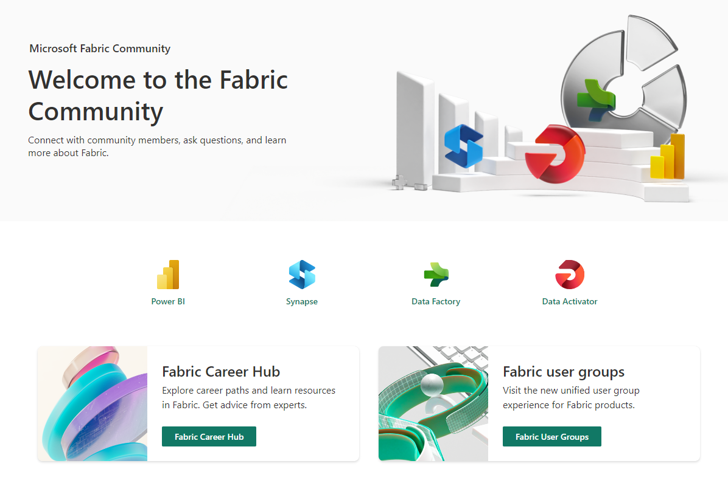
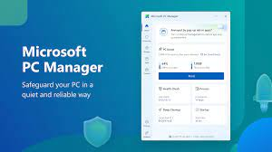
Miscellaneous Updates
Fabric Community Hub
Microsoft Fabric is offering a one-stop solution for cloud analytics—a central hub that unites multiple Microsoft services like Power BI, Data Factory, and Synapse Analytics under one umbrella.
Microsoft PC Manager is designed to keep your PC running smooth through several maintenance and security features.
The Boost feature cleans temporary files and improves your memory usage.
Health Check allows you to clear system logs and recent files and you can also disable unwanted startup apps to save resources.
Store Management has four options:
Deep cleanup - Perform a full cleanup scan
Manage large files - Look for large files in drive
Manage apps - Remove rarely used apps to save space
Storage Senes - Automatically clean up temporary files
Process Manangement - End unused processes to make your system run faster
Startup Apps - Manage apps the run automatically at log in

Slide 17
Information

Slide 18
Information
Azure Times GitHub Repo

Slide 19
Questions

