Slide 1
Azure Times #112
April 3, 2023

Slide 2
Networking

Slide 3
Networking Updates
Azure Front Door (classic) will be retired on 31 March 2027
On 31 March 2027, Azure Front Door (classic) will be retired for the public cloud, and it is required to migrate to Front Door Standard or Premium by that date.
Beginning 1 April 2025, it will no longer be possible to create new Front Door (classic) resources via the Azure portal, Terraform, or any command line tools. However, it will be possible to continue to make modifications to existing resources until Front Door (classic) is fully retired.
Azure Front Door Standard and Premium combine the capabilities of static and dynamic content delivery with turnkey security, enhanced DevOps experiences, simplified pricing, and better Azure integrations.
Required action
To avoid potential disruptions in service, MS recommends to migrate to Azure Front Door Standard or Premium by 31 March 2027.
General availability: Rate Limiting on ExpressRoute Direct Circuits
MS announced the general availability of Rate Limiting over ExpressRoute Direct port circuits. This essential Quality of Service (QoS) feature provides enhanced control over bandwidth usage. Without this feature, all circuits, regardless of their configured bandwidth, can burst up to the port pair bandwidth. Circuits bursting beyond their configured bandwidth can potentially impact the performance and reliability of the network. With Rate Limiting, users can throttle traffic throughput in line with the configured bandwidth of their circuits.
Rate-limiting can be enabled for each circuit individually, providing flexibility to prioritize certain circuits over others within your direct port. This feature can be enabled during or after the creation of the ExpressRoute Direct circuit.
The general availability of Rate Limiting includes:
The option to enable rate-limiting during the circuit creation process, with the flexibility to modify it after the circuit has been created.
Rate limiting on both Private Peering and Microsoft Peering.
Rate limiting in both ingress and egress directions.
The availability of these features in all Azure regions of the public cloud.

Slide 4
Security & Identity

Slide 5
Security & Identity Updates
Continuous export now includes attack path data
MS announced that continuous export now includes attack path data. This feature allows to stream security data to Log Analytics in Azure Monitor, to Azure Event Hubs, or to another Security Information and Event Management (SIEM), Security Orchestration Automated Response (SOAR), or IT classic deployment model solution.
Agentless scanning supports CMK encrypted VMs in Azure
Until now agentless scanning covered CMK encrypted VMs in AWS and GCP. With this release, MS added support for Azure as well. The capability employs a unique scanning approach for CMK in Azure:
Defender for Cloud does not handle the key or decryption process. Key handling and decryption are seamlessly handled by Azure Compute and is transparent to Defender for Cloud's agentless scanning service.
The unencrypted VM disk data is never copied or re-encrypted with another key.
The original key is not replicated during the process. Purging it eradicates the data on both your production VM and Defender for Cloud’s temporary snapshot.
During public preview, this capability is not automatically enabled.
Inclusion of DevOps recommendations in the Microsoft cloud security benchmark
MS announced support of monitoring for DevOps security and compliance posture in the Microsoft cloud security benchmark (MCSB) in addition to Azure, AWS, and GCP. DevOps assessments are part of the DevOps Security control in the MCSB.
ServiceNow integration is now generally available (GA)
As part of the integration, it is possible to create and monitor tickets in ServiceNow directly from Defender for Cloud:
Incident
Problem
Change
It is a bi-directional synchronization and occurs every 24 hours
Defender for Cloud Containers Vulnerability Assessment powered by Qualys retirement
The Defender for Cloud Containers Vulnerability Assessment powered by Qualys is being retired. The retirement will be completed by March 6, and until that time partial results may still appear both in the Qualys recommendations, and Qualys results in the security graph. Any customers who were previously using this assessment should upgrade to Vulnerability assessments for Azure with Microsoft Defender Vulnerability Management.

Slide 6
Security & Identity Updates
Microsoft Defender for APIs' plans
Defender for APIs Plan 1: Priced at $200 per month for up to 1 million API calls. For usage exceeding this limit, an overage price of $0.00020 per API transaction is applied.
Microsoft Defender for APIs Plan 2: Available at $700 per month, this plan covers up to 5 million API calls. Should your subscription exceed this entitlement, you'll be charged an overage rate of $0.00014 per API transaction.
Microsoft Defender for APIs Plan 3: This plan is set at $5,000 per month, accommodating up to 50 million API calls. For any amount over this cap, the overage cost is $0.00010 per API transaction.
Microsoft Defender for APIs Plan 4: At $7,000 per month, this plan allows for up to 100 million API calls, with an overage charge of $0.00007 per API transaction for volumes beyond the plan's entitlement.
Microsoft Defender for APIs Plan 5: The most extensive plan, priced at $50,000 per month, supports up to 1 billion API calls. Exceeding this limit incurs an overage fee of $0.00005 per API transaction.

Slide 7
Management & Governance

Slide 8
Management & Governance Updates
Public Preview: On-demand capacity reservations for Specialty SKUs
On-demand capacity reservation for specialty SKUs in now in Public Preview.
Mv3 series
NC-series, v3 and newer
NV-series, v2 and newer
Lsv2 series
For the above mentioned additional supported series for N, at VM deployment, Fault Domain (FD) count of 1 can be set using Virtual Machines Scale Sets. A deployment with more than 1 will fail to deploy against a Capacity Reservation. FD>1 will be supported at future release.
On-demand capacity reservations for Azure Virtual Machines let deploy and manage the compute capacity required to run Azure Virtual Machines separately from the virtual machines (VMs) themselves. This new feature enables your IT organization to reserve compute capacity for a VM size. The reservation can be for any length of time in any public Azure region or availability zone and supports most VM series. You can create and cancel an on-demand capacity reservation at any time, no commitment is required.
Public Preview: Azure Container Apps OpenTelemetry collector support
Azure Container Apps now supports a managed OpenTelemetry collector. Available in public preview, this feature allows to use open-source standards to send app’s data. It is possible to use the managed collector to choose where to send logs, metrics, and traces.
Data can currently be sent to Azure Monitor Application Insights (logs, traces) or 3rd party product Datadog (metrics, traces).
Public preview: Springboot Apps discovery and assessment is now available using Packaged solution to deploy Kubernetes appliance.
Public preview: Springboot Apps discovery and assessment is now available using Packaged solution to deploy Kubernetes appliance.

Slide 9
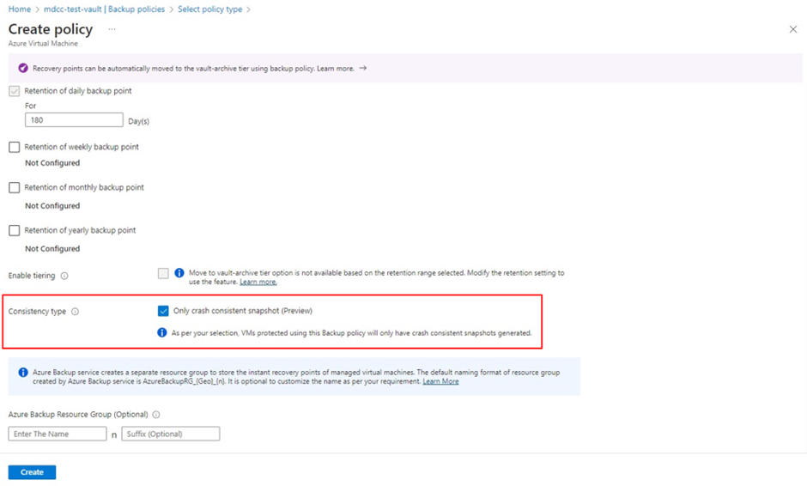
Management & Governance Updates
Public Preview: Agentless multi-disk crash consistent backup by Azure Backup for VM
Azure VM backup now supports agentless multi-disk crash consistent backups in public preview.
Agentless multi-disk crash consistent backups for Azure VM backup allows to take VM backups without installing additional software like the VM agent or snapshot extension in your VM. If the workload is performance sensitive and can recover from crash-consistent backups, this feature can help reduce the quiesce time during backup. It also can be used for operating system that are not supported for application or file-system consistent backup.
Using agentless crash-consistent backup is as simple as setting the Consistency Type in the Azure VM Backup policy.

Slide 10
Management & Governance Updates
Azure Files vaulted backup (preview)
Azure Backup now allows vaulted backup of Azure Files to protect data from ransomware attacks or source data loss due to a malicious actor or rogue admin. It is possible to define the schedule and retention of backups by using a backup policy. Azure Backup creates and manages the recovery points as per the schedule and retention defined in the backup policy.
By using vaulted backups, Azure Backup copies and stores data in the Recovery Services vault. This creates an offsite copy of data that can retain for up to 99 years. If any data loss occurs on the source account, it is possible to trigger a restore operation to an alternate account and access data. Additionally, you can use Backup center to manage the vaulted backups at scale and monitor the backup operations by using the rich Alerting and Reporting capabilities of Azure Backup.
Vaulted backup (preview) currently doesn't support restore to a file share registered with File sync service.
Support for long-term Retention for Azure Database for MySQL - Flexible Server (preview)
Azure Backup and Azure Database Services provide a new backup solution for the MySQL - Flexible Servers that support retaining backups for up to 10 years. This feature provides you with access to:
Comprehensive data protection for different levels of data loss due to accidental deletions or ransomware attacks.
Customer controlled scheduled and on-demand backups.
Isolated backups stored in a separate security and fault domain.
Long-term retention of backups.
Centralized monitoring of all backup operations and jobs.

Slide 11
Compute

Slide 12
Compute Updates
Public preview: Support for Key Vault Certificates in Azure Container Apps
It is now possible to use Azure Key Vault to store and manage own TLS/SSL certificates for use with Azure Container Apps at the app and environment level. This follows security best practices by leveraging managed identities and simplifies management tasks like auto-rotation.
Generally Available: Free managed certificates on Azure Container Apps
Free managed certificates on Azure Container Apps is now generally available!
Getting a certificate free of cost for apps and without having to worry about the management of the certificate’s life cycle has now become a standard that customers expect from services. Azure Container Apps now provides a free managed certificate for custom domain. Without any action required TLS/SSL server certificate is automatically renewed as long as app continues to meet the requirements for managed certificates.

Slide 13
Compute Updates
GA: Azure Logic Apps Designer for Consumption
MS announced the general availability of the new Azure Logic Apps Designer for Consumption, revolutionizing workflow experience with unparalleled speed, smoothness, and reliability. Unifying the designer experience across all supported platforms, including standard Azure Logic Apps, the Azure Logic Apps Visual Studio Code extension, and consumption Azure Logic Apps in the portal, ensures seamless usability and familiarity wherever you work.
Key Benefits:
Enhanced Speed
Simplified Workflow Management
Intuitive Interface
Innovative Features
Accessibility
Community Collaboration
GA: Azure SQL Trigger support for Azure Functions
Azure SQL trigger for Azure Functions is now generally available.
It is now possible to build an application logic in azure function apps which can be driven by the data from Azure SQL database. Azure SQL trigger for Azure Functions allows to use nearly any SQL database enabled with change tracking to develop and scale event-driven applications using Azure Functions.
Invoking an Azure Function from changes to an Azure SQL table is now possible through the Azure SQL trigger for Azure Functions in Elastic Premium and Dedicated plans for Azure Functions supported languages.
Azure SQL trigger for Azure Functions will allow to develop and scale event-driven applications using Azure Functions. The Azure SQL trigger is compatible with Azure SQL Database, Azure SQL Managed Instance, and SQL Server and can be developed with all Azure Functions supported languages for Elastic Premium and Dedicated plans.
With input and output bindings for SQL already in GA, it is possible to quickly write Azure Functions that read and write from databases. Together with triggers and input/output bindings, the SQL extension for Azure Functions provides you improved efficiency with low-code/no-code database interactions and enables those who are looking to migrate their applications to Azure the ability to participate in modern architectures.

Slide 14
Compute Updates
General Availability: Automatic Scaling for App Service Web Apps
Azure App Service is pleased to announce general availability of the "Automatic Scaling" feature.
Automatic scaling is available for b(P1V2, P2V2, P3V2) and Premium V3 (P0V3, P1V3, P2V3, P3V3, P1MV3, P2MV3, P3MV3, P4MV3, P5MV3) pricing tiers, and supported for all app types: Windows, Linux, and Windows container.
A new metric viz. "Automatic Scaling Instance Count" is now available for web apps where Automatic Scaling is enabled. AutomaticScalingInstanceCount will report the number of virtual machines on which the app is running including the pre-warmed instance if it is deployed.
In addition to these enhanced capabilities please remember that the automatic scaling feature continues to support following key capabilities:
The App Service platform will automatically scale out the number of running instances of application to keep up with the flow of incoming HTTP requests, and automatically scale in application by reducing the number of running instances when incoming request traffic slows down.
Developers can define per web app scaling and control the minimum number of running instances per web app.
Developers can control the maximum number of instances that an underlying app service plan can scale out to. This ensures that connected resources like databases do not become a bottleneck once automatic scaling is triggered.
Enable or disable automatic scaling for existing app service plans, as well as apps within these plans.
Address cold start issues for your web apps with pre-warmed instances. These instances act as a buffer when scaling out your web apps.
Automatic scaling is billed on per second basis and uses the existing Pv2 and Pv3 billing meters.
Pre-warmed instances are also charged on per second basis using the existing Pv2 and Pv3 billing meters once it's allocated for use by your web app.

Slide 15
Compute Updates
Azure Static Web Apps distributed functions capability now in Public Preview
Distributed functions for Azure Static Web Apps is a new capability that can reduce network latency by up to 70% for requests to backend managed functions, improving performance globally for full-stack web apps.
Currently in Public Preview, this feature automatically distributes Static Web Apps’ managed functions to regions of high demand. When an Azure Static Web App host in a different region receives a significant amount of traffic to the managed functions, the distributed functions capability will deploy a copy of managed functions to that region and route the traffic to this new managed function backend.
Public preview: PowerShell 7.4 support for Azure Functions
It is now possible to develop apps using PowerShell 7.4 locally and deploy them to all Azure Functions plans except Linux consumption plans. To learn more about the release, see What’s New in PowerShell 7.4.
Please note that PowerShell 7.4 support for Linux consumption plans will be released in the near future.

Slide 16
Compute Updates
New Azure Logic Apps Designer for Consumption: Faster, Smoother, and More Reliable
MS have unified the designer experience for all our supported platforms with the general availability of the new designer for consumption. This covers standard Azure Logic Apps, the standard Azure Logic Apps Visual Studio Code extension, and our consumption Azure Logic Apps experience in portal.
Newly designed consumption interface provides numerous advanced features compared to its predecessor:
Enhanced Speed
Complex Workflow Support
Intuitive User Interface
Accessibility
Future Enhancements
Public preview of azure Kubernetes service on VMware
It is now possible to deploy AKS clusters on the Arc-Enabled VMware platform on-prem via ARM management plane

Slide 17
Storage & Data

Slide 18
Storage & Data Updates
GA: Improved throughput performance on Azure Disks’ Standard SSD
MS announced that Standard SSD Disks sizes E50 and below now have increased throughput limits of 100 MB/s. This means Standard SSD Disks sized with 8191 GBs capacity and below now have 100 MB/s, an increase from 60 MB/s. The increased throughput is beneficial for workloads that require higher throughput, such as big data processing, online analytical processing (OLAP), high-performance computing (HPC), and artificial intelligence/machine learning (AI/ML). No additional steps are required to access this enhanced performance, and it's accessible across all regions. The bursting performance for the Standard SSD Disk tiers remains unchanged.
General availability: Availability zone volume placement for Azure NetApp Files
Azure NetApp Files availability zone volume placement feature is now generally available. This feature lets deploy new volumes in the logical availability zone of choice to support enterprise, mission-critical high availability (HA) deployments across multiple availability zones.
It is possible to use this feature to create cross-zone replication of volumes to improve resiliency in case of zonal failures. This feature is now generally available in all availability zone-enabled regions with Azure NetApp Files presence.

Slide 19
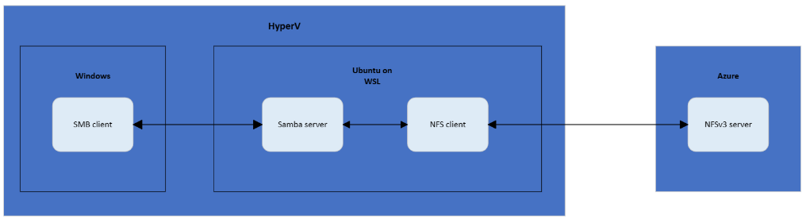
Storage & Data Updates
Preview: New Features in Azure Container Storage
Azure Container Storage (in preview) is a fully managed, cost-efficient volume orchestration service built natively for Kubernetes. Azure Container Storage offers Azure Kubernetes Service (AKS)-integrated block storage volumes for production-scale stateful container applications on Azure. By packing multiple persistent volumes in a single disk, Azure Container Storage helps you achieve better price performance.
Simplify volume management by leveraging a new ephemeral backing storage option, Temp SSD, to enhance efficiency for use cases like caching
Achieve reduced TCO with resource optimization with updates to the AKS Command Line Interface (CLI) installation process
Scale your backing storage up and on demand to meet your workload’s storage needs in a cost-efficient manner without downtime
Public Preview: Use Azure Blob Storage on Windows as a file share using Network File System(NFS) 3.0
Azure Blob Storage team is announcing the Public Preview of the capability to use Blob storage on Windows using Network File System (NFS) 3.0 protocol, while capability to access Blob Storage using NFS on Linux is generally available (GA).
Mounting Blob Storage as a file share using NFS has following advantages:
Works with existing applications - Customer can take advantage of widely used NFS protocol with POSIX compliance on top of Blob Storage on cloud without refactoring their existing applications. They can easily replace the path of on-premises file share with path of Blob Storage mounted as a file share using NFS.
Open & Interoperable - Customer can bring data via. rest or sftp protocol and operate on the same data using NFS and vice versa.
Scalable & Performant – Offers petabyte scale and high throughput as it is built on top of Azure Blob Storage.
Durable & Available – Multiple redundancy options to protect customers from disaster and data loss.
Manageable and Secure - Data management and security features such as lifecycle management, immutable storage, customer-managed key for encryption.
Cost efficient - Flexible pay-as-you-go blob pricing model allows for cost-optimizations and low total cost of ownership (TCO). Data is billed at the same rate as Azure Blob Storage capacity charges.

Slide 20
Storage & Data Updates
Data Factory Increases Maximum Activities Per Pipeline to 80
Data Factory is a platform service that is shared across ADF, Synapse, and Fabric, and it was limiting the number of activities in a single pipeline to 40 as a way to avoid resource exhaustion.
However, just this week, MS doubled the limit on number of activities may define in a pipeline, from 40 to 80.

Slide 21
Databases

Slide 22
Databases Updates
General availability: Migration service in Azure Database for PostgreSQL
MS announced a new migration service within Azure Database for PostgreSQL designed to streamline the transfer of PostgreSQL workloads to Azure. This fully managed service offers a straight-forward migration process, expertly managing the transfer of schemas and data regardless of size. Eliminate complex setup procedures and embrace a solution that scales with your needs, ensuring a smooth transition.
By choosing to migrate, benefit from enhanced performance, strengthened security, and simplified database management. Our service ensures minimal downtime, so operations continue uninterrupted. Plus, with Azure's global infrastructure, data is always close to users, reducing latency and improving user experience.
Start migration journey today and transform database management with Azure. Discover how our migration service can help achieve a more secure, efficient, and scalable data environment.
Public Preview: Real-time text translation using the azure_ai extension in Azure Database for PostgreSQL
The azure_ai extension on Azure Database for PostgreSQL now has text translation capabilities in public preview. Using Azure AI translator, real-time text translations enables building intelligent multilingual applications on Azure Database for PostgreSQL. The extension automatically detects the source language and translates to over 100 languages in real time including the ability to filter profanities.
Public Preview: Invoke Azure Machine Learning models using the azure_ai extension
Traditionally, integrating machine learning models with databases has been a complex and cumbersome process. With the new azure_ai extension, now in public preview, it is possible to perform real-time inferences or predictions with low latency right from within the database with a single line of SQL.

Slide 23
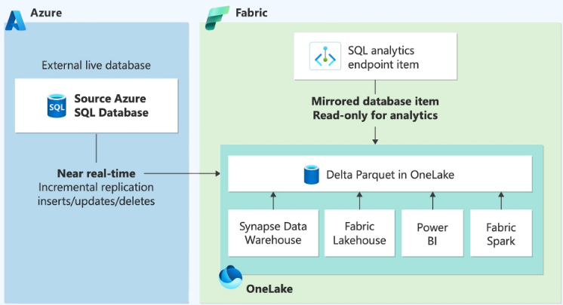
Databases Updates
General availability: Azure SQL updates for late-March 2024
Advance notifications are available for databases configured to use a nondefault maintenance window. Advance notifications enable customers to configure notifications to be sent up to 24 hours in advance of any planned event.
Notifications can be configured to get texts, emails, Azure push notifications, and voicemails when planned maintenance is due to begin in the next 24 hours. Follow-up notifications are sent when maintenance begins and when maintenance ends.
Public Preview: Azure SQL updates for late-March 2024
Configure a maintenance window for Azure SQL Database Hyperscale elastic pools to make maintenance events predictable and less disruptive on workload.
The public preview of Azure SQL Database Hyperscale elastic pools is now available in Azure U.S. government regions.
Public Preview: Azure SQL Database Mirroring in Microsoft Fabric
It is now possible to mirror Azure SQL Database in Microsoft Fabric to easily replicate data residing in Azure SQL databases in near real-time directly into Fabric's OneLake. This new feature helps avoid complex ETL (Extract Transform Load) processes and reduces total cost of ownership. It also enables faster time to insights in Fabric by unlocking powerful business intelligence, artificial intelligence, data Engineering, data Science, and data sharing scenarios in Fabric.

Slide 24
Databases Updates
Public preview: Change partition key of a container in Azure Cosmos DB (NoSQL API)
MS announced the introduction of the capability to change the partition key of a container in Azure Cosmos DB for the NoSQL API. It is possible now to efficiently create a new partition key for a container and transfer data from the old to the new container seamlessly through the Azure Portal, utilizing the offline container copy process with only a few clicks.

Slide 25
Integration

Slide 26
Integration Updates
Breaking Changes to Azure API Management Workspaces
MS is implementing several critical breaking changes effective June 14, 2024. These changes are designed to streamline functionality and improve overall performance.
Change to Supported Service Tiers: Workspaces will no longer be supported in the Standard and Developer tiers. They will be available exclusively in the Premium tier.
Changes to Support for Assigning Service-Level Entities in Workspaces: Several assignments of workspace entities to service-level entities will no longer be supported, including:
Assigning workspace APIs to service-level products
Assigning workspace APIs to service-level tags
Assigning workspace products to service-level tags
Assigning service-level groups to workspace products for visibility controls
Please note that the built-in Guests and Developer groups will continue to be accessible within workspaces.
Changes to Supported Context Objects: The following context objects will no longer be supported in workspace policies or in the all-APIs policy at the service level:
context.Api.Workspace
context.Product.Workspace
You can still reference users from the service level in the context object within workspace-level policies.

Slide 27
ML & AI & IOT

Slide 28
ML & AI & IOT Updates
Azure Sphere version 24.03 and Azure Sphere (Integrated) are now generally available
The Azure Sphere 24.03 feature release is now available and includes the following components:
General availability of Azure Sphere (Integrated)
Updated Azure Sphere OS
Updated Azure Sphere SDK for Windows and for Linux
Updated Azure Sphere extensions for Visual Studio and for Visual Studio Code
Updated Samples
If devices are connected to the internet, they will receive the updated OS from the cloud. For information on how to update the SDK and extensions, and for more information about features included in this release, visit What’s new in 24.03 in our customer documentation.
Public Preview: Safety evaluations for generative AI applications in Azure AI Studio
MS announced the public preview of automated safety evaluations in Azure AI Studio. These safety evaluations measure an application’s susceptibility to jailbreak attempts and to producing violent, sexual, self-harm, and hateful content. They also provide natural language explanations for each measurement to help inform appropriate mitigations. Developers can evaluate an application using their own test dataset or simply generate a high-quality test dataset using adversarial prompt templates developed by Microsoft Research. With this capability, Azure AI Studio can also help augment and accelerate manual red teaming efforts by enabling red teams to generate and automate adversarial prompts at scale.

Slide 29
DevOps & IaC & Automation

Slide 30
DevOps & IaC & Automation
Generally available: Microsoft Dev Box in Southeast Asia, Brazil South, South Africa North, and Switzerland North
Deploy ready-to-code, secure cloud-based workstations optimized for developers.

Slide 31
Miscellaneous

Slide 32
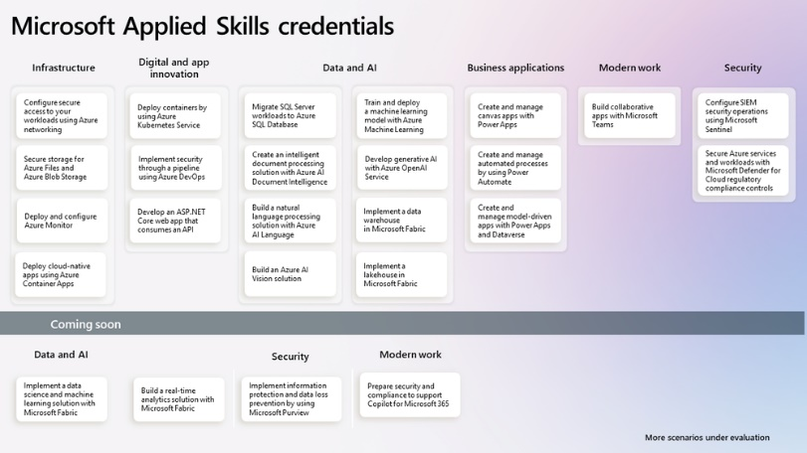

Miscellaneous Updates
Microsoft Applied Skills
Microsoft Applied Skills credentials validate ability to solve real-world problems by using Microsoft technologies.
Announcing the Microsoft Automation and Integration day in Toronto!
On April 25th, 2024 there is a unique opportunity to hear the latest about Power Automate and Azure Integration Services in a local event.

Slide 33
Miscellaneous Updates
Enhancing Screen Sharing with AV1 in Microsoft Teams
AV1, an open video coding format, is known for its high compression efficiency , which means it can deliver high-quality video streams using less bandwidth. MS has leveraged it for screensharing transmissions in Teams, where clarity and fluidity are paramount. Using AV1, users can experience lowered bandwidth for Teams screensharing by 63% compared to the H.264 video codec, as measured by A/B tests. For instance, sharing static content usually requires less than 200Kbps bandwidth, while sharing content that moves, such as when scrolling, needs about 1.2Mbps. It provides:
Sharper Visuals and Fluid Motion
Bandwidth Efficiency: Cost savings for organizations
Sustainability and the Future
AV1’s Role in the Future of Collaboration
Introducing the Queues app: Enabling customer engagement in Microsoft Teams
MS announced the Queues app, a Teams-native solution that empowers organizations to efficiently manage customer engagements, starting with calls.

Slide 34
Retirement

Slide 35
Retirement
Custom .net deserializer for Azure Stream Analytics will be retired on 30 September 2024
Custom .net deserializer for Azure Stream Analytics will be retired on 30 September 2024. After that date, it won't be possible to use the feature. Please transition to a JSON, AVRO, or CSV built-in deserializer by that date.
Retirement notice: The legacy Azure Storage C++ client libraries will be retired on 29 March 2025
Legacy Azure Storage C++ client libraries will be retired on 29 March 2025. Before that date, it is required to transition to the latest version of the Azure Storage C++ client libraries.
After 29 March 2025, the older client libraries can still be used, but any associated updates will no longer be issued by Microsoft. If you choose not to switch to the latest version of the Azure Storage C++ client libraries, you can find the source code for the legacy Azure Storage C++ client libraries on GitHub as an open-source resource.
Long Audio API will be retired on 31 March 2027 – Migrate to the new batch synthesis API
On 31/03/2027 the Long Audio API of Azure AI Speech will be retired. Please transition to the new batch synthesis API by that date.
Retirement notice: Windows Server 2022 will retire with k8s 1.34 in March 2027
On 15 March 2027, Windows Server 2022 will be retired when Kubernetes 1.34 reaches the end of platform support. You will not be able to create new Windows Server 2022 node pools on Kubernetes 1.35 and above. We encourage you to make the switch before 15 March 2027 to gain the richer benefits of Windows Server 2025 or Windows Server Annual Channel. These new Windows OS versions will be supported on AKS before Windows Server 2022 is retired. For more updates, see our AKS public roadmap.
Azure Maps Web SDK Map Control version 2.0.x and Azure Maps Service Module will be retired on 30 September 2026
Azure Maps Web SDK Map Control version 2.0.x and Azure Maps Service Module will be retired on 30 September 2026. Please transition to Azure Maps Web SDK Map Control version 3 if you’re on Azure Maps Web SDK control version 2.0.x and Azure Maps JavaScript REST SDK if you are currently using Azure Maps Service Module by 30 September 2026.
Migrate your Git Repository to automated deployments with APIOps by 15 March 2025
The Git repository capability in Azure API Management will be retired effective on 15 March 2025.MS now provides a similar functionality called APIOps based on the ARM-based REST API and ARM RBAC.

Slide 36
Retirement
Standard_NC6s_v3, Standard_NC12s_v3 and Standard_NC24s_v3 Azure virtual machines will be retired on September 30, 2025
On September 30th, 2025, Microsoft Azure will retire the Standard_NC6s_v3, Standard_NC12s_v3 and Standard_NC24s_v3 virtual machines (VMs) in NCv3-series virtual machines (VMs). To avoid any disruption to service ms recommends to change the VM sizing for workloads from the current NCv3-series VMs to the newer VM series in the same NC product line.
Standard_NC24rs_v3 virtual machines will be retired on March 31st, 2025
On March 31st, 2025, Microsoft Azure will retire the Standard_NC24rs_v3 virtual machine (VM) size in NCv3-series virtual machines (VMs). To avoid any disruption to your service we recommend that you change the VM sizing for your workloads from the current Standard_NC24rs_v3 to the newer VM series in the same NC product line.
Migrate to Azure AI Document Intelligence v3.1 GA version
On August 31st, 2026 Azure AI Document Intelligence v2.0 API will be retired. Please transition to Azure AI Document Intelligence v3.1 API by that date.
Retirement: Support for the in-process model for .NET apps in Azure Functions ends 10 November 2026.
Beginning 10 November 2026, the in-process model for .NET apps in Azure Functions will no longer be supported. To ensure that your apps that use this model continue being supported, you'll need to transition to the isolated worker model by that date.
Retirement: Support for .NET 6 ends on 12 November 2024—upgrade your Azure Functions apps to .NET 8
In alignment with the end of community support, on 12 November 2024, support for .NET 6 in Azure Functions will end. Your apps that are hosted on Functions will continue to run, but security updates will no longer be available, and we'll no longer provide customer service for .NET 6. Learn more about Azure Functions stack version support.

Slide 37
Retirement
Support for Basic and Standard A-series VM families support will be retired on 31 August 2024 for Batch pools
On 31 August 2024, we'll retire support for Basic and Standard A-series VMs in Batch pools. Please refer to the original Azure retirement announcement regarding these VM families.
From now to 31 August 2024, you'll need to migrate your Batch pools to Av2-series VMs, which provide more memory per vCPU and faster storage on solid-state drives (SSDs). You may also migrate to a different Batch-supported VM size.
Support for Ubuntu 20.04 LTS for Batch pools will be retired on 23 April 2025
Stop using Ubuntu 20.04 LTS based VM images for Batch pools before 23 April 2025. Please migrate your Batch pools to a VM image based on Ubuntu 22.04 or later, or the microsoft-dsvm ubuntu-hpc 2204 (or later) image for container and/or workloads requiring Infiniband/GPU support.
Every-write AOF persistence on Azure Cache for Redis Enterprise and Enterprise Flash will be retired on 1 April 2025
The Enterprise and Enterprise Flash tiers of Azure Cache for Redis currently offer a data persistence feature in preview. During the preview period, we discovered that there were potential data loss events when using the AOF persistence feature. While we have a fix for this issue, it requires significant degradation to the performance of AOF persistence if used with the every-write setting.
As a result, we are retiring the every-write AOF feature as it doesn’t provide performance to meet our bar for GA. The option to use AOF every second will remain and be available when the feature reaches GA.
Every-write AOF will be retired on 1 April 2025, and all instances using the feature will automatically switch to use every-second AOF instead.

Slide 38
Retirement
Azure CycleCloud support for Chef run_lists and cookbooks in cluster-init projects is ending on 31 March 2025
Stop using Chef run_lists and cookbooks in CycleCloud cluster-init projects. You can use shell script driven configuration in your cluster-init projects after 31 March 2025.
Custom .Net deserializer for Azure Stream Analytics will be retired on 30 September 2024.
Custom .Net Deserializer for Azure Stream Analytics will retire on the 30th of September 2024. After that date, it will not be possible to use the feature.
Azure HDInsight 5.0 will be retired on 31 March 2025
Migrate your HDInsight 5.0 clusters to HDInsight 5.1
Begin using Azure Monitor–based dashboards in Azure API Management before the built-in analytics dashboards are retired on 15 March 2027
On 15 March 2027, the analytics dashboards that are built into Azure API Management will be retired
MS is retiring Memory Optimized Data Flows in Azure Data Factory - use General Purpose for better performance at a lower price
To avoid disruptions, MS recommend these actions:
Existing pipelines can continue to use existing memory optimized data flows, but can't create new Azure Integration Runtimes using Memory Optimized.
To create new data flows, create a new Azure Integration Runtime using Memory Optimized instead of General Purpose.
User will then assign general purpose IRs to existing and new data flows instead of using Memory Optimized, which will provide better performance at a lower price.

Slide 39
Information

Slide 40
Information
Azure Times GitHub Repo

Slide 41
Questions

