Slide 1
Azure Times #147
February 20, 2023

Slide 2
Networking

Slide 3
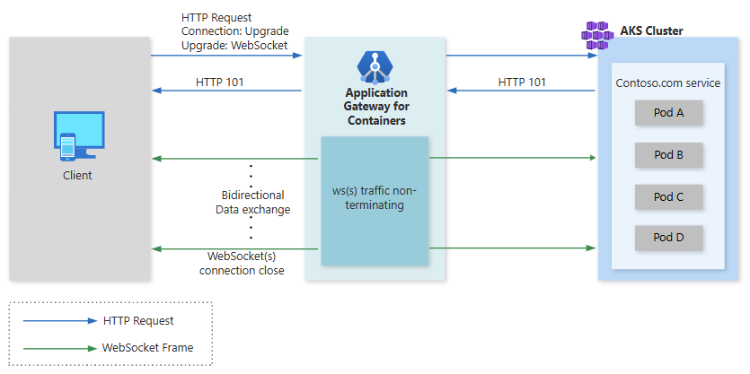
Networking Updates
GA: WebSocket support in Application Gateway for Containers
WebSockets established in RFC6455, enable two-way communication between a client and server. Unlike a traditional HTTP or HTTPS request that, WebSockets allow for the browser to establish a connection and receive continuous data from a server, without having to constantly pull the remote server or need to establish multiple connections in both directions (client to server and server to client).
Key benefits of WebSocket support in Application Gateway for Containers include:
Bidirectional Communication: Enable bidirectional data exchange between clients and servers.
Reduced Latency: Improve the performance of applications with faster data transmission by utilizing full-duplex communication channels over a single TCP connection.
Enhanced User Experience: Deliver more interactive and engaging applications to your users.
NOTE: After a connection is upgraded to WebSocket, as an intermediary/terminating proxy, Application Gateway for Containers will send the data received from the frontend to the backend and vice-versa, without any inspection or manipulation capability. Therefore, any manipulations like Header Rewrites, URL Rewrites, or Overriding Hostname will not apply after establishing a WebSocket connection.

Slide 4
Security & Identity

Slide 5
Security & Identity Updates
GA: Azure Confidential Ledger Achieves SOC 2 Type II Compliance
Azure confidential ledger provides a managed and decentralized ledger for data entries backed by Blockchain. Azure Confidential Ledger is now SOC 2 Type II compliant. The SOC 2 Type II certification is a rigorous standard for data security, availability, processing integrity, confidentiality, and privacy. It demonstrates that Azure Confidential Ledger has implemented robust controls and processes to protect customer data.
This compliance is part of our ongoing efforts to meet and exceed industry standards, ensuring that customers can confidently use Azure Confidential Ledger for their most sensitive and critical workloads.
Defender for Endpoint extends support to ARM-based Linux servers
MS announced that Microsoft Defender for Endpoint now supports ARM64 based Linux servers in Public Preview.
Microsoft Defender for Endpoint for ARM-based Linux servers will support all the capabilities it currently supports on x86_64 processor-based Linux Servers:
Antivirus (AV) protection
Endpoint Detection and Response (EDR)
Vulnerability Management
Response Actions
Device Isolation
Live Response
AV Scan
Configure policies via Security Settings Management
Advanced Hunting
List of supported Linux distributions:
Ubuntu 20.04 and 22.04
Amazon Linux 2 and 2023

Slide 6
Management & Governance

Slide 7
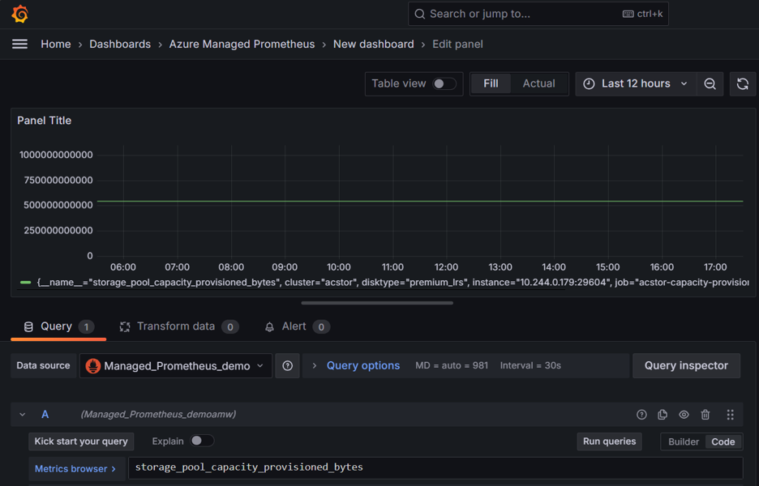
Management & Governance Updates
PP: Collect Azure Container Storage metrics with Azure Monitor Managed Service for Prometheus
Azure Container Storage is a cloud-based volume management, deployment and orchestration service and works with Azure Kubernetes Service (AKS) to effectively scale across storage services while providing a cost-effective, container-native experience.
Customers using Azure Container Storage (ACStor) on AKS clusters can now collect storage pool and disk metrics with Azure Monitor Managed Service for Prometheus and view/query metrics in Azure Managed Grafana.
The default scrape frequency for all default targets and scrapes is 30 seconds
AMBA Portal Accelerator is now Generally Available!
MS introduced AMBA into the ALZ portal experience and with the increased flexibility AMBA-ALZ provided for the preferred action notification types, this introduced a need to provide a post ALZ-AMBA Portal to accommodate those notification types that required an existing resource (Azure Function, Event Hub, and Logic App) and in the case of deploying ALZ possibly for the first time these resources may not be present.
The AMBA-ALZ Portal Accelerator is designed to simplify the process of setting up baseline alerts, helping boost observability maturity in Azure environment with minimal effort or expertise. It is possible to set up alerts faster and with more confidence.

Slide 8
Compute

Slide 9
Compute Updates
GA: App Service session affinity proxy compatibility
In multiple-instance deployments, session affinity ensures that client requests are routed to the same instance for the life of the session. Session affinity can be configured to adapt the cookie domain to the incoming header from reverse proxy. By configuring session affinity proxy to true, session affinity looks for X-Original-Host or X-Forwarded-Host and adapt the cookie domain to the domain found in this header. As a recommended practice when enabling session affinity proxy, you should configure access restrictions on the site to ensure that traffic is coming from reverse proxy.
The new session affinity proxy setting allows to adapt the session affinity cookie to the custom domain used by a reverse proxy when calling the App Service app using the default host name
az resource update --resource-group myRG --name myWebApp --resource-type "Microsoft.Web/sites" --set properties.clientAffinityProxyEnabled=true
Azure Lab Services - Upcoming maintenance update on February 8, 2025
On February 8, 2025, MS will be updating Lab Account Service between 2:00 PM - 11:00 PM UTC.
This maintenance will only affect the Lab Account Service not Lab Plan Service. Please expect downtime for most common operations like create/ update/ delete labs, start/stop virtual machines etc. The Lab Account service will be available after the update. Thank you for your patience.

Slide 10
Compute Updates
PP: JavaScript code interpreter dynamic sessions in Azure Container Apps
Azure Container Apps dynamic sessions offers serverless, isolated sandboxes for executing untrusted code. The latest update includes support for native JavaScript code execution in public preview.
This new JavaScript code interpreter augments the existing Python code interpreter and custom containers, which are already generally available options within dynamic sessions.
JavaScript code interpreter dynamic sessions can be integrated into applications that require the execution of potentially malicious JavaScript code, such as code provided by end users. Each session operates in a Hyper-V sandbox and is network isolated by default.
GA: Open-source feature update: KAIOT Retrieval-Augmented Generation (RAG) support
Advanced inference with retrieval-augmented generation (RAG) is now supported in open-source KAITO. RAG can be used on a base model in the KAITO registry to improve its accuracy and make your AI workload more context-aware to new data. This enables to index and query new data efficiently with RAG and leverage low-cost GPU compute without retraining the entire LLM using KAITO in your AKS cluster.

Slide 11
Storage & Data

Slide 12
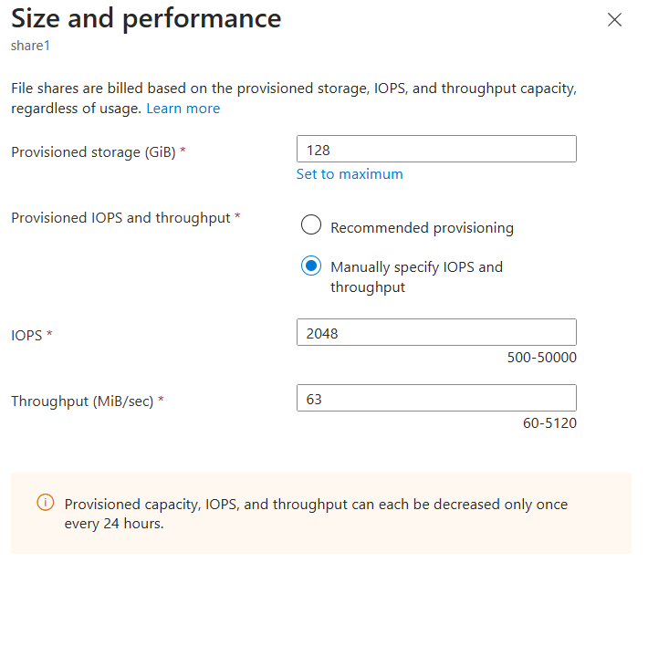
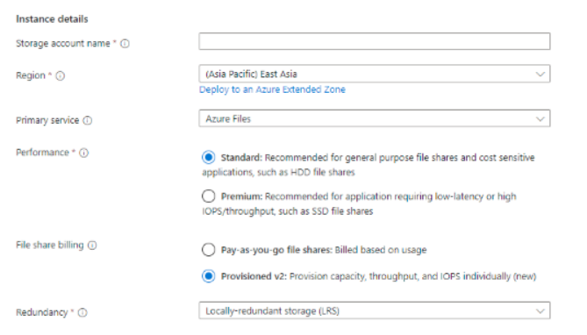
Storage & Data Updates
GA: Azure Files provisioned v2 billing model for HDD (standard)
The provisioned v2 model for Azure Files HDD (standard) pairs predictability of total cost of ownership with flexibility, allowing to create a file share that meets exact storage and performance requirements. Provisioned v2 shares enable independent provisioning of storage, IOPS, and throughput. In addition to predictable pricing and flexible provisioning, provisioned v2 also enables increased scale and performance, up to 256 TiB, 50,000 IOPS, and 5 GiB/sec of throughput; and per share monitoring.
Provisioned v2 is generally available in a subset of regions.

Slide 13
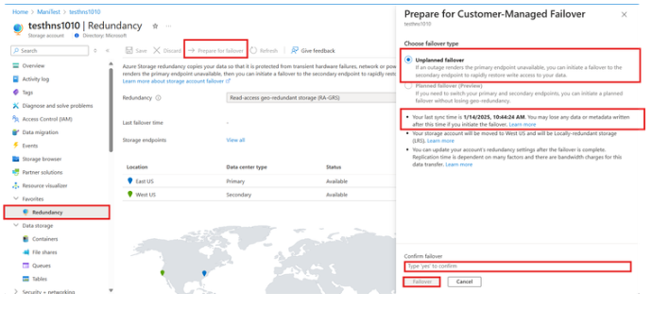
Storage & Data Updates
GA: Customer Managed Unplanned Failover for Azure Data Lake Storage and SSH File Transfer Protocol
MS announced the general availability of customer managed unplanned failover for Azure Data Lake Storage (ADLS) and storage accounts with SSH File Transfer Protocol (SFTP) enabled.
Customer managed unplanned failover enables to failover geo-redundant (GRS) or geo-zone-redundant (GZRS) storage account to secondary region if the storage service endpoints in the primary region become unavailable. During failover, the original secondary region becomes the new primary region. All storage service endpoints are then redirected to the new primary region while restoring write access to the storage account. After the storage service endpoint outage is resolved, it is possible to reconfigure geo-redundancy then perform another failover operation to fail back to the original primary region.
Unplanned failover is only supported with accounts that have GRS or GZRS enabled.

Slide 14
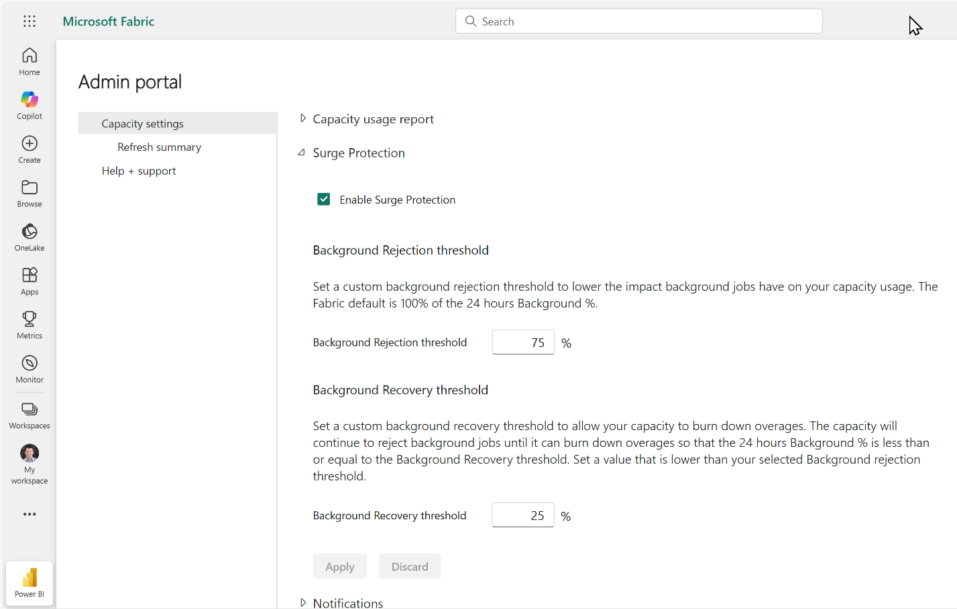
Storage & Data Updates
Announcing Surge Protection (Preview)
MS announced the preview of Surge Protection, in this first release, capacity admins can set limits on background usage within a capacity. The preview is rolling out now and should be available within the next week.
Surge protection helps protect capacities from excess usage by background workloads. It acts as a resource governor, rejecting background operations when the capacity reaches a limit set by the capacity admin.
Retirement: MS Fabric Runtime 1.1 End of Support
End of support for Microsoft Fabric Runtime 1.1 was announced July 12, 2024. MS recommend to upgrade Fabric workspace and environments to use Runtime 1.3 (Apache Spark 3.5 and Delta Lake 3.2). This latest Fabric Runtime 1.3 also offers a Native Execution Engine to boost performance and flexibility at no additional cost.

Slide 15
Databases

Slide 16
Databases Updates
SQL Server on RHEL with SELinux
SQL Server 2022 marked a significant milestone by enabling you to run SQL Server on RHEL 9 as a confined application.
To enforce SELinux-based security policies for SQL Server 2022 and higher versions, install the supported mssql-server-selinux package which includes customized SELinux-specific rules that enable you to run SQL Server as a confined application
Service endpoint policies for Azure Storage now generally available in SQL Managed Instance subnets
Service endpoint policies are an Azure Networking mechanism that provides fine-grained access control at the level of individual resources. Azure SQL Managed Instance now allows service endpoint policies for Azur Storage accounts, allowing to deny managed instances from accessing any storage account outside of a set of preapproved ones. This security mechanism helps guard data from unauthorized copying (data exfiltration) or configuration errors, like exporting production data to development accounts.

Slide 17
Databases Updates
GA: User-Managed plugin enablement in Azure Database for MySQL-Flexible Server
It is now possible directly manage Azure Database for MySQL – Flexible Server plugins, starting with the validate_password plugin. It helps to enhance server’s security by enabling the validate_password plugin to enforce strong password policies or by disabling it as needed—all without requiring a server restart. Previously, plugin management was limited to the platform, but now it is possible to take control, tailoring MySQL environment to meet specific requirements.
This release simplifies security configuration, making it easier to enforce compliance and protect data..
GA: Accelerated logs now default along with support for customer managed keys in Azure Database for MySQL
The accelerated logs feature is now enabled by default for all new Azure Database for MySQL – Flexible Server deployments. The feature boosts server performance by optimizing operations related to transactional logs. When this feature is enabled, the server can automatically store transactional logs on faster storage to enhance server throughput without incurring any extra cost.
It is possible to enable it on all existing Business-Critical servers—including those using customer-managed keys (CMKs) for data encryption—providing improved performance and reliability across a wide range of workloads.
The accelerated logs feature enhances a server's throughput, reduces commit latency for workloads, and supports high-concurrency applications seamlessly. With this feature enabled by default, new servers are automatically optimized for better performance without additional configuration. Furthermore, this enhancement is available at no additional cost in the Business-Critical service tier, ensuring maximum performance and reliability for mission-critical workloads.

Slide 18
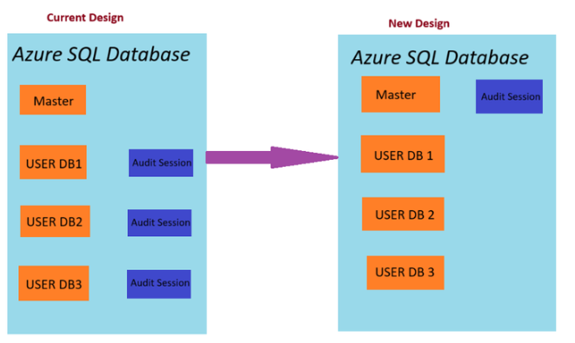
Databases Updates
Enhanced Server Audit for Azure SQL Database
MS announced a significant update to the server audit feature for Azure SQL Database. They have re-architected major portions of SQL Auditing resulting in increased availability and reliability of server audits. As an added benefit, they have achieved closer feature alignment with SQL Server and Azure SQL Managed Instance. Database auditing remains unchanged.
In the current design when server audit is enabled, it triggers a database level audit and executes one audit session for each database.
With the new architecture, enabling server audit will create one extended event session at the server level that captures audit events for all databases.
This optimizes memory and CPU and is consistent with how auditing works in SQL Server and Azure SQL Managed Instance.

Slide 19
ML & AI & IOT

Slide 20
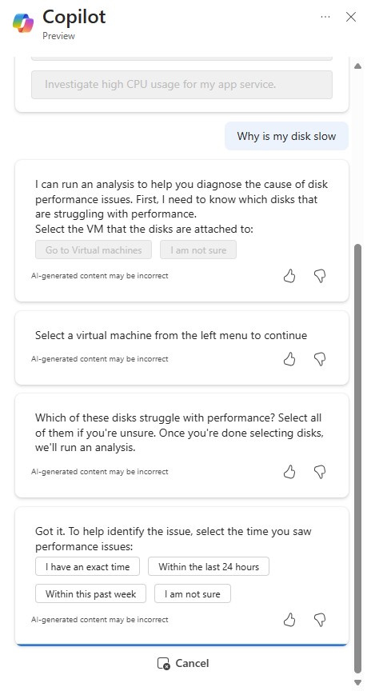
ML & AI & IOT Updates
PP: Troubleshoot Disk Performance with Copilot in Azure
Azure offers a rich variety of disk metrics, providing insights into the performance of Virtual Machines (VMs) and disks. These metrics help diagnose performance issues when application requires higher performance than what have configured for the VMs and disks.
Azure Copilot further enhances experience by analyzing these metrics to resolve performance issues on your behalf, along with providing guided recommendations for optimizing VM and disk performance to improve your application's experience.
Copilot in Azure analyzes the following disk metrics:
Data Disk IOPS Consumed Percentage
Data Disk Bandwidth Consumed Percentage
OS Disk IOPS Consumed Percentage
OS Disk Bandwidth Consumed Percentage
VM Cached and Uncached IOPS Consumed Percentage
VM Cached and Uncached Bandwidth Percentage

Slide 21
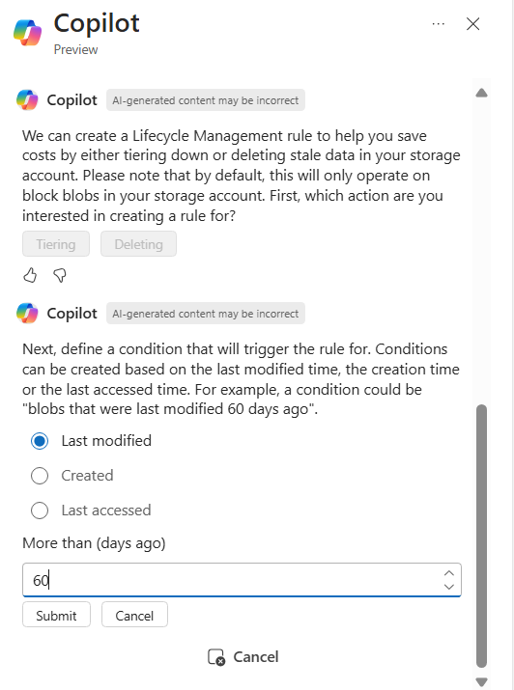
ML & AI & IOT Updates
Managing Storage Lifecycle Management with Copilot in Azure
Copilot in Azure allows to save on costs by tiering blobs that haven't been accessed or modified for a while. In some cases, might even decide to delete those blobs. With Copilot in Azure, can simply automate lifecycle management (LCM) rule authoring, enabling to perform bulk actions on Storage accounts through a natural language interface. This means no more manual rule creation or risk of misconfiguration!
To use this capability, simply enter a prompt related to cost management, such as “Help me reduce my storage account costs” or “I want to lower my storage costs.” Copilot will then guide through authoring an LCM rule to help achieve goals.
It helps to reduce storage costs, it provides suggestions and helps accomplish bulk tiering by automating lifecycle management rule authoring.

Slide 22
ML & AI & IOT Updates
Troubleshoot File Sync errors with Copilot in Azure
With Copilot in Azure, it is possible now quickly troubleshoot and resolve common Azure File Sync issues, such as network misconfiguration, incorrect RBAC permissions, or accidental file share deletions. Copilot in Azure detects errors and misconfigurations, provides exact steps to fix them, and can act on your behalf to resolve common errors.
To use this capability, simply enter a prompt related to File Sync such as “Why are my files not syncing?” or “Help me troubleshoot error 0x80C83096.”
Announcing the Azure AI RAG Vercel Next.JS Template
MS introduced the Azure AI RAG Vercel Next.JS Template, now available in the Vercel Templates Marketplace. This new template empowers developers to easily deploy retrieval-augmented generation (RAG) applications using Azure AI Search and Azure OpenAI—all with just a few clicks.
One-Click RAG Integration: Quickly stand up a RAG application that incorporates battle-tested retrieval from Azure AI Search, and advanced modes like Hybrid Search and Semantic Ranking. This lets you ground Azure OpenAI model responses in relevant, up-to-date data with the top-quality candidates.
Fully-Managed AI Stack: Leverage Vercel’s global hosting platform and the Vercel AI SDK’s Azure provider to run inference and embedding generation on Azure OpenAI.
Modern Web App Foundation: Built with Next.js and integrate with the useChat hook for real-time streaming responses, this template ensures a smooth user experience. It also includes pre-configuration for Tailwind CSS, and a vector embedding retrieval workflow backed by Azure AI Search.

Slide 23
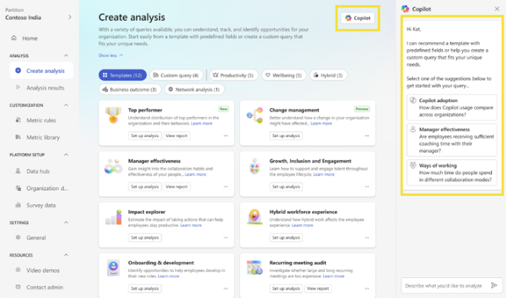
ML & AI & IOT Updates
Microsoft 365 Copilot now available to Viva Insights analysts
Copilot can help analysts choose a Power BI report or simplify the query creation process by suggesting metrics, filters, and attributes relevant to their analysis.
With this new functionality, analysts don’t need to search through a wide array of templates, metrics, attributes, and filters to pick the ones relevant to their analyses. With Copilot, they can now just type the query in their own words, and Copilot will do the rest.
Codestral 25.01: Mistral's First Code Model in Azure AI Model Catalog
Mistral has launched Codestral 25.01, a groundbreaking model explicitly designed for code generation tasks, now available in the Azure AI Model Catalog. With its advanced capabilities, Codestral 25.01 is set to redefine how software developers approach coding, debugging, and building applications.
Codestral 25.01 is a next-generation AI model tailored for developers. It is designed to seamlessly handle complex code generation tasks while also serving as a conversational assistant for technical queries. With a shared instruction and completion API endpoint, developers can harness the power of AI to:
Generate high-quality code snippets.
Summarize and document existing code.
Translate code between different programming languages.
Review, refactor, and debug code efficiently.

Slide 24
ML & AI & IOT Updates
Retirement: Azure AI Image Analysis 4.0 Preview APIs retiring on March 31, 2025
On March 31, 2025, the Image Analysis 4.0 Preview APIs will be retired. Before that date, migrate Azure Image Analysis workloads to the Image Analysis 4.0 GA API.
These preview Image Analysis 4.0 APIs will retire on March 31, 2025:
2022-07-31-preview
2022-10-12-preview
2023-02-01-preview
2023-04-01-preview
2023-07-01-preview
v4.0-preview.1

Slide 25
DevOps & IaC & Automation

Slide 26
DevOps & IaC & Automation
Action required: MSOnline and AzureAD PowerShell retirement - 2025 info and resources
MSOnline PowerShell will retire (and stop working) between early April 2025 and late May 2025.
AzureAD PowerShell will no longer be supported after March 30, 2025, but its retirement will happen after July 1, 2025. This postponement is to allow you time to finish MSOnline PowerShell migration.
To ensure customer readiness for MSOnline PowerShell retirement, a series of temporary outage tests will occur for all tenants between January and March 2025
Introducing Azure CLI 1.4.0
MS announced the release of Azure CLI version 1.4.0, bringing powerful new capabilities of Azure Load Testing to CLI!
Multi-Region Load Testing - This feature allows you to distribute load across up to eight regions, helping you assess application performance under real-world, distributed traffic scenarios.
Advanced URL Tests - Easily create and update load tests using URL-based test plans in JSON format, without requiring JMeter scripts.
Test Run Debug Mode - Debugging complex load tests is now simpler. Use debug mode to get detailed log files for error-free and large-scale testing.
Get Artifacts SAS URL - Retrieve secure SAS URLs to access test artifacts directly from your storage account.
Convert URL Test to JMX - Seamlessly convert your URL-based test plans into JMeter-compatible JMX files for advanced test configurations.

Slide 27
Miscellaneous

Slide 28
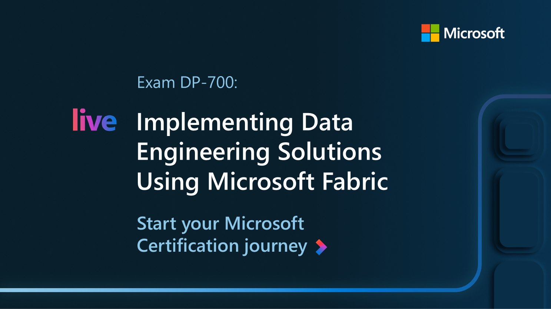
Miscellaneous Updates
Microsoft Certified: Fabric Data Engineer Associate Certification is GA
MS announced the general availability of the Microsoft Certified: Fabric Data Engineer Associate Certification and its related Exam DP-700: Implementing Data Engineering Solutions Using Microsoft Fabric.
This new certification validates the skills needed to implement and manage analytics solutions using Microsoft Fabric, a unified, AI-powered solution that integrates Power BI, Azure Data Factory, and Azure Synapse Analytics to help you turn raw data into actionable insights. By earning this certification, data engineers can demonstrate their expertise in:
Implementing and managing an analytics solution.
Ingesting and transforming data.
Monitoring and optimizing an analytics solution.

Slide 29
Information

Slide 30
Information
Azure Times GitHub Repo

Slide 31
Questions

