Slide 1
Azure Times #149
February 3, 2025

Slide 2
Networking

Slide 3
Networking Updates
GA: Application Gateway support new custom error pages
Application Gateway allows to create customized error pages instead of displaying default ones. It is possible to use branding and layout for errors related to different response codes. Some scenarios for setting custom error pages are
Showing a maintenance or status page for 502 Bad Gateway
Showing a customized unauthorized access page for 403 Forbidden response code
Showing a company-branded page with contact details in case of an issue.
The Azure Application Gateway now lets configure company-branded error pages for more response codes - 400, 405, 408, 500, 503, and 504. It is possible to configure these error pages at a global level to apply to all the listeners on gateway or individually for each listener. The custom error pages set are displayed to the clients when the Application Gateway generates these response codes. You can host these error page files at any publicly accessible URLs.

Slide 4
Security & Identity

Slide 5
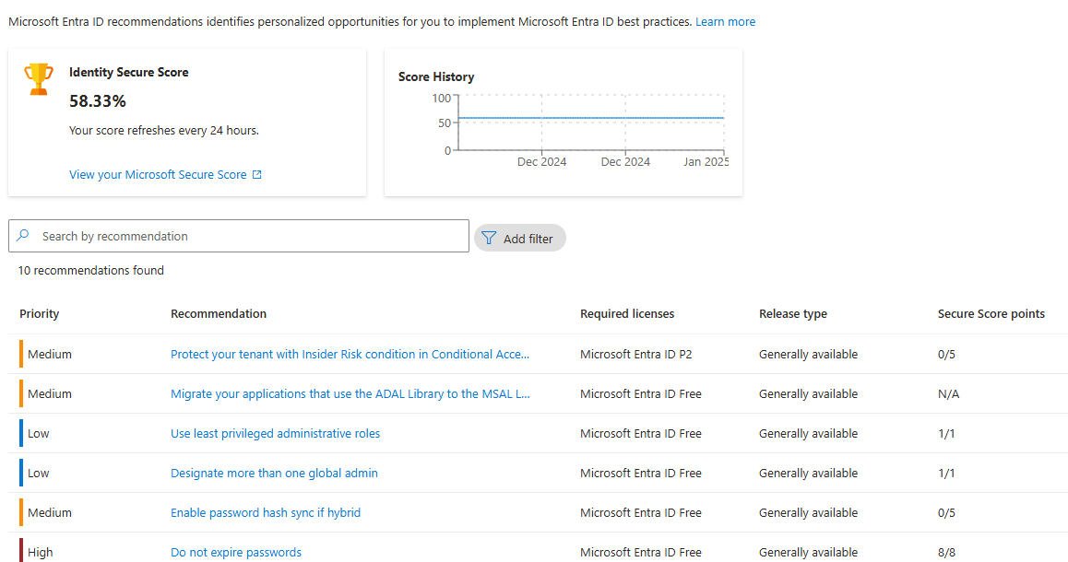
Security & Identity Updates
Azure AD Graph is retiring
Applications will be unable to make requests to Azure AD Graph APIs starting February 1, 2025.
Microsoft Graph is the replacement for Azure AD Graph APIs. MS strongly recommend immediately migrate use of Azure AD Graph APIs to Microsoft Graph and ceasing any further use of Azure AD Graph APIs.
Microsoft Entra provide recommendation for such cases
Azure Resource Manager Retire the TLS 1.0 and 1.1
On March 1, 2025, Azure Resource Manager will be retiring support for TLS 1.0 and TLS 1.1. After that date, any incoming calls to Azure using TLS 1.0/1.1 will fail. This is part of an Azure-wide initiative to enhance security.

Slide 6
Security & Identity Updates
Microsoft Entra PowerShell module now generally available
The Microsoft Entra PowerShell module is a command-line tool that allows administrators and developers to manage and automate Microsoft Entra resources programmatically. This includes efficiently managing users, groups, applications, service principals, policies, and more. The module builds upon and is part of the Microsoft Graph PowerShell SDK. It’s fully interoperable with all cmdlets in the Microsoft Graph PowerShell SDK, enabling you to perform complex operations with simple, well-documented commands. The module also offers a backward compatibility option to streamline migration from the retiring AzureAD PowerShell module. Microsoft Entra PowerShell works with Windows PowerShell 5.1 and PowerShell 7+. For the best experience on Windows, Linux, and macOS, MS recommend using PowerShell 7 or later.
GA: FIPS 140 Level 3 HSMs Premium Key Vault in China
Azure Key Vault Premium is now available in the China Region. This significant milestone marks the first time Azure Key Vault Premium, featuring FIPS 140 Level 3 Hardware Security Modules (HSMs), is accessible in China.
The FIPS 140 Level 3 HSMs offer the highest level of security for cryptographic keys, ensuring your data is protected with the most stringent standards. For more information on FIPS 140, see Federal Information Processing Standard (FIPS) 140 . With the Introduction of Premium Key Vault in Mooncake China, customers can now benefit from advanced security features, including:
Enhanced Security: FIPS 140 Level 3 certification ensures that the HSMs meet rigorous security requirements, providing robust protection for your cryptographic keys.
Compliance: This launch helps customers in highly regulated industries meet their compliance requirements.
This general availability is offered in the China North 3, China North 2, China East 3, and China East 2 region

Slide 7
Security & Identity Updates
People administrator is GA
The People administrator role will provide the following capabilities:
Update profile photos for all users, including admins.
Update people settings for pronouns and name pronunciation, Profile card settings, and photo update settings for all users.
Microsoft Defender for Cloud Integrates with Endor Labs
Integration of these solutions brings:
A Unified Approach to Vulnerability Management
Complete Visibility and Prioritized Remediation
Reduced Risk Through Early Intervention
Code-to-Runtime Exploitability
Streamlined Communication & Collaboration

Slide 8
Management & Governance

Slide 9
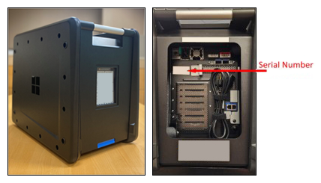
Management & Governance Updates
Retirement: Migrating to TLS 1.2+ with Deprecation of Outdated Security Protocols
On March 1, 2025, Azure Resource Manager will be retiring support for TLS 1.0 and TLS 1.1. After that date, any incoming calls to Azure using TLS 1.0/1.1 will fail. This is part of an Azure-wide initiative to enhance security.
Public Preview: The next generation of Azure Data Box Devices
MS announced the preview of Azure Data Box 120 and Azure Data Box 525, next-generation compact, NVMe-based Data Box devices. These new devices incorporate several improvements to accelerate offline data transfers to Azure, including:
Fast copy - Built with NVMe drives for high-speed transfers and improved reliability and support for faster network connections
Easy to use - larger capacity offering (525 TB) in a compact form-factor for easy handling
Resilient- Ruggedized devices built to withstand rough conditions during transport
Secure - Enhanced physical, hardware and software security features
Broader availability – Presence in more Azure regions, meeting local compliance standards and regulations

Slide 10
Management & Governance Updates
PP: Azure Monitor Integrates Performance Diagnostic for Enhanced VM Troubleshooting
This integration is now available in the VM Overview Monitoring Tab and VM Insights blade of Azure Monitor, providing a seamless experience that combines monitoring and diagnostics in one place. It is possible to troubleshoot directly within Azure Monitor workflow and easily access continuous and on-demand insights, recommendations, and diagnostics data from Performance Diagnostics for VM performance issues. Available in both continuous and on-demand modes, continuous Performance Diagnostics provides you with actionable insights into high resource usage. This proactive approach to performance management empowers you to swiftly diagnose performance issues as they arise, mitigating downtime and maximizing efficiency.

Slide 11
Compute

Slide 12
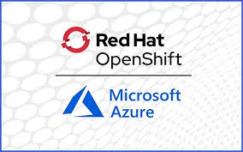
Compute Updates
GA: Azure Red Hat OpenShift in Spain Central
Azure Red Hat OpenShift is now available in Spain Central region. This strategic expansion strengthens multi-region deployment options across Europe, enabling enhanced geographic redundancy and scalability for containerized workloads. The new region offers seamless integration with Spain Central's comprehensive suite of Azure services, allowing to build sophisticated cloud-native solutions while maintaining data residency requirements.
Azure Red Hat OpenShift provides highly available, fully managed OpenShift clusters on demand, and is monitored and operated jointly by Microsoft and Red Hat.
Public Preview: Reduce costs with Hibernation in Azure DevTest Labs
MS introduced the Hibernation feature for virtual machines (VMs) in Azure DevTest Labs.
The new Hibernation feature in Azure DevTest Labs helps optimize costs by pausing Virtual Machines (VMs) while preserving their state, making it easy to resume work without losing progress.
Azure DevTest Labs has traditionally provided capabilities such as shutdown of Virtual Machine, either manually or through scheduling, to help users manage VM costs efficiently. While effective at reducing expenses, the shutdown feature doesn’t maintain the state of applications and processes between VM sessions. That’s where the new hibernation feature fills the gap — enabling VMs to pause while preserving their memory contents, so it is possible to pick up right where it is left off without reconfiguring or restarting.
When you hibernate a machine, Azure stores the memory contents of the VM in the OS disk and then deallocates the VM. When the VM is started again from its hibernated state, the memory contents are transferred from the OS disk back into memory. Once a VM is placed in a hibernated state, you aren’t charged for the compute cost of the VM, just like how you aren’t charged for it in a stopped (deallocated) state. You’re only charged for the storage (OS disk, data disks) and networking resources (IPs, etc.) attached to the VM.

Slide 13
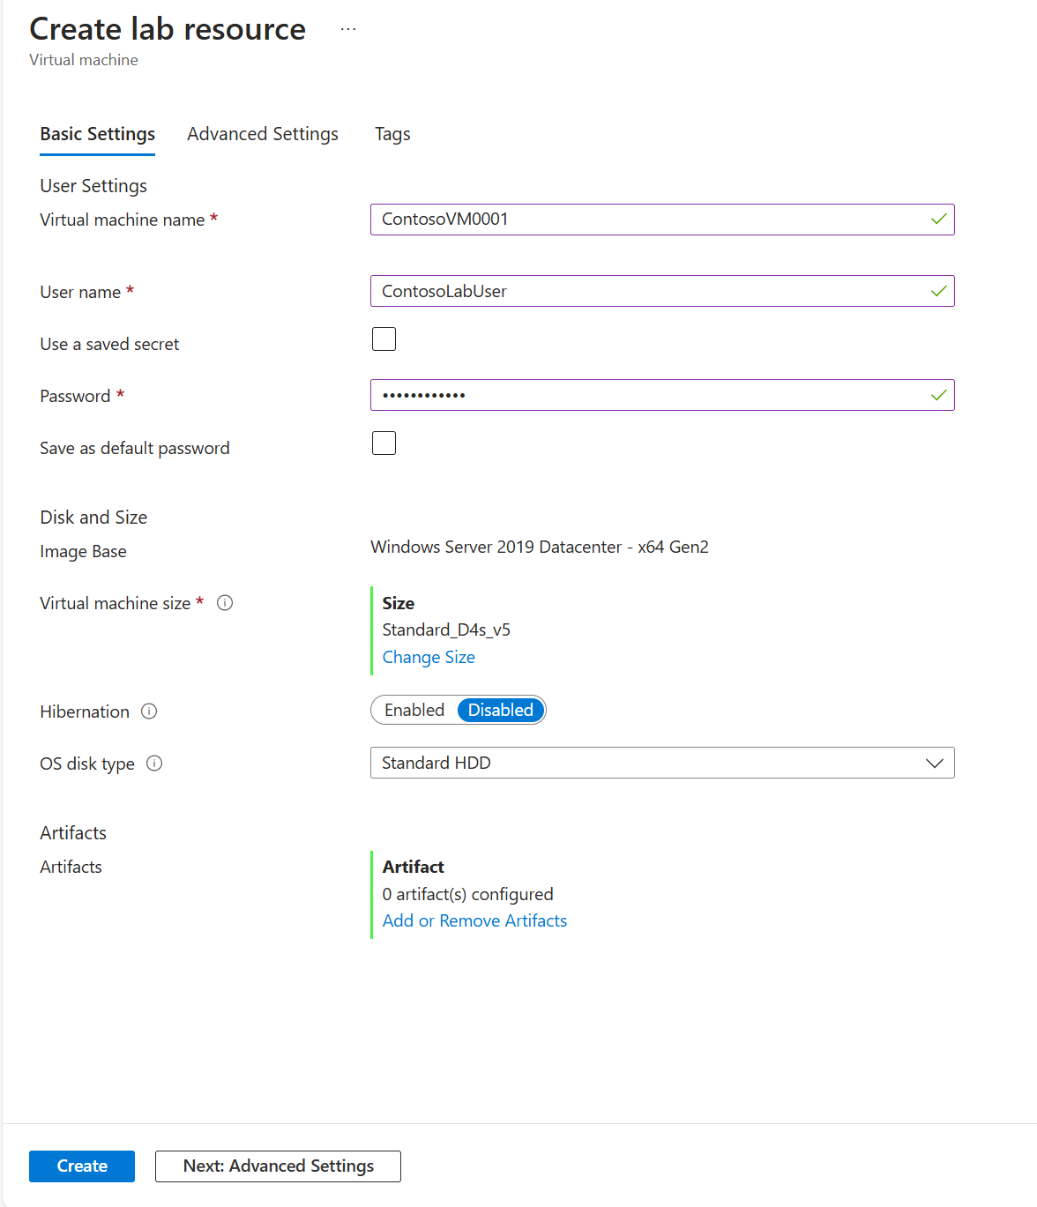
Compute Updates
Public Preview: Introducing enhanced support for Generation 2 VMs in Azure DevTest Labs
MS announced enhanced support for Generation 2 VMs on Azure DevTest labs. It is now possible to choose between Generation 1 and Generation 2 versions of the same marketplace image while creating a VM in Azure DevTest Labs. Generation 2 Virtual Machines (VMs) support key capabilities that are not supported in Generation 1 VMs such as increased memory, Intel Software Guard Extensions (Intel SGX), and virtualized persistent memory (vPMEM). Generation 2 VMs might have improved boot and installation times.

Slide 14
Compute Updates
Upgrading Logic Apps standard to .NET 8
Logic Apps standard runtime is currently running on .NET6, which will reach end of support by Nov 12, 2024. MS is working on migrating Logic Apps standard to run on .NET 8 in the coming weeks. MS will continue support Logic Apps running on top of .NET 6 until this upgrade is completed. As part of this change, MS will transparently upgrade all Logic Apps to run on .NET 8, except the ones in the following categories:
Logic Apps that use NuGet based deployment model.
Logic Apps that have been pinned to a particular bundle version
Logic Apps that are still running on top of Functions V3
If you have an application in one of exception categories, you need to update your application and deployment processes to include the following app setting:
FUNCTIONS_INPROC_NET8_ENABLED 0
This app setting is needed for preventing an app being automatically migrated to run on .NET 8.
Retirement: Azure HDInsight support for TLS 1.1 and lower will be deprecated by March 31, 2025
Customers that have Azure HDInsight cluster is using TLS version 1.1 or lower are requested to upgrade to clusters have TLS version 1.2.
To enhance security and provide best-in-class encryption for data, MS will require all connections to Azure HDInsight clusters to be secured using Transport Layer Security (TLS) 1.2 or later beginning March 31, 2025, when connectivity will only be available through TLS 1.2 or later versions. This retirement notice applies only to Azure HDInsight clusters; all other TLS retirements aren’t impacted by this announcement.
Required action
Upgrade to versions 5.1 of the Azure HDInsight cluster with TLS version 1.2 by March 31 to keep your clusters working as expected.

Slide 15
Compute Updates
Retirement of Virtual Network Injection for Azure Data Explorer Extended to May 1st 2025
The retirement date for Virtual Network Injection (VNet Injection) has been extended to May 1st, 2025. This extension provides with additional time to transition their workloads and adapt their configurations to the new network capabilities of Private Endpoints.

Slide 16
Storage & Data

Slide 17
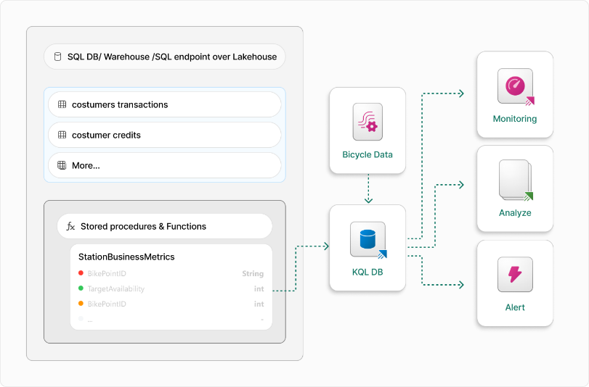
Storage & Data Updates
SQL Endpoint Connection now available in Microsoft Fabric Eventhouse
Microsoft Fabric Eventhouse has expanded its SQL query federation capabilities by supporting query federation to more Tabular Data Stream (TDS) protocol endpoints, like Fabric data warehouses and SQL Analytical endpoints. Through the Create and Alter Azure SQL External Tables command, it is now possible to connect to Fabric SQL Analytical endpoints and warehouses in addition to the previously supported Azure SQL Database, SQL Server, and other TDS-compatible databases.
Introducing ownership takeover for Fabric items
Now, when an item owner leaves the company, their credentials expire, or they lose access, many Fabric items cease to function. For example, Lakehouses and their SQL Endpoints become inoperative, pipelines fail to execute due to user access errors. In these situations, enabling another user to assume ownership would ensure business continuity.
For this reason, MS pleased to announce that Fabric users with the right permissions can now take ownership of Fabric items.

Slide 18
Storage & Data Updates
Private Preview of Migration assistant for Fabric Data Warehouse
This tool enables users to migrate the code and data from the source database(SQL Server, Synapse dedicated SQL pools, and other warehouses), automatically converting the source schema and code to Fabric Data Warehouse, helping with data migration, and providing AI powered assistance.
MS currently running a Private Preview for Migration Assistant and invite to participate and share valuable feedback.

Slide 19
Databases

Slide 20
Databases Updates
Shrink for Azure SQL Database Hyperscale is now generally available
Database shrink in Azure SQL Database allows customers to reclaim unused space within their databases to optimize storage costs. Now this is available in Hyperscale service tier too. This improvement needs no new learnings as the same DBCC SHRINKDATABASE and DBCC SHRINKFILE commands are used.
Key features
Storage Optimization: Database shrink effectively reclaims unused space, reducing the allocated storage footprint of your database.
Cost Efficiency: By optimizing storage usage, customers can potentially lower their storage costs.
Ease of Use: The feature uses the same syntax as what is available in other service tiers and in SQL Server. So, customers are able to seamlessly use existing scripts, minimizing disruption during adoption.

Slide 21
Integration

Slide 22
Integration Updates
Announcing AMQP v2 stack engine support in the Azure Messaging Event Hubs library for Java
MS announced a new stable release of the Azure Event Hubs library for Java (azure-messaging-eventhubs 5.20.0). Version 5.20.0 integrates the AMQP v2 stack engine, which is the new AMQP (Advanced Message Queuing Protocol) client stack redesigned to improve the reliability and performance of the Azure Messaging libraries.
The AMQP v2 stack engine brings several key improvements to Azure Messaging libraries:
Reducing thread hopping, removing locks, optimizing code in hot paths, and reducing memory allocations.
Resolving multiple race conditions, including those issues related to prefetching and credit calculations.
Enhancing error handling to improve reliability in the face of transient issues.
In the Event Hubs library using the AMQP v2 stack, memory usage for receiving events improved by up to ~40% compared to the AMQP v1 stack.
The Service Bus library using AMQP v2 stack delivers up to 50% higher throughput for message processor use cases.

Slide 23
ML & AI & IOT

Slide 24
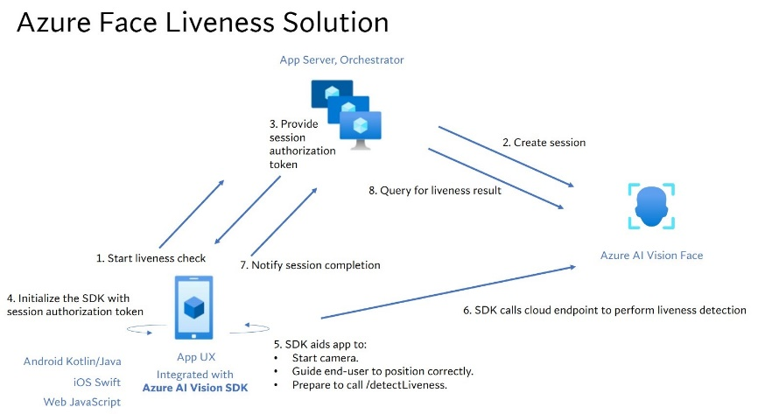
ML & AI & IOT Updates
Announcing General Availability of Face Liveness Detection
MS announce the general availability of face liveness detection features, a key milestone in making identity verification both seamless and secure. As deepfake technology and sophisticated spoofing attacks continue to evolve, organizations need solutions that can verify the authenticity of an individual in real time.
Microsoft Translator Pro is now Generally Available (GA)
MS Translator is a MS robust solution crafted to help enterprises break down language barriers in the workplace.
Core feature - speech-to-speech translation
Break language barriers
Unified experience
On-device translation
Full administrator control
Uncompromised privacy and security
Customized phrasebook
International availability
Availability in US Government cloud

Slide 25
ML & AI & IOT Updates
DeepSeek R1 is now available on Azure AI Foundry and GitHub
DeepSeek R1 is now available in the model catalog on Azure AI Foundry and GitHub, joining a diverse portfolio of over 1,800 models, including frontier, open-source, industry-specific, and task-based AI models. As part of Azure AI Foundry, DeepSeek R1 is accessible on a trusted, scalable, and enterprise-ready platform, enabling businesses to seamlessly integrate advanced AI while meeting SLAs, security, and responsible AI commitments—all backed by Microsoft’s reliability and innovation.
Announcing the availability of the o3-mini reasoning model in Microsoft Azure OpenAI Service
MS announced that OpenAI o3-mini is now available in Microsoft Azure OpenAI Service. o3-mini adds significant cost efficiencies compared with o1-mini with enhanced reasoning, with new features like reasoning effort control and tools, while providing comparable or better responsiveness.
o3-mini’s advanced capabilities, combined with its efficiency gains, make it a powerful tool for developers and enterprises looking to optimize their AI applications.
With faster performance and lower latency, o3-mini is designed to handle complex reasoning workloads while maintaining efficiency.

Slide 26
DevOps & IaC & Automation

Slide 27
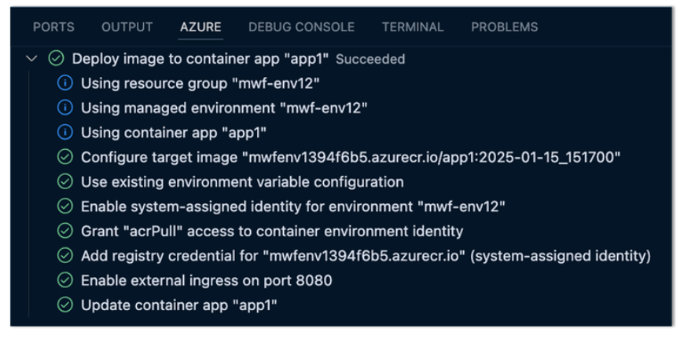
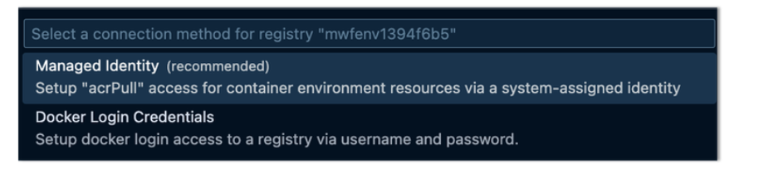
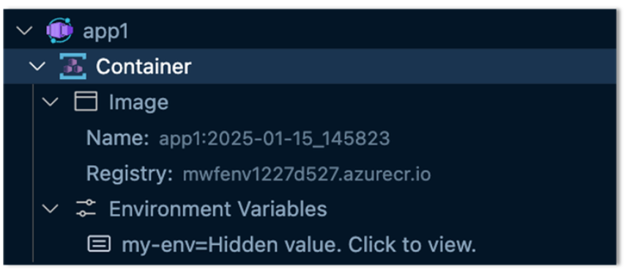
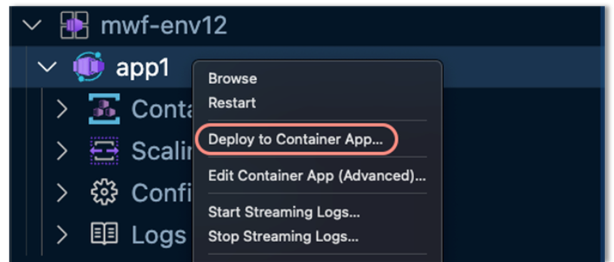
DevOps & IaC & Automation
New Features in Azure Container Apps VS Code extension
New Managed Identity Support
New Container View
Deploy to Container App
Improved Activity Log Output
Image for Container App Creation

Slide 28
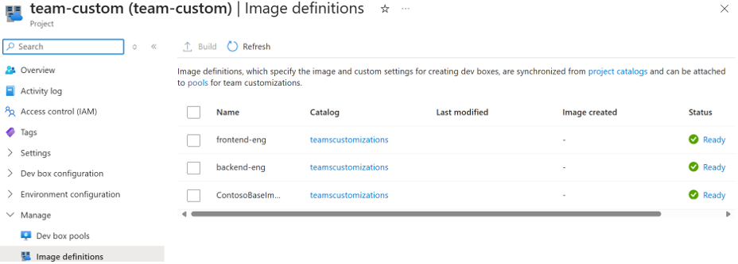
DevOps & IaC & Automation
Teams Foundation Service retirement
October 14, 2025, is the date for the end of Extended Support for Team Foundation Server 2015 – meaning it will no longer receive security updates or technical support.
Upon end of support, there will be no new updates, free or paid assisted support options or online technical content updates. Upgrading from Team Foundation Server 2015 to Azure DevOps Server 2022.2 is fully supported and strongly recommended that customers upgrade to the latest version before October 14, 2025, to continue getting security patches and support.
October 14, 2025, is also the date for the end of Mainstream Support for Azure DevOps Server 2020.
Automating Developer Environments with Microsoft Dev Box and Teams Customizations
This allows developer team leads or managers to define the software installed by default every time a developer creates a new environment, ensuring that every team member has the latest tools and frameworks needed to deliver on a project right away. This automates the typical process of using a combination of custom images, miscellaneous scripts, and manual configuration that is used in most organizations today. Moving to an automated approach enables developer teams to work more efficiently and not have to spend additional time configuring developer environments. If you are new to Dev Box, there may be some concepts that are mentioned below you may not be aware of

Slide 29
Information

Slide 30
Information
Azure Times GitHub Repo

Slide 31
Questions

