Slide 1
Azure Times #88
September 27, 2023

Slide 2
Security & Identity

Slide 3
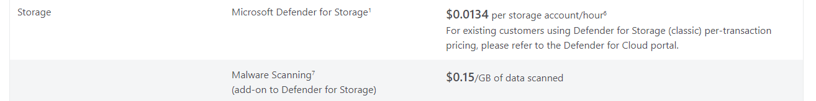
Security & Identity Updates
General Availability: Malware Scanning in Defender for Storage
Malware Scanning helps overcome traditional challenges in non-compute malware protection, providing a scalable solution tailored for high-compliance industries. Malware Scanning is available as an add-on to Defender for Storage and is a significant enhancement to Microsoft Defender for Cloud’s security offerings for Azure Blob Storage. Malware Scanning offers:
Near real-time agentless protection: full malware scan on uploaded content in near real time, using Microsoft Defender Antivirus capabilities.
Cost-effective security
Simple enablement at scale
Use-case versatility
Malware Scanning is priced per gigabyte of data scanned.
Unsupported features and services
Unsupported storage accounts: Legacy v1 storage accounts aren't supported by malware scanning.
Unsupported service: Azure Files isn't supported by malware scanning.
Unsupported blob types: Append and Page blobs aren't supported for Malware Scanning.
Unsupported encryption: Client-side encrypted blobs aren't supported as they can't be decrypted before scanning by the service.
Unsupported index tag results: Index tag scan result isn't supported in storage accounts with Hierarchical namespace enabled (Azure Data Lake Storage Gen2).
Event Grid: Event Grid topics that don't have public network access enabled (i.e. private endpoint connections) are not supported by malware scanning in Defender for Storage
Scan throughput rate limit: Malware Scanning can process up to 2 GB per minute for each storage account
Blob scan limit: Malware Scanning can process up to 2,000 files per minute for each storage account.
Blob size limit: The maximum size limit for a single blob to be scanned is 2 GB.

Slide 4
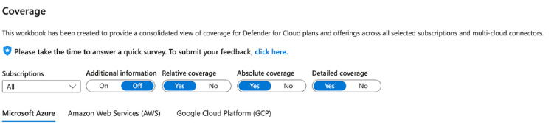
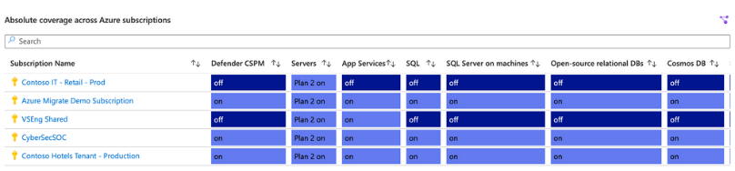
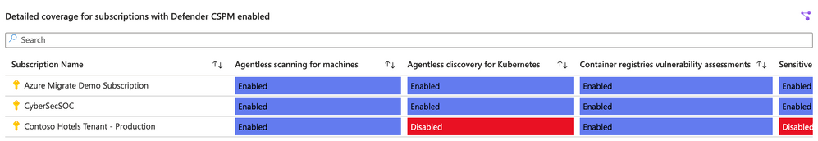
Security & Identity Updates
Azure AD Rename Rollout
MS started rollout of the rename of Azure Active Directory (Azure AD) to Microsoft Entra ID. The majority of text updates to be completed by mid-November of this year, and updates for on-premises software to be completed in 2024.
MS Released a guidelines for the doc renaming
Defender for Cloud Coverage Workbook
Microsoft updated the Defender for Cloud Coverage Workbook:
The Additional information toggle displays additional information about the workbook.
Relative coverage, provides an overview table that will show the percentage of subscriptions, or multicloud connectors that have a particular plan enabled.
Absolute coverage table will show an overview with all subscriptions and multiload connectors
The Detailed coverage option has been added as a new view.

Slide 5
Management & Governance

Slide 6
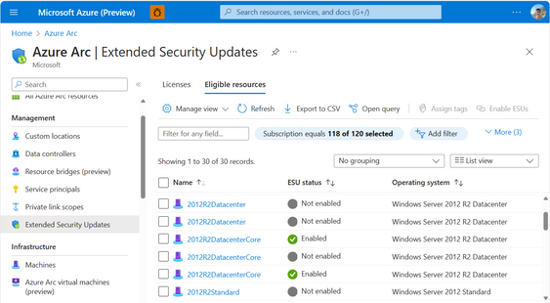
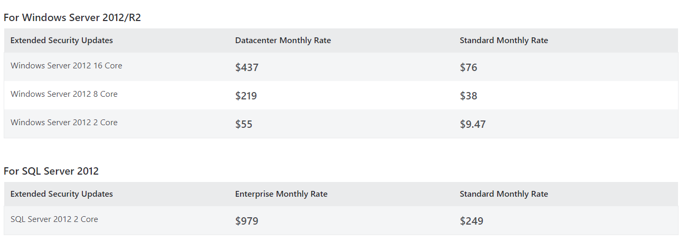
Management & Governance Updates
Azure ARC Connected Agents Updates
New features
Extended Security Updates for Windows Server 2012 and 2012 R2 can be purchased and enabled through Azure Arc. If your server is already running the Azure Connected Machine agent, upgrade to agent version 1.34 or later to take advantage of this new capability.
Additional system metadata is collected to enhance your device inventory in Azure:
Total physical memory
Additional processor information
Serial number
SMBIOS asset tag
Network requests to Microsoft Entra ID (formerly Azure Active Directory) now use login.microsoftonline.com instead of login.windows.net
Fixed
Better handling of disconnected agent scenarios in the extension manager and policy engine.
Generally Available: Windows Server 2012 and 2012 R2 Extended Security Updates enabled by Azure Arc
MS announced Windows Server 2012 and 2012 R2 Extended Security Updates (ESUs) enabled by Azure Arc is now Generally Available. Windows Server 2012 and 2012 R2 are going End of Support on October 10, 2023. With ESUs, customers who are running Windows Server 2012 on-premises or in other clouds can get three more years of critical security updates from Microsoft to protect their End of Life infrastructure

Slide 7
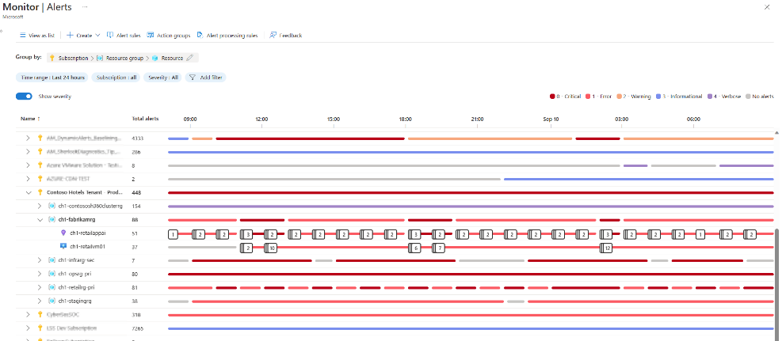
Management & Governance Updates
Generally available: Azure Monitor OpenTelemetry-based Distro for Node.js and Python
The Azure Monitor OpenTelemetry “Distro” includes a thin wrapper that enables to get started with a single line of code, and it includes added Azure-specific capabilities to give a first-class experience on Azure. The Distro is open and extensible, meaning send data to multiple destinations and extend the Distro with OpenTelemetry’s rich set of instrumentation libraries that collect data from a large variety of frameworks and environments.
For context, the Azure Monitor OpenTelemetry Java Distro is already Generally Available, and the Azure Monitor OpenTelemetry .NET Distro remains in Preview state.
Public preview: Alerts timeline view
Azure Monitor alerts is previewing a new timeline view that simplifies the consumption experience of fired alerts. The new view has the following advantages:
Shows fired alerts on a timeline
Helps identify co-occurrence of alerts
Displays alerts in the context of the resources they fired on
Focuses on showing counts of alerts to better understand impact
Supports viewing alerts by severity
Provides a more intuitive discovery and investigation path

Slide 8
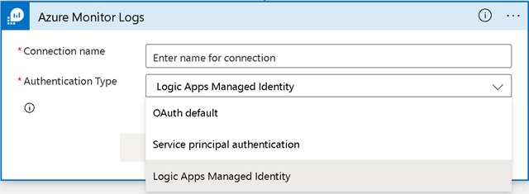
Management & Governance Updates
General Availability: GitHub Advanced Security for Azure DevOps
The core scanning capabilities of GitHub Advanced Security for Azure DevOps can now be self-enabled within Azure DevOps and connect to Microsoft Defender for Cloud. GitHub Advanced Security for Azure includes:
Secret Scanning push protection: check if code pushes include commits that expose secrets such as credentials
Secret Scanning repo scanning: scan your repository and look for exposed secrets that were committed accidentally
Dependency Scanning – search for known vulnerabilities in open source dependencies (direct and transitive)
Code Scanning – use CodeQL static analysis engine to identify code-level application vulnerabilities such as SQL injection and authentication bypass
NOTE:
Each active committer to at least one repository with Advanced Security enabled consumes one license and costs $49.
Advanced Security is billed directly to the Azure subscription associated with Azure DevOps organization.
Daily charges emit to Azure subscription based off of the total number of active committers per day across organizations.
Authenticate Azure Monitor logs connector in Logic App with managed identity
Managed identities in Azure lets authenticate to any resource that supports Azure AD authentication, including own applications. When you enable managed identity authentication in Logic App and grant it permissions in Log Analytics workspace or Application Insights component, you can query data without needing to provide credentials, secrets, or Azure AD tokens, for Azure Monitor Logs connector authentication.

Slide 9
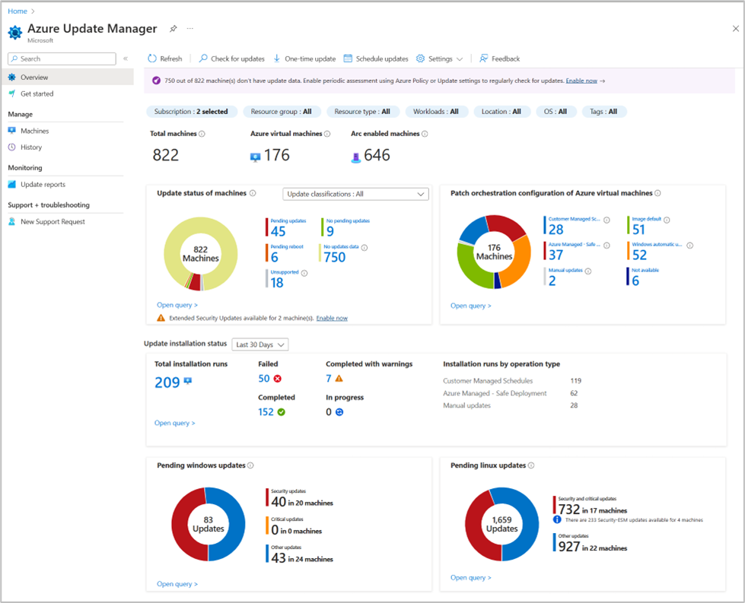
Management & Governance Updates
Generally Available: Azure Update Manager
Azure Update Manager, previously known as Update Management Center, is now generally available. It allows to:
Oversee update compliance for entire fleet of machines in Azure (Azure VMs), on-premises, and multi cloud environments (Arc-enabled Servers).
View and deploy pending updates to secure machines instantly.
Manage extended security updates (ESUs) for Azure Arc-enabled Windows Server 2012/2012 R2 machines.
Define recurring time windows during which machines receive updates and may undergo reboots using scheduled patching.
Enable incremental rollout of updates to Azure VMs in off-peak hours using automatic VM guest patching and reduce reboots by enabling hotpatching.
Automatically assess machines for pending updates every 24 hours, and flag machines that are out of compliance.
Create custom reports for deeper understanding of the updates data of the environment.
Granular access management to Azure resources with Azure roles and identity, to control who can perform update operations and edit schedules.
Azure Update Manager is available at no additional charge for managing Azure VMs. For Arc-enabled Servers, the price is up to $5 per server per month.

Slide 10
Management & Governance Updates
Azure Policy Exemptions Added to Resource Graph
Azure Policy Graph was extended by including the policy exception. Previously we had to use the API to get such information bit now it is possible to use KQL to get this data
policyresources
| where type =~ 'microsoft.authorization/policyexemptions'
General Availability: Share VM images publicly with community gallery - Azure Compute Gallery feature
With community gallery, a new feature of Azure Compute Gallery, it is possible to easily share VM images with the wider Azure community. By setting up a 'community gallery', group images and make them available to other Azure customers. As a result, any Azure customer can utilize images from the community gallery to create resources such as virtual machines (VMs) and VM scale sets.
Azure customers can then deploy VMs and VM scale sets using the portal, CLI, rest API, and PowerShell with the images you published and shared.
Additionally, Fedora, CentOS Stream, AlmaLinux, FreeBSD, RockyLinux and other publishers will be able to share their non-commercial images and software packages with their customers using community galleries on Azure Compute Gallery.

Slide 11
Compute

Slide 12
Compute Updates
Azure Service Fabric 10.0 Release
MS announced that 10.0 release of the Service Fabric runtime has completed rolling out to the various Azure regions along with tooling and SDK updates. The updates for .NET SDK, Java SDK, and Service Fabric runtimes can be downloaded from the links provided in Release Notes.
Public Preview of NVMe-enabled Ebsv5 VMs
MS released a Public Preview of accelerated remote storage performance using Azure Premium SSD v2 or Ultra disk and selected sizes within the existing NVMe-enabled Ebsv5 family. The higher storage performance is offered on the E96bsv5 and E112ibsv5 VM sizes and delivers up to 400K IOPS (I/O operations per second) and 10GBps of remote disk storage throughput.
This Public Preview of accelerated NVMe-Ebsv5 with increased remote storage performance is part of the Azure Boost family, which upgrades the fleet with these new capabilities.
This Public Preview is initially available in the US East

Slide 13
Compute Updates
Public Preview: Web PubSub support for Socket.IO
Azure Web PubSub for Socket.IO is a new capability that manages client connections for an application using the Socket.IO library. This means it is not needed to manage multiple Socket.IO servers or adapters, and don't need to develop expertise in distributed systems - instead, it is possible to focus on building real-time experiences.
Now it is easily to migrate from self-hosted Socket.IO to a fully managed solution through Web PubSub for Socket.IO.
Version 1.2.4582 of the Windows Desktop client for AVD has been released to all users!
Fixed an issue when using the default display settings and a change is made to the system display settings, where the bar does not show when hovering over top of screen after it is hidden.
Improved client logging, diagnostics, and error classification to help admins troubleshoot connection and feed issues.
Accessibility improvements:
Narrator now announces the view mode selector as "View combo box", instead of "Tile view combo box" or "List view combo box".
Narrator now focuses on and announces Learn more hyperlinks.
Keyboard focus is now set correctly when a warning dialog loads.
Tooltip for the close button on the About panel now dismisses when keyboard focus moves.
Keyboard focus is now properly displayed for certain drop-down selectors in the Settings panel for published desktops.

Slide 14
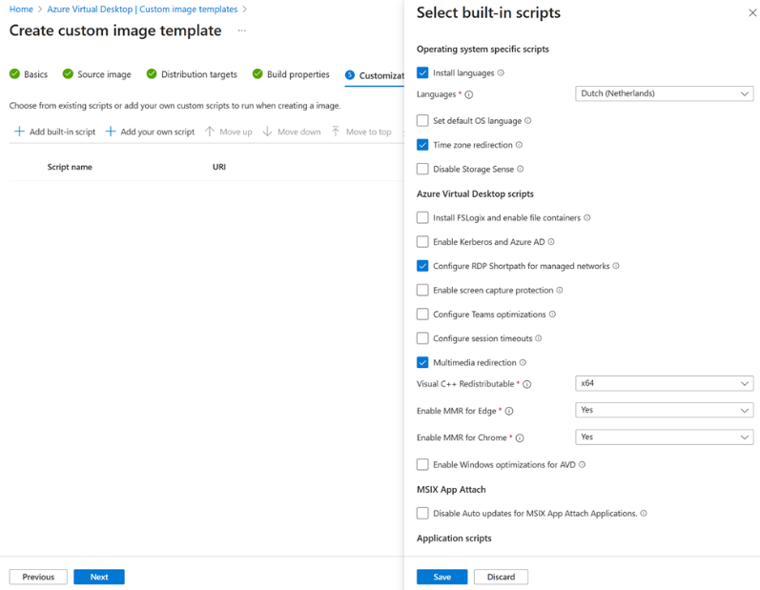
Compute Updates
Azure Virtual Desktop Custom Image Templates
MS Announced that Azure Virtual Desktop Custom image templates is now general available in Azure Public Cloud and entering public preview in Azure Government Cloud and China.
Custom image templates allow admins to build a custom “golden image” using the Azure Virtual Desktop management user interface. Leverage a variety of built-in customizations or add own customization scripts to install applications or configurations.
This feature is a wrapper for the Azure Image Builder (AIB) service. Azure Virtual Desktop passes it to the AIB service. AIB will then distribute the resulting image to either a managed image or to the Azure Compute Gallery which supports capabilities such as automated versioning and image replication across any Azure region

Slide 15
Storage & Data

Slide 16
Storage & Data Updates
Azure Storage TLS changes: Intermediate certificate renewals
Azure Storage uses some intermediate certificates that are set to expire on 27th June,2024. MS will be rolling out new certificates for the expiring intermediate certificates starting March 2024.
The most of the Azure Storage customers will not be impacted; however, application may be impacted if explicitly specify a list of acceptable CAs (a practice known as “certificate pinning”).
This change is limited to public Azure cloud and US Government cloud. There are no changes in other sovereign clouds like Azure China.
Action Required
If client application has pinned to the intermediate CAs, please make sure the Issuing CAs are added to your trusted root store by end of Feb 2024.
Keep using the current root or intermediate CAs in your applications or devices until the transition period is completed (necessary to prevent connection interruption).

Slide 17
ML & AI & IOT

Slide 18
ML & AI & IOT Updates
OpenAI Whisper model in preview in Azure OpenAI service and Azure AI Speech
Azure OpenAI Service and Azure AI Speech now offer the OpenAI Whisper model in preview. The OpenAI Whisper model has multi-lingual capabilities that offer precise and efficient transcription of human speech in 57 languages, and translation into English. It also creates transcripts with enhanced readability.
Azure Functions – September Updates
Starting with version 6.0.0 of the Azure Functions Event Hubs extension, a higher default value of 100 will be used for the maxEventBatchSize configuration setting for improved performance. Learn more here.
Durable Functions for Python v2 Programming Model now generally available
.NET Updates:
.NET on Azure Functions – August 2023 roadmap update
Azure Functions .NET 8 support in Linux plans in preview
Application Insights integration for the Azure Functions .NET worker generally available
SDK type bindings in Azure Functions generally available
ASP.NET Core integration in Azure Functions generally available
Azure Functions .NET worker cold start improvements in preview

Slide 19
Retirement

Slide 20
Retirement Updates
Azure Maps Render V1 APIs will be retired on 17 September 2026 – transition to Azure Maps Render V2 APIs
Azure Maps Render V1 APIs will be retired on 17 September 2026, please transition to Azure Maps Render V2 APIs by that date.
Azure Maps team is retiring Azure Maps Render V1 APIs services. In lieu, Azure Maps has deployed Azure Maps Render V2 APIs. The Azure Maps Render V2 APIs offers enhanced data quality and performance.
Retirement notice: The legacy Azure Storage Python client libraries will be retired on 13 September 2024
Legacy Azure Storage Python client libraries will be retired on 13 September 2024. Before that date, please transition to the latest version of the Azure Storage Python client libraries.
After 13 September 2024, the older client libraries can still be used, but any associated updates will no longer be issued by Microsoft.
Retirement: HTTP application routing add-on (preview) for AKS will retire 03/03/2025
HTTP application routing add-on (preview) for Azure Kubernetes Service (AKS) will be retired on 03 March 2025. Please transition ingresses to the Web Application Routing add-on by that date.
The HTTP Application Routing add-on is only supported up to Kubernetes version 1.22 which has already reached end of life, according to the Azure Kubernetes Service support policy. Transition ingresses to use the Web Application Routing add-on for a better experience. The Web Application Routing add-on provides monitoring through Prometheus metrics, Azure DNS zone management, and SSL termination through certificates stored in Azure Key Vault.
Retirement notice: The Azure Storage Ruby client libraries will be retired on 13 September 2024
Azure Storage Ruby client libraries will be retired on 13 September 2024. Before that date, please transition to calling the Azure Storage REST API directly from Ruby applications.

Slide 21
Retirement Updates
Retirement notice: The legacy Azure Storage Go client libraries will be retired on 13 September 2024
Legacy Azure Storage Go client libraries will be retired on 13 September 2024. Before that date, please transition to the latest version of the Azure Storage Go client libraries.
After 13 September 2024, the older client libraries can still be used, but any associated updates will no longer be issued by Microsoft
Azure AI Video Indexer features adjustments following Media Services Retirement
Due to the Retirement notice of Azure Media Services, Azure AI Video Indexer is removing all dependencies related to Azure Media Services:
On 15 January 2024 Azure AI Video Indexer will no longer support creation of new classic accounts.
On 30 June 2024 Azure AI Video Indexer will no longer support update or deletion of classic accounts or adaptive bitrates for newly uploaded videos and APIs which are using Azure Media services will be retired, replaced by the updated set of APIs which do not depends on AMS.
Azure Database for MariaDB will be retired on 19 September 2025 – Migrate to Azure Database for MySQL Flexible Server
Azure Database for MariaDB will be retired on 19 September 2025, please migrate to Azure Database for MySQL Flexible Server by that date.
Azure Database for MySQL Flexible Server has better features, performance, improved architecture, and more controls to manage costs across all service tiers compared to Azure Database for MariaDB. It provides:
More ways to optimize costs, including support for burstable tier compute options.
Improved performance for business-critical production workloads that require low latency, high concurrency, fast failover, and high scalability.
Improved uptime with the ability to configure a hot standby on the same or a different zone, and a one-hour time window for planned server maintenance.

Slide 22
Retirement Updates
Azure Maps Data V1 / V2 APIs will be retired on 16 September 2024 – transition to Azure Maps Data Registry APIs
Azure Maps Data V1 / V2 APIs will be retired on 16 September 2024 , please transition to Azure Maps Data Registry APIs by that date.
Azure Maps team is retiring Data V1 / V2 APIs. In lieu, Azure Maps has deployed Data Registry APIs. The Data Registry APIs offer enhanced data security.
Azure Monitor Data Collection API Retirement
On 14 September 2026, we’ll retire Data Collector API for ingesting custom logs to Azure Monitor logs. Before that date, please transition to the Data Collection Rules based log ingestion API that provides all the functionality of the Data Collector API, as well as new ones, including:
Secure token-based authentication
Full control over the shape of the destination table
Ability to filter and transform data during ingestion
Transition to using standard tests for single-step availability testing in Azure Monitor application insights by 30 September 2026
On 30 September 2026, the URL ping test capability of the application insights feature of Azure Monitor will be retired and ping tests will be removed from resources. Before that date, please transition to using standard tests, which also provide:
SSL certificate validity
Proactive lifetime check
HTTP request verb (such as GET, HEAD, POST)
Custom headers and custom data associated with HTTP requests
Azure Monitor for AKS-Engine will not be supported on 14 September 2026
On 14 September 2026, AKS-Engine will be retired. With this retirement, Azure Monitor users will no longer have access to the UX support, portal experience, or monitoring agent for any applications hosted on AKS-Engine.
Required action
To avoid monitoring disruption, please enable Azure Monitor when migrate to AKS before 14 September 2026.

Slide 23
Miscellaneous

Slide 24

Miscellaneous Updates
Microsoft at Oracle CloudWorld in Las Vegas
Retirement of Exchange Web Services in Exchange Online
MS announced that on October 1, 2026, MS will start blocking EWS requests from non-Microsoft apps to Exchange Online.
If the you use the EWS, please consider the migration to the MS Graph

Slide 25
Miscellaneous Updates
GitHub Enterprise Importer (GEI) support t for the GitHub Enterprise Importer (GEI)
Starting from February 15, 2024, Atlassian will no longer offer technical support, security updates or vulnerability fixes for their Server products like Bitbucket Server and Bamboo Server.
GitHub Enterprise Importer (GEI) now supports migrations from Bitbucket Server and Bitbucket Data Center, and GitHub Actions Importer now allows to move from any of Atlassian’s CI/CD products–Bitbucket, Bamboo Server, and Bamboo Data Center–to GitHub Actions.
GitHub Actions Importer uses a phased approach to simplify the migration process:
Planning. In this phase, analyzes of existing CI/CD usage is performed to build a roadmap for migration.
Testing. Dry-run migrations to validate that the converted workflows function the same as existing pipelines. GitHub Actions Importer supports unlimited iterations in this step to ensure any custom behavior is accurately encapsulated in your new GitHub Actions workflows.
Migration. In this last phase, GitHub Actions Importer generates validated workflows and opens pull requests to add them to your GitHub repository.
Announcing the GitHub Innovation Graph
The Innovation Graph includes longitudinal metrics on software development for economies around the world. It has a dedicated webpage and repository, it provides quarterly data on Git pushes, developers, organizations, repositories, languages, licenses, topics, and economy collaborators, dating back to 2020. The platform offers a number of data visualizations, and repository outlines our methodology.
Innovation Graph might be useful for researchers, policymakers, and developers.

Slide 26
Miscellaneous Updates
GitHub Copilot Chat beta now available for all individuals
All GitHub Copilot for Individuals users now have access to GitHub Copilot Chat beta, bringing natural language-powered coding to every developer in all languages.
GitHub Copilot Chat’s other powerful features:
Real-time guidance
Code analysis.
Fixing security issues
Simple troubleshooting
Passkeys are generally available
Passkeys are a new form of sign-in and phishing resistant credential that make it easier to protect your GitHub account by reducing use of passwords and other, more easily phishable authentication methods.
Passkeys allow to sign in securely to GitHub.com, without having to input password. Passkeys satisfy both password and 2FA requirements, so it is possible to complete sign in with a single step. It is also possible to use passkeys for sudo mode and resetting your password.
Passkeys are pairs of cryptographic keys (a public key and a private key) that are stored by an authenticator you control. The authenticator can prove that a user is present and is authorized to use the passkey. Authenticators prove authorization with a PIN, passcode, biometric, or device password, depending on the authenticator's capabilities and configuration. Authenticators come in many forms, such as an iPhone or Android device, Windows Hello, a FIDO2 hardware security key, or a password manager

Slide 27
Miscellaneous Updates
Windows Subsystem for Linux
Added support for new opt-in experimental features
autoMemoryReclaim – Makes the WSL VM shrink in memory as you use it by reclaiming cached memory
Sparse VHD – Automatically shrinks the WSL virtual hard disk (VHD)
Mirrored mode networking – A new networking mode for WSL that adds new features and improves network compatibility
dnsTunneling – Changes how WSL resolves DNS requests to improve network compatibility
firewall – Applies Windows firewall rules to WSL, and allows for advanced firewall controls for the WSL VM
autoProxy – Makes WSL automatically use the proxy information from Windows to improve network compatibility
Fixes and improvements
This release also has some significant bug fixes:
GH 9231 Store WSL isn’t accessible from Session 0
WSL GUI apps now have Windows snapping with the keyboard (Press WIN + an arrow key to snap to the side)

Slide 28
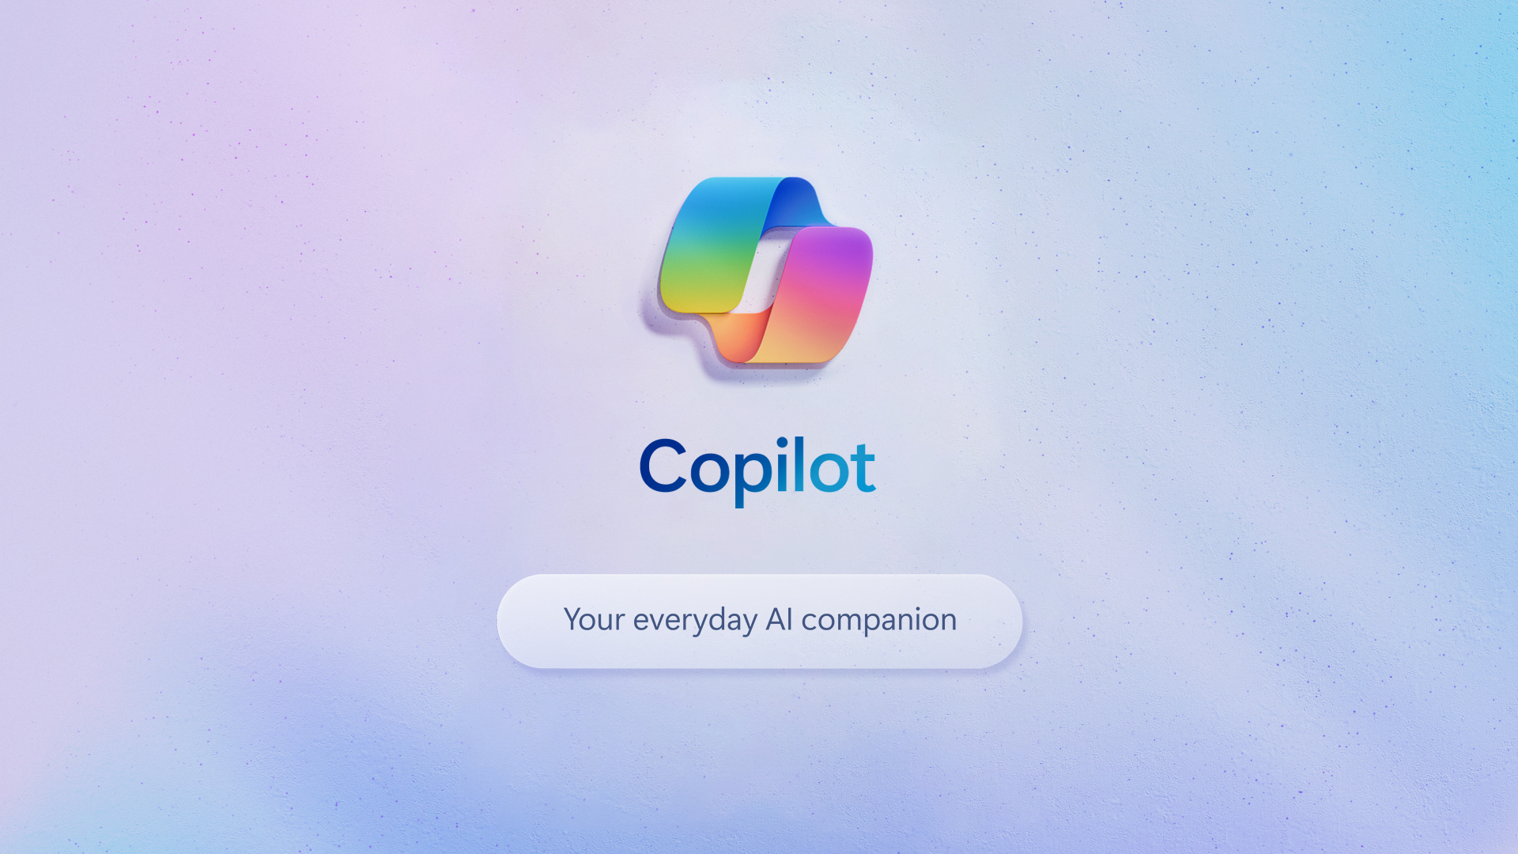

Slide 29
Miscellaneous Updates
Copilot will begin to roll out in its early form as part of our free update to Windows 11, starting Sept. 26 — and across Bing, Edge, and Microsoft 365 Copilot this fall. Updates:
With over 150 new features, the next Windows 11 update is one of our most ambitious yet, bringing the power of Copilot and new AI powered experiences to apps like Paint, Photos, Clipchamp and more right to your Windows PC.
Bing will add support for the latest DALL.E 3 model from OpenAI and deliver more personalized answers based on your search history, a new AI-powered shopping experience, and updates to Bing Chat Enterprise, making it more mobile and visual.
Microsoft 365 Copilot will be generally available for enterprise customers on Nov. 1, 2023, along with Microsoft 365 Chat, a new AI assistant that will completely transform the way you work.
Additionally, MS introduced powerful new Surface devices that bring all these AI experiences to life, and they are available for pre-order beginning today.
Windows 11 Updates
Copilot in Windows (in preview)
Paint has been enhanced with AI for drawing and digital creation with the addition of background removal and layers as well as a preview of Cocreator that brings the power of generative AI to the Paint app.
Photos has also been enhanced with AI including new features to make editing photos a breeze.
Snipping Tool now offers more ways to capture content on screen
Clipchamp, now with auto compose, helps with scenes suggestions, edits and narratives based on images and footage automatically
Notepad will start automatically saving session state allowing to close Notepad without any interrupting dialogs and then pick up where left off when return.
With the new Outlook for Windows, it is possible to connect and coordinate various accounts (including Gmail, Yahoo, iCloud, and more) in one app.
Modernized File Explorer, MS is introducing a modernized File Explorer home, address bar and search box all designed to help more easily access important and relevant content, stay up to date with file activity and collaborate without even opening a file.
Windows Backup makes moving to a new Windows 11 PC easier than ever.

Slide 30
Information

Slide 31
Information
Azure Times GitHub Repo

Slide 32
Questions

