Slide 1
Azure Times #115
April 24, 2024

Slide 2
Networking

Slide 3
Networking Updates
General availability: Azure Virtual Network encryption availability in all regions
Azure Virtual Network encryption is a feature of Azure Virtual Networks. Virtual network encryption allows to seamlessly encrypt and decrypt traffic between Azure Virtual Machines.
Virtual Network encryption is supported on general-purpose and memory optimized VM instance sizes
Accelerated Networking must be enabled on the network interface of the virtual machine. For more information about Accelerated Networking, see What is Accelerated Networking?.
Encryption is only applied to traffic between virtual machines in a virtual network. Traffic is encrypted from a private IP address to a private IP address.
Traffic to unsupported Virtual Machines is unencrypted. Use Virtual Network Flow Logs to confirm flow encryption between virtual machines. For more information, see Virtual network flow logs.
The start/stop of existing virtual machines is required after enabling encryption in a virtual network.
NOTE: Azure Virtual Network encryption is a free feature offered under the Azure subscription within Azure Virtual Network.
Azure Virtual Network encryption has the following limitations:
In scenarios where a PaaS is involved, the virtual machine where the PaaS is hosted dictates if virtual network encryption is supported. The virtual machine must meet the listed requirements.
For Internal load balancer, all virtual machines behind the load balancer must be a supported virtual machine SKU.

Slide 4
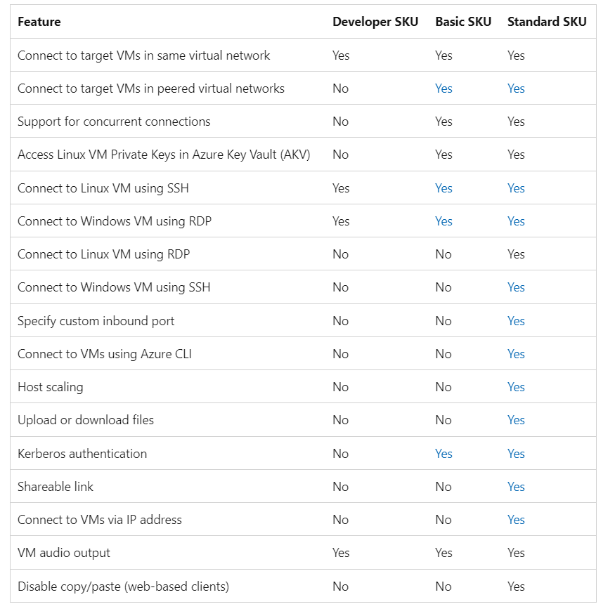
Networking Updates
GA: Announcing the new Azure Bastion Developer SKU
The Bastion Developer SKU represents a novel, cost-effective, and streamlined version of the Bastion service. Bastion Developer allows users to establish secure connections to a single VM at a time without the necessity of additional network configurations or exposing public IPs on VMs. Users can directly access their VMs through the connect experience on the VM blade in portal, with RDP/SSH access already available and CLI-based SSH access coming soon. Bastion Developer caters to Dev/Test users seeking secure VM connections without the need for additional features or scalability.

Slide 5
Networking Updates
Using Azure Virtual Network Manager network groups in security admin rules is now in public preview
Using Azure Virtual Network Manager network groups in the source and/or destination of security admin rules is now in public preview!
This feature enables to achieve network isolation across different environments in an easier and logical way. It is possible to achieve scenarios such as segregating production and non-production environments and allowing communication between only certain environments, helping manage network segments more easily at scale. With network groups, it is possible to create logical groups of virtual networks or subnets that have common attributes. It is possible to create security admin rules with network groups as the source and/or destination to enforce that specified traffic among your grouped network resources.
This feature streamlines the process of securing traffic across workloads and environments by removing the manual step of identifying individual classless inter-domain routing (CIDR) ranges or resource IDs.
The following limitations apply when using network groups with security admin rules:
Only supports manual aggregation of CIDRs in a network group.
Supports 100 networking resources (virtual networks or subnets) in any one network group referenced in the security admin rule.
CIDR ranges for network groups members can be either Ipv4 or Ipv6 CIDRs, but not both in the same group.
Role-based access control ownership is inferred from the Microsoft.Network/networkManagers/securityAdminConfigurations/rulecollections/rules/write permission only.
Network groups must have the same member-types. Virtual networks and subnets are supported but must be in separate network groups.
Force-delete of any network group used as the source and/or destination in a security admin rule isn't currently supported. Usage causes an error.

Slide 6
Security & Identity

Slide 7
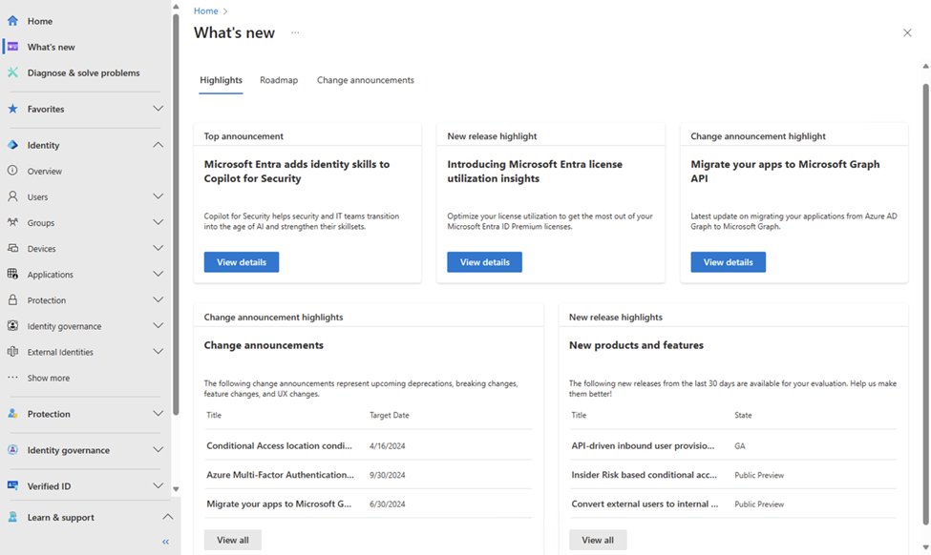
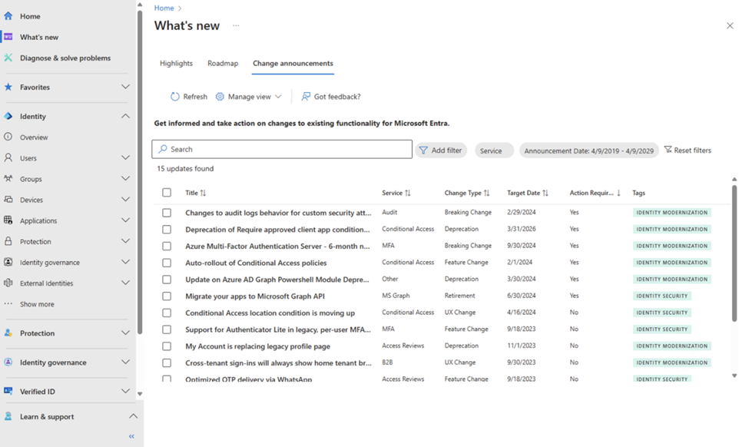
Security & Identity Updates
Introducing "What's New" in Microsoft Entra
This new hub in the Microsoft Entra admin center offers a centralized view of our roadmap and change announcements across the Microsoft Entra identity and network access portfolio.

Slide 8
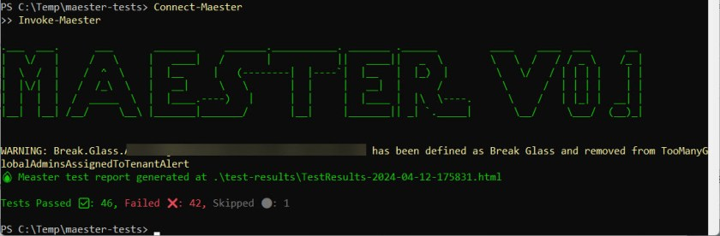
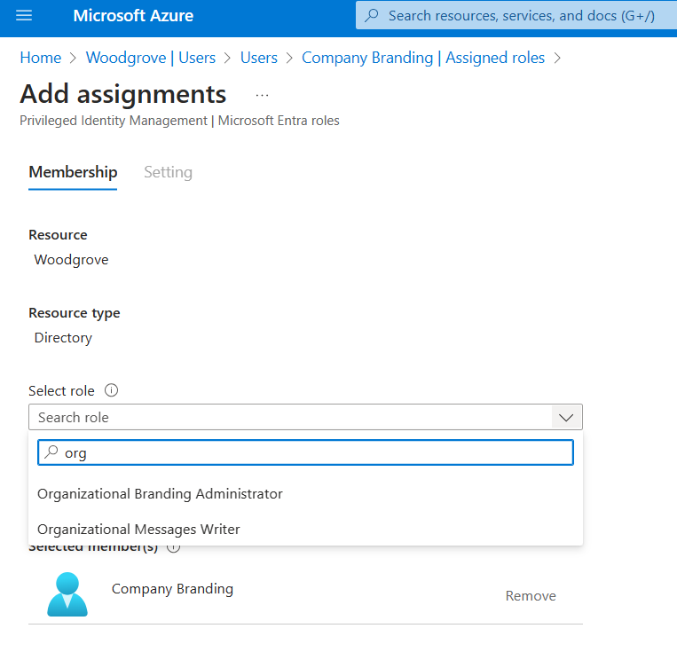
Security & Identity Updates
Microsoft Security test automation framework
Maester is a PowerShell based test automation framework to help stay in control of your Microsoft security configuration.
Maester is built using Pester and Microsoft Graph APIs. Basically, it runs a bunch of tests against an Entra ID tenant (usually a Microsoft 365 tenant) and measures tenant security configuration settings against the MITRE ATT&CK framework using the Entra ID Security Configuration Analyzer. The output is a report telling the administrator what tests passed and what failed
Enforce least privilege for Entra ID Company Branding with the new Organizational Branding role
MS announced General Availability (GA) of the Organizational Branding role for Microsoft Entra ID Company Branding.
This new role is part of their ongoing efforts to implement Zero Trust network access by enforcing the principle of least privilege for users when customizing their authentication user experience (UX) via Entra ID Company Branding.
Previously, users wanting to configure Entra ID Company Branding required the Global Admin role. This role, though, has sweeping privileges beyond what’s necessary for configuring Entra ID Company Branding.

Slide 9
Management & Governance

Slide 10
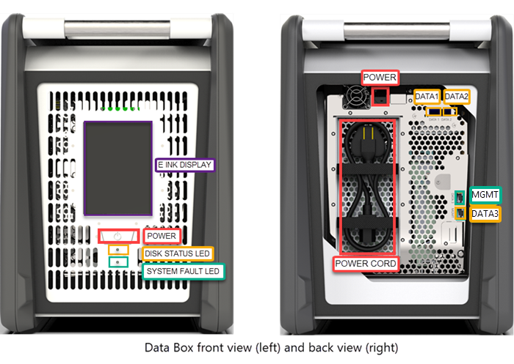
Management & Governance Updates
Azure Data Box Disk is now available with hardware encryption
Azure Data Box Disk is Generally Available with AES-256 hardware encryption for Linux based hosts. Customers in the US, EU and Japan can now choose to order either software encrypted (BitLocker) or hardware encrypted (self-encrypted) Data Box Disk.
Self-encrypted Data Box Disks provide copy performance on Linux which is comparable to BitLocker encrypted disks on Windows.
Generally available: Azure Site Recovery update rollup 73 - April 2024
The update provides the following improvements for the latest version of Azure Site Recovery components.
Mobility Service – Added support for Linux OS for:
Azure to Azure – Debian 12 and Ubuntu 18.04 Pro
Modernized VMware/Physical to Azure - Debian 12 and Ubuntu 18.04 Pro
Improvements:
Added support for Lsv2 series VMs for Azure-to-Azure replication scenario.
Added an improvement where for Linux based VMware VMs, enable replication was blocked because of GPT type partitioning.
Added improvements to the resynchronization operation, where it was not being triggered automatically post a service restart operation.

Slide 11
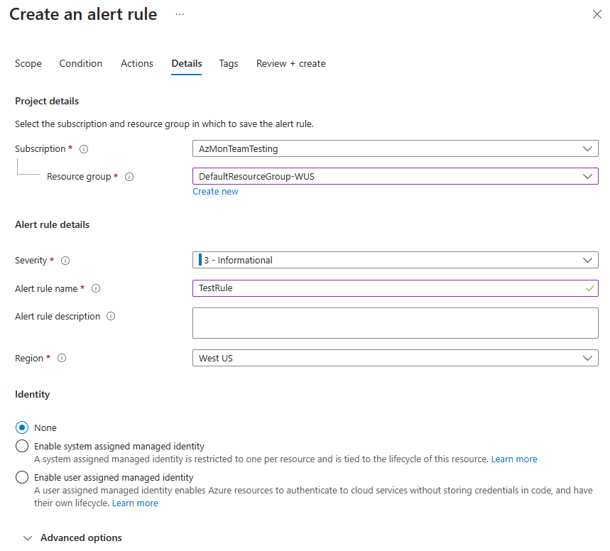
Management & Governance Updates
GA: Azure Monitor log search alerts support managed identities
Azure Monitor alerts allow to monitor Azure and application data to quickly identify issues affecting service. It is possible to use log search alert rules to run queries periodically on log data get notifications or trigger actions when an a potential issue is identified.
A common challenge for developers is the management of credentials for applications to use when connecting to resources. Managed identities provide an automatically managed identity in Microsoft Entra ID. Applications can use managed identities to obtain Microsoft Entra tokens without having to manage any credentials.
It is now possible to use managed identities in log search alert rules using either of these two options:
System assigned managed identity: Azure creates a new, dedicated identity for this alert rule. After you create the rule, you must assign permissions to this identity to access the workspace and data sources needed for the query.
User assigned managed identity: Before you create the alert rule, you create an identity and assign it appropriate permissions for the log query.

Slide 12
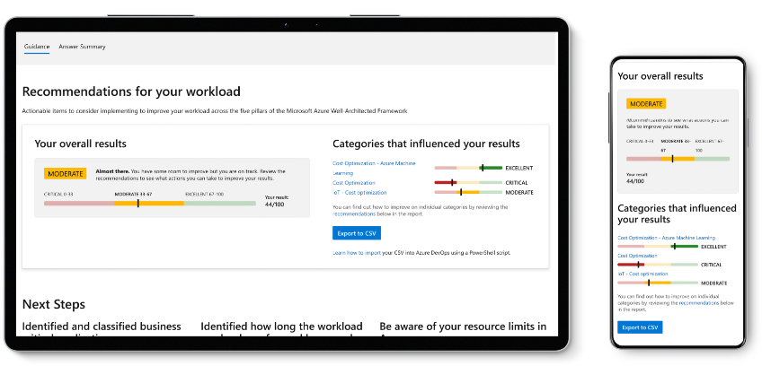
Management & Governance Updates
Microsoft FinOps Review Assessment
MS Released a FinOps Assessment Review that can be complete if required:
Integration with the Azure Advisor
FinOps Docs
Interactive Guides
TimeZone changes in Kazakhstan
In Kazakhstan the local authorities have operationalized a Time Zone Change for the country, where all cities will converge to UTC+5 (and UTC+6 is getting deprecated and converging into UTC+5).
Logic Apps presents the following Time Zones for Kazakhstan:
TRime Zones | Impact
(UTC+05:00) Ashgabat, Tashkent | If you are using Qyzylorda timezone, there will be no impact for you.
(UTC+06:00) Astana | Astana timezone is being moved to UTC+5. This work will be underway in the next weeks, but if you want this change to be reflected now, you should move your timezone to Qyzylorda, to guarantee that the official timezone offset is in effect.

Slide 13
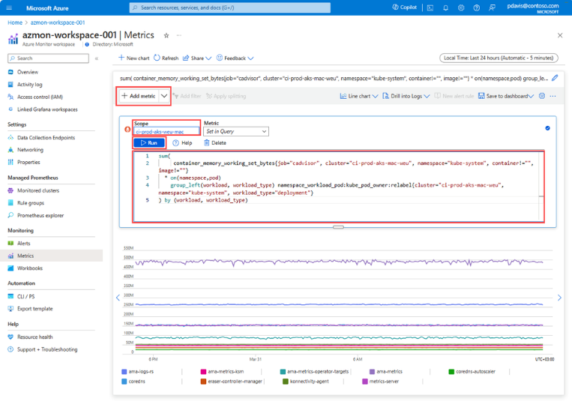
Management & Governance Updates
Announcing Public Preview of Query editor in Azure Monitor Metrics
Public Preview of Query editor in Azure Monitor Metrics is now Available!
MS announced the Public Preview of Query Editor in Azure Metric Explorer through Azure Monitor Workspace (AMW). With this update, customers can directly query promotheus metrics using PromQL within their Azure Monitor workspace. This empowers users to efficiently explore and analyze their metric data by writing PromQL queries directly in Metric Explorer, gaining valuable insights to optimize their resources and enhance performance.
Announcing the Public Preview of Azure Change Analysis New Portal Experience
The following functionality is now in public preview.
The ability to view changes that are happening on your resources in the Azure Portal
Filter between Creates/Updates/Deletes, Subscriptions, Resource Groups, Time Span
Group by Subscription, Resource Group, Type, Resource, Change Type, Client Type, Changed By, Operation, Changed By Type and Correlation ID
Change Actor: Who made the change and how a change was made

Slide 14
Compute

Slide 15
Compute Updates
General availability: HBv4-series & HX-series VMs are now available in Sweden Central.
HBv4 and HX VMs feature up to 176 AMD EPYC™ 9V33X ("Genoa-X") CPU cores with AMD's 3D V-Cache, clock frequencies up to 3.7 GHz, and no simultaneous multithreading. HBv4-series VMs provide 768 GB of RAM, HX-series VMs provide 1.4 TB of RAM and both HBv4 and HX provide 2.3 GB L3 cache. The 2.3 GB L3 cache per VM can deliver up to 5.7 TB/s of bandwidth to amplify up to 780 GB/s of bandwidth from DRAM, for a blended average of 1.2 TB/s of effective memory bandwidth across a broad range of customer workloads. The VMs also provide up to 12 GB/s (reads) and 7 GB/s (writes) of block device SSD performance.
All HBv4-series VMs feature 400 Gb/s NDR InfiniBand from NVIDIA Networking to enable supercomputer-scale MPI workloads.
General Availability: Free hosting plan for WordPress on App Service
MS announced that WordPress on App Service free hosting plan is now generally available. Available plans:
Hosting Plan | WebApp Server | Database Server
Free | F1 Free Tier (60 CPU minutes per day, 1 GB RAM, 1 GB Storage) | Burstable, B1ms Free trial (1 vCores, 2 GB RAM, 32 GB storage, 396 IOPS)
Basic | B1 (1 vCores, 1.75 GB RAM, 10 GB Storage) | Burstable, B1s (1 vCores, 1 GB RAM, 20 GB storage, Auto IOPS)
Standard | P1V2 (1 vCores, 3.5 GB RAM, 250 GB Storage) | Burstable, B2s (2 vCores, 4 GB RAM, 128 GB storage, Auto IOPS)
Premium | P1V3 (2 vCores, 8 GB RAM, 250 GB Storage) | General Purpose, D2ds_v4 (2 vCores, 16 GB RAM, 256 GB storage, Auto IOPS)

Slide 16

Compute Updates
Kubernetes v1.30: Uwubernetes
Announcing the release of Kubernetes v1.30: Uwubernetes, the cutest release!
This release consists of 45 enhancements. Of those enhancements, 17 have graduated to Stable, 18 are entering Beta, and 10 have graduated to Alpha.

Slide 17
Storage & Data

Slide 18
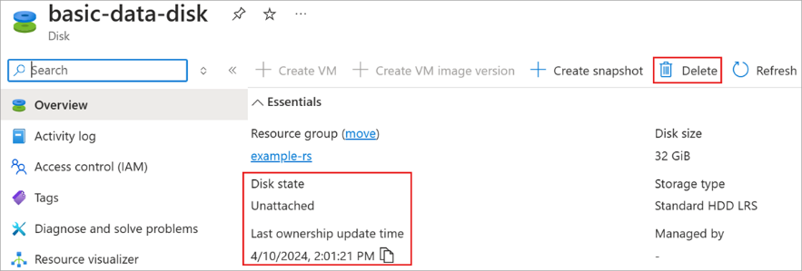
Storage & Data Updates
GA: New Property for Disks-LastOwnershipUpdateTime
MS introduced a new property for Disks in the Azure Portal, PowerShell (PS), and Command-Line Interface (CLI). This property, LastOwnershipUpdateTime, reflects the time when the Disk’s state was last changed. This property can be used in conjunction with the diskState to identify the current state of the Disk, and when it was last updated.
Generally available: Bulk delete operation for the FHIR service in Azure Health Data Services
Now, with the bulk delete operation, it is possible to delete data from the FHIR service asynchronously. The FHIR service bulk delete operation allows to delete resources at the system level, resource level, and by search criteria. Healthcare organizations that use the FHIR service need to comply with data retention policies and regulations. Incorporating the bulk delete operation in the workflow enables organizations to delete data at high throughput.

Slide 19
Storage & Data Updates
Public Preview – DR for Shared Disks – Azure Site Recovery
MS excited to announce the Public Preview of Azure Site Recovery for Shared Disk feature, which enables to protect, monitor, recover, and re-protect your workloads running on Windows Server Failover Clusters (WSFC) on Azure VMs with Shared Disk.
Now it is possible to use the benefits of Shared Disk for mission-critical applications such as SQL FCI, SAP ASCS, Scale-out File Servers, etc., while ensuring business continuity and disaster recovery with Azure Site Recovery.
With Azure Site Recovery for Shared Disk, it is possible to replicate and recover WSFC-clusters as a single unit across its disaster recovery (DR) lifecycle, while generating cluster-consistent recovery points.
Protect your cluster.
Generate recovery points that are consistent across all the VMs and disks of the cluster.
Monitor protection and health of the cluster and all its nodes from a single page.
Failover the cluster with a single click.
Change recovery point and re-protect the cluster after failover with a single click.
Failback the cluster to primary region with minimal data loss and downtime
Supported Features:
OS Support: Windows Server 2016 and later.
Nodes: Up to 4 nodes per cluster.
Shared Disks: Any number of shared disks can be attached to the cluster.

Slide 20
ML & AI & IOT

Slide 21
ML & AI & IOT Updates
Azure Machine Learning data collector is now generally available
Azure Machine Learning data collector provides real-time logging of input and output data from models that are deployed to managed online endpoints or Kubernetes online endpoints. Azure Machine Learning stores the logged inference data in Azure blob storage. This data can then be seamlessly used for model monitoring, debugging, or auditing, thereby providing observability into the performance of your deployed models.
Now generally available, data collector provides:
Logging of inference data to a central location (Azure Blob Storage)
Support for managed online endpoints and Kubernetes online endpoints
Definition at the deployment level, allowing maximum changes to its configuration
Support for both payload and custom logging
React to event-driven applications, processes, and workflows with EventGrid integration :
It is now possible to use Event Grid with modern serverless architectures to react to Azure Machine Learning events, such as the completion of training runs, the registration and deployment of models, and the detection of data drift.
Network isolation in managed feature store :
It is now possible to use the managed feature store (with network isolation) to experiment and ship models faster, increase reliability of your models, and reduce your operational costs.

Slide 22
DevOps & IaC & Automation

Slide 23
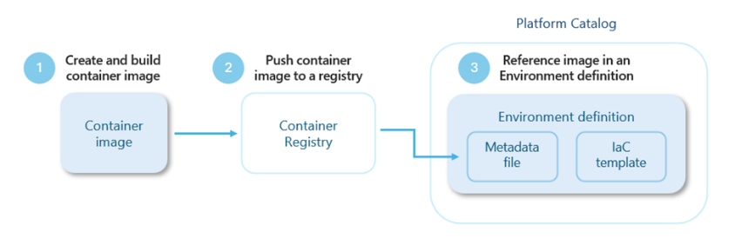
DevOps & IaC & Automation
Azure Deployment Environments
MS announced a new extensibility model, now available in public preview, that empowers customers to customize deployment workflows using Bicep, Terraform, Pulumi, or any other infrastructure-as-code (IaC) framework of their choice. This new model further streamlines app infrastructure provisioning and makes it easier for platform engineers to meet the unique needs of their organization.

Slide 24
Miscellaneous

Slide 25
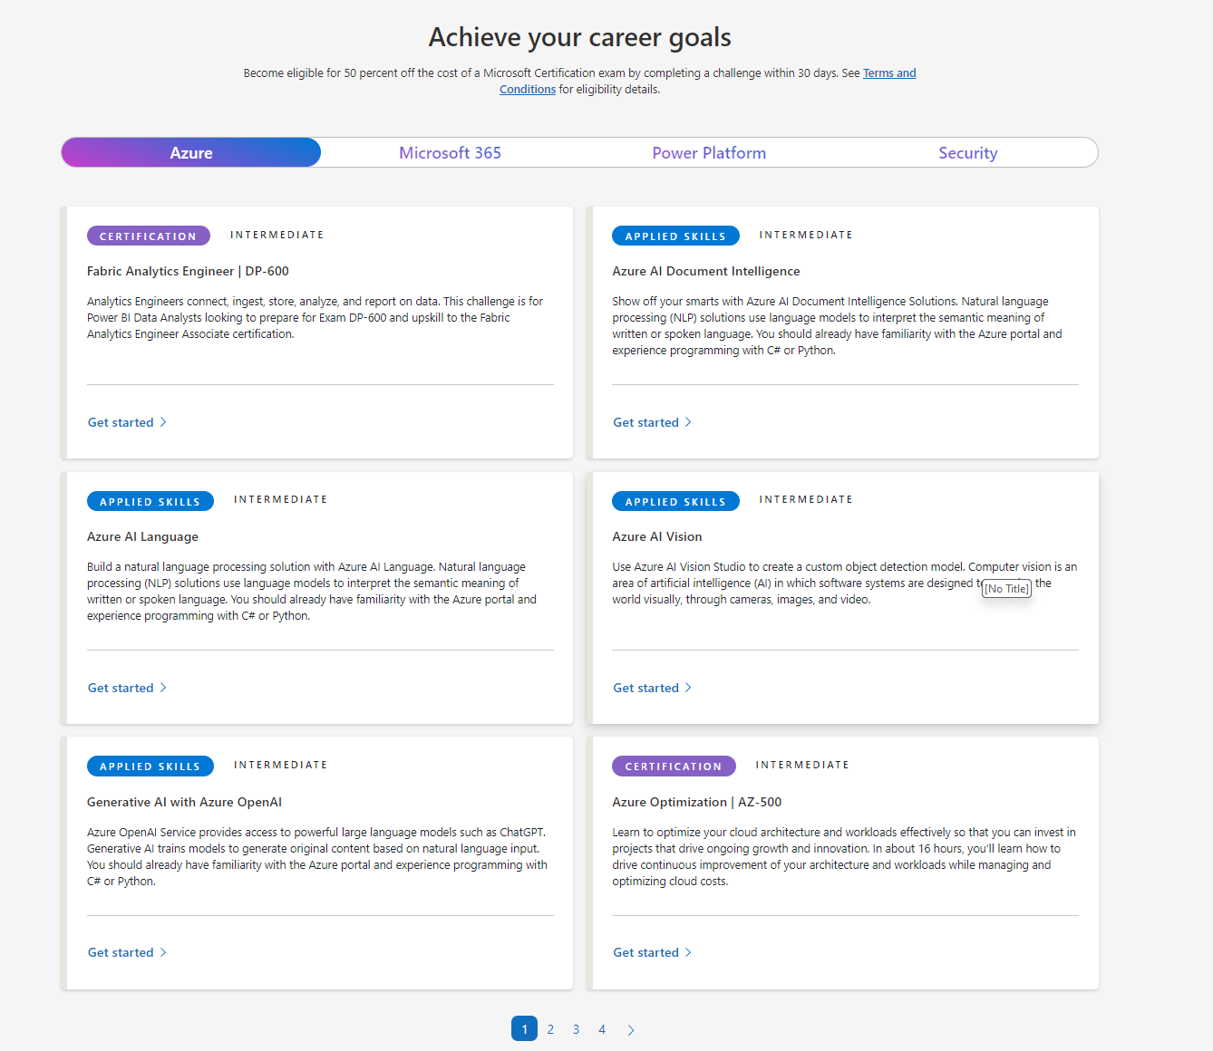
Miscellaneous Updates
MICROSOFT LEARN CLOUD SKILLS CHALLENGE
Upcoming End of Life (EOL), End of Support (ES), and/or End of Maintenance (EOM)
CentOS Linux 7: CentOS 7 will reach EOL on June 30, 2024. Customers will need to migrate to a new operating system to continue receiving updates, security patches, and new features. Read the documentation for CentOS migration options and paths in Azure.
RHEL 7: RHEL 7 will reach EOM on June 30, 2024. Customers will need to upgrade to a newer version of RHEL or purchase Extended Lifecycle Support (ELS) from Red Hat to continue to receive security updates and bug fixes. We recommend upgrading to the latest version of RHEL if possible to take full advantage of new features, ongoing support and more.
RHEL 6: RHEL 6 Extended Life Cycle Support (ELS) will end on June 30,2024. Customers will need to migrate to a newer version of RHEL to take full advantage of new features, security enhancements, bug fixes, ongoing support and more.

Slide 26
Miscellaneous Updates
Exchange Online to retire Basic auth for Client Submission (SMTP AUTH)
MS announced that Exchange Online will permanently remove support for Basic authentication with Client Submission (SMTP AUTH) in September 2025. After this time, applications and devices will no longer be able to use Basic auth as an authentication method and must use OAuth when using SMTP AUTH to send email.
Basic auth is a legacy authentication method that sends usernames and passwords in plain text over the network.
During September 2025, we will remove support for Basic auth with the Client Submission (SMTP AUTH) endpoints:
smtp.office365.com
smtp-legacy.office365.com
MS announced that, beginning in January 2025, Exchange Online will begin enforcing an external recipient rate limit of 2,000 recipients in 24 hours.
Exchange Online does not support bulk or high-volume transactional email. MS enforced limiting of bulk email until now, but we plan on doing so with the introduction of an External Recipient Rate (ERR) limit. The ERR limit is per user/mailbox and being introduced to help reduce unfair usage and abuse of Exchange Online resources.
The 2,000 ERR limit will become a sub-limit within this 10,000 Recipient Rate limit. There is no change to the Recipient Rate limit, and both of these will be rolling limits for 24-hour windows. You can send to up to 2,000 external recipients in a 24-hour period, and if you max out the external recipient rate limit then you will still be able to send to up to 8,000 internal recipients in that same period. If you don't send to any external recipients in a 24-hour period, you can send to up to 10,000 internal recipients.
The new ERR limit will be introduced in 2 phases:
Phase 1 - Starting Jan 1, 2025, the limit will apply to cloud-hosted mailboxes of all newly created tenants.
Phase 2 - Between July and December 2025, we will start applying the limit to cloud-hosted mailboxes of existing tenants.

Slide 27
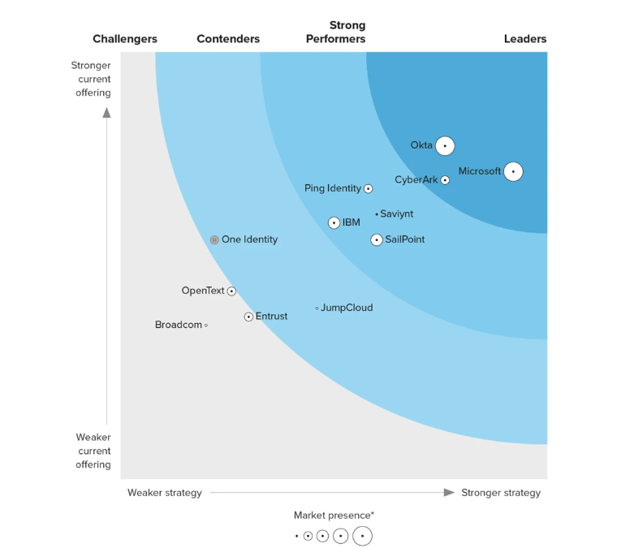
Miscellaneous Updates
​Microsoft recognized as a Leader in the Forrester Wave™: Workforce Identity Platform, Q1 2024

Slide 28
Information

Slide 29
Information
Azure Times GitHub Repo

Slide 30
Questions

