Slide 1
Azure Times #122
June 12, 2024

Slide 2
Security & Identity

Slide 3
Security & Identity Updates
Entra ID – Public Preview
Bicep templates support for Microsoft Graph - The Microsoft Graph Bicep extension brings declarative infrastructure-as-code (IaC) capabilities to Microsoft Graph resources. It allows to author, deploy, and manage core Microsoft Entra ID resources using Bicep template files, alongside Azure resources.
Platform Single Sign-on for macOS with Microsoft Entra ID – MS announced that Platform SSO for macOS is available in public preview with Microsoft Entra ID. Platform SSO is an enhancement to the Microsoft Enterprise SSO plug-in for Apple Devices that makes usage and management of Mac devices more seamless and secure than ever. At the start of public preview, Platform SSO works with Microsoft Intune. Other Mobile Device Management (MDM) providers are coming soon.
Workflow History Insights in Lifecycle Workflows - Customers can now monitor workflow health and get insights throughout all their workflows in Lifecycle Workflows including viewing workflow processing data across workflows, tasks, and workflow categories.
Configure Lifecycle Workflow Scope Using Custom Security Attributes - Customers can now leverage confidential HR data stored in custom security attributes in addition to other attributes to define the scope of their workflows in Lifecycle Workflows for automating joiner, mover, and leaver scenarios.
Enable, Disable and Delete synchronized users accounts with Lifecycle Workflows - Lifecycle Workflows can now enable, disable, and delete user accounts that are synchronized from Active Directory Domain Services (AD DS) to Microsoft Entra. This allows to ensure that the offboarding processes of employees are completed by deleting the user account after a retention period.
External authentication methods for multifactor authentication - External authentication methods enable to use preferred multifactor authentication (MFA) solution with Microsoft Entra ID.

Slide 4
Security & Identity Updates
Entra ID – General Availability
$select in signIn API - The long-awaited $select has been implemented into the signIn API. Utilize the $select to reduce the number of attributes that are returned for each log. This should greatly help customers who deal with throttling issues, and allow every customer to run faster, more efficient queries.
Multiple Passwordless Phone Sign-in for Android Devices - End users can now enable passwordless phone sign-in for multiple accounts in the Authenticator App on any supported Android device. Consultants, students, and others with multiple accounts in Microsoft Entra can add each account to Microsoft Authenticator and use passwordless phone sign-in for all of them from the same Android device. The Microsoft Entra accounts can be in the same tenant or different tenants. Guest accounts aren't supported for multiple account sign-ins from one device.
LastSuccessfulSignIn - Due to popular demand and increased confidence in the stability of the properties, MS have now brought LastSuccessfulSignIn & LastSuccessfulSigninDateTime into V1. Feel free to take dependencies on these properties in your production environments now.
Changing default accepted token version for new applications - Starting August 2024, new Microsoft Entra applications created using any interface (including the Microsoft Entra admin center, Azure portal, Powershell/CLI, or the Microsoft Graph application API) will have the default value of the 'requestedAccessTokenVersion' property in the app registration set to '2'; this is a change from the previous default of 'null' (meaning '1'). This means that new resource applications receive v2 access tokens instead of v1 by default. This improves the security of apps.
Windows Account extension is now Microsoft Single Sign On - The Windows Account extension is now the Microsoft Single Sign On extension in docs and Chrome store. The Windows Account extension has been updated to represent the new macOS compatibility. It's now known as the Microsoft Single Sign On extension for Chrome, offering single sign-on and device identity features with the Enterprise SSO plug-in for Apple devices. This is just a name change for the extension, there are no software changes to the extension itself.

Slide 5
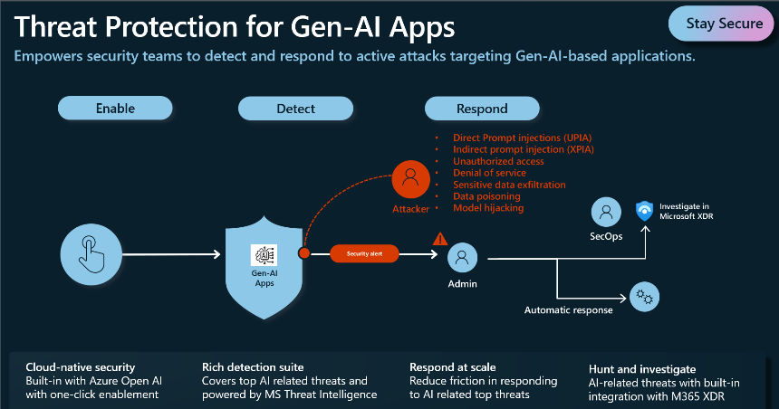
Security & Identity Updates
Microsoft Defender for Cloud – Public Preview
Defender for open-source databases is now available on AWS for Amazon instances (Preview) - Microsoft Defender for Cloud detects anomalous activities in AWS environment indicating unusual and potentially harmful attempts to access or exploit databases for the following RDS instance types:
Aurora PostgreSQL
Aurora MySQL
PostgreSQL
MySQL
MariaDB
Limited public preview of threat protection for AI workloads in Azure - Threat protection for AI workloads in Defender for Cloud provides contextual insights into AI workload threat protection, integrating with Responsible AI and Microsoft Threat Intelligence. Threat protections for AI workloads security alerts are integrated into Defender XDR in the Defender portal. This plan helps you monitor your Azure OpenAI powered applications in runtime for malicious activity, identify, and remediate security risks.
AI multicloud security posture management is publicly available for Azure and AWS
MS announced the inclusion of AI security posture management in Defender for Cloud. This feature provides AI security posture management capabilities for Azure and AWS that enhance the security of your AI pipelines and services.

Slide 6
Security & Identity Updates
Checkov integration for IaC scanning in Defender for Cloud (Preview)
MS announced the public preview of the Checkov integration for DevOps security in Defender for Cloud. This integration improves both the quality and total number of Infrastructure-as-Code checks run by the MSDO CLI when scanning IaC templates.
While in preview, Checkov must be explicitly invoked through the 'tools' input parameter for the MSDO CLI.

Slide 7
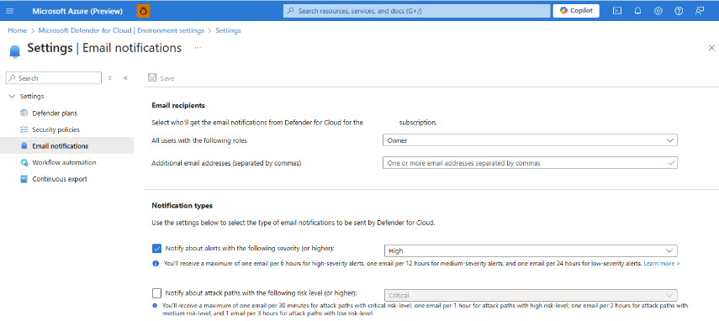
Security & Identity Updates
Microsoft Defender for Cloud – General Availability
Updated security policy management is now generally available - Security policy management across clouds (Azure, AWS, GCP) is now generally available (GA). This enables security teams to manage their security policies in a consistent way and with new features:
A simplified and same cross cloud interface for creating and managing the Microsoft Cloud Security Benchmark (MCSB) as well as custom recommendations based on KQL queries.
Managing regulatory compliance standards in Defender for Cloud across Azure, AWS, and GCP environments.
New filtering and export capabilities for reporting.
Configure email notifications for attack paths
It is now possible to configure email notifications for attack paths in Defender for Cloud. This feature allows to receive email notifications when an attack path is detected with a specified risk level or higher.
General availability of permissions management in Defender for Cloud
MS announced the general availability (GA) of permissions management in Defender for Cloud.
General Availability of Unified Disk Encryption recommendations
The following Unified Disk Encryption recommendations are now generally available (GA) within Azure Public Cloud.
Linux virtual machines should enable Azure Disk Encryption or EncryptionAtHost
Windows virtual machines should enable Azure Disk Encryption or EncryptionAtHost

Slide 8
Management & Governance

Slide 9
Management & Governance Updates
Microsoft and Broadcom to support license portability for VMware Cloud Foundation on Azure VMware Solution
Microsoft and Broadcom released plans to support VMware Cloud Foundation subscriptions on Azure VMware Solution. Customers that own or purchase licenses for VMware Cloud Foundation will be able to use those licenses on Azure VMware Solution, as well as their own datacenters.
With​​​​​​ improved license portability for customers with eligible VMware Cloud Foundation entitlements, customers will be able to purchase subscriptions of the new VMware Cloud Foundation software and have complete mobility to and from their on-premises environment to Azure VMware Solution. VMware customers that have already purchased and begun deploying the new VMware Cloud Foundation will be able to transfer the remaining value of an existing subscription to Azure VMware Solution. Additionally, customers will be able to move their VMware Cloud Foundation subscription between on-premises and Azure VMware Solution as their needs and requirements evolve over time. ​​​​​​Customers will retain the rights to their software subscription when moving their VMware Cloud Foundation subscription to Azure VMware Solution.
Added support for Azure Monitor log search alert rules in Resource Health
Azure Resource Health helps diagnose and get support for service problems that affect Azure resources. Azure Resource Health now supports log search alert rules, so that can use the activity log to check the health status of log search alert rules.
It is possible to create a resource health alert for specific events to send alert an alert and notify you when a log search alert rule is unhealthy.

Slide 10
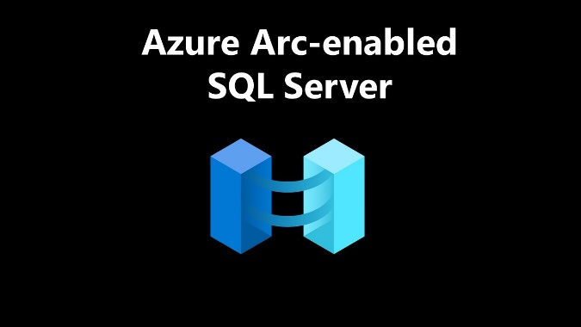
Management & Governance Updates
What's new with Azure Connected Machine agent
Certificate-based authentication is now supported when using a service principal to connect or disconnect the agent.
azcmagent check now allows to also check for the endpoints used by the SQL Server enabled by Azure Arc extension using the new --extensions flag. This can help troubleshoot networking issues for both the OS and SQL management components.
Fixed
Fixed a memory leak in the Hybrid Instance Metadata service
Better handling when IPv6 local loopback is disabled
Improved reliability when upgrading extensions
Improved reliability when enforcing CPU limits on Linux extensions
PowerShell telemetry is now disabled by default for the extension manager and policy services
The extension manager and policy services now support OpenSSL 3
Colors are now disabled in the onboarding progress bar when the --no-color flag is used
Improved detection and reporting for Windows machines that have custom logon as a service rights configured.
SQL Server enabled by Azure Arc Updates
Move instances or databases to a different subscription or resource group (preview)
Support licensing SQL Server by physical cores with unlimited virtualization
Support ESU subscriptions for SQL Server 2014 (12.x)
Database inventory feature for all license types
New built-in role and action available to manage access to the performance dashboard
Review Monitor SQL Server enabled by Azure Arc (preview).

Slide 11
Compute

Slide 12
Compute Updates
Announcing inbound IPv6 support in public preview
MS announced the first part of IPv6 implementation in App Service. Public preview of inbound IPv6 support for multi-tenant apps on Premium SKUs, Functions Consumption, Functions Elastic Premium, and Logic Apps Standard. We’ll be adding IPv6 support in four stages.
This announcement: IPv6 inbound support (multi-tenant)
In development: IPv6 non-vnet outbound support (multi-tenant)
Backlog: IPv6 vnet outbound support (multi-tenant and App Service Environment v3)
Backlog: IPv6 vnet inbound support (App Service Environment v3 - both internal and external)
Limitations in this public preview:
Only a subset of regions are supported
Basic and Standard tier currently does not support changing the IPMode property.
Functions Consumption may have multiple IP addresses in the DNS result.
Functions Consumption and Elastic Premium may not remove the IPv4 address in IPv6 mode.
The IPv6 address is not visible in the inboundIpAddress or possibleInboundIpAddresses properties.
IP-SSL IPv6 bindings are not supported.
For GA we will work on including Basic and Standard tier, adding all regions, include the IPv6 addresses in new properties and stabilize the DNS results to not show extra addresses.
az resource update --name <app-name> --set ipMode="IPv6" -g <resource-group-name> --resource-type "Microsoft.Web/sites"

Slide 13
Compute Updates
Public Preview of Resubmit from an Action in Logic Apps Consumption Workflows
MS introduced Resubmit Action in the Consumption SKU. This is a feature that customers have been asking for a long time, and we are glad to finally deliver it to Consumption SKU. Resubmit action has been part of Standard SKU for a while, and we have gotten positive feedback from customers. Standard SKU announcement.
Once selected the action to be resubmitted, all actions before the selected action including the trigger are replayed from the original workflow run. This means we will reuse the inputs and outputs of those actions and not actually execute them. Once the workflow execution reaches the resubmitted action, we will process that action and all following actions as normal.
Limitations
The resubmit actions feature is not available to all actions and workflow configurations. Below are the limitations to keep in mind when using this feature:
The workflow must be a Stateful workflow
The resubmitted run will execute the same flow version as the original run. This is true even if the workflow definition has been updated.
The workflow must have 40 or fewer actions to be eligible for action resubmit.
The workflow must be in a completed state e.g. Failed, Successful, Cancelled
Only actions of sequential workflows are eligible to be resubmitted. Workflows with parallel paths are currently not supported.
Actions inside of a Foreach or Until operations are not eligible to be resubmitted. Additionally, the Foreach and Until operations themselves are not eligible.
Actions that occur after Foreach and Until operations are not eligible to be resubmitted.
This feature is currently not available in VS Code or the Azure CLI.

Slide 14
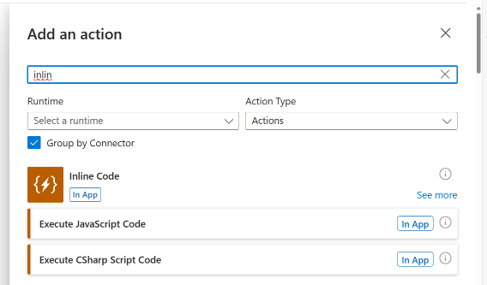
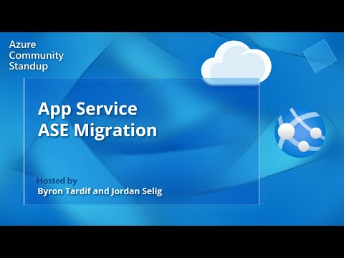
Compute Updates
App Service Environment Migration
If you’re using App Service Environment v1 or v2, you must migrate workloads to App Service Environment v3. App Service Environment v1 and v2 will be retired on 31 August 2024. Failure to migrate by that date will result in loss of the environments, running applications, and all application data.
For more information on ASE Upgrade check out the following resources:
Upgrade to App Service Environment v3
Using AI with App Service to deploy differentiated web apps and APIs
Introducing .NET C# Inline Action for Azure Logic Apps (Standard) – Preview
MS introduced a new capability that allows developers to write .NET C# script right within the Logic Apps designer. This complements the custom code feature that we introduced previously for invoking .NET FX and NET8 functions written and deployed to a Logic App.

Slide 15
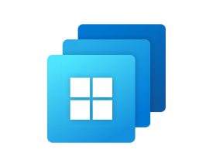
Compute Updates
Windows 365 May Updates
Device management
New Windows 365 Cloud PC images available in the gallery - New Cloud PC gallery images for Windows 10 and Windows 11 are now available. These improved images have harmonized optimizations with Windows 365 apps images for better policy management:
Windows 365 Cloud PC gallery images now pre-install new Microsoft Teams - Gallery images for Windows 365 Cloud PCs now come with the new Microsoft Teams pre-installed (not Teams (Classic)). Manage redirections for Cloud PCs on Android devices
Manage redirections for Cloud PCs on iOS/iPadOS devices – It is now possible to use the Intune admin center to manage redirections for iOS/iPadOS users who access their Cloud PCs using Microsoft Remote Desktop and Windows App.
Device security
FQDNs removed from requirement list - Many required FQDNs were previously moved to the *.infra.windows365.microsoft.com wildcard FQDN. The old FQDNs are now being removed. For an updated list of FQDNs, see Network requirements.
Monitor and troubleshoot
Cloud PCs that aren't available report is now generally available - The Cloud PCs that aren't available report has moved out of preview and into general availability. For more information, see Cloud PCs that aren't available report.
Role-based access control
Intune scope tags (preview) - Windows 365 now supports Intune scope tags. For more information, see Scope tags.

Slide 16
Storage & Data

Slide 17
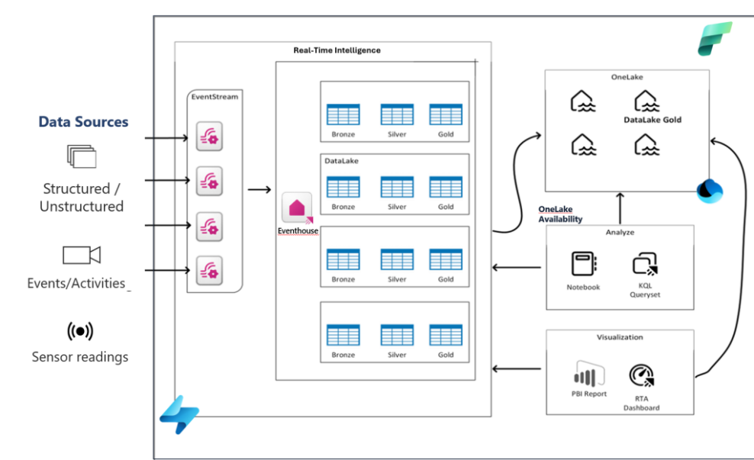
Storage & Data Updates
Eventhouse OneLake Availability is Generally Available
MS announce that OneLake availability of Eventhouse in Delta Lake format is Generally Available.
Eventhouse is a cutting-edge database workspace meticulously crafted to manage and store event-based data. Engineered to handle data in motion, Eventhouse seamlessly integrates indexing and partitioning into its storing process, accommodating structured, semi-structured, and free text data formats. This sophisticated design empowers high-performance analysis with minimal latency, facilitating lightning-fast ingestion and querying within seconds.
Delta Lake is the unified data lake table format chosen to achieve seamless data access across all compute engines in Microsoft Fabric.
The data streamed into Eventhouse is stored in an optimized columnar storage format with full text indexing and supports complex analytical queries at low latency on structured, semi-structured, and free text data.

Slide 18
Databases

Slide 19
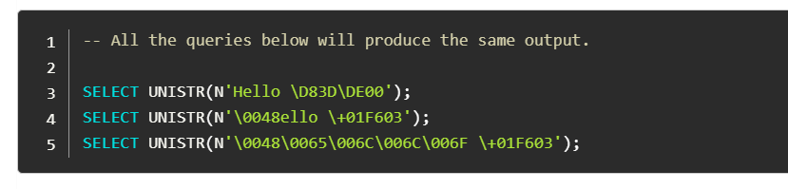
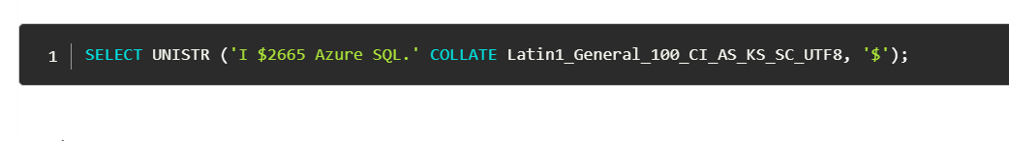
Databases Updates
Announcing UNISTR and || operator in Azure SQL Database – preview
MS announced that the UNISTR intrinsic function and ANSI SQL concatenation operator (||) are now available in public preview in Azure SQL Database. The UNISTR function allows to escape Unicode characters, making it easier to work with international text. The ANSI SQL concatenation operator (||) provides a simple and intuitive way to combine characters or binary strings. These new features will enhance ability to manipulate and work with text data.

Slide 20
Integration

Slide 21
Integration Updates
General Availability: Audit logging in Azure API Management developer portal
MS announced that audit logging for user actions in the Azure API Management developer portal is now generally available. API administrators and managers can now enable a diagnostic setting in Azure API Management to send developer portal audit logs to a storage account, event hub, or Log Analytics workspace.
Developer portal audit logs include:
User authentication actions: Sign-in and sign-out activities.
Views of API details: Access to API details, API operation details, and products.
API testing: Actions taken in the interactive test console.
This new feature enhances the ability to monitor and audit user activities within the developer portal, providing better security and compliance management.

Slide 22
ML & AI & IOT

Slide 23
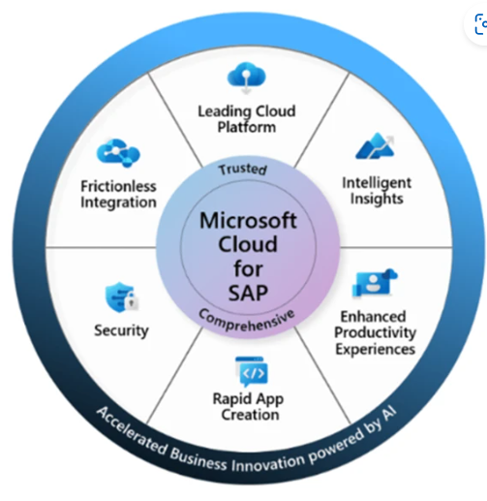
ML & AI & IOT Updates
Announcing new joint AI integration between Microsoft 365 Copilot and SAP Joule
Microsoft and SAP expanded partnership by bringing Joule together with Microsoft Copilot into a unified experience, allowing employees to get more done in the flow of their work through seamless access to information from business applications in SAP as well as Microsoft 365.
By integrating Joule and Copilot for Microsoft 365, the generative AI solutions will interact intuitively so users can find information faster and execute tasks without leaving the platform they are already in.
A user in Copilot for Microsoft 365 will be able to leverage SAP Joule to access information stored in SAP—for example S/4HANA Cloud, SAP SuccessFactors, or SAP Concur.

Slide 24
DevOps & IaC & Automation

Slide 25
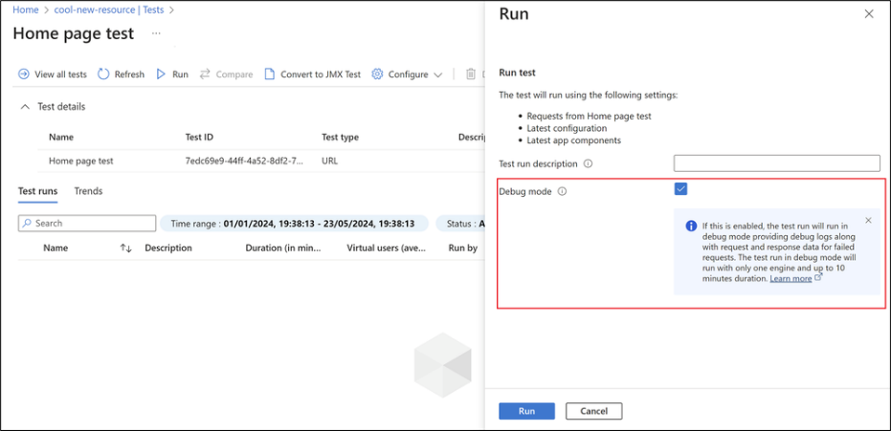
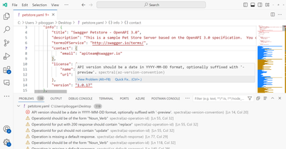
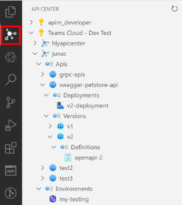
DevOps & IaC & Automation
Better Debuggability with Enhanced Logging in Azure Load Testing
MS introduced Debug mode in Azure Load Testing, which enables running low scale test runs with better debuggability and enhanced logging.
Debug mode is designed to help validate test configuration and application behavior by running a load test with a single engine for up to 10 minutes. It provides debug logs for the test script, and request and response data for every failed request during the test run. This mode is powerful for troubleshooting issues with your test plan configuration.
Announcing: General Availability of Azure API Center extension for Visual Studio Code
The Azure API Center extension for Visual Studio Code enables developers to build, discover, try, and consume APIs in your API center:
Build APIs - Make APIs building discoverable to others by registering them in API center. Shift-left API design conformance checks into Visual Studio Code with integrated linting support. Ensure that new API versions don't break API consumers with breaking change detection.
Discover APIs - Browse the APIs in API center, and view their details and documentation.
Try APIs - Use Swagger UI or REST client to explore API requests and responses.
Consume APIs - Generate API SDK clients for favorite language including JavaScript, TypeScript, .NET, Python, and Java, using the Microsoft Kiota engine that generates SDKs for Microsoft Graph, GitHub, and more.

Slide 26
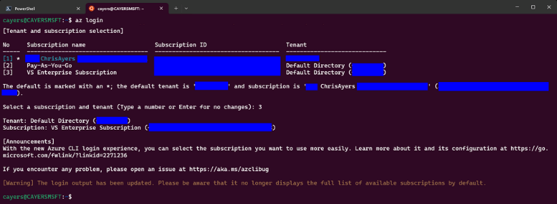
DevOps & IaC & Automation
New Login Experience for Azure Subscriptions with az login
There is a new login experience that makes it easier to select the right subscription.
Once you have the latest version, you can run the az login command as usual. However, instead of logging into the default subscription, you will see a list of your available subscriptions and a prompt to choose one.
The new login experience has several benefits for Azure users who have multiple subscriptions:
Reduces Errors and Confusion: Minimizes the risk of logging into the wrong subscription.
Saves Time and Effort: Avoids the need to run additional commands to set or change the default subscription.
Improves User Experience: Provides an interactive and intuitive way to choose the subscription.
The new login experience has several benefits for Azure users who have multiple subscriptions:
Reduces Errors and Confusion: Minimizes the risk of logging into the wrong subscription.
Saves Time and Effort: Avoids the need to run additional commands to set or change the default subscription.
Improves User Experience: Provides an interactive and intuitive way to choose the subscription.

Slide 27
Miscellaneous

Slide 28
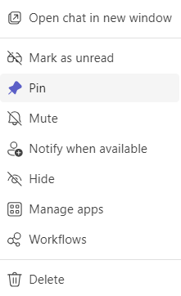
Miscellaneous Updates
Notify When Available Comes to Teams 2.1
Microsoft released Notify when available feature without any warning is that this functionality exists in the old Teams client but not in the new 2.1 client (see “Features that are changing in the new Teams”).
Log search alert rules using linked storage will require using a managed identity staring July 2024
As of today, when defining a log search alert rule with linked storage, it is not required to explicitly grant permissions to the storage account itself.
Starting July 2024, alert rules using linked storage will require a managed identity to access the linked storage. This requirement will be enforced on alert rules created with API version 2023-12-01 or newer. Creating or updating linked storage rules using an older API version will be blocked.
This change will be rolled out in two phases:
July 2024 –log search alert rules requiring linked storage will be blocked for updates using API versions older than 2023-12-01. Same applies for creation of new rules requiring linked storage. Use API version 2023-12-01 or newer to update your existing rules or create new rules to use workspace linked storage and define managed identity access.
September 2024 - all log search alert rules using linked storage that do not use a managed identity will break and stop evaluating.

Slide 29
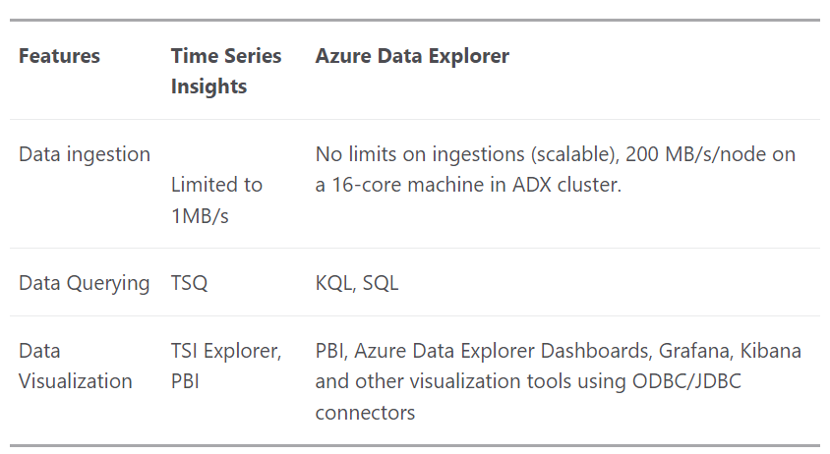
Miscellaneous Updates
Azure Time Series Insights is retiring on 7 July 2024 – transition to Azure Data Explorer
Please transition to using Azure Data Explorer by that date. On the retirement date, Azure Time Series Insights will stop functioning and will be inaccessible.
MS encourage to make the switch sooner to gain the richer benefits of Azure Data Explorer. In addition to the current features already use, here’s a quick comparison between Azure Time Series Insights and Azure Data Explorer:

Slide 30
Information

Slide 31
Information
Azure Times GitHub Repo

Slide 32
Questions

