Slide 1
Azure Times #94
November 8, 2023

Slide 2
Networking

Slide 3
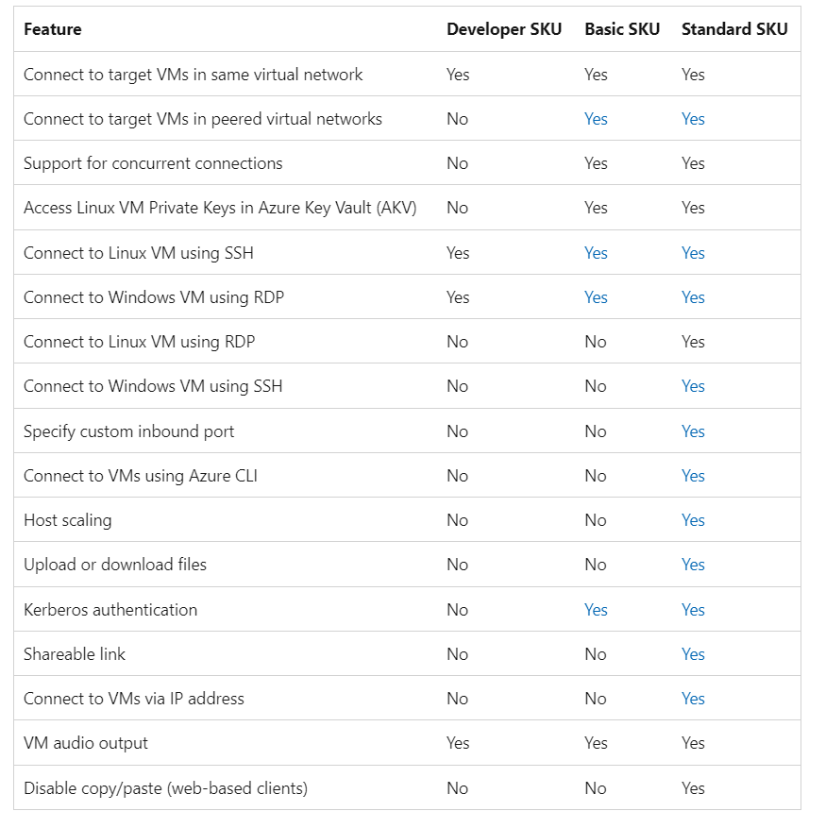
Networking Updates
Public preview: Announcing the new Azure Bastion Developer SKU
The Bastion Developer SKU represents a novel, cost-effective, and streamlined version of the Bastion service. Bastion Developer allows users to establish secure connections to a single VM at a time without the necessity of additional network configurations or exposing public IPs on VMs. Users can directly access their VMs through the connect experience on the VM blade in portal, with RDP/SSH access already available and CLI-based SSH access coming soon. Bastion Developer caters to Dev/Test users seeking secure VM connections without the need for additional features or scalability.

Slide 4
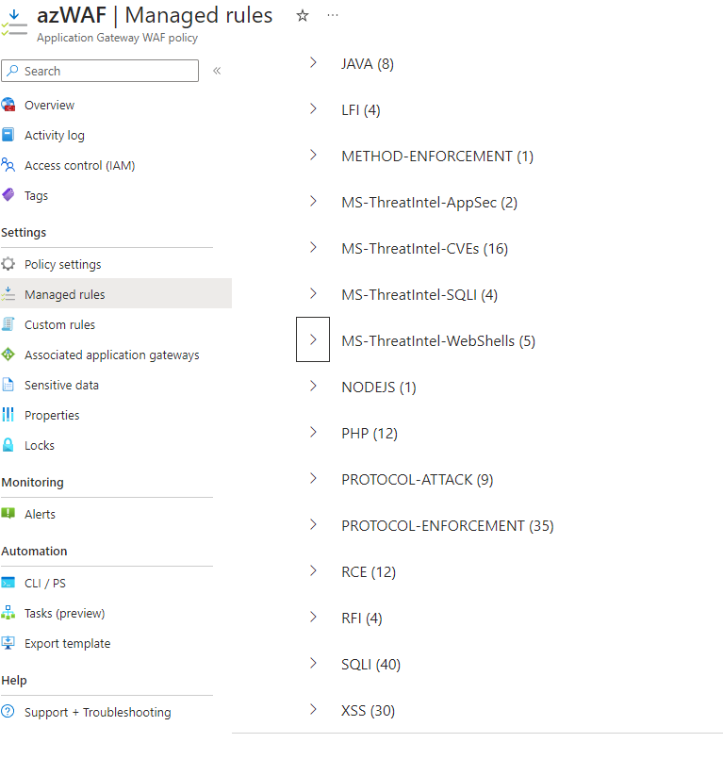
Networking Updates
General availability: Default Rule Set 2.1 for regional WAF with Application Gateway
Default Rule Set (DRS) 2.1 for the regional Web Application Firewall (WAF) on Azure Application Gateway is now generally available on the Azure Application Gateway WAF V2 SKU.
DRS 2.1 is baselined off the Open Web Application Security Project (OWASP) Core Rule Set (CRS) 3.3.2 and extended to include additional proprietary protections rules developed by Microsoft Threat Intelligence team. The Microsoft Threat Intel team analyzes Common Vulnerabilities and Exposures (CVEs) and further adapts the CRS ruleset to address CVEs and reduce false positives.

Slide 5
Security & Identity

Slide 6
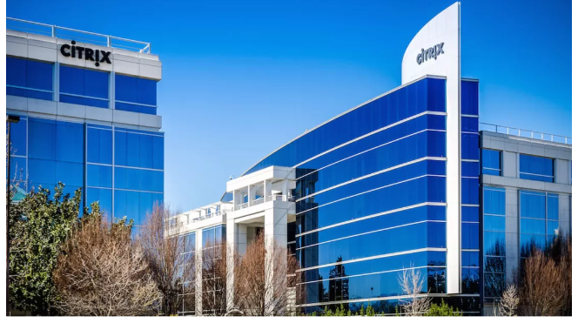
Security & Identity Updates
Citrix Bleed vulnerability is now seeing mass exploitation by ransomware groups
It was reported that the Citrix Bleed vulnerability (tracked as CVE-2023-4966) has been actively exploited since last August, although the problem has grown exponentially in recent weeks. According to cybersecurity researcher "multiple organizations" are reporting seeing widespread exploitation of the vulnerability, with an estimated 20,000 compromised Citrix devices believed to have had their session tokens stolen.
Microsoft Entra Connect Updates
Functional Changes
The attribute onPremisesObjectIdentifier has been added to the default sync rules. This attribute is required by Microsoft Entra Cloud Sync's Group Provisioning to AD feature.
The minimum .NET runtime requirement has been increased to 4.7.1.
Bug Fixes
Improvements to upgrade and auto-upgrade components.
Fixed an issue preventing deprovisioning of group when deletions of both the group and a member belonging to a different domain are processed in the same sync cycle.

Slide 7
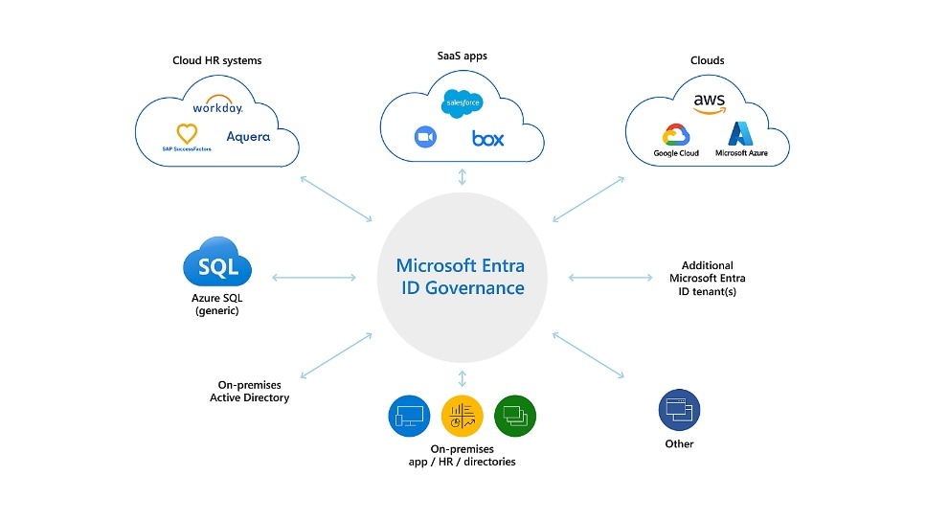
Security & Identity Updates
Microsoft Entra ID Governance licensing for business guests
MS announced a new ID Governance license for business guests. This license will operate on a monthly active usage (MAU) model. Customers will be able to acquire licenses matching their anticipated business guest MAU.
ID Governance for business guest licenses will be priced at $0.75 per MAU, and be anticipated available in spring 2024. In the interim, organizations that govern the identities of their employees with ID Governance can govern the identities of their business guests for no additional cost. Existing Azure AD External ID customers are grandfathered to continue using the subset of identity governance features that are included in Entra ID P1 and P2.

Slide 8
Management & Governance

Slide 9
Management & Governance Updates
New E-mail templates for Log search alerts - API version 2021-08-01 and up
Log alerts are one of the alert types that are supported in Azure Monitor. Log alerts allow users to use a log analytics query to evaluate resources logs every set frequency, and fire an alert based on the results. Rules can trigger one or more actions using action groups. Rules can trigger one or more actions using action groups.
Previously, all types of log search alerts (API version 2021-08-01 and up) employed a common schema email template (for non-common schema and common schema actions).
During November, MS will replace log search alerts (API version 2021-08-01 and up) that uses non-common schema template with an upgraded and more informative email template. The new email template will provide additional information in a more visually appealing format, making it easier to investigate alerts.
Azure Connected Machine agent
New features
The Linux installation script now downloads supporting assets with either wget or curl, depending on which tool is available on the system
azcmagent connect and azcmagent disconnect now accept the --user-tenant-id parameter to enable Lighthouse users to use a credential from their tenant and onboard a server to a different tenant.
It is possible to configure the extension manager to run, without allowing any extensions to be installed, by configuring the allowlist to Allow/None. This supports Windows Server 2012 ESU scenarios where the extension manager is required for billing purposes but doesn't need to allow any extensions to be installed. Learn more about local security controls.
Fixed
Improved reliability when installing Microsoft Defender for Endpoint on Linux by increasing available system resources and extending the timeout
Better error handling when a user specifies an invalid location name to azcmagent connect
Fixed a bug where clearing the incomingconnections.enabled configuration setting would show <nil> as the previous value
Security fix for the extension allowlist and blocklist feature to address an issue where an invalid extension name could impact enforcement of the lists.

Slide 10
Management & Governance Updates
Project Flash update: Advancing Azure Virtual Machine availability monitoring
Introducing degraded VM availability state for improved VM availability monitoring
VM health detection, MS revealed a significant improvement in quality with the introduction of the degraded VM availability state. This new feature harnesses machine learning-based anomaly detection models to predict VM degradations due to hardware issues affecting the underlying host server, such as central processing unit (CPU), disk, or memory problems. It is seamlessly integrated into Azure resource graph, event grid, resource health, and activity logs, complementing the already flowing VM health annotations
Public preview of low-latency event grid notifications on VM availability changes
To ensure seamless operation of business-critical applications, it’s crucial to have real time awareness of any event that might adversely impact VM availability. This awareness enables you to swiftly take remedial actions to shield end-users from any disruption. To support real-time in daily operations, MS announced the public preview of the HealthResources event grid system topic with newly added VM health annotations!
Announcing General Availability: Azure Change Tracking & Inventory using Azure Monitor agent (AMA)
MS announced the general availability to configure Azure Change Tracking & Inventory using the Azure Monitor agent (AMA). The Change Tracking and Inventory service tracks changes to Files, Registry, Software, Services and Daemons and uses the MMA (Microsoft Monitoring Agent)/OMS (Operations Management Suite) agent.
Migration experience was updated, there are two methods:
Migration from Azure Portal
100 VMs per Automation Account can be migrated in one instance.
Any VM with > 100 file/registry settings for migration via portal isn't supported now.
Arc VM migration isn't supported with portal, we recommend that you use PowerShell script migration.
For File Content changes-based settings, you have to migrate manually from LA version to AMA version of Change Tracking & Inventory. Follow the guidance listed in Track file contents.
Alerts that you configure using the Log Analytics Workspace must be manually configured.
Migrate Using PowerShell scripts
At a functional level, GA version of this service with AMA has parity experience with the previous version of Change Tracking & Inventory (with LA agent)

Slide 11
Compute

Slide 12
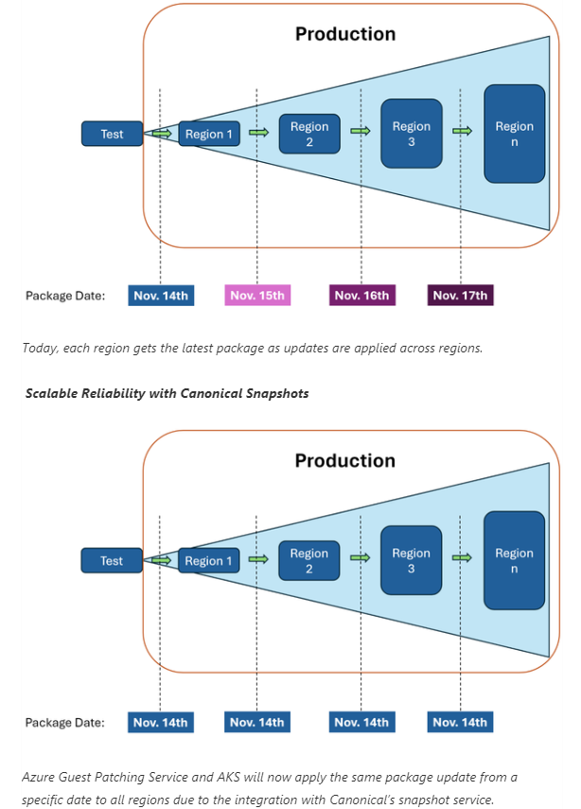
Compute Updates
Public Preview: Azure integration with Canonical’s Snapshot Service for safe deployment
Microsoft and Canonical have partnered to make it easier to stay current with Linux operating system (OS) updates and increase the security and resiliency of Canonical workloads on Azure. Azure is the first cloud provider to collaborate with Canonical to integrate its snapshot service. Azure Guest Patching Service (AzGPS) and Azure Kubernetes Service (AKS) will leverage the new capability to apply the same update consistently on fleet across regions via safe deployment principles (SDP).

Slide 13
Compute Updates
GA: gRPC support on Azure App Service
MS announced gRPC support on App Service is now generally available for Linux workloads.
gRPC is a Remote Procedure Call framework that is used to streamline messages between your client and server over HTTP/2. Using gRPC protocol over HTTP/2 enables the use of features like multiplexing to send multiple parallel requests over the same connection and bi-directional streaming for sending requests and responses simultaneously. Support for gRPC on App Service (Linux) is currently available.
Azure VMware Solution was approved and added to the FedRAMP HIGH Authorization for Azure Government
MS announced that Azure VMware Solution in Microsoft Azure Government was approved to be added as a service within the Azure Government Federal Risk and Authorization Management Program (FedRAMP) High Provisional Authorization to Operate (P-ATO).
Azure VMware Solution (AVS) is a fully managed service in Azure that customers can use to extend their on-premises VMware workloads more seamlessly to the cloud, while maintaining their existing skills and operational processes. Learn more about how you can streamline your migration efforts with Azure VMware Solution in Azure Government.

Slide 14
Compute Updates
Private Preview: Introducing DCesv5 and ECesv5-series Confidential VMs with Intel TDX
MS announced the expansion of our Confidential VM family with the launch of the DCesv5-series and ECesv5-series in private preview. Featuring 4th Gen Intel® Xeon® Scalable processors, these VMs are backed by an all-new hardware-based Trusted Execution Environment called Intel® Trust Domain Extensions (TDX). Organizations can use these VMs to seamlessly bring confidential workloads to the cloud without any code changes to their applications.
Version 1.2.4763 of the Windows Desktop client for AVD released last week to all Insiders!
Added a link to the troubleshooting documentation to error messages to help users resolve minor issues without needing to contact Microsoft Support.
Improved the connection bar user interface (UI).
Fixed an issue that caused the client to stop responding when a user tries to resize the client window during a Teams video call.
Fixed a bug that prevented the client from loading more than 255 workspaces.
Fixed an authentication issue that allowed users to choose a different account whenever the client required more interaction.
Improved client logging, diagnostics, and error classification to help admins troubleshoot connection and feed issues.

Slide 15
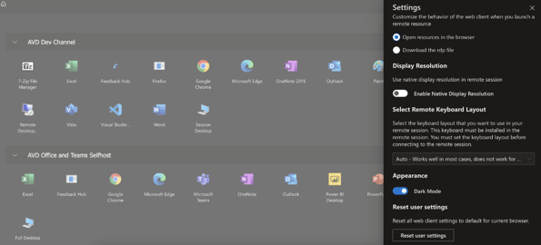
Compute Updates
Announcing the new Azure Virtual Desktop Web Client User Interface
MS Announced the general availability of the User Interface (UI) for the Azure Virtual Desktop Web Client. The new UI offers a cleaner, more modern look and feel. With this update, it is possible:
Switch between Light and Dark Mode
View your resources in a grid or list format
Reset web client settings to their defaults
The new client is toggled on by default on the web client, and the “preview” caption has now been removed from the toggle.
Announcing App Service Multi-plan subnet join
Virtual network integration in App Service requires one subnet per App Service plan integration today. If you are working with many App Service plans, managing the subnets can be an unnecessary administrative task. Therefore, MS is introducing Multi-plan subnet join (MPSJ) in limited public preview at Ignite 2023.
MPSJ reduces subnet sprawl when dealing with many apps across many plans and simplifies management of networking control such as Network Security Groups and Route tables across App Service plans. With MPSJ it is possible to join a virtual network/subnet in a different subscription, but all App Service plan joining a specific subnet must be in the same subscription.
The minimum requirement for subnet size will be /26.
There is currently no validation if the subnet has available IPs, so you might be able to join N+1 plan, but the instances will not get an IP.
There is currently no Azure portal support for joining multiple plans.

Slide 16
Storage & Data

Slide 17
Storage & Data Updates
Generally available: Azure Premium SSD v2 Disk Storage is now available in more regions
Azure Premium SSD v2 Disk Storage is now available in Poland Central, China North 3, and US Gov Virginia regions. This next-generation storage solution offers advanced general-purpose block storage with the best price performance, delivering sub-millisecond disk latencies for demanding IO-intensive workloads at a low cost. It is well-suited for a wide range of enterprise production workloads, including SQL Server, Oracle, MariaDB, SAP, Cassandra, MongoDB, big data analytics, gaming on virtual machines, and stateful containers.
TLS 1.2 to become the minimum TLS version for Azure Storage
Azure Storage will remove support for TLS version 1.1 and 1.0, and the minimum supported version will be TLS1.2 starting November 1, 2024. TLS 1.2 is more secure and faster than older TLS versions. TLS 1.0 and 1.1 do not support modern cryptographic algorithms and cipher suites.
This change impacts existing and new storage accounts using TLS 1.0 and 1.1 in all clouds. To avoid disruptions to applications connecting to Azure Storage, you must migrate to TLS 1.2 and remove dependencies on TLS version 1.0 and 1.1.
Azure Storage already supports TLS 1.2 which is set as the default. Customers using TLS 1.2 will not be impacted by the removal of support for TLS 1.0 and 1.1.

Slide 18
Storage & Data Updates
Generally available: Azure Blob Storage Cold Tier support on Blob Batch operations
Azure Blob Storage Cold Tier was generally available since Aug 10th, 2023. It is a new online access tier that is the most cost-effective Azure Blob offering for storing infrequently accessed data with long-term retention requirements, while providing instant access.
With Blob Batch operations, it is possible to change tier of massive blobs to or from a blob access tier with optimal performance. It now supports the tiering operations for cold tier.

Slide 19
Miscellaneous

Slide 20
Miscellaneous Updates
Microsoft 365 Copilot is generally available
Microsoft 365 Copilot is generally available for enterprise customers worldwide.
Microsoft 365 Copilot combines the power of large language models (LLMs) with data in the Microsoft Graph, the Microsoft 365 apps, and the web to turn words into the most powerful productivity tool on the planet.
Copilot is currently supported in the following languages: English (US, GB, AU, CA, IN)​​, Spanish (ES, MX)​​, Japanese​​, French (FR, CA)​​, German​​, Portuguese (BR)​​, Italian​​, and Chinese Simplified​​.
Microsoft 365 Copilot GCC is expected to begin rollout during the Summer of 2024.
Git Partial Clone Now Supported in Azure DevOps
Treeless and blobless Git Partial Clones are now enabled in Azure DevOps.
Partial clones are a reduced type of git clone that users create via specific arguments on the git command line. For large repositories with a lot of history, they offer a dramatic performance improvement compared to a regular clone, with some tradeoffs. Partial clones do not download every single historical object in the repository at clone time like a traditional clone. Instead, they delay downloading many objects until checkout of a branch (or other git scenario) that needs them.

Slide 21
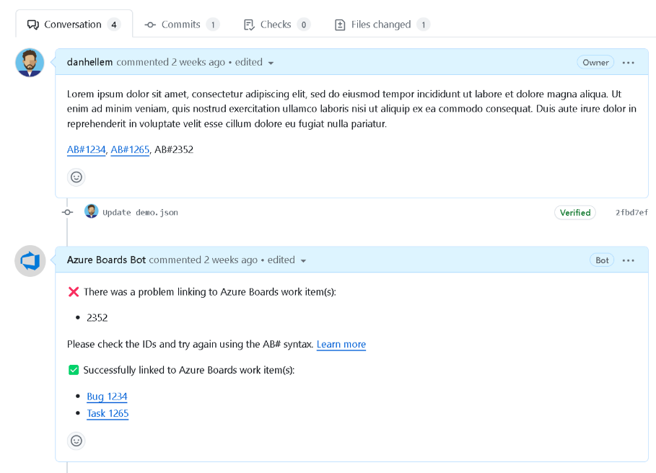
Miscellaneous Updates
Azure Boards + GitHub Integration Improvements
Improved AB#ID validation: Azure Boards GitHub app allows to inform users when a link to a work item is invalid. This will help users to identify and fix before the Pull Request is merged.
Add link to GitHub commit or pull request: Today users must cut and paste the full URL of the GitHub commit or pull request. We is going to improve to improve that experience to allow to search for the commit or pull request and select it from a list of repositories. This will make it easier to link to the correct commit or pull request.
Create branch from work item: One of the more popular features of Azure Boards and Repos integration is to create a new branch from a work item. This creates a new branch in the repository and automatically links the work item to future commits and pull requests. We would like to provide a similar experience for customers who have their GitHub repository connected to Azure Boards.
Azure DevOps Server 2022.1 RC2 now available
MS released Azure DevOps Server 2022.1 RC2. This is a last planned prerelease before final release of Azure DevOps Server 2022.1. A direct upgrade is supported from Azure DevOps Server 2022.1 RC1, any version of TFS, including Team Foundation Server 2015 and newer.

Slide 22
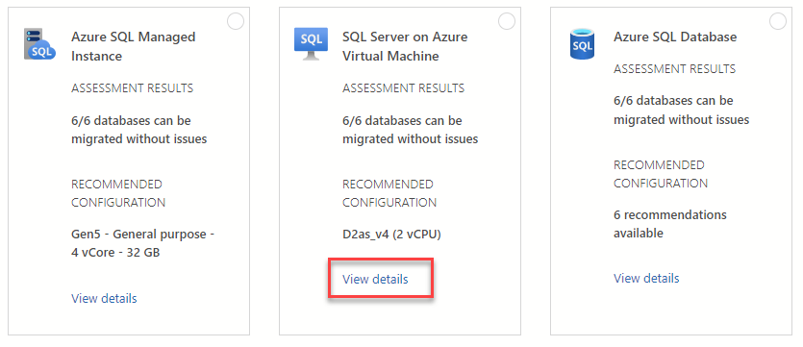
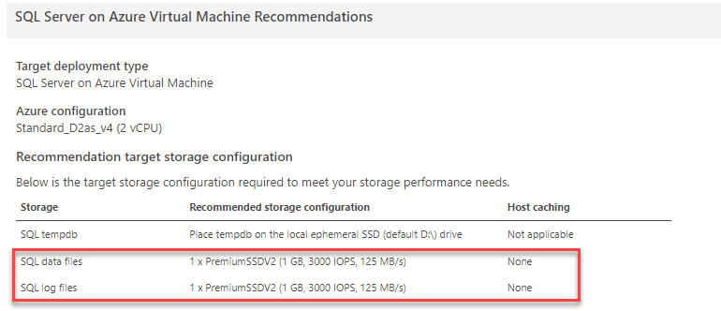
Miscellaneous Updates
Game Dev VM Marketplace Application will be retired on February 1st, 2024
Azure Game Development Virtual machines provide images to create and test games in the cloud with preinstalled game development tools. Azure Game Development Virtual Machines is just one of many investments Microsoft is making to accelerate developer productivity for game developers
On February 1st, 2024, the Game Development Virtual Machine on the Azure Marketplace will be retired. Before that date MS recommend reviewing usage of this marketplace application. Virtual Machines created prior to retirement using this marketplace application will not be impacted. These virtual machines will continue to be available for as long as you keep the virtual machine and related resources provisioned in your Azure subscription.
Azure SQL Migration extension for Azure Data Studio v1.4.11
MS announced the release of the latest version of the Azure SQL Migration extension for Azure Data Studio, v1.4.11.
This latest version of the extension supports Azure SKU recommendation for a target SQL server on an Azure Virtual Machine that uses Premium SSD v2 disks based on a performance analysis of the source workload.

Slide 23
Information

Slide 24
Information
Azure Times GitHub Repo

Slide 25
Questions

