Slide 1
Azure Times #136
30 September, 2023

Slide 2
Networking

Slide 3
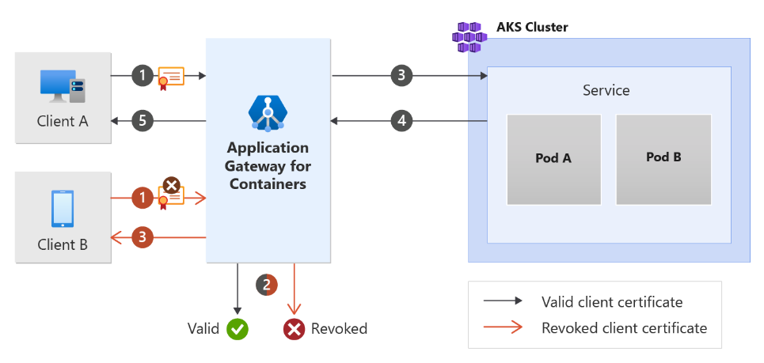
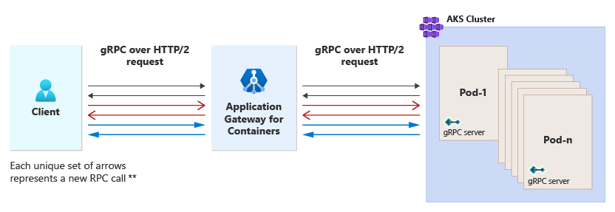
Networking Updates
Generally Available: gRPC and frontend mTLS now available for Application Gateway for Containers
Application Gateway for Containers is introducing support for gRPC and frontend mutual authentication (mTLS).
Frontend mutual authentication (mTLS) brings feature parity to Application Gateway for Containers, for customers using Application Gateway Ingress Controller. This enhancement increases security by ensuring only specific clients are authenticated before their requests are proxied to a backend service. Combined with the previously released backend mutual authentication, this update unlocks end-to-end mutual authentication.
Additionally, Application Gateway for Containers now supports gRPC. With gRPC, four new communication methods between the client and Application Gateway for Containers are enabled: unary, client streaming, server streaming, and bidirectional streaming capabilities.

Slide 4
Security & Identity

Slide 5
Security & Identity Updates
Introducing the new File Integrity Monitoring with Defender for Endpoint integration
The new version of File Integrity Monitoring (FIM) replaces the legacy experience based on Log Analytics Agent (MMA), which is set for deprecation. It introduces several significant improvements over the previous version:
Ease of Onboarding: The new FIM version offers a simple onboarding process with Microsoft Defender for Endpoint as the only prerequisite, eliminating the need for additional solution configurations or collection rules.
Built-in support for key security regulatory compliance standards: File Integrity Monitoring supports PCI-DSS, CIS, NIST, and other standards
Additional information about the user and the process initiated the change
Data Allowance Inclusion: For Defender for Servers Plan 2 customers, events collected for FIM powered by Defender for Endpoint are included in the data types that qualify for the 500MB data allowance benefit.

Slide 6
Management & Governance

Slide 7
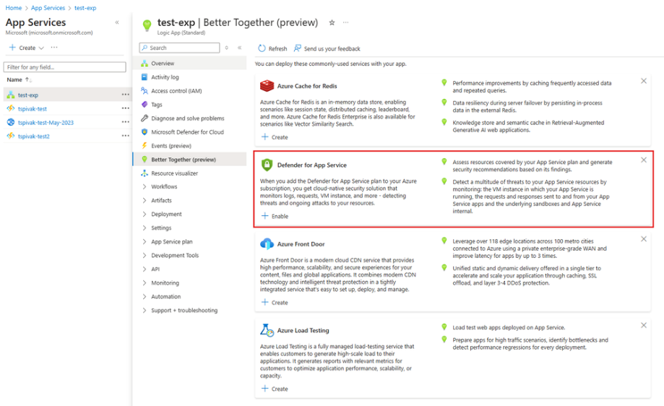
Management & Governance Updates
Better Together tab in Azure portal
The Better Together experience is designed to enhance your development journey by recommending and deploying the right services precisely when you need them, focusing especially on Azure App Service, Azure Container Apps (ACA), and Azure Kubernetes Service (AKS).

Slide 8
Compute

Slide 9
Compute Updates
Generally Available: Extended support: PHP 8.1 on App Service
PHP has updated their release cycles to include the extension of security support for PHP 8.1 which will now be supported until December 31 2025.
Public Preview: Virtual machines node pools support in AKS
With virtual machines node pools, Azure Kubernetes Service directly manages the provisioning and bootstrapping of every single node. Typically, when deploying a workload onto Azure Kubernetes Service (AKS), each node pool can only contain one virtual machine (VM) type or SKU. Virtual Machines node pools allow the capability to add multiple VM SKUs of a similar family to a single node pool. Virtual Machines node pools allow you to specify a family of SKUs for a node pool without the need to maintain one node pool per SKU type, reducing the node pool footprint.
This feature is now in public preview.
Public Preview: Azure Functions .NET 9 support in Linux plans
Azure Functions now supports .NET 9 preview 7 for applications using the isolated worker model and running on Linux plans.
To use .NET 9, Functions projects can adjust their target framework and update their references of Microsoft.Azure.Functions.Worker and Microsoft.Azure.Functions.Worker.Sdk to version 2.0.0-preview1 or later. Project code may need other changes in order to use these new versions. See the core packages documentation for details on these changes.

Slide 10
Compute Updates
Generally Available: Long-term support for version 1.27 and 1.30 in Azure Kubernetes Service (AKS)
AKS provides a long-term support (LTS) option, which extends the support window for a Kubernetes version to give you more time to plan and test upgrades to newer Kubernetes versions.
The Kubernetes community releases a new minor version approximately every four months, with a support window for each version for one year. In Azure Kubernetes Service (AKS), this support window is called community support.
AKS now supports 1.27 version as well as 1.30 version in LTS.
Generally Available: FIPS mutability support in AKS
The Federal Information Processing Standard (FIPS) 140-2 is a US government standard that defines minimum security requirements for cryptographic modules in information technology products and systems. Azure Kubernetes Service (AKS) allows to create Linux and Windows node pools with FIPS 140-2 enabled. Deployments running on FIPS-enabled node pools can use those cryptographic modules to provide increased security and help meet security controls as part of FedRAMP compliance. For more information on FIPS 140-2, see Federal Information Processing Standard (FIPS) 140.
With FIPS mutability, it is possible to enable or disable FIPS on an existing Linux node pool. When you update an existing node pool, the node image will change from the current image to the recommended FIPS image of the same OS SKU. This will immediately trigger a reimage. When migrating your application to FIPS, first validate that your application is working properly in a test environment before migrating it to a production environment.

Slide 11
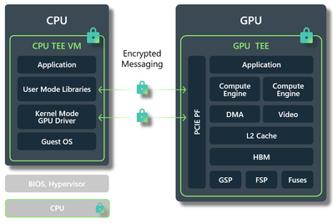
Compute Updates
Public Preview: New FX series VMs - FXmsv2 and FXmdsv2
Azure is proud to announce newest additions to the FX subfamily of VMs, the FXmsv2 FXmdsv2 series, powered by the 5th Generation Intel® Xeon® Platinum 8473C (Emerald Rapids) processor in a hyper threaded configuration, ideal for memory and compute intensive workloads. This new processor features an all- core turbo clock speed of 3.0 GHz with Intel® Turbo Boost Technology, Intel® Advanced-Vector Extensions 512 (Intel® AVX-512) and Intel® Deep Learning Boost. These VM series target workloads that require a high CPU clock speed and high memory to CPU ratio, and applications requiring a high single-core performance, high IOPS and throughput, such as electronic design automation (EDA) workloads. These virtual machines offer up to 96 vCPU and 1832 GiB of RAM.
All these VM series are available with and without a local diskю
During the preview period, the VMs are available in the West US 3 and Southeast Asia regions for all VM sizes up to 96 vCPU. The number of regions will continue to expand in 2024 and beyond.
Generally Available: Azure confidential VMs with NVIDIA Tensor Core GPUs
MS Announced the general availability of Azure confidential VMs with NVIDIA H100 Tensor Core GPUs and inviting customers to start deploying their production GPU workloads on these VMs. This NCC H100 v5 VM SKU is based on AMD 4th Gen EPYCTM processors with SEV-SNP technology paired with NVIDIA H100 Tensor Core GPUs. These VMs allow Azure customers to migrate their most sensitive GPU intensive workloads to Azure with minimal performance impact and without code changes.
These NCC H100 v5 VM SKUs provide a hardware-based trusted execution environment (TEE) that enhances guest protection against potential access by the hypervisor and other host management code to VM memory and state, thereby safeguarding against unauthorized operator access. Customers can initiate attestation requests inside these VMs to verify that the VMs are running on a properly configured TEE before releasing keys and launching sensitive applications.

Slide 12
Compute Updates
OneDrive support for RemoteApp in Azure Virtual Desktop
MS announced that Microsoft OneDrive support is now available for RemoteApp in Azure Virtual Desktop!
Previously, OneDrive could only be used on Azure Virtual Desktop with non-persistent desktops and was not supported on RemoteApp. With this new support, it is now possible to use OneDrive alongside a RemoteApp in Azure Virtual Desktop, which allows users to access and synchronize their files while using a RemoteApp. When a user connects to a RemoteApp, OneDrive can automatically launch as a companion to RemoteApp. The new support has the same features and usability as the OneDrive on your personal device.
OneDrive support for Azure Virtual Desktop RemoteApp is currently fully supported with Windows 11, version 23H2 (Windows Insider is still in preview).
Announcing the General Availability of Azure CycleCloud Workspace for Slurm
MS announced the general availability of Azure CycleCloud Workspace for Slurm https://aka.ms/ccw4slurm , a groundbreaking solution template available on the Azure Marketplace. This innovative template allows users to effortlessly create, configure, and deploy pre-defined Slurm clusters with CycleCloud on Azure, all without requiring any prior knowledge of Azure or Slurm.
Dapr v1.14.4 now available in the Dapr extension for AKS and Arc-enabled Kubernetes
The Dapr extension for AKS and Arc-enabled Kubernetes now supports Dapr v1.14.4.
Dapr is a developer framework for building cloud-native applications, making it easier to run multiple microservices on Kubernetes and interact with external state stores/databases, secret stores, pub/sub brokers, and other cloud services and self-hosted solutions.
The Dapr v1.14 release offers several new features, including a new Jobs API for scheduling and running jobs, a new Scheduler control plane service, streaming subscriptions, actor multi-tenancy with namespaces, outbox pattern projections, HTTP metrics path matching, many fixes in the core runtime and components, and more.

Slide 13
Microsoft Fabric

Slide 14
Microsoft Fabric
Databricks Unity Catalog tables available in Microsoft Fabric
Announcing the General Availability of Copilot for Data Factory in Microsoft Fabric
Announcing Public Preview: Incremental Refresh in Dataflow Gen2
Exciting Enhancements Announced for Fabric Data Factory Pipelines!
Announcing the General Availability of Mirroring for Snowflake in Microsoft Fabric
Announcing Public Preview: Copy Job in Microsoft Fabric
Organizing your tables with lakehouse schemas and more (Public Preview)
Google Cloud Storage shortcuts and S3 Compatible shortcuts generally available
Announcing Public Preview of T-SQL Notebook in Fabric
Introducing High Concurrency Mode for Notebooks in Pipelines for Fabric Spark
Announcing the Fabric Apache Spark Diagnostic Emitter: Collect Logs and Metrics
Copilot for Data Warehouse: Public Preview Update
Mirroring Azure SQLDB – new features and what’s coming up?
Announcing Updates to Data Activator in Public Preview
Announcing improved JSON support in Fabric DW
Unlock faster insights with the new support for Copilot conversations in Real-Time Intelligence (Public Preview)
Announcing the Private Preview of the Microsoft Fabric SKU Calculator at the European Fabric Community Conference
Announcing the General Availability of Fabric Data Pipeline Support in the On-Premises Data Gateway
Announcing Service Principal support for Fabric APIs
Announcing the new Terraform Provider for Microsoft Fabric (Public Preview)
Announcing the General Availability of Fast Copy in Dataflows Gen2
Mirroring Azure Database for PostgreSQL Flexible Server in Microsoft Fabric - Private Preview

Slide 15
Databases

Slide 16
Databases Updates
Generally Available: Latest PostgreSQL minor versions supported by Azure Database for PostgreSQL – Flexible Server
PostgreSQL minor versions 16.4, 15.8, 14.13, 13.16, 12.20, and 17 Beta 3 are now supported by Azure Database for PostgreSQL – Flexible Server.
These minor version upgrades are automatically performed as part of the monthly planned maintenance in Azure Database for PostgreSQL – Flexible Server. This upgrade automation ensures that your databases are always running the latest optimized versions without requiring manual intervention. This release fixes one security vulnerability and more than 55 bugs reported over the last several months.
Generally Available: Online migration from Azure Database for PostgreSQL - Single Server to Flexible Server
It is now possible to use online migration option to migrate from Azure Database for PostgreSQL –Single Server to Flexible Server. Online migration is the ideal choice when have large databases and require limited application downtime.
In online migration, applications connecting to source instance aren't stopped while databases are copied to a flexible server. The initial copy of the databases is followed by replication to keep the flexible server in sync with the source instance. A cutover is performed when the flexible server completely syncs with the source instance, resulting in very minimal downtime to applications.
Generally Available: V5 reservations for Azure Database for PostgreSQL – Flexible Server
MS announced that reservations are now available for Azure Database for PostgreSQL – Flexible Server V5 instances (both Intel and AMD). By reserving compute resources, it is possible to save significantly compared to pay-as-you-go pricing. With Azure Database for PostgreSQL – Flexible Server reserved capacity, it is possible to commit to a one-year or three-year term, receiving a substantial discount on compute costs—up to 65%.

Slide 17
Databases Updates
Generally Available: Smaller Enterprise tier cache instance for Azure Cache for Redis
Get started with Azure Cache for Redis with the E1 cache instance. This option gives you a lower cost starting point to use the expanded features of Redis Enterprise, including vector search and storage.
Generally Available: Azure Cosmos DB dynamic scaling—per region and per partition autoscale
Azure Cosmos DB now provides dynamic scaling to help optimize costs for nonuniform, large-scale workloads. By default, Azure Cosmos DB autoscale scales workloads uniformly based on the most active region and partition. This behavior can cause unnecessary scale-ups if one or few partitions are active. The new dynamic scaling behavior enables your workload partitions and regions to scale independently based on usage—improving cost efficiency with zero downtime or performance impact.

Slide 18
ML & AI & IOT

Slide 19
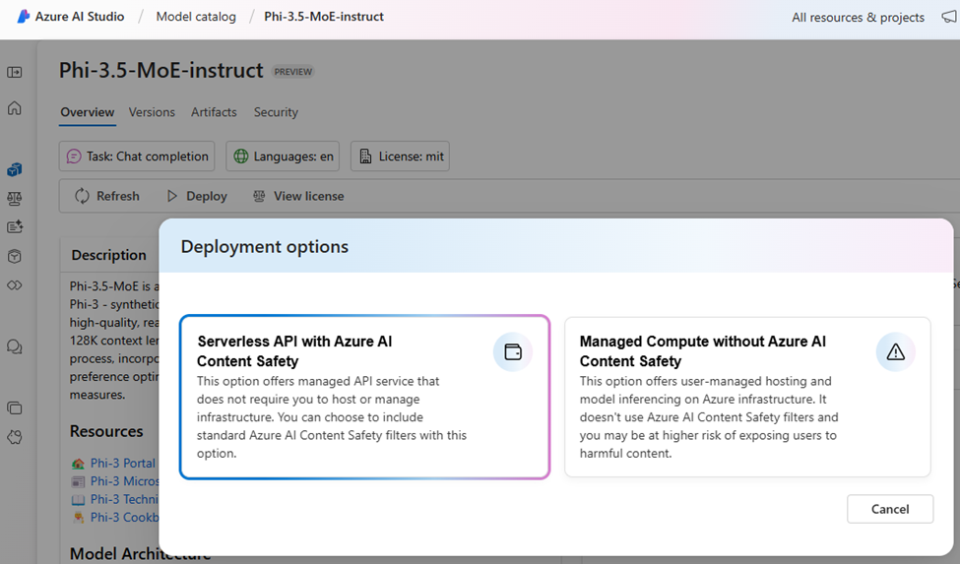
ML & AI & IOT Updates
Announcing the Availability of Phi-3.5-MoE in Azure AI Studio and GitHub
MS announced that the Phi-3.5-MoE model is now available through Serverless API deployment method in Azure AI Studio (Figure 1) and GitHub (Figure 2). Key benefits include:
Scalability: Easily scale usage based on demand without worrying about underlying hardware constraints. Phi-3.5-MoE and other Phi-3.5 models are available in East US 2, East US, North Central US, South Central US, West US 3, West US, and Sweden Central regions.
Cost Efficiency: Pay only for the resource use, ensuring cost-effective operation, at $0.00013 per 1K input tokens and $0.00052 per 1K output tokens.
Ease of Integration: Seamlessly integrate Phi-3.5-MoE into existing workflows and applications with minimal effort.

Slide 20
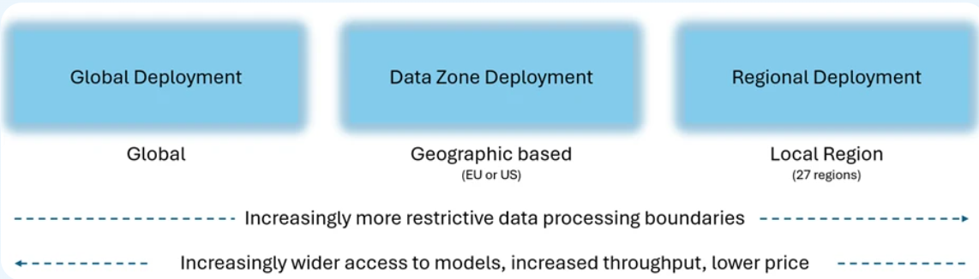
ML & AI & IOT Updates
Announcing Azure OpenAI Data Zones
Azure OpenAI Data Zones now available for the European Union and United States. Now there are three options:
Global deployments: Available in over 25 regions, this option offers access to all new models (including o1 series) at the lowest price with the highest throughputs. Data is stored at rest within the customer selected region of the Azure resource, while the global backbone ensures optimized response times.
Data Zones: Introducing Data Zones for customers who need greater data processing assurances while accessing the latest models, combined with the flexibility of cross region load balancing within the customer selected geographic boundary. The United States Data Zone spans all Azure OpenAI regions within the United States. The European Union Data Zone spans all Azure OpenAI regions located within the European Union member states. The new Azure Data Zones deployment type will be available in the coming month.
Regional deployments: For the strictest levels of data control, regional deployments ensure processing and storage occur within the resource’s geography. This option offers the most limited model availability compared to Global and Data Zone deployments.

Slide 21
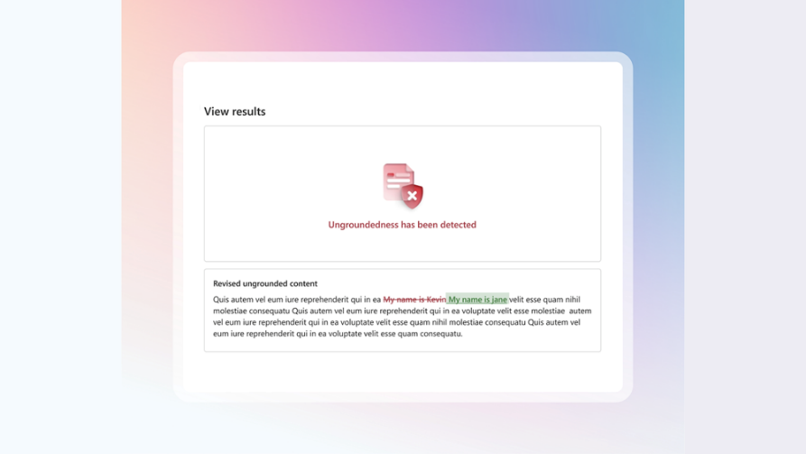
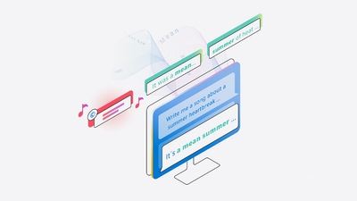
ML & AI & IOT Updates
MS Announced a correction capabilities in Azure AI Content Safety
With this enhancement, groundedness detection not only identifies inaccuracies in AI outputs but also corrects them, fostering greater trust in generative AI technologies.
Groundedness detection is a feature that identifies ungrounded or hallucinated content in AI outputs, helping developers enhance generative AI applications by pinpointing responses that lack a foundation in connected data sources.
Multimodal Public Preview
MS announced the Public Preview release of our Multimodal model in Azure AI Content Safety. The Multimodal API analyzes materials containing both image content and text content to help make applications and services safer from harmful user-generated or AI-generated content. It allows:
Detect Harmful Content Across Multiple Modalities:
Contextual Analysis Across Text and Visuals
Real-Time Moderation

Slide 22
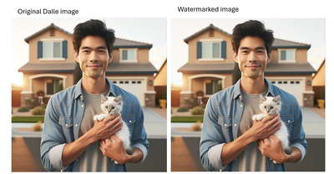
ML & AI & IOT Updates
Protected Material Detection for Code now in Preview in Azure AI Content Safety
Microsoft announced the launch of Protected Materials Detection for Code, a new feature in the Azure AI Content Safety is a generative AI guardrail that can be used with generative AI applications that generate code. Previously available exclusively in Azure OpenAI Service, this advanced model can now be utilized by developers using a wide range of AI tools, enhancing the protection and detection of intellectual property (IP) in code outputs.
The Protected Materials Detection for Code feature compares AI-generated code against a comprehensive database of all public GitHub repositories. If a significant portion of code matches public code, the system will flag the corresponding GitHub repository and provide a citation link, including license details. This allows developers to review the source of the matching code and ensure proper attribution or licensing.
Watermarks in preview in Azure OpenAI Service
‘Watermarks’ add invisible watermarks to all images generated using DALL·E, the company’s flagship generative AI image generator. This watermarking technology is designed to provide an additional layer of transparency and disclosure to AI-generated content.
Microsoft’s watermarking feature embeds signals within the pixels of AI-generated images. These signals are imperceptible to the human eye but detectable by AI-based verification tools. Watermarks embed GUIDs that are traceable to offline provenance manifests.

Slide 23
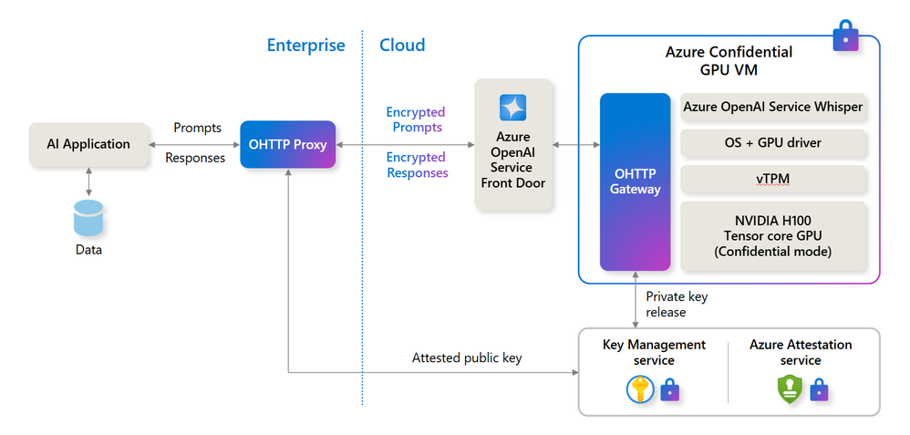
ML & AI & IOT Updates
Azure AI Confidential Inferencing Preview
MS Released confidential inference for the Azure OpenAI Service Whisper model for speech to text transcription, Microsoft is the first cloud provider offering confidential AI. Confidential Whisper offers end-to-end privacy of prompts containing audio and transcribed text responses by ensuring that the prompts are decrypted only within Trusted Execution Environments (TEE) on Azure Confidential GPU virtual machines (VMs).
Confidential inferencing is designed for enterprise and cloud native developers building AI applications that need to process sensitive or regulated data in the cloud that must remain encrypted, even while being processed. They also require the ability to remotely measure and audit the code that processes the data to ensure it only performs its expected function and nothing else. This enables building AI applications to preserve privacy for their users and their data.

Slide 24
DevOps & IaC & Automation

Slide 25
DevOps & IaC & Automation
Azure SDK Release (September 2024)
MS release an update for Java Script and Python libraries
GitHub Copilot now available in github.com for Copilot Individual and Copilot Business plans
GitHub Copilot Individual and Business plans now include preview access to Copilot functionality, including GitHub Copilot Chat, in github.com. The integration with GitHub allows Copilot to leverage the rich context from repositories, pull requests, issues, actions, and more, providing you with more valuable interactions, more tailored coding assistance, and an AI-native developer experience with GitHub.

Slide 26
Miscellaneous

Slide 27


Slide 28
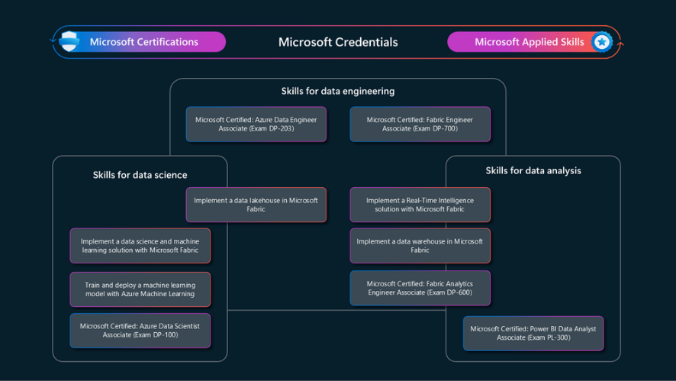
Miscellaneous Updates
Announcing the new Fabric Data Engineer Associate Certification
Microsoft announced Microsoft Certified: Fabric Data Engineer Associate Certification and its related Exam DP-700: Implementing data engineering solutions using Microsoft Fabric (beta)

Slide 29
Miscellaneous Updates
Retirement: Azure Automange Best Practices Migrating to Azure Policy
Azure Automanage Best Practices was useful for automating the configuration and management of virtual machines according to Azure's best practices. It achieved this by automatically onboarding VMs to services like Azure Monitor, Backup, and Microsoft Defender, and continuously monitoring and correcting configuration drift to ensure compliance.
All Automanage Best Practices features and much more are already available in Azure Policy today and MS suggest to transition to it
Retirement: Transition from Helm Repositories to OCI Artifacts for Storing Helm Charts
In November 2020, Helm v2 reached end of life. Starting March 30th, 2025, Azure Container Registry will no longer support Helm v2. Therefore, the legacy “Helm repositories” functionality will also be retired. After this date, Azure Container Registry will only support storing Helm charts as Open Container Initiative (OCI) Artifacts.
Open Container Initiative (OCI) Artifacts are container artifacts that utilize the OCI image specification. This allows you to store a Helm chart as an artifact inside your registry by running a `helm push` command and install a Helm chart by running a `helm install` command.
Starting October 30, 2024, the CLI command `az acr helm push` will be retired. This will prevent pushing new helm charts to legacy helm repositories.
Starting March 30, 2025, the CLI command group `az acr helm` will be retired. This will end all legacy helm repository capabilities in Azure Container Registry.
All Helm charts not stored as an OCI Artifact will be deleted from Azure Container Registry March 30th, 2025.
Retirement: VpnGw1-5 (Non-AZ SKUs) will be retired on Sep 30, 2026 – gateways will be automatically migrated to AZ SKUs
Due to the lack of redundancy, lower availability, and potential higher costs associated with additional failover solutions, MS will be transitioning all Non-AZ SKUs to AZ SKUs. On Sep 30, 2026, the VpnGw1–5 (Non-AZ SKUs) will be retired.
Jan 1, 2025: Creation of new gateways on VpnGw1-5 SKUs (Non-AZ SKUs) will no longer be possible.
Jan 1, 2025: Reduced pricing for AZ SKUs will come into effect.
Sep 30, 2026: VpnGw1-5 (Non-AZ SKUs) will be retired, and all gateways will be automatically migrated before this date.

Slide 30
Miscellaneous Updates
Retirement: Conversation Transcription Multi Channel Diarization
Conversation Transcription Multichannel Audio Diarization will be retired on March 28th, 2025, please transition to Speech to Text Diarization enhanced add-on feature by that date.
Retirement: Azure AI Speaker Recognition
Beginning on September 30, 2025, Azure AI Speaker Recognition will be retired, and applications will no longer be able to access its APIs.
To continue providing speaker verification and/or speaker identification capabilities in applications, MS request to migrate to other solutions available in the market and suggest to explore Nuance Gatekeeper as one of the alternative solutions.
Retirement: Retirement of Classic Alerts for Azure Site Recovery
Azure Site Recovery recently introduced a new and improved alerting solution based on Azure Monitor. This solution offers multiple benefits such as:
Ability to configure notifications to a wide range of notification channels
Ability to select which scenarios to get notified for
Ability to manage alerts and notifications programmatically
Ability to have consistent alerts management experience for multiple Azure services including backup
As a next step, the prior solution of Classic Alerts for Azure Site Recovery will retire on Sept 23 2027.
Retirement: Network security group flow logs in Azure Network Watcher will be retired
As part of this retirement, MS will no longer be able to create new NSG flow logs starting June 30th, 2025.MS recommend to migrate to virtual network flow logs in Network Watcher, which overcomes the limitations of NSG flow logs and provides enhanced capabilities.

Slide 31
Miscellaneous Updates
Retirement: Intent Recognition an Azure AI Speech feature will be retired on September 30th, 2025
Azure AI Services is restructuring its Speech service features, prioritizing new innovations in line with the introduction of large language models. This shift has changed the direction of speech interactions for Voice Commanding scenarios. For these reasons, Intent Recognition will be deprecated on September 30th, 2025.
Intent Recognition (IR) capability in the Speech Service will be supported until September 30th, 2025, however, The Intent Recognition API will be removed from new versions of the Speech SDK after November 30th, 2024.
You can use Speech Recognition with Conversational Language Understanding (CLU) API directly to classify intents and entities of recognized utterances.
Retirement: Azure Application Gateway support for TLS 1.0 and TLS 1.1 will end by 31 August 2025
To align with Azure's ongoing security enhancements, all connections to Application Gateway must use Transport Layer Security (TLS) 1.2 or later, as support for TLS 1.0 and 1.1 on Azure Application Gateway will be discontinued starting 31 August 2025. The TLS versions 1.2 and later offer improved security with features such as perfect forward secrecy and stronger cipher suites.
Retirement: Azure CDN Standard from Microsoft (classic) will be retired on September 30th, 2027
On September 30th, 2027, Azure CDN Standard from Microsoft (classic) will be retired. To avoid service disruptions, you’ll need to migrate to Azure Front Door Standard or Premium by that date.
As a result of this retirement, you’ll no longer be able to create new Azure CDN Standard from Microsoft (classic) resources via the Azure portal, Terraform, or command line tools starting October 1st, 2025.
Until October 1st, 2025, you’ll still be able to make modifications to your existing Azure CDN Standard from Microsoft (classic) resources. After that, all new resources will need to be created using Azure Front Door Standard or Premium.
Azure Front Door Standard and Premium offer the same benefits as Azure CDN Standard from Microsoft (classic), plus additional features and security enhancements.

Slide 32
Miscellaneous Updates
Retirement: Azure Front Door support for TLS 1.0 and TLS 1.1 will end by Dec 1st, 2024
All connections to Azure Front Door must use Transport Layer Security (TLS) 1.2 or later, as support for TLS 1.0 and 1.1 on Azure Front Door will be discontinued starting Dec 1st, 2024. The TLS versions 1.2 and later offer improved security with features such as perfect forward secrecy and stronger cipher suites.
Retirement: Azure Machine Learning data drift detection will retire on September 1st, 2025
The Azure Machine Learning data drift detection for datasets feature is in public preview and will retire on September 1st, 2025. MS recommend to migrate monitoring jobs to the Azure Machine Learning model monitoring service (v2), which is generally available to mitigate any interruption in monitoring services. We apologize for any inconvenience this retirement may cause.
Retirement: Azure Load Balancer Inbound NAT rule V1 for Azure VMs and Azure VMSS will be retired
On September 30, 2027, Inbound NAT rule V1 for Azure Virtual Machines and Azure Virtual Machine Scale Sets in Azure Load Balancer will be retired. To avoid service disruptions, you’ll need to migrate to Inbound NAT rule V2 by that date.
Retirement: Extended support for PHP 8.2 ends December 31st, 2026 – upgrade apps to PHP 8.3
On December 31st, 2026, extended support for PHP 8.2 will end. Apps that are hosted on App Service will continue to run, but security updates will no longer be available, and we’ll no longer provide customer service for PHP 8.2.

Slide 33
Miscellaneous Updates
Retirement: Extended support for Python 3.9 ends October 2025 – upgrade your apps to Python 3.10
In October 2025, extended support for Python 3.9 will end. Apps that are hosted on App Service will continue to run, but security updates will no longer be available, and MS will no longer provide customer service for Python 3.9.
Retirement: AKS GPU image (preview) will retire on Jan 10, 2025
Customers will no longer be able to create new GPU-enabled node pools with the GPU image. MS recommend customers with GPU image enabled node pools to migrate existing workloads onto GPU-enabled node pools created with the AKS supported solutions of (1) Default Experience with NVIDIA device plugin installation, or (2) GPU Operator
Retirement: Open Service Mesh add-on for AKS will be retired on September 30, 2027
Following the archival of the Open Service Mesh project, the Istio service mesh add-on was released for Azure Kubernetes Service (AKS) and is Generally Available since February 28,2024.
Due to the upstream archival of open-source Open Service Mesh, the Open Service Mesh add-on for AKS will no longer receive any new minor version releases or new features and will be retired on September 30, 2027. Security patch updates will be provided up until September 30, 2027.
Retirement: Deprecation of Virtual Network Injection for Azure Data Explorer
MS announced deprecation of the Virtual Network Injection feature for Azure Data Explorer. This feature allowed customers to inject their Azure Data Explorer cluster into their own virtual network and control the network traffic. However, due to its limitations and challenges, MS is deprecating this feature and recommending customers to move to a private endpoint-based network security architecture.
Effective immediately, no new customers can create virtual network injected clusters.
Starting from February 1, 2025, all running virtual network injected clusters will be stopped.

Slide 34
Miscellaneous Updates
Retirement: Azure Maps Spatial APIs V1 & 2022-08-01 will be retired on September 30th, 2025.
Azure Maps Spatial APIs V1 & 2022-08-01 will be retired on September 30th, 2025.
From now until September 30th, 2025, you can continue to use Azure Maps Spatial APIs V1 or V2022-08-01 without disruption. On September 30th, 2025, workloads running Azure Maps Spatial APIs V1 or V2022-08-01 will be deleted and associated application data will be lost.
Retirement: Open Service Mesh extension for Arc-enabled Kubernetes will be retired on September 30, 2027
Following the archival of the upstream open-source Open Service Mesh project in upstream open source, the Open Service Mesh extension for Azure Arc-enabled Kubernetes will no longer receive any new minor version releases or new features and will be retired on 30 September 30, 2027. Security patch updates will be provided up until September 30, 2027.
Retirement: Information regarding the end of support for the "Microsoft Translator [DEPRECATED]" connector
The Microsoft Translator connector has been deprecated since 2020, and the underlying API used has been deprecated since May 2021. On October 30, 2024, the Microsoft Translator connector will no longer be supported and will be disabled on Power Platform.

Slide 35
Information

Slide 36
Information
Azure Times GitHub Repo

Slide 37
Questions

