Slide 1
Azure Times #137
October 7, 2023

Slide 2
Networking

Slide 3
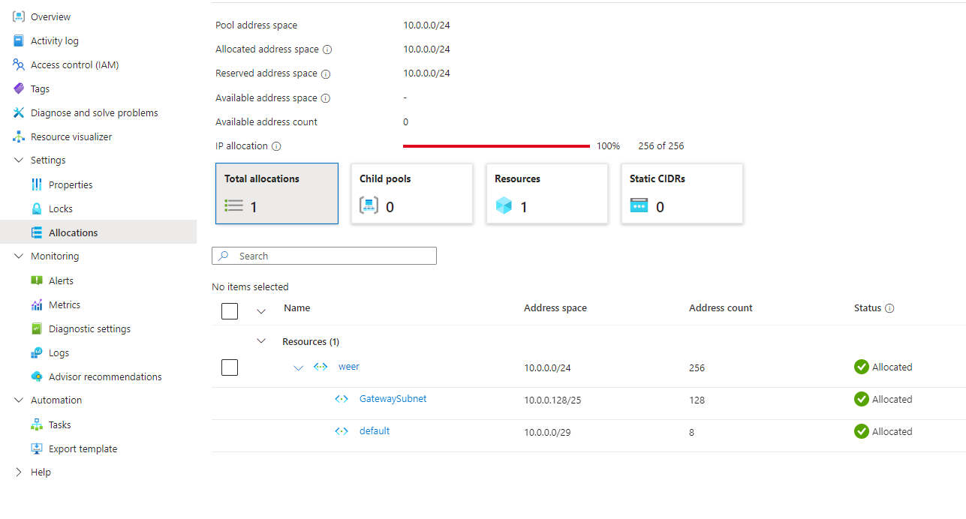
Networking Updates
Public Preview: Azure Virtual Network Monitoring IP address management
MS released the public preview of the Azure Virtual Network Monitoring IP address management feature, an enhancement to the network management suite. This feature is designed to streamline and optimize IP address management, providing with greater control and efficiency.
The new IP Address Management feature simplifies this process by providing a centralized solution for IP address planning and allocation. With IP address management, users can automatically assign non-overlapping addresses, reserve IPs for specific demands, and prevent Azure address space from overlapping with on-premises or multi-cloud environments. This feature ensures that users can see the usage and allocation of IPs, providing a clear overview of their network resources.
When virtual networks are associated with an IPAM pool, peering sync may show as out of sync, even though peering is functioning correctly.
When a VNet is moved to a different subscription, the references in IPAM are not updated, leading to inconsistent management status.
When multiple requests for the same VNet are made, it can result in duplicate allocations entries.
When entering an IP address space, the address space entered must be a valid address range (valid starting address and valid size), else a failure will be encountered when sending a request. Currently, the portal does not validate CIDR input prior to sending requests.

Slide 4
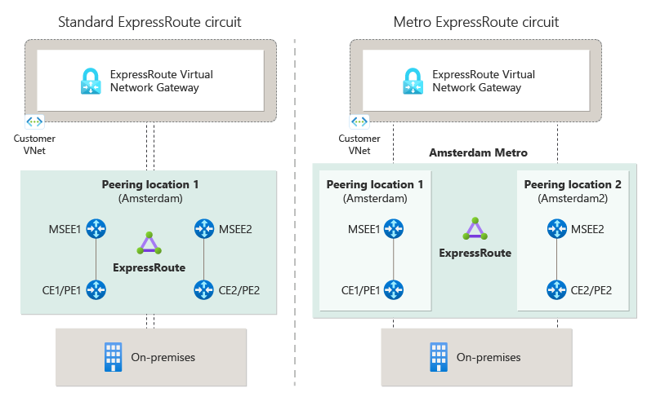
Networking Updates
ExpressRoute Metro is now generally available
MS announced the general availability of ExpressRoute Metro, a new private connectivity architecture designed to enhance network resiliency for our customers. ExpressRoute Metro provides a highly resilient circuit that enables diverse connections to two separate edge sites within a city, ensuring increased redundancy and reliability.
With Metro Provider and Metro Direct, customers can benefit from enhanced redundancy across the circuit and port infrastructure, while also gaining an additional layer of resiliency at the edge site level. This solution is engineered to maintain robust connectivity in case of site-wide disruptions, ensuring uninterrupted service and business continuity.
Key Highlights:
Enhanced Resiliency: Dual-homed connections across two distinct edge sites offer improved resiliency.
Locations Coverage: Metro is currently available in Amsterdam, Singapore and Zurich with more locations including Atlanta, Milan, Madrid, Chicago, and Dublin, scheduled to go live in coming months.
Simple Setup: The setup process is designed for simplicity and ease of configuration, featuring a guided portal that provides clear navigational support.

Slide 5
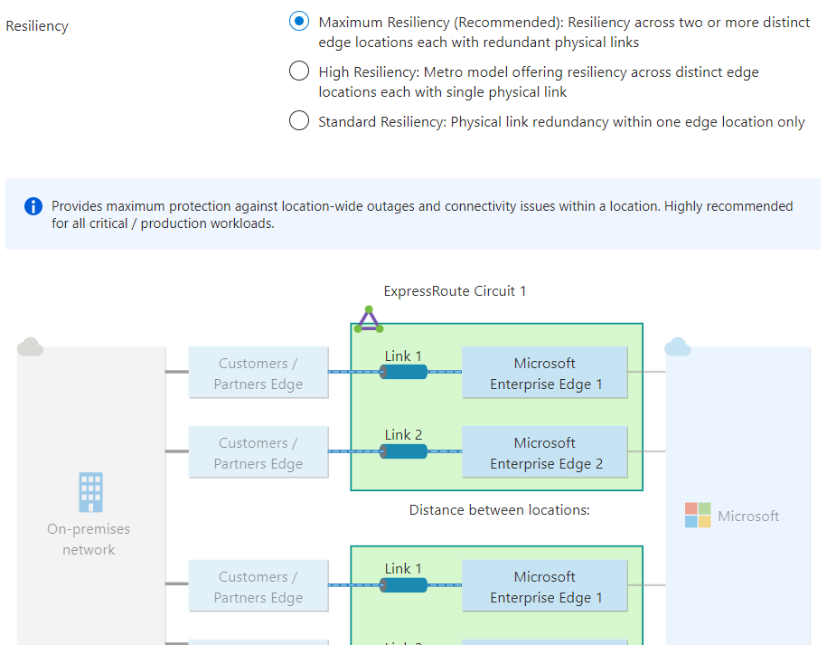
Networking Updates
ExpressRoute guided configuration of multi-site circuits and connections is generally available
ExpressRoute guided experience for configuring multi-site resiliency circuits and connections is generally available in Azure public cloud. The guided experience makes resiliency the central aspect of configuring ExpressRoute circuits and virtual network gateway connections. Three resiliency options—maximum, high, and standard—are offered. Maximum resiliency offers redundancy both across peering locations and within a peering location. High resiliency offers redundancy across peering locations, but not within a peering location. The standard resiliency offers redundancy only within a peering location. The new experience provides information including distance between the peering-locations (sites) and traffic engineering recommendations to help users make informed configuration decisions.

Slide 6
Security & Identity

Slide 7
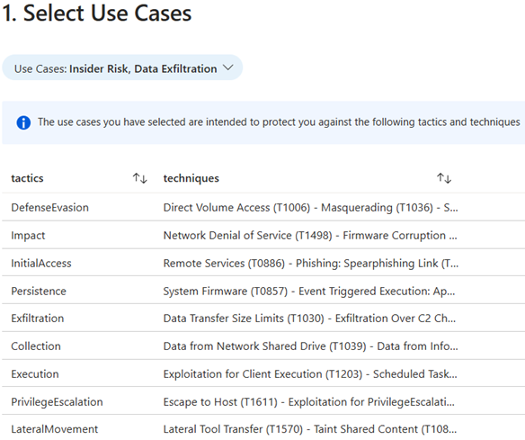
Security & Identity Updates
Introducing the Use Cases Mapper workbook
The workbook and the complementary resources (watchlists) can be used to map common Use Cases to the Mitre ATT&CK framework, i.e. the tactics and techniques listed there. This gives a quick overview of the analysis options available in Sentinel (e.g. Analytic Rules & Hunting Queries) according to these Use Cases.
The identified Use Cases in this context are:
Credential Exploitation
Lateral Movement
Rapid Encryption
Command and Control Communication
Insider Risk
Anomalous Privilege Escalation​
Third-Party Abuses
Overexposure
Data Exfiltration
Mobile Data Security
Communication Abuse​
Web Application Abuse

Slide 8
Entra ID Updates
Public preview - New Conditional Access Template Requiring Device Compliance
A new Conditional Access template requiring device compliance is now available in Public Preview. This template restricts access to company resources exclusively to devices enrolled in mobile device management (MDM) and compliant with company policy. Requiring device compliance improves data security, reducing risk of data breaches, malware infections, and unauthorized access. This is a recommended best practice for users and devices targeted by compliance policy through MDM.
Public preview - Tenant admin can fail certificate based auth when the end user certificate issuer isn't configured with a certificate revocation list
With Certificate based authentication, a CA can be uploaded without a CRL endpoint, and certificate-based authentication won't fail if an issuing CA doesn't have a CRL specified.
To strengthen security and avoid misconfigurations, an Authentication Policy Administrator can require CBA authentication to fail if no CRL is configured for a CA that issues an end user certificate.

Slide 9
Entra ID Updates
General Availability: Microsoft Authenticator on Android is FIPS 140 compliant for Microsoft Entra authentication
Beginning with version 6.2408.5807, Microsoft Authenticator for Android is compliant with Federal Information Processing Standard (FIPS 140-3) for all Microsoft Entra authentications, including phishing-resistant device-bound passkeys, push multifactor authentication (MFA), passwordless phone sign-in (PSI), and time-based one-time passcodes (TOTP). No changes in configuration are required in Microsoft Authenticator or Microsoft Entra ID Admin Portal to enable this capability. Microsoft Authenticator on iOS is already FIPS 140 compliant, as announced last year.
General Availability - Microsoft Entra External ID extension for Visual Studio Code
Microsoft Entra External ID Extension for VS Code provides a streamlined, guided experience to help kickstart identity integration for customer-facing apps. With this extension, it is possible to create external tenants, set up a customized and branded sign-in experience for external users, and quickly bootstrap your projects with preconfigured External ID samples—all within Visual Studio Code.

Slide 10
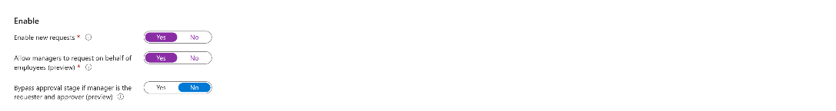
Entra ID Updates
Public Preview - Custom Claims API for Claims Configuration of Enterprise Apps
Custom Claims API allows to manage and update additional claims for their Enterprise Applications seamlessly through MS Graph. The Custom Claims API offers a simplified and user friendly API experience for claims management.
Admins can now use Microsoft Entra admin center and MS Graph API interchangeably to manage claims configurations for their Enterprise Applications. It facilitates admins to execute their automations using the API while allowing the flexibility to update claims on the Microsoft Entra admin center as required on the same policy object.
Public Preview - Request on behalf of
Entitlement Management enables admins to create access packages to manage their organization’s resources. Admins can either directly assign users to an access package, or configure an access package policy that allows users and group members to request access. This option to create self-service processes is useful, especially as organizations scale and hire more employees. However, new employees joining an organization might not always know what they need access to, or how they can request access. In this case, a new employee would likely rely on their manager to guide them through the access request process.
Instead of having new employees navigate the request process, managers can request access packages for their employees, making onboarding faster and more seamless. To enable this functionality for managers, admins can select an option when setting up an access package policy that allows managers to request access on their employees' behalf.

Slide 11
Entra ID Updates
Introducing seamless authentication with Power Pages and Microsoft Entra External ID
MS announced the public preview of Microsoft Entra External ID as an identity provider for Microsoft Power Pages—simplifying authentication for external-facing apps so that you can focus on building features.
Advantages of using External ID include:
Enhanced security: Businesses can ensure secure access for their users, protecting sensitive information and reducing the risk of unauthorized access.
Improved user experience: A streamlined authentication process reduces complexity for users, providing a smoother and more intuitive experience.
Scalability: The ability to handle large numbers of users and various identity providers makes this integration ideal for businesses of all sizes.
.
Announcing the General Availability (GA) of Native Authentication for Microsoft Entra External ID
Native Authentication empowers to take complete control over the design of the login experience. It allows to craft stunning, pixel-perfect authentication screens that are seamlessly integrated into mobile apps, removing the need to redirect users to an external browser.
Full control over the user experience
Platform SDKs for easy integration
Secure from the ground up

Slide 12
Management & Governance

Slide 13
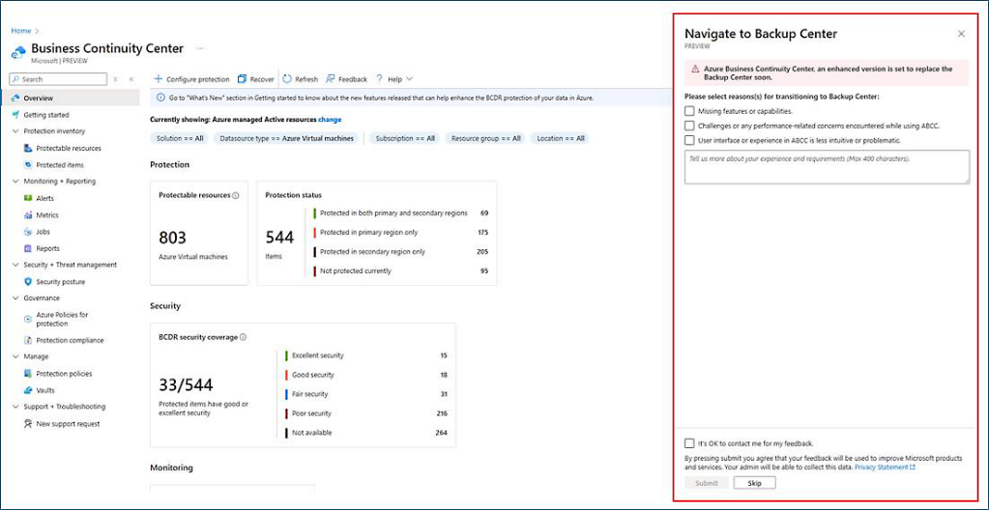
Management & Governance Updates
Generally Available: Azure Backup- Reduced Protected Instance Fee for SAP HANA Backup
MS announced a significant update that will bring enhanced cost efficiency to SAP HANA Database Backup service. Starting September 1, 2024, MS is reducing the Protected Instance (PI) fees for "Azure Backup for SAP HANA on Azure VM.“
HANA Streaming Backup: A flat rate of $80 (East US2) per instance, with standard regional uplift, regardless of the HANA database size.
HANA Snapshot Backup: $80 (East US2) per 5 TB increment, with standard regional uplift
Public Preview: Switch to Azure Business Continuity Center for at scale BCDR management
ABCC, currently in public preview since November 2023, is designed as an enhanced version of the Backup Center and will eventually replace it.
Azure Business Continuity Center (ABCC) provides enhanced experiences for business continuity. To support this transition, MS has removed the Backup Center from the global search in the Azure portal, but there is still an option available from ABCC to go to Backup Center.

Slide 14
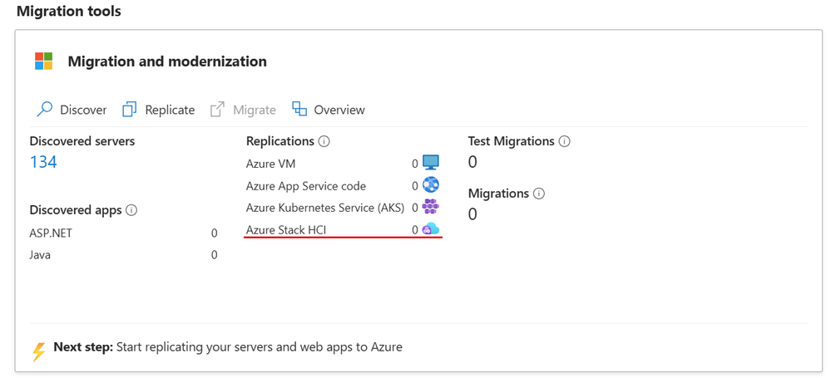
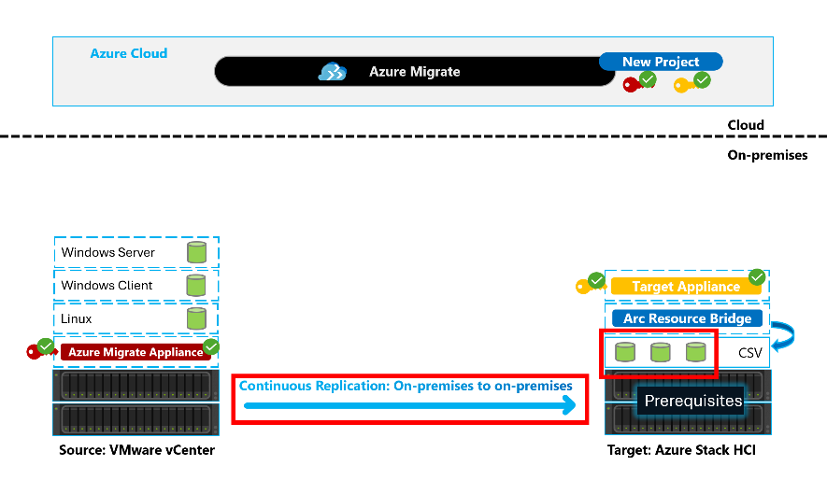
Management & Governance Updates
Public Preview of Azure Migrate from VMware to Azure Stack HCI
MS announced the public preview of the Azure Migrate functionality to migrate VMs from VMware to Azure Stack HCI, a significant enhancement in cloud migration capabilities that seamlessly extends to the edge, in line with adaptive cloud approach.
Key Benefits of Azure Migrate for VMware to HCI
Agent-less Replication
Configure your workload during Migration
No workload impact during replication
Data stays on premises
Minimal Cutover Time

Slide 15
Management & Governance Updates
Generally Available: Reminder New E-mail templates for Log search alerts - API version 2021-08-01 and up
Log alerts are one of the alert types that are supported in Azure Monitor. Log alerts allow users to use a log analytics query to evaluate resources logs every set frequency, and fire an alert based on the results. Rules can trigger one or more actions using action groups. Rules can trigger one or more actions using action groups.
Previously, all types of log search alerts (API version 08-01-2021 and up) employed a common schema email template (for non-common schema and common schema actions).
MS will be upgrading the email template for log search alerts (API version 08-01-2021 and up). This new template will provide additional information in a more visually appealing format, making it easier to investigate alerts.
The new email template will offer a more informative and user-friendly design, helping quickly understand and act on the alerts. If you prefer to continue using the standard email template, you can easily switch back by accessing the action group and enabling the common schema. Detailed instructions on how to do this can be found here.
Retirement: Azure Diagnostic Extensions set to Retire in 18 months
On March 31st, 2026, we'll retire the Azure Diagnostic Extensions for Windows and Linux (WAD/LAD) and it will no longer be supported by Microsoft. This also includes the collection of diagnostic extension data from Azure Storage accounts imported into Log Analytics workspaces.
Azure Monitor Agent should be used instead

Slide 16
Management & Governance Updates
Retirement: Planned Service Retirement - Azure Automation State Configuration on September 30, 2027
Azure Automation State Configuration will be retired on September 30, 2027, please transition to Azure Machine Configuration by that date.
Azure Machine Configuration provides additional capabilities including:
Configurations are now assigned natively in Azure Resource Manager without the need for an Automation Account
Azure Policy provides at-scale assignment of configurations to machines
When machines drift from the desired state, you control when remediation occurs
Manage multiple configurations for the same machine
Advanced reporting through Azure Resource Graph including resource ID and state
Linux and Windows both consume PowerShell-based DSC resources

Slide 17
Compute

Slide 18
Compute Updates
Public Preview: Azure NVads V710 v5-series virtual machines
The NVads V710 v5-series virtual machines are powered by AMD Radeon™ Pro V710 GPUs and AMD EPYC 9374 F (Genoa) CPUs with a base frequency of 4.3 GHz and all-cores peak frequency of 3.8 GHz. VMs take advantage of the AMD Simultaneous Multithreading technology to assign dedicated vCPU threads to each VM.
The series provides five options ranging from 1/6 of a GPU with 4-GiB frame buffer to a full V710 GPU with 24-GiB frame buffer. No other GPU licensing is required for use of AMD GPU-based VMs. The NVads V710 v5 VMs also support NVMe for ephemeral local storage capability. The NVads V710 v5-series enables right-sizing for demanding GPU-accelerated graphics applications and cloud-based virtual desktops to provide a seamless end user experience while providing a cost-effective choice for a full range of graphics-enabled virtual desktop experiences. The VMs are also sized to deliver high-quality, interactive gaming experiences in the cloud, optimized for rendering and streaming complex graphics.
The NVads V710 v5-series virtual machines also support small to medium AI/ML inference workloads such as SLMs, recommendation systems and sematic indexing, by taking advantage of the computational IP blocks in the Radeon Pro V710 GPUs.
Public Preview: Azure NMads MA35D-Series virtual machines
The Azure NMads MA35D-Series virtual machines (VM) are now in public preview in the East US region. This VM series is Azure's first SKU to offer specialized hardware (Xilinx MA35D “Supernova”) accelerated VM optimized for batch and real-time video transcoding workloads. It offers 1 ASIC video processing unit (VPU) with 8GB of memory in addition to 16 vCPUs, 32GB of RAM, 76GB of temporary storage, and 4Gbps of network bandwidth.
Compared with existing general-purpose CPU or GPU based solutions, the NMads MA35D-Series VM SKU provides much higher throughout and lower latency while maintaining a significantly lower TCO for customers. NMv1 presents a huge opportunity to save on infrastructure costs and improve performance and efficiency on video transcoding. Additionally, the SKU provides access to modern codecs such as AV1 to further improve efficiency for video processing. It is the ideal choice for running your video transcoding workloads on the cloud.

Slide 19
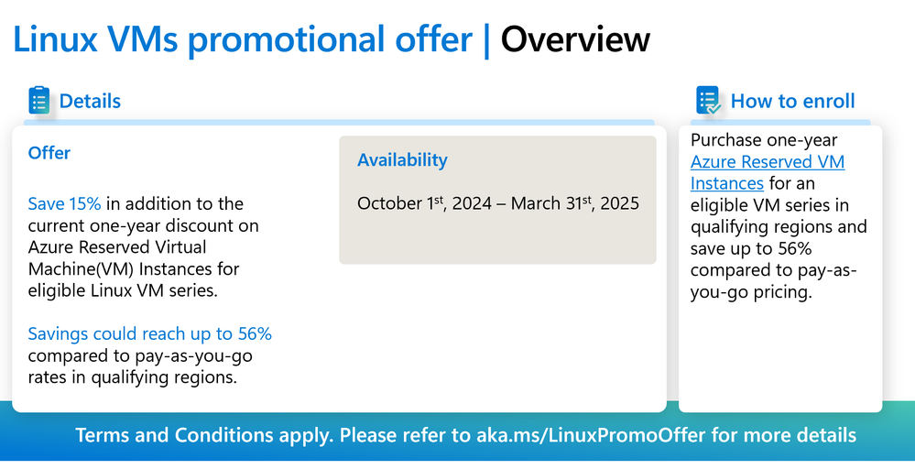
Compute Updates
Generally Available: Save up to 56% on the latest Linux VMs in most Azure regions for a limited time
MS announced the promotional offer for the latest Linux VMs in Azure. You can save 15 % in addition to the existing one-year Azure Reserved Virtual Machine (VM) Instances discount for latest Linux VMs for a limited period. This means you could save up to 56% compared to running an Azure VM on a pay-as-you-go basis. This offer is available between October 1, 2024, and March 31, 2025.
The offer applies to a variety of VM series, including:
AMD-based VM-series: Dasv6, Dadsv6, Dalsv6, Daldsv6, Easv6, Eadsv6, Lasv3, DCadsv5, DCasv5, ECadsv5, ECasv5
Cobalt 100 Arm-based VM-series: Dpdsv6, Dpldsv6, Dplsv6, Dpsv6, Epdsv6, Epsv6
Intel-based VM-series: Ddv5, Ddsv5, Dlsv5, Dv5, Dsv5, Edv5, Edsv5, Ev5, Esv5, and Lsv32.
However, please note that certain VMs in specific regions, such as US East, US Gov Iowa, and US Gov Virginia, are not eligible for this promotional offer.

Slide 20
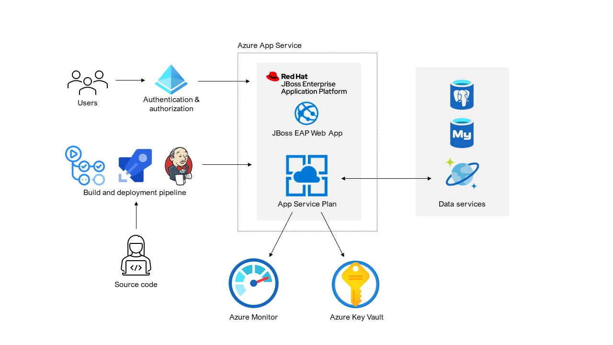
Compute Updates
Announcing Reduced Pricing for JBoss EAP on App Service
Across all available SKUs, including JBoss EAP License fees have been reduced by 63%! This reduction in license fees makes JBoss EAP on App Service more accessible than ever. Whether you’re migrating an application to the platform or scaling an existing one, take advantage of newly reduced pricing for JBoss EAP on App Service.
Microsoft launches latest Azure virtual machines optimized for AI supercomputing, the ND H200 v5 series
The Azure ND H200 v5 VMs are architected with Microsoft’s systems approach to enhance efficiency and performance, and feature eight NVIDIA H200 Tensor Core GPUs. Specifically, they address the gap due to GPUs growing in raw computational capability at a much faster rate than the attached memory and memory bandwidth. The Azure ND H200 v5 series VMs deliver a 76% increase in High Bandwidth Memory (HBM) to 141GB and a 43% increase in HBM Bandwidth to 4.8 TB/s over the previous generation of Azure ND H100 v5 VMs. This increase in HBM bandwidth enables GPUs to access model parameters faster, helping reduce overall application latency, which is a critical metric for real-time applications such as interactive agents. The ND H200 V5 VMs can also accommodate more complex Large Language Models (LLMs) within the memory of a single VM, improving performance by helping users avoid the overhead of running distributed jobs over multiple VMs.
The ND H200 v5 VMs come pre-integrated with Azure Batch, Azure Kubernetes Service, Azure OpenAI Service and Azure Machine Learning to help businesses get started right away.

Slide 21
Compute Updates
Azure Virtual Desktop Updates:
Relayed RDP Shortpath (TURN) for public networks is now available - This enhancement allows UDP connections via relays using the Traversal Using Relays around NAT (TURN) protocol, extending the functionality of RDP Shortpath on public networks for everyone.
Windows App is now available - Windows App is now generally available on Windows, macOS, iOS, iPadOS, and web browsers, and in preview on Android.
Enabling HEVC GPU acceleration for Azure Virtual Desktop is now in preview - High Efficiency Video Coding (H.265) hardware acceleration is currently in preview. Azure Virtual Desktop supports graphics processing unit (GPU) acceleration for frame encoding which will result in improved graphical experience when using the Remote Desktop Protocol (RDP) with a GPU-enabled Virtual Machine. GPU acceleration is crucial for delivering high-fidelity graphical experiences in graphics-intensive applications, such as those used by graphic designers, video editors, and 3D modelers.
Retirement: Azure Spring Apps will be retired on March 31, 2028
Microsoft and Broadcom have made the difficult decision to retire the Azure Spring Apps service. Azure Spring Apps, including Standard consumption and dedicated, Basic, Standard and Enterprise plans, will be retired, through a two-phased retirement plan:
On September 30, 2024, Standard consumption and dedicated plan (preview) will enter a 6-month sunset period and will be retired on March 31, 2025.
In mid-March 2025, all other Azure Spring Apps plans including Basic, Standard and Enterprise plans will enter a 3-year sunset period and will be retired on March 31, 2028.

Slide 22
Compute Updates
Retirement: End of life for NCv3-series VM family support in Azure Batch pools
Microsoft Azure will retire support for NCv3-series VMs on September 30th, 2025 including Standard_NC24rs_v3, Standard_NC6s_v3, Standard_NC12s_v3, and Standard_NC24s_v3. Azure Batch will follow Microsoft Azure support retirement dates for NCv3-series VM support in Batch pools.

Slide 23
Storage & Data

Slide 24
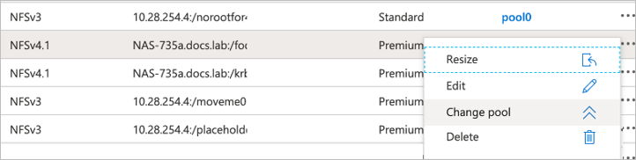
Storage & Data Updates
Dynamically change the service level of an Azure NetApp Files volume
It is now possible to change the service level of an existing volume by moving the volume to another capacity pool in the same NetApp account that uses the service level you want for the volume. This functionality enables to meet your workload needs on demand. You can change an existing volume to use a higher service level for better performance, or to use a lower service level for cost optimization.
Considerations
Dynamically changing the service level of a volume is supported within the same NetApp account.
After the volume is moved to another capacity pool, you no longer have access to the previous volume activity logs and volume metrics.
If you move a volume to a capacity pool of a higher service level (for example, moving from Standard to Premium or Ultra service level), you must wait at least 24 hours before you can move that volume again to a capacity pool of a lower service level (for example, moving from Ultra to Premium or Standard).
If the target capacity pool is of the manual QoS type, the volume's throughput isn't changed with the volume move.
Regardless of the source pool’s QoS type, when the target pool is of the auto QoS type, the volume's throughput is changed with the move to match the service level of the target capacity pool.

Slide 25
Storage & Data Updates
Announcing UNLIMITED Public Preview of Metadata Caching for Azure Premium SMB/REST File Shares
Azure Files announceв the Unlimited public preview of Metadata Caching for the premium SMB/REST file share tier.
Unlimited Public Preview allows customers to automatically self-serve the onboarding process though feature registration (AFEC) in the support regions.
The following Metadata APIs will benefit from Metadata Caching.
Create: Creating a new file; Up to 30% Faster
Open: Opening a file; Up to 55% Faster
Close: Closing a file; Up to 45% Faster
Delete: Deleting a file; Up to 25% Faster

Slide 26
Databases

Slide 27
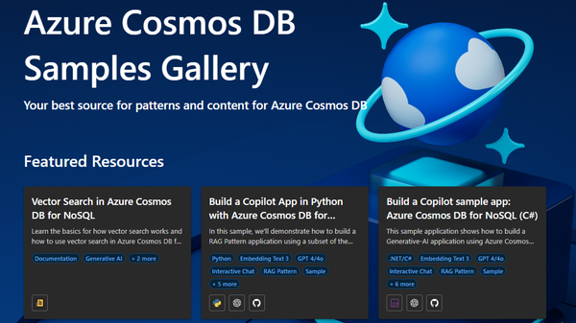
Databases Updates
Discover the New Azure Cosmos DB Samples Gallery!
MS announced the Azure Cosmos DB Samples Gallery —ultimate destination for top-tier Azure Cosmos DB samples, technical guidance, and content created by both Microsoft and the community, including Azure OpenAI samples.
Retirement: SQL Data Sync will be retired on September 30th, 2027
SQL Data Sync (SQL Data Sync is a service built on Azure SQL Database that lets you synchronize the data you select bi-directionally across multiple databases, both on-premises and in the cloud.) will be retired on September 30th, 2027. By the date, please consider migrating to alternatives data replication/synchronization solutions.
The target solution depends on individual use case, with services like Azure Data Factory, Azure Functions, read replicas or SQL features like linked server, mirroring, Always-On, and transaction replication as alternatives.

Slide 28
ML & AI & IOT

Slide 29
ML & AI & IOT Updates
Public Preview: New evaluations for quality and similarity in Azure AI Studio
New quality evaluations are now available in public preview, accessible through the Azure AI SDK today with UI support coming in October 2024. ROUGE, BLEU, METEOR, and GLEU are popular math-based metrics that can help AI developers assess text-based outputs for qualities such as similarity to expected outputs, precision, recall, and grammatical correctness. AI developers can evaluate each metric using a dedicated evaluator and combine multiple evaluators into a holistic evaluation run. After reviewing evaluation results, users may decide to compare different models, adjust their grounding data, or make other changes through prompt engineering before rerunning the evaluation to see the impact of their changes. Overall, these evaluations can help AI developers improve the quality, accuracy and trustworthiness of their AI application.
Public Preview: Simulate everyday interactions with your app in Azure AI Studio
A synthetic data generator and simulator for non-adversarial tasks is now available in public preview, accessible through the Azure AI evaluation SDK.
Now, MS announced an end-to-end synthetic data generation capability to help developers understand how their application responds to everyday user prompts. AI developers can use an index-based query generator and fully-customizable simulator to create robust test datasets around non-adversarial tasks and personas specific to their application. This can help organizations fill a critical gap in their existing evaluation toolkit, facilitating higher-quality evaluations and faster iteration on an application.

Slide 30
ML & AI & IOT Updates
Public Preview: Evaluations for protected material (text) in Azure AI Studio
Risk and safety evaluations for protected material (text) are now available in public preview, accessible through Azure AI Studio UI and SDK experiences. Because foundation models are typically trained using a massive corpus of data, users are understandably concerned that models may output responses containing protected material, putting end users at risk of unintended infringement.
Public Preview: Evaluations for indirect prompt injection attacks in Azure AI Studio
Risk and safety evaluations for indirect prompt injection attacks are now available in public preview, accessible through Azure AI Studio UI and SDK experiences. Indirect prompt injection attacks (also known as cross-domain prompt injection attacks or XPIA) are an emerging attack vector where a threat actor poisons a model’s grounding data source, such as a public website, email, or internal document, to pass hidden, malicious instructions to a model and circumvent safety guardrails. With the Azure AI Evaluation SDK, users can now simulate indirect prompt injection attacks on their generative AI model or application and measure how often their AI fails to detect and deflect the attacks (the defect rate) along subcategories of manipulated content, intrusion, and information gathering. Users can also drill into evaluation details to better-understand how their application typically responds to these attacks and the associated risks. With this information, users may decide to activate Prompt Shields using Azure AI Content Safety, adjust grounding data sources, or apply other mitigations in their system message before rerunning the evaluation and deploying to production.

Slide 31
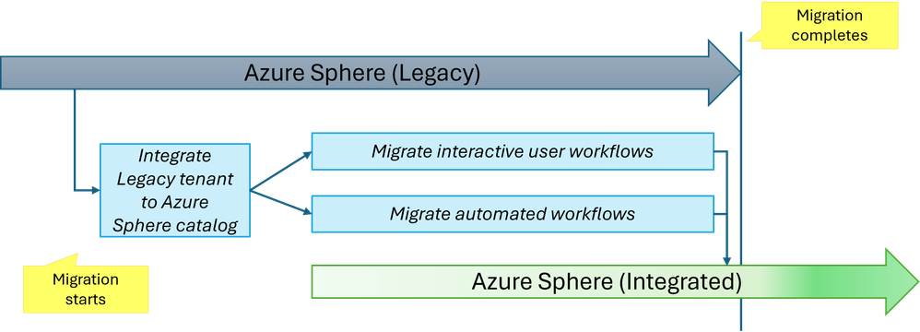
ML & AI & IOT Updates
New HD voices preview in Azure AI Speech: contextual and realistic output evolved
MS announced a new and improved HD version of neural text to speech service for selected voices. This new version further enhances the overall expressiveness, incorporating emotion detection based on the context of the input.
These new HD voices are designed to speak in the selected platform voice timber. And it also provides some extra value:
Human-like speech generation:
Conversational
Prosody variations
Retirement: Azure Sphere is retiring Legacy service interfaces on September 27th, 2027
MS is announcing the upcoming retirement of the Azure Sphere Legacy service interfaces, including the Azure Sphere (Legacy) API (also known as PAPI), and the Azure Sphere (Legacy) CLI (also known as azsphere), on September 27th, 2027. Before this date, you must migrate from Azure Sphere (Legacy) to Azure Sphere (Integrated). Azure Sphere (Legacy) will remain fully supported until the retirement date.

Slide 32
DevOps & IaC & Automation

Slide 33
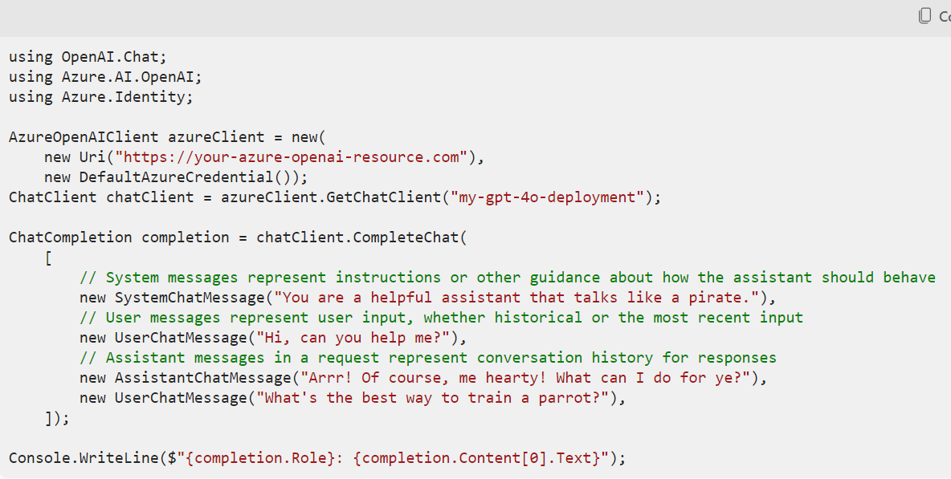
DevOps & IaC & Automation
Deprecation of the macOS-12 Hosted Pipeline Image
Azure DevOps is starting the deprecation process for the macOS-12 (Monterey) hosted pilelines image. While the image is being deprecated, it is possible experience longer queue times during peak usage hours. Deprecation will begin on October 7 and the image will be fully unsupported by December 3. Pipeline jobs using the macOS-12 image label should be updated to use macOS-latest, macOS-13 or macOS-14.
Announcing the stable release of the Azure OpenAI library for .NET
OpenAI team announced their first stable release of the official OpenAI library for .NET.

Slide 34
Miscellaneous

Slide 35
Miscellaneous Updates
Retirement: Azure Orbital Ground Station Retirement
Customers with existing private spacecrafts with appropriate licenses and authorizations can continue to use the Azure Orbital Ground Station Service until December 18th, 2024. New authorizations will no longer be accepted. Public spacecraft authorizations will end on October 28th, 2024.

Slide 36
Information

Slide 37
Information
Azure Times GitHub Repo

Slide 38
Questions

