Slide 1
Azure Times #148
February 27, 2025

Slide 2
Security & Identity

Slide 3
Security & Identity Updates
Announcing mandatory multifactor authentication for the Microsoft 365 admin center
Starting February 3rd, 2025, Microsoft will begin requiring MFA for all user accounts accessing the Microsoft 365 admin center. This requirement will be rolled out in phases at the tenant level. A notification message through the Microsoft 365 admin center Message center will be send approximately 30 days before tenant is eligible for enforcement.
New Identity Secure Score recommendations in General Availability
MS Release 11 recommendation in for Entra ID in GA
Require multifactor authentication for administrative roles
Ensure all users can complete MFA
Enable policy to block legacy authentication
Do not expire passwords
Protect all users with a user risk policy
Protect all users with a sign-in risk policy
Enable password hash sync if hybrid
Do not allow users to grant consent to unreliable applications
Use least privileged administrative roles
Designate more than one Global Admin
Enable self-service password reset

Slide 4
Security & Identity Updates
Announcing Public Preview: New STIX Objects in Microsoft Sentinel
STIX (Structured Threat Information Expression) objects are a critical tool for incident responders attempting to understand an attack and threat intelligence analysts seeking more information on critical threats. It is designed to improve interoperability and sharing of threat intelligence across different systems and organizations.
These objects can be useful for:
Ingesting Objects from any TI sources
Curating Threat Intelligence
Creating Relationships
Hunt and Investigate Threats More Effectively

Slide 5
Management & Governance

Slide 6
Management & Governance Updates
Azure Migrate application and code assessment for Java version 7 (Preview)
The tool enables to evaluate application readiness for replatforming and migration to Azure. This tool is offered as a command-line interface (CLI), and assesses Java application binaries and source code to identify replatforming and migration opportunities for Azure. It helps modernize and replatform large-scale Java applications by identifying common use cases and code patterns and proposing recommended changes.
The tool discovers application technology usage through static code analysis, provides effort estimation, and accelerates code replatforming. This assessment helps to prioritize and move Java applications to Azure. With a set of engines and rules, the tool can discover and assess different technologies such as Java 11, Java 17, Jakarta EE, Spring, Hibernate, Java Message Service (JMS), and more.
Announcing Jumpstart ArcBox 25Q1 general availability
A new version provide the following:
Introduced Windows Server 2025 on both the ArcBox-Client as well as in a nested VM
WinGet and Windows Terminal Integration
SSH Included and Enabled
Advanced Management Capabilities for Arc-enabled servers
ArcBox now provides the flexibility to deploy SQL Server Standard or Enterprise editions on the ArcBox-SQL guest VM, replacing the previously default Developer edition.
Cost Optimization:
Azure ArcBox Client VM data disk changed from Premium SSD to Premium SSD v2.
Azure VM Spot pricing for the ArcBox Client VM

Slide 7
Management & Governance Updates
GA: Azure Automation is revising Service and Subscriptions Limits
Starting January 15, 2025, Azure Automation is revising its Service and Subscription limits to ensure fair distribution of cloud resources across all customers. This change is another step towards improving the reliability and performance of the service while optimizing resource utilization. Since the resource requirements vary across organizations and evolve over time, we are empowering customers to configure their quotas based on actual usage.You can find the complete list of Azure Automation limits here.
Limits for following resources is being revised:
Maximum number of Automation accounts in a subscription in a region.
Maximum number of concurrent running jobs at the same instance of time per Automation account
Retirement: Azure Automation will discontinue execution of PowerShell runbooks using AzureRM modules from February 1, 2025
Starting February 1, 2025, Azure Automation will discontinue execution of all runbooks that use AzureRM modules.
The AzureRM PowerShell module has retired on February 29, 2024, in favour of Az PowerShell that offers more security, stability and functionalities. You must update all runbooks from AzureRM to Az PowerShell and remove AzureRM modules from your Automation account, to ensure continued support and updates

Slide 8
Management & Governance Updates
Retirement: All Azure Automation jobs running on Agent-based Hybrid Worker will be stopped from 1 April 2025
Starting April 1, 2025, all jobs running on agent-based User Hybrid Runbook Worker will be stopped.
Azure Automation Agent-based User Hybrid Worker (Windows & Linux) retired on August 31, 2024, and is no longer supported. It poses a potential Security risk since Agent-based Hybrid Worker has not been getting any Security fixes post-retirement. Hence, it is strongly recommended that you move to extension-based User Hybrid Runbook Worker (Windows & Linux) for executing Hybrid jobs.
Key benefits of new approach:
Enhanced security posture for your VMs through access control using system-assigned managed identities, instead of self-managed certificates
Improved operational productivity for keeping the workers up to date, using automatic upgrades and at-scale management of the VMs
Simplified installation of extension while eliminating the need to install Log Analytics agent.
Extension-based workers can be managed through the Azure portal, PowerShell cmdlets, Bicep, ARM templates, REST API and Azure CLI.
Retirement: Resources interacting with Azure Automation using TLS 1.0/1.1 protocol will be blocked from March 1, 2025
Transport Layer Security (TLS) 1.0 and 1.1 are security protocols for establishing encryption channels over computer networks. Starting March 1, 2025, your resources interacting with Azure Automation using TLS 1.0/1.1 protocols won’t be able to connect to Azure Automation. All interactions through Webhooks, Agent-based/Extension-based User Hybrid Runbook Workers, Automation DSC navigating on the outdated TLS protocols will be blocked. All jobs running or scheduled on Hybrid Workers using TLS 1.0 and 1.1 protocols will fail.
Ensure your resources interact with Azure Automation using TLS 1.2 or higher.

Slide 9
Compute

Slide 10
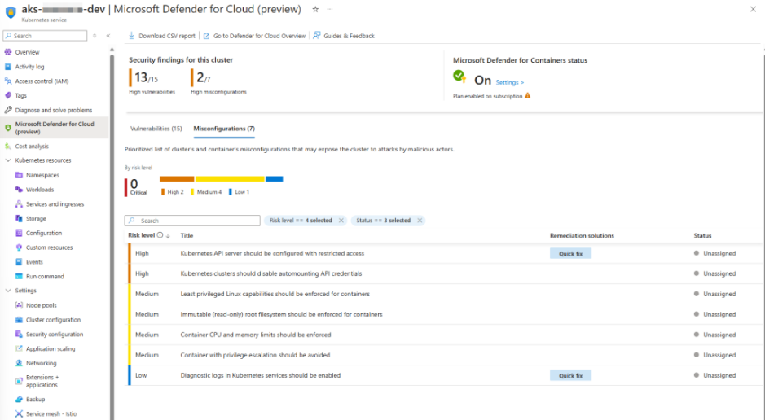
Compute Updates
Introducing the AKS Security Dashboard: Now in Preview
This dashboard centralizes security insights, making it easier for cluster administrators and resource owners to identify and address vulnerabilities and misconfigurations directly from the AKS portal.
The AKS Security Dashboard simplifies the process by providing a single pane of glass to monitor and manage security risks. It’s designed to help teams save time, reduce errors, and focus on what matters most: securing their clusters effectively.
The AKS Security Dashboard provides a unified view of cluster’s security posture. It helps streamline vulnerability assessment and remediation workflows without leaving the Azure portal. Key features include:
Security posture overview: Get a summary of vulnerabilities and misconfigurations categorized by risk levels.
Defender for Containers configuration: Enable and customize security settings for individual clusters.
Guided remediation: Access detailed recommendations for resolving identified security issues.
Task assignment: Delegate remediation responsibilities to team members with due dates and reminders.
To use the AKS Security Dashboard effectively, you need the following:
Defender for Containers: Learn how to enable Defender for Containers.
Defender Cloud Security Posture Management (DCSPM)

Slide 11
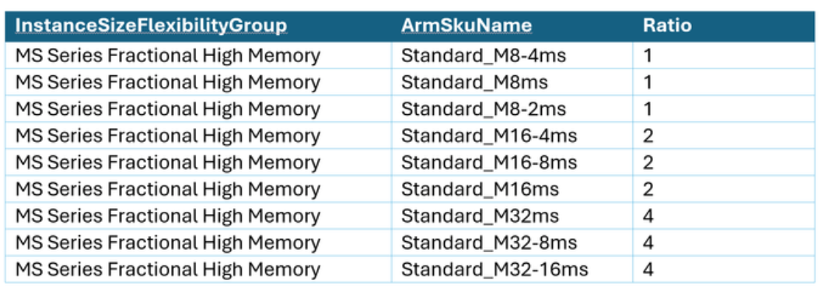
Compute Updates
GA: Changes to instance size flexibility ratios for Azure Reserved Virtual Machine Instance for M-series
MS updated the instance size flexibility ratios for this product to optimize reservation discount within instance size flexibility groups and their respective SKUs.
When you purchase a RI, you can choose to optimize for instance size flexibility or capacity priority. When you choose instance size flexibility, it allows the RI discount to apply to all VM sizes (SKUs) within that instance size flexibility group. The discount application varies based on the VM size selected when purchasing RIs, the sizes of VMs in use, and the ratio, which represents the relative footprint for each VM size within the instance size flexibility group. See an example of instance size flexibility group, SKUs included in that group and their ratios in the table below.

Slide 12
Storage & Data

Slide 13
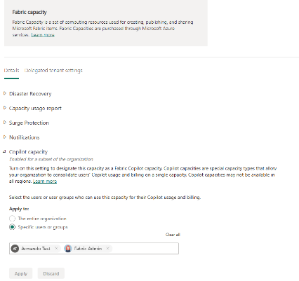
Storage & Data Updates
Introducing Fabric Copilot capacity: Democratizing AI usage in Microsoft Fabric
MS announced the launch of Fabric Copilot capacity, a new billing feature designed to enhance experience with Microsoft Fabric.
Today, when using Copilot, a Power BI report or semantic model must be saved in a Premium capacity (P1 or higher/F64 or higher) workspace in order to access Copilot.
With Fabric Copilot capacities (referred to as FCCs in this blog), capacity admins can give Copilot access to end users directly, rather than requiring creators to move their content into a specific workspace or link a specific capacity
Introducing SSD storage account support for Ephemeral OS disks
Ephemeral OS disks are split into 2 disks - a diff disk on local temp disk and a base disk using managed disks. All writes to existing and new files occur on the diff disk, while the original files are read from the base disk. Both the diff disk and the base disk are crucial for the VM's operation.
SSD support is a new option that allows customers to choose the type of base disk that is used for the ephemeral OS disk. Previously, the base disk could only be Standard HDD. Now, customers can choose between the three types of disks: Standard HDD(Standard_LRS), Standard SSD (StandardSSD_LRS) or Premium SSD (Premium_LRS).
SSD with Ephemeral OS disk, provides:
Enhanced SLA: VMs created with Premium SSD provide the maximum 99.9% SLA, while VMs created with Standard HDD provide 95% SLA.
Improved performance: By choosing Premium SSD as the base disk, customers can enhance the disk read performance of their VMs. While most writes occur on the local temp disk, some reads are performed from managed disks. Premium SSD disks provide 8-10 times higher IOPS than Standard HDD.

Slide 14
Databases

Slide 15
Databases Updates
Virtual Canary Maintenance for Azure Database for MySQL updates
This innovative feature provides with early access to maintenance updates, allowing to validate workload compatibility with upcoming Azure Database for MySQL enhancements and contribute to the continuous improvement of the service.
Virtual Canary Maintenance addresses this need by offering early access to updates, empowering you to:
Proactively validate workloads against upcoming Azure Database for MySQL features.
Identify and address potential compatibility issues before updates are broadly deployed.
Provide feedback to shape future releases.
GA: Azure Confidential Ledger achieves ISO 27001 certification
Azure Confidential Ledger is now ISO 27001 certified. ISO 27001 is an internationally recognized standard for information security management systems (ISMS). This certification demonstrates that Azure Confidential Ledger has implemented a comprehensive and robust framework to manage and protect customer data.

Slide 16
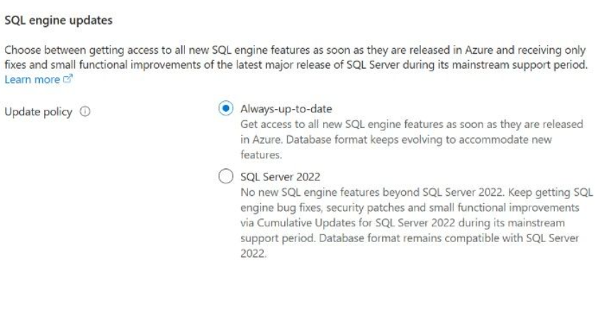
Databases Updates
Regular Expressions (Regex) Support on Azure SQL Managed Instance (MI)
MS announced the Private Preview of Regular Expressions (Regex) support on Azure SQL Managed Instance (MI). This new feature brings powerful text processing capabilities to SQL queries, enabling to perform complex pattern matching and data manipulation with ease.
The Regex feature in Azure SQL follows the POSIX standard and is compatible with the standard regex syntax and supports a variety of regex functions, such as REGEXP_LIKE, REGEXP_COUNT, REGEXP_INSTR, REGEXP_REPLACE, and REGEXP_SUBSTR. The feature also supports case sensitivity, character classes, quantifiers, anchors, and capturing groups.
Here are the functions and features supported:
REGEXP_LIKE: Checks if a string matches a regular expression pattern.
REGEXP_COUNT: Returns the number of times a pattern occurs in a string.
REGEXP_INSTR: Returns the position of the first or the last (based on the specified option) occurrence of a pattern in a string.
REGEXP_REPLACE: Replaces occurrences of a pattern in a string with another string.
REGEXP_SUBSTR: Extracts a substring that matches a regular expression pattern.
To start using Regex feature in Azure SQL MI, please ensure to select “Always-up-to-date”

Slide 17
Databases Updates
Announcing the Release of SSMS Preview 3
Preview 3 has a smaller set of updates and fixes due to the holidays:
Azure SQL Managed Instance - Introduced new validation steps in the Failover Readiness Assessment dialog to assess the health status of the link before failover.
Always Encrypted - Introduced online encryption support in the Always Encrypted Wizard, which enables incremental copying, encrypting, decrypting, or re-encrypting of data.
Configuration - The default value for a firewall rule name created in SSMS uses the format ClientIPAddress_YYYY-MM-DD_HH-MM-SS.
SQL Server Integration Services (SSIS) Microsoft Connector for Oracle deprecation
In July 2025, Microsoft will discontinue support for the Microsoft Connector for Oracle in SQL Server Integration Services (SSIS).
The Microsoft Connector for Oracle enables data export from and import into Oracle databases within an SSIS package. This feature, available in Enterprise editions of SQL Server 2019 and 2022, will remain functional for the lifecycle of the SQL Server product. However, support for this feature will officially end on July 4, 2025. With the deprecation, future product releases will provide no further bug fixes. Additionally, it will not be supported from SQL Server 2025 and onwards.
MS recommend that to use the SSIS ADO.NET Source and ADO.NET Destination components as the primary alternative solution to the Microsoft Connector for Oracle.

Slide 18
Integration

Slide 19
Integration Updates
PP: Seamless Amazon API Gateway Integration for API Center
This new feature allows customers to point to any Amazon API Gateway, and we will seamlessly import their APIs into API Center. This integration simplifies the process of managing APIs by automating the import process, ensuring that organizations can focus on their core business activities without worrying about manual updates.
One of the standout capabilities of this integration is its ability to handle changes on the AWS side. Once the APIs are registered, any updates or modifications made on AWS will be continuously synchronized with API Center. This ensures that organizations always have the most up-to-date information without any additional effort.
This integration not only enhances efficiency but also provides peace of mind, knowing that their API management is always current and accurate.
Synchronization is one-way from Amazon API Gateway to your Azure API center, meaning API updates in the API center aren't synchronized back to Amazon API Gateway.

Slide 20
ML & AI & IOT

Slide 21
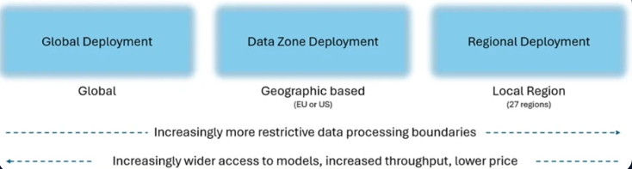
ML & AI & IOT Updates
Announcing Data Zones for Azure OpenAI Service Batch
MS expanded support of Data Zones to Azure OpenAI Service Batch.
Azure OpenAI Data Zones is a new deployment option that provides enterprises with even more flexibility and control over their data privacy and residency needs. Tailored for organizations in the United States and European Union, Data Zones allow customers to process and store their data within specific geographic boundaries, ensuring compliance with regional data residency requirements while maintaining optimal performance. By spanning multiple regions within these areas, Data Zones offer a balance between the cost-efficiency of global deployments and the control of regional deployments, making it easier for enterprises to manage their AI applications without sacrificing security or speed.
Introducing the GPT-4o-Audio-Preview
MS announced the release of audio support accessible via Chat Completions API featuring the new GPT-4o-Audio preview Model, now available in preview. Building on to our recent launch of GPT-4o-Realtime-Preview, this groundbreaking addition to the GPT-4o family introduces support for audio prompts and the ability to generate spoken audio responses. It provides:
Engaging Spoken Summaries: GPT-4o-Audio-Preview can generate spoken summaries from text content, offering a dynamic, engaging way to present information.
Sentiment Analysis from Audio: With the ability to detect sentiment in audio recordings, this model can analyze vocal nuances and translate them into meaningful, text-based insights.
Asynchronous Speech-In, Speech-Out Interactions: GPT-4o-Audio-Preview enables seamless asynchronous voice interactions, supporting applications where users can submit spoken queries or commands and receive spoken responses at a later time.

Slide 22
ML & AI & IOT Updates
Azure AI Foundry: Cutting-Edge Models from Microsoft Research: Aurora, MatterSim, and TamGen
MS Announced availability of three groundbreaking models from Microsoft Research: Aurora, MatterSim, and TamGen. These models are available on Azure AI Foundry starting January 20, 2025.
Aurora is a cutting-edge foundation model that offers a new approach to weather forecasting to transform our ability to predict and mitigate the impacts of extreme events, air pollution, and the changing climate.
Microsoft Research developed MatterSim, a deep-learning model for accurate and efficient materials simulation and property prediction over a broad range of elements, temperatures, and pressures to enable the in silico materials design. MatterSim employs deep learning to understand atomic interactions from the very fundamental principles of quantum mechanics, across a comprehensive spectrum of elements and conditions—from 0 to 5,000 Kelvin (K), and from standard atmospheric pressure to 10,000,000 atmospheres.
TamGen, short for “target-aware molecule generation,” is a state-of-the-art AI framework designed to accelerate drug design by overcoming the limitations of traditional methods. Developed by Microsoft Research, TamGen leverages advanced AI techniques to predict and generate novel drug molecules with significantly improved binding affinities.

Slide 23
DevOps & IaC & Automation

Slide 24
DevOps & IaC & Automation
Announcing General Availability of Terraform Azure Verified Modules for Platform Landing Zone (ALZ)
MS announced the general availability of Terraform Azure Verified Modules for Platform Landing Zone (ALZ).
Azure Verified Modules for Platform Landing Zones (ALZ) is collection of Azure Verified Modules that are composed together to create Platform Landing Zone. This replaces the existing CAF Enterprise Scale modules.

Slide 25
Miscellaneous

Slide 26

Miscellaneous Updates
Oracle CloudWorld Tour
Mumbai, India - February 6
Singapore - March 13
Milan, Italy - March 18
London, England - March 20
Frankfurt, Germany - April 10
Microsoft AI Genius Series
Explore cutting-edge models: LLMs, SLMs and more – 28/01/2025
Production-ready RAG with Azure AI Search – 4/02/2025
Getting started with AI Agents – 11/02/2025
Building Intelligent Multi-agent Systems -18/02/2025
Leverage cloud native infra for intelligent apps – 25/02/2025
Getting Started with Copilot for Azure to Deploy to the Cloud – 4/03/2025

Slide 27
Information

Slide 28
Information
Azure Times GitHub Repo

Slide 29
Questions

