Slide 1
Azure Times #126
July 12, 2024

Slide 2
Security & Identity

Slide 3
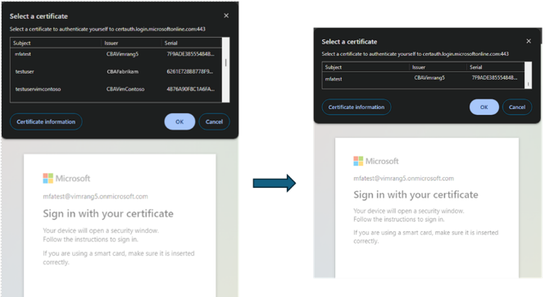
Security & Identity Updates
Microsoft Entra certificate-based authentication enhancements – Public Preview
MS released in public preview a new capability - issuer hints. The issuer hints feature greatly improves user experience by helping users to easily identify the right certificate for authentication.
When enabled by tenant admin, Entra will send back Trusted CA Indication as part of the TLS handshake. The trusted Certificate Authority (CA) list will be set to subject of the Certificate Authorities (CAs) uploaded by the tenant in the Entra trust store. The client or native application client will use the hints sent back by server to filter the certificates shown in certificate picker and will show only the client authentication certificates issued by the CAs in the trust store.
Microsoft Entra certificate-based authentication enhancements – GA
CBA username bindings, which CBA added support for three remaining username bindings and is now at parity with on-premises Active Directory. The three bindings that are being added are: IssuerAndSerialNumber, IssuerAndSubject, and Subject. More at Configure Username binding policy.
CBA Affinity Binding allows admins to set affinity binding at the tenant level, as well as create custom rules to use high affinity or low affinity mapping for covering many potential scenarios our customers have in use today. More at CBA Affinity Bindings.
CBA Authentication policy rules help determine the strength of authentication as either single-factor or multifactor. Multiple custom authentication binding rules can be created to assign default protection level for certificates based on the certificate attributes (Issuer or Policy Object Identifiers (OID) or by combining the Issuer and OID). More at Configure authentication binding policy.
Advanced CBA options in Conditional Access allow access to specific resources based on the certificate Issuer or Policy OIDs properties. More at authentication strength advanced options.

Slide 4
Security & Identity Updates
Security update to Entra ID affecting clients which are running old, unpatched builds of Windows
MS required a security update to Entra ID such that use of older unpatched version of Windows which still use the less secure Key Derivation Function v1 (KDFv1) will no longer be supported. Once the update is rolled out, unsupported and unpatched Windows 10 and 11 clients will no longer be able to sign in to Entra ID. Globally, more than 99% of Windows clients signing in to Entra ID have the required security patches.
If Windows devices have Security Patches after July 2021 no action is required.
Teams trial tenants blocked by default
Microsoft is introducing a new tenant-wide control for the federation configuration to block external access with trial-only tenants. The new control is called ExternalAccessWithTrialTenants and is set to Blocked by default.
Blocked means that users from trial tenants are unable to search for people or create federated chats with users in tenant and Teams will remove any users from trial tenants from existing chats.

Slide 5
Security & Identity Updates
Microsoft Fabric is compliant with SOC certifications
MS announced that Microsoft Fabric, our all-in-one analytics solution for enterprises, is now System and Organization Controls (SOC) 1 Type II, SOC 2 Type II, and SOC 3 compliant.
Visit Azure Compliance Offerings to find out what other compliance certifications Microsoft Fabric has to offer, or Microsoft Service Trusted Portal to learn more about each certification and detailed documentation
Microsoft Entra Suite now generally available
Microsoft Entra Private Access – an identity-centric Zero Trust Network Access that secures access to private apps and resources and reduces operational complexity and cost by replacing legacy VPNs.
Microsoft Entra Internet Access – an identity-centric Secure Web Gateway (SWG) for SaaS apps and internet traffic that protects against malicious internet traffic, unsafe or non-compliant content, and other threats from the open internet.
Microsoft Entra ID Governance – a complete identity governance and administration solution that automates identity and access lifecycle to ensure that the right people have the right access to the right apps and services at the right time.
Microsoft Entra ID Protection – an advanced identity solution that blocks identity compromise in real time using high-assurance authentication methods, automated risk and threat assessment, and adaptive access policies powered by advanced machine learning (also included in Microsoft Entra ID P2).
Microsoft Entra Verified ID - a managed verifiable credentials service based on open standards that enables real-time identity verification in a secure and privacy respecting way. Included in the Microsoft Entra Suite are premium Verified ID capabilities, starting with Face Check.

Slide 6
Management & Governance

Slide 7
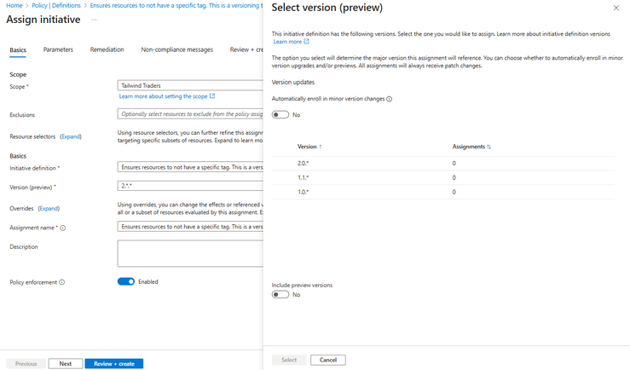
Management & Governance Updates
Public Preview Announcement: Azure Policy Built-in Versioning
Version management support for controlled built-in definition and initiative updates through Azure Policy. In a push to empower and simplify policy management, built-in definitions and initiatives will have the ability to store & reference multiple versions within a single definition ID. This new development will enhance ability to govern, enforce and evolve cloud governance policies.
Generally Available: Backup and restore of virtual machines with private endpoint enabled disks
This support is available for virtual machines using standard backup policies as well as enhanced backup policies and can be configured using standard Azure Backup experiences. Additionally, while initiating restores, it is also possible to specify the network access settings for restored disks- you can choose if you want the restored disks to use the same network configuration as the source disks, allow access from specific networks only, or allow public access from all networks.
Generally Available: Azure Site Recovery support for Azure Trusted Launch VMs (Windows OS)
MS announced the General Availability of Azure Site Recovery support for Azure Trusted Launch VMs. Azure Trusted Launch VMs provide foundational compute security to Azure Generation 2 VMs by enabling Secure Boot and vTPM capabilities. Please note that this general availability is for Windows OS only.
NOTE:
Support available only for Windows OS. Linux OS is currently not supported.
Trusted virtual machines with attached shared disks aren't currently supported.

Slide 8
Management & Governance Updates
Generally Available: Encryption using Customer Managed Keys for Backup Vaults
Azure Backup offers the ability to use own encryption keys for securing backup data. This capability is supported for Recovery Services Vaults and is extended for Backup Vaults. You can use Customer Managed Keys (CMK) when creating a new backup vault or update the encryption settings for an existing vault to use CMK. CMK for Backup Vaults is now generally available in all Azure Public regions.

Slide 9
Compute

Slide 10
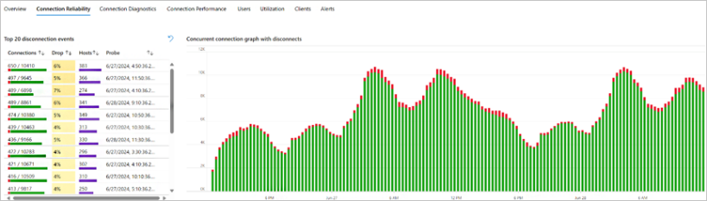
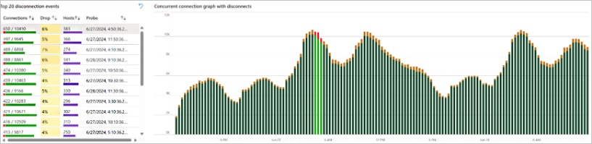
Compute Updates
Connection Reliability in Azure Virtual Desktop Insights
MS announced that the Connection Reliability tab in Azure Virtual Desktop Insights is now generally available. IT administrators can now monitor the connection resilience between users and Azure Virtual Desktop host pools. This gives administrators a simpler experience when it comes to understanding disconnection events and correlations between errors that affect their end users.
Update to Microsoft Desktop Virtualization API v. 2023-09-05 by August 2, 2024 to avoid any impact
Older Microsoft Desktop Virtualization API version(s) utilized for Azure Virtual Desktop host pool resource will no longer support ‘get’ actions for registration token retrieval as of August 2nd, 2024.
The affected API versions are as follows:
2019-01-23-preview
2019-09-24-preview
2019-12-10-preview
2020-09-21-preview
2020-11-02-preview
2020-11-10-preview
2021-01-14-preview
On August 2nd, 2024, these affected API versions will no longer support the retrieval of the registration token. Users on older versions will not be able to use the 'get' action to retrieve the token. However, with the newer versions, a new 'post' action can be used to securely retrieve the token

Slide 11
Compute Updates
General Availability Announcement: Azure VM Regional to Zonal Move
Azure released the general availability of the capability to convert regional VMs to a zonal configuration within the same region. This feature will enable to achieve better application resiliency and availability by helping move application to a zonal configuration. Also new features were added:
Built-In validation for SKU and capacity
Enhanced scale support
Azure Government and Sovereign Cloud regions support
NOTE: Downtime is required
Public Preview of the Windows Server Annual Channel for Containers on Azure Kubernetes Service
Now it is possible to use new channel version on AKS nodes as well as upgrade the current Windows Server 2022 clusters to the Windows Server Annual Channel for Containers, customers will need to create a new node pool with the new “Windows Annual Channel” OS SKU.

Slide 12
Storage & Data

Slide 13
Storage & Data Updates
Microsoft Fabric .NET SDK
MS Introduced the very first release of the Microsoft Fabric .NET SDK! This SDK version marks a significant milestone in providing a powerful and flexible platform for building applications that interact with Microsoft Fabric service.
Key features of the Microsoft Fabric .NET SDK include:
Cross-Platform Development: Build applications that run on Windows, macOS, and Linux.
Build in Utilities: Access a set of utilities to accelerate your development.
Modern Language Features: Leverage the latest features of C#.
Generally Available: Azure Elastic SAN Feature Updates
Azure released possibility to delete unused space on SANs and scale down as needed.
Azure release diagnostic logging capabilities that allows to configure the diagnostic settings of Elastic SAN to send Azure platform logs and metrics to different destinations. Currently, there are two log configurations:
All - Every resource log offered by the resource.
Audit - All resource logs that record customer interactions with data or the settings of the service. Audit logs are an attempt by each resource provider to provide the most relevant audit data, but might not be considered sufficient from an auditing standards perspective.

Slide 14
Databases

Slide 15
Databases Updates
Announcing the retirement of SQL Server Stretch Database
On November 16, 2022, the SQL Server Stretch Database feature was deprecated from SQL Server 2022. Effective July 9, 2024, the supporting Azure service, known as SQL Server Stretch Database edition, is retired. Impacted versions of SQL Server include SQL Server 2022, 2019, 2017, and 2016.
In July 2024, SQL Server Stretch Database will be discontinued for SQL Server 2022, 2019, 2017, and 2016.
Public Preview: Shrink for Azure SQL Database Hyperscale
MS announced in preview possibility to reduce the allocated size of a Hyperscale database using the same DBCC SHRINK* commands that are familiar with. This allows to reduce the size of the databases and free up unused space to save storage costs.
Known behaviors / limitations
Database shrink is a long-running operation. For larger databases, it may span multiple days. To avoid shrink getting interrupted, MS recommend using a client that is unlikely to get disconnected from the database.
While shrink is running, used and allocated space for the database in the Azure portal might not be reported.
Running SHRINKFILE with a target size slightly higher than the used space in the file tends to have a higher success rate compared to setting it to the exact used space. For instance, if a file is 128 GB in total size with 50 GB used and 78 GB free, setting the target size to 55 GB results in a better space reduction compared to using 50 GB.
When executing DBCC SHRINKFILE concurrently on multiple files, you may encounter occasional blocking between the sessions. This is expected and does not impact the outcome of shrink.
Shrinking of the transaction log file in the Hyperscale tier is not required as it does not contribute to the allocated data size and cost. Executing DBCC SHRINKFILE(2) has no effect on the transaction log size.

Slide 16
Databases Updates
Online Migration Capability for vCore-based Azure Cosmos DB for MongoDB in Azure Data Studio
MS announced a significant enhancement to the Azure Cosmos DB Migration for MongoDB extension! Now it is possible, seamlessly migrate MongoDB workloads to vCore-based Azure Cosmos DB for MongoDB with the added convenience of online migration capability.
Till now migrations were carried out offline, leading to substantial service interruptions lasting hours. With online migrations, the process is now seamless, minimizing disruptions.
Online migrations utilize the change stream feature to transfer data updates from the source database to the target database while minimizing downtime. Here’s how it works:
Initial Bulk Data Copy: During an online migration, an initial bulk data copy is performed to set up the target environment and move bulk of the data.
Change Stream Mechanism: Simultaneously, the migration tool continuously captures changes made to the source data using the change stream mechanism.
Instant GraphQL APIs with Hasura Data Connector for Azure Cosmos DB for NoSQL
MS launched a new Hasura native data connector that generates instant GraphQL APIs on Azure Cosmos DB for NoSQL.
Hasura DDN makes data access easy by enabling backend teams to effortlessly deliver a unified API on all data. With unparalleled on-demand composability, performance, security, and reliability baked in, frontend teams are empowered to ship new experiences faster.
The Hasura data connector for Azure Cosmos DB offers instant, real-time, and production-ready GraphQL APIs on top of Azure Cosmos DB for NoSQL.

Slide 17
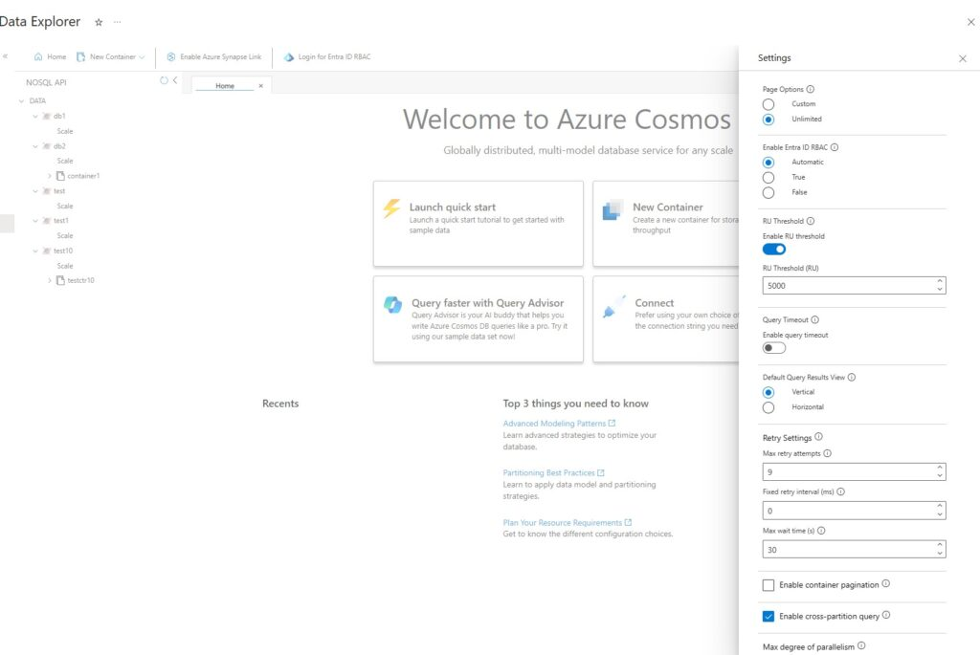
Databases Updates
Role-based access control in Azure Cosmos DB Data Explorer
Azure Cosmos DB Data Explorer is a web-based tool that allows to interact with data, run queries, and visualize results in Azure Cosmos DB. It is available in the Azure Portal and as a standalone web app.
RBAC allows to use Microsoft Entra ID identities to control data access in Data Explorer, instead of using account keys. This way, it is possible to grant granular permissions to different users and groups and audit their activities. RBAC also enables you to use features such as Entra ID Conditional Access and Entra ID Privileged Identity Management to further protect your data. It allows for finer-grained access control based on roles, reducing the risk associated with key management and distribution.
Previously, RBAC could only be used with the standalone app, and not directly within the Data Explorer in the Azure portal. Today you have enhanced capabilities, and you can use it within the Data Explorer in the portal and the standalone Data Explorer web app for your Azure Cosmos DB NoSQL accounts.

Slide 18
Databases Updates
Authenticating Microsoft Entra ID using windows principal metadata - Public Preview
MS Announced the public preview for Native Windows Principals for SQL Managed Instance. This capability simplifies the migration to SQL Managed Instance and unblock the migration of legacy applications that are tied to windows logins.
The Windows authentication metadata mode is a new mode that allows users to use Windows authentication or Microsoft Entra authentication (using a Windows principal metadata) with Azure SQL Managed Instance. This mode is available for SQL Managed Instance only. The Windows authentication metadata mode isn't available for Azure SQL Database

Slide 19
Miscellaneous

Slide 20
Miscellaneous Updates
New and Free Azure Arc Applied Skill Credential
Microsoft recently launched a brand new Applied Skill Credential related to deploying and managing Azure Arc enabled servers.
Specific skills include:
Deploy Azure resources by using an Azure Resource Manager template.
Implement the operating system prerequisites for connecting Azure VMs to Azure Arc.
Prepare for connecting on-premises servers to Azure Arc.
Connect a Windows Server to Azure Arc by using Windows Admin Center.
Connect Windows servers to Azure Arc non-interactively at scale.
Create a policy assignment for Azure Arc-enabled Windows servers.
Evaluate results of the policy assignment.
Configure Microsoft Defender for Cloud-based protection of Azure Arc-enabled Windows servers.
Review the Microsoft Defender for Cloud-based protection of Azure Arc-enabled Windows servers.
Configure VM Insights for Azure Arc-enabled Windows servers.
Review the monitoring capabilities of Azure Arc-enabled Windows servers.
Configure Update Manager for Azure Arc-enabled Windows servers
Retirement: Azure Cloud Services Guest OS Families 2, 3, and 4
In July 2024, Azure announced the upcoming retirement of Guest OS Families 2, 3, and 4 for Cloud Services and Cloud Services Extended Support. The end-of-life dates are as follows: Windows Server 2008 R2 will retire in December 2024, while Windows Server 2012 and Windows Server 2012 R2 will retire in February 2025. Customers utilizing these OS families need to take action to ensure their cloud services remain supported.

Slide 21
Information

Slide 22
Information
Azure Times GitHub Repo

Slide 23
Questions

