Slide 1
Azure Times #127
July 19, 2024

Slide 2
Networking

Slide 3
Networking Updates
Generally Available: ExpressRoute FastPath Support for Vnet Peering & UDR
The data flow between On-Premises and Azure using ExpressRoute is asymmetric by design.
The traffic from On-Premises to Azure transits via the ExpressRoute Gateway, but the return traffic (Azure to On-Premises) bypasses the ExpressRoute Gateway and is forwarded directly to the MSEEs.
FastPath on ExpressRoute Direct circuit connections now also honors:
UDRs on the Gateway subnet
VNet peering within the same region: traffic coming from On-Premises will be sent directly to VMs in spoke VNets, bypassing the ExpressRoute Gateway (global VNet peering is not supported).
When FastPath is enabled, it enhances data path performance, and instead of routing through the gateway, FastPath sends network traffic directly to virtual machines within the virtual network, reducing the number of hops and potential bottlenecks. FastPath still requires a virtual network gateway to be created to exchange routes between the virtual network and on-premises network
Current constraints and limitations:
IP address limit
Private Endpoint/Private Link
FastPath is available in Hub & Spoke environments only, and currently not supported in vWAN.

Slide 4
Networking Updates
Generally Available: ExpressRoute Traffic Collector support for provider circuits
Azure ExpressRoute customers are now able to configure ExpressRoute Traffic Collector on 1G+ provider circuits. This is an expansion of the existing service which previously only supported ExpressRoute Direct circuits.
ExpressRoute Traffic Collector is a fully managed traffic monitoring solution built for ExpressRoute. ExpressRoute Traffic Collector logs IPFIX flow records that can then be queried to gain improved visibility into circuit traffic.
Flow logs are collected at an interval of every 1 minute. All packets collected for a given flow get aggregated and imported into a Log Analytics workspace for further analysis. During flow collection, not every packet is captured into its own flow record. ExpressRoute Traffic Collector uses a sampling rate of 1:4096, meaning 1 out of every 4096 packets gets captured.
Generally Available: Azure Virtual Network Manager mesh and direct connectivity
This feature enables a group of virtual networks to directly communicate to each other without an additional hop, thus improving the latency and management overhead of establish each virtual network's desired connectivity.
For example, it is possible to use this feature to let a subset of the spoke virtual networks in a hub and spoke topology that require low latency to directly communicate to each other. The traffic between these virtual networks can be filtered using network security groups (NSGs) and Azure Virtual Network Manager's security admin rules while still maintaining this direct connectivity. To learn more about security admin rules and their use cases, please see our public documentation on security admin rules.

Slide 5
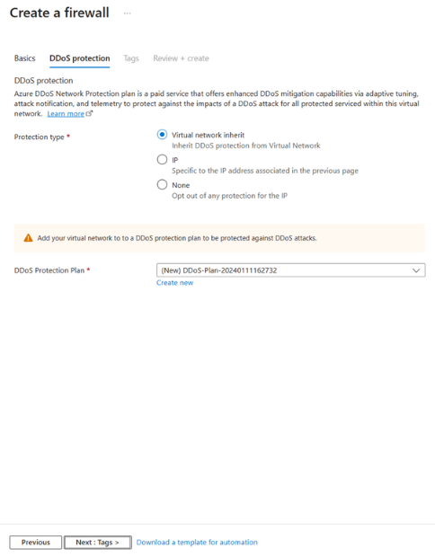
Networking Updates
Portal extension for Azure Firewall with DDoS protection
MS integrated DDoS protection configuration into Azure Firewall creation wizard

Slide 6
Security & Identity

Slide 7
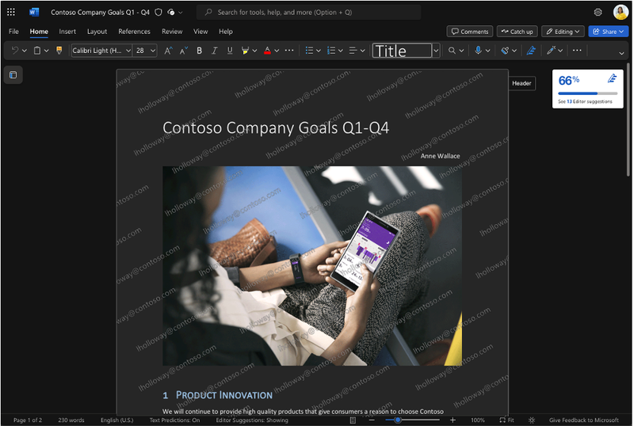
Security & Identity Updates
(Preview) Dynamic watermarking for sensitivity labels in Word, Excel, and PowerPoint
The future is aimed to both deter users from leaking sensitive information and attribute leaks if they do occur. This feature is rolling out to a public preview, with full general availability planned for later in 2024.
Dynamic watermarks contain the UPN (email address) associated with the account being used to open the file

Slide 8
Management & Governance

Slide 9
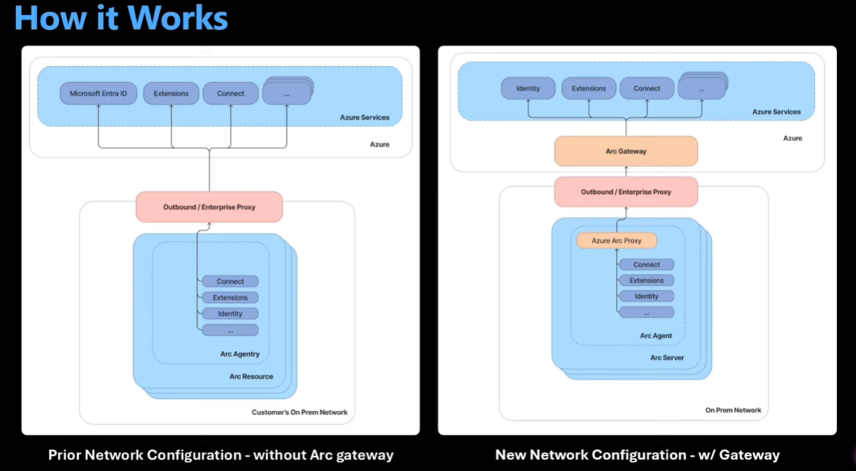
Management & Governance Updates
Azure ARC Gateway is in Public Preview
Today Azure Arc require around 15 endpoints for basic scenario and 150+ for all scenarios.
Azure ARC Gateway is aimed to reduced amount of endpoint that must be opened in the enterprise proxies & firewalls
Azure ARC Gateway has 2 components:
Arc Gateway – created in the Azure Cloud and will be a common gateway for all scenarios
Azure Arc Proxy – a component that routes all traffic to the Azure ARC Gateway
Agent and Gateway Extensions in Azure Monitor SCOM MI
A new capability that allows you to initiate monitoring on Azure and Arc enabled Windows machines at-scale and programmatically.
Extensions for Agents and Gateways offer the following benefits:
Monitor workloads everywhere
At-scale deployment
Transition at your pace
Secure and latest by default
Following are the supported Windows versions that can be monitored using SCOM Managed Instance:
Windows 2022
Windows 2019
Windows 2016
Windows 2012 R2
Windows 2012

Slide 10
Compute

Slide 11
Compute Updates
Public Preview: Upgrade existing Azure Gen1/Gen2 VMSS to Gen2-Trusted launch
MS announced preview support to enable Trusted launch on existing Azure Gen1/Gen2 Virtual Machine Scale Sets (VMSS) Uniform by upgrading the VMSS Uniform resource to Gen2-Trusted launch. This will help improve the foundational security of existing Azure VMSS resources.
Trusted Launch VMs provide Secure Boot and vTPM capabilities. Trusted Launch capabilities protect OS against rootkits, boot kits and enables attestation by measuring the boot chain of VM.
Generally Available: Redis extension for Azure Functions
The extension can be used as a trigger in Azure Functions, allowing Redis to initiate a serverless workflow. This functionality can be highly useful in data architectures like a write-behind cache, or any event-based architectures.
The Redis extension also supports Azure Functions input and output bindings. The input binding facilitates data retrieval from a cache, and this retrieved data can be passed into a function as an input parameter. The output binding allows users to change keys in a cache.
Redis triggers are currently only supported for functions running in either a Elastic Premium plan or a dedicated App Service plan.

Slide 12
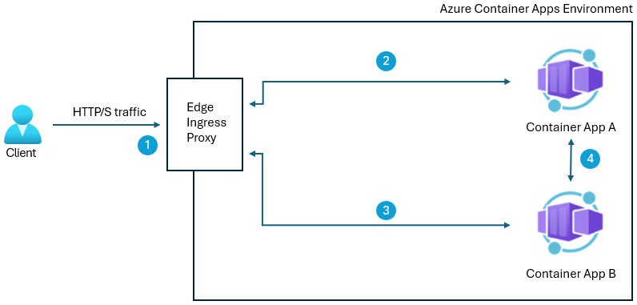
Compute Updates
Retirement: Azure Synapse Runtime for Apache Spark 3.3
End of Support for Azure Synapse Runtime for Apache Spark 3.3 was announced on July 12th, 2024. MS recommend that upgrade Apache Spark 3.3-based workloads to Azure Synapse Runtime for Apache Spark 3.4 - Azure Synapse Analytics
Generally Available: Azure Container Apps support for peer-to-peer encryption
Azure Container Apps support for environment level peer-to-peer Transport Level Security (TLS) encryption is now generally available. By enabling the peer-to-peer encryption feature, all network traffic within the environment will be TLS encrypted with a private certificate that is valid within the Azure Container Apps environment scope. These certificates are automatically managed by Azure Container Apps.
Retirement: Azure Synapse Runtime for Apache Spark 3.2
On July 8, 2024, extended support for Azure Synapse Runtime for Apache Spark 3.2 will end, and the runtime will be deprecated as of that day and soon disabled. Retired runtimes are unavailable for new Spark pools. We recommend you upgrade your workloads to Azure Synapse Runtime for Apache Spark 3.4 (GA).

Slide 13
Compute Updates
Generally Available: Support for .NET 8 using the in-process model in Azure Functions
The in-process model for .NET applications on Azure Functions now supports .NET 8. Initial support covers Windows apps outside of App Service Environment deployments.
To date, apps using the in-process model in the Azure Functions V4 runtime have run on .NET 6, and support for .NET 6 ends on 12 November 2024. These apps can upgrade to .NET 8 either by migrating to .NET 8 on the isolated worker model or by leveraging this new in-process option for .NET 8.
As a reminder, support for the in-process model for .NET on Azure Functions ends 10 November 2026. Function authors that choose this in-process model option for .NET 8 should still begin planning a migration to the isolated worker model prior to that date.
Announcing Preview of New Azure Dlsv6, Dsv6, Esv6 VMs with new CPU, Azure Boost, and NVMe Support
New VMs powered by the latest 5th Generation Intel® Xeon® processor. They come with three different memory-to-core ratios and offer options with and without local SSD across the VM families: the General Purpose Dlsv6, Dldsv6, Dsv6, and Ddsv6 series and the Memory Optimized Esv6 and Edsv6 series.
Up to 17% better performance
3X larger L3 cache
Up to 192vCPU and >18GiB of memory
Azure Boost which enables:
Up to 400k IOPS and 12 GB/s remote storage throughput
Up to 200 Gbps VM network bandwidth
46% larger local SSD capacity and >3X read IOPS
NVMe interface for local and remote disks
Enhanced security through Total Memory Encryption (TME) technology

Slide 14
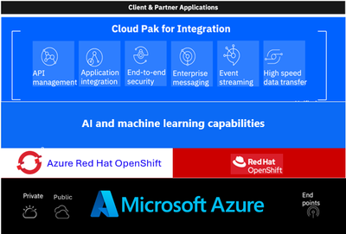
Compute Updates
IBM Cloud Pak for Integration on Azure Red Hat OpenShift Now Generally Available
Cloud Pak for Integration is a hybrid integration platform that brings together a comprehensive set of integration components optimized to work together, deployed on Red Hat® OpenShift®.
Generally Available: Support for Azure Key Vault certificates in Azure Container Apps
It is now possible to use Azure Key Vault to store and manage own TLS/SSL certificates for Azure Container Apps at the environment level.
This follows security best practices by leveraging managed identities and simplifies management tasks like auto-rotation.
Public Preview: Managed identity support for scaling rules in Azure Container Apps
It is now possible to use managed identities in scale rules to authenticate with supported Azure services. This can be done using the Azure CLI or Azure Resource Manager (ARM.) We recommend using managed identity whenever possible to avoid storing secrets within the app.

Slide 15
Storage & Data & Analytics

Slide 16
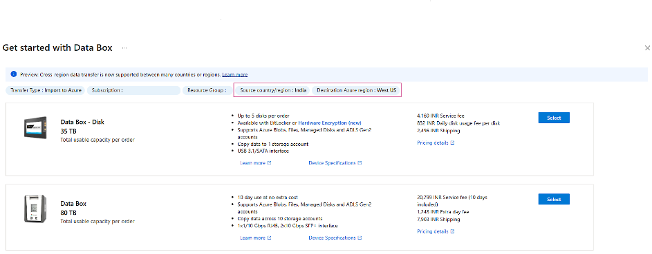
Storage & Data & Analytics Updates
Public Preview: Azure Data Box now supports select cross region transfers
MS announced that Azure Data Box cross-region data transfer capabilities, now in preview, supports seamless ingest of on-premises data from a source country/region to select Azure destinations in a different country/region.
For example, with this capability, it is now possible to copy on-premises data from Singapore or India to the West US Azure destination region.
Note that the Azure Data Box device isn't shipped across commerce boundaries.
Instead, it's transported from/to an Azure data Center within the originating country or region where the on-premises data resides. Data transfer to the destination Azure region takes place across the Azure network and incurs no additional fee.

Slide 17
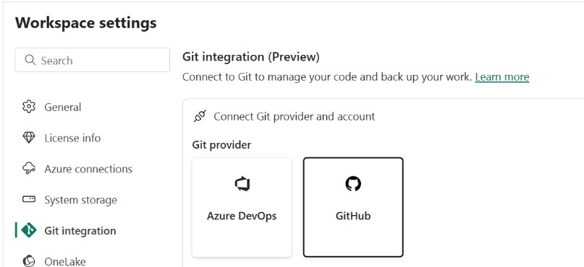
Storage & Data & Analytics Updates
Announcing GitHub integration for source control (Preview)
Fabric developers can easily choose GitHub as their source control tool, and version their Fabric items there.
Announcing the General availability of time travel and 30 days of data retention in Fabric Warehouse
MS increased data retention period to 30 calendar days from 7 calendar days and announce the General availability of Time travel at the T-SQL Statement level.
Announcing Fabric API for GraphQL pricing
API for GraphQL in Microsoft Fabric allows data engineers and scientists connect to different Fabric data sources in seconds, use the APIs in their workflows, or share the API endpoints with app development teams to speed up business data analytics application development.
API for GraphQL in Fabric starts billing on July 12th, 2024

Slide 18
Databases

Slide 19
Databases Updates
General Availability: Major version upgrade support for PostgreSQL 16
Azure Database for PostgreSQL - Flexible Server now supports in-place major version upgrades to PostgreSQL 16.
Key Benefits include:
Enhancements like pg_stat_io for I/O monitoring, improved query execution, and advanced replication.
The ability to upgrade directly without data migration or changing server settings.
A streamlined process ensuring a smooth transition with reduced production disruptions.
Note:
An in-place major version upgrade is an offline operation that results in a brief period of downtime. The downtime is typically less than 15 minutes. The duration can vary, depending on the number of system tables involved.
Please run the ANALYZE command in each database to refresh the pg_statistic table.
General Availability: Pgvector 0.7 support in Azure Database for PostgreSQL – Flexible Server
This updated version of pgvector provides multiple performance improvements including:
Support for binary vectors using the bit type with indexing up to 64,000 dimensions
Support for quantizing vectors using expression indexes
Support for HNSW indexing for L1 distance operations
Pgvector 0.7 also adds two new vector types
halfvec: 2-byte floats with support to index up to 4,000 dimensions
sparsevec: a vector where most of its elements are zero with support for up to 1,00 nonzero dimensions
Lastly, gvector 0.7 introduces new distance functions including hamming_distance and jaccard_distance for bit vectors.

Slide 20
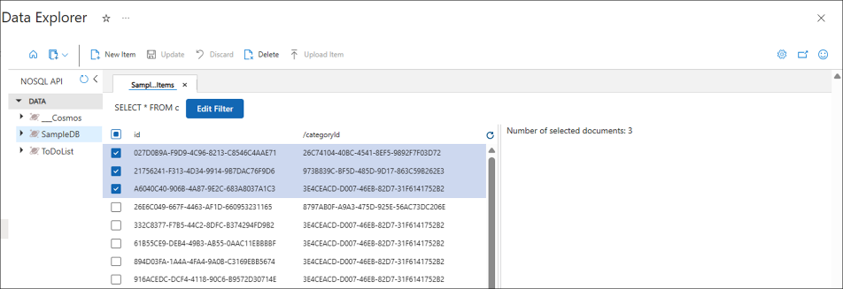
Databases Updates
General Availability: Latest PostgreSQL minor versions supported by Azure Database for PostgreSQL - Flexible Server
PostgreSQL minor versions 16.3, 15.7, 14.12, 13.15, and 12.19 are now supported by Azure Database for PostgreSQL – Flexible Server.
These minor version upgrades are automatically performed as part of the monthly planned maintenance in Azure Database for PostgreSQL – Flexible Server. This upgrade automation ensures that databases are always running on the most secure and optimized versions without requiring manual intervention. This release fixes two security vulnerabilities and over 40 bugs.
General Availability: Multi-select delete in Azure Cosmos DB with Data Explorer
Azure announced new deletion capabilities in the Data Explorer experience. With the new multi-select capability, it is possible to select multiple items to delete at the same time. It is no longer needed to open each item and click on the Delete button one at a time. Gain efficiencies in database maintenance within Azure Cosmos DB Data Explorer with this new feature.

Slide 21
Databases Updates
Generally Available: Update records in a Kusto Database
This command allows you to update records by deleting existing records and appending new ones in a single transaction.

Slide 22
ML & AI & IOT

Slide 23
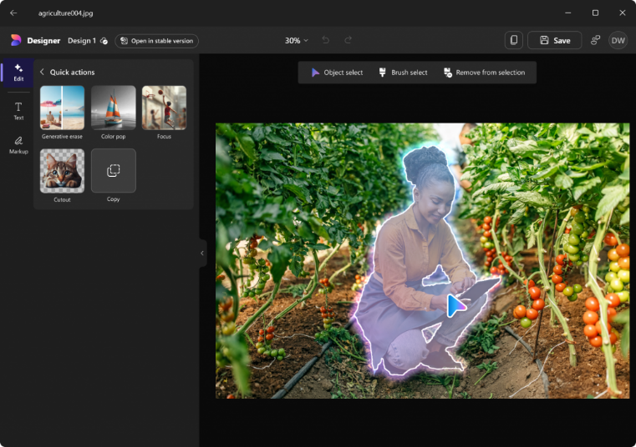
ML & AI & IOT Updates
Microsoft Photos integrates AI editing with Designer
MS mproved the user experience – from loading a separate webpage to now offering a fully integrated Designer image editing experience that lets easily edit photos like an expert
Copilot for Microsoft 365 now supports Traditional Chinese
OneNote Copilot now supports inked notes
now Copilot is able to analyze both typed text and handwritten (inked) notes in OneNote, both via the ribbon and from the canvas!
Fast Transcription Public Preview in Azure AI Speech
It allows customers and developers to transcribe audio file to text accurately and synchronously, with a high speed factor.
Fast Transcription service includes latest end-to-end model technologies, with best quality and super high Speed Factor leveraging GPU inference (it can transcribe a 30-minute audio file in less than 1 minute).

Slide 24
DevOps & IaC & Automation

Slide 25
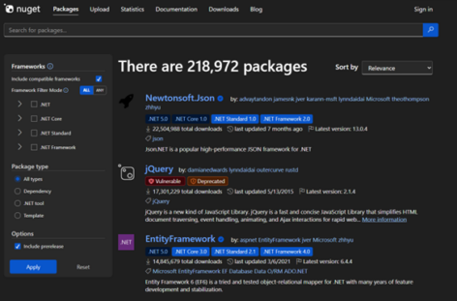
DevOps & IaC & Automation
Dark Mode Now Available on NuGet.org
Azure Verified Modules - Monthly Update [June]
Language | Published | In development
Bicep | 214 | 49
Terraform | 44 | 24

Slide 26
Miscellaneous

Slide 27
Miscellaneous Updates
Retirement: Azure Lab Services is being retired on June 28, 2027
Azure Lab Services will be retired on June 28, 2027 because of the availability of other Microsoft VDI services such as Azure Virtual Desktop, Windows 365, Azure DevTest Labs, and Microsoft Dev Box.
If these services don’t meet requirements, then we are suggesting that review and choose one of the recommended partner solutions. Review the retirement guide for more details about the partner options.
If you are an existing customer of Azure Lab Services, you can continue to use the service till June 28, 2027. New customers, however, will not be allowed to sign up for the service starting July 15, 2024. We are committed to support you till June 28, 2027 for the service. After this date Azure Lab Services won’t be supported, and you will not have access to your lab accounts, lab plans, or labs.
Retirement: API “Microsoft.AlertsManagement alerts 2018-05-05-preview”
The API “Microsoft.AlertsManagement alerts 2018-05-05-preview” that is in preview mode will be deprecated from the date 10-10-2024.
After 10-10-2024, ARM will return that the “API version is not supported”.
Azure DevOps Server 2022.2 RTW now available

Slide 28
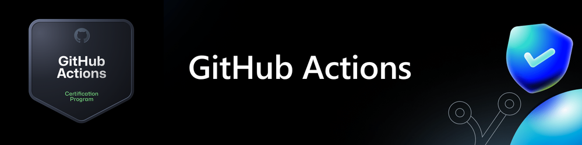
Miscellaneous Updates
Study guide: GitHub Actions certification
Domain 1: Author and maintain workflows
Workflow syntax for GitHub Actions
Events that trigger workflows
Configuring workflows
Using actions in workflows
Managing workflow runs
Workflow commands
Domain 2: Consume workflows
Interpreting the effects of a workflow
Viewing workflow run history and details
Workflow status badges
Domain 3: Author and maintain actions
Creating actions
Action metadata syntax
Domain 4: Manage GitHub Actions in the enterprise
Managing GitHub Actions in your enterprise
Setting up self-hosted runners
Managing access to self-hosted runners

Slide 29
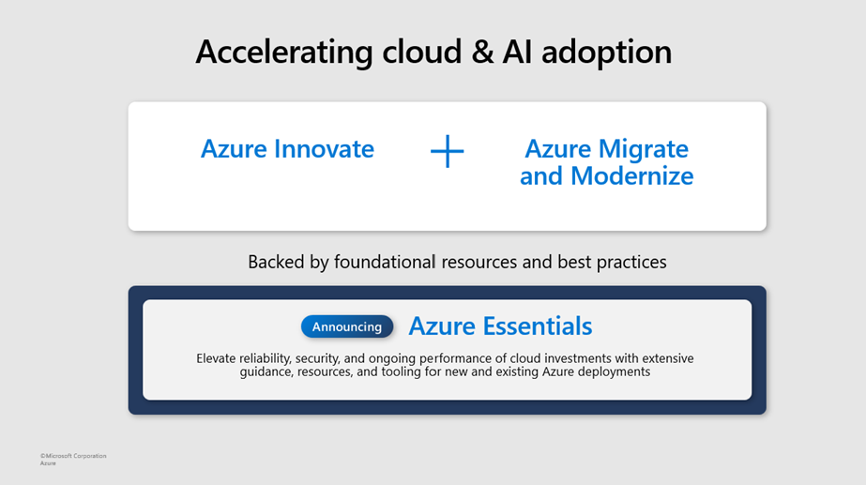
Miscellaneous Updates
Azure Essentials
Azure Essentials brings together Microsoft's best practices, product experiences, reference architectures, skilling, and our array of resources into a single destination to help you maximize the value of your investments on Azure. Built upon Microsoft and industry best practices, Azure Essentials offers detailed guidance, as a resource kit, tailored to your specific business scenarios.

Slide 30
Information

Slide 31
Information
Azure Times GitHub Repo

Slide 32
Questions

