Slide 1
Azure Times #143
December 2, 2024

Slide 2
Security & Identity

Slide 3
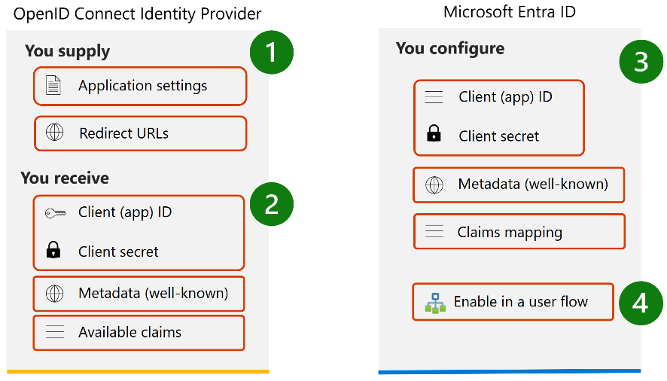
Security & Identity Updates
Entra ID Connect
Updated Features
SQL related drivers shipped with Microsoft Entra Connect have been updated to OLE DB version 18.7.4
Bug fixes
Fixed an issues with Privileged Identity Management (PIM), Microsoft Entra roles, and PIM for Groups to verify that PIM is enabled and that the user has the Hybrid Identity Administrator role enabled.
Fixed an issue where AD FS commands were failing when Connect Sync is installed on a non-ADFS server.
Announcing the Public Preview of OpenID Connect external identity provider support for Microsoft Entra External ID
MS announced the Public Preview of OpenID Connect (OIDC) identity provider support in Microsoft Entra External ID. This new functionality allows to federate sign-in and sign-up user flows with identity providers using the OAuth 2.0 authorization standard and OpenID Connect specifications.
Enabling users to access applications with existing accounts from other identity providers offers two key benefits: it enables partner integrations through identity federation, and it allows users to sign in using their existing identities instead of creating new credentials associated with their accounts. This streamlined approach supports partnerships and improves conversion rates and user satisfaction.

Slide 4
Security & Identity Updates
New support for mapping Azure API Management API endpoints to backend compute
Defender for Cloud's API security posture now supports mapping API endpoints published through Azure API Management Gateway to backend compute resources, such as virtual machines, in the Defender Cloud Security Posture Management (Defender CSPM) Cloud Security Explorer. This visibility helps identify API traffic routing to backend cloud compute destinations, enabling to detect and address exposure risks associated with API endpoints and their connected backend resources.
Enhanced support for API sensitive data classification
Microsoft Defender for Cloud extends API Security sensitive data classification capabilities to API URL path and query parameters along with API request and responses, including the source of sensitive information found in the API properties. This information will be available in the Attack Path Analysis experience, the Cloud Security Explorer's Additional Details page when API Management operations with sensitive data are selected, and on the API Security Dashboard under the Workload Protections within API collection details page, with a new side context menu that provides detailed insights into sensitive data found, enabling security teams efficiently locate and mitigate data exposure risks.

Slide 5
Security & Identity Updates
Enhanced Kubernetes (K8s) Alert Documentation and Simulation Tool
Scenario-based alert documentation: K8s alerts are now documented based on real-world scenarios, providing clearer guidance on potential threats and recommended actions.
Microsoft Defender for Endpoint (MDE) integration: Alerts are enriched with additional context and threat intelligence from MDE, improving the ability to respond effectively.
New Simulation Tool: A powerful simulation tool is available to test security posture by simulating various attack scenarios and generating corresponding alerts.
Enhanced container protection with vulnerability assessment and malware detection for AKS nodes (Preview)
Defender for Cloud now provides vulnerability assessment and malware detection for the nodes in Azure Kubernetes Service (AKS), and provides clarity in the shared security responsibility have with the managed cloud provider.
Providing security protection for these Kubernetes nodes allow to maintain security and compliance across the managed Kubernetes service.
To receive the new capabilities, the agentless scanning for machines option must be enabled in the Defender CSPM, Defender for Containers, or Defender for Servers P2 plan in subscription.

Slide 6
Security & Identity Updates
Sensitivity scanning capabilities now include Azure file shares (Preview)
Defender for Cloud's Security Posture Management (CSPM) sensitivity scanning capabilities now include Azure file shares (in preview) in addition to blob containers.
Before this update, enabling the Defender CSPM plan on a subscription would automatically scan blob containers within storage accounts for sensitive data. With this update, Defender for CSPM's sensitivity scanning feature now includes file shares within those storage accounts. This enhancement improves the risk assessment and protection of sensitive storage accounts, providing a more comprehensive analysis of potential risks.
Defender for Storage Malware Scanning for blobs up to 50GB (Preview)
Starting on December 31, 2024, Defender for Storage Malware Scanning will support blobs up to 50GB in size (previously limited to 2GB).
Please note that for storage accounts where large blobs are uploaded, the increased blob size limit will result in higher monthly charges.
To avoid unexpected high charges, please set an appropriate cap on total GB scanned per month.

Slide 7
Security & Identity Updates
Agentless code scanning in Microsoft Defender for Cloud (preview)
Agentless code scanning in Microsoft Defender for Cloud is now available for public preview. It offers fast and scalable security for all repositories in Azure DevOps organizations with one connector. This solution helps security teams find and fix vulnerabilities in code and infrastructure as code (IaC) configurations across Azure DevOps environments. It doesn't require agents, changes to pipelines, or interruptions to developer workflows, making setup and maintenance simple. It works independently from continuous integration and continuous deployment (CI/CD) pipelines. The solution provides continuous and automated insights to speed up risk detection and response, ensuring security without interrupting workflows.
On-demand malware scanning in Microsoft Defender for Storage (Preview)
On-demand malware scanning in Microsoft Defender for Storage, now in public preview, enables scanning of existing blobs in Azure Storage accounts whenever needed. Scans can be initiated from the Azure portal UI or via the REST API, supporting automation through Logic Apps, Automation playbooks, and PowerShell scripts. This feature uses Microsoft Defender Antivirus with the latest malware definitions for every scan and provides upfront cost estimation in the Azure portal before scanning.
Use cases:
Incident response: Scan specific storage accounts after detecting suspicious activity.
Security baseline: Scan all stored data when first enabling Defender for Storage.
Compliance: Set automation to schedule scans that help meet regulatory and data protection standards.

Slide 8
Security & Identity Updates
AI security posture management is now generally available (GA)
Defender for Cloud's AI security posture management features are now generally available (GA).
Defender for Cloud reduces risk to cross cloud AI workloads by:
Discovering generative AI Bill of Materials (AI BOM), which includes application components, data, and AI artifacts from code to cloud.
Strengthening generative AI application security posture with built-in recommendations and by exploring and remediating security risks.
Using the attack path analysis to identify and remediate risks.
JFrog Artifactory container registry support by Defender for Containers (Preview)
This feature extends Microsoft Defender for Containers coverage of external registries to include JFrog Artifactory. JFrog Artifactory container images are scanned using Microsoft Defender Vulnerability Management to identify security threats and mitigate potential security risks.

Slide 9
Management & Governance

Slide 10
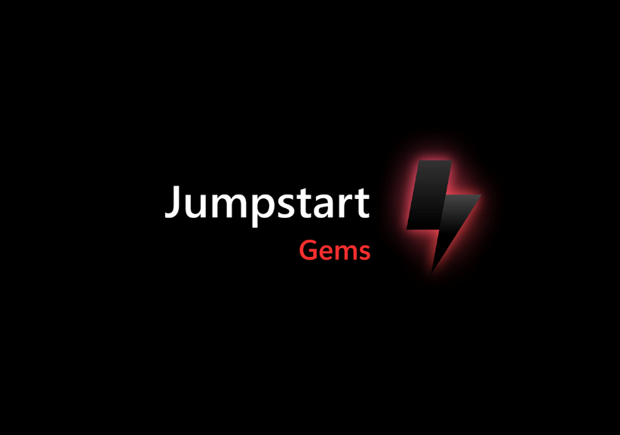
Management & Governance Updates
Introducing Jumpstart Gems
It provides a set of artifacts such diagrams, wallpapers and details of the Azure ARC JumpStart.
GA: Regional Disaster Recovery by Azure Backup for AKS
MS announced the general availability (GA) of Vaulted Backup support in Azure Backup for Azure Kubernetes Service (AKS). This new feature helps organizations meet compliance requirements, enhance operational resilience, and protect cloud-native applications from regional disasters.
Key Benefits for Azure Customers:
Disaster Recovery Across Regions: Cross-Region Restore supports critical failover capabilities, ensuring business continuity and disaster recovery compliance
Regulatory Compliance: Achieve long-term retention (LTR) for up to 10 years to meet global compliance frameworks.
Enhanced Security & Cyber Resilience: Immutable vaults and role-based access control protect backup data from ransomware and unauthorized access.

Slide 11
Management & Governance Updates
Public Preview: New graph operators in Kusto
MS announced the release of two powerful new graph operators in Kusto: graph-shortest-path and graph-mark-components.
The graph-shortest-paths operator is designed to streamline the process of finding the shortest paths between nodes in a graph. This operator efficiently identifies the shortest routes between a set of source nodes and a set of target nodes, returning a table with the.
The graph-mark-components operator is designed to mark all connected components of a graph and assign each node with a unique component identifier.
Both operators are now available in public preview, offering users the opportunity to explore and utilize these powerful tools in their graph analysis tasks. We invite to try out these new features and experience the enhanced capabilities they bring.
GA: Star pattern and default node identifier in Kusto
MS announced two powerful new features in Kusto Graph Semantics:
The star pattern allows users to express nonlinear patterns using comma-delimited sequences, making it particularly useful for describing connections where different sequences share one or more variable names of a node.
Additionally, the new approach for defining the default node identifier simplifies the process of creating a graph from a tabular expression of edges. By setting a default node identifier in make-graph, it is readily available for the constraints section of the subsequent graph-match operator. These features are now generally available.

Slide 12
Management & Governance Updates
Microsoft Cost Management updates—November 2024
Cost Management updates for November 2024:
Export to Microsoft Fabric preview signup.
New Azure OpenAI view in Cost analysis.
Estimate costs for Azure OpenAI in Copilot for Azure.
Build Cost analysis views in Copilot for Azure.
New ways to save money with Microsoft cloud:
Storage account default egress limit increase to 200 gbps.
Azure backup reduced protected instance fees hana backup.
Linux VM promotional offer.
Autoscale in vCore based Azure Cosmos DB for MangoDB (Preview).
Extended security updates enabled by Azure Arc.
New capabilities to aid Migration and Hybrid Cloud Management (Preview).
Documentation updates Azure OpenAI, Red Hat Linux, and Nutanix reservations
Azure Migrate Updates
Support for migrating Enterprise Linux machines (RHEL and SLES) in VMware and Hyper-V environments to Azure, leveraging Azure Hybrid benefit.

Slide 13
Compute

Slide 14
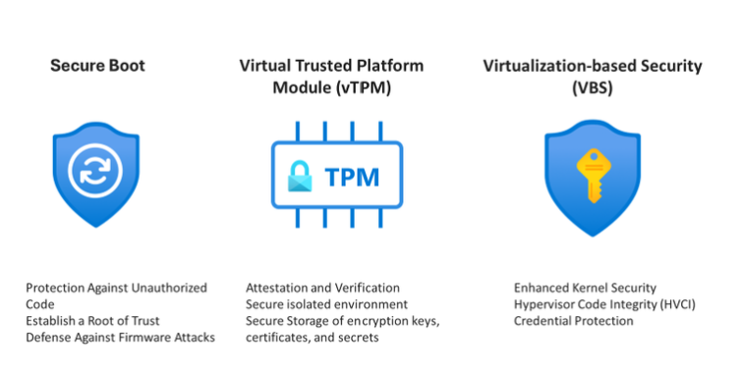
Compute Updates
Generally Available: Trusted Launch for Azure VMware Solution
This powerful feature combines Secure Boot, vTPM, and VBS to create a robust security layer for virtual environment.
By enabling trusted boot processes and secure hardware emulation, Trusted Launch helps protect VMs from advanced threats. This not only ensures compliance with the latest security standards but also unlocks the potential for running modern operating systems like Windows 11.
What's new in Windows 365 Enterprise
Windows 365 Frontline in shared mode (preview) - Windows 365 Frontline in shared mode gives the ability to provision a collection of Cloud PCs that can be used across multiple users mapped to a Microsoft Entra ID group. One active Cloud PC is permitted per license.
Use Citrix HDX Plus with Windows 365 Frontline – It is now possible to use Citrix HDX Plus with Windows 365 Frontline Cloud PCs.
Support for FIDO devices and passkeys on macOS and iOS - Windows App and the Remote Desktop app for macOS and iOS now support FIDO devices and passkeys for Microsoft Entra ID sign in on brokered and unbrokered devices.

Slide 15
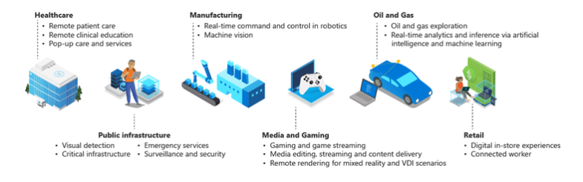
Compute Updates
Azure Virtual Desktop Metadata Database available in South Africa
Azure Virtual Desktop metadata service is now generally available in South Africa North, extending the service’s regional database capability to meet your organization’s needs.
When you create host pools, the metadata for those host pool objects is only stored within the geography selected and replicated to the Azure paired region for disaster recovery purposes.
Azure Virtual Desktop now supports Azure Extended Zones
Azure Virtual Desktop now supports the ability to deploy session host virtual machines in Azure Extended Zones. This reflects commitment to providing organizations with a broad selection of Azure locations to run their workloads.

Slide 16
Compute Updates
Windows Server 2025 is now supported in Azure Virtual Desktop
Windows Server 2025 is now supported in Azure Virtual Desktop to be deployed as a session hosts to provide desktops and applications.
Dynamic autoscaling for Azure Virtual Desktop is now in preview
Dynamic autoscaling is now in preview for Azure Virtual Desktop. This new scaling method can adjust the available capacity in the host pool by creating, deleting, and/or turning on/off session hosts. Dynamic autoscaling can only be used for pooled host pools with session host configuration.
Azure Virtual Desktop for Azure Stack HCI is now Azure Virtual Desktop for Azure Local
All current features and existing pricing for AVD for Azure Stack HCI are now supported in select versions of AVD for Azure Local.

Slide 17
Storage & Data

Slide 18
Storage & Data Updates
Announcing REST APIs for Fabric Eventstream
These new APIs are designed to automate development workflows for Eventstream, making it easier and faster for team to build robust streaming solutions. With the Eventstream REST API, it is now possible to programmatically create, manage, and update Eventstream items, reducing manual work and the potential for errors. This enhances productivity, minimizes costs, and helps your team focus on building complex streaming solutions efficiently.
Eventstream CI/CD – Git Integration and Deployment Pipeline
MS announced the CI/CD support in Fabric Eventstream, designed to enhance team collaboration, version control, and deployment processes. With Fabric’s Git integration and deployment pipelines, users can now work more efficiently on shared projects, track changes seamlessly in a Git repository, and deploy Eventstream updates confidently across different environments.
Git Integration: Allows sync workspace to a Git repository, such as Azure DevOps or GitHub, allowing for easy tracking of incremental changes, team collaboration, and commit history. Once synced, it is possible to edit the Eventstream definition—such as adding new sources or updating processing logic—directly in the Git repository, then update the Eventstream items in your workspace.
Deployment Pipelines: This feature enables allows to deploy Eventstream items across various environments (e.g., development, testing, and production workspaces). It simplifies the deployment lifecycle, giving control over each stage and ensuring that updates flow smoothly across environments.

Slide 19
Storage & Data Updates
Announcing the General Availability of Activator
Fabric Activator is a no-code experience in Microsoft Fabric for automatically taking actions when patterns or conditions are detected in changing data. It monitors data in Power BI reports and eventstreams, for when the data hits certain thresholds or matches other patterns. It then automatically takes appropriate action such as alerting users or kicking off Power Automate workflows.
Activator allows to build a digital nervous system that acts across all data, at scale, and in a timely manner. Business users can describe business conditions in a no-code experience to launch actions such as email, Teams notifications, Power Automate flows, and call into third party action systems. Business users can self-serve their needs and reduce their reliance on internal IT and developer teams, either of which is often costly and hinders agility. Customer organizations don’t need a developer team to manage and maintain custom in-house monitoring or alerting solutions.
Announcing new event categories in Fabric Real-Time Hub
Real-Time Hub enables to easily discover, manage, and consume data-in-motion from a wide variety of streaming sources. The hub provides a unified space to access and oversee all streams and events within your organization.
MS announced a new event categories in Real-Time Hub in public preview.
OneLake events: Events produced by actions on files or folders on OneLake, such as file created, deleted, or renamed.
Job events: Events produced by actions on Fabric monitor items, such as a job created, succeeded, or failed.
Capacity utilization events: Events produced by actions on capacity management and load balancing.

Slide 20
Storage & Data Updates
Query Acceleration for Delta External Tables (Preview)
An external table is a schema entity that references data stored external to a Kusto database. Queries run over external tables can be less performant than on data that is ingested due to various factors such as network calls to fetch data from storage, the absence of indexes, and more. Query acceleration allows specifying a policy on top of external delta tables. This policy defines a number of days to cache data for high-performance queries.
Query Acceleration policy allows customers to set a policy on top of external delta tables to define the number of days to cache. Behind the scenes, Kusto continuously indexes and caches the data for that period, allowing customers to run performant queries on top.
QAP is supported by Azure Data Explorer (ADX) over ADLSgen2/blob storage and Eventhouse over OneLake/ADLSgen2/blob storage.
Enabling Query Acceleration does come with some additional costs. The accelerated data will be ingested in Kusto and count towards the SSD storage, similar to native Kusto tables.

Slide 21
Databases

Slide 22
Databases Updates
Azure Database for MySQL bindings for Azure Functions (Public Preview)
These newly released input and output bindings enable seamless integration with Azure Functions, allowing developers and organizations to build at-scale event-driven applications and serverless APIs that integrate with MySQL, using programming languages of their choice, including C#, Java, JavaScript, Python, and PowerShell.
Types of Azure Database for MySQL bindings:
Input Binding
Output Binding
Trigger Binding (Coming soon!)
Microsoft Entra CBA enhancements
Certificate Revocation List (CRL) validation fail safe: Admins can strengthen the security by failing CBA authentication if the issuing certificate authority (CA) has no Certificate Revocation List (CRL).
Enhanced PKI based certificate authority (CA) store: This enhancement removes any current size limitation and supports issuer hints at each CA level.

Slide 23
ML & AI & IOT

Slide 24
ML & AI & IOT Updates
Multimodal parsing for RAG: Azure OpenAI GPT-4o, LlamaParse and Azure AI Search
Azure OpenAI endpoints are now available in LlamaParse. This new integration allows to extract unstructured data using Azure OpenAI’s GPT-4o family of models for document transformations. It provides:
Direct connectivity with models like Azure OpenAI GPT-4o and GPT-4o-mini models
Multimodal document parsing in LlamaParse, through Azure OpenAI’s multimodal support
LLM-optimized outputs for enhanced retrieval and semantic search
Seamless ingestion into Azure AI Search’s vector store via LlamaIndex
Enterprise-grade security and compliance for sensitive workloads

Slide 25
DevOps & IaC & Automation

Slide 26
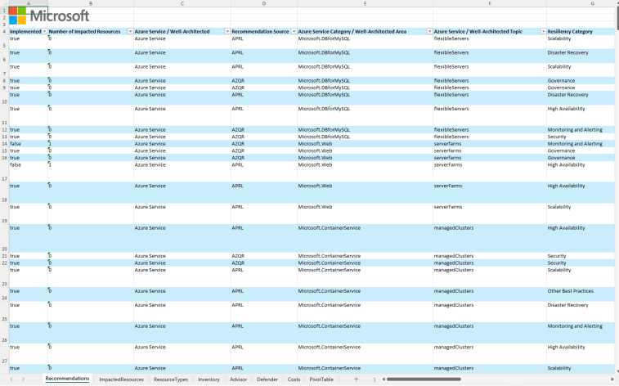
DevOps & IaC & Automation
Azure Quick Review (azqr): A Practical Overview
Azure Quick Review is a command-line tool designed to simplify the assessment of Azure subscriptions and resources. It’s available on GitHub (https://github.com/Azure/azqr) and provides an automated way to perform a high-level analysis of Azure infrastructure. The main goal is to offer insights into security, compliance, performance, and cost-related aspects of Azure resources, all in a digestible format.
It provides:
Automated Assessments
Consistent, Standardized Reviews
Focus on Security and Compliance
Cost Optimization Insights
Quick, Readable Reports
Easy to Set Up and Use

Slide 27
DevOps & IaC & Automation
Azure SDK Release (November 2024)
The Azure OpenAI and Assistants client libraries for JavaScript v1.0.0-beta.x will be retired on January 14, 2025. Migrate to the stable OpenAI library for JavaScript using the migration guide before that date.

Slide 28
Information

Slide 29
Information
Azure Times GitHub Repo

Slide 30
Questions

