Slide 1
Azure Times #132
August 30, 2024

Slide 2
Security & Identity

Slide 3
Security & Identity Updates
Retirement: Migrating to TLS 1.2+ with the Deprecation of Outdated Security Protocols
On October 31 2024, Azure Resource Manager will be retiring support for TLS 1.0 and TLS 1.1. After that date, any incoming calls to Azure using TLS 1.0/1.1 will fail. This is part of an Azure-wide initiative to enhance security.

Slide 4
Compute

Slide 5
Compute Updates
Azure Red Hat OpenShift Now Supports 250 Nodes
Azure Red Hat OpenShift (ARO) is a fully managed Red Hat OpenShift service on Azure. MS announced two significant enhancements to ARO's capabilities:
The ability to configure multiple IP addresses per cluster load balancer is now generally available.
ARO clusters can now scale up to 250 worker nodes.
Previously, ARO clusters were limited to 62 worker nodes due to having only one IP (Internet Protocol) address associated with the cluster's load balancer. By enabling multiple IP addresses for the load balancer, MS has removed this bottleneck, offering organizations greater flexibility in expanding their deployments.
These enhancements significantly improve the scalability and adaptability of ARO public clusters, empowering organizations to scale their infrastructure more effectively. Our goal is to support even larger clusters, providing robust solutions for enterprises with extensive computational requirements. In this blog post, we will delve into the specifics of deploying large ARO clusters, explore a real-world use case, and provide essential information to help you get started with this powerful new capability

Slide 6
Databases

Slide 7
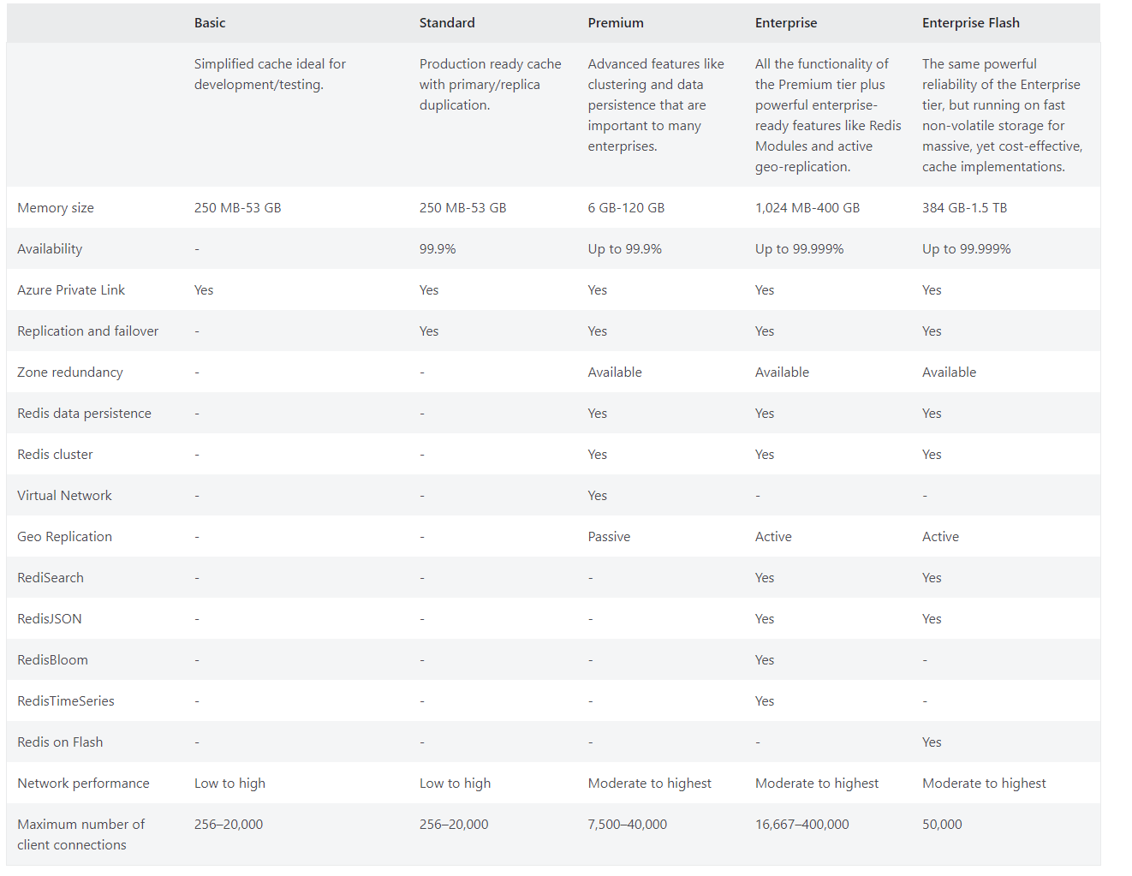
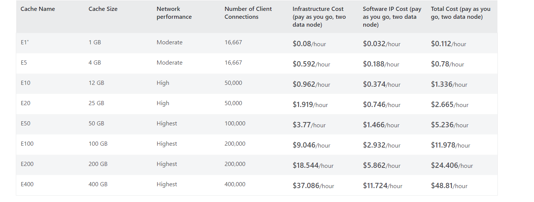
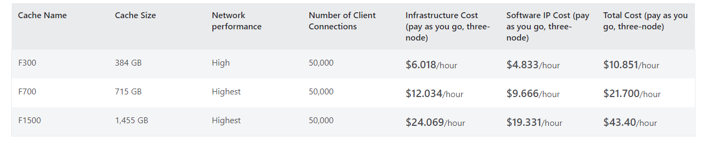
Databases Updates
Generally Available: Larger Enterprise tier cache instances for Azure Cache for Redis
Experience the highest Redis performance on Azure using the E200 and E400 cache instances of Azure Cache for Redis. These options give hundreds of gigabytes of memory and up to 240 vCPUs of compute power for largest and most demanding Redis workloads.

Slide 8
Integration

Slide 9
Integration Updates
Public Preview – Managed linting support in API Center
MS announced the public preview of managed linting support for API Analysis in API Center.
Enable API analysis in Azure API Center effortlessly, without the need for manual management.
Linting Capabilities: API analysis offers linting to ensure API definitions adhere to organizational style rules. This helps maintain consistency and quality across all APIs.
Out-of-the-Box Functionality: It is possible to enable API analysis in Azure API Center without any additional management. It works seamlessly out-of-the-box, simplifying the setup process.
Error and Inconsistency Identification: API analysis helps identify and correct common errors and inconsistencies in API definitions, improving overall API reliability and performance.
Reporting: Linting generates both individual and summary reports, providing detailed insights into the adherence of API definitions to style rules and highlighting areas for improvement.
Currently, only OpenAPI specification documents in JSON or YAML format are analyzed.
By default, enable analysis with the spectral:oas ruleset.
Currently, it is possible to configure a single ruleset, and it's applied to all OpenAPI definitions in API center.
The following are limits for maximum number of API definitions linted per 4 hours:
Free tier: 10
Standard tier: 100

Slide 10
DevOps & IaC & Automation

Slide 11
DevOps & IaC & Automation
Azure SDK Release (August 2024)
Initial Stable Releases
Management Library for Java
Container Apps
Management Library for JavaScript
Container Apps
Management Library for Python
Container Apps
Initial Beta Releases
Management Library for .NET
Fabric
Management Library for Go
Compute Fleet
Service Fabric Managed Clusters
Management Library for Java
Compute Fleet
Service Fabric Managed Clusters
Management Library for JavaScript
Compute Fleet
Edge Zones
Red Hat Open Shift
Service Fabric Managed Clusters
Management Library for Python
Compute Fleet
Client Library for .NET
AI Model Inference
Health Deidentification
Language Text
Client Library for Java
Health Deidentification
Client Library for JavaScript
Health Deidentification
Client Library for Python
Health Deidentification

Slide 12
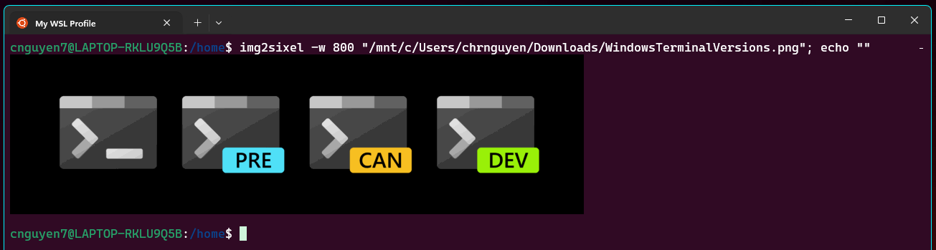
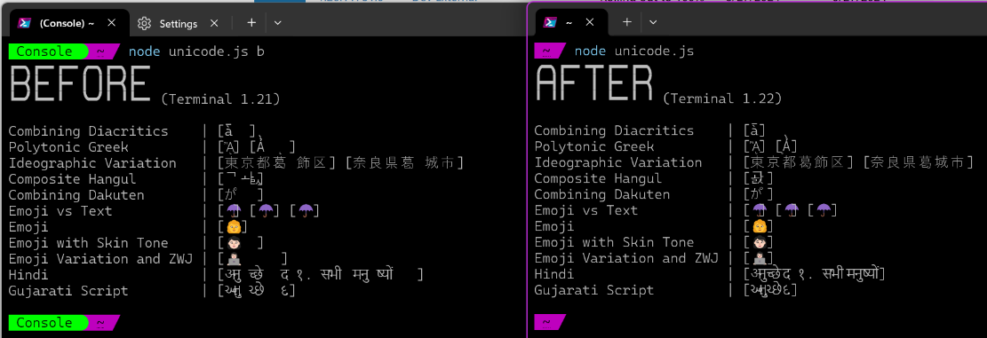
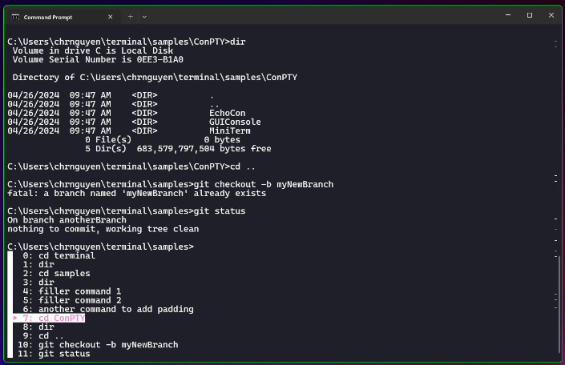
DevOps & IaC & Automation
Windows Terminal Preview 1.22 Release
Sixel Image Support
Grapheme Cluster Support
Snippets Pane
Quick Fixes in CMD
New Cooked Read Popup in CMD
New Hosting Subsystem
Usability Updates
UI Updates
Bug Fixes

Slide 13
Miscellaneous

Slide 14
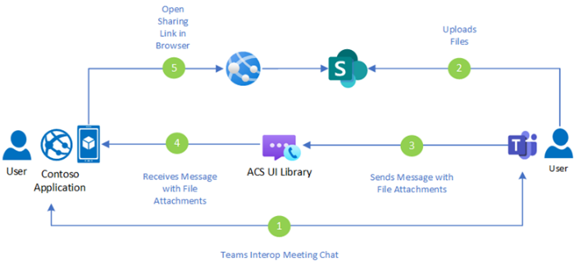
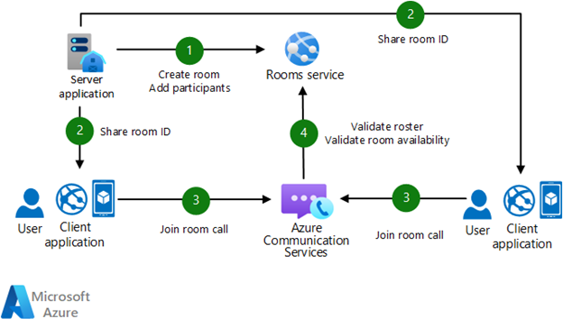
Miscellaneous Updates
Azure Communication Services
Closed Captions - Closed Captions are now generally available in the Native UI Library for Android and iOS. This feature applies to a range of scenarios in which closed captions are essential, enhancing the experience for users with hearing impairments and ensuring inclusivity.
Rooms Roles and Capabilities - The Native UI Library for Android and iOS now includes Rooms Integration in general availability, offering enhanced roles and capabilities for call participants. This integration offers customers greater flexibility and control over their calls, keeping the management on the customer side.
File sharing in Teams Meetings - Now in general availability, share files during a Microsoft Teams meeting with Azure Communication Services Chat service. File sharing enables participants to share documents required for daily business needs such as product information, brochures, or follow-up care instructions.
Support for Teams Breakout rooms - The JavaScript Calling SDK now supports Microsoft Teams Breakout rooms in public preview. Azure Communication Services native participants and Microsoft 365 participants using the Calling SDK can participate in Teams meetings breakout rooms. Support for Teams Breakout rooms brings more flexibility and collaboration opportunities to your virtual meetings.

Slide 15
Miscellaneous Updates
Retirement: Azure Logic Apps Integration Service Environment is retired as of August 31, 2024 & Azure API Management STV1 compute platform is retired as of August 31, 2024
Starting September 1, 2024, Service Level Agreement (SLA) and Service Credits will no longer apply be applied
LA: From September 1, 2024, ISE Developer instances will become read-only, meaning no executions will occur, but Logic Apps deployed to these instances will remain available for export. Starting October 1, 2024, ISE Premium instances will also become read-only. No executions will take place on these instances, but the deployed Logic Apps will still be available for export. Please note that read-only instances will continue to incur standard charges. To avoid unnecessary costs, delete any instances that are no longer in use.
API: MS will automatically migrate all remaining stv1 service instances to the stv2 compute platform starting September 1, 2024. All affected customers will be notified of the upcoming automatic migration one week in advance. Please note that the automatic migration may cause downtime for your upstream API consumers.
Azure HDInsight on AKS will retire on January 31, 2025
On January 31, 2025, we will retire Azure HDInsight on AKS. The remaining clusters on subscription will be stopped and removed from the host.
Before January 31, 2025, you will need to migrate your workloads to Microsoft Fabric or an equivalent Azure product to avoid abrupt termination of your workloads.

Slide 16
Miscellaneous Updates
Retirement: Azure Monitor experience (preview) in HDInsight is retiring by February 1, 2025
On February 1, 2025, Azure HDInsight is retiring the Log Analytics used in Azure Monitor experience (preview).

Slide 17
Information

Slide 18
Information
Azure Times GitHub Repo

Slide 19
Questions

