Slide 1
Azure Times #133
September 6, 2024

Slide 2
Networking

Slide 3
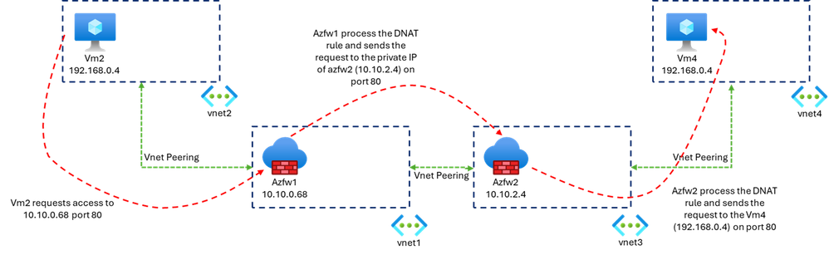
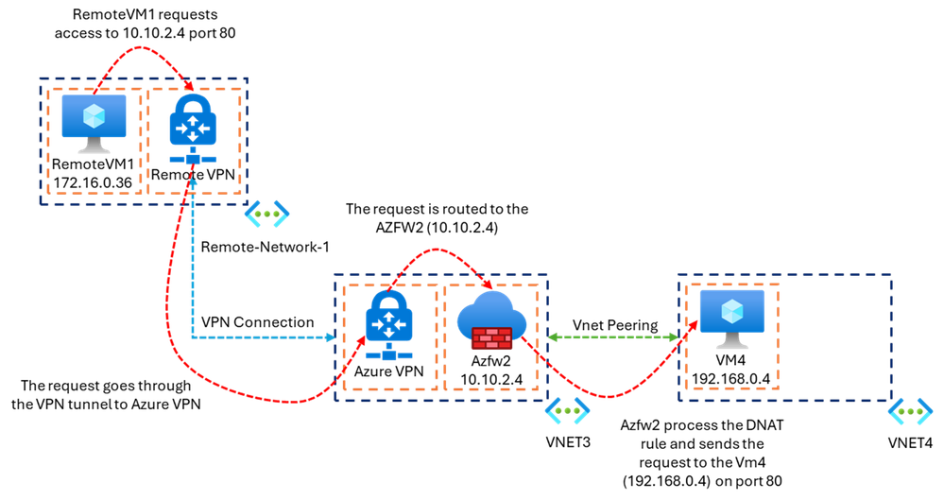
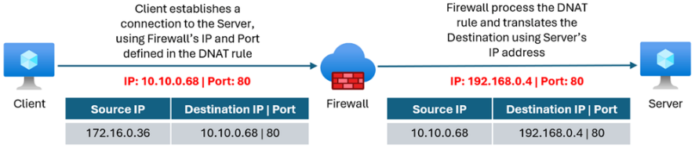
Networking Updates
Private IP DNAT Support and Scenarios with Azure Firewall
MS enhanced DNAT scenario to support port translation on Azure Private IP (VIP). This capability helps with connectivity between overlapped IP networks, which is a common scenario for enterprises when onboarding new partners to their network or merging with new acquisitions. DNAT on Private IP is also relevant for hybrid scenarios (connecting on-premises datacenters to Azure), where DNAT bridges the gap, enabling communication between private resources over non-routable IP addresses.

Slide 4
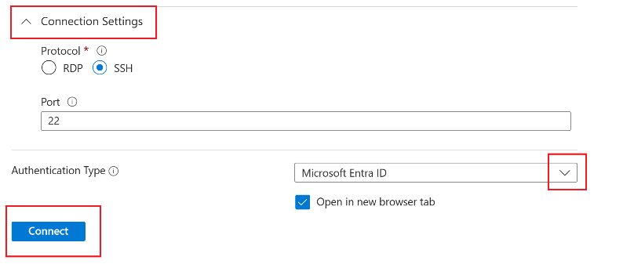
Networking Updates
Generally Available: Azure Public IPs are zone redundant by default
MS announced that Azure Public IPs are zone redundant by default. Unless you specifically select a single zone when create Standard Public IPs, it will be zone redundant.
Zone-redundant by default for Public IPs has no extra cost associated with it. A zone-redundant IP is created in all 3 zones for a region and can survive any single zone failure improving the resiliency of application using this public IP.
Generally Available: Entra ID support for SSH connections in portal
Azure Bastion now supports Microsoft Entra ID authentication for SSH connections in the portal. With Microsoft Entra ID authentication, there are two main benefits to users connecting to their virtual machines. First, it eliminates the need for local authentication mechanisms, reducing a point of attack for malicious actors. Second, with Microsoft Entra ID authentication set as the authentication mechanism, instead of providing additional authentication to connect, users can experience a one-click sign-on into their virtual machines.
Microsoft Entra ID Login should be enabled on the VM.
One of the following required roles should be configured on the VM for the user:
Virtual Machine Administrator Login: This role is necessary if you want to sign in with administrator privileges.
Virtual Machine User Login: This role is necessary if you want to sign in with regular user privileges.

Slide 5
Security & Identity

Slide 6
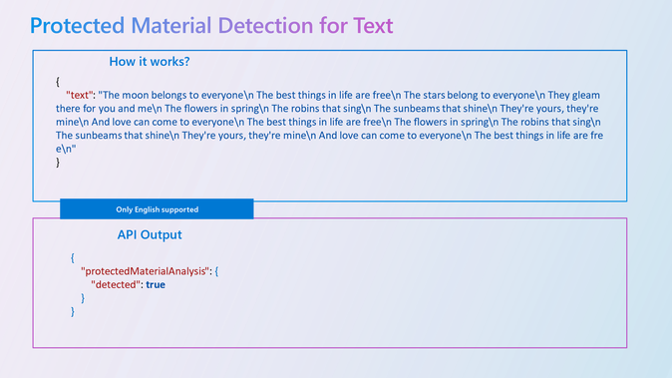
Security & Identity Updates
GA release of Protected Material Detection in Azure AI Content Safety and Azure OpenAI Service
MS announced the GA release of Protected Material Detection in Azure AI Content Safety and Azure OpenAI Service. GA release of Protected Material Detection
Protected Material Detection is a feature designed to guard against outputs that could potentially violate copyright. Many customers and end users are apprehensive about the risk of IP infringement claims when integrating and using Generative AI. To address these concerns, MS introduced this new feature that specifically targets LLM model completions and scans for matches against an index of third-party text content to detect the usage of third-party text content, including songs, news articles, recipes, and selected web content.
Azure AI announces Prompt Shields GA
Prompt Shields protects applications powered by Foundation Models from two types of attacks: direct (jailbreak) and indirect attacks, both of which are now available in GA.
Direct Attacks (Jailbreak Attacks) | Indirect Attacks
Attacker | User | 3rd Party
Entry Point | User Prompt / Message | 3rd Party Data embedded in System Prompt or Assistant role
Taxonomy | Attempts to change system rules, Conversation mockups, Role-play, Encoding | Any “out of place” command that may be related to manipulating content, fraud, malware, actions + Direct Attack Taxonomy
Result | LLM ignores System Prompt rules or RLHF behavior | LLM performs action found in the 3rd party content

Slide 7
Defender for Cloud Updates
Enable Microsoft Defender for SQL servers on machines at scale
It is now possible to now enable Microsoft Defender for SQL servers on machines at scale. This feature allows to enable Microsoft Defender for SQL on multiple servers at once, saving time and effort.
It is done via MS provided PowerShell Script
New version of File Integrity Monitoring based on Microsoft Defender for Endpoint
The new version of File Integrity Monitoring based on Microsoft Defender for Endpoint is now in public preview. It's part of Defender for Servers Plan 2.
Meet compliance requirements by monitoring critical files and registries in real-time and auditing the changes.
Identify potential security issues by detecting suspicious file content changes.
As part of this release, the FIM experience over AMA will no longer be available in the Defender for Cloud portal. The FIM experience over MMA will remain supported until the end of November 2024. In the beginning of September, an in-product experience will be released which allows you to migrate your FIM configuration over MMA to the new FIM over Defender for Endpoint version.
Retirement of Defender for Cloud alert integration with Azure WAF alerts
Defender for Cloud alert integration with Azure WAF alerts will be retired on September 25, 2024. No action is needed.

Slide 8
Management & Governance

Slide 9
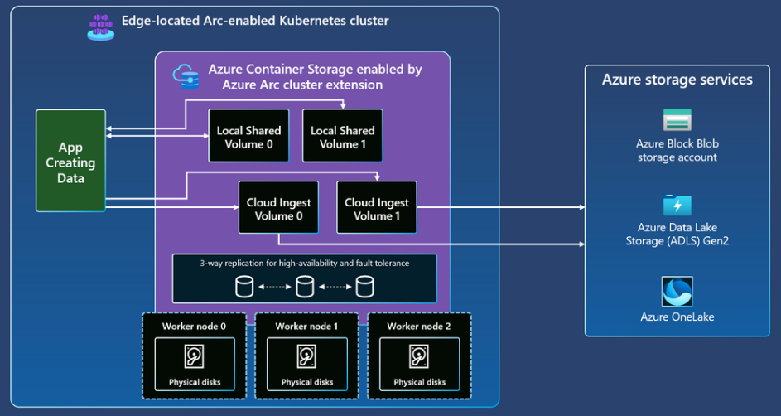
Management & Governance Updates
Public Preview of Azure Container Storage enabled by Azure Arc Edge Volumes
MS announced the Public Preview of Azure Container Storage enabled by Azure Arc Edge Volumes, a groundbreaking addition to our Azure storage solutions, designed to revolutionize data handling at the edge.
Local Edge Volume: Shared ReadWriteMany storage with no cloud dependencies
High-Availability Storage: Provides resilient, failover-capable storage that remains online and accessible even without network connectivity to cloud infrastructure.
Versatile Use Cases: Ideal for persistent scratch space, temporary storage, and local application-state data, ensuring continuous operation and data accessibility at the edge.
Cloud Edge Volume: Ingest data to cloud while tolerating network disconnections
Data Ingestion: Enables seamless, application-transparent ingestion of file data from the edge to Azure storage, including Blob, ADLSgen2, and OneLake/Fabric.
User-Defined Capacity: Ensures continuous space availability by purging local copies after confirmed uploads to the cloud.
Network Outage Flexibility: Data is retained and queued for upload during network disconnections, so your data is never lost.

Slide 10
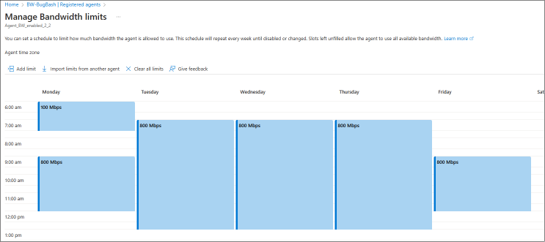
Management & Governance Updates
What's new with Azure Connected Machine agent
Fixed
Fixed an issue where EnableEnd telemetry would sometimes be sent too soon.
Added sending a failed timed-out EnableEnd telemetry log if extension takes longer than the allowed time to complete.
New features
Azure Arc proxy now supports HTTP traffic.
New proxy.bypass value 'AMA' added to support AMA VM extension proxy bypass.
Generally Available: Azure Storage Mover with Bandwidth Management
Azure Storage Mover now supports setting bandwidth management schedules for Storage Mover agents to optimize file migrations and ensuring a smooth network performance. This feature helps Storage Mover agents act as a good neighbor in your on-prem data centers by limiting how much WAN link upload bandwidth they may consume at any point of the day.

Slide 11
Management & Governance Updates
Generally Available: Auto-renewal of certificates for on-premises to Azure Site Recovery
Azure Site Recovery has introduced automatic renewal of certificates for on-premises to Azure disaster recovery. Azure Site Recovery uses various components for doing disaster recovery (DR) from on-premises to Azure. Certificates are essential for communication between components and need regular renewal to avoid disruptions in Azure Site Recovery operations (like data replication, etc.).

Slide 12
Compute

Slide 13
Compute Updates
What’s new in Azure VMware Solution
Azure VMware Solution is now in 33 regions
Azure VMware Solution is now approved to be added as a service within the DoD SRG Impact Level 4 Provisional Authorization (PA) in Azure Government
Expanded Support for VMware Cloud Foundation (VCF): NetApp and Broadcom customers will now be able to simplify their VCF hybrid cloud environments by using NetApp ONTAP® software for all storage requirements, including standard and consolidated architectures.
New Capabilities for Azure VMware Solution (AVS): Spot Eco by NetApp with AVS reserved instances to get the most value out of their deployments. Using Spot Eco to manage AVS reserved instances while also using Azure NetApp Files to offload data storage can reduce compute costs significantly.
VMware Rapid Migration Plan
Enhance Disaster Recovery and Ransomware Protection with Azure VMware Solution and JetStream
What's new in Windows 365 Enterprise
Azure Monitor support on Windows 365 Cloud PCs
Session lock experience configuration for single sign-on: it is now possible to configure the remote session lock experience when single sign-on is enabled between the default disconnect behavior and showing the remote lock screen.
Windows 365 support for Microsoft Purview Customer Key is now generally available

Slide 14
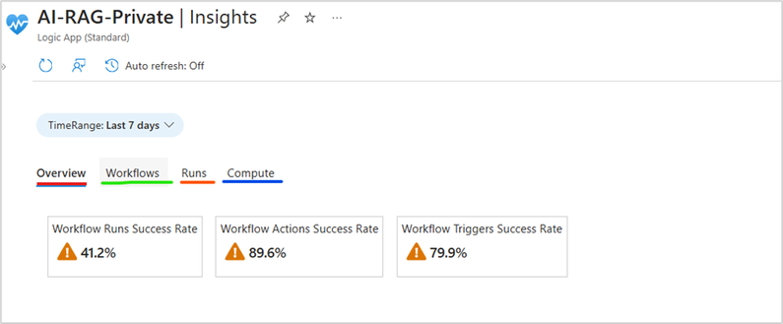
Compute Updates
Public Preview – Out of box monitoring dashboards for Logic Apps Standard
MS introduced Insights support for Azure Logic Apps Standard, offering curated visualizations to help monitor applications and workflows more effectively. With these new dashboards, gain a comprehensive view of Logic Apps Standard environments, enabling better oversight of your integration scenarios.
The monitoring dashboards, specifically designed for Logic Apps Standard, offer detailed insights at multiple levels:
Overview: Get a high-level view of your application's health, including success rates and trends for runs, actions, and triggers.
Workflows: Dive deeper into individual workflows to see the status of each run and identify any issues.
Runs: Access detailed run information from Application Insights to pinpoint exact actions that may have caused failures, with options to resubmit failed runs.
Compute: Monitor compute utilization, helping you manage performance and scalability effectively.

Slide 15
Compute Updates
Generally Available: VMSS Automatic Instance Repairs – Reimage, Restart Repair Actions
Automatic instance repairs help Virtual Machine Scale Set customers achieve high application availability by automatically detecting and recovering unhealthy VM instances at runtime.
MS announced that customers can now choose between Replace, Reimage (New), or Restart (New) as the default repair action performed in response to an "Unhealthy" application signal. These new options provide a less-impactful repair process, ensuring higher application availability while preserving VM properties and metadata for customers with sensitive workloads.
The default repair action is Replace, but you can configure automatic repairs to use Reimage or Restart by modifying the repairAction setting under automaticRepairsPolicy object.
Replace deletes the unhealthy instance and creates a new instance to replace it. The latest Virtual Machine Scale Set model is used to create the new instance. This repair action is the default.
Reimage applies the reimage operation to the unhealthy instance.
Restart applies the restart operation to the unhealthy instance.
Repair action | VM instance ID preserved? | Private IP preserved? | Managed data disk preserved? | Managed OS disk preserved? | Local (temporary) disk preserved?
Replace (default) | No | No | No | No | No
Reimage | Yes | Yes | Yes | No | Yes
Restart | Yes | Yes | Yes | Yes | Yes

Slide 16
Compute Updates
Public Preview – Templates Support in Azure Logic Apps Standard
MS announced the Public Preview of Templates Support in Azure Logic Apps Standard!
Templates in Azure Logic Apps are pre-built workflow solutions designed to address a variety of integration scenarios, ranging from simple data transfers to complex automations and event-driven processes. These templates provide a robust starting point, enabling users to quickly set up and deploy workflows without having to build from scratch.
With Templates Support now in Public Preview, developers can tap into a growing library of pre-built templates to jumpstart their Logic Apps projects. Whether you’re working on straightforward workflows or intricate integrations, these templates are designed to make it easier than ever to build, deploy, and manage your applications.

Slide 17
Integration

Slide 18
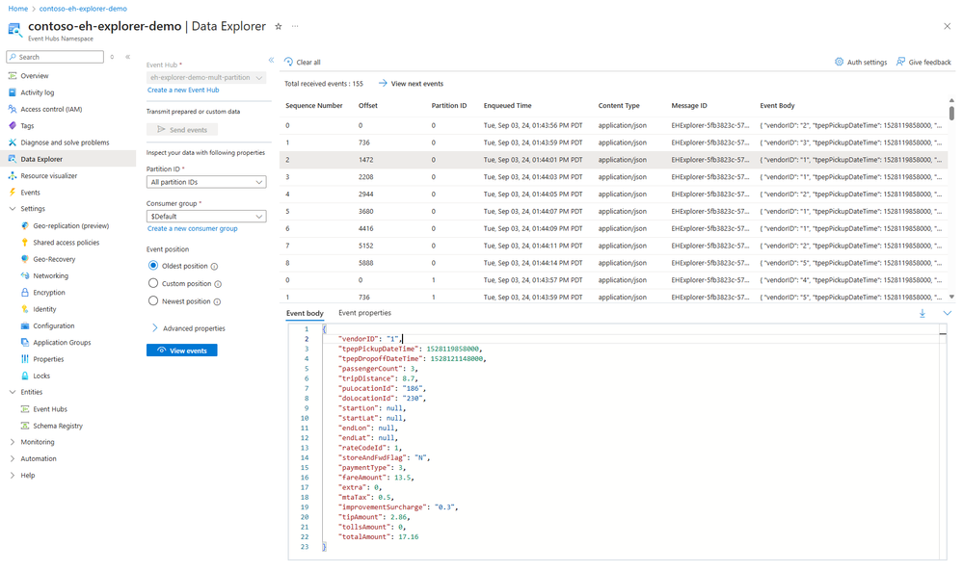
Integration Updates
Service Bus Premium SKU Performance Update
Microsoft review the performance benchmarks from 2016 and compare them with the current performance of Service Bus Premium in 2024.
These results show that there has been a significant performance improvement since we first introduced Service Bus Premium, with an average increase of ~50%, and even over 150% for some scenarios.
Announcing the Event Hubs Data Explorer
MS announced the launch of the new Event Hubs Data Explorer feature in the Azure portal! This user-friendly yet highly powerful tool allows developers to generate and retrieve event data from an Event Hubs topic, all within the ease of the Azure portal.

Slide 19
Integration Updates
Public Preview: Expanded GenAI Gateway capabilities in Azure API Management
MS announced new enhancements to GenAI Gateway capabilities, specifically designed for large language model (LLM) use cases. New policies support a wider range of LLMs via the Azure AI Model Inference API. These new policies offer the same robust functionality:
Key Highlights of the New GenAI Policies:
LLM Token Limit Policy (Preview): This policy allows to define and enforce token limits for interactions with large language models, helping manage resource usage and control costs. It automatically blocks requests that exceed the set token limit, preventing overuse and ensuring fair usage across applications.
LLM Emit Token Metric Policy (Preview): Gain detailed insights into token consumption with this policy, which emits metrics in real-time. It provides valuable information on token usage patterns, aiding in cost management by allowing you to attribute costs to different teams, departments, or applications.
LLM Semantic Caching Policy (Preview): Designed to enhance efficiency and reduce costs, this policy caches responses based on the semantic content of prompts. By reducing redundant model inferences and lowering latency, it optimizes resource utilization and speeds up response times for frequently requested queries.

Slide 20
ML & AI & IOT

Slide 21
ML & AI & IOT Updates
Announcing support for Welsh and Catalan language in Copilot for Microsoft 365
Copilot for Microsoft 365 is now rolling out support for users working in the Welsh and Catalan languages, bringing the total number of supported languages and language variants up to 30.
Now available: Transparency Note for Copilot for Microsoft 365
The Transparency Note for Copilot for Microsoft 365 serves as a simple, central document that explains how AI-powered productivity tool integrates large language models (LLMs) with Microsoft 365 apps. It covers key features such as document creation in Word, presentation facilitation in PowerPoint, data insights in Excel, email management in Outlook, and conversation summaries in Teams, among others. The note also highlights the importance of understanding the capabilities and limitations of the tool, focusing on the entire system including the technology, users, and deployment environment.

Slide 22
ML & AI & IOT Updates
Introducing GPT-4o-2024-08-06 API with Structured Outputs on Azure
MS announced the release of the API for GPT-4o-2024-08-06, the newest and most advanced AI model from OpenAI. This model brings significant advancements to AI capabilities, including the game-changing JSON Structured Outputs feature, which enhances developer productivity and application versatility.
JSON Structured Outputs: JSON Structured Outputs enable developers to specify the desired output format from the AI model by defining a JSON Schema. This feature ensures that outputs are well-structured and consistent, simplifying the generation of structured data and reducing the need for post-processing. It also provides significant cost savings, with up to 50% savings on input costs and up to 33% savings on output costs compared to the previous model
Expanded Availability: The GPT-4o-2024-08-06 API is now available globally through Global and Regional Standard deployments in every US region plus Sweden Central
Availability and Pricing: The GPT-4o-2024-08-06 API offers significant cost reductions compared to its predecessor, GPT-4o-2024-05-13. Inputs are priced at $2.50 per 1M tokens, and outputs are $10.00 per 1M tokens. For detailed pricing, please refer to the Azure OpenAI Service pricing page.
New Features for GitHub Copilot for Azure
Building Apps for Azure: @azure can now look up developer templates that could be a good starting point for what you're trying to build.
Deploying to Azure: ask @azure for help with init'ing, deploying, and creating pipelines for your Azure projects via the Azure developer CLI (azd), and expect to receive more than just simple text responses in return.
GPT-4o: @azure is now using GPT-4o for more accurate, faster answers.
Slash Commands:
@azure /learn ... to learn about Azure
@azure /resources ... to get information about your Azure resources

Slide 23
ML & AI & IOT Updates
Retirement: Azure App Service Environment v1/v2 is retired as of August 31, 2024
As of August 31, 2024, Service Level Agreement (SLA) and Service Credits will no longer apply for App Service Environment v1 and v2 workloads that continue to be in production since they are retired products.
Customers must complete migration to App Service Environment v3 immediately or your apps and resources may be deleted. We will attempt to auto-migrate any remaining App Service Environment v1 and v2 on a best-effort basis, but Microsoft makes no claim or guarantees about application availability after auto-migration. If auto-migration is not feasible, your resources and associated app data will be deleted.

Slide 24
DevOps & IaC & Automation

Slide 25
DevOps & IaC & Automation
Windows App SDK 1.6
Native AOT support: Windows App SDK now supports native Ahead-Of-Time (AOT) compilation
Decoupled WebView2 versioning
New Package Deployment APIs
Improved TabView tab tear-out
Azure CLI docker container base Linux image is now Azure Linux
az commands are unaffected.
shell commands specific to Alpine will not be functional (ex: apk).
The GitHub action will use the new image and could impact scripts using Alpine specific commands or components

Slide 26
Miscellaneous

Slide 27
Miscellaneous Updates
Teams Improves Text Pasting
Microsoft announced in MC878422 (30 August 2024) that Teams no longer includes metadata in messages copied from chats or channel conversations. The change is effective now and means that instead of having Teams insert a timestamp and the name of the person who created the text, only the text is pasted.
Retirement: Azure Logic Apps Integration Service Environment is retired as of August 31, 2024
Starting September 1, 2024, Service Level Agreement (SLA) and Service Credits will no longer apply for Logic Apps workflows deployed in ISE environments that continue to be in production.
Customers must complete migration to Logic Apps Standard immediately or your apps and resources may be deleted. From September 1, 2024, your ISE Developer instances will become read-only, meaning no executions will occur, but Logic Apps deployed to these instances will remain available for export. Starting October 1, 2024, your ISE Premium instances will also become read-only. No executions will take place on these instances, but the deployed Logic Apps will still be available for export. Please note that read-only instances will continue to incur standard charges. To avoid unnecessary costs, delete any instances that are no longer in use.
Retirement: Azure API Management STV1 compute platform is retired as of August 31, 2024
Starting September 1, 2024, the Service Level Agreement (SLA) and Service Credits will no longer apply to any stv1 compute instances that remain in production.
Customers must complete migration to the Azure API Management stv2 compute platform immediately. If you do not complete the migration, your API Management stv1 instances will be automatically migrated, which may result in downtime. We will automatically migrate all remaining stv1 service instances to the stv2 compute platform starting September 1, 2024. All affected customers will be notified of the upcoming automatic migration one week in advance. Please note that the automatic migration may cause downtime for your upstream API consumers.

Slide 28
Information

Slide 29
Information
Azure Times GitHub Repo

Slide 30
Questions

