Slide 1
Azure Times #87
September 20, 2023

Slide 2
Networking

Slide 3
Networking Updates
Azure Front Door Standard and Premium support bring your own certificated based domain validation
Azure Front Door Standard and Premium support Bring Your Own Certificates (BYOC) based domain ownership validation. Azure Front Door automatically approves the domain ownership if the Certificate Name (CN) or Subject Alternative Name (SAN) of the provided certificate matches the custom domain and the certificate is valid. This feature reduces the steps and efforts required to prove the domain ownership and makes the Dev-Ops experience more streamlined.
For custom domains created before this feature is supported and the domain validation status is not approved yet, the validation must be triggered manually
General availability: Sensitive Data Protection for Application Gateway Web Application Firewall
Azure's regional Web Application Firewall (WAF) running on Application Gateway now supports sensitive data protection through log scrubbing. When a request matches the criteria of a rule, and triggers a WAF action, that event is captured within the WAF logs.
Sensitive data protection using log scrubbing supports the creation of rules using the following variables:
Request Header Names
Request Cookie Names
Request Arg Names
Request Post Arg Names
Request JSON Arg Names
Request IP Address

Slide 4
Security & Identity

Slide 5
Security & Identity Updates
SMB dialect management now supported in Windows Insider
Beginning in Windows 11 Insider Preview Build 25951 (Canary), the SMB server now supports controlling which SMB 2 and 3 dialects it will negotiate. This changes legacy behavior, where Windows SMB server always negotiated the highest matched server dialect from SMB 2.0.2 to 3.1.1 clients. Beginning in Windows 10, support was added for controlling SMB client dialects, but not server dialects.
With this new option, an administrator can remove specific SMB protocols from usage in the organization, blocking older, less secure, and less capable Windows devices and third parties from connecting.
Can be configured via GPO, CMD, PS and WMI
Computer Configuration \ Administrative Templates\ Network\Lanman Server\Mandate the minimum version of SMB
Computer Configuration\Administrative Templates\Network \Lanman Server\Mandate the Maximum version of SMB
SMB NTLM blocking now supported in Windows Insider
Beginning in Windows 11 Insider Preview Build 25951 (Canary), the SMB client now supports blocking NTLM for remote outbound connections. This changes legacy behavior, where Windows SPNEGO would negotiate Kerberos, NTLM, and other mechanisms with the destination server to decide on a supported security package. NTLM in this case refers to all versions of the LAN Manager security package: LM, NTLM, and NTLMv2.
With this new option, an administrator can intentionally block Windows from offering NTLM via SMB. An attacker who tricks a user or application into sending NTLM challenge responses to a malicious server will no longer receive any NTLM data and cannot brute force, crack, or pass hashes. This adds a new level of protection for enterprises without a requirement to entirely disable NTLM usage in the OS.
Note: This setting has no effect on loopback SMB NTLM usage, i.e. mapping a drive locally on a device with a local account.
Can be configured via GPO, CMD, PS and WMI
Computer Configuration\Administrative Templates\Network\Lanman Workstation \ Block NTLM (LM, NTLM, NTLMv2)

Slide 6
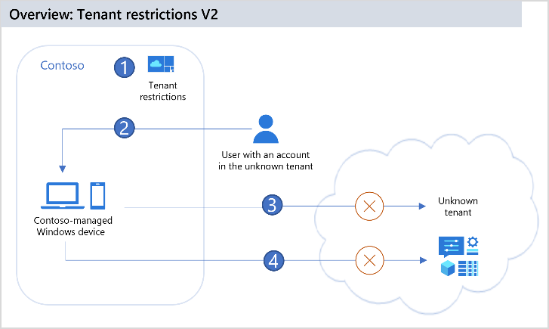
Security & Identity Updates
General Availability: Set up tenant restrictions v2
It is now possible to limit what user can access when they use an external account to sign in from corporate networks or devices
Tenant restrictions v2 provides options for both authentication plane protection and data plane protection:
Authentication plane protection refers to using a tenant restrictions v2 policy to block sign-ins using external identities.
Data Plane protection refers to preventing attacks that bypass authentication.
There are three ways to apply the policy:
Universal tenant restrictions v2 - Universal tenant restrictions use Global Secure Access (preview) to tag all traffic no matter the operating system, browser, or device form factor.
Authentication plane tenant restrictions v2 - deploy a corporate proxy in organization and configure the proxy to set tenant restrictions v2 signals on all traffic to Microsoft Entra and Microsoft Accounts (MSA).
Windows tenant restrictions v2 - corporate-owned Windows devices, can enforce both authentication plane and data plane protection by enforcing tenant restrictions directly on devices.

Slide 7
Security & Identity Updates
Microsoft Defender for Identity Updates
The following two updates were released:
New Sensor type for the AD CS
AD CS new alerts and secure score report

Slide 8
Management & Governance

Slide 9
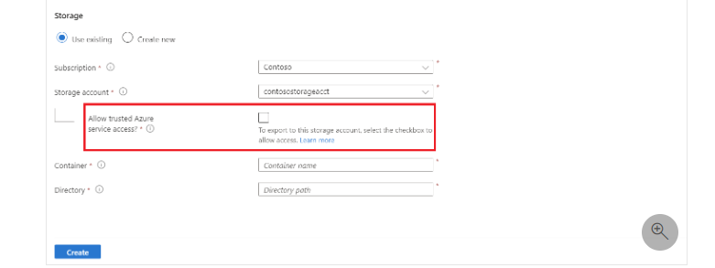
Management & Governance Updates
Generally available: Export Cost Management data to secure storage accounts with firewall
Now it is possible to export Cost Management data to Azure storage accounts with configured firewall. For this functionality to work the Allowed trusted Azure Services must be enabled
The export itself can be scheduled on a daily, weekly, or monthly basis.
New in Kusto: `.show databases entities` command for viewing tables, functions, and more
MS announced a new command for Kusto: `.show databases entities`. This command allows to view the entities of all cluster databases that have access to, such as tables, materialized views, external tables, functions, and entity groups.
This is applicable for the ADE, Azure Synapse Analytics and etc

Slide 10
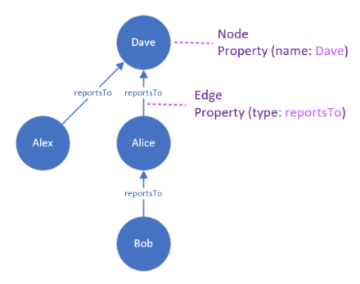
Management & Governance Updates
Introducing Graph Semantics in Kusto, a new way to contextualize time series data
The graph semantics extension enables users to contextualize their data in Kusto using graphs, a data structure that consists of nodes and edges that connect them. Graphs are useful for representing complex and dynamic data that involve many-to-many, hierarchical, or networked relationships, such as social networks, recommendation systems, connected assets, or knowledge graphs.
Limitation:
You can only create or query graphs that fit into the memory of one cluster node.
Graph data isn't persisted or distributed across cluster nodes, and is discarded after the query execution.
General availability: Azure Backup support for Azure Files in China North2, China East 2, China North 3, and China East 3
The native snapshot-based backup solution offered by Azure Backup for Azure Files is now generally available in China North2, China East 2, China North 3, and China East 3.

Slide 11
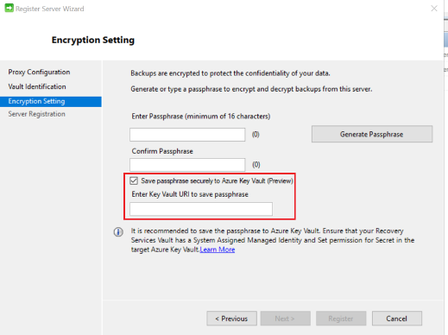
Management & Governance Updates
General availability: Selective Disk Backup and Restore in Enhanced Policy for Azure VM Backup
Selective disk backup was added to the enhanced policy. It is now possible:
Select the data disks to backup directly from the portal when configuring backup and through CLI/PowerShell.
Only the OS disk and selected data disks are included in the backup snapshot and for billing.
Exclude disk types currently not supported by Azure VM Backup and configure backup for the VM using Enhanced Policy.
Preview: Save Azure Backup Recovery Services Agent (MARS) passphrase to Azure Key Vault
Azure Recovery Services Agent encryption passphrase can be saved in Azure Key Vault directly from the console, making the Recovery Services Agent installation seamless and secure. Azure Recovery Services Agent encryption passphrase in Azure Key Vault directly from the console, making the Recovery Services Agent installation seamless and secure. This capability is available with Recovery Services Agent version 2.0.9254.0 or higher.
The solution requires:
Enabling Managed identity on the RSV
Delegate Riths to the KV and Enable Purge Protection
Save the key during the configuration

Slide 12
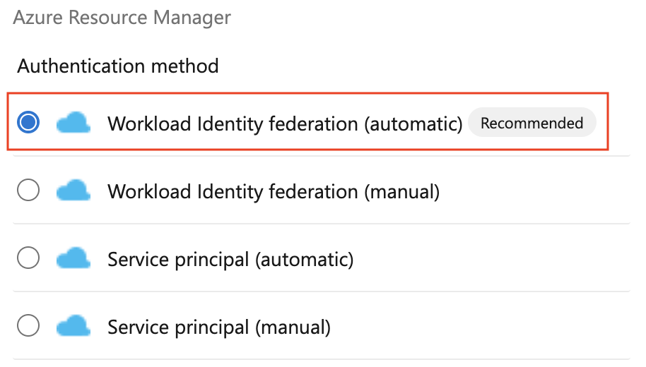
Management & Governance Updates
Preview: Cross Region Restore (CRR) for Recovery Services Agent (MARS) using Azure Backup
Cross Region Restore is now supported for the workload that are backed up by the MARS agent. The backup data in the primary region can also be geo replicated to an Azure-paired secondary region for durability. Earlier, the data that is replicated to secondary region is available to restore in secondary region only if Azure declares a disaster in primary region. With CRR it will be possible to:
Restore from backup data in secondary region for audit/compliance purposes
Restore from backup data in secondary region for audit/compliance purposes
Public preview of Workload identity federation for Azure Pipelines
MS announced a public preview of workload identity federation for Azure service connections. Workload identity federation uses an industry-standard technology, Open ID Connect (OIDC), to simplify the authentication between Azure Pipelines and Azure. Instead of secrets, a federation subject is used to facilitate this authentication.

Slide 13
Compute

Slide 14
Compute Updates
Azure Service Fabric 9.1 Sixth Refresh Release
Microsoft has announced that the 9.1 Sixth Refresh release of the Service Fabric runtime has completed rolling out to the various Azure regions along with tooling and SDK updates.
More information can be found here
General Available: GA: Latest generation burstable VMs - Bsv2, Basv2, and Bpsv2
The Bsv2, Basv2, and Bpsv2 series virtual machines are the latest generation of Azure burstable general purpose VMs, providing a baseline level of CPU utilization and capable of expanding to higher CPU utilization as workload volume increases.
New VMs provides:
Up to 15 % performance
Up to x5 higher network bandwidth
10X higher remote storage throughput.

Slide 15
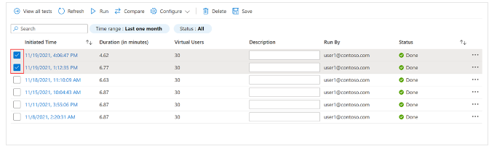
Compute Updates
View trends of client-side metrics across test runs in Azure Load Testing
Azure Load Testing, now allows to track trends in client-side metrics from last ten test runs. This allows to see historical data and how applications are performed.
It is also possible to pick one test run as a baseline and compare the recent metrics to it.
General Available: Configure load testing in your CI/CD pipeline from Azure portal
Azure Portal now has capabilities to set up load testing in CI/CD pipeline through a simple process. Test files, such as JMeter scripts and YAML configuration, will automatically be added to repository. This enables automated pipeline runs, helping to detect performance issues early in the development cycle.

Slide 16
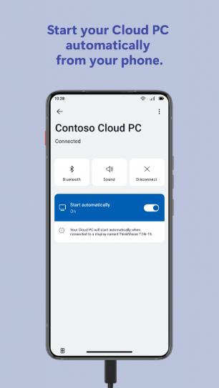
Compute Updates
Public Preview: Azure CLI “az aks copilot” for AKS
Azure CLI integrates CHAT GPT functionality in the CLI that provides an expert assistance for the AKS.
Key Features and Benefits
Chat-Based Assistance
Flexible Integration with OpenAI and Azure
Real-Time Troubleshooting
Direct Querying
The following command should be run:
az extension add --name aks-preview
az extension update --name aks-preview
set OPENAI_API_KEY=xxx
set OPENAI_API_MODEL=gpt-3.5-turbo
To test the functionality runt the command:
az aks copilot –p “question”
Windows 365 App Experience
Microsoft released a new app for the Android devices that allows automatically start the Virtual Desktop during the connection of external monitor to the device. The connection to the remote desktop is fully moved to the external monitor and support all features of the W365 and simultaneous usage of the phone device as well.
They also introduce the AutoStart feature that will start your desktop as soon as you connect the external monitor

Slide 17
Compute Updates
Generally available: Higher default value for Azure Functions Event Hubs max batch size
Azure Function Event Hubs Extension starting from version 6.0.0 will have aa higher default value for the maxEventBatchSize to 100.
This value set a maximum number of events that function can receive from the Event Hub.
It might be beneficial to the average scenario by helping to improve performance as well as lower costs due to fewer function executions.
General availability: Use Azure Key Vault to securely store and retrieve access key when mounting Azure Storage as a local share in App Service
Azure Key Vault now can be used to retrieve and store Azure Storage Account access key for the App Service to mount the share. This feature is available for App Service Linux code and container, Windows containers and Windows code
Limitations:
SA firewall is supported only through the SE and PE
FTP/FTPS access to custom-mounted storage isn't supported
Mapping / or /home to custom-mounted storage isn't supported
Azure Storage isn't supported with Docker Compose scenarios.
Storage mounts aren't included in backups.

Slide 18
Storage & Data

Slide 19
Storage & Data Updates
Public Preview: Azure NetApp Files Standard network features support in US Government region
Azure NetApp files in the US Government now supports standard network features that deliver enhanced Virtual Networking experience. The features are:
NSG Support
UDR Support
On-Premises Connectivity
ExpressRoute FastPath support
Cross-Region Mount Volumes
Private Link and Service Endpoint Support
VWAN Support
Generally available: Azure Ultra Disk Storage is now available in UK West
Azure Ultra Disk Storage is now available in UK West. Azure Ultra Disk Storage offers high throughput, high IOPS, and consistent low latency disk storage for Azure virtual machines (VMs). Ultra Disk Storage is suited for data-intensive workloads such as SAP HANA, top-tier databases, and transaction-heavy workloads.

Slide 20
Databases

Slide 21
Databases Updates
Public Preview: Configure customer-managed keys on existing Cosmos DB accounts
Azure Cosmos DB accounts now supports enabling the Customer Managed Keys (CMK) on existing accounts. This eliminates the need to migrate data to a new account to enable CMK.
Known limitations
Enabling CMK is available only at a Cosmos DB account level and not at collections.
It is now supported enabling CMK on existing Azure Cosmos DB for Apache Cassandra accounts.
It is now supported enabling CMK on existing accounts that are enabled for Materialized Views and Full Fidelity Change Feed (FFCF) as well.
Ensure account must not have documents with large IDs greater than 990 bytes before enabling CMK.
During encryption of existing data, control plane actions such as "add region" is blocked. These actions are unblocked and can be used right after the encryption is complete.
Public Preview: Azure Cosmos DB Javascript SDK v4.0
Microsoft Release a JavaScript SDK version 4.0 for the Cosmos DB. The Azure Cosmos DB JavaScript SDK empowers developers to construct Azure Cosmos DB applications using the NOSQL API, streamlining a multitude of operations with enhanced ease and efficiency.
The SDK targets Node v16 and above and has many new features including:
Hierarchical partition keys
Client-side request diagnostics
Index metrics
New implementation for Change Feed
Priority-based throttling

Slide 22
Azure SQL Updates
General Availability: Azure SQL updates for mid-September 2023
The following updates/features are GA:
The automated backups taken in Azure SQL Database using sys.dm_database_backups(not supported for HyperScale)
Azure SQL Database Hyperscale backups now support up to 35 days of point-in-time retention.
Azure SQL Database Hyperscale backups now support long-term retention (LTR) for up to 10 years.
Private preview of Data Virtualization in Azure SQL Database
MS announced the private preview of Data Virtualization in Azure SQL Database. Data Virtualization in Azure SQL Database enables working with CSV, Parquet, and Delta files stored on Azure Storage Account v2 (Azure Blob Storage) and Azure Data Lake Storage Gen2. Azure SQL Database will now support: CREATE EXTERNAL TABLE (CET), CREATE EXTERNAL TABLE AS SELECT (CETAS) as well as enhanced OPENROWSET capabilities to work with the new file formats.
Major benefits of Data Virtualization in Azure SQL Database are:
No data movement: Access real-time data where it is.
T-SQL language: Ability to leverage all the benefits of the T-SQL language, its commands, enhancements, and familiarity.
One source for all data: Users and applications can use Azure SQL Database as a data hub, accessing all the required data in a single environment.
Security: Leverage SQL security capabilities to simplify permissions, credential management, and control
Export: Easily export data as CSV or Parquet to any Azure Storage location, either to empower other applications or reduce cost

Slide 23

Databases Updates
Microsoft expands partnership with Oracle to bring customers’ mission-critical database workloads to Azure
Microsoft introduced Oracle Database@Azure as an Oracle Database services inside Azure. With the ability for customers to migrate Oracle databases “as is” to OCI and deploy them in Azure alongside their current workloads in the Microsoft Cloud, organizations can create new solutions and further competitive differentiation.
Azure is the only cloud provider other than Oracle Cloud Infrastructure to host Oracle services, including Oracle Exadata Database Service and Oracle Autonomous Database on Oracle Cloud Infrastructure in Azure datacenters.

Slide 24
ML & AI & IOT

Slide 25
ML & AI & IOT Updates
Azure Machine Learning - Public Preview for September
Vision models for model catalog: Allows to utilize new task types, namely image classification, image segmentation, and object detection, to finetune, evaluate, and deploy base models using own training data.
Enjoy the Prompt Flow code-first functionality: ​ To fully leverage the power of LLMs, start quickly with pre-built workflows and evaluation metrics, and enjoy high-efficiency iterations with LLMOps integration into Prompt Flow.
Model Monitoring for LLM Applications​: Allows to monitor LLM applications in production for safety and quality on a user-defined cadence to ensure they deliver maximum business impact.

Slide 26
Retirement

Slide 27
Retirement Updates
Important Notice: Azure Product Retirement: End of Life Announcement of Azure Sphere classic CLI on 30 September 2024. Replace with Azure Sphere CLI
Retirement: Azure AI Document Intelligence v2.0 API will be retired on 31 August 2026
Announcing Azure FXT Edge Filer Retirement
Project Azure FarmBeats will be retired on 30 Sep 2023 – transition to Azure Data Manager for Agriculture.
Azure Maps Gen1 Price Tier will be retired on 15 September 2026 -- transition to Azure Maps Gen2 Price Tier

Slide 28
Miscellaneous

Slide 29
Miscellaneous Updates
Microsoft badges vs Credly
As was announced before Microsoft is going to deprecated Credly badges and move all things to the MS Learn. Now all new badges will not be created in Credly and will be stored only in the MS learn.
The existing badges also are not updating in case of the certificate renewal
September patches for Azure DevOps Server and Team Foundation Server
The following versions of the products have been patched. Check out the links for each version for more details.
Azure DevOps Server 2022.0.1
Azure DevOps Server 2020.1.2
Azure DevOps Server 2020.0.2
Azure DevOps Server 2019.1.2
Azure DevOps Server 2019.0.1
Team Foundation Server 2018.3.2
Patches are related to two vulnerabilities:
CVE-2023-33136 – Azure DevOps Server Remote Code Execution Vulnerability.
CVE-2023-38155 – Azure DevOps Server and Team Foundation Server Elevation of Privilege Vulnerability.

Slide 30
Miscellaneous Updates
Azure Communication Services September 2023 Feature Updates
Call Automation updates
Microsoft Teams Extensibility - with this public preview , developers can use Call Automation APIs to add subject matter experts (SMEs) over Teams, enabling agents on a customer call to invite subject matter experts into their workflow for faster resolution.
Advanced Actions with Azure Cognitive Services - Azure Communication Services has released two new advanced actions with Azure Cognitive Services:
Enhance play action with support for Text-to-Speech and SSML, and
Recognize voice input using Azure Speech-to-Text
Enhanced DTMF (Dual Tone Multi-Frequency) features
PSTN Direct Offers Geo-Expansion – support in the following countries Australia, China, Finland, Hong Kong, Israel, South Korea, Malaysia, New Zealand, Philippines, Poland, Saudi Arabia, Singapore, Taiwan, Thailand, and the United Arab Emirates.

Slide 31
Information

Slide 32
Information
Azure Times GitHub Repo

Slide 33
Questions

