Slide 1
Azure Times #144
December 9, 2024

Slide 2
Security & Identity

Slide 3
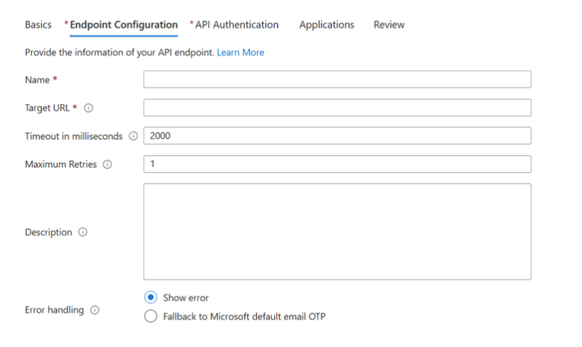
Security & Identity Updates
Action required: Azure AD Graph API retirement
Apps can’t make requests to Azure AD Graph APIs after February 1, 2025. Retirement of the Azure AD Graph API service began in September 2024 and impacts both new and existing applications.
Now All new applications will not be able to use Azure AD Graph APIs unless they are configured for extended access. Microsoft Graph is the replacement for Azure AD Graph APIs, and MS strongly recommend immediately migrating use of Azure AD Graph APIs to Microsoft Graph and limiting any further development using Azure AD Graph APIs.
MS Entra provides two recommendations:
Migrate Applications from the retiring Azure AD Graph APIs to Microsoft Graph - Details applications that are created in your tenant that are accessing Azure AD Graph APIs currently.
Migrate Service Principals from the retiring Azure AD Graph APIs to Microsoft Graph: Details multi-tenant applications provided by a software vendor that are used in your tenant and are accessing Azure AD Graph APIs currently.
Enhance end-user experiences with Custom OTP Email Provider Support
MS released custom authentication extension that enables the integration with any Microsoft and non-Microsoft email providers of choice for one time passcode events triggered during sign-up, sign-in and forgot password flows.

Slide 4
Compute

Slide 5
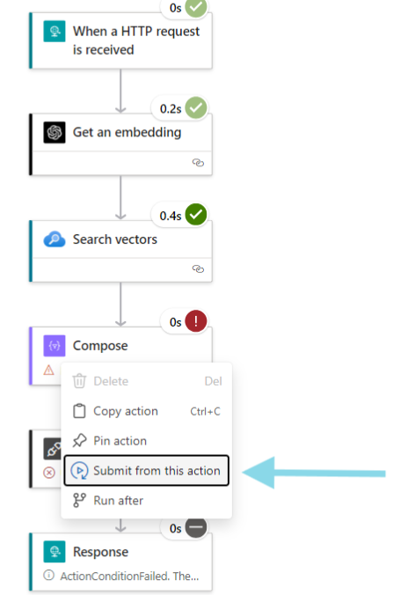
Compute Updates
Azure Automation is revising Service and Subscription Limits
Azure Automation will be revising its service limits in January 2025.
Maximum number of Automation accounts in a subscription in a region.
Maximum number of concurrent running jobs at the same instance of time per Automation account
Announcing General Availability of Resume from Action in Logic Apps
This feature allows to restart Logic App workflow from any action, saving time and effort during troubleshooting. Instead of restarting the workflow from the beginning, this functionality enables a targeted resumption, improving efficiency when debugging complex workflows.
For example, if a workflow fails due to an issue with an SQL connection, you can fix the SQL issue and resume the workflow from the action where it failed by right-clicking on the failed action in Run History view, rather than rerunning the entire process. This makes it much easier to recover and continue operations without unnecessary delays.
Resource | Limit | Notes
Maximum number of Automation accounts in a subscription in a region | 10 2 1 | Enterprise and CSP subscriptions Pay-as-you-go, Sponsored, MSDN, MPN, Azure Pass subscriptions Free trial, Azure for Student, Azure in Open subscriptions can create only one
Maximum number of concurrent running jobs at the same instance of time per Automation account per region | 50 10 5 | Enterprise and CSP subscriptions Pay-as-you-go, Sponsored, MSDN, MPN, Azure Pass subscriptions Free trial, Azure for Student, Azure in Open subscriptions

Slide 6
Storage & Data

Slide 7
Storage & Data Updates
GA: Enhancement on Elastic SAN
MS published an availability Service Level Agreement (SLA).
MS enabled CRC protection to help customers maintain the integrity of their data by providing CRC32C checksum verification. If enabled on the client side, Elastic SAN supports checksum verification at the volume group level. This will cause connections that don’t have CRC32C set for both header and data digests to be rejected, to prevent accidental errors during communication or storage of data.
Integration of Elastic SAN with Azure VMware Solution (AVS) is GA. Azure Elastic SAN offers AVS customers an Azure deployed, fully managed, VMware certified SAN that can achieve massive scale, is easy to manage, and has redundancy built in at a low TCO. AVS customers now have options to deploy their workloads based on a variety of storage performance and reliability characteristics with Elastic SAN as the native block storage, and Azure NetApp Files for native file storage. Not every workload requires the performance of directly attached storage, and many workloads like backup and disaster recovery use cases or other capacity intensive workloads can benefit from this cost-efficient, extensible storage solution.
Notebook Live Versioning
The Fabric notebook version history feature has launched! This new feature is designed to significantly improve your experience in developing and managing notebooks by providing robust built-in version control capabilities.
Automatic Checkpoints: These checkpoints are created automatically every 5 minutes based on the editing time, ensuring that work is consistently saved and versioned.
Manual Checkpoints: It is possible to create checkpoints to record development milestones, providing flexibility in how you manage your notebook versions.
Track History of Changes: Users can now view a list of previous notebook versions, see what changes were made, contributed by whom, and when.
Compare Different Versions: Easily compare different versions of a notebook through a diff view to understand the evolution of your work.
Restore Previous Versions: If you make a mistake or want to explore a different approach, you can restore previous versions of your notebook or save a new copy of it.

Slide 8
Storage & Data Updates
Announcing Real-Time Dashboards generally available
Real-Time Dashboards in Microsoft Fabric is now generally available, bringing fast, actionable insights to fingertips. Real-Time Dashboards make it easier than ever for organizations to track and act on key metrics in real-time, empowering faster decisions and deeper insights without the need for complex coding.
Real-Time Dashboards allows to monitor critical data events as they happen. Users can now set auto-refresh rates as low as 10 seconds or even continuous updates for real-time data streams, ensuring you stay up to date on every key metric.

Slide 9
Databases

Slide 10
Databases Updates
PP: Neon Serverless Postgres – an Azure Native Integration
This integration enhances developer experience by combining the power and flexibility of Neon’s serverless Postgres database service with Azure's robust cloud infrastructure.
The key features of Neon’s Postgres service include:
Instant Provisioning: Neon's architecture allows the creation of new databases in under a second, thanks to its custom-built storage engine.
Efficient Scaling: Neon automatically scales resources based on load, ensuring optimal performance during traffic spikes without the need for overprovisioning.
Integrated Developer Workflows: With features like database branching, Neon enables shorter software development lifecycles and cost-effective integration into CI/CD pipelines.
GA: Index tuning in Azure Database for PostgreSQL – Flexible Server
Now it is possible to use index tuning to analyze the most resource intensive set of queries in workload and produce recommendations of indexes that, once created, improve the performance of those queries. Index tuning also recommends indexes can be droped if they are identified as duplicates or are considered irrelevant for lack of use.
The new index tuning feature builds on query store in Azure Database for PostgreSQL - Flexible Server, which captures and retains a history of queries executed in workload and the runtime statistics of those queries.

Slide 11
Databases Updates
GA: vCore-based Azure Cosmos DB for MongoDB – up to 32 Tib Storage
Higher capacity storage with higher IOPS enables to host larger workloads on vCore-based Azure Cosmos DB for MongoDB cluster. Now during provisioning new clusters, it is possible to elevate performance by choosing from 8 TiB, 16 TiB, and 32 TiB with 16,000 IOPS, 18,000 IOPS, and 20,000 IOPS respectively. It is also possible to scale up existing clusters using any of the new storage sizes as your workloads grow.
Combining these new options with multiple physical shards in vCore-based Azure Cosmos DB for MongoDB cluster, storage capacity can comfortably handle hundreds of terabytes of data.
GA: vCore-Based Azure Cosmos DB for MongoDB multicharged cluster
It is now possible to have five physical shards on vCore-based Azure Cosmos DB for MongoDB clusters. An increased number of shards in a cluster enables to host larger workloads and get elevated performance through higher concurrency.
During creation of a vCore-based Azure Cosmos DB for MongoDB cluster, it is possible to select from one to five shards. As before, each physical shard gets the same compute (vCore count and amount of RAM) and storage (GiB and IOPS) configuration.
Using a greater number of physical shards can also help increase cluster performance for larger workloads that require multishard clusters because of better parallelization.

Slide 12
Databases Updates
GA: Cross-region replication in vCore-based Azure Cosmos DB for Mongo DB
With new support for cross-region disaster recovery in vCore-based Azure Cosmos DB for MongoDB, it is possible to create a replica of a cluster in another region. This cluster replica is continuously updated with the data written in the primary region. In the rare case of an outage in the primary region, it can be promoted this replica to become the new read-write cluster.
Also it can be used in another region for reading. This helps offload read operations from the primary cluster and deliver reads with lower latency to applications that are hosted closer to the other region.
When the cluster replica in region B is promoted and becomes the new read-write cluster, it mirrors the original configuration by maintaining a read replica in the former primary region A. The global read-write connection string always points to the cluster available for writes. It allows uninterrupted work with the database after replica cluster promotion.
GA: Azure SQL Updates
In early-December 2024, the following updates and enhancements were made to Azure SQL:
Get enhanced monitoring now that the dynamic management function (DMF) displays the component causing throttling of the primary log generation rate in Azure SQL Database Hyperscale.
Save 35% to 55% on compute costs with a one-year or three-year reservation for Azure SQL Database, now also available for zone-redundant General Purpose databases.

Slide 13
Databases Updates
GA: Azure Database for PostgreSQL – Flexible Server new regions
Azure Database for PostgreSQL – Flexible Server now available in the Spain Central and Mexico Central regions.
GA: Performance management server parameters now modifiable in Azure Database for PostgreSQL
MS announced that possibility to modify multiple performance management server parameters in Azure Database for PostgreSQL – Flexible Server. It is possible to specify the value of hash_mem_multiplier, wal_sender_timeout, and wal_receiver_timeout. You can also modify log_min_duration_sample, log_parameter_max_length, log_parameter_max_length_on_error, log_statement_sample_rate, vacuum_buffer_usage_limit, vacuum_failsafe_age, vacuum_multixact_failsafe_age , log_connections, and log_disconnections.

Slide 14
Databases Updates
PP: Azure Database for PostgreSQL – Flexible Server network monitoring metrics
MS announced the release of new network monitoring metrics in Azure Database for PostgreSQL – Flexible Server. With these enhancements, it provides a deeper insights into network activities at the virtual machine level, helping effectively identify and address network-related issues more quickly. These new metrics—including TCP Connection Backlog and Postmaster Process CPU Usage—provide actionable data that enhances the stability and reliability of your services. By enabling these features, you can be better equipped to prevent potential service outages and improve overall performance. We encourage you to enable these metrics and start monitoring today to help ensure your applications run smoothly and efficiently.
GA: High Availability health status monitoring for Azure Database for PostgreSQL – Flexible server
With the general availability of high-availability (HA) health status monitoring for Azure Database for PostgreSQL – Flexible Server, it is possible to track and maintain the health of HA-enabled instances with ease. This feature offers real-time insights into the readiness of your primary and standby replicas, helping you proactively identify and address any issues impacting availability or failover capability. Based on the Azure Resource Health Check framework, this monitoring solution enables you to optimize uptime and minimize potential disruptions to your database services.

Slide 15
Databases Updates
limited public preview of the ABORT_QUERY_EXECUTION query hint
MS announced a limited preview of a new query hint, ABORT_QUERY_EXECUTION. The hint is intended to be used as a Query Store hint to let administrators block future execution of known problematic queries, for example non-essential ad hoc queries impacting application workloads.
EXEC sys.sp_query_store_set_hints
@query_id = 17,
@query_hints = N'OPTION (USE HINT (''ABORT_QUERY_EXECUTION''))';

Slide 16
Integration

Slide 17
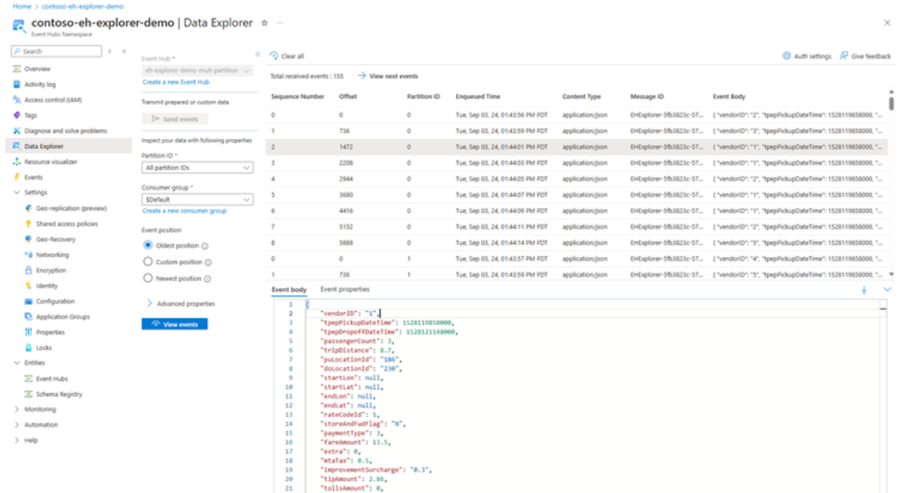
Integration Updates
Announcing the General Availability of Event Hubs Data Explorer
Developers and Operators are often looking for an easy tool to send sample data to event hub to test the end-to-end flow, or view events at a specific offset (or point in time) for light debugging, often after the fact. The Event Hubs Data Explorer makes these common workflows simple by eliminating the need to write bespoke client applications to test and inspect the data on the event hub. It allows:
Management Operations - Create, update, delete of Event Hubs namespace, and event hubs.
Data Operations - Send and view events from an event hub.

Slide 18
ML & AI & IOT

Slide 19
ML & AI & IOT Updates
GA: Azure Health Data Services de-identification
The de-identification service in Azure Health Data Services enables healthcare organizations to anonymize clinical data so that the resulting data retains its clinical relevance and distribution while also adhering to the Health Insurance Portability and Accountability Act of 1996 (HIPAA) Privacy Rule. The service uses state-of-the-art machine learning models to automatically extract, redact, or surrogate 28 entities - including the HIPAA 18 Protected Health Information (PHI) identifiers – from unstructured text such as clinical notes, transcripts, messages, or clinical trial studies.
The de-identification service is designed to receive unstructured text. To de-identify data stored in the FHIR® service, see Export de-identified data.
The following service limits are applicable:
Requests can't exceed 50 KB.
Jobs can process no more than 10,000 documents.
Each document processed by a job can't exceed 2 MB.

Slide 20
DevOps & IaC & Automation

Slide 21
DevOps & IaC & Automation
GA: New Built-in roles for Azure Chaos Studio
Azure Chaos Studio Experiment Contributor, Chaos Studio Operator, and Chaos Studio Reader are new Azure built-in roles users can utilize to manage access to Chaos Studio within organizations
Chaos Studio Experiment Contributor: Can create, run, and see details for experiments, onboard targets, and manage capabilities.
Chaos Studio Operator: Can run and see details for experiments but cannot create experiments or manage targets and capabilities.
Chaos Studio Reader: Can view targets, capabilities, experiments, and experiment details.

Slide 22
Miscellaneous

Slide 23
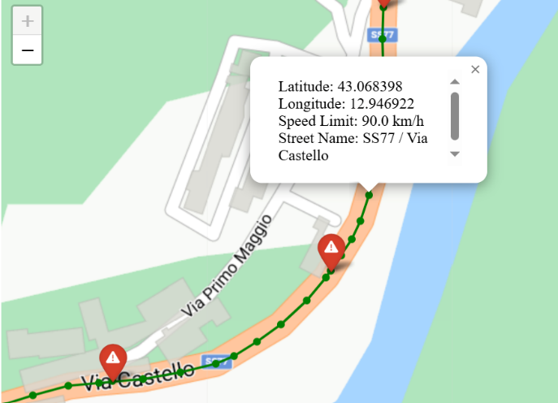
Miscellaneous Updates
Snap to Roads is now available for Azure Maps
MS introduced the Snap to Roads API in Azure Maps, a powerful API designed to transform raw GPS data into precise road-aligned coordinates. This new capability is a game-changer for businesses managing fleets and mobile assets, delivering the accuracy and context needed for efficient operations.
Whether GPS data is impacted by weak signals or environmental obstructions, the Snap to Roads API ensures tracking is precise. By aligning GPS points with real-world roads and enriching them with additional data like speed limits and street names, it provides the clarity and insights need for informed decision-making.

Slide 24
Information

Slide 25
Information
Azure Times GitHub Repo

Slide 26
Questions

