Slide 1
Azure Times #95
November 15, 2023

Slide 2
Networking

Slide 3
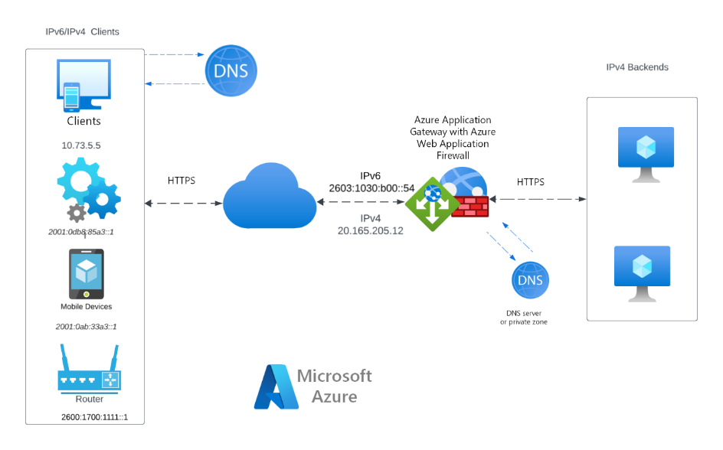
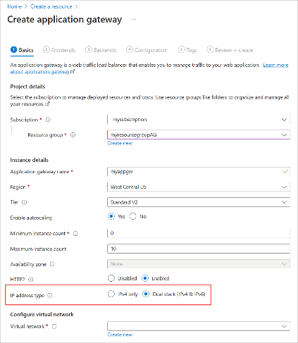
Networking Updates
Public preview: Application Gateway IPv6 support
Azure Application Gateway v2 now supports dual-stack (IPv4 and IPv6) connections at the front end. This means that Application Gateway can handle traffic from both IPv4 and IPv6 clients, offering more flexibility and connectivity to users. Whether you are facing IPv4 address exhaustion or need to comply with various regulatory requirements from government agencies, it is now possible to benefit from IPv6 addressing by creating a new Application Gateway that uses both IPv4 and IPv6 addresses.
Only v2 SKU supports a frontend with both IPv4 and IPv6 addresses
IPv6 backends are currently not supported
IPv6 private Link is currently not supported
IPv6-only Application Gateway is currently not supported. Application Gateway must be dual stack (IPv6 and IPv4)
Deletion of frontend IP addresses aren't supported
Existing IPv4 Application Gateways cannot be upgraded to dual stack Application GatewaysA dual-stack Vnet is required(dual stack VNet has subnets for both IPv4 and IPv6)
WAF rules only apply to IPv4 traffic and IPv6 traffic bypasses WAF

Slide 4
Networking Updates
General availability: Using a common port for public and private listeners
The provision enables easily use a single Application Gateway deployment to serve both internet-facing and internal clients. With this, it is not required to use non-standard ports on listeners or customize the backend application. This feature is now generally available in all public regions, Azure China cloud regions, and Azure Government cloud regions.
When using private and public listeners with the same port number, the application gateway changes the "destination" of the inbound flow to the frontend IPs of the gateway. Hence, depending on the Network Security Group's configuration, it might be needed an inbound rule with Destination IP addresses as the application gateway's public and private frontend IPs.
General availability: Rate-limit rules for Application Gateway Web Application Firewall
Rate-limit custom rules on Azure’s regional Web Application Firewall (WAF) running on Application Gateway are now available. Rate-limiting enables to detect and block abnormally high levels of traffic destined for application. By using rate limiting, it is possible to mitigate many types of denial-of-service attacks, protect against clients that have accidentally been misconfigured to send large volumes of requests in a short time period, or control traffic rates to your site from specific geographies.
Rate limiting on Application Gateway WAF_v2 uses a sliding window algorithm to determine when traffic has breached the threshold and needs to be dropped. During the first window where the threshold for the rule is breached, any more traffic matching the rate limit rule is dropped.
Rate limit rules are only supported on Web Application Firewalls running the latest WAF engine

Slide 5
Security & Identity

Slide 6
Security & Identity Updates
Microsoft Defender for Cloud Apps
Automatic redirect to Microsoft 365 Defender general availability
Now, all customers are automatically redirected to Microsoft 365 Defender from the classic Microsoft Defender for Cloud Apps portal, as the redirect is in general availability. Admins can still update the redirect setting as needed to continue using the classic Defender for Cloud Apps portal.
Integrating Defender for Cloud Apps inside Microsoft 365 Defender streamlines the process of detecting, investigating, and mitigating threats to your users, apps, and data – so that you can review many alerts and incidents from a single pane of glass, in one XDR system.
Microsoft Defender for Cloud latest protection against sophisticated abuse of Azure VM Extensions
MS announced a new protection as a result of extensive research and monitoring, thus announcing the new and enhanced protection capabilities that Microsoft Defender for Cloud offers as part of Microsoft Defender for Servers plan 2 offering, against extension abuse, and its importance.
Microsoft Defender for Servers can now detect suspicious activity of the virtual machine extensions, allowing to get better coverage of the workload's security.
Azure virtual machine extensions are small applications that run post-deployment on virtual machines and provide capabilities such as configuration, automation, monitoring, security, and more. While extensions are a powerful tool, they can be used by threat actors for various malicious intents, for example:
Data collection and monitoring
Code execution and configuration deployment with high privileges
Resetting credentials and creating administrative users
Encrypting disks

Slide 7
Security & Identity Updates
SMB firewall rule changes in Windows Insider
Starting with Windows 11 Insider preview Build 25992 (Canary), creating SMB shares changes a longtime Windows Defender Firewall default behavior.
Before: Previously, creating a share automatically configured the firewall to enable the rules in the “File and Printer Sharing” group for the given firewall profiles.
Now: Windows now automatically configures the new “File and Printer Sharing (Restrictive)” group when you create an SMB share, which no longer contains inbound NetBIOS ports 137-139. Those ports are not used by SMB2 or later and are an artifact of SMB1.
This change enforces a higher degree of default of network security as well as bringing SMB firewall rules closer to the Windows Server “File Server” role behavior, which only opens the minimum ports needed to connect and manage sharing.
SMB alternative ports now supported in Windows Insiders
Starting with Windows 11 Insider preview Build 25992 (Canary), the SMB client now supports connecting to an SMB server over TCP, QUIC, or RDMA using alternative network ports.
Before: SMB server in Windows has required inbound connections using the IANA-registered port TCP/445 for decades, and the SMB TCP client has only supported connecting outbound to that TCP port. The newer SMB over QUIC protocol requires the QUIC-mandated UDP/443, both for server and client. Until now these were hard-coded and unalterable.
Now: It is possible to connect to alternative TCP, QUIC, and RDMA ports with the SMB client as long as the SMB server supports listening on that port and has been configured to do so.
NET USE \\server\share /TCPPORT:<some port between 0 and 65536>
NET USE \\server\share /QUICPORT:<some port between 0 and 65536>
NET USE \\server\share /RDMAPORT:<some port between 0 and 65536>
NOTE: Windows Server Insider does not support changing the SMB server TCP listening port to something besides the default 445.

Slide 8
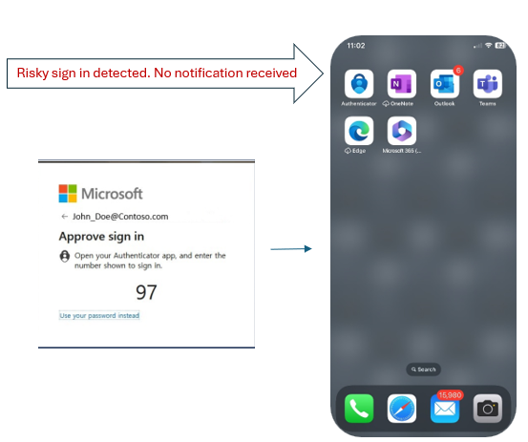
Security & Identity Updates
Suppressing Risky Authenticator Notifications
Microsoft announced a new security feature that suppresses Authenticator notifications when a request displays potential risks, such as when it originates from an unfamiliar location or is exhibiting other anomalies. This approach significantly reduces user inconvenience by eliminating irrelevant authentication prompts.
In the event of a login request that looks risky to, the standard notification will not be sent to the user. Instead, they’ll be given the following instructions: “Open your Authenticator app and enter the number shown to sign in,” with no corresponding notification displayed on the user's phone.
When the user opens their Authenticator app, it will present the request, allowing the user to take appropriate action.
It’s important to note that the notifications are not deleted. They’re simply suppressed and can still be accessed by the user within the Authenticator App. If a user encounters a genuine request from an unusual source, they can retrieve the notification by accessing their authenticator app. The app serves as a repository for all authenticator notifications, ensuring users have a convenient way to retrieve any missed requests.
Automatic Conditional Access policies in Microsoft Entra streamline identity protection
Many customers use security defaults, but many others need more granular control than security defaults offer. Customers may not be in a position to disable legacy authentication for certain accounts (a requirement for security defaults), or they may need to make exceptions for certain automation cases.
Microsoft-managed Conditional Access policies provide clear, self-deploying guidance. Customers can tune the policies (or disable them altogether), so even the largest, most sophisticated organizations can benefit from them. Over time, we’ll offer policies tailored to specific organizations, but we’re starting simple.

Slide 9
Management & Governance

Slide 10
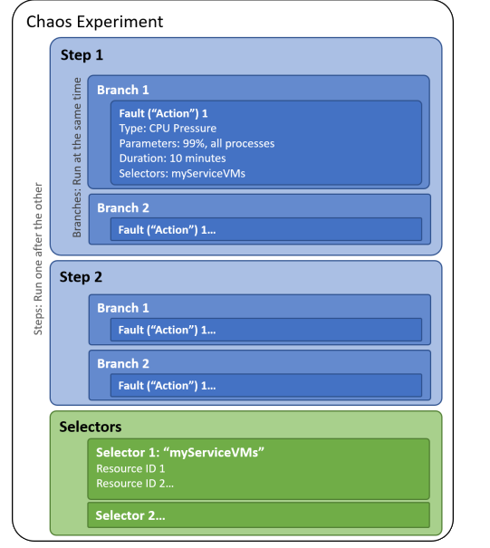
Management & Governance Updates
Azure Monitor managed service for Prometheus is available in 7 additional Azure regions
Azure Monitor managed service for Prometheus allows to collect and analyze metrics at scale using a Prometheus-compatible monitoring solution, based on the Prometheus project from the Cloud Native Computing Foundation. This fully managed service allows to use the Prometheus query language (PromQL) to analyze and alert on the performance of monitored infrastructure and workloads without operating the underlying infrastructure.
Azure Managed Prometheus was announced GA in May 2023 and was available in 19 regions, with this new update Azure Managed Prometheus will be available in 7 additional public Azure regions.
Customer-Managed Keys (preview) integration with Azure Chaos Studio
Azure Chaos Studio now supports running Experiments encrypted using your own (Customer-managed) encryption keys. This feature is in preview and is supported on all Chaos Studio experiments via REST API and preview SDKs only. Run Chaos Experiments and have fine-grained control over key-rotation policies using CMK for Chaos Studio. Available using the 2023-10-27-preview REST API.

Slide 11
Management & Governance Updates
General Availability: Azure Advisor recommendation improves the reliability of Azure Disks with Zone Redundant Storage
Disks with Zone Redundant Storage (ZRS) provide synchronous replication of data across three Availability Zones in a region. By adopting this recommendation, it is possible to design solutions to utilize ZRS Disks, ensuring disks can withstand a zonal outage.
Latency metrics for disks and performance metrics for temporary disks on Azure Virtual Machines
MS Introduced the capability to monitor latency (in preview) across OS, data, and temporary disks using the SCSI protocol (default), with support for the NVMe protocol coming soon. This enhancement is particularly important for high-performance applications such as SAP Hana and OLTP databases, where latency plays a crucial role in read and write operations. Now, it is possible to track the latency of disk operations on OS, data, and temporary disks using Azure Monitor metrics.
In addition, temporary disks, which are inherently non-persistent and are typically found in Virtual Machines (VM) families marked with a 'd' in their name, such as the edsv5 family, have now become accessible for performance monitoring on Azure Monitor. It is now possible to track queue depth, IOPS and throughput for these temporary disks, even though their storage does not endure beyond the lifecycle of the associated VM.

Slide 12
Management & Governance Updates
Azure Monitor Logs archive provides up to 12 years of retention
Over a year ago, Azure Monitor Logs launched a log archive solution that retains logs for up to seven years at a reduced cost. This capability is valuable for many customers with regulations that require them to retain data for long periods.
MS announced that they extended the supported retention period, and Azure Monitor Logs now supports up to 12 years of data retention.
Ability to add dynamic values in Alert’s custom fields
In the Details tab at the advance options there is the Custom properties section, if it is configured with action groups. At this section it is possible to add custom properties to include in the alert notification payload. It is possible to use these properties in the actions called by the action group, such as webhook, Azure function or logic app actions.
As a part of those custom properties a dynamic value extracted from the alert payload, or a combination of both can be added to the alert notification payload.
Use the common alert schema format to specify the field in the payload, whether or not the action groups configured for the alert rule use the common schema.

Slide 13
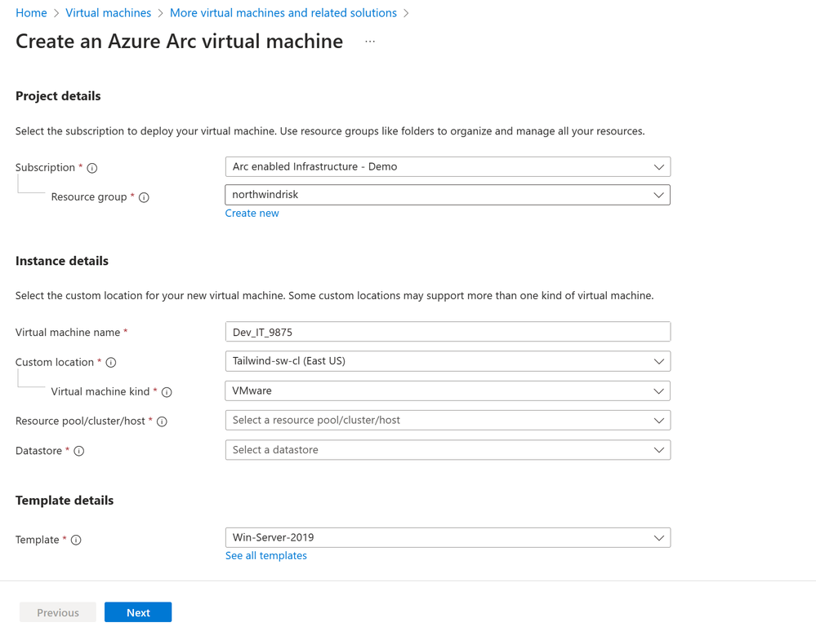
Management & Governance Updates
Announcing GA of VMware vSphere enabled by Azure Arc
MS announced that VMware vSphere enabled by Azure Arc is now generally available to manage VMware resources in Azure.
With VMware vSphere enabled by Azure Arc, you can:
Enable Azure services at scale for entire VMware estate – on-premises, AVS and multicloud
Enable self-service access and management to VMware resources for developers and end users
It is now possible to discover the entire VMware estate, install Azure Arc agents at scale directly from Azure, and easily onboard VMware machines to Azure management services. It is possible to use services like Microsoft Defender for Cloud, Azure Monitor, Azure Update Manager, and more to enhance the security, monitoring, and governance of VMware machines.
IT administrators can use Azure RBAC to set up self-serve access to VMware resources for developers and end users. End users can provision virtual machines with ease on VMware vSphere using Azure portal, ARM and bicep templates. They can perform virtual hardware operations like start, stop, restart, resize, add and manage disks on VMware machines from Azure.

Slide 14
Compute

Slide 15
Compute Updates
Version 1.2.4763 of the Windows Desktop client for AVD has been released to all users!
Added a link to the troubleshooting documentation to error messages to help users resolve minor issues without needing to contact Microsoft Support.
Improved the connection bar user interface (UI).
Fixed an issue that caused the client to stop responding when a user tries to resize the client window during a Teams video call.
Fixed a bug that prevented the client from loading more than 255 workspaces.
Fixed an authentication issue that allowed users to choose a different account whenever the client required more interaction.
Improved client logging, diagnostics, and error classification to help admins troubleshoot connection and feed issues.
Azure Red Hat OpenShift November 2023 updates
Azure Red Hat OpenShift(ARO) provides highly available, fully managed OpenShift clusters on demand, monitored and operated jointly by Microsoft and Red Hat.
The latest Azure Red Hat OpenShift update delivers the following enhancements:
Extended support: OpenShift 4.12 now offers an extended 14-month support lifecycle for users.
Larger cluster size: Customers can now deploy Azure Red Hat OpenShift clusters with more worker nodes. The new limit is up to 120 nodes, up from the previous limit of 62 nodes.
Tagging: It is now possible to use Azure Policy to tag resources in an ARO cluster's resource group. The process creates a policy assignment and an ARO cluster through the Azure CLI.

Slide 16
Compute Updates
General availability: Introducing NGads V620 Series VMs optimized for gaming scenarios
The NGads V620 series are GPU-enabled virtual machines powered by AMD Radeon(tm) PRO V620 GPUs and AMD EPYC 7763(Milan) CPUs. The NGads V620 VMs provide GPU, CPU, and memory resources optimized for a high-quality, interactive gaming experience hosted in Azure.
The VMs feature GPU Partitioning to provide VMs with ¼, ½, or 1 whole GPU, allowing customers to right-size their choice for the performance and cost for their business needs. The NGads V620 series also features NVMe drives standard with each VM size, with up to 1025 GB of temp storage for very fast local data access.
The other critical component provided by the NGads V620 series is the AMD Software: Cloud Edition, which targets the same optimizations available in the consumer gaming version of the AMD Adrenaline driver. It is further tested and optimized for the cloud environment and is updated frequently to capture the latest game releases.
The AMD Software: Cloud Edition includes support for accelerated virtual desktop environments, with Radeon PRO optimizations to support high-end workstation applications for design or rendering.
Public Preview: App Service End-to-end (E2E) Encryption for Linux Multi-tenant Resources
MS announced that the end-to-end (E2E) TLS encryption for intra-cluster traffic between App Service front-ends and workers, which used to be only available for App Service Environment (ASE) resources, is now available in Preview for multi-tenant Linux App Service.
By default, all App Service resources will have their TLS encryption terminated in the front-end.
PUT https://management.azure.com/subscriptions/{subscriptionId}/resourceGroups/{resourceGroupName}/providers/Microsoft.Web/sites/{name}?api-version=2022-03-01
{
"location": "<region>",
"properties": {
"endToEndEncryptionEnabled": true
}
}

Slide 17
Compute Updates
Public preview: Enhancements for Istio-based service mesh add-on for AKS
Istio-based service mesh add-on for AKS, currently in public preview, is launching several new features that provide egress support:
Minor version upgrade: Previously, AKS provided automatic weekly updates for patch versions of Istio. Now, it is possible to perform explicit upgrades from minor version/release of Istio to the next.
Bring your own certificate authority (CA): Previously the add-on only supported self-signed certificate authority. With this new feature, it can be configured with bring your own CA by providing inputs via Azure Key Vault and later be able to reference the same in the service mesh profile.
Egress: Istio uses ingress and egress gateways to configure load balancers executing at the edge of a service mesh. An ingress gateway allows to define entry points into the mesh that all incoming traffic flows through. Public and private ingresses are already supported with the mesh add-on. Istio add-on now supports egress gateways, which defines exit points from the mesh. Egress gateways allow to apply Istio features, for example, monitoring and route rules, to traffic exiting the mesh
Public preview: Artifact streaming support in Azure Kubernetes Service (AKS)
It is now possible to accelerate containerized workloads on Azure Kubernetes Service (AKS) using Azure Container Registry (ACR) artifact streaming. Artifact streaming will allow to scale workloads without having to fully wait for images to be pulled into the clusters.
Artifact Streaming is available now for Linux-based container images via the ACR and AKS Preview API. CLI and Portal support will be available in the next two weeks.
Preview: Azure Container Storage in AKS
Azure Container Storage (in preview) provides highly scalable, cost-effective persistent volumes, built natively for containers. Azure Container Storage provides rapid scale out of volumes, reduced pod failover time, reduced total cost of ownership, consistently across different block storage options, including ephemeral disks, Azure Disks and Azure Elastic SAN.
Preview Updates:
Configure multi-zone storage pools for high availability and redundancy
Secure storage pools using server-side encryption with customer-managed keys
Dynamically resize volumes
Protect and recover volumes in a storage pool using snapshot and clone

Slide 18
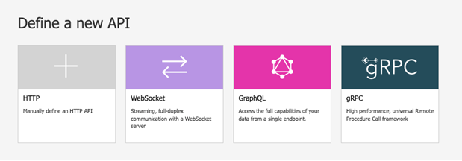
Compute Updates
Introducing gRPC API Support in Azure API Management Self-Hosted Gateway
MS announced the public preview of gRPC support in Azure API Management in the self-hosted gateway. This new feature allows customers to manage their gRPC services as APIs in Azure API Management.
It provides:
Full gRPC support.
First-Class Schema Support.
Security and Compliance.
Unified Management.
Deployment Flexibility.
Distributed Caching with Azure Redis to boost your WordPress site's Performance
MS announced the integration of Azure Redis Cache with WordPress on App Service. The integration of WordPress on App Service and Azure Cache for Redis offers improved user experience, reduced load on the App Service and database, and the flexibility to handle increased demands with ease.
Caching in WordPress is a technique used to improve the performance and speed of WordPress website. By caching certain parts of website or entire pages, you can reduce the load on server and decrease page load times for visitors. Caching can significantly improve the performance of WordPress site, particularly when site experiences high traffic loads.
Azure Redis Cache is a fully managed, in-memory data store service offered by Microsoft Azure. It is based on the popular open-source Redis database and is used to build high-performance, scalable applications by providing a fast and low-latency data cache. Azure Redis Cache is designed to handle data storage and retrieval in memory, which makes it suitable for scenarios where you need to accelerate data access and reduce the load on backend data stores or databases.

Slide 19
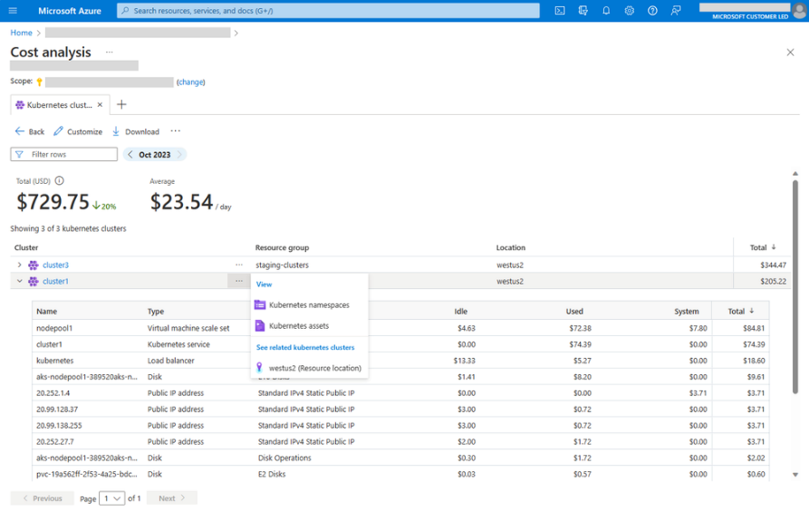
Compute Updates
AKS Cost Analysis add-on
MS announced the preview of the AKS Cost Analysis add-on, an Azure native experience that enables granular breakdown of AKS cluster costs. This add-on is built on the OpenCost project and available for Standard and Premium tier AKS clusters at no additional cost. Cost allocation data is reported directly in the Azure Portal.
AKS is the first Azure service to provide service-specific cost drill downs. Azure Cost Management will now offer Kubernetes-specific views in the Cost Analysis UI to show cost allocation of AKS cluster infrastructure resources (ex: VMSS, public IPs, disks, etc.) by Kubernetes specific constructs like cluster and namespace. This added granularity will help organizations understand exactly how much individual applications cost and which clusters or applications need optimization.
Shared costs such as idle, system reserved, and service SLA costs, which typically can’t be apportioned to a specific namespace are also reported. This gives organizations the flexibility to allocate shared costs in the way that works best for their scenario – proportionally, by fixed percentage, uniformly etc.

Slide 20
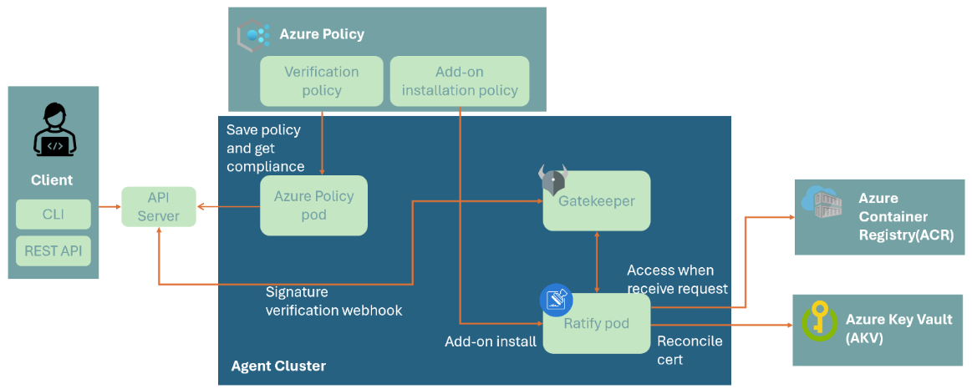
Compute Updates
Public preview: Image integrity support in Azure Kubernetes Service (AKS)
Using signed container images helps verify that deployments are built from a trusted entity and that images haven't been tampered with since their creation.
Image integrity for AKS allows to add an Azure Policy built-in definition to verify that only signed images are deployed to your AKS clusters.
Image Integrity is a feature based on Ratify. On an AKS cluster, the feature name and property name is ImageIntegrity, while the relevant Image Integrity pods' names contain Ratify.
AKS clusters must run Kubernetes version 1.26 or above.
Image Integrity supports a maximum of 200 unique signatures concurrently cluster-wide.
Notation is the only supported verifier.
Audit is the only supported verification policy effect.

Slide 21
Compute Updates
GA: Kubernetes 1.28 support in Azure Kubernetes Service (AKS)
AKS support for Kubernetes version 1.28 is now generally available.
Kubernetes 1.28 contains over 40 features and enhancements with continued improvement on reliability and performance.
GA: Kube-reserved resource optimization in Azure Kubernetes Service (AKS)
Reserved space contains resources set aside on a node, such as system daemons that back Kubernetes and the operating system itself. If these resources are not allocated sufficient reserved space, pods and system daemons will compete. This competition leads to starvation on the node.
Azure Kubernetes Service (AKS) addresses this issue by enforcing a rate at which it reserves space, as detailed by the Kube-reserved flag. This flag shows the resource reservation for Kubernetes system daemons including kubelet, container runtime, and more.
Optimized AKS reservation logic reduces Kube-reserved memory by up to 20% depending on the node configuration and will apply to everyone.
GA: Kubernetes Event-driven Autoscaling (KEDA) Add-on for AKS
The Kubernetes Event-driven Autoscaling(KEDA) add-on or AKS is now generally available.
KEDA is a single-purpose and lightweight component that strives to make application autoscaling simple and is a CNCF-graduated project. It applies event-driven autoscaling to scale your application to meet demand in a sustainable and cost-efficient manner with scale-to-zero.
The KEDA add-on makes it even easier by deploying a managed KEDA installation and provides a rich catalog of more than 60 KEDA scalers that can be used to scale applications on the AKS cluster.
Provider for running Karpenter on Azure Kubernetes Service (AKS)
Karpenter is an open-source node provisioning project for Kubernetes. A new provider for running Karpenter on Azure Kubernetes Service is now available as an open-source project.
Karpenter improves the efficiency and cost of running workloads on Kubernetes clusters by:
Watching for pods that the Kubernetes scheduler has marked as unschedulable
Evaluating scheduling constraints (resource requests, nodeselectors, affinities, tolerations, and topology spread constraints) requested by the pods
Provisioning nodes that meet the requirements of the pods
Scheduling the pods to run on the new nodes
Removing the nodes when the nodes are no longer needed

Slide 22
Compute Updates
GA: Application routing add-on for Azure Kubernetes Service (AKS)
Application routing add-on for Azure Kubernetes Service (AKS) is now generally available.
App routing is the easiest way to get web application up and running in AKS securely while removing the complexity of setting up an ingress controller, certificate, and DNS management all while constructing a solid foundation that enterprises can utilize as their demands grow.
App routing offers a supported and managed ingress controller powered by the ingress-nginx project.
The application routing add-on supports up to five Azure DNS zones.
All public Azure DNS zones integrated with the add-on have to be in the same resource group.
All private Azure DNS zones integrated with the add-on have to be in the same resource group.
Editing any resources in the app-routing-system namespace, including the Ingress-nginx ConfigMap isn't supported.
Snippet annotations on the Ingress resources through nginx.ingress.kubernetes.io/configuration-snippet aren't supported.
Public preview: Dual-stack networking in Azure CNI Overlay for AKS
Dual-stack support in Azure CNI Overlay for AKS is now in public preview. This preview release enhances AKS networking capabilities, allowing both IPv4 and IPv6 addresses to coexist and operate within the same Cluster, offering greater flexibility and connectivity options. The Azure CNI Overlay model, known for its performance and scaling merits, now extends its advantages to dual-stack networking, ensuring seamless communication with external systems operating on either IP address family. This feature not only addresses the growing demand for IPv6 support but also facilitates a smooth transition for enterprises adapting to the evolving network standards.
In this configuration, nodes receive both an IPv4 and IPv6 address from the Azure virtual network subnet. Pods receive both an IPv4 and IPv6 address from a logically different address space to the Azure virtual network subnet of the nodes. Network address translation (NAT) is then configured so that the pods can reach resources on the Azure virtual network. The source IP address of the traffic is NAT'd to the node's primary IP address of the same family (IPv4 to IPv4 and IPv6 to IPv6).

Slide 23
Storage & Data

Slide 24
Storage & Data Updates
Azure NetApp Files datastores for Azure VMware Solution is available in US Government regions.
Azure NetApp Files datastores are now generally available in the US Gov Cloud to run storage-intensive workloads on Azure VMware Solution (AVS). This integration between Azure VMware Solution and Azure NetApp Files allows the creation of datastores via the Azure VMware Solution resource provider with Azure NetApp Files NFS volumes and attaches the datastores to private cloud clusters of choice. With this capability, it is possible to scale storage independently of computing and can go beyond the limits of the local instance storage provided by vSAN reducing the total cost of ownership.
Region Availability:
US Gov Virginia & US Gov Arizona
Azure Elastic SAN updates: Security, and Usability
Updates:
Improved Elastic SAN's performance by reducing latency and simplifying management with features like:
live volume resizing
force delete
Elastic SAN now is a VMware Certified datastore
Support for Server-Side Encryption with Customer Managed Keys (SSE with CMK)

Slide 25
Storage & Data Updates
Azure support for TLS 1.0 and TLS 1.1 will end by 31 October 2024
To enhance security and provide best-in-class encryption for your data, MS will require interactions with Azure services to be secured using Transport Layer Security (TLS) 1.2 or later beginning 31 October 2024, when support for TLS 1.0 and 1.1 will end.
The Microsoft implementation of older TLS versions is not known to be vulnerable, however, TLS 1.2 and later offer improved security with features such as perfect forward secrecy and stronger cipher suites.

Slide 26
Databases

Slide 27
Databases Updates
Public Preview: Azure SQL updates for early-November 2023
Announcing a significant update to the Azure SQL Database Elastic Jobs preview! This update adds many new features while maintaining full backward compatibility for existing job agents.
Microsoft Entra ID (formerly Azure Active Directory) support
Service-managed Private Link support to securely connect to target databases.
Integration with Azure Alerts for job execution status
Easily scale Job Agent’s tier to connect to more targets concurrently.

Slide 28
Miscellaneous

Slide 29
Miscellaneous Updates
Introducing AI-powered application security testing with GitHub Advanced Security
Three AI-powered features were released to GitHub Advanced Security:
Code scanning autofix - autofix capability designed to help developers achieve faster fix times, leading to increased productivity, less technical security debt, and more secure code. It provides AI-generated fixes for CodeQL JavaScript and TypeScript alerts right in pull requests. These are not just any fixes, but precise, actionable suggestions that will allow to quickly understand what the vulnerability is and how to remediate it.
Detect leaked passwords with secret scanning - Currently in limited public beta, secret scanning now leverages the power of AI to detect generic or unstructured secrets in your code.
GitHub now includes an AI-powered experience for authoring custom patterns - This new feature enables you to execute dry runs in real time to ensure proper scanning before saving the newly created pattern.
Universe 2023: Copilot transforms GitHub into the AI-powered developer platform
GitHub is announcing the general availability of:
GitHub Copilot Chat - Copilot Chat will be generally available in December 2023
GitHub Copilot Chat is coming to github.com and mobile app
Previews of
GitHub Copilot Enterprise - Copilot Enterprise allows teams of developers to quickly get up to speed on own codebase, search through and build documentation, get suggestions based on internal and private code, and quickly review pull requests. Additionally, smart actions, such as the ability to generate pull request summaries, will be available throughout GitHub helping developers stay in their flow state with the click of a button. And of course, this all comes with enterprise-grade security, safety and privacy.
GitHub Copilot Partner Program - GitHub Copilot will be supercharging by integrating it with third-party developer tools, online services, and knowledge outside GitHub. The GitHub Copilot Partner Program will create an ecosystem for new networks and ingenuity to be infused into GitHub Copilot.

Slide 30
Information

Slide 31
Information
Azure Times GitHub Repo

Slide 32
Questions

