Slide 1
Azure Times #113
April 10, 2024

Slide 2
Networking

Slide 3
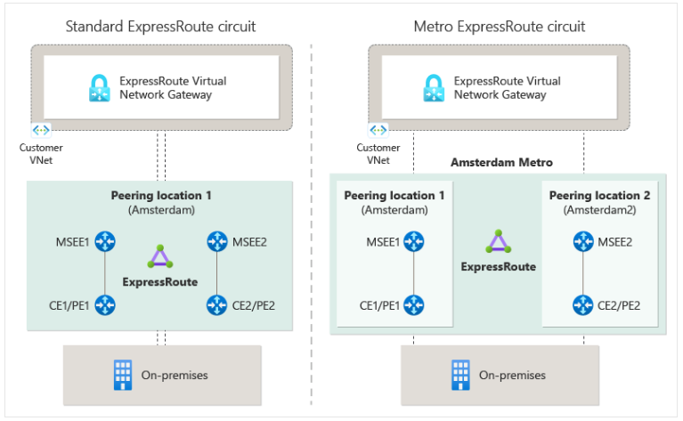
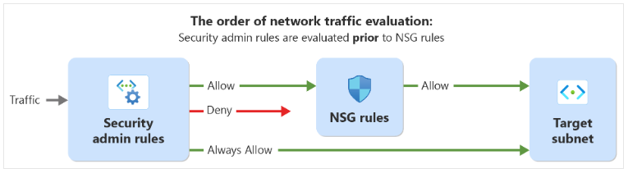
Networking Updates
Azure Virtual Network Manager Security Admin Rule generally available in 45 regions
Azure Virtual Network Manager's security admin rule configuration feature is now generally available (GA) in 45 regions.
This feature allows to enforce security policies for virtual networks at scale across subscriptions and regions globally. These rules will be evaluated before network security groups (NSGs), ensuring standardized security enforcement. They help prevent potential misconfigurations and oversights, making sure that critical services run without interruption and that network owners adhere to company policies.
Security admin rules allow users to manage security efficiently, reducing operational complexities. They also offer a default setting to avoid errors or oversights in setting up NSGs. As such, users can simplify and enhance their network security for their growing network environments.
Public preview: ExpressRoute Metro for High Resiliency
The standard ExpressRoute configuration is set up with a pair of links to enhance the reliability of ExpressRoute connection. This setup is designed to provide redundancy and improves the availability of ExpressRoute connections during hardware failures, maintenance events, or other unforeseen incidents within the peering locations. However, these redundant connections don't provide resilience against certain events. These events could disrupt or isolate the edge location where the MSEE devices are located. Such disruptions could potentially lead to a complete loss of connectivity from on-premises networks to cloud services.
ExpressRoute Metro (preview) is a high-resiliency configuration designed to provide multi-site redundancy. This configuration allows to benefit from a dual-homed setup that facilitates diverse connections to two distinct ExpressRoute peering locations within a city.

Slide 4
Security & Identity

Slide 5
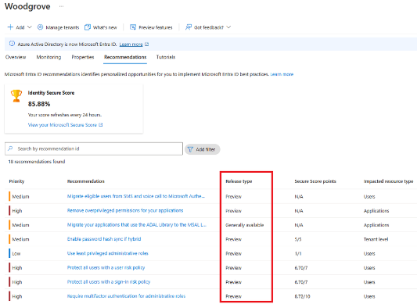
Security & Identity Updates
Introducing new and upcoming Entra Recommendations to enhance security and productivity
MS announced the upcoming general availability of new recommendations, and another three recommendations in public preview.
Remove unused credentials from applications
Renew expiring service principal credentials
Renew expiring application credentials
Remove unused applications
Migrate applications from the retiring Azure AD Graph APIs to Microsoft Graph
Migrate Service Principals from the retiring Azure AD Graph APIs to Microsoft Graph
Important update: Deprecation of Azure AD PowerShell and MSOnline PowerShell modules
As of March 30, 2024, these PowerShell modules are now deprecated:
Azure AD PowerShell (AzureAD)
Azure AD PowerShell Preview (AzureADPreview)
MS Online (MSOnline)
Support will only be offered for critical security fixes. They will continue to function through March 30, 2025. Note: Only MSOnline versions 1.1.166.0 (2017) and later are assured to function through March 30, 2025. Use of versions earlier than 1.1.166.0 may experience disruptions after June 30, 2024.
Please migrate to Microsoft Graph PowerShell SDK as soon as possible.

Slide 6
Security & Identity Updates
Important update: Azure AD Graph API retirement
After June 30, 2024, MS will start a rollout for the first stage of Azure AD Graph retirement. Entra ID Applications that are created after June 30, 2024 will receive an error for any API requests to Azure AD Graph APIs (https://graph.windows.net).
Applications that are created before June 30, 2024 will not be impacted or experience interruption at this stage.
To allow an application created after June 30, 2024 to have an extension for access to Azure AD Graph APIs, you must make a configuration change on the application after it’s created. This configuration change is done through the AuthenticationBehaviors interface. By setting the blockAzureADGraphAccess flag to false, the newly created application will be able to continue to use Azure AD Graph APIs until further in the retirement cycle.
Azure Multi-Factor Authentication Server - 6-month notice
Beginning September 30, 2024, Azure Multi-Factor Authentication Server deployments will no longer service multifactor authentication (MFA) requests, which could cause authentications to fail for your organization. MFA Server will have limited SLA and MFA Activity Report in the Azure Portal will no longer be available. To ensure uninterrupted authentication services and to remain in a supported state, organizations should migrate their users’ authentication data to the cloud-based Azure MFA service using the latest Migration Utility included in the most recent Azure MFA Server update. Learn more at Azure MFA Server Migration.
Entra Connect v2.3.8.0 upgrades Entra Connect Health
Microsoft Entra Connect Health has been updated to 4.5.2466.0 to address an endpoint discovery issue that could occur in some clouds.
Microsoft Entra Connect 2.x version retirement
In March of 2023, Microsoft started retiring past versions of Microsoft Entra Connect Sync 2.x 12 months from the date they were superseded by a newer version. Currently only builds 2.1.20.0 (release November 9, 2022) or later are supported.
Changes in Dynamic Group rule builder
To encourage efficient dynamic group rules, the dynamic group rule builder UX in both Entra and Intune Admin Centers has been updated. As of July 2024, the 'match' and 'notMatch' operators have been removed from the rule builder because they are less efficient and should only be used when necessary.

Slide 7
Security & Identity Updates
Secrets scanning for Cloud deployments
MS released a new capability in Public Preview: Secrets scanning for cloud deployments(a cloud deployment is an instance of IaC template)! Covering Azure and AWS during Public Preview.
The scanning of deployment resources operates entirely without agents, relying solely on the control plane’s API. This capability allows for a comprehensive & continuous scan of all organizational deployment resources, ensuring they are safeguarded against secret exposures.
The new capability is included in Defender CSPM and automatically enabled during onboarding. For existing Defender CSPM customers, no further action is required, and the new feature already covers your cloud deployments.
Relevant recommendations for this capability:
Azure Resource manager deployments should have secrets findings resolved.
AWS CloudFormation stack should have secrets findings resolved
Microsoft Defender for Cloud Free Trial per Plan
Historically, Microsoft Defender for Cloud offered new users a 30-day free trial, commencing from the activation of their first plan. While beneficial, this model posed limitations. If a user activated the D4Servers plan and, 20 days later, decided to explore the DCSPM plan, the latter would only enjoy a 10-day free trial. Moreover, any plans activated post the initial 30-day window would incur immediate charges, potentially deterring users from exploring the full spectrum of MDC's offerings.
The "Trial per Plan" feature elegantly addresses these concerns by resetting the clock with each new plan activation. This means if you start with the D4Servers plan, you get 30 days free, and should you decide to activate the DCSPM plan later, regardless of the timing, another 30-day free trial kicks off for that specific plan.

Slide 8
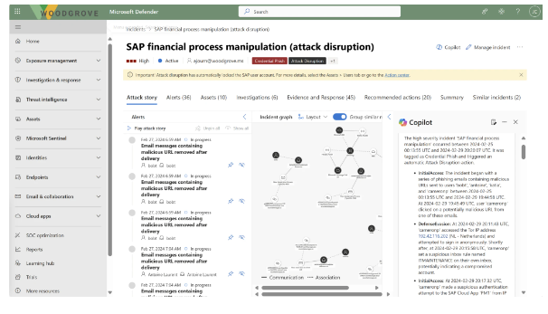
Security & Identity Updates
Microsoft’s unified security operations platform, now in public preview
Microsoft Sentinel is available as part of the public preview for the unified security operations platform in the Microsoft Defender portal. When you onboard Microsoft Sentinel to the Microsoft Defender portal, you unify capabilities with Microsoft Defender XDR like incident management and advanced hunting. Reduce tool switching and build a more context-focused investigation that expedites incident response and stops breaches faster.
The Microsoft Defender portal supports a single Microsoft Entra tenant and the connection to one workspace at a time.

Slide 9
Management & Governance

Slide 10
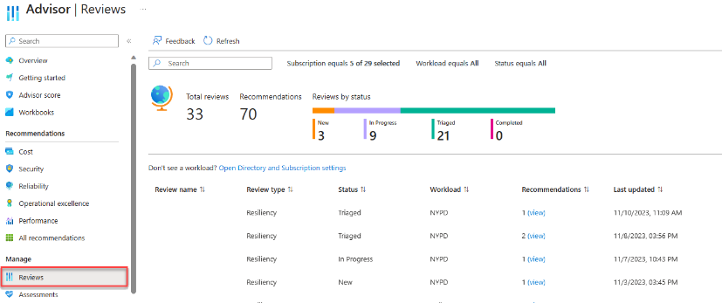
Management & Governance Updates
Public Preview: Resiliency Review on Azure Advisor
Recommendations from WAF Reliability reviews in Advisor helps focus on the most important recommendations to ensure workloads remain resilient. As part of the review, personalized and prioritized recommendations from Microsoft Cloud Solution Architects will be presented.
Resiliency reviews are available to customers with Unified or Premier Support contracts via a Well Architected Reliability Assessment.
Public Preview: High Volume Email for Microsoft 365
MS announced the public preview of High-Volume Email (HVE) for Microsoft 365. HVE is a new service designed primarily for line of business applications and other high-volume SMTP Auth submissions that enables to send internal messages beyond the current limits of Exchange Online. Customers using on-premises servers in an Exchange hybrid configuration to send a large volume of internal messages can use this service instead and decommission their on-premises servers.
HVE allows you to create MailUsers (up to 20 during the preview) in Exchange Online that can send messages using a specific SMTP endpoint.
Server/Endpoint: smtp-hve.office365.com
Port: 587
TLS: STARTTLS
TLS 1.2 and TLS 1.3 are supported
Authentication: Username and password

Slide 11
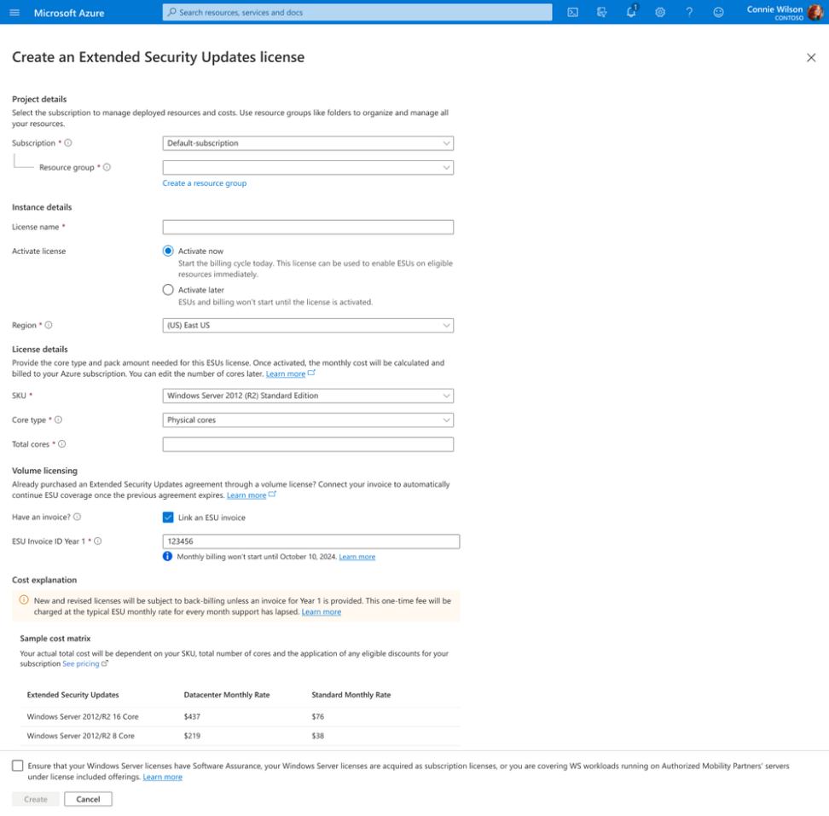
Management & Governance Updates
Transition to WS2012/R2 ESUs enabled by Azure Arc for Year 2 and beyond
Customers will be able to transition to Azure Arc for WS2012 Extended Security Updates enabled by Azure Arc for Year 2 if they had purchased Year 1 of Extended Security Updates for Volume Licensing. This experience will ask customers to supply their Invoice Id, corresponding to WS2012 ESU purchases from Volume Licensing.
With its pay as you go flexibility as an Azure billed service and inclusion of Azure management services like Azure Update Manager and Machine Configuration at no additional cost, WS2012 ESUs enabled by Azure Arc offer financial and experience benefits to customers. This is especially critical to support customers in their journey of migrating and modernizing End of Life infrastructure to Azure.

Slide 12
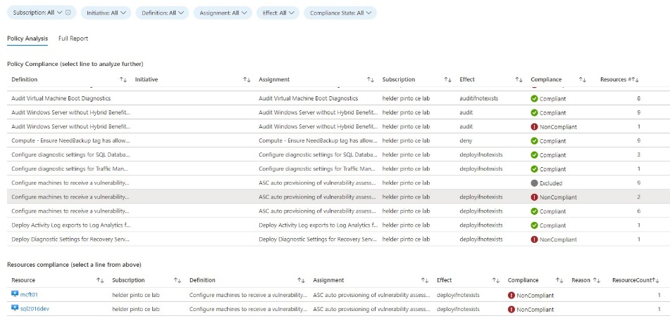
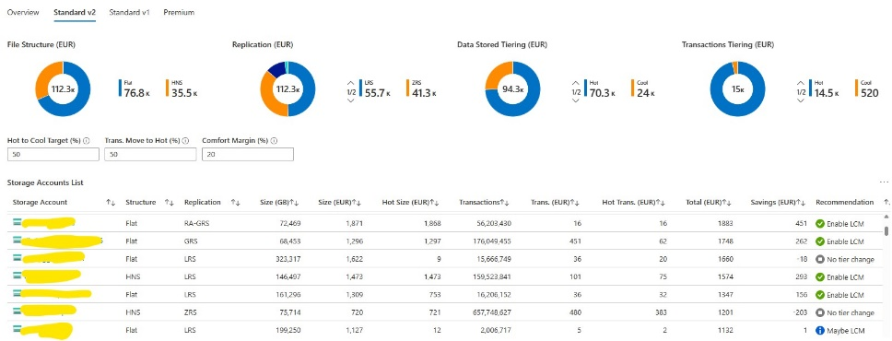
Management & Governance Updates
Azure Optimization Engine
The Azure Optimization Engine (AOE) provides you with additional reporting that complements Azure-native tooling for Azure commitment purchase decision and review processes, based on a daily export of your Azure billing events to a Log Analytics workspace.
Benefits Usage: an overview of Azure pricing models usage.
Benefits Simulation: exploring different commitment scenarios.
Reservations Potential: deep analysis of On-Demand VM sizes usage.
Reservations Usage: deep analysis of Reservations performance.
Savings Plans Usage: deep analysis of Savings Plans performance.

Slide 13
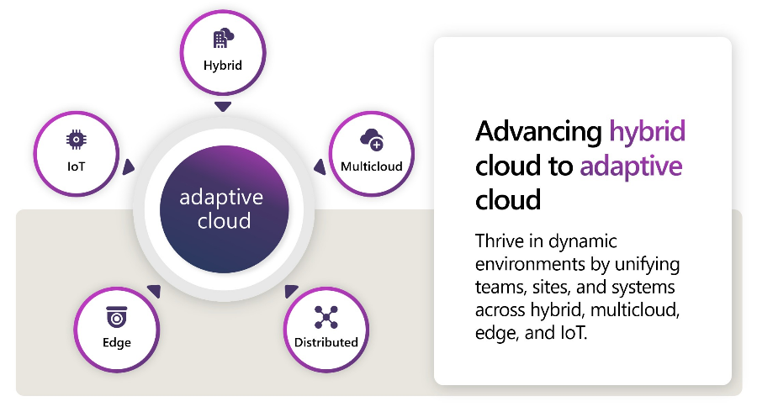
Management & Governance Updates
Azure Adaptive Cloud Community
Once a month, the various Adaptive Cloud product groups at Microsoft will hold a call to showcase new features, talk through important topics and engage in a Q&A regarding hybrid, multicloud, and edge. The foundational goals of the call are highlighted below:
Provide the Adaptive Cloud community with product updates for products and services such as Azure Arc, Azure Stack HCI, Azure IoT, AKS and much more.
Host a short talk and/or demo on Azure Adaptive Cloud technologies and products technologies
Collect feedback from the community on issues, blockers, use cases, and questions related to Azure Adaptive Cloud technologies and products

Slide 14
Management & Governance Updates
Public Preview: Azure Backup enables vaulted backups for Azure Files for comprehensive data protection.
Azure Backup now supports transferring Files backups to the vault. The isolated backups enable seamless and assured recovery even if the source data gets compromised.
Enhanced backup security with features like immutability, customer managed key encryption (CMK), soft delete and multi-user authorization (MUA).
Long term retention of data up to 99 years to meet the compliance requirements in regulated industries.
Business continuity in the face of region outages with the ability to restore from the replicated backup copy in Azure paired region.
Assured data recovery even if the production storage or subscription is compromised with an ability to restore to an alternate subscription and file share.
Public preview: Azure Backup supports long term retention for backup of Azure Database for MySQL– Flexible Server
Azure Backup and Azure Database Services bring to a new backup solution for MySQL-Flexible servers that supports retaining backups for up to 10 years.
In preview:
Comprehensive data protection against different levels of data loss ranging from accidental deletes to ransomware attacks.
Customer controlled scheduled and ad-hoc backup.
Isolated backups stored in a separate security and fault domain.
Long term retention of backups
Central Monitoring of all backup operations and jobs

Slide 15
Compute

Slide 16
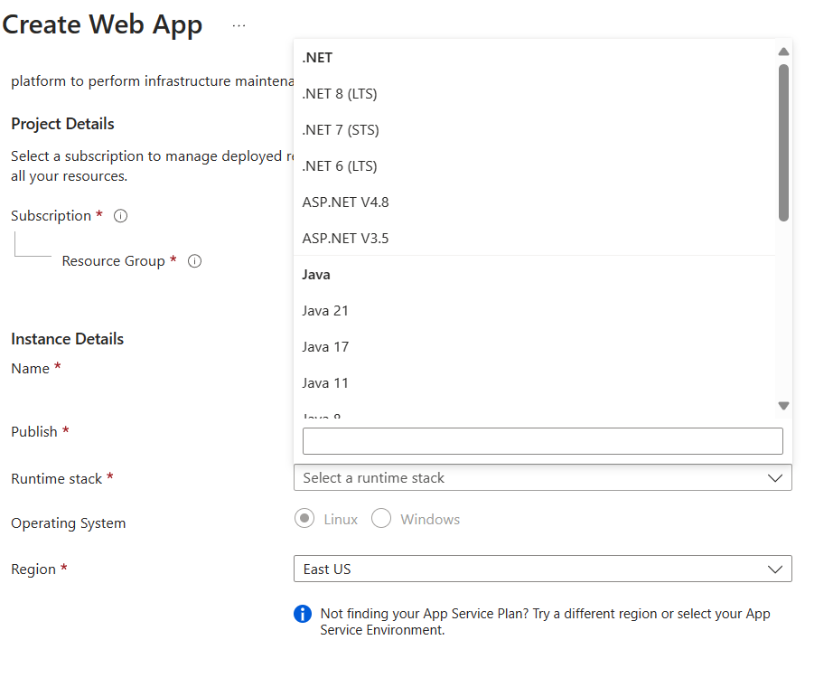
Compute Updates
Hardware support change with GPU labs that use lab accounts
Azure Datacenters regularly refresh hardware to ensure the highest quality offerings are available. An upcoming hardware change will impact specific lab account-based GPU SKUs
These virtual machine sizes are impacted:
Small GPU (Compute)
Small GPU (Visualization)
Medium GPU (Visualization)
Please finish using current lab setup by July 15, 2024, to avoid any issues. If such labs are required with these specific virtual machines sizes after that date, please create new labs
Otherwise, you may receive an allocation error similar to:
"Unable to start due to Allocation failed. We do not have sufficient capacity for the requested VM size in this region."
Announcing Java 21 and Tomcat 10.1 on Azure App Service!
It is possible now to use Java 21 and Tomcat 10.1 on Azure App Service!

Slide 17
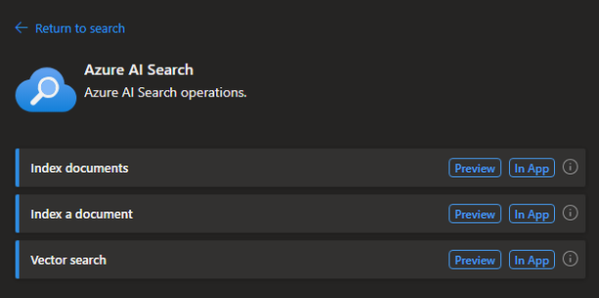
Compute Updates
Public Preview of Azure OpenAI and AI Search in-app connectors for Logic Apps (Standard)
MS announced two new built-in connectors for Azure Logic Apps: Azure OpenAI and Azure AI Search.
With the Azure OpenAI and AI Search it is possible now to build powerful automations by integrating enterprise data and services with generative AI capabilities offered by Azure Open-AI and AI Search services inside of Logic Apps. These new connectors support multiple types of authentications such as connection keys, AAD and managed identity and support connecting to your Azure OpenAI and Azure Search endpoints behind your firewalls enabling your workflows to securely connect to your AI resources in Azure.
General Availability of Azure Logic Apps connectors for IBM Mainframe and Midranges
Azure Logic Apps connectors for IBM Mainframe and Midrange, including IBM 3270, IBM CICS, IBM DB2, IBM i, IBM MQ, and IBM IMS, are now generally available. These connectors address highly sought-after customer requests, bring capabilities to extend Azure Logic Apps cloud native workloads with some of the oldest systems ever built for Mainframes and Midranges.
Flexibility
Reliability
Agility
Cost Savings
Seamless Transition
Skills Availability
Modernization

Slide 18
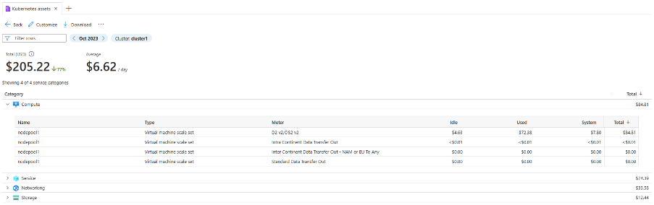
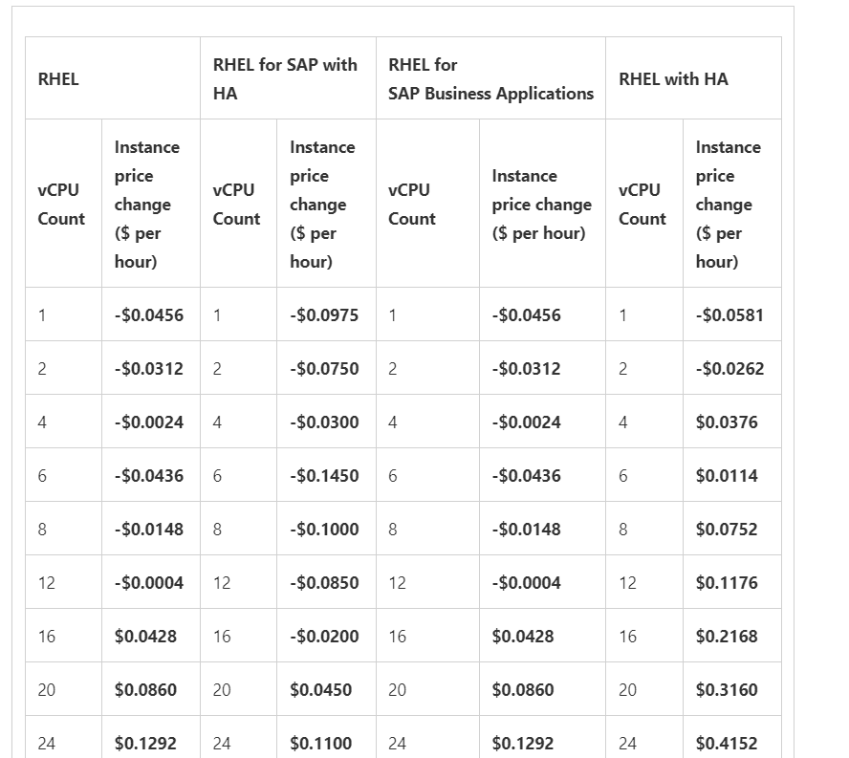
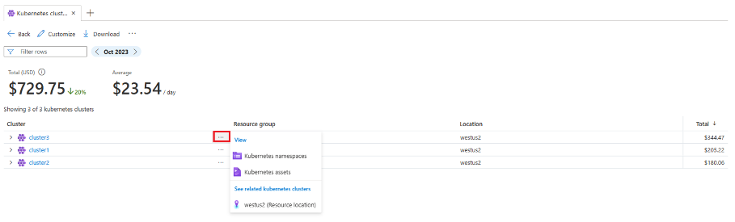
Compute Updates
Generally Available: AKS cost views
The Kubernetes clusters and Kubernetes namespaces cost views are now generally available in Cost analysis within Azure portal. It is now possible to view the aggregated costs for all AKS clusters and namespaces across a subscription and drill down into infrastructure and namespaces costs of a cluster. Having granular visibility will help gain deeper insights into infrastructure costs enabling to allocate and optimize AKS costs efficiently.
Red Hat Enterprise Linux Pricing update
Red Hat is updating its Red Hat Enterprise Linux (RHEL) royalty model to a scalable model to achieve better consistency with the most common model for cloud virtual machines. These changes are expected to affect all Red Hat resellers across the market.
In response to Red Hat’s price changes, Azure will also be rolling out price changes for all Red Hat Enterprise Linux instances. These changes will start occurring on April 1, 2024, with price decreases for Red Hat Enterprise Linux and RHEL for SAP Business Applications licenses for vCPU sizes less than 12. All other price updates will be effective June 1, 2024.
These price changes will mostly lead to a price decrease for workloads with 12vCPUs or less, while all other workloads will experience a price increase.

Slide 19
Compute Updates
Azure App Service introduced the Sidecar Pattern
The Sidecar pattern allows to co-locate a cohesive set of tasks with the primary application but place them inside their own process or container. This allows to seamlessly extend the functionality of primary application by attaching companion containers, or “sidecars,” each serving a specific purpose or function.
In Azure App Service, support up to 4 sidecar containers for each sidecar-enabled custom container app. Sidecar containers let deploy extra services and features to container application without making them tightly coupled to main application container. For example, you can add monitoring, logging, configuration, and networking services as sidecar containers. An OpenTelemetry collector sidecar is one such monitoring example.
Currently, the feature is enabled for custom Container image.
Azure App Service introduced Webjobs for Linux App Service
Linux App Service now hasthe ability to create Webjobs. Designed to streamline the execution of background tasks and scheduled processes, Webjobs offer a solution for automating routine operations within applications hosted on the Linux App Service.
File Systems Connector Support on Workflow Standard Plans
The File Systems Connector allows workflows to connect to files shares inside virtual network. Until now, this was only supported on Logic Apps Standard deployed under an App Service Environment (ASE) V3 resource.
The Logic Apps team, in partnership with the App Service team recently implemented some updates that now allow Workflow Standard Plans to host Logic Apps Standard workflows that contains File System Connector.

Slide 20
Databases

Slide 21
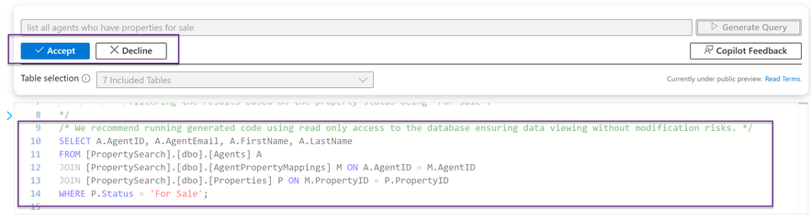
Databases Updates
Announcing SQL Server Data Tools (SSDT) for ARM64 Architecture in Visual Studio 17.10 Preview 2
MS announced the launch of SQL Server Data Tools (SSDT) for Visual Studio in ARM64. This enhancement comes with the exciting release version 17.10 Preview 2. Release of SSDT for Visual Studio on arm64 adds SQL development to the capabilities of Visual Studio on arm64. This latest development brings a host of features tailored to enhance your database development experience on ARM64 devices.
Key Features:
SQL Projects (Open, Build, Publish)
Schema Compare
Data Compare
Query Editor
Table Designer
Database Properties Editor
Object Refactoring
Microsoft Copilot in Azure extends capabilities to Azure SQL Database (Private Preview)
MS released a new Copilot skills for Azure SQL Database. Copilot in Azure can now help streamline the design, operation, optimization, and health of Azure SQL Database-driven applications. It improves productivity in the Azure portal by offering natural language to SQL conversion and self-help for database administration.
The new Copilot skills can be invoked in two Azure portal experiences:
Natural language to SQL: This experience within the Azure portal query editor for Azure SQL Database translates natural language queries into SQL, making database interactions more intuitive.
Azure Copilot integration: This experience adds Azure SQL Database skills into Microsoft Copilot for Azure, provides customers with self-guided assistance, and empowers them to manage their databases and solve issues independently.
Additionally, the Copilot integrates data and formulates applicable responses using public documentation, database schema, dynamic management views, catalog views, and Azure supportability diagnostics.

Slide 22
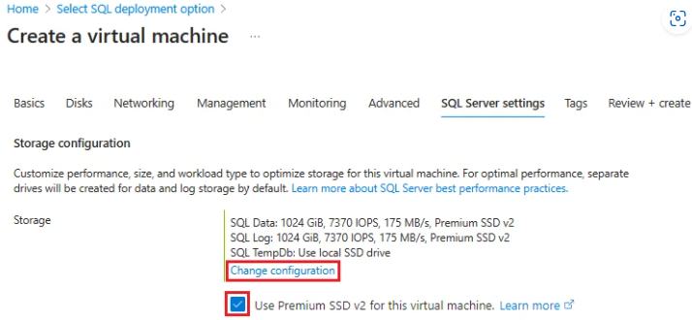
Databases Updates
Provision Premium SSD v2 Storage for Microsoft SQL Server on Azure Virtual Machines in the Microsoft Azure portal
MS announced the public preview of the Premium SSD v2 provisioning experience for SQL Server on Azure Virtual Machines (VMs) deployed in the Azure portal. Premium SSD v2 storage improves performance, reliability, and scalability of your SQL Server workloads while offering robust resource capacity, as you can create a single disk with up to 64 TiBs, 80,000 input/output per second (IOPS), and 1,200 MB/s throughput.
Introducing vCore-based Azure Cosmos DB for MongoDB’s Latest Features
HNSW Vector Index: Now Generally Available! - Azure Cosmos DB for MongoDB proudly introduces the general availability of the HNSW Vector Index, a leap forward in AI-driven database capabilities. This update adds a powerful tool to the platform for fast and precise approximate nearest neighbor searches, perfectly suited for complex tasks like image recognition, creating dynamic recommendation systems etc. The HNSW Vector Index is great in handling and querying high-dimensional data, designed to make applications quicker, more scalable, and intuitively smarter.
Leveraging Semantic Caching with Langchain - The integration of Langchain for semantic caching marks a leap towards smarter, more efficient databases. The feature actively optimizes data retrieval and significantly reduces latency by prefiltering search queries, ensuring faster access to relevant information.
Refined Search Capabilities for Complex Queries using Filtered Vector Search - Azure Cosmos DB for MongoDB has improved its vector search capabilities through the introduction of pre-filter vector search.

Slide 23
Databases Updates
Create SQL logins and users for nonunique Microsoft Entra principals with Object ID – Public preview
The 'WITH Object_ID' syntax for creating SQL logins and users for nonunique Microsoft Entra service principals and groups is now in public preview.
When a principal or group is created, a unique Object ID GUID is assigned and a custom display name is defined by the user. With the Object ID acting as the unique identifier, Entra does not require a principal display name to be unique making it possible for more than one service principal or group to have the same display name. However, in Azure SQL unique login and user names are a requirement.
The introduction of the Object_ID syntax resolves the naming conflict between Entra allowing nonunique or duplicate display names for principals and groups, and SQL requiring unique names for logins and users by enabling SQL to perform the Microsoft Entra principal lookup by Object ID when the CREATE query is run.

Slide 24
Integration

Slide 25
Integration Updates
Announcing General Availability of Azure API Management Basic v2 and Standard v2 Tiers
MS announced the General Availability of Azure API Management's newest pricing tiers – Basic v2 and Standard v2.
The new tiers are built on a new, more reliable and scalable platform and are designed to make API Management accessible to a broader set of customers and offer flexible options for a wider variety of scenarios. The v2 tiers are in addition to the existing classic tiers (Developer, Basic, Standard, and Premium) and the Consumption tier.
The following v2 tiers are generally available:
Basic v2 - The Basic v2 tier is designed for development and testing scenarios, and is supported with an SLA.
Standard v2 - Standard v2 is a production-ready tier with support for network-isolated backends.
Key capabilities:
Faster deployment, configuration, and scaling
Simplified networking
More options for production workloads
Developer portal options
Most capabilities of the classic API Management tiers are supported in the v2 tiers. However, the following capabilities aren't supported in the v2 tiers:
API Management service configuration using Git
Back up and restore of API Management instance
Enabling Azure DDoS Protection
Built-in analytics (replaced with Azure Monitor-based dashboard)
Zone redundancy
Multi-region deployment
Multiple custom domain names
Capacity metric
Autoscaling
Inbound connection using a private endpoint
Injection in a VNet in external mode or internal mode
Upgrade to v2 tiers from v1 tiers
Workspaces

Slide 26
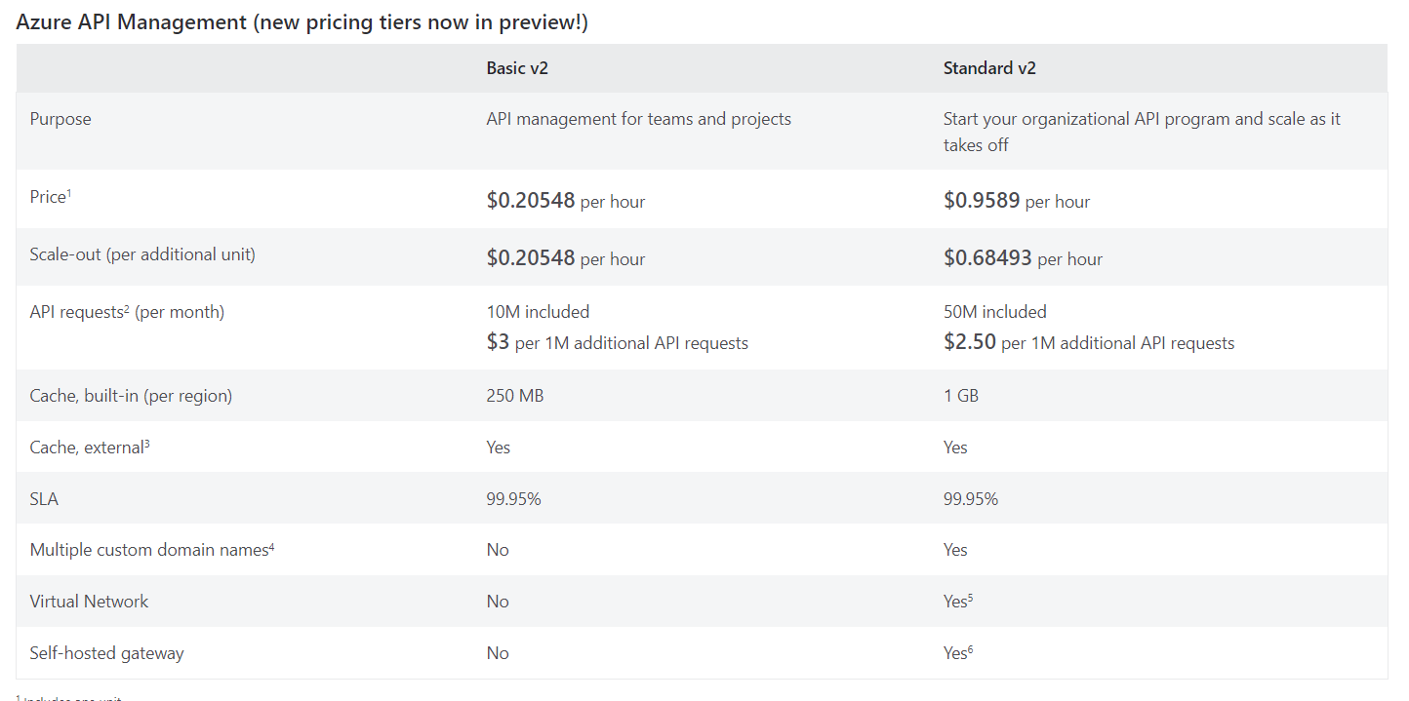
Integration Updates

Slide 27
DevOps & IaC & Automation

Slide 28
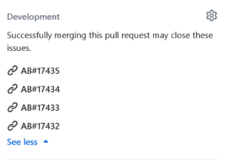
DevOps & IaC & Automation
End of Support for Microsoft products reliant on older Azure DevOps authentication
Azure DevOps will no longer guarantee support for older authentication methods in use by out-of-support Visual Studio and Microsoft products. Known impacted clients include:
Visual Studio 2010 (end of support: July 14, 2020)
Visual Studio 2012 (end of support: January 10, 2023)
Visual Studio 2013 (end of support: April 9, 2024)
Dynamics AX 2009 (end of support: April 12, 2022)
Dynamics AX 2012 (end of support: April 12, 2022)
Dynamics AX 2012 R2 (end of support: April 12, 2022)
Dynamics AX 2012 R3 (end of support: January 10, 2023)
Team Foundation Server 2008 (out of support)
Team Foundation Server 2010 (end of support: July 14, 2020)
Team Foundation Server 2012 (end of support: January 10, 2023)
MS recommends to migrate from these older clients to newer versions by December 31, 2024.
ADO and DevOps integration
Add link to GitHub commit or pull request (GA) - MS announced GA for new enhanced experience for linking work items to GitHub. It is now possible to search and select the desired repository and drill down to find and link to the specific pull request or commit.
GitHub connection improvements (private preview) - For GitHub organizations that have thousands of repositories, connecting them to an Azure DevOps project has posed significant challenges. Previously, attempts to connect encountered timeout issues, preventing from integrating GitHub with Azure Boards. MS announced a preview that will unblock large GitHub organizations.
AB# links on GitHub pull request (private preview) – MS enhanced Azure Boards + GitHub integration, by introducing a private preview feature that enhances the experience with AB# links. With this update, AB# links will now appear directly in the Development section of GitHub pull requests.

Slide 29
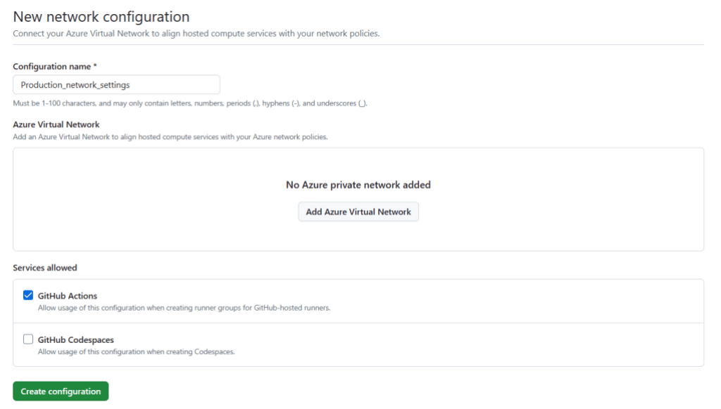
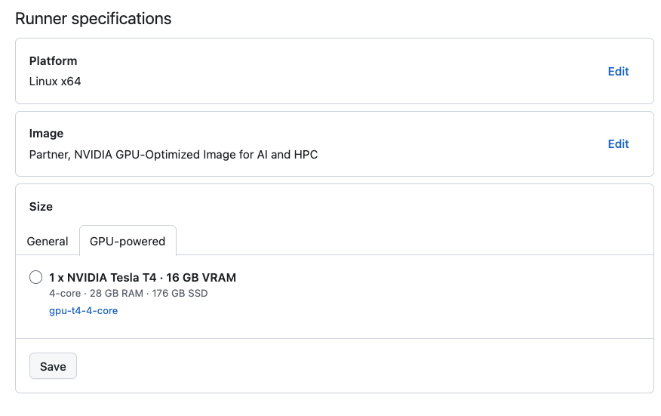
DevOps & IaC & Automation
Azure private networking for GitHub-hosted runners is generally available
GitHub Announced that Azure private networking for GitHub-hosted runners is now generally available. This feature allows to run actions workflows on GitHub-hosted runners that are connected to Azure virtual network, without compromising on security or performance. GitHub-hosted runners provide powerful compute in the cloud for running CI/CD and automation workflows that are fully managed, eliminating the overhead of managing and maintaining your own infrastructure. Any existing or new networking policies, such as Network Security Group (NSG) or firewall rules, will automatically apply to GitHub-hosted runners giving platform administrators comprehensive control over network security, all managed within a single place.
Azure private networking is now supported with the GitHub Team plan, in addition to the GitHub Enterprise Cloud plan.
Introducing additional runners SKUs
GitHub introduced the latest additions to the GitHub-hosted runner fleet, 2 vCPU Linux and 4 vCPU Windows runners, supporting auto-scaling and private networking features
GPU hosted runners available in public beta
The GPU hosted runners was released in public beta! This new runner empowers teams working with machine learning models, such as large language models (LLMs) or those requiring GPU graphic cards for game development, to run these more efficiently as part of their automation or CI/CD process. This allows teams to do complete application testing, including the ML components, with GitHub Actions.

Slide 30
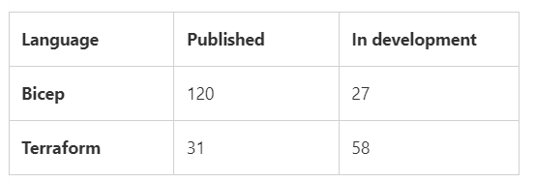
DevOps & IaC & Automation
Azure Verified Modules - Monthly Update [March]
As of March 31st the AVM Footprint currently looks like:
Terraform
Build of automated testing framework to support WAF alignment using TFlint for Terraform finished.
Static Analysis - AVM and TFVM teams agree to utilize TFVM's static analysis and linting steps tools set. The development of the tool-set has finished. We have 59+rules to be added to the tflint tool and the implementation is in progress where 3 rules have been added so far.
Repository Linting/Governance - The implementation for files inside the repo is finished. This is a central workflow that runs on a schedule and ensures your repository contains the most up to date files, e.g., for workflows and other required governance. GREPT tool will handle the repository settings as well and the implementation is in progress.
Git Hub App in development to support post push events and auto fix the code.
Bicep
WAF Reliability tests added and enforced in module publishing CI workflow using PSRule
Pester checks developed and implemented to check and enforce AZ properties for zonal resources have no default value and therefore must be provided by consumer
Introduced a platform pipeline to run PSRule checks on the entire BRM library, optionally selecting a specific WAF pillar, and providing an overview of all failing rules if any
Improve module workflow triggers: Updates to platform only related scripts are exempted from module workflow triggers, avoiding unnecessary runs
Improve module workflow publishing step: Updated Git tag handling to be more robust
Enforce specific auto-formatting for PowerShell scripts

Slide 31
Miscellaneous

Slide 32
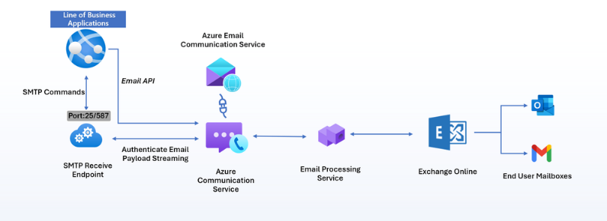
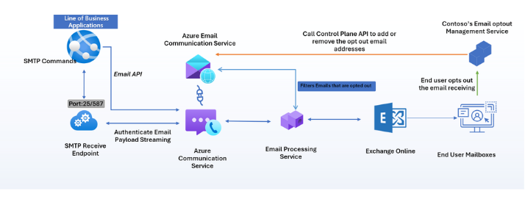
Miscellaneous Updates
Azure Communication Services April 2024 Feature Updates
Calling to Microsoft Teams Call Queues and Auto Attendants
Azure Communication Services Calling to Teams call queues and auto attendants and click-to-call for Teams Phone are now generally available. Organizations can enable customers to easily reach their sales and support members on Microsoft Teams with just a single click. By adding a click-to-call widget onto a website, such as a “Sales” button that points to a sales department, or a “Purchase” button that points to procurement, customers are just one click away from a direct connection into a Teams call queue or auto attendant.
Opt-out Management
Azure Communication Service Email opt-out management, now in public preview, offers a powerful platform with a centralized managed unsubscribe list with opt-out preferences saved to our data store. This feature helps developers meet guidelines of email providers who often require one-click list-unsubscribe implementation in the emails sent from their platforms.
SMTP - Azure Communication Services Email’s SMTP as a Service is now generally available. DDevelopers can use the SMTP support in Azure Communication Services to send emails easily, improve security features, and have more control over outgoing communications. The SMTP Relay Service acts as a link between email clients and mail servers and helps deliver emails more effectively. With this capability, customers can switch from on-premises SMTP solutions or link their line of business applications to a cloud-based solution platform with Azure Communication Services Email. This specifically enables:
Secure and reliable SMTP endpoint with TLS 1.2 encryptions
Access with Microsoft Entra Application Id to secure authentication for sending emails using SMTP.
High volume sending support for B2C communications using SMTP and REST APIs.
The security and compliance to honor and respect data handling and privacy requirements that Azure promises to our customers.

Slide 33

Miscellaneous Updates
The new Microsoft Planner begins roll out to General Availability
MS announced that starting today and over the course of the coming weeks we are rolling out general availability of the new Planner in Microsoft Teams
Action recommended: Prepare for model version retirement in Azure OpenAI
On {{date}}, we’ll begin updating Azure OpenAI deployments that use {{model}} {{oldversion}} to stop inference traffic. The update will be complete within two weeks of that date.
Recommended action
Migrate your applications and workflows that use {{model}} {{oldversion}} to a replacement {{date}} to ensure they’ll continue working as expected after the retirement.

Slide 34
Information

Slide 35
Information
Azure Times GitHub Repo

Slide 36
Questions

