Slide 1
Azure Times #109
March 13, 2024

Slide 2
Networking

Slide 3
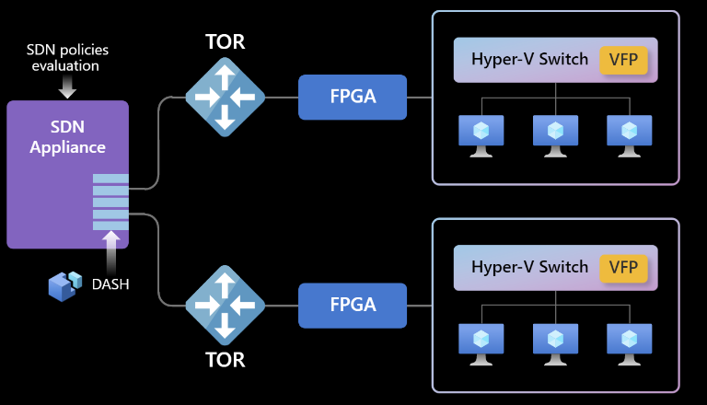
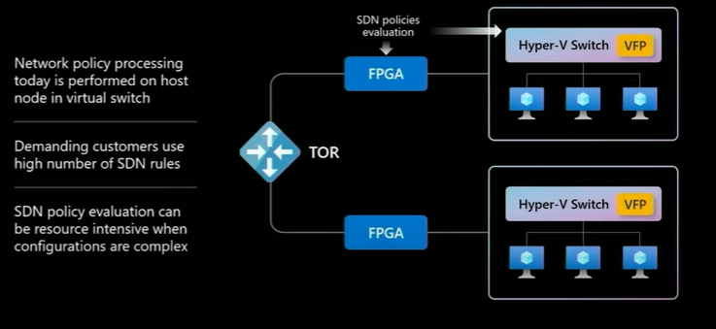
Networking Updates
Benefits
Industry leading Connections Per Second (CPS)
Increased number of total connections
Consistent throughput across a very large number of active connections
Reduced jitter on connection creation
Cost savings when using fewer VMs and licenses while achieving industry leading network connection performance
Considerations and limitations
This feature is available for NVAs deployed from Azure Marketplace and Azure Virtual Machines during limited GA.
To enable this feature, you must sign up using the sign-up form.
This feature can be enabled and is supported only on new deployments.
Feature support may vary as per the NVAs available on Marketplace.
Detaching and attaching a network interface on a VM requires stop-deallocate first.
Marketplace portal isn't supported for the limited GA. Other tools such as templates, CLI, Terraform and other multi-cloud tools are supported.
Announcing the limited general availability of Accelerated Connections
MS announced the limited GA of Accelerated Connections, a new Azure Network feature that delivers highest connections per second (CPS) and total active connections (TAC) performance to the most demanding VM workloads through specialized hardware in the Azure fleet.
Accelerated Connections is configured at the network interface level to allow flexibility to size the performance at vNIC. After enabling the feature, a performance improvement of up to twenty-five times (x25) in terms of Connections Per Second (CPS) can be achieved, especially for high numbers of simultaneous active connections.

Slide 4
Networking Updates
General availability: Azure Virtual Network encryption now in additional regions
Azure Virtual Network encryption is available in the following additional regions: West Us, West US 2, East US 2, US East, Europe North, Europe West, France Central, India Central, UAE North, East Asia, Japan West, Japan East

Slide 5
Management & Governance

Slide 6
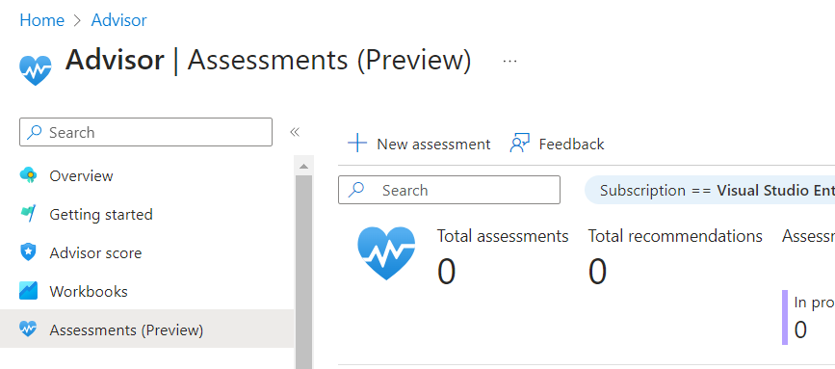
Management & Governance Updates
Public preview: Change Actor
What’s new: Actor Functionality
Who made the change
With which client the change was made
What operation was called
Public Preview: Well-Architected Framework assessment on Azure Advisor
The Well-Architected Framework (WAF) assessment provides a holistic view of a workload’s architecture. Take the WAF assessment and manage recommendations on Azure Advisor to improve resiliency, security, cost, operational excellence and performance efficiency.

Slide 7
Compute

Slide 8
Compute Updates
Generally available: Azure Functions Support for Node.js 20
You can now develop functions using Node.js 20 locally and deploy them to all Azure Functions plans on Linux and Windows.
Public preview: New Generation AMD VMs - Dasv6/Easv6/Fasv6
On March 4th, 2024, Azure introduces the latest AMD-based VMs in public preview for the D, E, and F family VMs, built on the 4th Generation AMD EPYC™ 9004 (Genoa) CPU. These new VMs introduce even greater performance and reliability than the previous AMD v5 VMs based on the 3rd Generation AMD EPYC™ (Milan) CPU. These new Genoa-based VMs will come in the form various series of different memory to core ratios spread across of the three VM families – the general purpose Dasv6 and Dalsv6 series, the memory optimized Easv6 series, and the compute optimized Fasv6, Falsv6, and Famsv6 series.
The Dav6 VM series are meant to provide a good balance between memory to core ratio, while the Dalsv6 series is meant to provide a more cost-effective option for applications that require less memory. The Easv6 VM series is built for applications demanding higher memory to core ratios. The Dalsv5, Dasv6, Easv6 VM series have variants with and without local disks. The Fasv6, Falsv6, and Famsv6 series all have increased CPU performance in comparison to the D and E series AMD VMs and are different only in their core to memory ratio.
The new VMs are also powered by Azure Boost and come with NVMe interface for local and remote disks. Workloads can see up to 80% better remote storage performance, 400% faster local storage speeds, and 20% networking bandwidth improvement over the previous generation of AMD-based VMs.
These new VMs significantly expand the VM options available for customers of Azure AMD VMs, spanning a multitude of popular VM series of varying memory sizes and budgets. It will be in preview beginning in the East US 2 region.

Slide 9
Compute Updates
General Availability: App Service Backup and Restore over Azure Virtual Network
Now it is possible to use custom backups, to back up web app's files and configuration data to a firewall-protected storage account if the following requirements are fulfilled:
The app is integrated with a virtual network, or the app is in a v3 App Service environment.
The storage account has granted access from the virtual network that the app is integrated with, or that the v3 App Service environment is created with.
Cloud Services (classic) deployment model is retiring on 31 August 2024
On 31 August 2024, MS will retire the Cloud Services (classic) deployment model. Before that date, it is required to migrate services that were deployed using this model to Cloud Services (extended support) in Azure Resource Manager, which provides new capabilities, including:
Support for deployment templates.
Role-based access control.
Regional resiliency.
In order to avoid service disruption and continue to use cloud services that were deployed using Cloud Services (classic), it is mandatory to migrate them to Cloud Services (extended support) in Resource Manager before 31 August 2024. Beginning 1st September 2024, Cloud Service deployments would be stopped and deallocated, and data will be permanently lost.

Slide 10
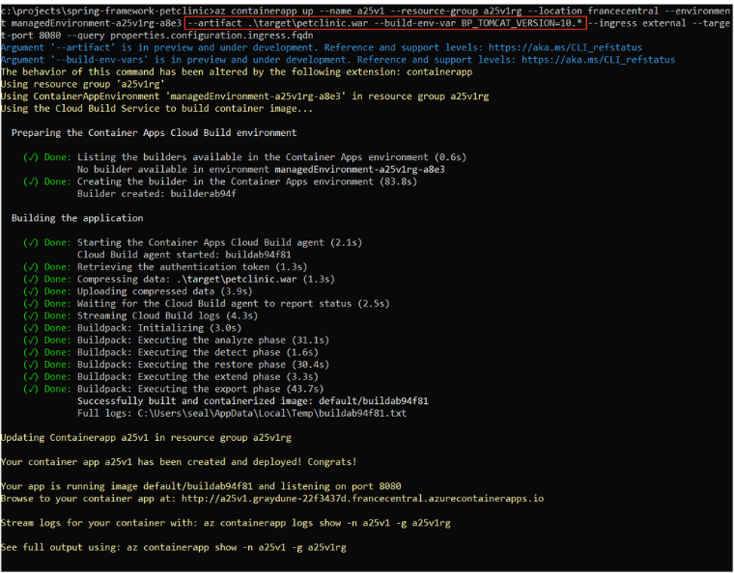
Compute Updates
Improved Next.js support (Preview) for Azure Static Web Apps
MS announced improvement of support for Next.js on Azure Static Web Apps (preview), increasing the compatibility with recent Next.js features and providing support for the newest Next.js versions, enabling to deploy and run your Next.js applications with full feature access on Azure:
Support for Next.js 14, React Server Components, Server Actions, Server Side Rendering
Increased size limits of Next.js deployments
Partial support for staticwebapps.config.json
Support for Azure Static Web Apps authentication and authorization
Next.js backend functions hosted on a dedicated App Service plan
Announcing Tomcat support in Azure Container Apps
MS enhanced the build process with two new features: Tomcat and build environment variable support.
Tomcat is one of the most popular and widely used Java web servers, providing a fast and reliable platform for running Java applications on the web.
Build environment variables affect how the build process is executed. It is possible to specify the versions of tools and frameworks, such as Maven or Tomcat

Slide 11
Storage & Data

Slide 12
Storage & Data Updates
Generally available: Service Level Agreements on Azure Blob Storage Cold Tier
Azure Blob Storage Cold Tier was generally available since Aug 10th, 2023. It is a new online access tier that is the most cost-effective Azure Blob offering for storing infrequently accessed data with long-term retention requirements, while providing instant access.
Azure Storage Service Level Agreements (SLA) describe Microsoft’s commitments for uptime and connectivity for Azure Storage services. The SLA now includes Azure Blob Storage Cold Tier.
Public preview: Azure NetApp Files volume enhancement – allow the same file path for volumes in different availability zones
Azure NetApp Files now allows the use of the same volume mount path for two or more volumes in the same region if they are each in a different availability zone. This is great for highly available architectures using cross-zone replication that would benefit from using the same mount path for both the source and target volumes. Having a common mount path for the source and target volumes eases automation and reduces manual effort during the failover of disaster recovery events which could lead to reduced recovery time objectives and improved application and data availability. This enhancement can also be used with regular volumes not participating in cross-zone replication. This could be useful for scenarios involving host-based replication or for test/dev environments that need to have consistent mount paths. This volume enhancement applies to SMB, NFS, and dual-protocol volumes.

Slide 13
Databases

Slide 14
Databases Updates
Azure SQL MI premium-series memory optimized hw is now available in all regions with up to 40 vCores
Having the latest and greatest hardware generation available for the Azure SQL Managed Instance Business Critical service tier can be crucial for the critical customer workloads. Until recently, premium-series memory optimized hardware generation was available only in a subset of Azure regions. Now a SQL MI BC instance with premium-series memory optimized hardware is available in any Azure region up to 40 vCores.
This means that the new state for premium-series memory optimized hardware availability is:
Up to 40 vCores: available in every Azure region.
48, 56, 64, 80, 96 and 128 vCore options: for now, available in a subset of Azure regions.

Slide 15
ML & AI & IOT

Slide 16
ML & AI & IOT Updates
Azure Sphere OS version 24.03 is now available for evaluation
For this release, the Azure Sphere OS contains an updated version of cURL. Azure Sphere OS provides long-term ABI compatibility, however the mechanisms of how cURL-multi operates, particularly with regard to recursive calls, have changed since the initial release of the Azure Sphere OS. Microsoft has performed additional engineering to provide backward compatibility for previously compiled applications to accommodate these changes. However, this is a special area of focus for compatibility release during this evaluation.
If your application leverages cURL-multi (as indicated by the usage of the `curl_multi_add_handle ()` API) we would encourage you to perform additional testing against the 24.03 OS. These changes do not impact applications that use the cURL-easy interface (as indicated by the usage of `curl_easy_perform()` API.).
Areas of special focus for compatibility testing with 24.03 include apps and functionality utilizing:
cURL and cURL-multi
wolfSSL, TLS-client, and TLS-server
Azure IoT, DPS, IoT Hub, IoT Central, Digital Twins, C SDK
Mutual Authentication

Slide 17
DevOps & IaC & Automation

Slide 18
DevOps & IaC & Automation
Azure Verified Modules - Monthly Update [February]
Bicep
All Azure Verified Bicep Modules have been published with the `with-source` function enabling you to access the module source in Visual Studio Code while consuming the module
All new issue and pull request templates
Announces on the Bicep Community call the retirement of the Public Bicep Registry Modules started, with Azure Verified Modules replacements in Development or Published!
Alignment of resources with the new version of the Private Endpoints interface
Fix for implicit dependencies to all module
Improved robustness of region rotation for bicep test deployments
Terraform
Fully implemented GREPT tool for repository linting
59+ Rules have been added to the TFLint tool which is currently being implemented
GitHub App – being developed by Engineering to support post push events and auto fix code
MVP in place for the AVM Terraform Testing Framework
AVM General
Contribution Guides have been updated for both Bicep and Terraform aligning to the latest processes.
@jtracey93msft features on the Ctrl+Alt+Azure | 226 - Azure Verified Modules discussing all things AVM!
GitHub Enterprise Server 3.12 is now generally available
GitHub Enterprise Server 3.12 is now generally available. With this version, customers can choose how to best scale their security strategy, gain more control over deployments, and so much more.
Highlights of this version include:
Restrict deployment rollouts to select tag patterns in GitHub Actions Environments.
Enforce which GitHub Actions workflows must pass with organization-wide repository rulesets.
Automate pull request merges using merge queues
Scale security strategy with Depend Bot alert rules
Enhance the security of code
GitHub Project templates are generally available
Updated global navigation to make using and finding information simpler, as well as improve accessibility and performance.
Highlight text in markdown files with the alerts markdown extension, which provides five levels to use (note, tip, important, warning, and caution).

Slide 19
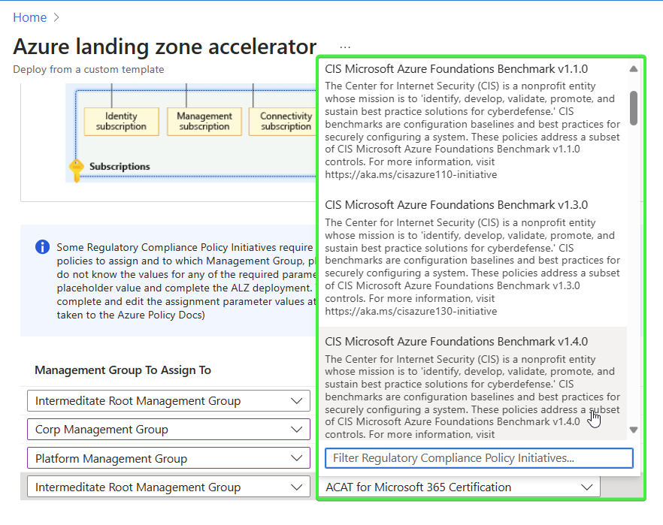
DevOps & IaC & Automation
New feature: easily assign regulatory compliance policies to your Azure Landing Zone
MS announced a new feature for the Azure Landing Zone portal accelerator that will make regulatory compliance at scale more consistent and simpler to deploy. Azure Policy initiatives can now be assigned to Azure Management Groups at deployment time with just a few clicks.
Dapr v1.13.0 now available in the Dapr extension for AKS and Arc-enabled Kubernetes
The Dapr extension for AKS and Arc-enabled Kubernetes now supports Dapr v1.13.0.
Dapr is a developer framework for building cloud-native applications, making it easier to run multiple microservices on Kubernetes and interact with external state stores/databases, secret stores, pub/sub brokers, and other cloud services and self-hosted solutions.
The Dapr v1.13 release offers several new features, including Go and JavaScript/TypeScript SDK support for Dapr workflow, component hot reloading, graceful shutdown, improvements to actor reminders performance, low cardinality for HTTP metrics, standardized error codes, many fixes in the core runtime and components, and more.

Slide 20
Miscellaneous

Slide 21
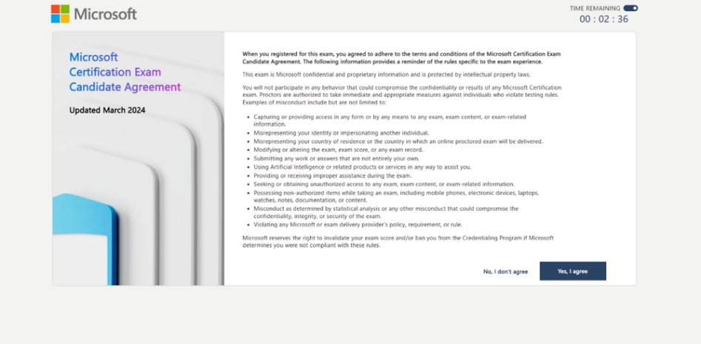
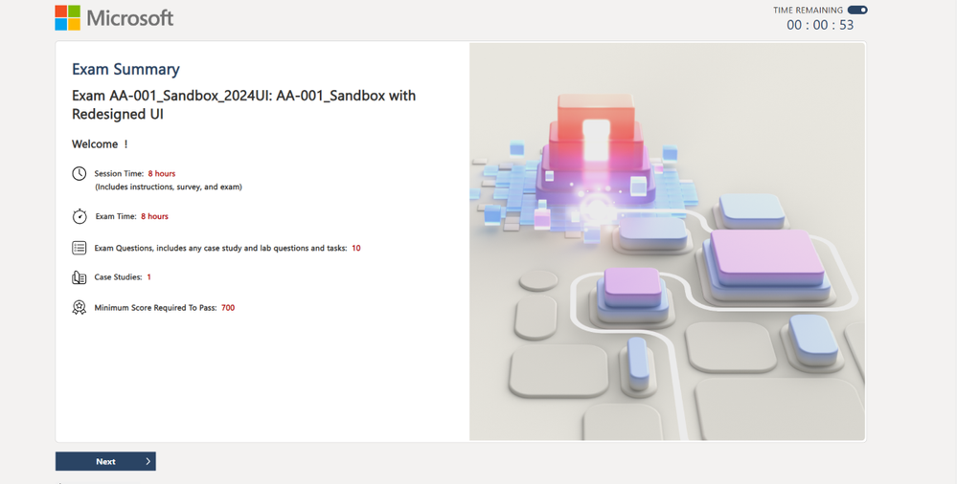
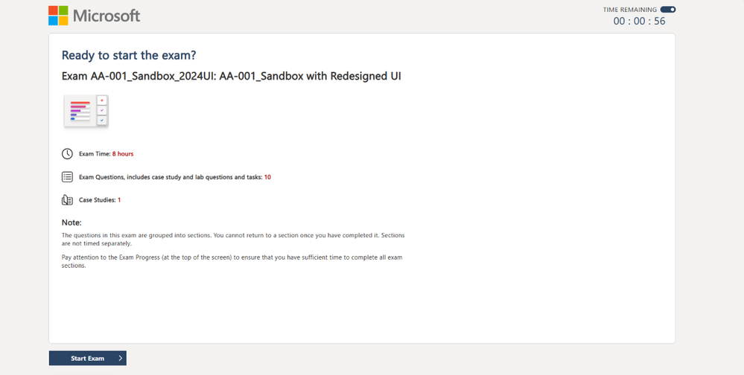
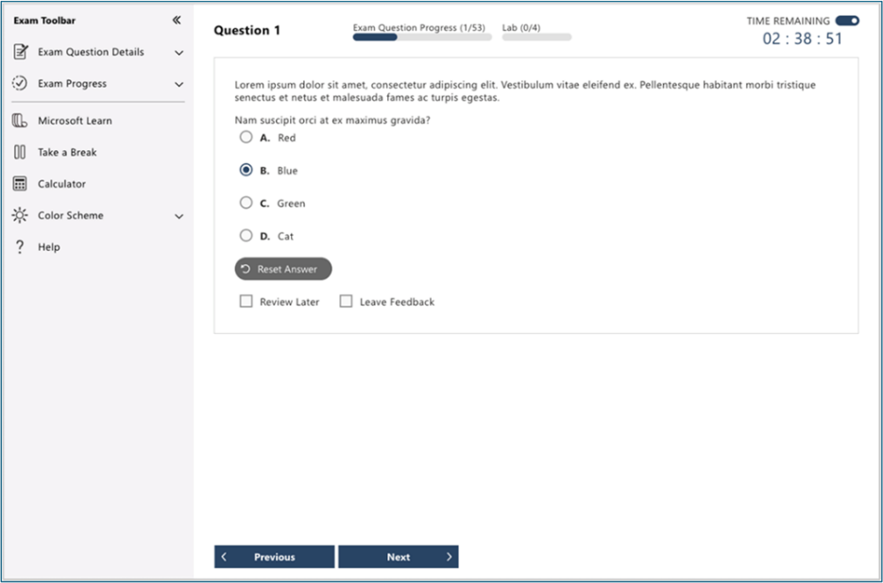
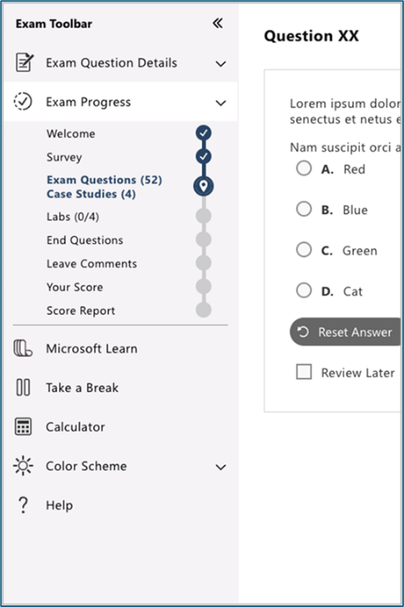
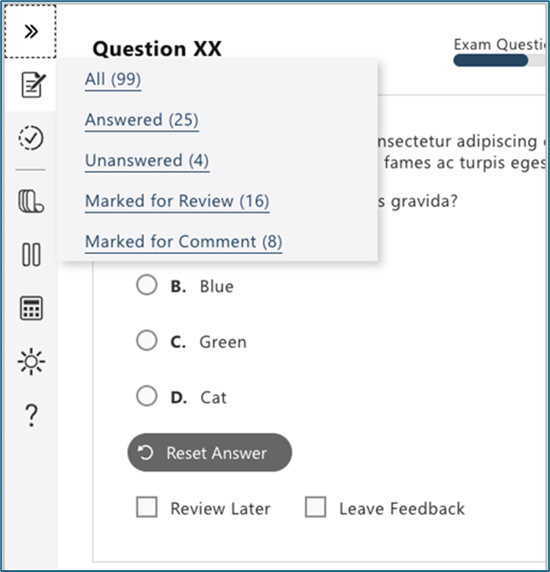
Miscellaneous Updates
Reimagining the Microsoft Certification exam UI experience
Highlights of the new and improved UI include:
The ability to turn the exam clock on and off.
An expandable exam menu toolbar on the side of the screen, providing more space for the question and minimizing scrolling.
A new flyout tools menu
A design that minimizes vertical and horizontal scrolling.
A more logical placement of the Review later and Leave feedback boxes.
A subway map that shows where you are in the exam.
An exam progress bar with each question so you know exactly how many sections and questions remain.
An improved review screen, with a filtered view that displays questions that are answered, unanswered, marked for review, or marked for comment. Review mode includes labels throughout, reminding you which items you’re reviewing.
Modernized color scheme options, including Dark mode.
Added calculation history to the calculator.

Slide 22
Information

Slide 23
Information
Azure Times GitHub Repo

Slide 24
Questions

