Slide 1
Azure Times #101
January 17, 2024

Slide 2
Networking

Slide 3
Networking Updates
General availability: Security Update for Application Gateway WAF CVE-2023-50164
MS deployed a new managed rule to address the security vulnerability CVE-2023-50164. This security vulnerability could potentially impact the application.
The fix has been rolled out for the ruleset versions listed below. If you believe that your application is vulnerable to this exploit MS recommends changing the action of this rule from log to block. Please note that anomaly score action is not supported by this rule.
Default Ruleset (DRS): 2.1
Note: This rule is only supported on WAFv2. Older WAFs running CRS 3.1 only support logging mode for this rule.

Slide 4
Security & Identity

Slide 5
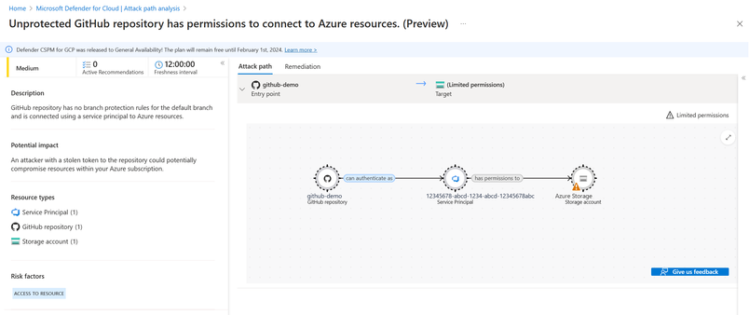
Security & Identity Updates
Securing DevOps with Microsoft's CNAPP: Defender for Cloud
Defender for Cloud, a Cloud Native Application Protection Platform (CNAPP), is enabling customers with new capabilities: DevOps Environment Posture Management, Code to Cloud Mapping for Service Principals, and new DevOps Attack Paths.
DevOps Environment Posture Management offers a deep dive into the security health of the cloud-native application lifecycle. Through deep scanning of source code management systems, Defender for Cloud identifies weaknesses in resources such as pipelines, repositories, and service connections, identifying potential vulnerabilities in platform configurations.
Azure DevOps Pipelines: Ensure that secrets are not accessible in builds of forks to prevent external entities from accessing internal build pipeline secrets.
GitHub Repositories and Organizations: Implement protection policies for default branches to safeguard against unauthorized or malicious changes.
Azure DevOps Service Connections, Variable Groups, and Secure Files: Recommendations to limit the access of the secure CI/CD resources to only pipelines that need access to reinforce least privilege access and prevent against privilege escalation threats.
Service Principal Mapping - CI/CD pipelines typically interact with cloud resources using a Service Principal (SPN) as their identity. However, this can create security risks, especially when SPNs are over-privileged or when pipelines, such as those in public Azure DevOps repositories, lack sufficient security controls. Such weaknesses can turn these pipelines into targets for malicious actors. Service Principal Mapping addresses this risk by offering visibility into the specific Azure resources accessible by each SPN.
DevOps Attack Paths - By leveraging insights from the new recommendations and mapping capabilities, our Microsoft Security research team has released a new attack path, highlighting the most critical risks within a customer’s environment.

Slide 6
Security & Identity Updates
Defender for Cloud updates
Coverage workbook - The Coverage workbook allows to keep track of which Defender for Cloud plans are active on which parts of environments. This workbook can help to ensure that environments and subscriptions are fully protected. By having access to detailed coverage information, it is possible to identify any areas that might need other protection and take action to address those areas.
Retirement of Classic connectors for multi-cloud - The classic multi-cloud connector experience is retired, and data is no longer streamed to connectors created through that mechanism. These classic connectors were used to connect AWS Security Hub and GCP Security Command Center recommendations to Defender for Cloud and onboard AWS EC2s to Defender for Servers. The full value of these connectors has been replaced with the native multi-cloud security connectors experience, which has been Generally Available for AWS and GCP since March 2022 at no extra cost.
Defender for Servers at the resource level available as GA
It is now possible to manage Defender for Servers on specific resources within a subscription, giving full control over the protection strategy. With this capability, it is possible to configure specific resources with custom configurations that differ from the settings configured at the subscription level.
Resource level enablement is available for Azure machines and on-premises with Azure Arc as part of Defender for Servers plans:
Defender for Servers Plan 1: it is possible to enable/disable the plan at the resource level.
Defender for Servers Plan 2: It is possible only to disable the plan at the resource level. For example, it’s possible to enable the plan at the subscription level and disable specific resources, however, it’s not possible to enable the plan only for specific resources.
The ability to enable or disable Defender for Servers at the resource level is available exclusively via REST API

Slide 7
Security & Identity Updates
Microsoft Defender for Identity
New Identities area and dashboard in Defender XDR – Public Preview
Organizations with Defender for Identity now have a new Identities area in Microsoft Defender XDR (formerly known as Microsoft 365 Defender) for information about identity security with Defender for Identity.
In Microsoft Defender XDR, select Identities to see any of the following new pages:
Dashboard: Shows graphs and widgets to help monitor identity threat detection and response activities.
Health issues: Now moved from the Settings > Identities area, and lists any current health issues for general Defender for Identity deployment and specific sensors.
Tools: Links to helpful information and resources when working with Defender for Identity, including links to documentation, specifically on the capacity planning tool, and the Test-MdiReadiness.ps1 script.
Security posture assessments for AD CS sensors Preview
Recommended actions now include the following new security posture assessments, specifically for certificate templates and certificate authorities.
Certificate templates recommended actions:
Prevent users to request a certificate valid for arbitrary users based on the certificate template (ESC1)
Edit overly permissive certificate template with privileged EKU (Any purpose EKU or No EKU) (ESC2)
Misconfigured enrollment agent certificate template (ESC3)
Edit misconfigured certificate templates ACL (ESC4)
Edit misconfigured certificate templates owner (ESC4)
Certificate authority recommended actions:
Edit vulnerable Certificate Authority setting (ESC6)
Edit misconfigured Certificate Authority ACL (ESC7)
Enforce encryption for RPC certificate enrollment interface (ESC8)
The new assessments are available in Microsoft Secure Score, surfacing security issues and severe misconfigurations that pose risks to the entire organization, alongside detections.

Slide 8
Security & Identity Updates
Decommissioning of group writeback v2 in Entra connect sync
The public preview of Group Writeback V2 in Entra Connect Sync will no longer be available after June 30, 2024. After this date, Entra Connect Sync will no longer support provisioning cloud security groups to Active Directory.
Another similar functionality is offered in Entra Cloud Sync, called Group Provision to AD, that may be used instead of Group Writeback V2 for provisioning cloud security groups to Active Directory. Enhanced functionality in Entra Cloud Sync, along with other new features, are being developed.
Organizations that use the preview Group Writeback V2 feature in Entra Connect Sync should switch their configuration from Connect Sync to Cloud Sync. Organizations may choose to:
Move all their hybrid sync to Entra Cloud Sync (if it supports their needs), or
Have Entra Cloud Sync run side-by-side and move only cloud security group provisioning to Active Directory onto Entra Cloud Sync.
Organizations that provision Microsoft 365 groups to Active Directory may continue using Group Writeback v1 for this capability.
A configurable redemption order for b2b collaboration - Public Preview
With configurable redemption, admins can customize the order of identity providers that guest users can sign in with when they accept an invitation. This lets organizations override the default configuration order set by Microsoft and use organization's. This can be used to help with scenarios like prioritizing a SAML/WS-fed federation above an Entra ID verified domain, disabling certain identity providers as an option during redemption, or even only using something like an email one-time passcode as a redemption option.
Edits to dynamic group rule builder - General Availability
The dynamic group rule builder has been updated to no longer include the 'contains' and 'notContains' operators, as they're less performant. If needed, admins can still create dynamic group rules with those operators by typing directly into the text box.

Slide 9
Security & Identity Updates
Defender for Cloud - Qualys retirement plan for Vulnerability assessment on cloud workloads
At Ignite 2023, MS unveiled a strategic decision to consolidate the vulnerability assessment engine to the cutting-edge Microsoft Defender Vulnerability Management offering. This strategic shift empowers security administrators with Microsoft's unparalleled threat intelligence, breach likelihood predictions, and business contexts, facilitating the identification, assessment, prioritization, and remediation of vulnerabilities. It also helps simplify how security admins manage an expanded attack surface, reduce overall cloud risk across the software development lifecycle, and cut remediation time and costs.
Effective May 1st, 2024, the built-in Qualys offering within the Defender for Servers plan will be retired. Any new Defender for Servers customers will be offered the built-in Qualys option until January 15th, 2024. Post-retirement, customers who wish to continue using Qualys can choose to subscribe to Qualys Vulnerability Management, available as a Bring Your Own License (BYOL) option. Similarly, within the Defender for Containers plan, the built-in Qualys offering will be retired by March 1st, 2024. All new customers will automatically benefit from Defender Vulnerability Management.
General Availability: Azure Managed HSM Backup/Restore when Storage is Behind a Private Endpoint
MS announced the General Availability of support for Azure Key Vault Managed HSM backup/restore when the storage account is behind a private endpoint. This method allows customers to backup/restore regardless of whether public access is enabled or disabled. Further, by becoming a Microsoft Trusted Service, MS has enhanced the backup and restore flow by allowing for private endpoint connection to Azure Storage accounts while backing up and restoring Managed HSM resources. This helps reduce the risk of exposure to the public internet and helps address compliance needs.

Slide 10
Management & Governance

Slide 11
Management & Governance Updates
Generally Available: Azure Chaos Studio supports new faults for Service Bus
Azure Chaos Studio now supports new fault actions for Service Bus resources.
Change Queue State, Change Topic State, and Change Subscription-State: These new service-direct faults allow customers to fully or partially disable entities within a targeted Service Bus namespace. This can help test messaging infrastructure for maintenance or failure scenarios for an application that depends on the Service Bus.
These new faults can be used in Azure Chaos Studio by deploying templates, using the REST API, or designing experiments in the Azure portal. Details and examples are available in the fault library.
General availability: “As on-premises” sizing in Azure Migrate SQL Discovery and Assessment
MS introduced “As on-premises” sizing criteria in SQL assessment.
Now use the “As on-premises” sizing criteria to generate a quick and reliable assessment that leverages the provisioning decisions for the source instance. The source instance configuration is used to generate size recommendations for the target Azure SQL service.
When performance data is available, it is possible to create a performance-based assessment to generate recommendations based on the actual usage of resources by the source instance. This will generate right-sized target SKU recommendations tailor-made for the source workload, increasing the return on investment. If performance data is not available for specific instances, ”As on-premises” sizing will be used for those instances to ensure reliable target sizing.

Slide 12
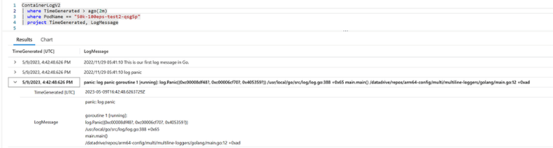
Management & Governance Updates
Generally Available: Multi-line Logging Feature in Azure Monitor - Container Insights
Multi-line logging is a new feature in Azure Monitor - Container Insights that allows to collect and store multiple lines of log data in a single log entry, making it easier to view and analyze logs. With this feature enabled, previously split container logs are stitched together and sent as single entries to the ContainerLogV2 table. This will also help customers save on cost as it reduces the metadata added on multiple lines. Customers are able see container log lines up to 64 KB (up from the existing 16 KB limit). If the stitched log line is larger than 64 KB , it gets truncated due to Log Analytics limits. This feature also helps capture stack traces for .NET, Go, Python, and Java as a single log record. We will continue to add support for additional languages and formats.
Generally available: Azure Site Recovery update rollup 70 - December 2023
This update provides the following improvements for the latest version of Azure Site Recovery components.
Mobility Service – Added support for Linux OS for:
Azure to Azure – RHEL 8.9, Oracle Linux 8.9, Rocky Linux 8.8, and Rocky Linux 8.9
Modernized VMware/Physical to Azure - RHEL 8.9, Oracle Linux 8.9, Rocky Linux 8.8, and Rocky Linux 8.9

Slide 13
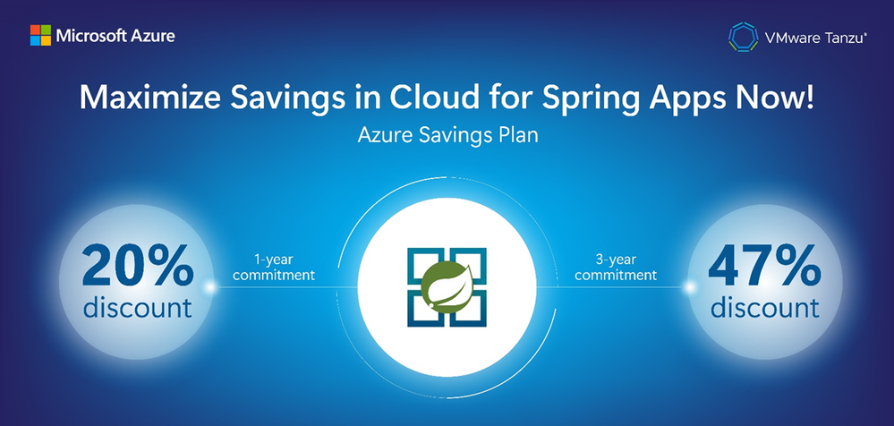
Management & Governance Updates
Azure Migrate Updates
Envision cost savings from Azure Management Services (Azure Backup, Azure Monitor and Azure Update Manager) using Azure Migrate Business case.
Azure Spring Apps Enterprise is now eligible for Azure savings plan for compute
Azure Spring Apps Enterprise plan is now eligible for Azure savings plan for compute!
All Azure Spring Apps regions under the Enterprise plan are eligible for substantial cost savings – 20% for one year and 47% for three years compared to pay-as-you-go Committing to the savings plan allows to get savings, up to the hourly commitment amount, on the resources use. It is possible to choose to pay all at once or monthly and the savings plan will not mess with current set-ups or apps.

Slide 14
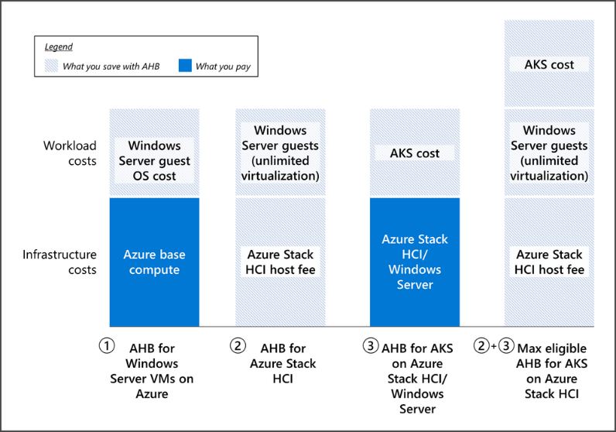
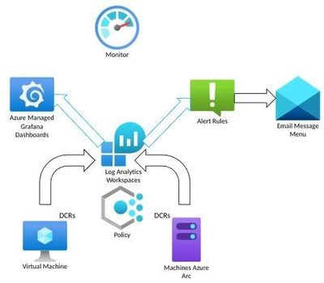
Management & Governance Updates
Azure Kubernetes Service with Azure Hybrid Benefits
It is possible to save with AHB on multiple Azure and hybrid services. For example, AHB can be used for Windows Server VMs running on Azure, Windows Server VMs running on Azure Stack HCI, and AKS and AKS Hybrid.
For the case of AKS, when running Windows Server nodes can apply the same principle. Windows Server nodes on AKS run on Azure Virtual Machine Scale Sets, so they are essentially Azure VMs – but managed by the AKS service. The cost reduction when AHB is applied is on the Windows Server Guest OS cost.
The Azure Monitor Starter Packs
Microsoft offers tailored experiences for specific workloads, such as Virtual Machine Insights. Some of these experiences also include alerts and modern dashboards (Grafana) to help act and troubleshoot issues. However, for server-based workloads, such as IIS, Print Servers, DNS, and others, there was no native cloud solution for monitoring.
The Azure Monitor Starter Packs (or “MonStar” packs) is a set of pre-configured components that provide monitoring configuration for multiple Azure resources without the need to create rules, alerts or dashboards. The monitoring features will be ready for assignment and consumption as soon as deployed.
Each pack will contain the required rules to collect the pertinent information (DCRs), the Alert Rules to inform about observations (alerts) and Dashboards (Grafana) to visualize the data.

Slide 15
Compute

Slide 16
Compute Updates
Generally Available: Azure Red Hat OpenShift v4.13 at install time
Azure Red Hat OpenShift version 4.13 is now available at install time.
Azure Red Hat OpenShift provides highly available, fully managed OpenShift clusters on demand, and is monitored and operated jointly by Microsoft and Red Hat.
Generally Available: Red Hat Enterprise Linux 8.9 now supported on Azure Virtual Machines
Red Hat Enterprise Linux (RHEL) 8.9 is the latest minor release of Red Hat Enterprise Linux 8, which provides stability and security for production environments along with bug fixes and enhancements for improved performance and reliability. It also includes more features and capabilities to help customers customize their operating environment while maintaining the consistency needed for more efficient management and deployment across varied infrastructures.
Key features offered:
New options in RHEL streamline tasks of deployment and migration via the included image builder service and the compatibility with Convert2RHEL tool
The latest version of performance co-pilot included with RHEL, adds new metrics to help monitor the performance of—and quickly detect potential issues with—more aspects of hardware, including interrupts, non-volatile storage, and external memory
RHEL 8.9 includes new Application Streams for Node.js 20, Java-21, and compiler toolkits, so developers can take advantage of the latest technology features

Slide 17
Compute Updates
Generally available: Crash Consistent VM Restore points
Announcing general availability support for multi-disk crash consistency mode in VM restore points. A crash-consistent VM restore point is an agentless solution that stores the VM configuration and point-in-time write-order consistent snapshots for all managed disks attached to a Virtual Machine. This is the same as the status of data in the VM after a power outage or a crash. Customers and Azure partners who are looking to build business continuity and disaster recovery solutions can leverage crash-consistent restore points to protect their Azure VMs.
Regions supported: All Azure commercial production regions.
NOTE: For disks configured with read/write host caching, multidisk crash consistency can't be guaranteed because writes that occur while the snapshot is taken might not be acknowledged by Azure Storage
Ultra disks, Premium SSD v2 disks, Write-accelerated disks, Ephemeral OS disks, and shared disks aren't supported for crash consistency mode.
Concurrent creation of restore points for a VM isn't supported.
Restore points for virtual machine scale sets in Uniform orchestration mode aren't supported.
Movement of VMs between resource groups or subscriptions isn't supported when the VM has restore points.
Public Preview: Azure Data Explorer connector for Apache Flink
MS announced the public preview of Azure Data Explorer Connector for Apache Flink.
Azure Data Explorer is a fast and scalable data analytics platform designed for real-time analysis of large volumes of data. Apache Flink is a framework and distributed processing engine for stateful computations over unbounded and bounded data streams.
The Azure Data Explorer connector for Flink is an open-source project that can run on any Flink cluster. It implements a data sink for moving data from a Flink cluster to an Azure Data Explorer table. Using Azure Data Explorer and Apache Flink, it is possible to build fast and scalable applications targeting data-driven scenarios. For example, machine learning (ML), Extract-Transform-Load (ETL), and Log Analytics.

Slide 18
Compute Updates
Public Preview of the ability of migrating an existing Azure Data Explorer (ADX) Cluster to support multiple availability zones.
MS announced Public Preview of the ability of migrating an existing Azure Data Explorer (ADX) Cluster to support multiple availability zones. By using availability zones, a cluster can better withstand the failure of a single data center in a region to support business continuity scenarios. The feature will allow clusters that were deployed not supporting zones, to be seamlessly redeployed to support multiple zones.
When availability zones are configured, a cluster's resources are deployed as follows:
Compute layer: Azure Data Explorer is a distributed computing platform that has two or more nodes. If availability zones are configured, compute nodes are distributed across the defined availability zone for maximum intra-region resiliency.
Persistent storage layer: Azure Data Clusters use Azure Storage as its durable persistence layer. If availability zones are configured, ZRS is enabled, placing storage replicas across all three availability zones for maximum intra-region resiliency.
Migration to multiple availability zones is supported in all regions that support availability zones but is limited to regions that don't have capacity restrictions.
Announcing Public Preview of Confidential VMs with Intel TDX in Azure Virtual Desktop
MS announced that Azure Virtual Desktop now supports the public preview of DCesv5 and ECesv5-series confidential VMs. These confidential VMs are powered by 4th Gen Intel® Xeon® Scalable processors with Intel® Trust Domain Extensions (Intel® TDX) and enable organizations to bring confidential workloads to the cloud without code changes to applications. Through the gated preview, we continued to enhance performance with our Intel partnership. These new virtual machines are up to 20% faster than 3rd Gen Intel Xeon virtual machines, and we expect performance for I/O intensive workloads to continue to improve as the technology matures.
Azure confidential VMs (CVMs) offer VM memory encryption with integrity protection, which strengthens guest protections to deny the hypervisor and other host management components code access to the VM memory and state. For additional CVM security benefits, please see the CVM documentation for more information.

Slide 19
Databases Updates
General availability of Diagnostics tools for App Service on Linux Node.js apps
MS announced the general availability of Diagnostic tools for App Services Linux for Node.js apps. With this capability, we now offer built-in support for collecting deep diagnostic artifacts that can help debug application code issues. These artifacts include memory dumps and profiler traces. These tools empower developers to diagnose a variety of Node.js code scenarios on Linux including:
High memory
High CPU
The experience uses V8 sample-based profiler to collect diagnostic traces/snapshots to identify if the application code is contributing to the problem.

Slide 20
Storage & Data

Slide 21
Storage & Data Updates
Store and manage medical imaging data with Azure Data Lake Storage (Preview)
MS announced the Public Preview of Azure Data Lake Storage integration for the DICOM® service in Azure Health Data Services. The DICOM service provides cloud-scale storage for medical imaging data using the DICOMweb standard. With the integration of Azure Data Lake Storage, organizations can now enjoy full control over their imaging data and increased flexibility for accessing and working with that data through the Azure storage ecosystem and APIs.
By using Azure Data Lake Storage with the DICOM service, organizations are able to:
Enable direct access to medical imaging data stored by the DICOM service using Azure storage APIs and DICOMweb APIs, providing more flexibility to access and work with the data.
Open medical imaging data up to the entire ecosystem of tools for working with Azure storage, including AzCopy, Azure Storage Explorer, and the Data Movement library.
Unlock new analytics and AI/ML scenarios by using services that natively integrate with Azure Data Lake Storage, including Azure Synapse, Azure Databricks, Azure Machine Learning, and Microsoft Fabric.
Grant controls to manage storage permissions, access controls, tiers, and rules.
Generally available: Zone Redundant Storage for Azure Disks is now available in more regions
Zone Redundant Storage (ZRS) for Azure Disk Storage is now generally available on Azure Premium SSDs and Standard SSDs in the West US3 and Germany West Central regions.
Disks with ZRS provide synchronous replication of data across three availability zones in a region, enabling disks to tolerate zonal failures without causing disruptions to application.

Slide 22
Storage & Data Updates
Azure Ultra Disk Storage is now available in UK West and Poland Central
Azure Ultra Disk Storage is now available in the UK West and Poland Central. Azure Ultra Disk Storage offers high throughput, high IOPS, and consistent low-latency disk storage for Azure virtual machines (VMs). Ultra Disk Storage is suited for data-intensive workloads such as SAP HANA, top-tier databases, and transaction-heavy workloads.
General Availability: Premium SSD v2 and Ultra disks support with Trusted launch
Trusted launch VMs now support Azure Premium SSD v2 disks and Ultra disks storage which allows to host workloads on high throughput, high IOPS, and consistent low latency disk storage with foundational compute security offered by Trusted Launch configuration.
Trusted Launch VMs provide foundational compute security to Azure Generation 2 VMs by enabling Secure Boot and vTPM capabilities. Trusted Launch capabilities protect OS against rootkits, and boot kits and enable attestation by measuring the boot chain of VM.
Ultra disks are the highest-performing storage option for Azure virtual machines, offering sub-millisecond latency and industry-leading performance per disk. They are best suited for data-intensive workloads such as SAP HANA, top-tier databases, and transaction-heavy workloads.

Slide 23
Storage & Data Updates
General Availability: Customer-managed keys for Azure NetApp Files volume encryption
Customer-managed keys for Azure NetApp Files volume encryption (CMK) provide the key manageability for additional security. With this capability, it is possible to increase the security of encryption keys by taking direct ownership of managing key rotation, access, permissions, and auditing tasks. It is possible to encrypt and decrypt data stored in Azure NetApp Files using its own secured key for maximum control/management of key access.
Key benefits:
Secure key management: The keys are generated and managed by the customer organization. This provides an additional security layer by reducing the risk of unauthorized key access. This protects against insider threats and unauthorized data access.
Regulatory/compliance: Several entities have strict regulations for data protection. CMK helps comply with various requirements and provides the ability to track key management for regulatory purposes.
Performance: There is no performance impact when using CMK. It simply protects the account encryption key using the Azure Key Vault.
TLS 1.0 and 1.1 support will be removed for new & existing Azure storage accounts starting Nov 2024
Azure Storage currently supports TLS 1.0 and 1.1 (for backward compatibility) and TLS 1.2 on public HTTPS endpoints. TLS 1.2 is more secure and faster than older TLS versions. TLS 1.0 and 1.1 do not support modern cryptographic algorithms and cipher suites. Many of the Azure storage customers are already using TLS 1.2 and we are sharing this guidance to expedite the transition for customers currently on TLS 1.0 and 1.1. Customers must secure their infrastructure by using TLS 1.2 with Azure Storage by Oct 31, 2024. The older TLS versions (1.0 and 1.1) are being deprecated and removed to meet evolving standards (FedRamp, NIST), and provide improved security for our customers.
This change will impact both existing and new storage accounts using TLS 1.0 and 1.1. To avoid disruptions to applications connecting to Azure Storage, you must migrate to TLS 1.2 and remove dependencies on TLS version 1.0 and 1.1, by Oct 31, 2024.

Slide 24
Databases

Slide 25
Databases Updates
Public Preview: Free SQL Managed Instance
Full capabilities of SQL Managed Instance, now available for free. MS recognizes the significance of effortless cloud migrations to the enhancement of database operations. With 4 or 8 vCores and 32GB of user data, SQL Managed Instance simplifies testing of cloud migrations, ensuring a seamless transition while mitigating potential complications. Explore a solution that offers efficiency, scalability, and security. Free SQL Managed Instance empowers to optimize database operations, reduce downtime, and realize improved performance.
General Purpose instance with up to 100 databases
720 vCore hours of compute every month (do not accumulate)
64 GB of storage
One instance per Azure subscription
The instance is automatically stopped when you reach the monthly vCore limit; managed instance starts automatically when credits are available again, or you can manually stop it to preserve free monthly vCore hours
Cross-subscription support for SQL MI database copy and move - GA refresh!
MS announced the refresh of database copy and move functionality. This refresh is bringing support for cross-subscription copy and move operations within an Azure tenant. This means that if you are using multiple subscriptions under the same Azure tenant and are hosting multiple SQL Managed Instances under those subscriptions, now it is possible to perform online, cross-instance database copy and move operations across all instances under the same tenant.
This is especially useful for those who are separating test and production environments with different subscriptions. Now, it is possible to promote a prepared database in a test environment to the production subscription and environment or to bring the production database to your test subscription to thoroughly investigate a new query performance regression.
Cross-subscriptions are supported with all standard interfaces, meaning via Azure portal, Azure PowerShell and CLI and REST API.

Slide 26
Databases Updates
Error Logs for Azure Database for MySQL - Flexible Server (Preview)
MS announced the public preview of the Error Logs feature for Azure Database for MySQL – Flexible Server! This feature empowers to gain direct access to MySQL error logs, significantly enhancing troubleshooting capabilities and providing transparency and independence in managing database environment.
Note: The Server Logs feature, including Error Logs, is available for all new servers created after November 14th, 2023. For existing servers, this feature will be made available after their next scheduled maintenance estimated to be performed in January 2024.
Key benefits associated with the Error Logs feature include:
Efficient troubleshooting: You can maintain MySQL error log files under Server Logs feature and download them for up to 7 days, enabling efficient issue identification and resolution.
Enhanced security: You can use Error Logs to proactively detect and respond to unauthorized access attempts, failed login attempts, and other security-related events.
Increased transparency: Enabling exposure of MySQL error logs in the Azure portal allows for a user-friendly interface to monitor your workload and troubleshoot issues.

Slide 27
Integration

Slide 28
Integration Updates
Generally available: Azure Stream Analytics in seven more regions
Azure Stream Analytics is now generally available in seven more regions:
Italy North
Poland Central
Qatar Central
Brazil Southeast
Israel Central
Spain Central
Mexico Central
Azure Stream Analytics No-code Editor: new features and improvements in Jan 2024
The Stream Analytics no-code editor empowers users to develop a Stream Analytics job seamlessly, without the need to write any code. MS introduced several new features and improvements to enhance the no-code experience, providing users with a more intuitive experience. Notable improvements include:
Enhanced operator operation experience on the canvas
Introducing instructional bubbles for new jobs
Switch to the query editor from the no-code editor

Slide 29
Miscellaneous

Slide 30
Miscellaneous Updates
On 31 August 2024, both the update management feature of Azure Automation and the Log Analytics agent it uses will be retired
On 31 August 2024, both the update management feature of Azure Automation and the Log Analytics agent it uses will be retired. It is needed to begin assessing and patching virtual machines using Azure Update Manager by that date.
Azure Update Manager is available at no charge for managing Azure Virtual Machines and Azure Stack HCI VMs. For Azure Arc–enabled servers, the price is $5 per server per month.
In addition to the familiar features already use, Azure Update Manager offers key improvements including:
Zero-step onboarding with native functionality built on Azure Compute and Azure Arc.
Granular, per-resource access control, and role-based access control.
Greater flexibility with Azure-orchestrated auto-patching, customer-defined maintenance schedules, and hotpatching.
Change tracking and inventory with Log Analytics agent in Azure Automation will be retired on 31 August 2024
On 31 August 2024, change tracking and inventory with Log Analytics agent in Azure Automation will be retired. You'll need to migrate to change tracking and inventory in Azure Monitoring Agent by that date.
In addition to the familiar capabilities you already use, change tracking and inventory in Azure Monitoring Agent offers key improvements such as:
Enhanced security and reliability.
At-scale onboarding with Azure Policy.
The ability to manage change and inventory with data collection rules.

Slide 31
Miscellaneous Updates
Naming Made Easy: AI-Powered Rename Suggestions
The latest Visual Studio Preview via GitHub Copilot Chat extension introduced an AI-powered rename suggestions. This feature doesn’t just suggest names; it learns how identifier is used and code style to propose identifiers that seamlessly fit into codebase. It’s like having a dedicated naming expert by your side, enhancing code while keeping in the coding flow.
Note: This feature is available in Visual Studio 17.9 Preview 1. There is currently a known issue in Preview 2. We are currently working on resolving the issue as soon as possible.
GitHub Copilot Chat now generally available for organizations and individuals
GitHub Copilot Chat is now generally available for both Visual Studio Code and Visual Studio, and is included in all GitHub Copilot plans alongside the original GitHub Copilot productivity boosting code completion capabilities. It is also available at no cost to verified teachers, students, and maintainers of popular open-source projects.

Slide 32
Miscellaneous Updates
Azure Load Testing supports fetching secrets from Azure Key Vault with access restrictions (private AKV)
In Azure Load Testing, you can use secrets from Azure Key Vault to set up your load test. If access to the Key Vault is restricted by a firewall or virtual networking, you can now access secrets from such a Key Vault by granting access to Azure Load Testing as a trusted Azure service.
Create tests by adding HTTP requests in Azure Load Testing
Azure Load Testing has introduced a new feature that simplifies the process of creating load tests, you can now directly input your HTTP requests in the Auzure portal without the need for a JMeter script. This eliminates the need for prior knowledge of testing tools, making it more accessible for users to run tests.
Entering requests is straightforward – just specify the endpoint, HTTP method, headers, query parameters, and request body. If you prefer, you can even use a cURL command for the request.
Azure Load Testing supports Web Driver Sampler plugin for Apache Jmeter
By supporting the Web Driver Sampler plugin for Apache JMeter, Azure Load Testing lets collect and analyze the performance metrics as experienced by the end user.
It is possible to measure the browser response time which includes the time taken for JavaScript execution, CSS transforms, etc. It is possible to use the Web Driver Sampler with a minimal load along with the other samplers in your test script to gauge the end user performance metrics while the backend is under load.

Slide 33
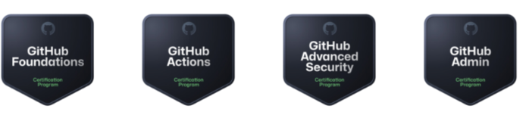
Miscellaneous Updates
GitHub Certification is GA
The GitHub released four new certification:
GitHub Foundations Certification
GitHub Actions Certification
GitHub Advanced Security Certification
GitHub Administration Certification
Microsoft Certified: Fabric Analytics Engineer Associate
As a candidate for this certification, you should have subject matter expertise in designing, creating, and deploying enterprise-scale data analytics solutions.
Your responsibilities for this role include transforming data into reusable analytics assets by using Microsoft Fabric components, such as:
Lakehouses
Data warehouses
Notebooks
Dataflows
Data pipelines
Semantic models
Reports

Slide 34
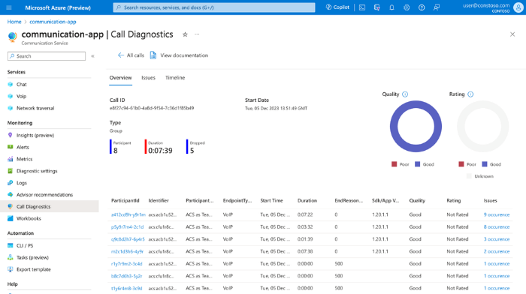
Miscellaneous Updates
Azure Communication Services January 2024 Feature Updates
Call Diagnostics
Azure Communication Services Call Diagnostics is now available in public preview. Call Diagnostics is an Azure Monitor experience that delivers tailored insight through specialized telemetry and diagnostic pages in the Azure portal.
Call Diagnostics acts as an investigator for calls. When a developer encounters an end-user reported issue, Call Diagnostics gives them the data to quickly understand what occurred and how the issue can be mitigated in the future. Call Diagnostics not only provides raw access to data through Azure Monitor patterns, but visualizations, detailed timeline views, and troubleshooting insights that give developers command over their application.
Updates for WebJS Calling SDK
Media Quality Statistics - Developers can leverage the Media Quality Statistics API to better understand their video calling quality and reliability experience real time from within the calling SDK. By giving developers the ability to understand from the client side what their end customers are experiencing they can delve deeper into understanding and mitigating any issues that arise for their end users.
Video Constraints - With Video Constraints developers can better manage the overall quality of their calls. For example, if a developer knows that a participant will join with a poor internet connection the developer can limit video resolution size on the sender side to smaller value so that there will be less bandwidth needed. The result of this is an improved calling experience for the end user.
Data Channel - The Data Channel API enables real-time messaging during audio and video calls. This functionality will enable developers their own data pipeline and vehicle that will allow them to send their own unique messages to remote participants on a call. This enhances communication capabilities and allows users to connect directly to remote participants when the scenario requires.

Slide 35
Information

Slide 36
Information
Azure Times GitHub Repo

Slide 37
Questions

