Slide 1
Azure Times #138
October 14, 2024

Slide 2
Networking

Slide 3
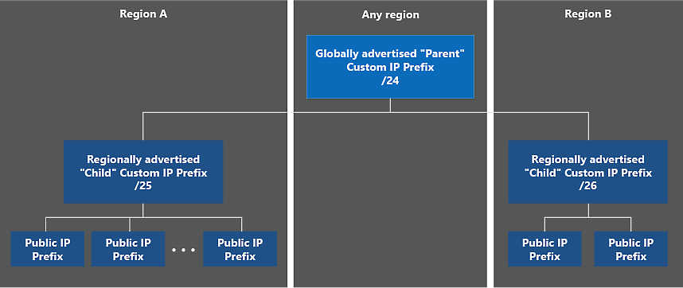
Networking Updates
Generally Available: Custom IPv4 Prefixes (BYOIP) can be used in a Global/Regional configuration
The ability to bring your own public IPv4 ranges using a global/regional configuration is already available in all public and US government regions. MS announced a possibility to bring a “global” IPv4 range (as small as /24) to Azure that will be advertised from Microsoft WAN and then divide this range into multiple “regional” ranges (as small as /26) associated with a specific region. This allows to onboard a single range that can be used across multiple regions for redundancy.
Retirement: End of Support Announcement for Azure Load Balancer numberOfProbes property on September 1, 2027.
Support for Azure Load Balancer numberOfProbes property ends on September 1, 2027. To avoid service disruption, upgrade apps to API version 2022-05-01 or higher and start using Azure Load Balancer probeThreshold property. MS will not be supporting the property numberOfProbes after September 1, 2027.
Before September 1, 2027, stop using the property numberOfProbes and/or migrate to probeThreshold property.

Slide 4
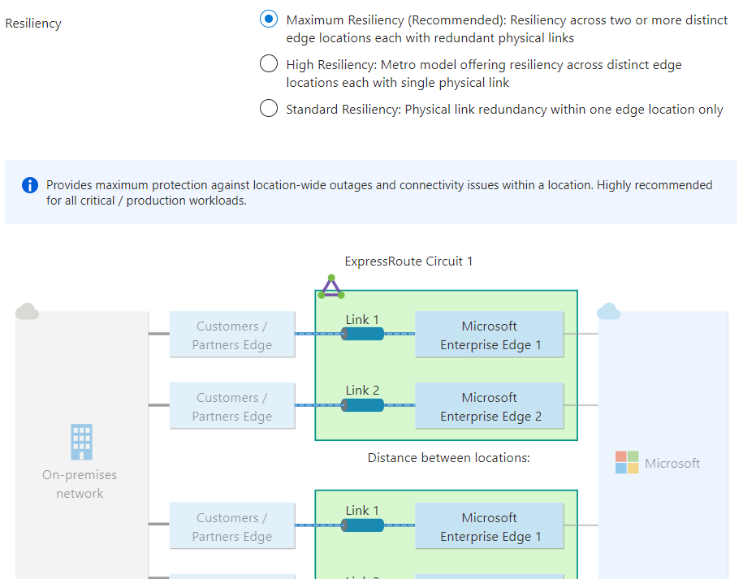
Networking Updates
ExpressRoute guided configuration of multi-site circuits and connections is generally available
ExpressRoute guided experience for configuring multi-site resiliency circuits and connections is generally available in Azure public cloud. The guided experience makes resiliency the central aspect of configuring ExpressRoute circuits and virtual network gateway connections. Three resiliency options—maximum, high, and standard—are offered. Maximum resiliency offers redundancy both across peering locations and within a peering location. High resiliency offers redundancy across peering locations, but not within a peering location. The standard resiliency offers redundancy only within a peering location. The new experience provides information including distance between the peering-locations (sites) and traffic engineering recommendations to help users make informed configuration decisions.

Slide 5
Networking Updates
Generally Available: Private endpoint support without NVA source network address translation
Source network address translation (SNAT) is no longer a requirement for private endpoint destined traffic passing through a network virtual appliance (NVA). You may now configure a tag on your NVA VMs that will notify the Microsoft platform that you wish to opt into this feature. For all connection requests, from source to destination, SNATing will no longer be a requirement for private endpoint destined traffic traversing through your NVA.
Enabling this feature will provide a more streamlined experience for guaranteeing symmetric routing without impacting nonprivate endpoint traffic. It will also allow you to follow internal compliance standards where the source of traffic origination needs to be available during logging.
Additional Considerations:
Enabling this feature is a platform update that will send a one-time reset of all long-running private endpoint connections established through the NVA. It is recommended that you enable this during a maintenance window.
This will only impact traffic through your NVA, private endpoint destined traffic that circumvents the NVA will not be impacted.
How to Enable this Feature:
Confirm the type of NVA you are using (VM or VMSS based).
Add relevant Tag to your resource:
a. VM Based: Add the Service Tag disableSnatOnPL to the VM NIC.
b. VMSS Based: Add the Service Tag disableSnatOnPL to VM instance.
Validate Scenario.

Slide 6
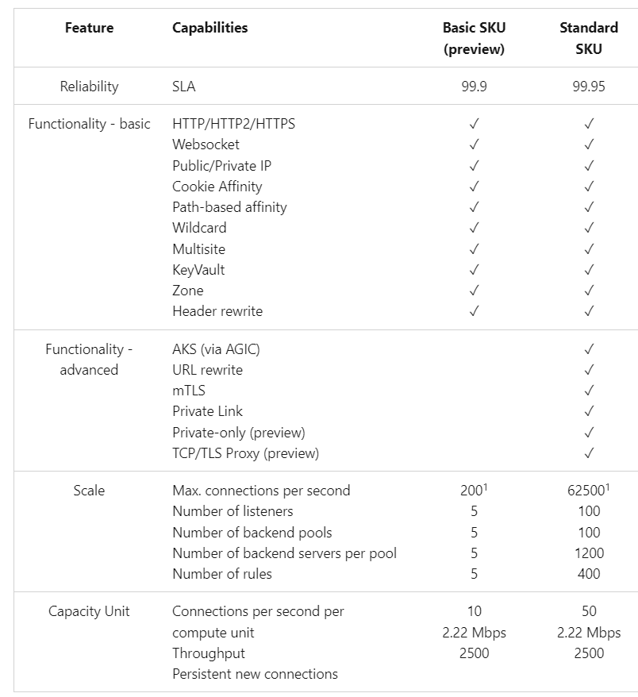
Networking Updates
Generally Available: Azure Application Gateway v2 Basic SKU
The Application Gateway Basic SKU is a new SKU within Application Gateway family. It is designed for small and medium-sized customers, making it ideal for applications with lower traffic and SLA requirements that don't require advanced auto-scale and traffic management features. Application Gateway Basic SKU has built-in high availability and supports HTTP2/HTTPS and WebSocket protocols. It offers core application-level load balancing features such as URL-based, host-based and multi-site routing, along with cookie-based affinity. It supports flexible backends, VMSS, App Services, and on-premises deployment. Customers can select the Basic SKU either directly from the Azure Portal or through their preferred scripting languages.

Slide 7
Management & Governance

Slide 8
Management & Governance Updates
Retirement: Older versions of EA Azure Price Sheet – Download by Billing Account API
All versions of the Azure Price Sheet - Download by Billing Account API prior to version 2023-09-01 (including 2022-06-01, 2021-10-01, 2020-01-01-preview, 2019-10-01, 2019-05-01) are scheduled to be retired on June 1, 2026. Please transition to Azure Price Sheet - Download by Billing Account API version 2023-11-01 by that date.
The new version of the API includes important enhancements, such as the addition of Reserved Instance (RI) pricing for the current month, market price, base price and improved metadata.
Public Preview Announcement-On Demand Capacity Reservation in Azure in China
MS announced the public preview of on demand capacity reservations for Azure Virtual Machines in Azure in China Cloud . It is now possible to manage and reserve capacity with guaranteed SLA for VM sizes available on Azure in China Cloud. The feature is not available yet in China North and China East regions.
On-demand capacity reservations can be leveraged in the following scenarios and beyond for the cloud:
Business-critical applications — use on-demand capacity reservations to protect capacity, for example when taking these VMs offline to perform updates.
Disaster recovery (DR) — set aside compute capacity to ensure a seamless recovery in the event of a natural disaster. The compute capacity can be repurposed to run other workloads whenever DR is not in effect.
Special events—claiming capacity ahead of time provides assurance that your business can handle the extra demand.

Slide 9
Compute

Slide 10
Compute Updates
Generally Available: App Service Environment memory intensive pricing tier
MS released a new memory-optimized series of Isolated v2 plans that are used for Azure App Service Environment v3. These I*mv2 plans are labeled as I1mv2, I2mv2, I3mv2, and so on.
These offerings provide the flexibility to scale memory configuration without having to pay for additional cores. They also complement existing line-up by creating more cost-effective options for workloads that need more memory to cache data or render a large page quickly, while working well using existing compute horsepower.
They range from two virtual cores with 16 GB RAM in I1mv2 (compared to two cores, 8 GB RAM in I1v2) to 32 virtual cores with 256 GB RAM in the I5mv2.

Slide 11
Storage & Data

Slide 12
Storage & Data Updates
Generally Available: Storage account default egress limit increase to 200 Gbps
The default maximum egress for general-purpose v2 and Blob storage accounts has been increased from 120 Gbps to 200 Gbps.
This applies to all existing and new storage accounts.

Slide 13
Databases

Slide 14
Databases Updates
Generally Available: Redis 7.2 on Azure Cache for Redis Enterprise
This newer version improves Redis 6.0, the previous version offered on Azure Cache for Redis. New features include expanded geospatial functionality, sharded pub/sub, and support for the Redis serialization protocol version 3 (RESP3) protocol.
The existing Enterprise caches will be upgraded automatically to Redis 7.2.
Generally Available: Azure Database for MySQL – Flexible Server flexible maintenance
MS announced that Flexible Maintenance for Azure Database for MySQL - Flexible Server is now Generally Available (GA)! This new feature enables greater control over the timing of the maintenance activities performed on database instances, so that customers can align maintenance schedules with their operational needs.
Key Features in GA
Reschedule via Azure CLI - With the GA release, users can now reschedule maintenance activities through the Azure CLI. This provides flexibility and automation for managing maintenance windows across multiple servers.
Expanded Reschedule Window - The reschedule window has been extended to cover all available maintenance dates within the region (30 days), offering much more flexibility compared to the limited 14-day window from the public preview.

Slide 15
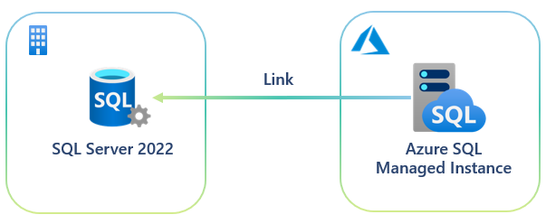
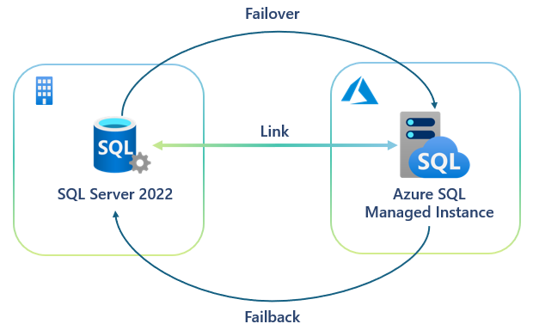
Databases Updates
Generally Available: Azure SQL updates for early-October 2024
The following updates and enhancements were made to Azure SQL:
Reduce costs by lowering the auto-pause delay for serverless compute in Azure SQL Database.
Perform bidirectional failovers between SQL Server 2022 and Azure SQL Managed Instance—now generally available using the link feature in Azure SQL Managed Instance. Two-way failover provides an easy and cost-effective hybrid disaster recovery solution and helps you unlock new scenarios, such as creating near real-time disaster recovery outside of Azure.
Creating a link from SQL Managed Instance to SQL Server 2022 to unlock off-PaaS data mobility for regulatory and dev/test scenarios

Slide 16
Azure Database PostgreSQL Updates
Public Preview: Azure Database for PostgreSQL – Flexible Server—support for postgresql_anonymizer extension version 1.3.2
MS announced that Azure Database for PostgreSQL – Flexible Server now supports the anon extension version 1.3.2. This extension enhances data anonymization capabilities, providing a powerful tool for protecting sensitive information in databases. With improved security upgrades, version 1.3.2 helps support more secure data masking, ensuring compliance with data privacy regulations.
Generally Available: Several performance management server parameters now modifiable on Azure Database for PostgreSQL
MS announced a possibility to modify a number of performance management server parameters in Azure Database for PostgreSQL – Flexible Server.
maximum number of parallel apply workers per subscription
temp_file_limit
logical_decoding_work_mem
idle_session_timeout
enable_incremental_sort
log_hostname

Slide 17
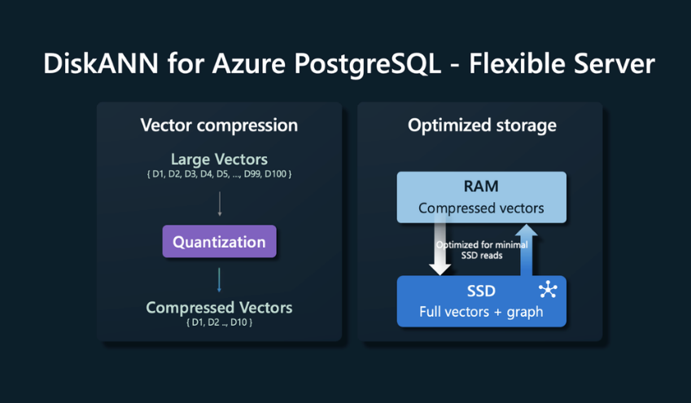
Azure Database PostgreSQL Updates
Public Preview: DiskANN indexing on Azure Database for PostgreSQL
MS announced the preview of DiskANN, one of the fastest vector indexing algorithms on the market, which is now available for Azure Database for PostgreSQL. Developed at Microsoft Research, DiskANN is used extensively at Microsoft in global services such as Bing and Microsoft 365.
DiskANN enables to build highly accurate, performant, and scalable generative AI applications that surpass pgvector’s HNSW and IVFFlat indexes in both speed and accuracy. DiskANN also overcomes a long-standing limitation of pgvector in filtered vector search, where it occasionally returns incorrect results.
DiskANN implements the following powerful techniques:
Cost-effective vector search at any scale: Affordable and accurate search capabilities, regardless of data size and throughput.
Robustness to incremental changes: Microsoft DiskANN maintains data integrity and high search accuracy during updates, inserts, and deletions.
Automatic scaling: Ensures seamless performance and cost-efficiency by dynamically adjusting resources to match your application’s workload demands.
Automated data sharding/partitioning: Optimizes performance and resource utilization.
High availability: Reduces downtime for continuous service.
Low-latency transactional operations: Ensures quick data retrieval and modification.
Built-in multitenancy: Multiple options depending on your requirement for tenant isolation.
Flexible data modeling: NoSQL schema-free nature enables developers to structure data according to their application needs.

Slide 18
Azure Cosmos DB for MongoDB Updates
Public Preview: vCore-based Azure Cosmos DB for MongoDB multishard clusters
It is now possible to use up to five physical shards on vCore-based Azure Cosmos DB for MongoDB clusters. An increased number of shards in a cluster enables to host larger workloads.
During the creation of a vCore-based Azure Cosmos DB for MongoDB cluster, it is possible to select from one to five shards. As before, each physical shard gets the same compute (vCore count and amount of RAM) and storage (GiB and IOPS) configuration.
Using a greater number of physical shards can also help increase cluster performance for larger workloads that require multishard clusters because of better parallelization.
Public Preview: vCore-based Azure Cosmos DB for MongoDB multishard, cross-region replication
With cross-region replication extended to multishard configurations of vCore-based Azure Cosmos DB for MongoDB clusters, it allows to create a replica cluster in another region for disaster recovery and for improved read scalability.
Once created, a cluster replica is continuously updated with the data written to the primary region. In the rare case of an outage in the primary region, replicate can be promoted the cluster replica, making it the new read-write cluster.
When it is promoted the cluster replica in region B and make it the new read-write cluster, it swaps roles with the cluster in region A. Connection strings for the cluster in region A and the cluster in region B are preserved after replica promotion.
It is also possible to use cluster replica in another region to offload read operations from the primary cluster. The read replica in the other region also delivers reads with lower latency to applications that are hosted in or closer to that region.

Slide 19
Azure Cosmos DB for MongoDB Updates
Public Preview: vCore-based Azure Cosmos DB for MongoDB—up to 32 TiB storage
Higher capacity storage with higher IOPS enables to host larger workloads on vCore-based Azure Cosmos DB for MongoDB cluster. Now it is possible to select from 8 TiB, 16 TiB, and 32 TiB with 16,000 IOPS, 18,000 IOPS, and 20,000 IOPS respectively. It is also possible to scale up existing clusters using any of the new storage sizes as workloads grow.
It is possible to combine these new options with multiple physical shards in vCore-based Azure Cosmos DB for MongoDB cluster, large storage capacity can comfortably handle hundreds of terabytes of data.
Generally Available: Azure Cosmos DB Data Explorer custom column selector and filter history
Now it is possible to manage data more easily using the new custom column selector and filter history features in Azure Cosmos DB Data Explorer. View can be customized by selecting specific columns that matter most , streamlining workflow.

Slide 20
Databases Updates
Generally Available: Dedicated gateway RBAC support and a new request option
MS announced new features for the Azure Cosmos DB integrated cache! The integrated cache is built into the dedicated gateway, and now there’s new ways to authenticate requests.
It is now possible to use Role-Based Access Control (RBAC) with Microsoft Entra ID to authenticate to the dedicated gateway, eliminating the security risks and complications that come with key-based authentication.

Slide 21
ML & AI & IOT

Slide 22
ML & AI & IOT Updates
Retirement: Announcing upcoming retirement of custom sentiment analysis (preview) in Azure AI Language
Custom sentiment analysis (preview) will be retired on January 10th, 2025, please transition to other custom model training services, such as custom text classification in Azure AI Language, by that date.
From now to January 10th, 2025, it is allowed to continue to use custom sentiment analysis (preview) in your existing projects without disruption. It will be not possible to create new projects. On January 10th, 2025 – workloads running on custom sentiment analysis (preview) will be deleted and associated project data will be lost.
Retirement: Announcing upcoming retirement of custom text analytics for health (preview) in Azure AI Language
Custom text analytics for health (preview) will be retired on January 10th, 2025. Please transition to other custom model training services, such as custom named entity recognition in Azure AI Language, by that date.
From now to January 10th, 2025, you can continue to use custom text analytics for health (preview) in your existing projects without disruption. It will be not possible to create new projects. On January 10th, 2025 – workloads running on custom sentiment analysis (preview) will be deleted and associated project data will be lost.

Slide 23
ML & AI & IOT Updates
Announcing Text PII Redaction Container Release
MS announced the container support for pre-built Text PII services for redacting Personally Identifiable Information (PII). This release allows customers with stringent security and privacy requirements to detect and redact PII entities from text locally, ensuring that user data is secure and private.
This release includes both connected and disconnected container options, with the connected container offering both Pay as You Go and Commitment Tier pricing options and the disconnected container providing Commitment Tier pricing, allowing long-term customers to also benefit from cost savings based on their commitment.

Slide 24
DevOps & IaC & Automation

Slide 25
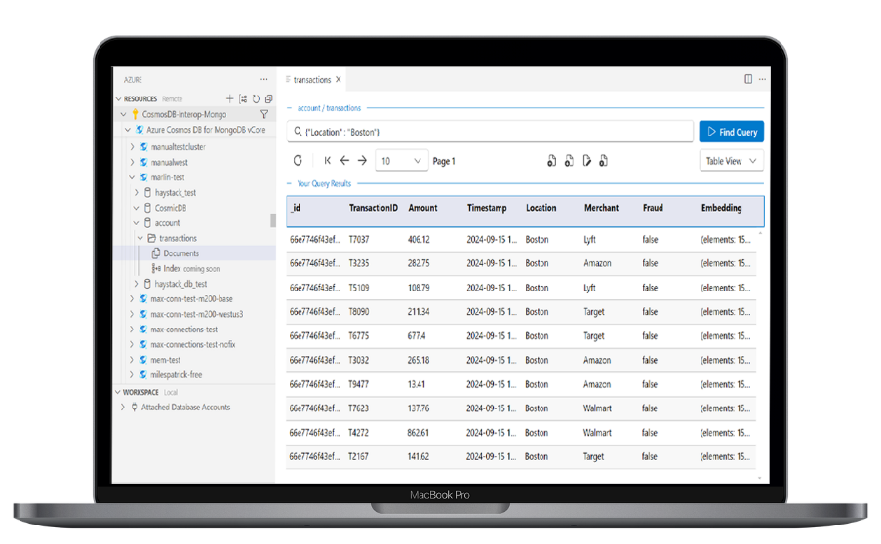
DevOps & IaC & Automation
Announcing Private Preview: VS Code Extension of vCore-based Azure Cosmos DB for MongoDB
MS introduced a new VS Code extension for vCore-based Azure Cosmos DB for MongoDB ! This tool allows users to connect, query, and manage vCore-based Azure Cosmos DB for MongoDB directly within VS Code, streamlining your workflow.
List vCore-bsased Azure Cosmos DB for MongoDB Resources
Connect to a cluster as an admin or user
View metadata
Execute find queries
Edit, Delete, Update documents
View indexes
Create and Drop Databases and Collections
View data in JSON, Table, and Tree views
View data for multiple collections simultaneously

Slide 26
Miscellaneous

Slide 27
Miscellaneous Updates
PPTP and L2TP deprecation: A new era of secure connectivity
MS is deprecating the PPTP (Point-to-Point Tunneling Protocol) and L2TP (Layer 2 Tunneling Protocol) protocols from future Windows Server versions. It is time to transition to more secure and efficient alternatives: SSTP and IKEv2.
Deprecation is not removal. Deprecation refers to the stage in the product lifecycle when a feature or functionality is no longer in active development and may be removed in future releases.
Breaking change for Window Server 2022 Image Users with .NET 6
Azure Marketplace media images for Windows Server 2022 currently include .NET 6, but going forward will not include a .NET version with the image (.NET 8 and later are not included with the image). Therefore, if you previously relied on the Azure Marketplace image to include the .NET 6 runtime, going forward you will need to handle the .NET deployment yourself.
On November 12th 2024, .NET 6 will reach end of support. However, based on customer feedback we have decided to provide customers with more time to handle the .NET 8 runtime deployment and upgrade to .NET 8. Microsoft will provide security updates for .NET 6 in the Azure Marketplace media images beyond the official end of support date, with an additional 6 months through May 13, 2025. Note this only applies to Azure marketplace media of Windows Server 2022.
.NET 6 will be removed from all Azure marketplace Windows Server 2022 media on May 13th, 2025. If you are impacted, and have not migrated to .NET 8, you need to take action to complete the change before May 2025.

Slide 28
Information

Slide 29
Information
Azure Times GitHub Repo

Slide 30
Questions

