Slide 1
Azure Times #139
November 4 , 2024

Slide 2
Networking

Slide 3
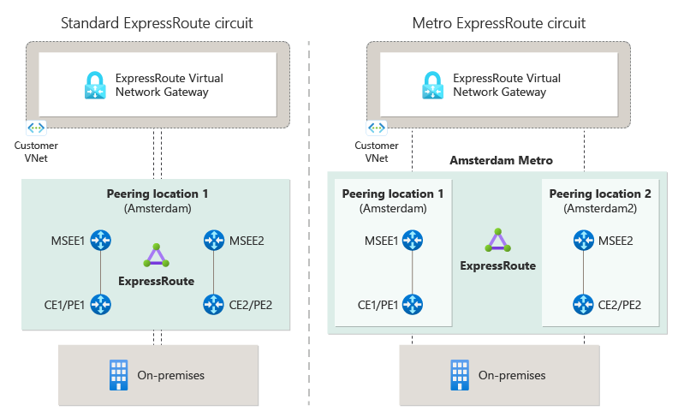
Networking Updates
Generally Available: ExpressRoute Metro
MS Announced general availability of ExpressRoute Metro, a new private connectivity architecture designed to enhance network resiliency. ExpressRoute Metro provides a highly resilient circuit that enables diverse connections to two separate edge sites within a city, ensuring increased redundancy and reliability.
Key Highlights:
Enhanced Resiliency: Dual-homed connections across two distinct edge sites offer improved resiliency.
Locations Coverage: Metro is currently available in Amsterdam, Singapore and Zurich with more locations including Atlanta, Milan, Madrid, Chicago, and Dublin, scheduled to go live in coming months.
Simple Setup: The setup process is designed for simplicity and ease of configuration, featuring a guided portal that provides clear navigational support.

Slide 4
Networking Updates
Generally Available: Bot Manager Ruleset 1.1 on Azure WAF with Azure Application Gateway
A new bot protection rule set (Microsoft_BotManagerRuleSet_1.1) is now generally available for Azure Web Application Firewall (WAF) with Azure Application Gateway.
This updated ruleset enhances the existing Bot Manager 1.0 by introducing new bad bot and good bot rules. Bot signatures are dynamically managed and updated by Azure WAF. The new bad bot rule 100300 improves malicious bot protection by incorporating risky IPs identified by Microsoft Threat Intelligence. MS updated good bot rules 200100 and 200200, and added new rules 200300, 200400, 200500, 200600, and 200700 for enhanced security and granular control. These new good bot rules expand the detection of good bots by including a broader set of known crawlers and distinguishing various categories of good bots. Bad bots are blocked by default, good bots are allowed, and unknown bots are set to log action.
MS introduced JS Challenge as the latest addition to list of actions. Customers can overwrite the default action with Allow, Block, Log, or JS Challenge for any type of bot rule.

Slide 5
Security & Identity

Slide 6
Security & Identity Updates
Retirement: Update on retirement of TLS 1.0 and TLS 1.1 versions for Azure Services
While the Microsoft implementation of TLS 1.0 and TLS 1.1 versions is not known to have vulnerabilities, TLS 1.2 or later versions provide improved security features, including perfect forward secrecy and stronger cipher suites.
Customers still using TLS 1.0 or 1.1 should transition their workloads to TLS 1.2 or later versions to ensure uninterrupted connectivity to Azure services.
To avoid potential service disruptions, confirm that your resources that interact with Azure services are using TLS 1.2 or later. Then:
If they're already exclusively using TLS 1.2 or later, you don't need to take further action.
If they still have a dependency on TLS 1.0 or 1.1, transition them to TLS 1.2 or later.
Azure Storage - TLS 1.0 and 1.1 retirement
TLS 1.0 and 1.1 retirement on Azure Storage was previously announced for Nov 1st, 2024, and it was postponed recently to 1 year later, to Nov 1st, 2025.

Slide 7
Security & Identity Updates
Update to security defaults
MS is removing the option to skip multifactor authentication (MFA) registration for 14 days when security defaults are enabled. This means all users will be required to register for MFA on their first login after security defaults are turned on. This will help reduce the risk of account compromise during the 14-day window, as MFA can block over 99.2% of identity-based attacks. This change affects newly created tenants starting on December 2nd, 2024 and will be rolled out to existing tenants starting in January 2025.

Slide 8
Management & Governance

Slide 9
Management & Governance Updates
Public Preview: Immutable WORM Storage for Backups in Azure Recovery Services Vaults
Azure Backup users will now have immutable WORM storage for their backups when immutability is enabled and locked on a Recovery Services Vault. When immutability is enabled, it ensures that a Recovery Point, once created, cannot be deleted or have its retention period reduced before its intended expiry. Now, when immutability is locked, Azure Backup will also use WORM-enabled immutable storage to meet any compliance requirements. This feature is applicable to both existing and new vaults with locked immutability. It is currently in preview in limited regions
Generally Available: GRS and CRR support for Azure VMs using Premium SSD v2 and Ultra Disk in Azure Backup
MS announced the general availability of enabling Azure Backup on Azure VMs using Premium SSD v2 and Ultra disk on GRS vaults. Premium SSD v2 offering provides the most advanced block storage solution designed for a broad range of IO-intensive enterprise production workloads that require sub-millisecond disk latencies as well as high IOPS and throughput — at a low cost. With GRS and cross-region restore support, you can protect your virtual machines from data loss during a disaster and perform periodic audits by restoring data on demand in the secondary region.
Enabling GRS vaults for VMs using Premium SSD v2 and Ultra Disk are available in Southeast Asia, East Asia, North Europe, West Europe, East US, West US, and West US 3. Support will be rolled out to other public regions in the upcoming months.

Slide 10
Management & Governance Updates
Generally Available: FinOps toolkit 0.6 - September 2024
the FinOps toolkit is an open-source collection of tools and resources that help you learn, adopt, and implement FinOps in the Microsoft Cloud.
The September 2024 release of the FinOps toolkit (version 0.6) is now available. This month, you’ll find:
New: FinOps best practices library.
New: Power BI reports for governance and workload optimization
Customizable promoted tags in Power BI.
Ingest prices, reservation details, reservation recommendations, and reservation transactions in FinOps hubs.
Performance and scalability improvements in Power BI reports.
New: Consolidated FinOps workbooks template.
Azure Optimization Engine security and troubleshooting updates.
FOCUS 1.1 ServiceSubcategory mapping in the Services open data file.
Other small improvements and bug fixes across all tools.
Generally Available: App Insights Code Optimizations
Application Insights Code Optimizations helps identify and resolve performance bottlenecks at the code level in your running .NET applications. Utilizing an advanced AI-based model, it analyzes Application Insights profiler traces and provides actionable next steps in the Azure portal at no additional cost.

Slide 11
Management & Governance Updates
Public Preview: VM watch for Azure VMs
VM watch, now in preview, is a standardized, lightweight, and adaptable in-VM service offering for virtual machines and virtual machine scale sets. It runs health checks within the VM at configurable intervals and sends the results via a uniform data model to Azure. These health results are consumed by Azure's production monitoring AIOps (AI Operations) engines for regression detection and prevention.
VM watch monitoring specifics
Ease of adoption: VM watch is made available through the Application Health VM extension.
Flexible Deployment: Users can enable VM watch with ease via ARM template, PowerShell, or AZ CLI.
Compatibility: VM watch operates seamlessly on both Linux and Windows environments. Also, VM watch is suitable for individual VMs and VMSS VMs alike.
Resource Governance: VM watch provides efficient monitoring without impacting system performance. Resource caps are placed on the CPU and memory utilization of the VM watch process itself to protect the VM.
Ready Out-of-the-Box: VM watch comes equipped with a suite of default tests, which are easily configurable to enable scenario specific tests. Detailed information regarding the Tests (Checks, Metrics, and Event Logs) are given below.
Retirement: Change Analysis (classic) API in Azure Monitor is retiring
On October 31st, 2025, Change Analysis (classic) API in Azure Monitor will be retired. As a result, any workloads using Change Analysis (classic) API in Azure Monitor will be deleted and the associated application data will be lost.
Before the retirement date, you'll need to migrate to Change Analysis powered by Azure Resource Graph (ARG), which provides the same monitoring capabilities plus additional benefits, including:
Real-time insights
Granular filtering
Grouping capabilities
Change-actor identification
Cross-query
Alerting

Slide 12
Compute

Slide 13
Compute Updates
Public Preview: Azure Functions support for Node.js 22
Azure Functions now supports Node.js 22 in preview. It is now possible to develop functions using Node.js 22 locally and deploy them to all Azure Functions plans on Linux and Windows.
Generally Available: Azure Cobalt 100 Arm-based Virtual Machines
Microsoft is announcing the general availability of the new Cobalt 100 Arm-based virtual machines (VMs). The Cobalt 100 VMs consist of new general purpose Dpsv6-series and Dplsv6-series and memory optimized Epsv6-series VM series. They offer up to 50% better price-performance than previous generation Arm-based VMs, making them an attractive option for a wide range of scale-out and cloud native Linux-based workloads, including data analytics, web and application servers, open source databases, caches, and more.
The Azure Cobalt 100 VMs deliver up to 1.4x CPU performance, up to 1.5x performance on Java-based workloads and up to 2x performance on web servers, .NET applications and in-memory cache applications compared to the previous generation Azure Arm-based VMs. These VMs also support 4x local storage IOPS (with NVMe) and up to 1.5x network bandwidth compared to the previous generation Azure Arm-based VMs.

Slide 14
Compute Updates
Generally Available: Reduced Pricing for JBoss EAP on App Service
Across all available non-free SKUs, JBoss EAP License fees have been reduced by 63%! This reduction in license fees makes JBoss EAP on App Service more accessible than ever.
Available SKUs for JBoss EAP on App Service:
F1 (price reduction not applicable to free tier)
P0v3
P1v3
P1mv3
P2v3
P2mv3
P3v3
P3mv3
P4mv3
P5mv3
Isolated
Generally Available: ED25519 SSH key support for Linux VMs
Azure customers can now use the secure and smaller ED25519 SSH keys with their Linux VMs. Previously, customers only had the option of using RSA keys for SSH connections to their Linux VMs on Azure. Now customers can choose between RSA and ED25519 based keys.
Azure now allows the creation of ED25519 SSH keys directly within the Azure Portal for a simplified key management process. Additionally, Azure CLI and PowerShell also support ED25519 keys in Azure.
While RSA remains the default key type, users can create or use existing ED25519 SSH keys with their Linux VMs, enhancing the security and deployment efficiency on Azure.
The ED25519 algorithm is based on the elliptic curve defined over the prime field of 2²⁵⁵-19. The private key is a 256-bit integer, while the public key is a 32-byte sequence.

Slide 15
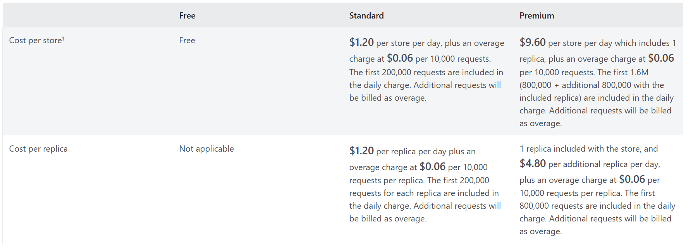
Compute Updates
Generally Available: Azure App Configuration – Premium pricing plan now generally available
The Premium tier for Azure App Configuration is now generally available, making it possible to support larger and more complex applications with higher performance and scalability.
This new pricing plan is ideal for organizations that need greater capacity, enhanced security, and global availability for configuration management.
Key capabilities include:
Increased Capacity: Supports higher configuration volumes and increased request throughput for large-scale applications.
Included Global Replication: 1 included replica ensures faster access and increased resilience through replication across multiple regions.
Improved SLA: Offers 99.99% SLA, tailored for mission-critical applications.

Slide 16
Compute Updates
Announcing Public Preview of new attach/detach disks API for VMs/VMSS
MS excited to announce the public preview of a new API that will make attaching and detaching disks to a VM faster and easier. The new API is designed to reduce the number of API calls and the latency involved in disk operations. It simplifies the inputs required to attach disks and allows multiple disks to be attached/detached in one request. The new API is compatible with single instance VMs, VMSS Uniform and VMSS Flex.
The new API offers several advantages over the existing disk management API. Here are some of the benefits you can expect from using the new API:
Faster and more efficient: The new API reduces the number of API calls and the latency involved in attaching and detaching disks.
Easier and more intuitive: The new API simplifies the disk management workflow by allowing to attach and detach multiple disks in one request, and by reducing the input parameters.
Separate Throttling limits – Currently, customers need to make Update VM API requests to attach/detach a disk and there is a limit of max 12 requests per VM per min. With this new API, customers will get additional quota of X requests per VM per min, in addition to the 12 requests already available for Update VM API.

Slide 17
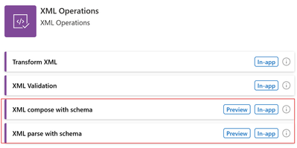
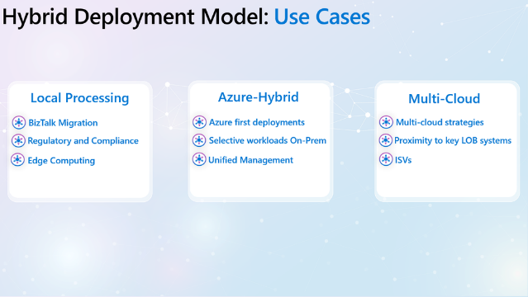
Compute Updates
Announcement: Introducing the Logic Apps Hybrid Deployment Model (Public Preview)
MS announced the launch of the Logic Apps Hybrid Deployment Model, a new feature that add flexibility and control. This new offering allows to build and deploy workflows that run on customer-managed infrastructure, providing you with the option to run Logic Apps on-premises, in a private cloud, or even in a third-party public cloud.
The Hybrid Deployment Model supports a semi-connected architecture. What this means is that get local processing of workflows, the data processed by the workflows remains in local SQL Server and also provides the ability to connect to local networks. Since the Hybrid Deployment Model is based upon Logic Apps Standard, the built-in connectors will execute in local compute giving you access to local data sources and higher throughput.
Announcing the Public Preview of the new XML Compose and Parse with schema actions
MS added two actions for the XML Operations connector: Parse with schema and Compose with schema. With this addition, Logic Apps customers can now interact with the token picker during design time. The tokens are generated from the XML schema provided by the customer. As a result, the XML document and its contained properties will be easily accessible, created and manipulated in the workflow.

Slide 18
Compute Updates
MMR Call Redirection for Azure Virtual Desktop, Windows 365 now available
Multimedia Redirection (MMR) Call Redirection for Azure Virtual Desktop and Windows 365 is now GA. Call Redirection allows users to enjoy audio calls on Windows delivered from the cloud just as they would through their local Windows OS.
Call Redirection redirects WebRTC calls from Azure Virtual Desktop session hosts and Windows 365 Cloud PCs to local client devices to reduce latency and improve call quality. Prior to this release, customers may have experienced interruptions to their calls that impaired productivity. With the release of Call Redirection, customers can have like-local audio calls while using WebRTC-based calling apps on Azure Virtual Desktop and Windows 365.
MMR Call Redirection also works seamlessly with Windows App, a unified app that provides a gateway to securely connect to Windows on any device or app across Windows 365, Azure Virtual Desktop, Remote Desktop, Remote Desktop Services, Microsoft Dev Box, and more.
New features for Azure Virtual Desktop for Azure Stack HCI
Autoscale is now generally available for Azure Virtual Desktop host pools on Azure Stack HCI. Autoscale allows to scale available session hosts up or down according to a schedule to optimize deployment costs. The same scaling plans applied to Azure virtual machines (VMs) can now be applied to Azure Stack HCI VMs.
Start VM on Connect helps reduce costs by enabling users to power on VMs used as session hosts only when they're needed. You can then power off VMs when they're not needed. Azure Virtual Desktop for Azure Stack HCI users now have the option to use this feature with Azure Stack HCI VMs.
IT admins can now download Windows 11 or Windows 10 Enterprise single-session images from Azure Marketplace to their Azure Stack HCI clusters.
Azure Virtual Desktop provides a centralized, first-party monitoring solution that enables IT admins to detect, diagnose, and resolve issues within their environments. You can now monitor Azure Virtual Desktop session hosts on Azure Stack HCI using Azure Virtual Desktop Insights.
Azure Virtual Desktop for Azure Stack HCI now supports per-user access pricing. Organizations, including independent software vendors (ISVs) could already use Azure Virtual Desktop to provide external users with a Software-as-a-Service (SaaS) experience for software access.

Slide 19
Compute Updates
Generally Available: App Service multi plan subnet join
Virtual network integration in App Service previously required one subnet per App Service plan integration.
MPSJ reduces subnet sprawl when dealing with many apps across many plans and simplifies management of networking control such as Network Security Groups and Route tables across App Service plans.
With MPSJ you can join a virtual network/subnet in a different subscription, but all App Service plans joining a specific subnet must be in the same subscription.
When you scale up/down in instance size, the amount of IP addresses used by the App Service plan is temporarily doubled while the scale operation completes. Finally, after scale up, down, or in operations complete, there might be a short period of time before IP addresses are released. In rare cases, this operation can be up to 12 hours and if you rapidly scale in/out or up/down, you need more IPs than the maximum scale.
Because subnet size can't be changed after assignment, use a subnet that's large enough to accommodate whatever scale your app might reach.
With multi plan subnet join (MPSJ), you can join multiple App Service plans in to the same subnet.
All App Service plans must be in the same subscription but the virtual network/subnet can be in a different subscription.
Each instance from each App Service plan requires an IP address from the subnet and to use MPSJ a minimum size of /26 subnet is required.

Slide 20
Compute Updates
Announcing availability of AlmaLinux as an endorsed Linux distribution in Azure
AlmaLinux has been available in the Azure Marketplace for over three years and we are excited to announce it is now an endorsed Linux distribution in Azure.
While a Linux distribution being endorsed is not an official recommendation from Microsoft, it indicates that the distribution has met the following criteria:
Market and customer demand.
A contractual agreement ensuring update cadences and remediation targets with the provider of the distribution, which can be the actual provider of the Linux distribution
Engineering relationship: There is a close engineering relationship between Microsoft and the Linux distribution provider with ongoing forums to discuss issues, customer feedback, new Azure feature enablement and future updates.
Content mirror in Azure: The Linux distribution provider maintains content and infrastructure across multiple Azure regions ensuring consistency of the update user experience and providing speedy, in-network software installation.

Slide 21
Storage & Data

Slide 22
Storage & Data Updates
Generally Available: Azure Elastic SAN for Azure VMware Solution
Azure Elastic SAN for Azure VMware Solution (AVS) is now generally available. Azure Elastic SAN offers AVS customers an Azure deployed, fully managed, VMware Certified storage area network (SAN) that can achieve massive scale, is easy to manage, and has redundancy built in at a low TCO.
With this integration, MS added an important tool for optimizing workloads, whether they are large-scale databases requiring high storage capacity, or performance-intensive, mission-critical applications. Not every application requires the high performance vSAN offers, and many workloads, like backup and disaster recovery use cases or other capacity intensive workloads, can benefit from a more cost-efficient storage solution. Azure Elastic SAN can be deployed and connected straight from the Azure portal, and at $0.06-0.08 per GiB per month*, it is the cheapest per GiB storage option for AVS, while still offering plenty of performance for a variety of use cases.
Microsoft Fabric updates
Adding more flexibility to your business applications with support for Service Principal Names (SPNs) in Fabric API for GraphQL
Fabric Runtime 1.3 is Generally Available!
Announcing Public Preview of the “Share” Feature for Fabric AI Skill
Announcing the Enhanced Tenant Setting Delegation for Export Controls in Microsoft Fabric
Real-Time Dashboards and underlying KQL databases access separation (preview)
Announcement: Microsoft Purview Data Loss Prevention policies have been extended to Fabric lakehouses
Microsoft Fabric and AI Learning Hackathon: Copilot in Fabric
Native Execution Engine available at no additional cost!
Usage reporting for Data Activator is now live
New Features and Enhancements for Virtual Network Data Gateway

Slide 23
Storage & Data Updates
Public Preview: Edit network features for Azure NetApp Files with no downtime
MS announced the public preview of Edit network features with no downtime for Azure NetApp Files volumes. Standard Network Features provide with an enhanced Virtual Networking experience for a seamless and consistent experience along with security posture for Azure NetApp Files.
It is now possible to edit existing Azure NetApp Files volumes and upgrade Basic network features to Standard network features with no downtime. This feature is currently in preview in the Australia East, Central India, North Central US, and Switzerland North regions. We will be expanding to other regions.
It provides:
Increased IP limits for the VNets with Azure NetApp Files volumes on par with VMs to enable customers to provision volumes in their existing topologies/architectures, eliminating the need for to rearchitect network topologies.
Enhanced network security with support for Network Security Groups on the Azure NetApp Files delegated subnet.
Enhanced network control with support for User-defined routes to and from Azure NetApp Files delegated subnets.
Connectivity over Active/Active VPN gateway setup for highly available connectivity to ANF from on-prem.
ExpressRoute FastPath connectivity to Azure NetApp Files. FastPath is designed to improve the data path performance (low latency and high bandwidth connectivity) between on-premises network and Azure virtual network.

Slide 24
Storage & Data Updates
Generally Available: Live Resize for Azure Premium SSD v2 and Ultra Disks
MS announced the General Availability of Live Resize for Premium SSD v2 and Ultra Disks. Dynamically increase the storage capacity of disks without causing any disruption to applications. To reduce costs, it is possible to begin by creating smaller disks and gradually increase their storage capacity without experiencing any downtime.
The future has the following limitations:
Only supported for data disks.
Not supported for shared disks.
You can't expand a disk while a background copy of data is also occurring on that disk, like when a disk is being hydrated from snapshots.
You can't expand a VM that's using NVMe controllers for Ultra Disks or Premium SSD v2 disks without downtime.
Generally Available: Azure Premium SSD v2 Disk Storage is now available in more regions
Azure Premium SSD v2 Disk Storage is now available in Germany West Central, Israel Central, Italy North, Spain Central, Mexico Central regions.

Slide 25
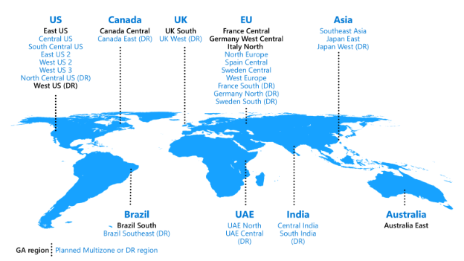
Storage & Data Updates
Announcing Oracle Database@Azure in Italy North and Brazil South
Microsoft and Oracle are excited to announce that we are expanding the general availability of Oracle Database@Azure for the Azure Italy North and Brazil South regions.
This significant expansion underscores our commitment to providing unrivaled cloud services, fostering innovation, and meeting the diverse needs of our enterprise customers. Out of the 21 announced regions, Oracle Database@Azure is now available in eight Azure regions – Italy North, Brazil South, Australia East, Canada Central, East US, France Central, Germany West Central, and UK South.

Slide 26
Databases

Slide 27
Databases Updates
Generally Available: In-place scaling for Enterprise caches
Enterprise and Enterprise Flash tier caches now have the ability to scale up or out without requiring downtime. Scaling up allows a cache to scale to a larger Enterprise SKU with more memory capacity, connections, and compute performance. Scaling out spreads data over additional nodes, which likewise boosts memory and compute performance. With in-place scaling, the scale operation occurs without disrupting the operation of the current cache, allowing to use the same cache resource with minimal interruption and no need to change cache addresses.
You can't scale from a higher pricing tier to a lower pricing tier
You can't scale between Enterprise and Enterprise Flash.
Generally Available: Azure SQL updates for late-October 2024
More than twice as many Azure regions as before now support autoscaling—up to 80 vCores—using serverless in Azure SQL Database.

Slide 28
Databases Updates
Introducing support for Graph data in Azure Database for PostgreSQL (Preview)
MS announced the addition of Apache AGE extension in Azure Database for PostgreSQL, a significant advancement that provides graph processing capabilities within the PostgreSQL ecosystem. This new extension brings a powerful toolset for developers looking to leverage a graph database with the robust enterprise features of Azure Database for PostgreSQL.
Apache Graph Extension (AGE) is a PostgreSQL extension developed under the Apache Incubator project. AGE is designed to provide graph database functionality, enabling users to store and query graph data efficiently within PostgreSQL. It supports the openCypher query language, which allows for intuitive and expressive graph queries. With AGE, you can manage and analyze complex relationships within your data, uncovering insights that traditional relational databases and even semantic search might miss.
The integration of AGE in Azure Database for PostgreSQL brings numerous benefits to developers and businesses looking to leverage graph processing capabilities:
Simplified Data Management: AGE's ability to integrate graph and relational data simplifies data management tasks, reducing the need for separate graph database solutions.
Enhanced Data Analysis: With AGE, you can perform complex graph analyses directly within your PostgreSQL database, gaining deeper insights into relationships and patterns in your data.
Cost Efficiency: By utilizing AGE within Azure Database for PostgreSQL, you can consolidate your database infrastructure, lowering overall costs and reducing the complexity of your data architecture.
Security and Compliance: Leverage Azure's industry-leading security and compliance features, ensuring your graph data is protected and meets regulatory requirements.

Slide 29
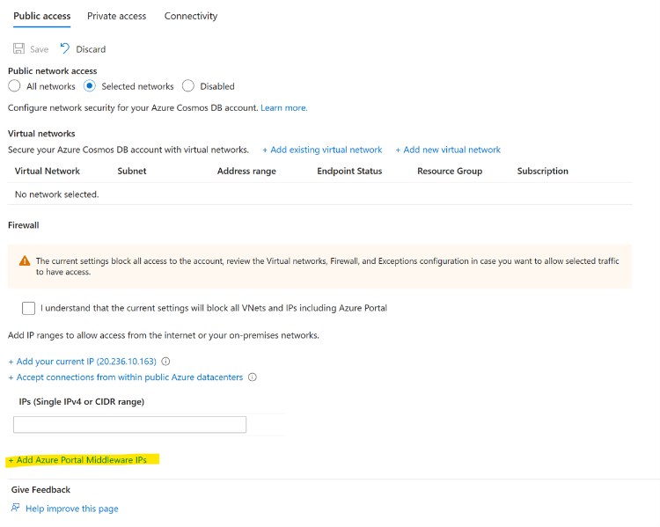
Databases Updates
Updates to Azure Cosmos DB’s Portal Networking Settings
Azure Cosmos DB networking configuration options was updated within the Azure Portal. This update introduces a split in the IP address list, now presented as two distinct categories: user IP addresses and Portal Middleware IPs. Managing IP access control policies is essential for maintaining a secure environment. Earlier this year, new Portal IP addresses were introduced as part of the Azure Cosmos DB portal service upgrade. Now, you can easily update these addresses with a single click in the portal.

Slide 30
Integration

Slide 31
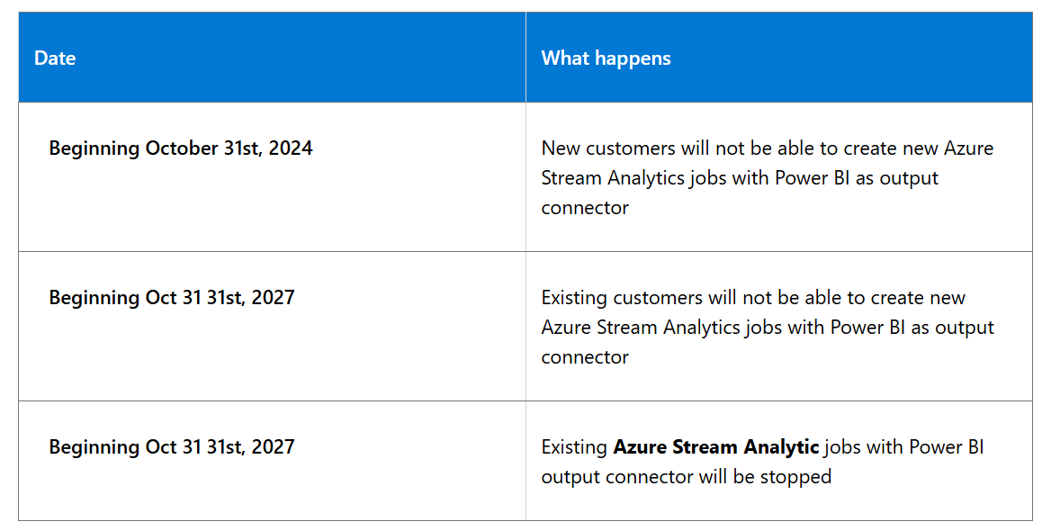
Integration Updates
Retirement: Azure Stream Analytics PowerBI output connector
Azure stream analytics PowerBI output connector will be retired on Oct 31, 2027.

Slide 32
ML & AI & IOT

Slide 33
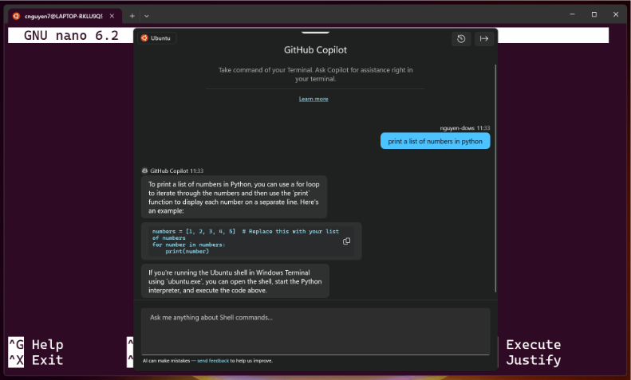
ML & AI & IOT Updates
More new languages supported in Microsoft 365 Copilot
MS rolled out support for an additional 12 languages in Microsoft 365 Copilot: Bulgarian, Croatian, Estonia, Greek, Indonesian, Latvian, Lithuanian, Romanian, Serbian (Latin), Slovak, Slovenian, and Vietnamese. Microsoft 365 Copilot now supports a total of 42 languages.
GitHub Copilot in Windows Terminal
GitHub Copilot users can now use the power of GitHub Copilot to get command suggestions and explanations without leaving the terminal with Terminal Chat in Windows Terminal Canary.

Slide 34
DevOps & IaC & Automation

Slide 35
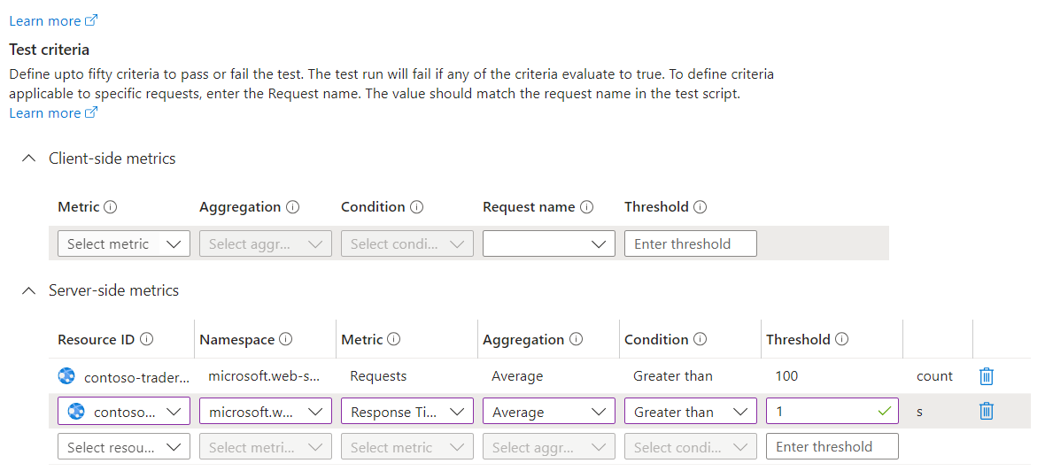
DevOps & IaC & Automation
Generally Available: Set fail criteria on server metrics in Azure Load Testing
It is now possible to set fail criteria on server metrics, thereby defining performance and quality expectations for application under load. Monitor applications components and specify the thresholds on server metrics for test failure.
Azure SDK Release (October 2024)
New Azure SDK version has been released with new features and bug fixes https://azure.github.io/azure-sdk/releases/latest/index.html

Slide 36
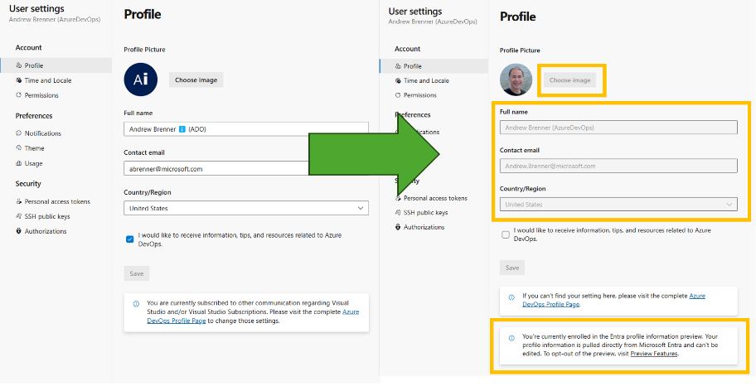
DevOps & IaC & Automation
Using Entra profile information in Azure DevOps
MS announces the ability to use Entra profile information in Azure DevOps. Beyond the convenience of configuring profile information in one place and ensuring the accuracy of personal information, using Entra profile information in Azure DevOps provides important security and compliance benefits for Enterprise customers.
Azure DevOps profile will become read-only, and information will be populated from Entra instead.
Introducing Pull Request Annotation for CodeQL and Dependency Scanning in GitHub Advanced Security for Azure DevOps
MS announced a new feature release that will take code security to the next level: PR (Pull Request) Annotation for CodeQL and Dependency Scanning.
Pull Request Annotation brings security insights directly into your development workflow. Here’s how it works:
When you raise a Pull Request, CodeQL runs automatically, scanning for any potential security issues.
Dependency Scanning concurrently checks for vulnerabilities in packages or libraries you might be using.
If any issues are found, they are reported directly on the PR interface as annotations.
Developers can see exactly what the problem is and where it occurs, allowing for quick fixes and efficient peer reviews.
Secure development becomes a part of your everyday process, not a separate, isolated task.

Slide 37
DevOps & IaC & Automation
Announcing AzAPI 2.0
The AzAPI provider, designed to expedite the integration of new Azure services with HashiCorp Terraform, has now released 2.0.
All resource properties, outputs, and state representation are now handled with HashiCorp Configuration Language (HCL) instead of JSON. This change allows the use of all native Terraform HCL functionalities
AzAPI now supports several Terraform provider functions:
build_resource_id: Constructs an Azure resource ID.
parse_resource_id: Breaks down an Azure resource ID into its components.
subscription_resource_id: Constructs an Azure subscription scope resource ID.
tenant_resource_id: Builds an Azure tenant scope resource ID.
management_group_resource_id: Creates an Azure management group scope resource ID.
resource_group_resource_id: Forms an Azure resource group scope resource ID.
extension_resource_id: Generates an Azure extension resource ID with additional names.

Slide 38
Miscellaneous

Slide 39
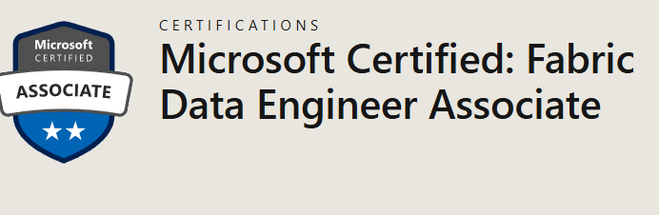
Miscellaneous Updates
Exam DP-700: Implementing Data Engineering Solutions Using Microsoft Fabric (beta)
Skills measured
Implement and manage an analytics solution
Ingest and transform data
Monitor and optimize an analytics solution
New URL for Exchange admin center (EAC) in Exchange Online
MS announced a new URL for accessing the Exchange admin center (EAC) in Exchange Online - https://admin.cloud.microsoft/exchange. This new URL is live and available for use now. This change is part of broader strategy to admin experiences under a single domain (cloud.Microsoft).
Requests sent to the legacy URL (https://admin.exchange.microsoft.com) will be redirected to the new URL.

Slide 40
Miscellaneous Updates
Retirement: Azure Health Data Services Retirement of Qatar Central Region
Azure Health Data Services from the Qatar Central region is retiring as of October 31, 2024. MS is asking customers to utilize one of other regions or remove/backup data they wish to retain before retirement.
Customers may use one of other regions.

Slide 41
Information

Slide 42
Information
Azure Times GitHub Repo

Slide 43
Questions

