Slide 1
Azure Times #140
November 11, 2024

Slide 2
Networking

Slide 3
Networking Updates
Proof of concept
Create a new profile
Configure new profile with similar configuration settings as existing profile.
Fine tune caching and compression configuration settings to meet requirements.
Implement
Set up the new content delivery network profile for production by performing validation before the change over.
Staging environment testing:
Test workload and DNS configuration to see whether it's working properly.
Ensure caching is configured correctly.
A/B environment validation (if allowed):
Configure Traffic Manager to route traffic to the new content delivery network profile and compare performance and caching behavior.
CDN service change over: configure DNS change to point to the new content delivery network CNAME.
Post change monitoring: monitor the content delivery network cache hit rate, origin traffic volume, any abnormal status codes, and top URLs.
Retirement: Azure CDN Standard/Premium from Edgio (formerly Verizon) will be retired
Azure CDN Standard/Premium from Edgio (formerly Verizon) will be retired on November 4, 2025. Customers of this service must migrate their workload(s) to a comparable service before this date to avoid service interruptions. New Azure CDN from Edgio profiles will no longer be allowed to be created after January 15, 2025. Given that Edgio filed for Chapter 11 Bankruptcy on September 9, 2024, Microsoft cannot guarantee that Edgio will continue to support this service through November 4, 2025.
Microsoft's flagship CDN product, Azure Front Door Standard or Premium, is recommended replacement and MS encourage to consider migrating compatible workloads there.
Prepare
Create an inventory of each endpoint, custom domains and their use cases.
Review existing endpoint configurations and capture caching, compression rules and other applicable settings, such caching rule and their scenarios.

Slide 4
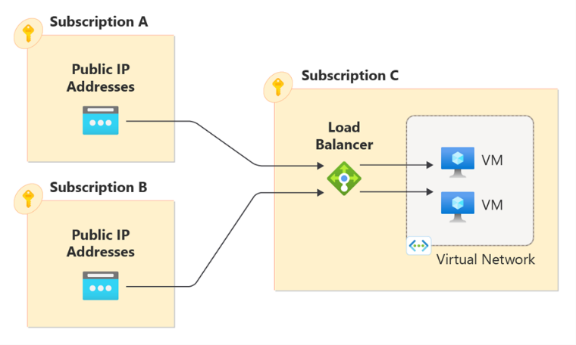
Networking Updates
Generally Available: Azure Load Balancer now supports Health Status
Azure Load Balancer Health Status, a powerful feature designed to provide detailed information about the health of backend instances in Azure Load Balancer backend pool.
The Health Status feature offers valuable insights into the state of health of backend instances and specific reasons for their health status, including:
User-triggered issues
Platform-triggered reason codes
With this feature, it is possible now monitor and manage the health of backend instances through detailed status reports. This improved visibility into the health of backend pool instances allows for easier troubleshooting and more efficient management of issues with Load Balancer.
Generally Available: Azure cross-subscription Load Balancer
Azure Load Balancer supports cross-subscription load balancing, where the frontend IP and/or the backend pool instances can be in a different subscription than the Azure Load Balancer.
SyncMode property isn't supported on cross-region load balancer backend pools
Cross-subscription load balancers can't be chained to Gateway Load Balancers
Inbound NAT pools aren’t supported for cross-subscription load balancers. Utilize inbound NAT rules

Slide 5
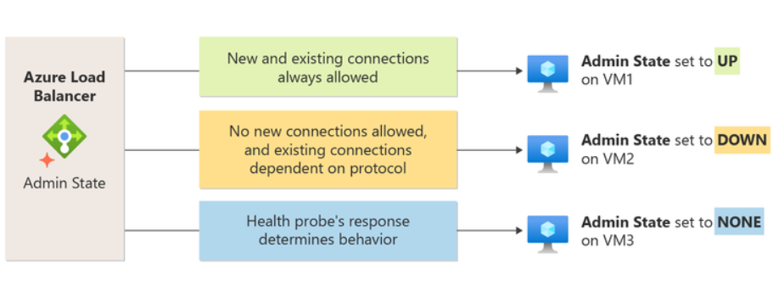
Networking Updates
Generally Available: Azure Load Balancer now supports Admin State
Announcing the general availability of Azure Load Balancer Administrative State (Admin State), which simplifies managing backend pool instances.
Admin State enables to override the health probe behavior for each instance without additional configuration changes to Load Balancer such as changing network security rules or closing ports.
This makes management, especially during maintenance easy, allowing to set instances as up or down and control connection behavior with no additional overhead.
Admin State | New Connections | Existing Connections
Up | Load balancer ignores the health probe and always considers the backend instance as eligible for new connections. | Load balancer disregards the configured health probe’s response and always allows existing connections to persist to the backend instance.
Down | Load balancer ignores the health probe and doesn't allow new connections to the backend instance. | Load balancer ignores the health probe and existing connections are determined according to the following protocols: TCP: Established TCP connections to the backend instance persists. UDP: Existing UDP flows move to another healthy instance in the backend pool. Note: This is similar to a Probe Down behavior.
None | Load balancer respects the health probe behavior. | Load balancer respects the health probe behavior.

Slide 6
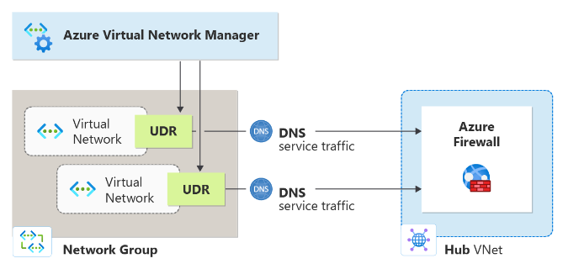
Networking Updates
Generally Available: Azure Virtual Network Manager user-defined route (UDR) management
This new feature simplifies managing complex routing behaviors by automating UDR orchestration. Through Azure Virtual Network Manager’s UDR management, users can easily set up routing configurations that define routing rules, allowing automatic deployment across virtual networks. This means users no longer need to manually create UDRs or use custom scripts—reducing errors and simplifying routing at scale.
The UDR Management feature enables users to structure routing rules into collections, each associated with specific network groups, making routing configurations reusable and consistent across subnets or virtual networks. Users can implement custom routing behaviors, such as directing traffic within a hub-and-spoke topology or routing specific traffic types through Azure Firewall. UDR Management thus ensures seamless, flexible routing that adapts to network changes without manual intervention.
Generally Available: Single prefix enhancement to seamless gateway migration
It is now possible to use Azure Portal or PowerShell scripts to deploy a second Virtual Network Gateway within the same GatewaySubnet. During the migration phase, upon customer initiation, Azure will transfer both the control plane and data path configurations from the existing gateway to the newly deployed one. This will result in two operational Gateways within the same Gateway Subnet. Once the migration is successfully completed, customers can proceed to remove the original Gateway, leaving the new Gateway in place for continued private connectivity.

Slide 7
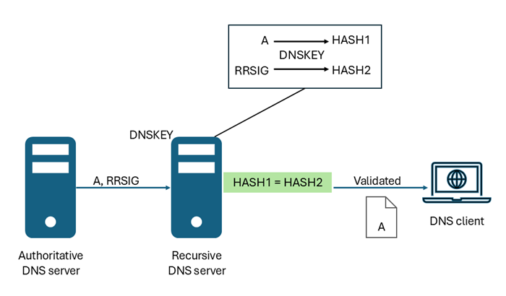
Networking Updates
Public preview of DNSSEC support in Azure
DNSSEC is a suite of extensions that add security to the Domain Name System (DNS) protocol by enabling DNS responses to be validated as genuine.
DNS zones are secured with DNSSEC using a process called zone signing. Signing a zone with DNSSEC adds validation support without changing the basic mechanism of a DNS query and response. To sign a zone with DNSSEC, the zone's primary authoritative DNS server must support DNSSEC.
Resource Record Signatures (RRSIGs) and other cryptographic records are added to the zone when it's signed. The following figure shows DNS resource records in the zone contoso.com before and after zone signing.
Virtual Network Ip Address
A virtual network today supports 65,000 routable IP addresses that could be assigned to virtual machines, virtual machine scale set instances, and pods in an AKS cluster. While this limit is more than sufficient for most customers in Azure, some of our cloud-native customers do require higher scale to keep up with instant demands and frequent scale-out and scale-in operations. To address this, Azure is excited to announce the support of “1 million routable IP Addresses” in a virtual network in preview via the “Ip Prefix on the Network Interface Card” (NIC) feature. This ability allows an additional /28 prefix to be added to the NIC along with a primary /32 Ip address. This increases the usable IP space in a NIC by 16 times.

Slide 8
Management & Governance

Slide 9
Management & Governance Updates
Retirement: Support for TLS 1.0/1.1 in Application Insights Availability Tests will be retired
On March 1, 2025, in alignment with the Azure-wide legacy TLS retirement announcement, TLS 1.0/1.1 protocol versions and TLS 1.2/1.3 Legacy Cipher Suites and Elliptical Curves will be retired for Application Insights Availability Tests.
Required action
To ensure Availability Tests continue to work after March 1, 2025, MS recommend ensuring that any remote endpoint your Availability Test is configured to interact with supports at least one of the supported TLS combinations.
Public Preview: Azure File Sync support for managed identities
Azure File Sync support for managed identities is now in public preview.
Managed Identity eliminates the need for shared keys as a method of authentication to Azure file shares by utilizing a system-assigned managed identity provided by Microsoft Entra ID.
When configure managed identities for Azure File Sync deployment, system-assigned managed identities will be used for the following scenarios:
Storage Sync Service authentication to Azure file share
Registered server authentication to Azure file share
Registered server authentication to Storage Sync Service
Public preview is available in all Azure Public and Gov regions supported by Azure File Sync and there is no additional cost to configure Azure File Sync deployment to use managed identities.

Slide 10
Management & Governance Updates
Introducing Reservations for Zone Redundant General Purpose SQL Database
MS announced the possibility to purchase reservations for General Purpose SQL Database configured with Zone Redundancy.
SQL DB General Purpose service tier offers two redundancy options for business continuity:
Availability using local redundancy, on by default.
High Availability using zone redundancy, available as an optional add-on.
Previously, the option to purchase a reservation was only available for databases with default local redundancy. This meant customers were able to get a reservation discount on the base price but not for the zone redundancy add-on. It's now possible to purchase reservations for the zone redundancy add-on as well.
vCore, for vCores in use.
vCore ZR, for zone redundancy add-on.
Azure Migrate Updates
The RVTools XLSX (preview) file import now reads storage data, when available, from vPartition and vMemory.
Less than 20,000 servers in a single RVTools XLSX file.
The file format should be XLSX.
File sensitivity is set to General or file protection is set to Any user.
Operating system names specified in the RVTools XLSX (preview) file contains and matches the supported names.
AVS assessments now support cost assessments with AV64 SKU and Azure NetApp Files (ANF) as an external storage option
Support for cost of SKUs when porting on-premises VCF subscription to AVS.

Slide 11
Management & Governance Updates
Vaulted backup and Cross Region Restore support for AKS is generally available
Azure Backup supports storing AKS backups offsite, which is protected against tenant compromise, malicious attacks and ransomware threats. Along with backup stored in a vault, it is possible to use the backups in a regional disaster scenario and recover backups.
Once the feature is enabled, snapshot-based AKS backups stored in Operational Tier are converted into blobs and moved to a Vault-standard tier outside of your tenant. It is possible to enable/disable this feature by updating the retention rules of backup policy. This feature also allows to back up data for long term storage as per the compliance and regulatory requirements. With this feature, it is possible to enable a Backup vault to be Globally redundant with Cross Region Restore, and then your vaulted backups will be available in an Azure Paired region for restore.

Slide 12
Compute

Slide 13
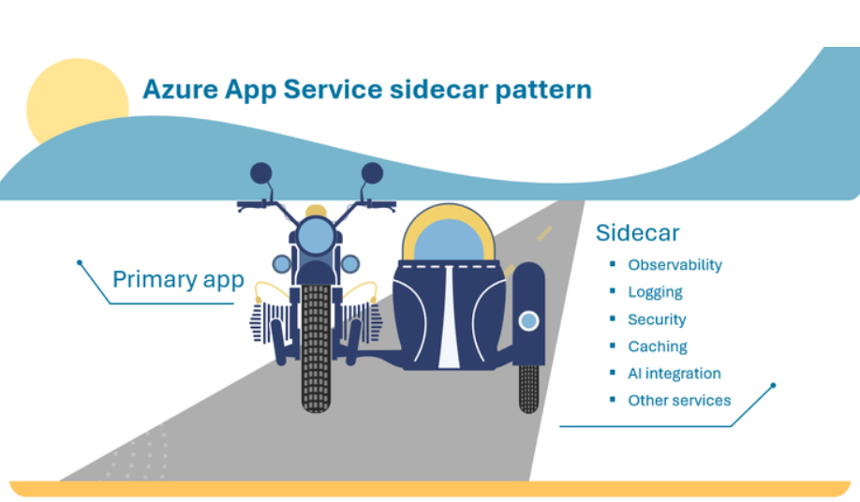
Compute Updates
Public Preview: Confidential Containers now in preview on Azure Red Hat OpenShift
MS excited to announce the public preview of Confidential Containers on Azure Red Hat OpenShift (ARO). This innovative feature enables cloud native confidential computing by leveraging Trusted Execution Environments to protect containers and data, addressing critical security concerns for organizations managing sensitive workloads in the cloud.
Confidential Containers protect data in use by encrypting data in memory and running workloads in a secure environment, utilizing Azure's Confidential Computing infrastructure with AMD SEV-SNP technology. Available for ARO version 4.15 and later, this preview offers seamless deployment using familiar workflows and tools, without requiring extensive confidential computing expertise.
Organizations can now explore enhanced data protection through memory encryption, reduced risk of unauthorized access to workload data, and seamless compatibility with public cloud infrastructure while maintaining regulatory compliance. During the preview period, this feature is available at no additional cost beyond standard Azure compute and ARO charges.
Announcing the general availability of sidecar extensibility in Azure App Service
MS announced general availability of Sidecars in Azure App Service, a versatile pathway for organizations to modernize existing apps and add powerful new capabilities without significant rewrites necessary in the main application code.
The sidecar pattern is an architectural approach that allows you to deploy components of an application in separate processes or containers, providing both isolation and encapsulation.

Slide 14
Compute Updates
Windows Server 2025
New Features
AD DS
Improvements in Security, encryption, hardening and etc
Delegated Managed Service Accounts
SMB over QUIC
SMB Security
Hardened FW
Brute Force Prevention
Protection from the man in the middle attacks
Hot Patching
SDN
Multisite support for L2 and L3
Hype-V
GPU partininig
240 TB RAM per VM
Removed
IIS 6 Management Console
WordPad
SMTP Server
PS 2.0
Deprecated
Computer Browser
Failover Clustering Cluster Set
RRAS: L2TP and PPTP
NLB
NTLM
TLS 1.0/1.1
WebDav Redirector
WID
VBScript
WSUS

Slide 15
Storage & Data

Slide 16
Storage & Data Updates
Generally Available: Convert to Azure Premium SSD v2 disks
MS announced the General Availability of the feature for Converting to Premium SSD v2 disks (Pv2). Confidently move workloads to Pv2, by leveraging this feature to take advantage of the unparalleled balance of price and performance of Pv2 disks.
This feature allows to migrate existing Standard SSD, Standard HDD, or Premium SSD v1 disks to Pv2 disks in a few clicks with minimal downtime. This process avoids disk destruction, eliminates the need to use snapshots as a staging resource, and doesn’t require waiting for background data copying.
You can't switch an OS disk to a Premium SSD v2 disk.
Existing disks can only be directly switched to 512 sector size Premium SSD v2 disks.
You can only perform 50 conversions at the same time per subscription per region.
If your existing disk is a shared disk, detach all VMs before changing to Premium SSD v2.
If your existing disk is using host caching, set it to none before changing to Premium SSD v2.
If your existing disk is using bursting, disable it before changing to Premium SSD v2.
If your existing disk is using double encryption, switch to one of the single encryption options before changing to Premium SSD v2.
You can't directly switch from a Premium SSD v2 to another disk type. If you want to change a Premium SSD v2 to another disk type, migrate using snapshots.
You can't directly switch from Ultra Disks to Premium SSD v2 disks, migrate using snapshots.
If your disk has Azure Site Recovery configured on it, disable it before changing to Premium SSD v2.
If you're using the rest API, use an API version 2020-12-01 or newer for both the Compute Resource Provider and the Disk Resource Provider.
Until the conversion process from your previous disk type to Premium SSD v2 is completed, the performance of the disk is degraded, and you can't change or rotate customer-managed keys for the disk if they're in us

Slide 17
Storage & Data Updates
Metadata Caching preview for Azure Premium Files SMB & REST
MS announced the unlimited public preview lighting up this capability on both new and existing shares in a broader set of regions. It is possible now automatically onboard subscriptions to leverage this functionality using feature registration (AFEC) in supported regions.
Metadata Caching is an enhancement aimed at reducing metadata latency up to 55% for file workloads running on Windows/Linux environments. In addition to lower metadata latency, workloads will observe a 2-3x improvement in latency consistency making metadata intensive workloads more predictable and deterministic. Workloads that perform a high volume of metadata operations (e.g. AI/ML) will see the bigger benefit compared to workloads with high data IO (e.g. databases). Reduced metadata latency will also translate up to 3x increase in metadata scale, and up to 60% increase in data IOPS (reads/writes) and throughput.
Example of metadata heavy workloads include:
Web\App Services: Frequently accessed files for CMS\LMS services such as Moodle\WordPress.
Indexing\Batch Jobs: Large scale processing using Azure Kubernetes or Azure Batch.
Virtual Desktop Infrastructure: Azure Virtual Desktop\Citrix users with home directories or VDI applications management needs.
Business Application: Custom line of business or legacy application with “Lift and shift” needs.
CI\CD DevOps Pipeline: Building, testing, and deployment workloads such as Jenkins open-source automation

Slide 18
Storage & Data Updates
MS Fabrics Updates
Copilot for Data Warehouse
AI Skill
Generally Available: Enhancements on Elastic SAN on resiliency, security, scalability, and integration with Azure VMWare Solution
MS published an availability Service Level Agreement (SLA)
MS announced CRC protection for security to help customers maintain the integrity of data by providing CRC32C checksum verification. If enabled on the client side, Elastic SAN supports checksum verification at the volume group level. This will cause connections that don’t have CRC32C set for both header and data digests to be rejected, thus ensuring data integrity.
Public Preview of autoscale for capacity. Elastic SAN is the first block storage solution in the cloud to support autoscaling. It will help save time by simplifying management of the Elastic SAN, set a policy for autoscaling capacity when are running out of storage rather than needing to actively manage storage. In addition, this will help with TCO control as can scale up on demand
Lastly, we are excited to announce GA of the integration of Elastic SAN with Azure VMware Solution (AVS).

Slide 19
Databases

Slide 20
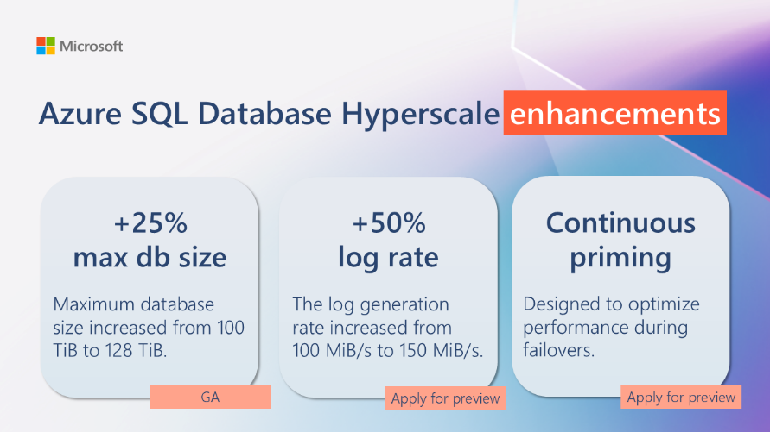
Databases Updates
Public Preview: PostgreSQL 17 on Azure Database for PostgreSQL – Flexible Server
MS announced the public preview of PostgreSQL 17 on Azure Database for PostgreSQL – Flexible Server. This release introduces several enhanced features, including improved vacuum processes and dynamic logical replication, optimizing performance and flexibility for databases. Dive into new JSON functionalities and detailed memory usage insights with PostgreSQL 17, enabling more efficient data management and query optimization. Start exploring these capabilities today to see how they can enhance your applications.
PostgreSQL 17 introduces an enhancement to the EXPLAIN command that reports the memory usage of the query planner during the preparation of execution plans
The enhanced vacuum process in PostgreSQL 17 ensures better space management and less interference with concurrent transactions, which means smoother database operations.
Enhanced JSON Functions
Dynamic Logical Replication
Public Preview: Azure SQL Database Hyperscale performance enhancements
MS announced performance enhancements for Azure SQL Database Hyperscale.
One key improvement is the increased log generation rate, now boasting an impressive 150 MB/s, up from the previous 100 MB/s. This significant boost means faster data processing and greater throughput for your most demanding workloads.
New continuous priming feature. This innovative caching mechanism ensures consistent performance levels even after a database failover. With continuous priming, it provides minimal disruption and maximum efficiency, keeping operations running smoothly.

Slide 21
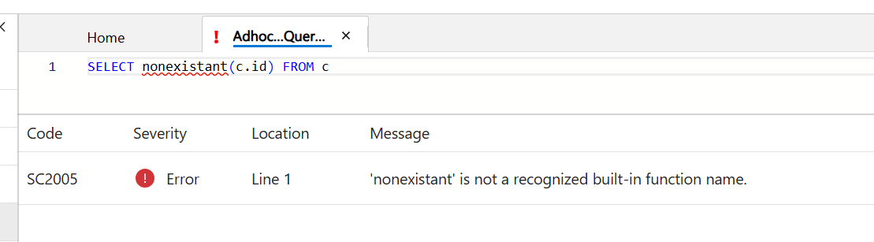
Databases Updates
Generally Available: Azure SQL updates for early November 2024
Azure SQL Database Hyperscale now offers 128 TB maximum storage capacity, up from 100 TB.
Generally Available: Enhanced error messaging in Azure Cosmos DB Data Explorer
It is now possible to debug queries more efficiently with the improved error messaging in Azure Cosmos DB Data Explorer.
This release addresses common challenges, such as syntax errors, invalid operators, parameters, or typos that previously resulted in generic, truncated error messages. Now, detailed, user-friendly error messages are displayed in a separate panel below the query editor. They highlight the exact location of the error, making it easier for you to identify and fix issues quickly. Additionally, you can use the F8 keyboard shortcut to navigate through multiple errors seamlessly, saving you time and effort. The error messages are also formatted to align with developer expectations, following the format of compiler errors, which are widely understood in the industry.

Slide 22
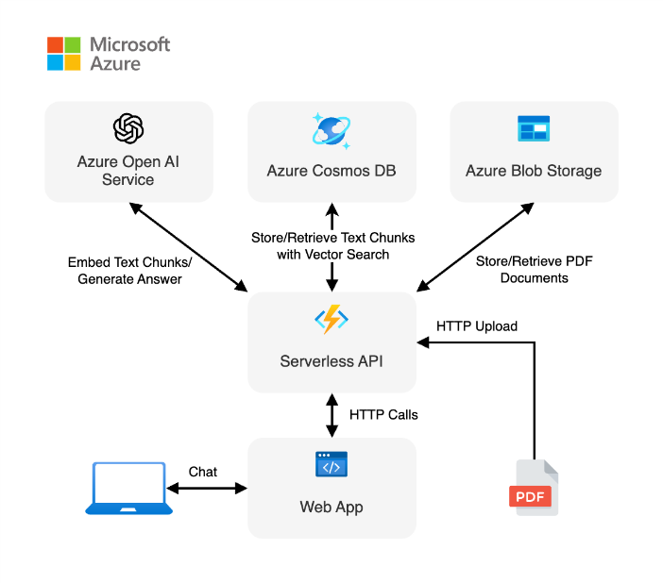
Databases Updates
Generally Available: Azure Cosmos DB vector database integration with LangChain.js
MS introduced LangChain.js integration with Azure Cosmos DB. Now it is possible to use this powerful combination to efficiently manage fast and accurate data retrieval with greater ease in JavaScript applications. The new LangChain.js integration makes the most of Azure Cosmos DB scalability and efficient vector search capabilities, simplifying applications development and large language model (LLM) orchestration tasks.
Generally Available: Azure Resource Manager API for vCore-based Azure Cosmos DB for MongoDB
Now generally available: vCore-based Azure Cosmos DB for MongoDB with an API for cluster management, offering you scalable, high-performance clusters on Azure. With this release, it is possible to programmatically manage vCore-based Azure Cosmos DB for MongoDB clusters with ease through the Azure Resource Manager (ARM) API and Terraform.

Slide 23
Databases Updates
Public Preview: New vector data type and functions in Azure SQL
Easily enable data for enterprise AI workloads thanks to the newly introduced support for vectors in the Azure SQL family of databases. Store embeddings and run vector similarity searchs right in Azure SQL using the new vector type and the related vector functions.

Slide 24
Integration

Slide 25
Integration Updates
Public Preview: API Management & API Center Synchronization
Managing API inventory in Azure API Center just got a whole lot easier with latest feature, “Links”. This seamless integration with Azure API Management service ensures that API inventory in Azure API Center stays automatically synced and updated, saving you time and effort:
Automatic Synchronization: Keep API inventory up-to-date effortlessly. Changes made in Azure API Management are automatically reflected in Azure API Center, ensuring consistency and accuracy.
Enhanced Efficiency: Reduce manual effort and potential errors with automated synchronization. Focus on developing and managing your APIs without worrying about manual updates.
Real-Time Updates: Experience real-time synchronization, providing immediate visibility into your API landscape. Stay informed about the latest changes and maintain control over your API ecosystem.
Seamless Integration: Enjoy an easy setup process in Azure API Center, allowing you to enable synchronization. It is possible to link not just one, but multiple Azure API Management instances to a single Azure API Center instance, providing greater flexibility and control over your API ecosystem
Public Preview: Azure Event Hubs offers new portal capabilities, and 100% Kafka compatibility
Kafka Streams and Kafka Transactions support are both in public preview in the Premium and Dedicated tiers. This means you can seamlessly integrate your Apache Kafka workloads with minimal configuration changes.
Real-Time Data Processing: Leverage Kafka Streams to build powerful applications and microservices that process streaming data in real-time.
Atomic Transactions: Ensure data integrity with Kafka Transactions, enabling atomic message production and consumption across multiple partitions and topics.
Effortless Migration: Modernize your existing Apache Kafka workloads effortlessly with Azure Event Hubs acting as a drop-in replacement, with cloud-native smarts
Event Hubs now offers a new portal-based feature to simplify testing and debugging, and generate insights. Among the benefits:
Seamless Onboarding
Enhanced Debugging
Unified Interface

Slide 26
DevOps & IaC & Automation

Slide 27
DevOps & IaC & Automation
Public Preview: SDK-style SQL projects in Visual Studio
Now available in both Visual Studio and Visual Studio Code, Microsoft.Build.Sql projects are a database development and deployment toolkit for SQL Server, the Azure SQL family, and Fabric Data Warehouse. This update adds SQL projects based on the Microsoft.Build.Sql SDK, which brings cross-platform support and improved package references to SQL Server Data Tools (SSDT) projects.
It is now possible to automate database deployments from a Microsoft.Build.Sql project in Windows and Linux environments where the Microsoft.SqlPackage dotnet tool publishes the build artifact (.dacpac) from the SQL project. The Microsoft.Build.Sql project SDK is open source and developed on GitHub.

Slide 28
Miscellaneous

Slide 29
Miscellaneous Updates
Retirement: Azure Health Data Services will be retired on October 31, 2025 in the Qatar Central region
MS is consolidating resources and there is low usage in the region, we'll be retiring Azure Health Data Services the Qatar Central region on October 31, 2025.
Until October 31, 2025, it is allowed to continue to use Azure Health Data Services without disruption. However, on October 31, 2025, all workloads running Azure Health Data Services in the Qatar Central region will be deleted, and associated application data will be lost.
Required action
Please transition workloads to another Azure Health Data Services region before October 31, 2025.

Slide 30
Information

Slide 31
Information
Azure Times GitHub Repo

Slide 32
Questions

